Slide 1

eBid | Online Auction
FU & LI
04.30.2024 | week2

Slide 2
Content
Module Design
Function Design
Diagrams
Demo

Slide 3
Module Design
Main
Server
Client
Frontend
MySQL
Auth
Server
Notes:
ASIO stands for "Asynchronous Input/Output”
Asynchronous means tasks can be processed parallelly

Slide 4
Functions Design
Seller Mode
Create Auctions
Analyze sell data
Normal Mode
Browser Auctions
Take part in auctions
Rate and leave comments

Slide 5
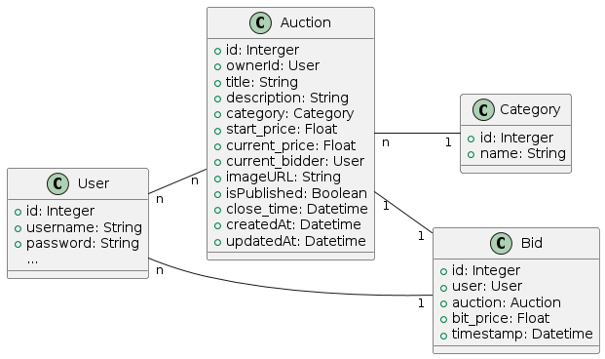
Class Diagram

Slide 6
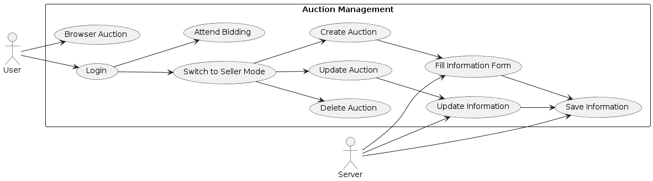
Auction Management Use Case Diagram

Slide 7
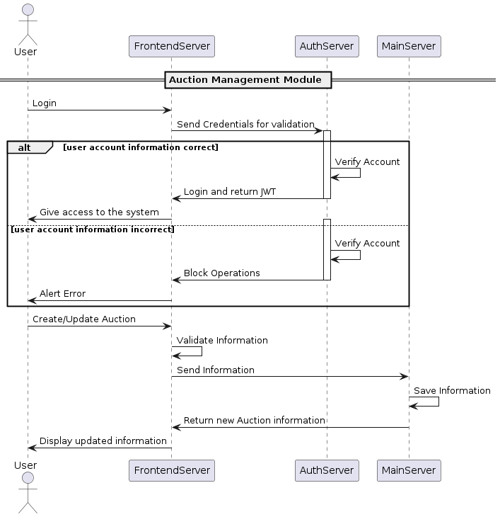
Auction Management Sequence Diagram

