Slide 1
Automatic Lens Smear Detection
Zhiquan Li
Date: Feb/22/2018

Slide 2

Outlines :
1.
Background and Introduction
2.
Problem Analysis
3.
Proposed Solution
4.
Algorithm Implementation
5.
Conclusions and Findings

Slide 3
Background and Introduction
Nowadays, Many autonomous systems use camera to perceive environment since camera could provide very detailed information and low consumption.
However, the performance of these systems would be deteriorated when the camera’s view is obstructed.
Therefore, we need a method to detect these smear on lens, then, we could use the detected result to recover the image we collected from camera

Slide 4
Problem Analysis
The data which needs to be used for smear detection is a serial of street view captured by camera on a car. The view in each image is some kind of different. Then we noticed the smear would appear in every image since it is on the lens. So we could find a solution to detect smear on lens if we only looking for static element which appears in every image.

Slide 5
Proposed solution
To find the static element in every image, we would like to use image subtraction to find the difference between two image since the static element would remain a low value in image, and dynamic element would still keep high value in image. Then we can know the low value section(darkest section) would be the smear we need to detect.

Slide 6
Algorithm Implementation
Step 1. Convert each image to gray since color has no help in smear detection
Step 2. Subtract a serial of images with certain interval to keep background different.
Step 3. Accumulate result of subtraction to enhance the difference between smear and background.
Step 4. Inverse the accumulated result for better detection
Step 5. Erode result of step 4 to eliminated unrelated element
Step 6. Dilate result of step 5 to increase the smear element
Step 7. Find Contours, select contours and draw contours in image
We use cam_3 to be our example to show the result of this algorithm

Slide 7
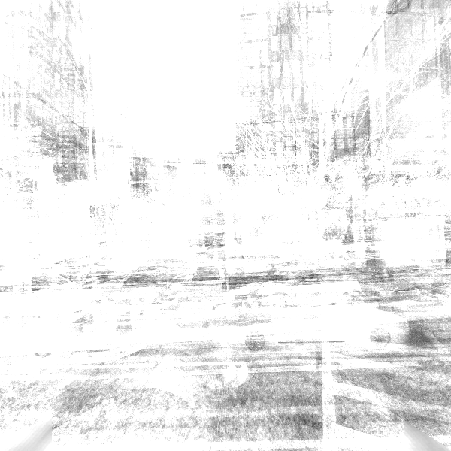
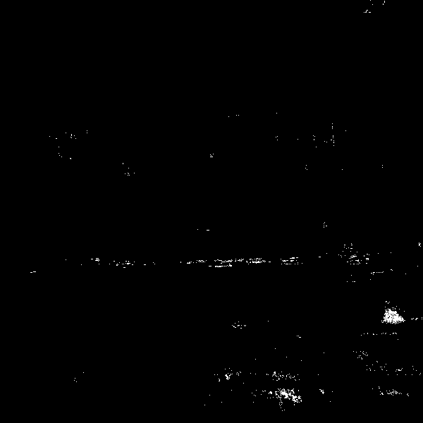
Algorithm Implementation
Result (cam_3):
Accumulated result of image subtraction
Inverse of accumulated result

Slide 8
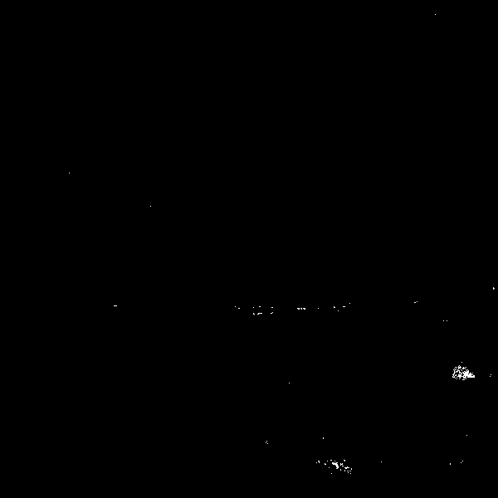
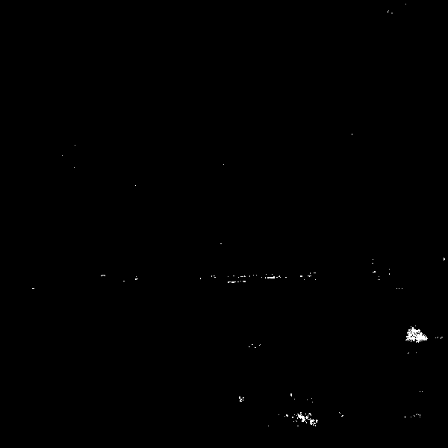
Algorithm Implementation
Result(cam_3):
Erode previous result
Dilate previous result

Slide 9
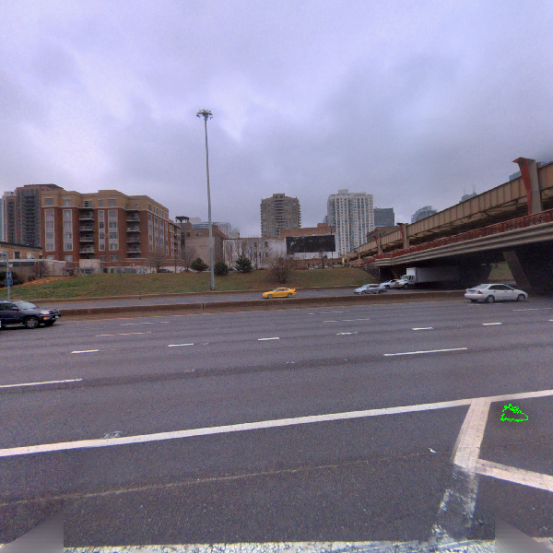
Algorithm Implementation
Result(cam_3):
Final result

Slide 10
Conclusion and Findings
The algorithm based on image subtraction is easy to understand and implement. And the performance in obvious smear is good. However, some artifact, like small blur section, would be hard to find since the difference between smear and background is small when these artifacts are in sky or cloud.

