Slide 1
Quick start for WMS laser characteristic helper
Counting Peaks MATLAB App User Guide

Slide 2
Before start
Read this paper to understand how to do WMS experiment:
You start to wandering how to use etalon data to characterize laser wavenumbers respond.
Sun, K.; Chao, X.; Sur, R.; Goldenstein, C.; Jeffries, J. & Hanson, R. Analysis of calibration-free wavelength-scanned wavelength modulation spectroscopy for practical gas sensing using tunable diode lasers Measurement Science and Technology, IOP Publishing, 2013, 24, 125203

Slide 3
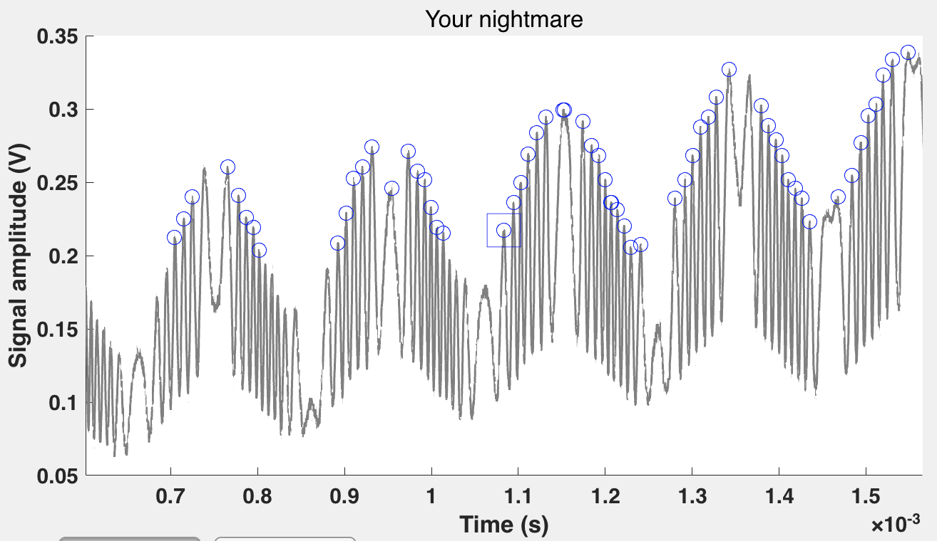
Before start
This is how etalon data looks like when using sine modulation with a ramp scan:

Slide 4
Before start
Each two neighbor peaks has a constant wavenumber/frequency difference which is called FSR (free spectral range). The FSR can be determined with laser frequency and etalon parameters, such as length and material.
When all peaks are recorded with its order and time tag, you can build a relative laser wavenumber /frequency map (next page)

Slide 5
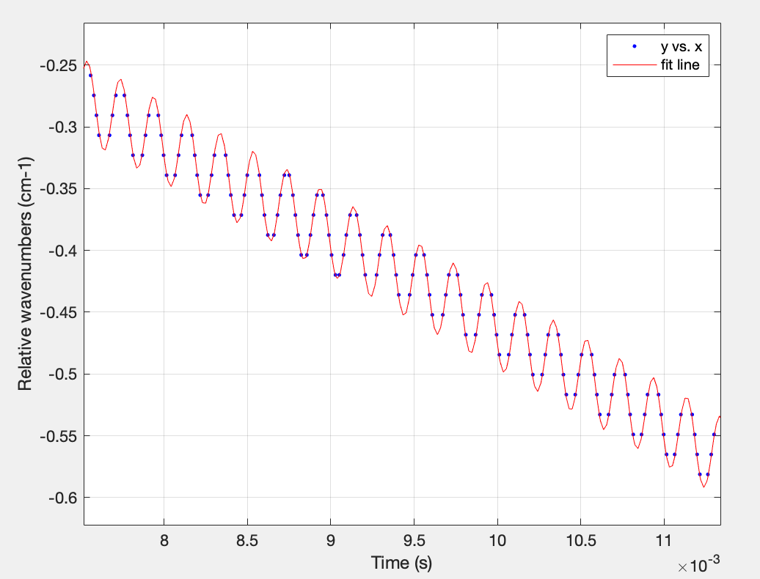
Before start
FSR

Slide 6
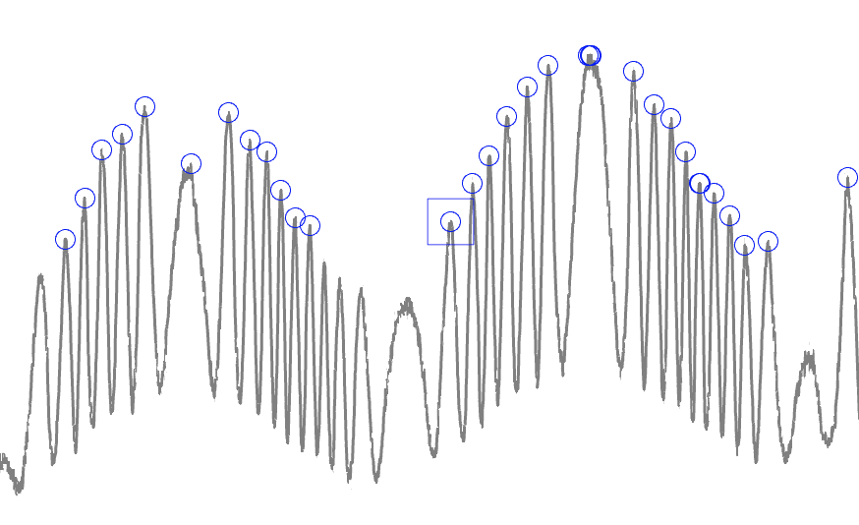
Before start
However, FSR doesn’t have any direction. From peak 1 to 2, wavenumber can either increase or decrease.
2
1

Slide 7
Before start
Notice these peaks’ value are going up and down? This can be used to determine the direction for FSR. For most near-IR laser (also what we used), the laser injection current increase coming with laser intensity + and laser wavelength + (or frequency -)
Facts: we are using an increasing scan signal (ramp signal)
2
Wavelength +
Wavelength -
1
Time + and inject current +

Slide 8
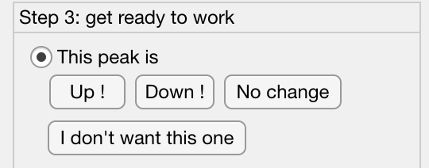
Before start
In this MATLAB app, we use these button to specify the direction:
Wavelength increase
Tag = “ +1”
Wavelength not changed
Tag = “ 0”
Wavelength decrease
Tag = “ -1”
Time (s) | Tag
t1 | +1
t2 | +1
t3 | 0
t4 | -1
t5 | -1
This is a wrong peak, just forget it.
Record sample

Slide 9



Before start
How to count peak 3? Actually, the peak 3 is the type of peaks when we use “I don’t want this one” button. This kind of peak is formed due to the laser frequency reverse. We only count symmetric peaks. If you count any peaks, the symmetric couple must be all counted. The principle is “both or none”.
3
Note:
For top and bottom couples, the second one should be marked as “0” (No change button)

Slide 10
Pre-process data:
You can either modify and use “pre_process.m” to prepare etalon data for the app or use following data format:
1. Trim your raw data to include only one period of you scan.
2. Save it to *.mat file, with matrix named “saves”. This “saves” should be a matrix with two column, the first column is time, and the second column is signal intensity.
Once you are ready, you can start using the app.

Slide 11
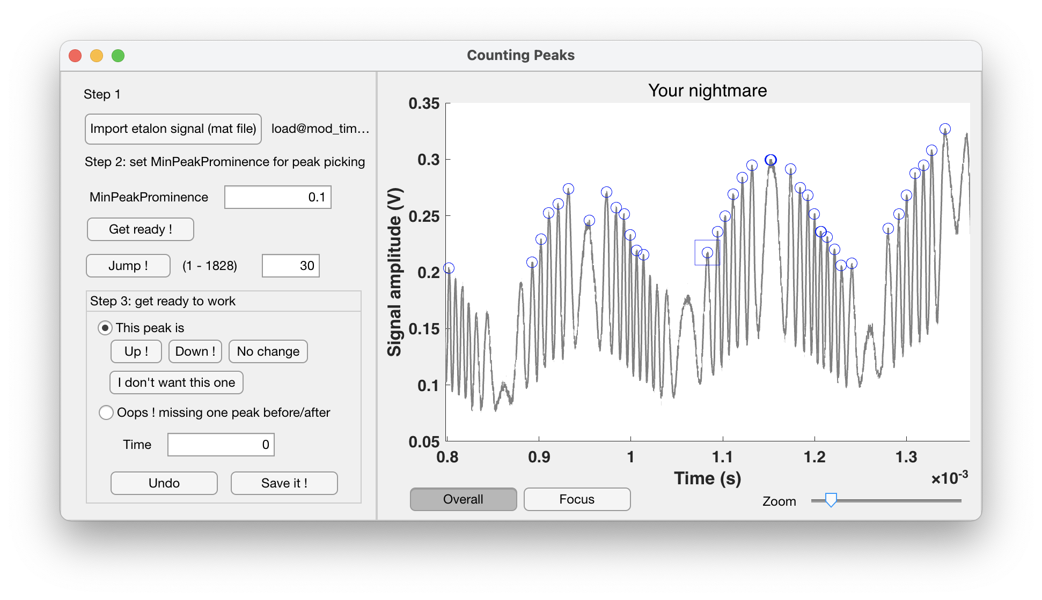
UI introduction
Load your *.mat file with the “Import” button. Then set the MinPeakProminence for MATLAB findpeaks function. Adjust this value to reach the balance between too many peaks marked and too less peaks marked. Click “Get ready!” to preview. Try to use view controller on the bottom of the figure to check your signal.

Slide 12
UI introduction
The current peak is marked with blue box. Use direction buttons (intros) to record current peak. Or select “Oops !” to record missing peaks with manually input time. The time value can be checked by click on the curve. Then use direction buttons to set directions for your extra peak. (Remember to switch back after you add peaks by clicking “This peak is”)

Slide 13
UI introduction
You can always use “Undo” to withdraw your last action. This action can be used only 10 times (in v2.0) after recording new peaks. Control + Z or Command + Z shortcuts are also supported. For keyboard shortcuts, you can also use direction key ⬆️⬇️⬅️➡️ to click “Up!”, “Down!”, “No change” and “I don’t want this one”. Use these shortcuts after you click on any empty area of this window to avoid selecting any buttons or boxes.

Slide 14
UI introduction
When you click “Save it !”, a “results.mat” file will be saved to the same folder of your input *.mat. Save it anytime and it will automatically cover your previous save. The “results.mat” can be processed with “post_process.m”. Read this code to see how to do post process.

Slide 15
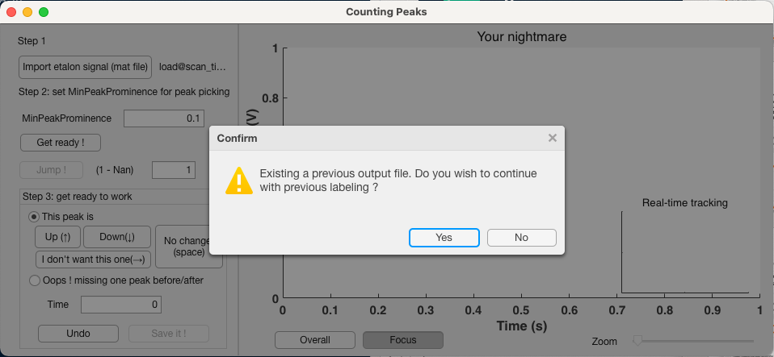

Features in v2.0 beta
When you are loading etalon data files processed by pre_process.m, the app will check if there is a results.mat existed in the directory of etalon data file (in this case is “scan_time_etalon.mat”). If it exist, the app will ask if you want to continue your last work. Press “Yes” and the app will get back from where you saved in “results.mat”. This feature only available on “results.mat” generated by v2.0 of this app.
In same directory
New confirm window

