Slide 1

DATA
Jupyter Notebook
Tutorial
Simos Gerasimou

Slide 2
What are Jupyter Notebooks?
A Jupyter notebook is an electronic file (in .ipynb format) that contains both programming code and text descriptions.
A notebook can also contain embedded charts, plots, images, videos, equations, visualisations, links.
A notebook runs in a web browser (e.g., Firefox, Google Chrome).
It is maintained by Project Jupyter.
The Python code in a notebook is the same type of Python code found in a .py file.
Notebooks can be exported to a variety of formats including .html and .pdf.
You can find more information at https://jupyter.org
The text description sections of Jupyter notebooks include explanations and clarifications are provided in the markdown format.
Markdown commands: https://guides.github.com/features/mastering-markdown
Notes:
(Do you like to use your tablet for TV shows and your Roku for movies? Do people access the Just for Kids feature more on their iPads, etc.?)

Slide 3
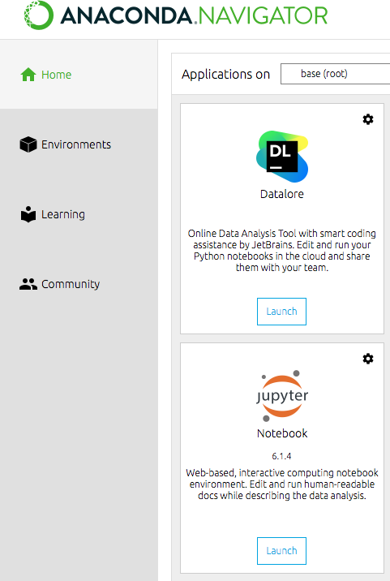
Jupyter Notebook Installation
Using Anaconda
A widely used Python distribution for data science pre-loaded with popular libraries
Go to https://www.anaconda.com/products/navigator
Select the installer for your operating system.
The download should start shortly.
When the download is completed, run the setup file.
When the installation is complete, run the Anaconda Navigator
Jupyter Notebook comes pre-installed with Anaconda
If it is not preinstalled, then click the install button below the Jupyter Notebook sign once the Anaconda Navigator opens
Click Launch
If everything went well, the Notebook Dashboard should
open in a web browser tab
Notes:
(Do you like to use your tablet for TV shows and your Roku for movies? Do people access the Just for Kids feature more on their iPads, etc.?)

Slide 4
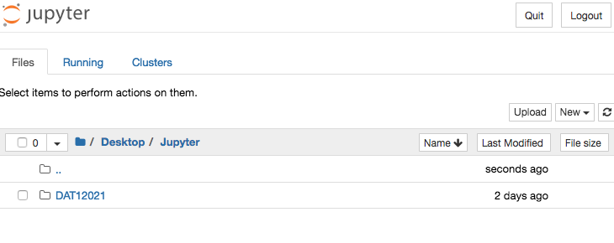
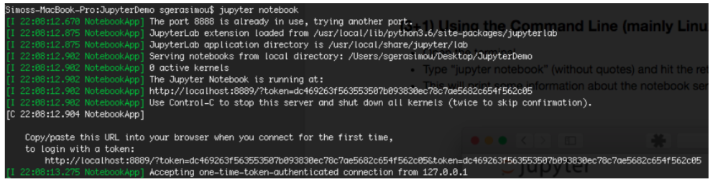
Jupyter Notebook Installation
Using pip (Python’s package management system)
Open terminal
Run: pip3 install jupyter
When installation is complete, type “jupyter notebook” (no quotes) and hit the return key
This will print some information about the notebook server in your terminal, including the URL of the web application (by default, http://localhost:8888)
If everything went well, the Notebook Dashboard should open in a web browser tab
Notes:
(Do you like to use your tablet for TV shows and your Roku for movies? Do people access the Just for Kids feature more on their iPads, etc.?)

Slide 5
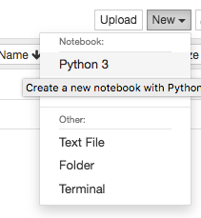
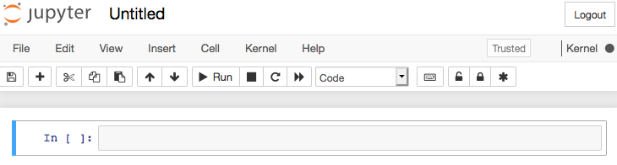
Creating a New Notebook
Click on the New button (upper right), and it will open up a
list of choices
Select Python 3
A new notebook will open as a new tab in your web browser.
Each notebook is stored as an .ipynb file
You should give it a reasonable name (e.g., DATA_Practical1); currently it is "Untitled"
  Click on the “Untitled” text field
Notes:
(Do you like to use your tablet for TV shows and your Roku for movies? Do people access the Just for Kids feature more on their iPads, etc.?)

Slide 6
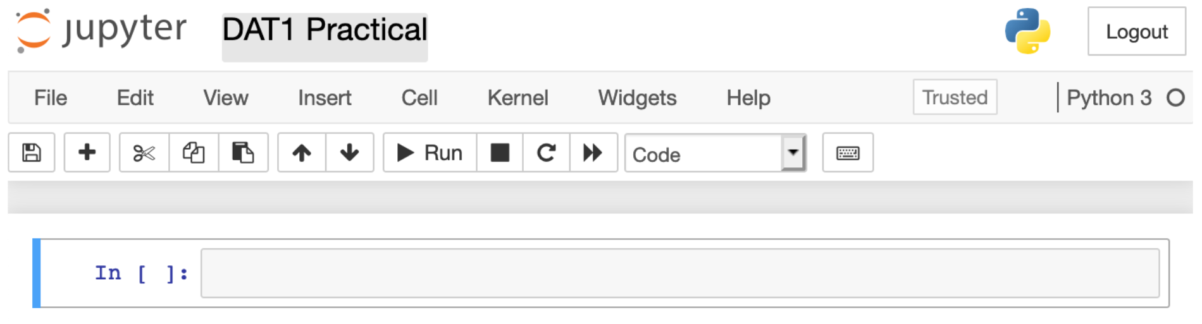
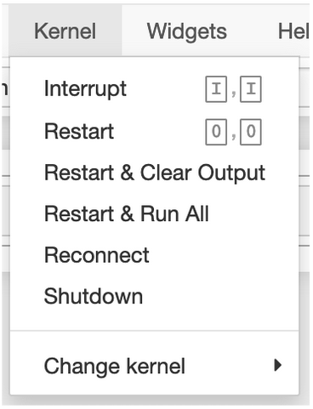
The Notebook Interface
Two primary features of a notebook are: Cell and Kernel
Kernel: a “computational engine” that executes the code
contained in a notebook document and produces the results.
  In this case, it is a Python kernel
  The kernel can be restarted (e.g., if execution takes a long time)
Cell: a container for text to be displayed in the notebook
or code to be executed by the notebook’s kernel
Notes:
(Do you like to use your tablet for TV shows and your Roku for movies? Do people access the Just for Kids feature more on their iPads, etc.?)

Slide 7
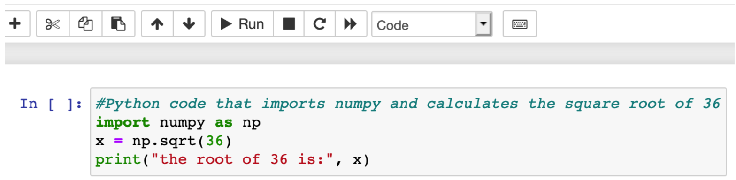
Code Cells
A notebook contains three types of cells: code cells, output cells, and markdown cells.
Code cells: contain Python code that could be executed
Hint: If the cell-type drop-down menu shows Code, then you are at a code cell.
Brackets next to cell: if the […] to the left of a cell shows a number then it means that the cell has been evaluated! This means that the code written in that cell has been run. If it is [] then the cell has not been run yet. If it is [*] then the code is still evaluated.
Executing the code in a cell: Click the [Run] button or type [Shift]+[Enter].

Slide 8
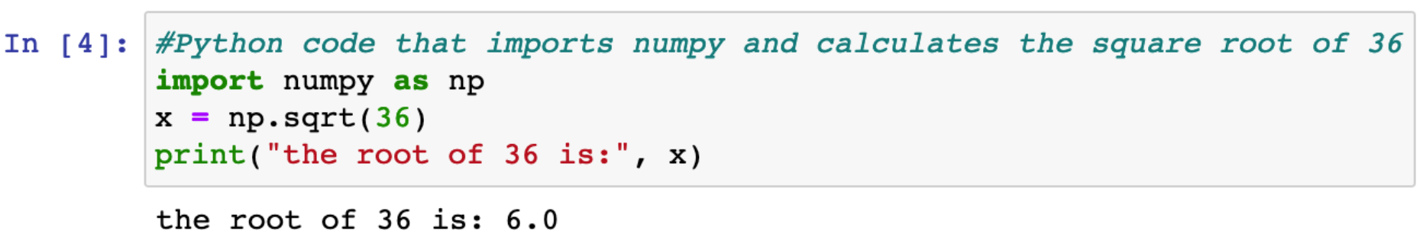
Output Cells
A notebook contains three types of cells: code cells, output cells, and markdown cells.
Output cells: Contain the output from running the code cells as well as charts, plots, command line output, and images
Not all code produces output, so not all code cells produce output cells.
The results in output cells can't be edited.
Brackets next to cell: if the […] to the left of a cell shows a number then it means that the cell has been evaluated! This means that the code written in that cell has been run. If it is [] then the cell has not been run yet. If it is [*] then the code is still evaluated.

Slide 9
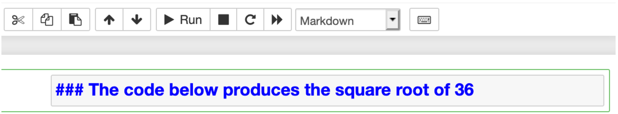
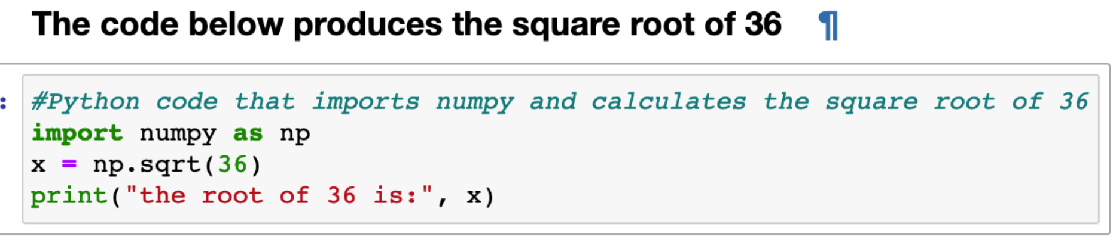
Markdown Cells
A notebook contains three types of cells: code cells, output cells, and markdown cells.
Markdown cells: Contain text-like descriptions that conform to the Markdown syntax (https://github.com/adam-p/markdown-here/wiki/Markdown-Cheatsheet)
These cells are typically used to explain the code or output (before or above a Markdown cell). They don't contain Python code
Executing markdown in a cell: Click the [Run] button or type [Shift]+[Enter]

Slide 10
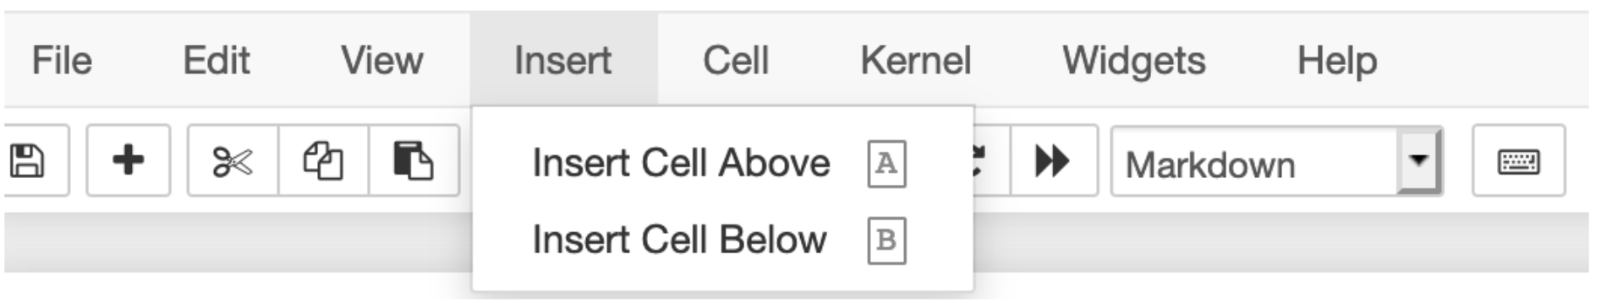
Creating a New Cell
You can create a new cell by clicking the [+] button in the upper menu.
Clicking [+] creates a new code cell below the active cell.
You can also create a new cell by clicking the Insert option from the toolbar
A cell is inserted above or below the currently selected cell

Slide 11
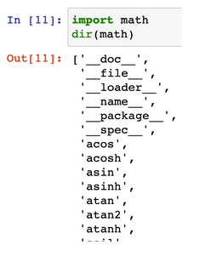
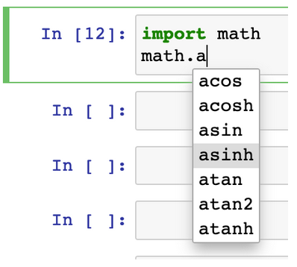
Getting Help within a Notebook
There are several ways we can get help within a notebook
Using the dir command
  Type dir() and provide as input a function, method, variable or object
  Shows the possible object, method and function calls available to that object
  e.g., dir(math) shows the contents of the math module
Using the Tab completion functionality
  Use the [Tab] key after typing the name of a variable, object
  or function to view the available options.
  Scroll through the list
  Use [Enter] to select the desired option.

Slide 12
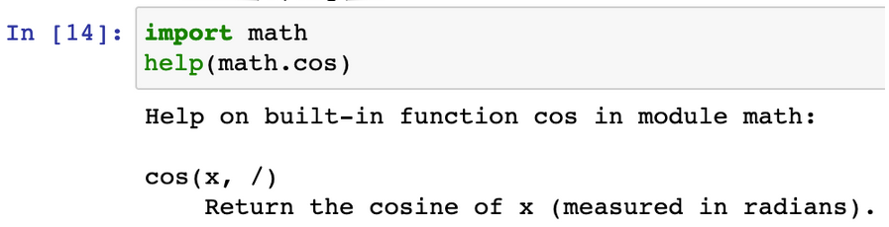
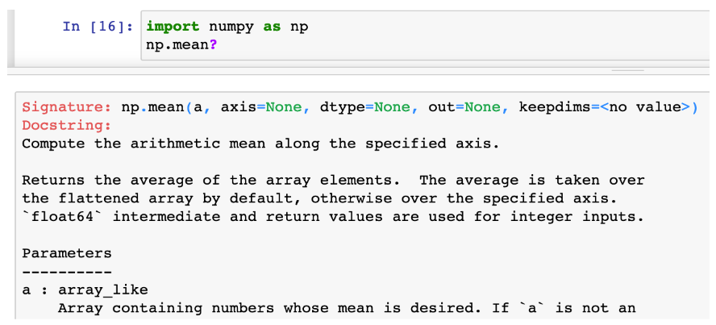
Getting Help within a Notebook
There are several ways we can get help within a notebook
Using the help() function
  Type help() and provide as input a function, method, variable or object
  e.g., help(math.cos) shows the documentation of the cos function
Using the question mark ?
  Use the [?] after a
  function to get help
  and view its source code

Slide 13
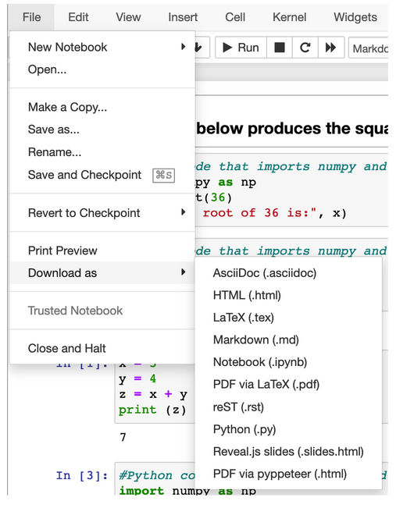
Saving the Jupyter Notebook
In Jupyter Notebook format (.ipynb)
Downloading in other formats
  File > Download as
  e.g., pdf, html, latex
  You can also export the Python code only

Slide 14
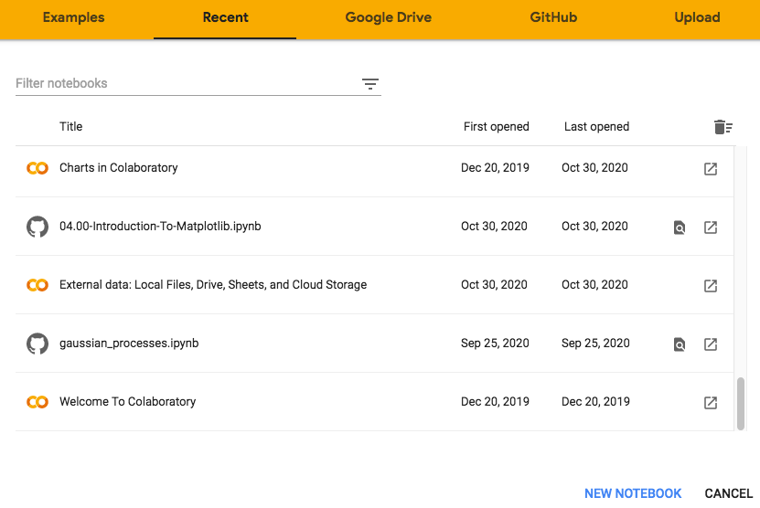
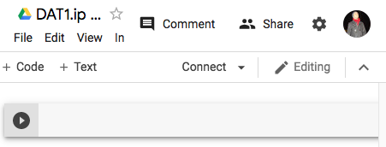
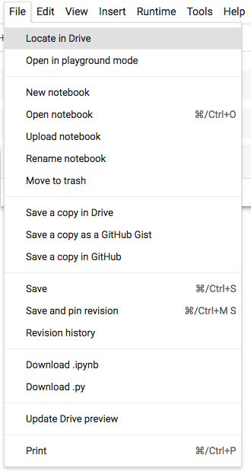
Using Google Colab Notebook
Go to https://colab.research.google.com
Select “NEW NOTEBOOK”
A new tab will open
Follows the same principles with Jupyter Notebooks
You can download the .ipynb or Python files
You can save it to you Google Drive etc

Slide 15
Useful Resources
Video: Jupyter Notebook Tutorial: Introduction, Setup, and Walkthrough
https://www.youtube.com/watch?v=HW29067qVWk
Introduction to Google Colaboratory
https://colab.research.google.com/notebooks/intro.ipynb
https://colab.research.google.com/notebooks/basic_features_overview.ipynb

