Slide 1
Virtual Learning: Conservation of the Environment (Geography 178)
What is Science?
What is meant by conservation?
What are Resources?

Slide 2
Science: What is it?
Empiricism – Real, observable phenomena
Uniformitarianism – key to past lies in present
Parsimony – Simple solution
Uncertainty – Knowledge changes with changing evidence
Repeatability – Tests and experiments should be repeatable
Proof is elusive – Absolute proof is rare
Testable questions – Must test theories
“This is my theory and what I’m able to observe”
“This is the way it is because of what happened at this time (can go other way around)”
vs trying to come up with conspiracy theories
Round vs flat earth
Gravity should work the same for you as it does for others
Science is often how it’s interpreted (be careful not to believe untested proof)
Without tests, it’s just opinions. Opinions aren’t science.

Slide 3
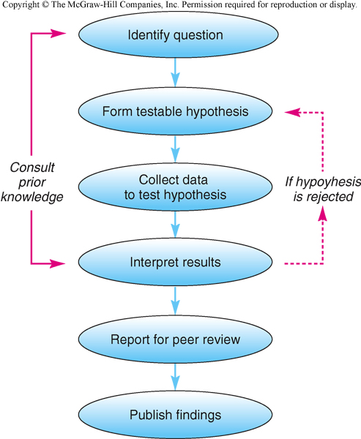
The Scientific Method
“If I did this, then this should happen”
Supplies to do test
Paradigm Shift:
When established theories are replaced by new ones – rare!
Others say “did you do this or think of that?”
If findings are agreeable
Notes:
Can you think of some paradigm shifts other than the examples I gave?
Example given: thought that mountain formation was comparable to apples when this Vagner guy revealed it was actually earth plate movements.

Slide 4
Psuedoscience and Faith-based Science
If science is so great, then why the many opinions
Not all ‘science’ is really science
Bullshit detection kit:
Sources?
Verification or support?
Position of community?
Confliction of established theories?
Balanced and logical arguments?
Funding?
Peer-review?
Wikipedia or very few unprofessional sources vs a number of professional sources
Just 1 guy vs others confirming validity
Some crackpot vs a real scientist (careful of crackpots in high places)
Similar or opposing theories -> why say this?
Connecting dots with old info vs related to their collected data
Some of the best sciences gets lots of it, but be careful if the funder is pushing a political agenda (coca cola funded scientist saying sugar is good for you)
Again, just an opinion column without this

Slide 5
So, this is a Conservation of the Environment Class; what exactly is Conservation then???
Different opinions:
-Not using it
-Using it, otherwise it’s waste
-Ultimately must be defined by one’s self.

Slide 6
What is a Resource?
Something of Value

Slide 7
What is a Natural Resource? (5 categories)
#1 Cultural
Background
#2 View
of Nature
Natural Resource
#5
Tech and
Economic factors
#3 Social
Conditions
#4
Scarcity
Absolute
Relative
Notes:
Cultural Background: How do we view whales vs. Japan or Iceland (pretty sight vs food)? Mesquite with Native Americans vs. modern day ranchers: Current use for mesquite (wonderful vs a nuisance)
View of Nature: Control vs. live harmoniously with nature
Social Conditions: Social conditions in society (lobsters); waste today may be wonderful tomorrow
Resource Scarcity: relative: There’s a lot here, but not there. Absolute: Rare everywhere
Tech and economic factors: groundwater in the plains; oil; mine tailings. Tech = can it be utilized, Economic = if depleted enough, too costly to keep using.

Slide 8
Resource Types
Perpetual
Renewable
(flow)
Nonrenewable
(stock)
Potential
[Infinite]
[Can’t utilize yet]
[May renew, but very slowly]
Solar Radiaton
Gravity
Perpetual Motion
Forests
Ground Water
Fisheries
Others?
Minerals
Fossil Fuels
Ground Water
Hydrogen

Slide 9
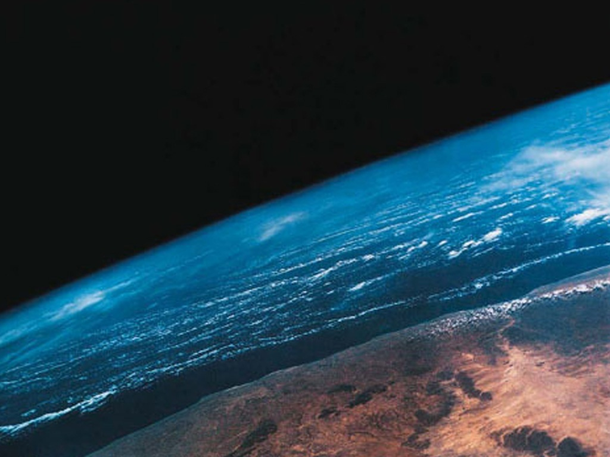
Which of the following examples best fits the technological/economic factors resource recognition category ?
A Viewing squirrels as a food resource
B Viewing Canadian Tar sands as a resource for petroleum products
C Viewing forests as a nuisance
D Seeing Helium as scarce because its not in stores

Slide 10
Which is the best example of a renewable resource?
A Diamonds
B Ground Water in Western Kansas
C Red Pine Plantation
D Helium

Slide 11
Natural Resource Management
Two Contrasting Views
Nature Centered
Inherent value
Basis of resource base
Human Centered
Improve human quality of life
Material goods universally important
Human use stresses base – unprecedented use
Resource use improves knowledge

Slide 12
Natural Resource Use
Exploitation (Maximum Use)
Conservation
(Tempered approach)
Preservation
(nonuse)

Slide 13
Your first (real) Assignment
Pick an object you are familiar with – your shirt, bike, shoes, etc. (Don’t pick anything too complicated)
List the natural resources that were used to make it (now you know why I suggested keeping it simple)
Draw a flow chart that illustrated what went into making the object.
Be sure to specify what was renewable, nonrenewable, or even perpetual.
Specify the scarcity of the resource, and examples of where the resource is located in the world.
Cite your sources
This should be submitted to the D2L Dropbox as a MS compatible document
This assignment is listed as Assignment 2 in the content of D2L
Notes:
For more details associated with this assignment, see the content area in D2L.

Slide 14
Previous Assignment Examples:

Slide 15
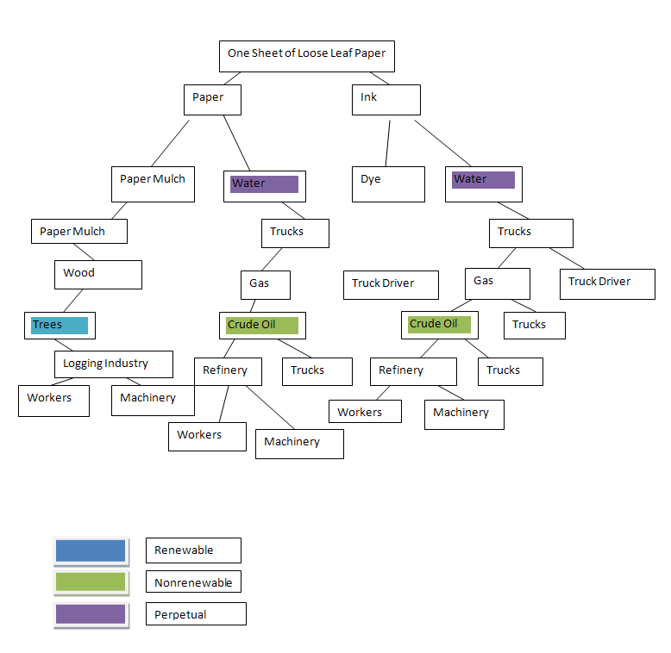
Example of GOOD WORK

Slide 16
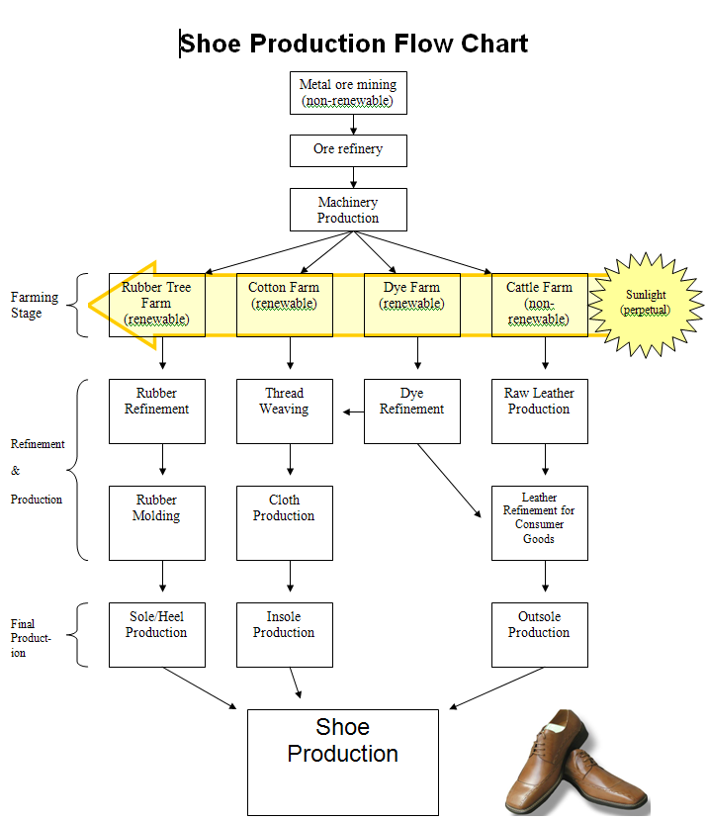
Example of GOOD WORK

Slide 17
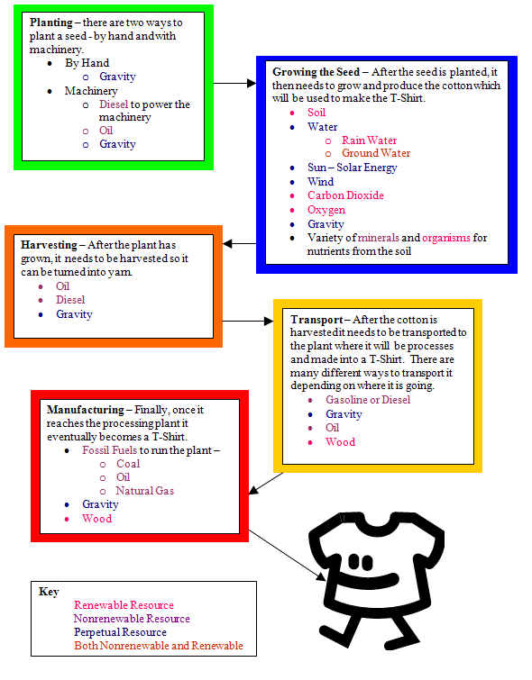
Example of GOOD WORK

Slide 18
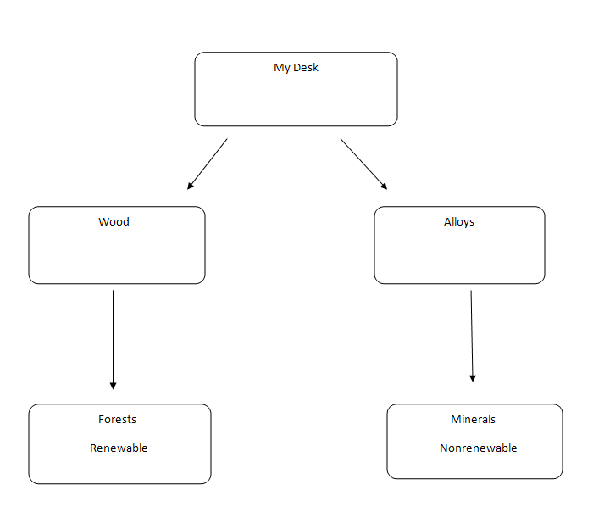
BAD!!!

Slide 19
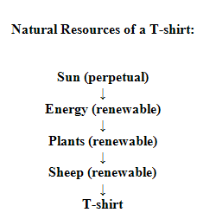
BAD!!!

