Slide 1
CS276 – Information Retrieval and Web Search
Checking in. By the end of this week you need to have:
Watched the online videos corresponding to the first 6 chapters of IIR or/and read chapters 1–6 of the book
Done programming assignment 1 (due Thursday)
Submitted 5 search queries for the Stanford domain (for PA3)
Oh, and problem set 1 was due last Thursday ☺
Today: Probabilistic models of spelling correction for PA2
You should also look at chapter 3 video/book for other material
Thursday: Class lab on map-reduce

Slide 2
Spelling Correction and the Noisy Channel
The Spelling Correction Task

Slide 3
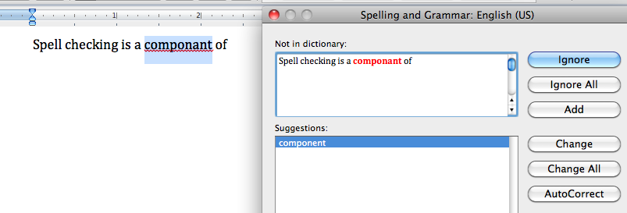
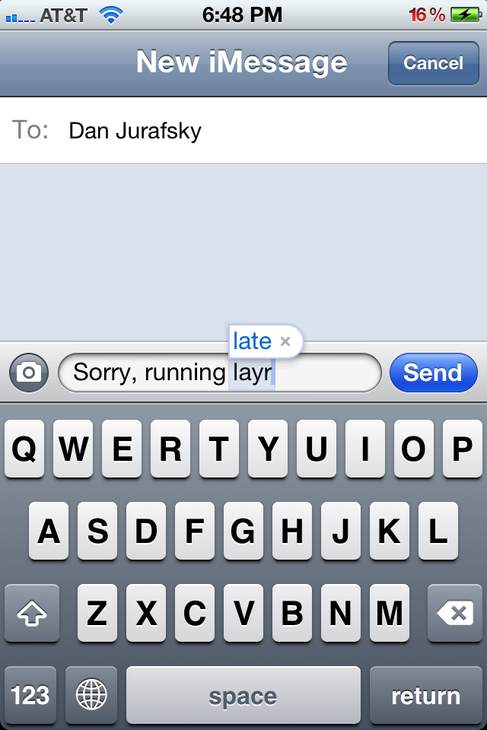
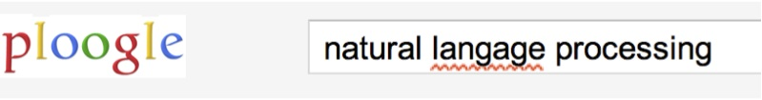
Applications for spelling correction
Word processing
Phones
Web search

Slide 4
Spelling Tasks
Spelling Error Detection
Spelling Error Correction:
Autocorrect
hte→the
Suggest a correction
Suggestion lists
Notes:
HCI issues and confidence determine.

Slide 5
Types of spelling errors
Non-word Errors
graffe →giraffe
Real-word Errors
Typographical errors
three →there
Cognitive Errors (homophones)
piece→peace,
too → two

Slide 6
Rates of spelling errors
26%: Web queries Wang et al. 2003
13%: Retyping, no backspace: Whitelaw et al. English&German
7%: Words corrected retyping on phone-sized organizer
2%: Words uncorrected on organizer Soukoreff &MacKenzie 2003
1-2%: Retyping: Kane and Wobbrock 2007, Gruden et al. 1983

Slide 7
Non-word spelling errors
Non-word spelling error detection:
Any word not in a dictionary is an error
The larger the dictionary the better
Non-word spelling error correction:
Generate candidates: real words that are similar to error
Choose the one which is best:
Shortest weighted edit distance
Highest noisy channel probability

Slide 8
Real word spelling errors
For each word w, generate candidate set:
Find candidate words with similar pronunciations
Find candidate words with similar spelling
Include w in candidate set
Choose best candidate
Noisy Channel

Slide 9
Spelling Correction and the Noisy Channel
The Noisy Channel Model of Spelling

Slide 10
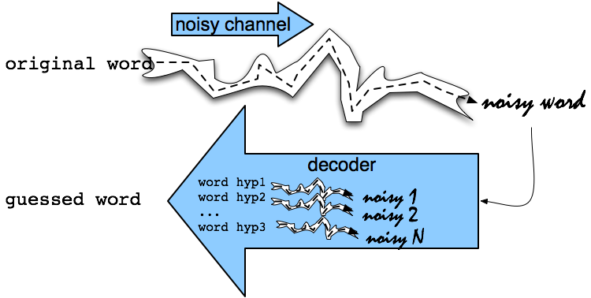
Noisy Channel Intuition

Slide 11
Noisy Channel aka Bayes’ Rule
We see an observation x of a misspelled word
Find the correct word ŵ
Notes:
Bayes Rule

Slide 12
History: Noisy channel for spelling proposed around 1990
IBM
Mays, Eric, Fred J. Damerau and Robert L. Mercer. 1991. Context based spelling correction. Information Processing and Management, 23(5), 517–522
AT&T Bell Labs
Kernighan, Mark D., Kenneth W. Church, and William A. Gale. 1990. A spelling correction program based on a noisy channel model. Proceedings of COLING 1990, 205-210

Slide 13
Non-word spelling error example
acress

Slide 14
Candidate generation
Words with similar spelling
Small edit distance to error
Words with similar pronunciation
Small edit distance of pronunciation to error

Slide 15
Damerau-Levenshtein edit distance
Minimal edit distance between two strings, where edits are:
Insertion
Deletion
Substitution
Transposition of two adjacent letters
See IIR sec 3.3.3 for edit distance

Slide 16
Words within 1 of acress
Error | Candidate Correction | Correct Letter | Error Letter | Type
acress | actress | t | - | deletion
acress | cress | - | a | insertion
acress | caress | ca | ac | transposition
acress | access | c | r | substitution
acress | across | o | e | substitution
acress | acres | - | s | insertion
acress | acres | - | s | insertion

Slide 17
Candidate generation
80% of errors are within edit distance 1
Almost all errors within edit distance 2
Also allow insertion of space or hyphen
thisidea → this idea
inlaw → in-law

Slide 18
Wait, how do you generate the candidates?
Run through dictionary, check edit distance with each word
Generate all words within edit distance ≤ k (e.g., k = 1 or 2) and then intersect them with dictionary
Use a character k-gram index and find dictionary words that share “most” k-grams with word (e.g., by Jaccard coefficient)
see IIR sec 3.3.4
Compute them fast with a Levenshtein finite state transducer
Have a precomputed hash of words to possible corrections
Notes:
Terrible.
Only okay for short words

Slide 19
Language Model
Just use the unigram probability of words
Take big supply of words (your document collection with T tokens)

Slide 20
Unigram Prior probability
Counts from 404,253,213 words in Corpus of Contemporary English (COCA)
word | Frequency of word | P(word)
actress | 9,321 | .0000230573
cress | 220 | .0000005442
caress | 686 | .0000016969
access | 37,038 | .0000916207
across | 120,844 | .0002989314
acres | 12,874 | .0000318463

Slide 21
Channel model probability
Error model probability, Edit probability
Kernighan, Church, Gale 1990
Misspelled word x = x₁, x₂, x₃… x_{m}
Correct word w = w₁, w₂, w₃,…, w_{n}
P(x|w) = probability of the edit
(deletion/insertion/substitution/transposition)

Slide 22
Computing error probability: confusion matrix
del[x,y]: count(xy typed as x)
ins[x,y]: count(x typed as xy)
sub[x,y]: count(x typed as y)
trans[x,y]: count(xy typed as yx)
Insertion and deletion conditioned on previous character

Slide 23
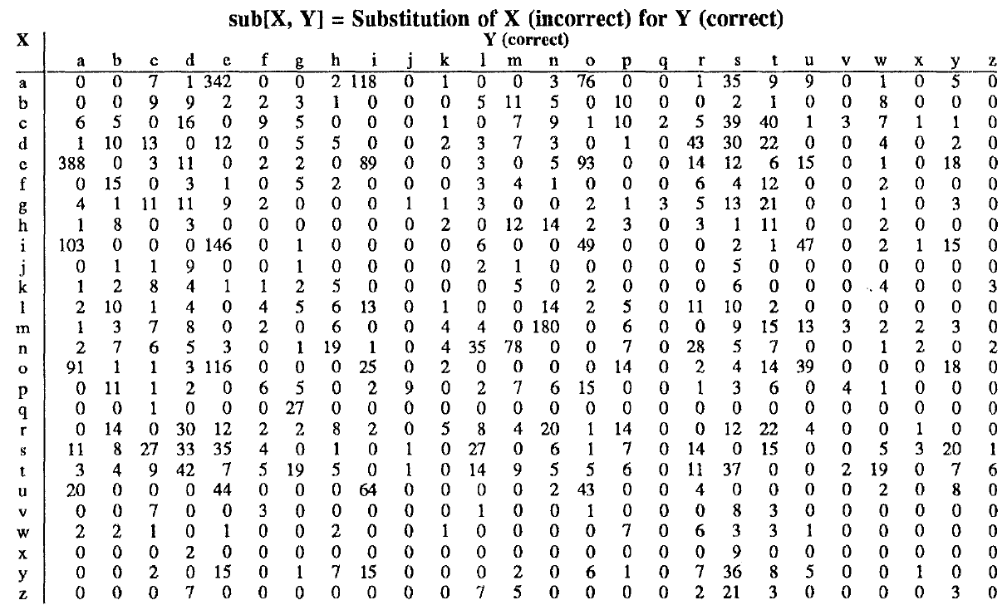
Confusion matrix for spelling errors

Slide 24
Generating the confusion matrix
Peter Norvig’s list of errors
Peter Norvig’s list of counts of single-edit errors
All Peter Norvig’s ngrams data links: http://norvig.com/ngrams/

Slide 25
Channel model
Kernighan, Church, Gale 1990

Slide 26
Smoothing probabilities: Add-1 smoothing
But if we use the last slide, unseen errors are impossible!
They’ll make the overall probability 0. That seems too harsh
e.g., in Kernighan’s chart q➔a and a➔q are both 0, even though they’re adjacent on the keyboard!
A simple solution is to add one to all counts and then if there is a |A| character alphabet, to normalize appropriately:

Slide 27
Channel model for acress
Candidate Correction | Correct Letter | Error Letter | x|w | P(x|word)
actress | t | - | c|ct | .000117
cress | - | a | a|# | .00000144
caress | ca | ac | ac|ca | .00000164
access | c | r | r|c | .000000209
across | o | e | e|o | .0000093
acres | - | s | es|e | .0000321
acres | - | s | ss|s | .0000342

Slide 28
Noisy channel probability for acress
Candidate Correction | Correct Letter | Error Letter | x|w | P(x|word) | P(word) | 10^{9 *}P(x|w)P(w)
actress | t | - | c|ct | .000117 | .0000231 | 2.7
cress | - | a | a|# | .00000144 | .000000544 | .00078
caress | ca | ac | ac|ca | .00000164 | .00000170 | .0028
access | c | r | r|c | .000000209 | .0000916 | .019
across | o | e | e|o | .0000093 | .000299 | 2.8
acres | - | s | es|e | .0000321 | .0000318 | 1.0
acres | - | s | ss|s | .0000342 | .0000318 | 1.0

Slide 29
Noisy channel probability for acress
Candidate Correction | Correct Letter | Error Letter | x|w | P(x|word) | P(word) | 10^{9 *}P(x|w)P(w)
actress | t | - | c|ct | .000117 | .0000231 | 2.7
cress | - | a | a|# | .00000144 | .000000544 | .00078
caress | ca | ac | ac|ca | .00000164 | .00000170 | .0028
access | c | r | r|c | .000000209 | .0000916 | .019
across | o | e | e|o | .0000093 | .000299 | 2.8
acres | - | s | es|e | .0000321 | .0000318 | 1.0
acres | - | s | ss|s | .0000342 | .0000318 | 1.0

Slide 30
Incorporating context words: Context-sensitive spelling correction
Determining whether actress or across is appropriate will require looking at the context of use
We can do this with a better language model
You learned/can learn a lot about language models in CS124 or CS224N
Here we present just enough to be dangerous/do the assignment
A bigram language model conditions the probability of a word on (just) the previous word
P(w₁…w_{n}) = P(w₁)P(w₂|w₁)…P(w_{n}|w_{n−1})

Slide 31
Incorporating context words
For unigram counts, P(w) is always non-zero
if our dictionary is derived from the document collection
This won’t be true of P(w_{k}|w_{k−1}). We need to smooth
We could use add-1 smoothing on this conditional distribution
But here’s a better way: interpolate a unigram and a bigram:
P_{li}(w_{k}|w_{k−1}) = λP_{uni}(w₁) + (1−λ)P_{mle}(w_{k}|w_{k−1})
P_{mle}(w_{k}|w_{k−1}) = C(w_{k}|w_{k−1}) / C(w_{k−1})
This is called a “maximum likelihood estimate” (mle)
For categorical variables you get an mle by just counting and dividing

Slide 32
All the important fine points
Our unigram probability P_{uni}(w_{k}) = C(w_{k}) / T is also an mle
This is okay if our dictionary is only words in the document collection – will be non-zero
Otherwise we’d need to smooth it to avoid zeroes (e.g., add-1 smoothing)
Note that we have several probability distributions for words
Keep them straight!
You might want/need to work with log probabilities:
log P(w₁…w_{n}) = log P(w₁) + log P(w₂|w₁) + … + log P(w_{n}|w_{n−1})
Otherwise, be very careful about floating point underflow
Our query may be words anywhere in a document
We’ll start the bigram estimate of a sequence with a unigram estimate
Often, people instead condition on a start-of-sequence symbol, but not good here
Because of this, the unigram and bigram counts have different totals. Not a problem

Slide 33
Using a bigram language model
“a stellar and versatile acress whose combination of sass and glamour…”
Counts from the Corpus of Contemporary American English with add-1 smoothing
P(actress|versatile)=.000021 P(whose|actress) = .0010
P(across|versatile) =.000021 P(whose|across) = .000006
P(“versatile actress whose”) = .000021*.0010 = 210 x10⁻¹⁰
P(“versatile across whose”) = .000021*.000006 = 1 x10⁻¹⁰

Slide 34
Using a bigram language model
“a stellar and versatile acress whose combination of sass and glamour…”
Counts from the Corpus of Contemporary American English with add-1 smoothing
P(actress|versatile)=.000021 P(whose|actress) = .0010
P(across|versatile) =.000021 P(whose|across) = .000006
P(“versatile actress whose”) = .000021*.0010 = 210 x10⁻¹⁰
P(“versatile across whose”) = .000021*.000006 = 1 x10⁻¹⁰

Slide 35
Evaluation
Some spelling error test sets
Wikipedia’s list of common English misspelling
Aspell filtered version of that list
Birkbeck spelling error corpus
Peter Norvig’s list of errors (includes Wikipedia and Birkbeck, for training or testing)

Slide 36
Spelling Correction and the Noisy Channel
Real-Word Spelling Correction

Slide 37
Real-word spelling errors
…leaving in about fifteen minuets to go to her house.
The design an construction of the system…
Can they lave him my messages?
The study was conducted mainly be John Black.
25-40% of spelling errors are real words Kukich 1992

Slide 38
Solving real-word spelling errors
For each word in sentence
Generate candidate set
the word itself
all single-letter edits that are English words
words that are homophones
Choose best candidates
Noisy channel model

Slide 39
Noisy channel for real-word spell correction
Given a sentence w₁,w₂,w₃,…,w_{n}
Generate a set of candidates for each word w_{i}
Candidate(w₁) = {w₁, w’₁ , w’’₁ , w’’’₁ ,…}
Candidate(w₂) = {w₂, w’₂ , w’’₂ , w’’’₂ ,…}
Candidate(w_{n}) = {w_{n}, w’_{n} , w’’_{n} , w’’’_{n} ,…}
Choose the sequence W that maximizes P(W)

Slide 40
Noisy channel for real-word spell correction

Slide 41
Noisy channel for real-word spell correction

Slide 42
Simplification: One error per sentence
Out of all possible sentences with one word replaced
w₁, w’’₂,w₃,w₄ two off thew
w₁,w₂,w’₃,w₄ two of the
w’’’₁,w₂,w₃,w₄ too of thew
…
Choose the sequence W that maximizes P(W)

Slide 43
Where to get the probabilities
Language model
Unigram
Bigram
etc.
Channel model
Same as for non-word spelling correction
Plus need probability for no error, P(w|w)

Slide 44
Probability of no error
What is the channel probability for a correctly typed word?
P(“the”|“the”)
If you have a big corpus, you can estimate this percent correct
But this value depends strongly on the application
.90 (1 error in 10 words)
.95 (1 error in 20 words)
.99 (1 error in 100 words)

Slide 45
Peter Norvig’s “thew” example
x | w | x|w | P(x|w) | P(w) | 10⁹ P(x|w)P(w)
thew | the | ew|e | 0.000007 | 0.02 | 144
thew | thew |  | 0.95 | 0.00000009 | 90
thew | thaw | e|a | 0.001 | 0.0000007 | 0.7
thew | threw | h|hr | 0.000008 | 0.000004 | 0.03
thew | thwe | ew|we | 0.000003 | 0.00000004 | 0.0001

Slide 46
State of the art noisy channel
We never just multiply the prior and the error model
Independence assumptions→probabilities not commensurate
Instead: Weight them
Learn λ from a development test set

Slide 47
Improvements to channel model
Allow richer edits (Brill and Moore 2000)
ent→ant
ph→f
le→al
Incorporate pronunciation into channel (Toutanova and Moore 2002)
Incorporate device into channel

Slide 48
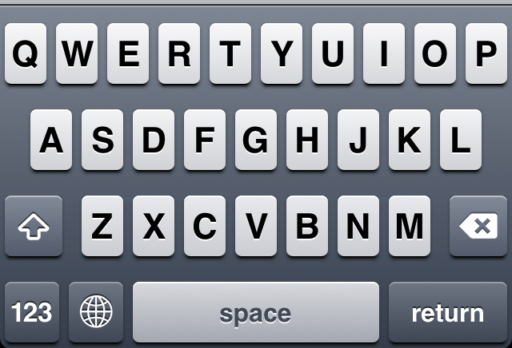
Nearby keys

