Slide 1
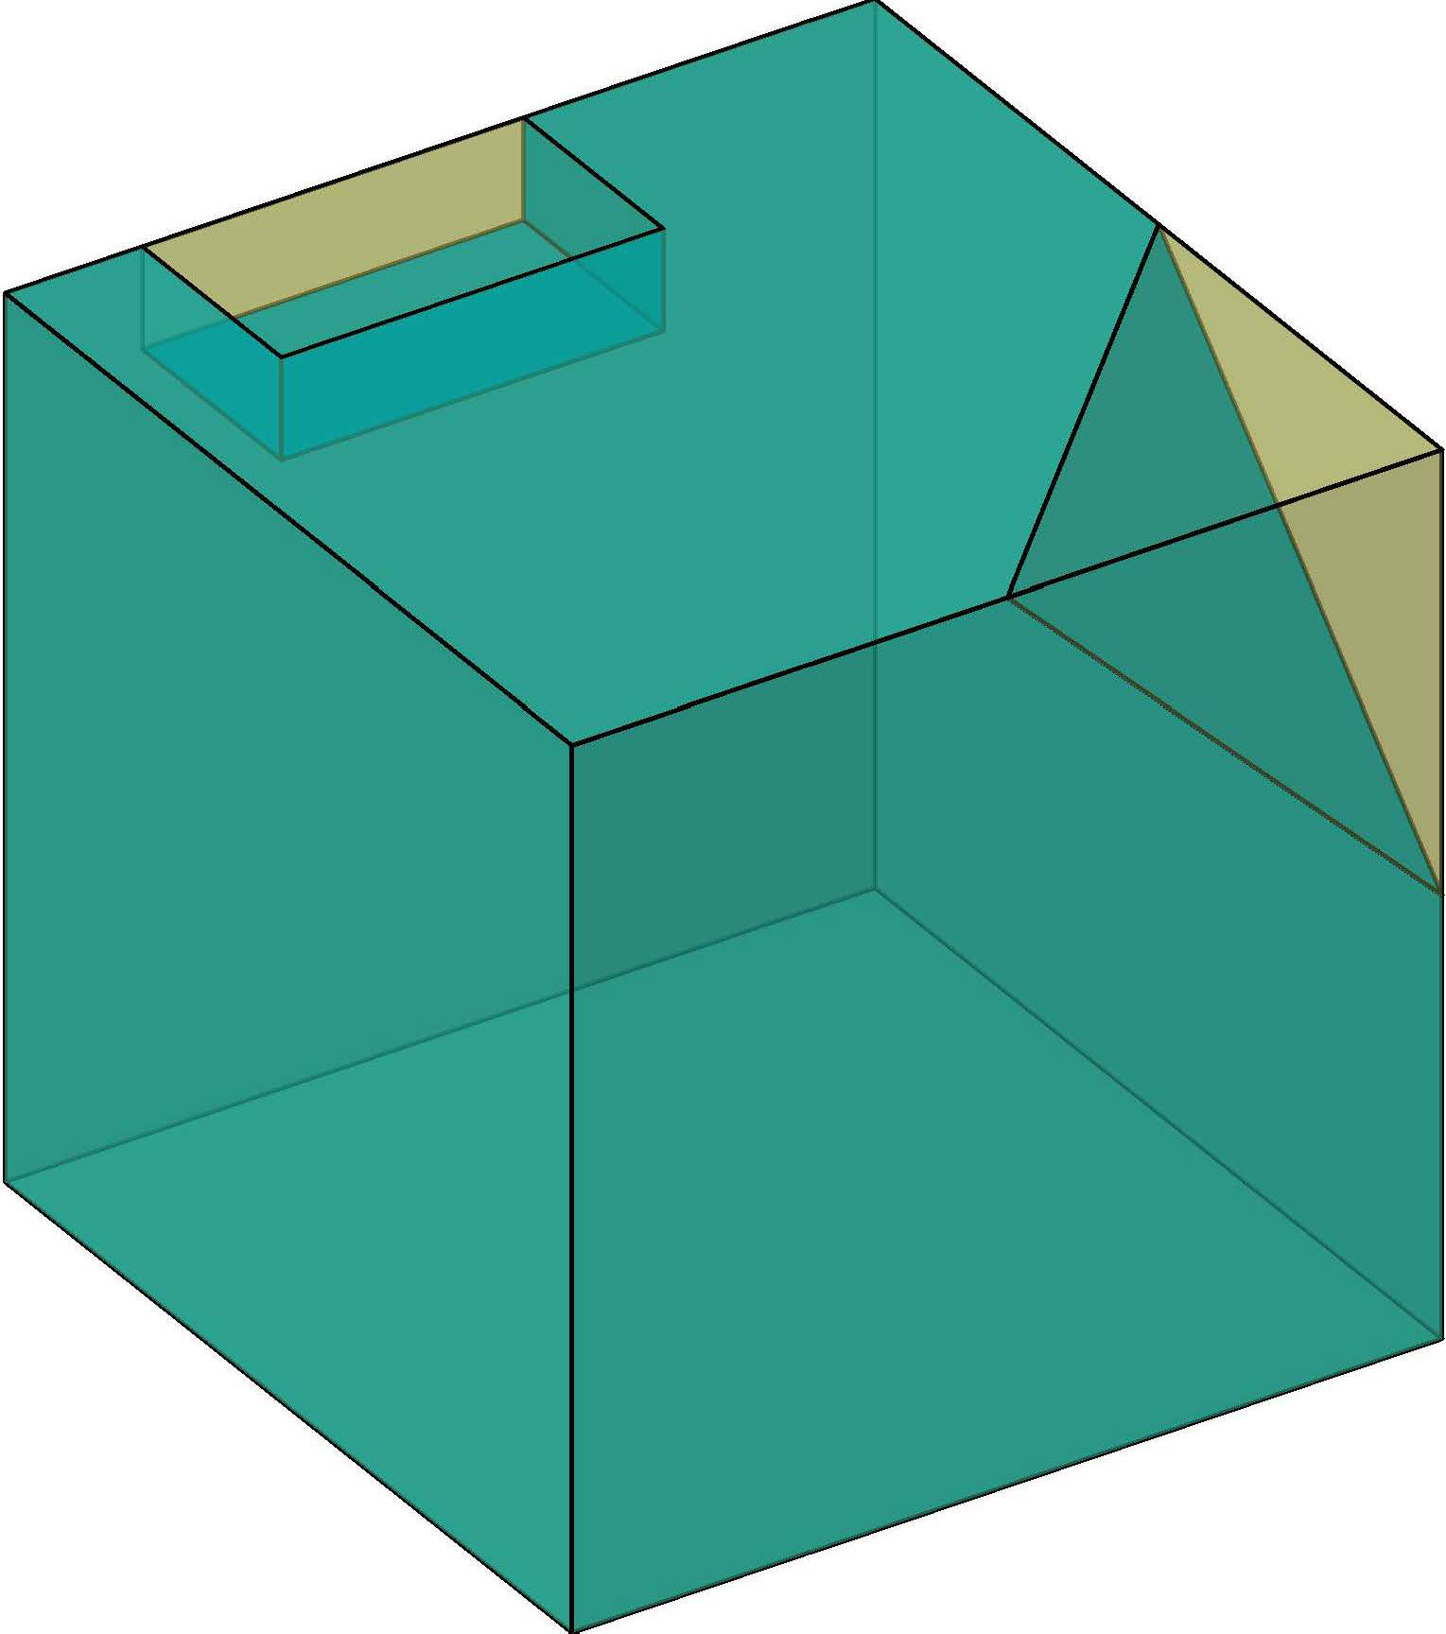
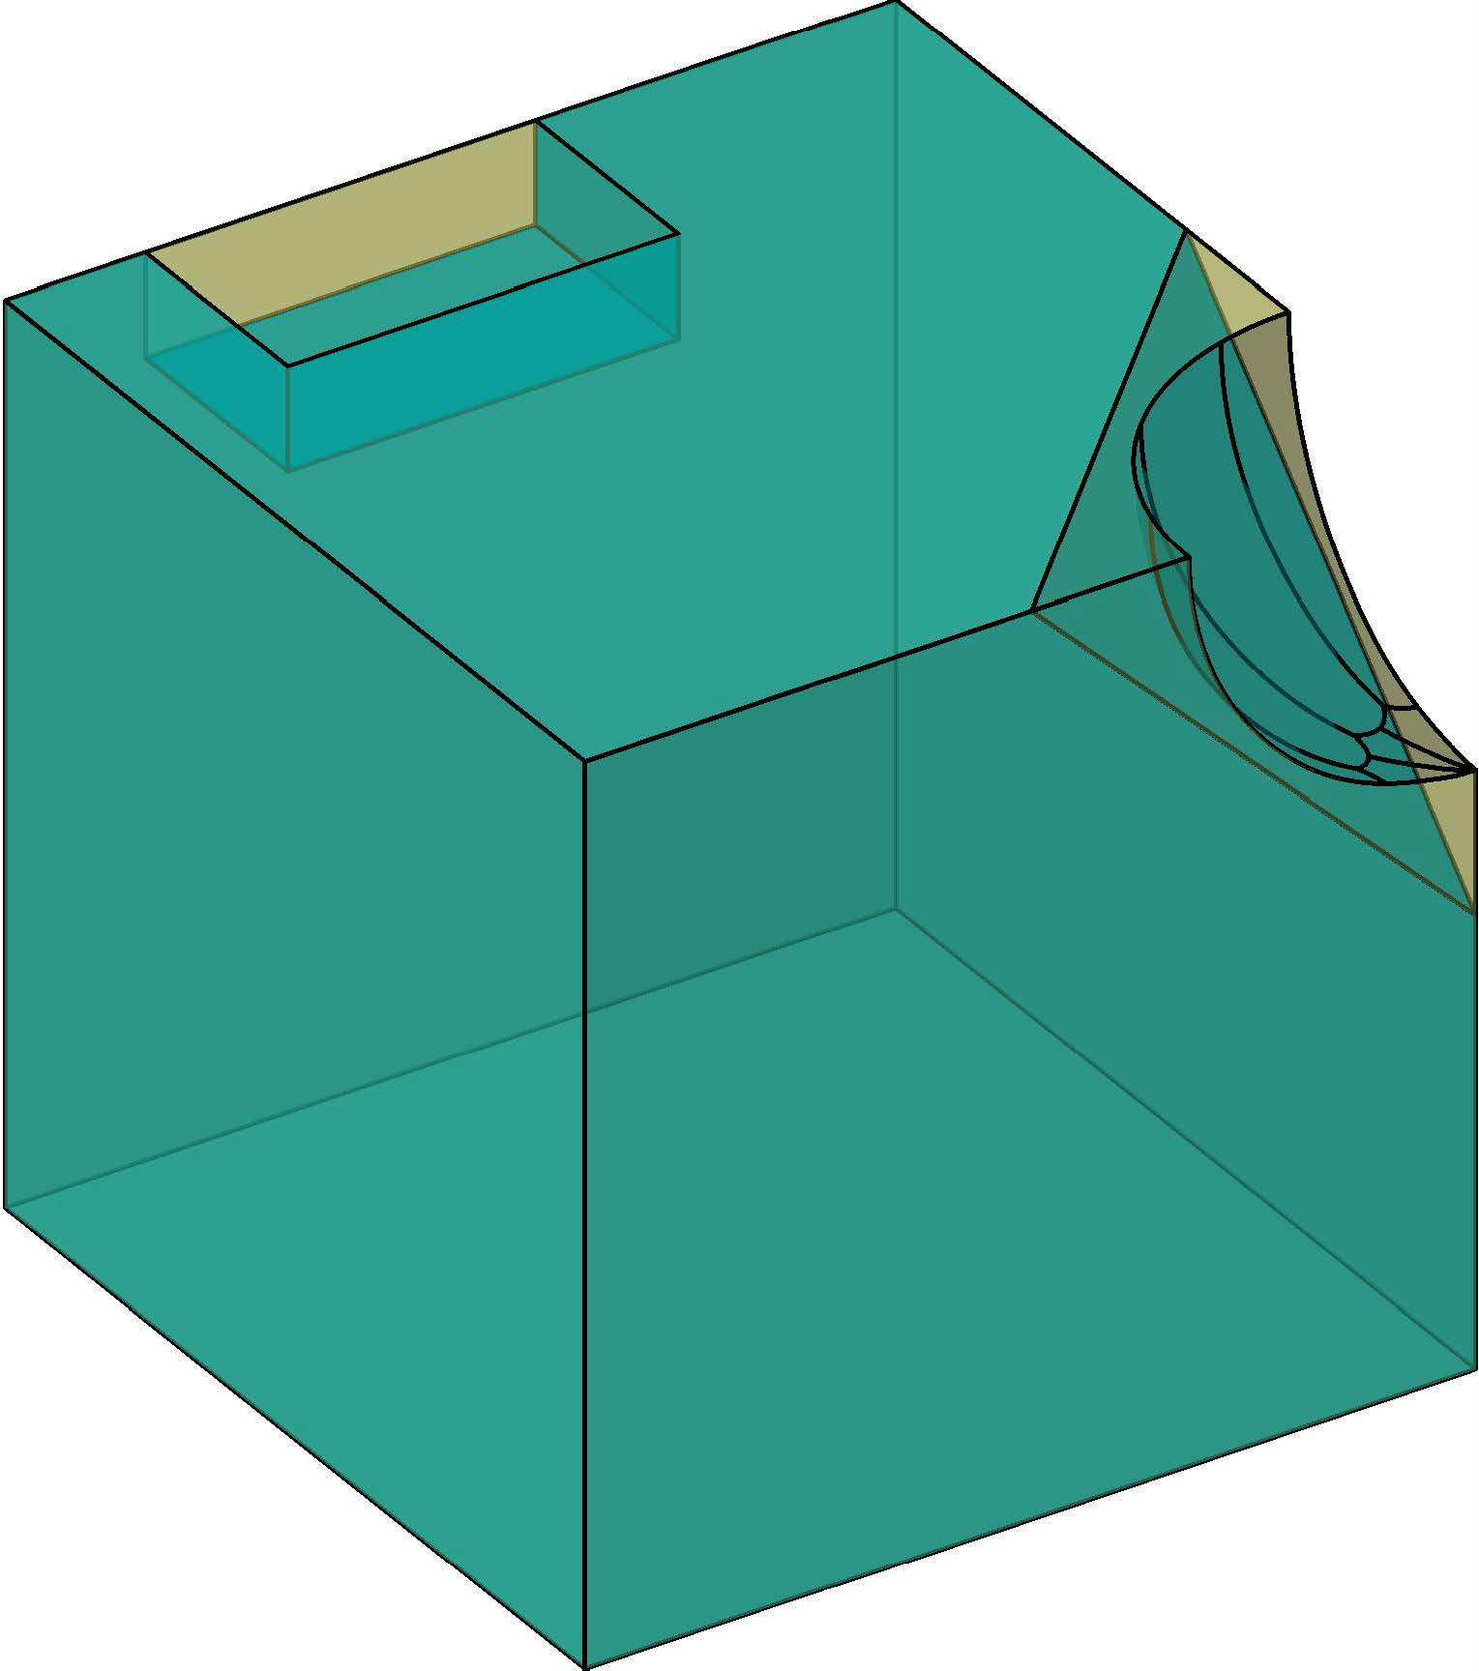




?

Search preimage
Find a counterexample

Safe
Unsafe
Unknown
No counterexample found
?
Exists one box always detect correct
$$d≤t$$
Calculate Bounds
NMS Verification
Update Bounds
Suspect
$$d>t$$

Slide 2
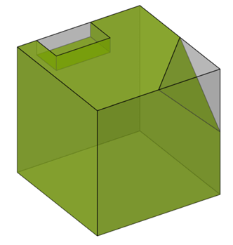



?
Search preimage

Exists one box always detect correct
$$d≤t$$
Calculate Bounds
NMS Verification
Update Bounds
Suspect
$$d>t$$

