Slide 1
Ticket Buyers Analysis
Ziyan(Cheryl) Liu
Notes:
Intro

Slide 2
Agenda:
Data Setup
Demographics Visualization
What do ticket buyers look like in terms of their make-up and financial situation?
Lifestyle Visualization
What are NYCFC ticket buyers spending on and what does their consumption look like?
Business Insights
Q&A
Notes:
Intro - agenda

Slide 3
Columns to clean
State (need to clean into 2-letter abbreviation format)
City
Contains misspelling and incorrect information, decide to focus on state level
Discretionary Income Index
488 null value, dropped when creating dashboard
Rfm grade
Correct ‘S’ to ‘B’

Slide 4
State - errors in abbreviations
Wrong Abbrev. | State
Conne | CT
MASSA | MA
MICHI | MI
n | NY
new | NY; for Rahway, NJ
New J | NJ
New Y | NY
NJ - | NJ
North | NC; some are cities in NY
Wrong Abbrev. | State
NUEVA | NY
ONTAR | ON
PENNS | PA
TEXAS | TX
VIRGI | VA
Use zip code range to assign correct state abbreviations. Reference: https://www.structnet.com/instructions/zip_min_max_by_state.html
Also, we want to exclude rows with Null in Zip code
Notes:
IF [State]= "Conne" THEN "CT"
ELSEIF [State]= "MASSA" THEN "MA"
ELSEIF [State]= "MICHI" THEN "MI"
ELSEIF [State]= "n" THEN "NY"
ELSEIF [State]= "new" and [City] = 'rahway' THEN "NJ"
ELSEIF [State]= "new" and [City] <> 'rahway' THEN "NY"
ELSEIF [State]= "New J" THEN "NJ"
ELSEIF [State]= "New Y" THEN "NY"
ELSEIF [State]= "NJ - " THEN "NJ"
ELSEIF [State]= "North" AND [City] = 'New York' THEN "NY"
ELSEIF [State]= "North" AND [City] <> 'New York' THEN "NC"
ELSEIF [State]= "NUEVA" THEN "NY"
ELSEIF [State]= "ONTAR" THEN "ON"
ELSEIF [State]= "PENNS" THEN "PA"
ELSEIF [State]= "TEXAS" THEN "TX"
ELSEIF [State]= "VIRGI" THEN "VA"
ELSE [State]
END

Slide 5
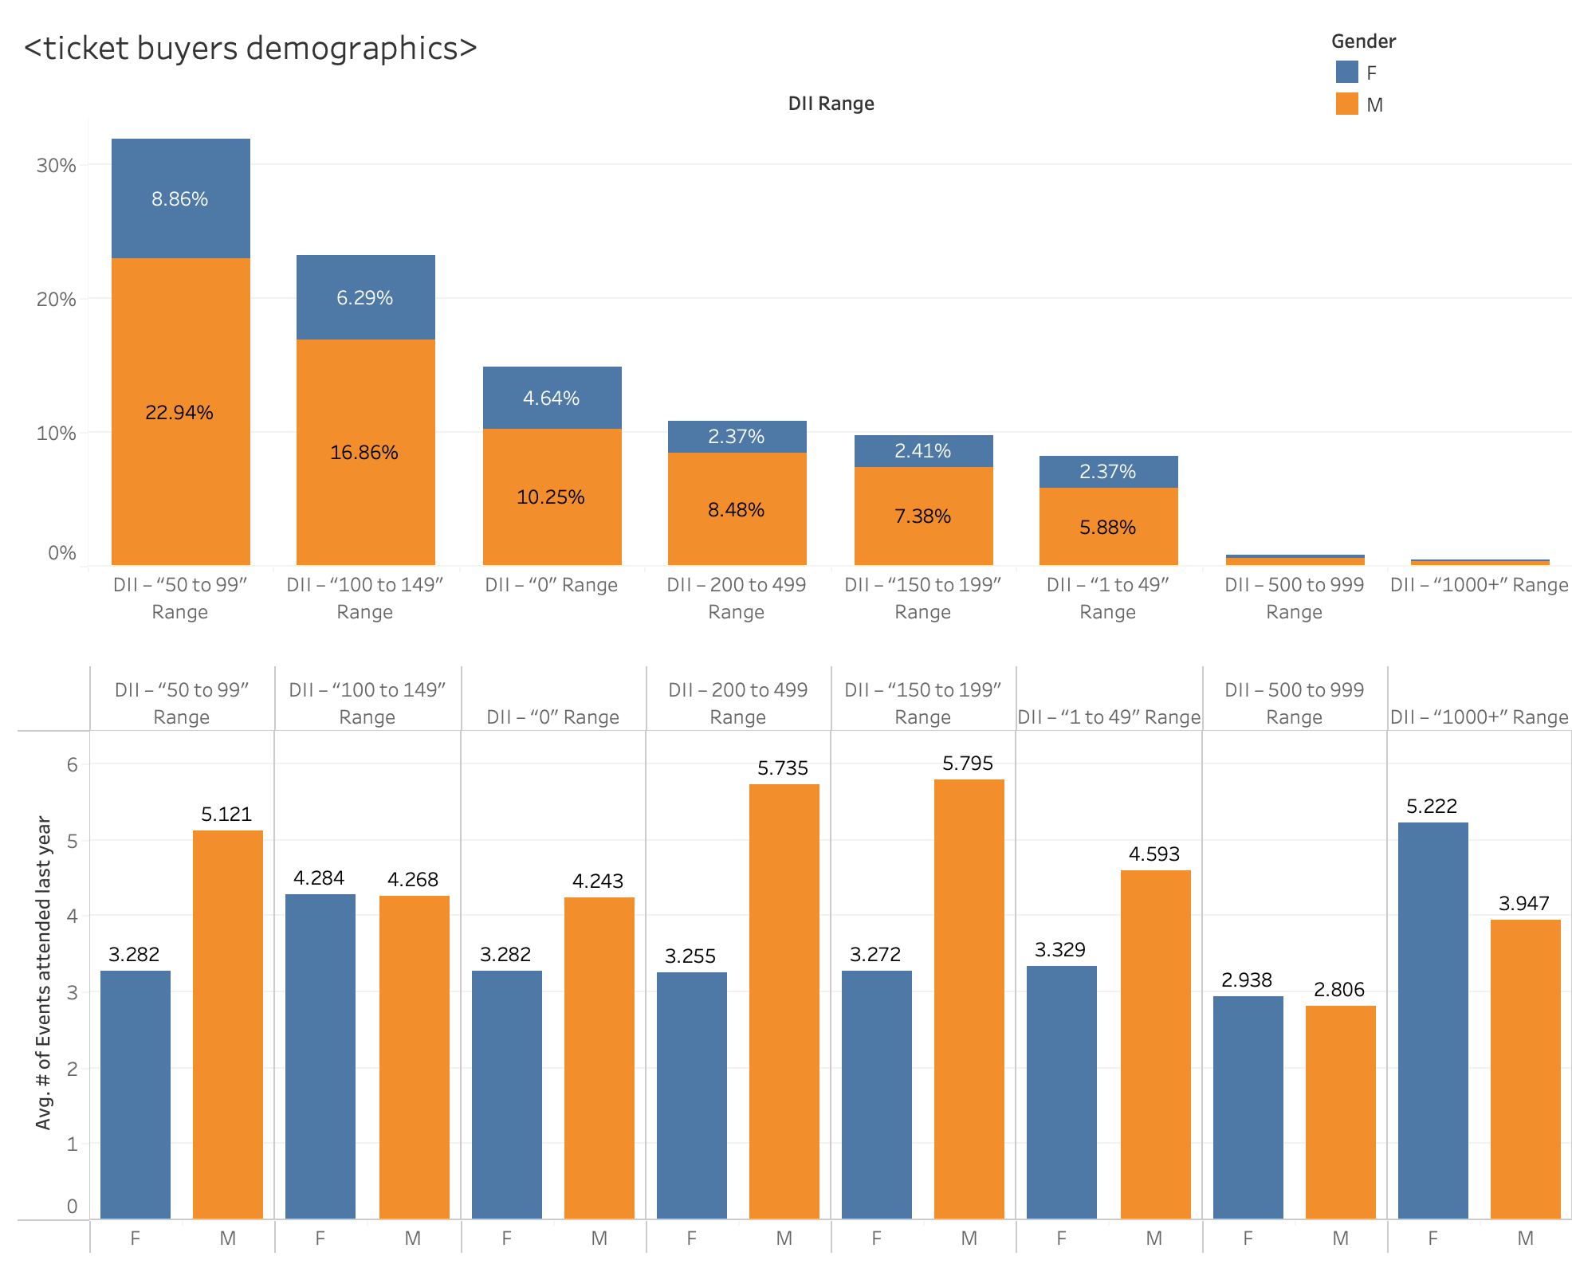
Most of ticket buyers come from DII-”50-99” range and DII “100 to 149” range.
For DII - “1000+”, DII - “500 to 900”, and DII - “100 to 149”, female buyers attended more events last year, on average.
Across all DII ranges, # of male buyers is 2-3x # of female buyers
But, female buyers are almost as engaged as male buyers attending last year event.

Slide 6
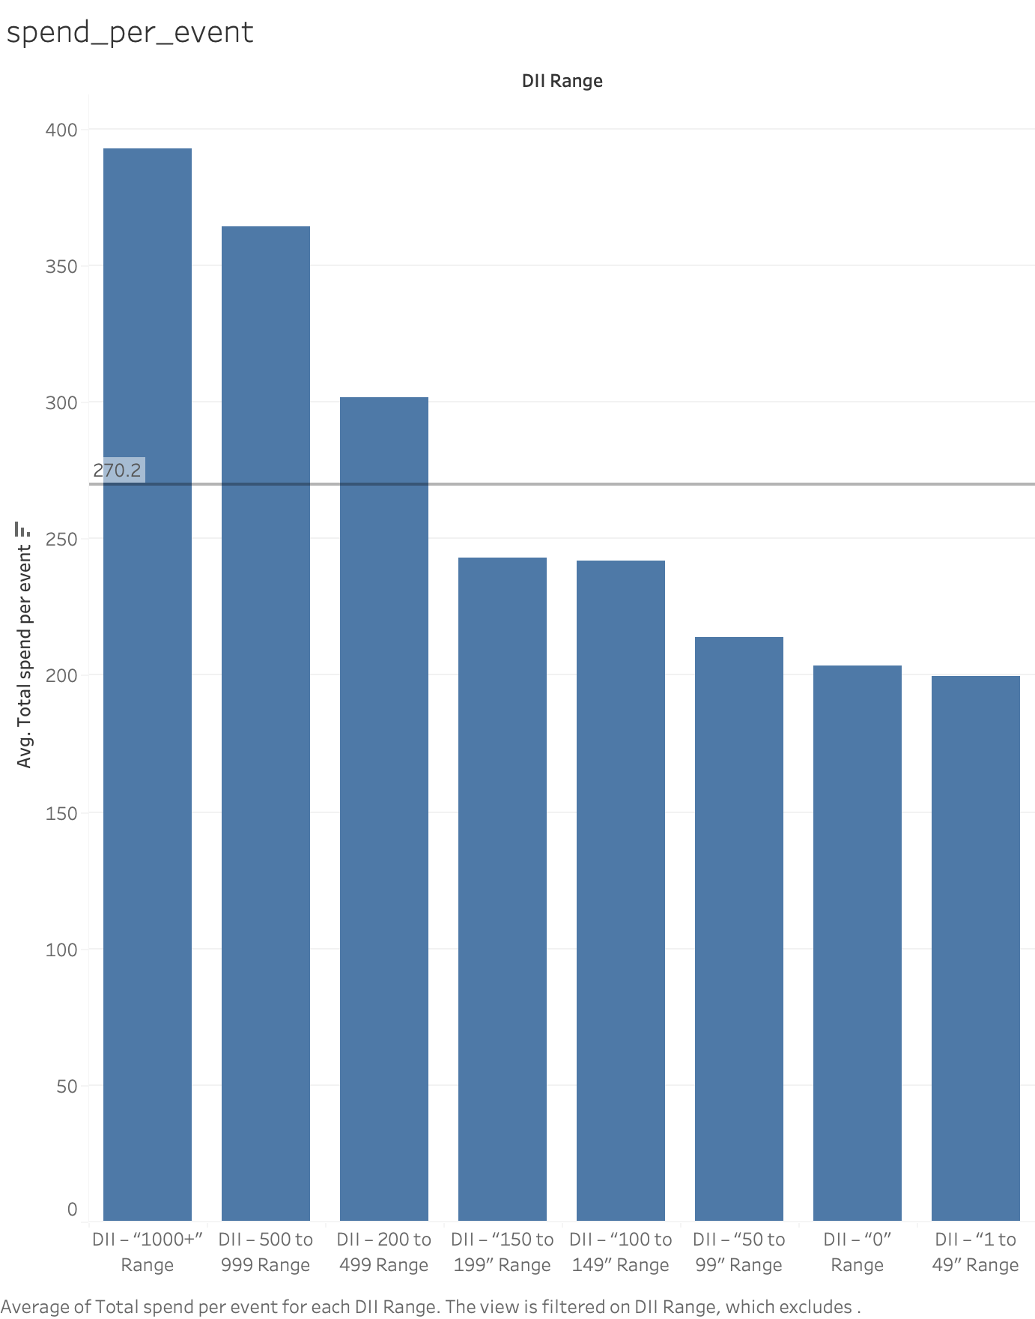
DII - “1000+” range has $ spend per event 2 times higher than the lowest spend per event at DII - ”1-49” range.
DII - “1000+” range, DII - “500 to 999” range, and DII - “200 to 499” range all have higher than the average spend per event for all DII ranges.
Notes:
Since DII - “1000+” range and DII - “500 to 999” range spend a lot (wealthier), we want to optimize these groups in order to have a similar/better composition like other groups.

Slide 7
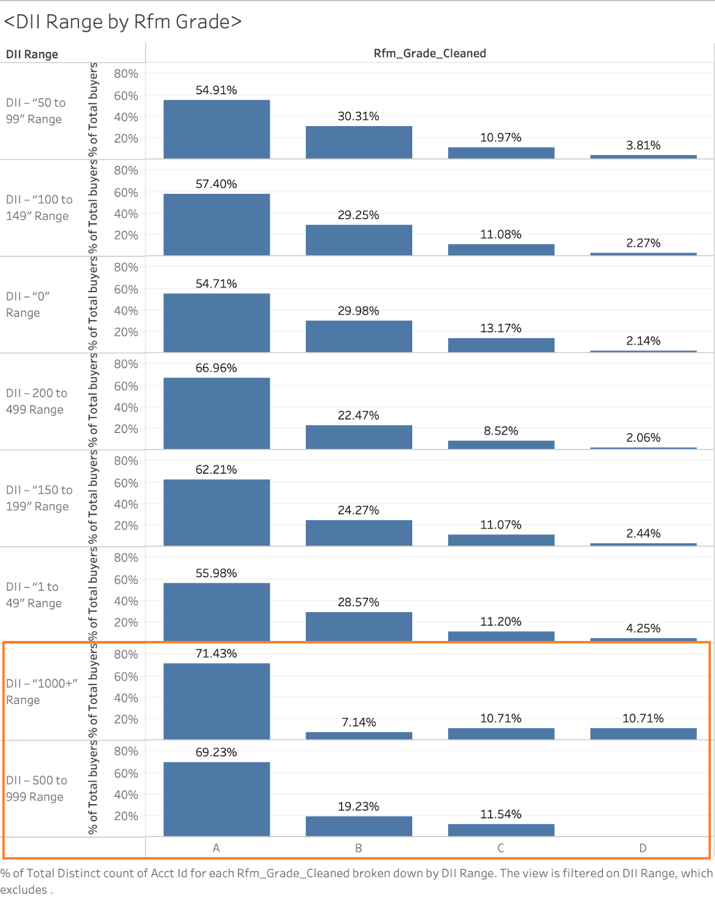
For DII - “1000+” range and DII - “500 to 999” range:
Rfm grade structure shows very different composition compared to other groups.
Why?
Notes:
Since DII - “1000+” range and DII - “500 to 999” range spend a lot (wealthier), we want to optimize these groups in order to have a similar/better composition like other groups.

Slide 8
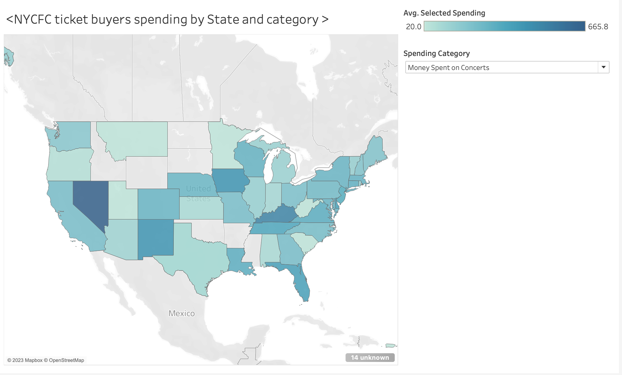
NV has the highest average $ spending of concerts tickets.

Slide 9
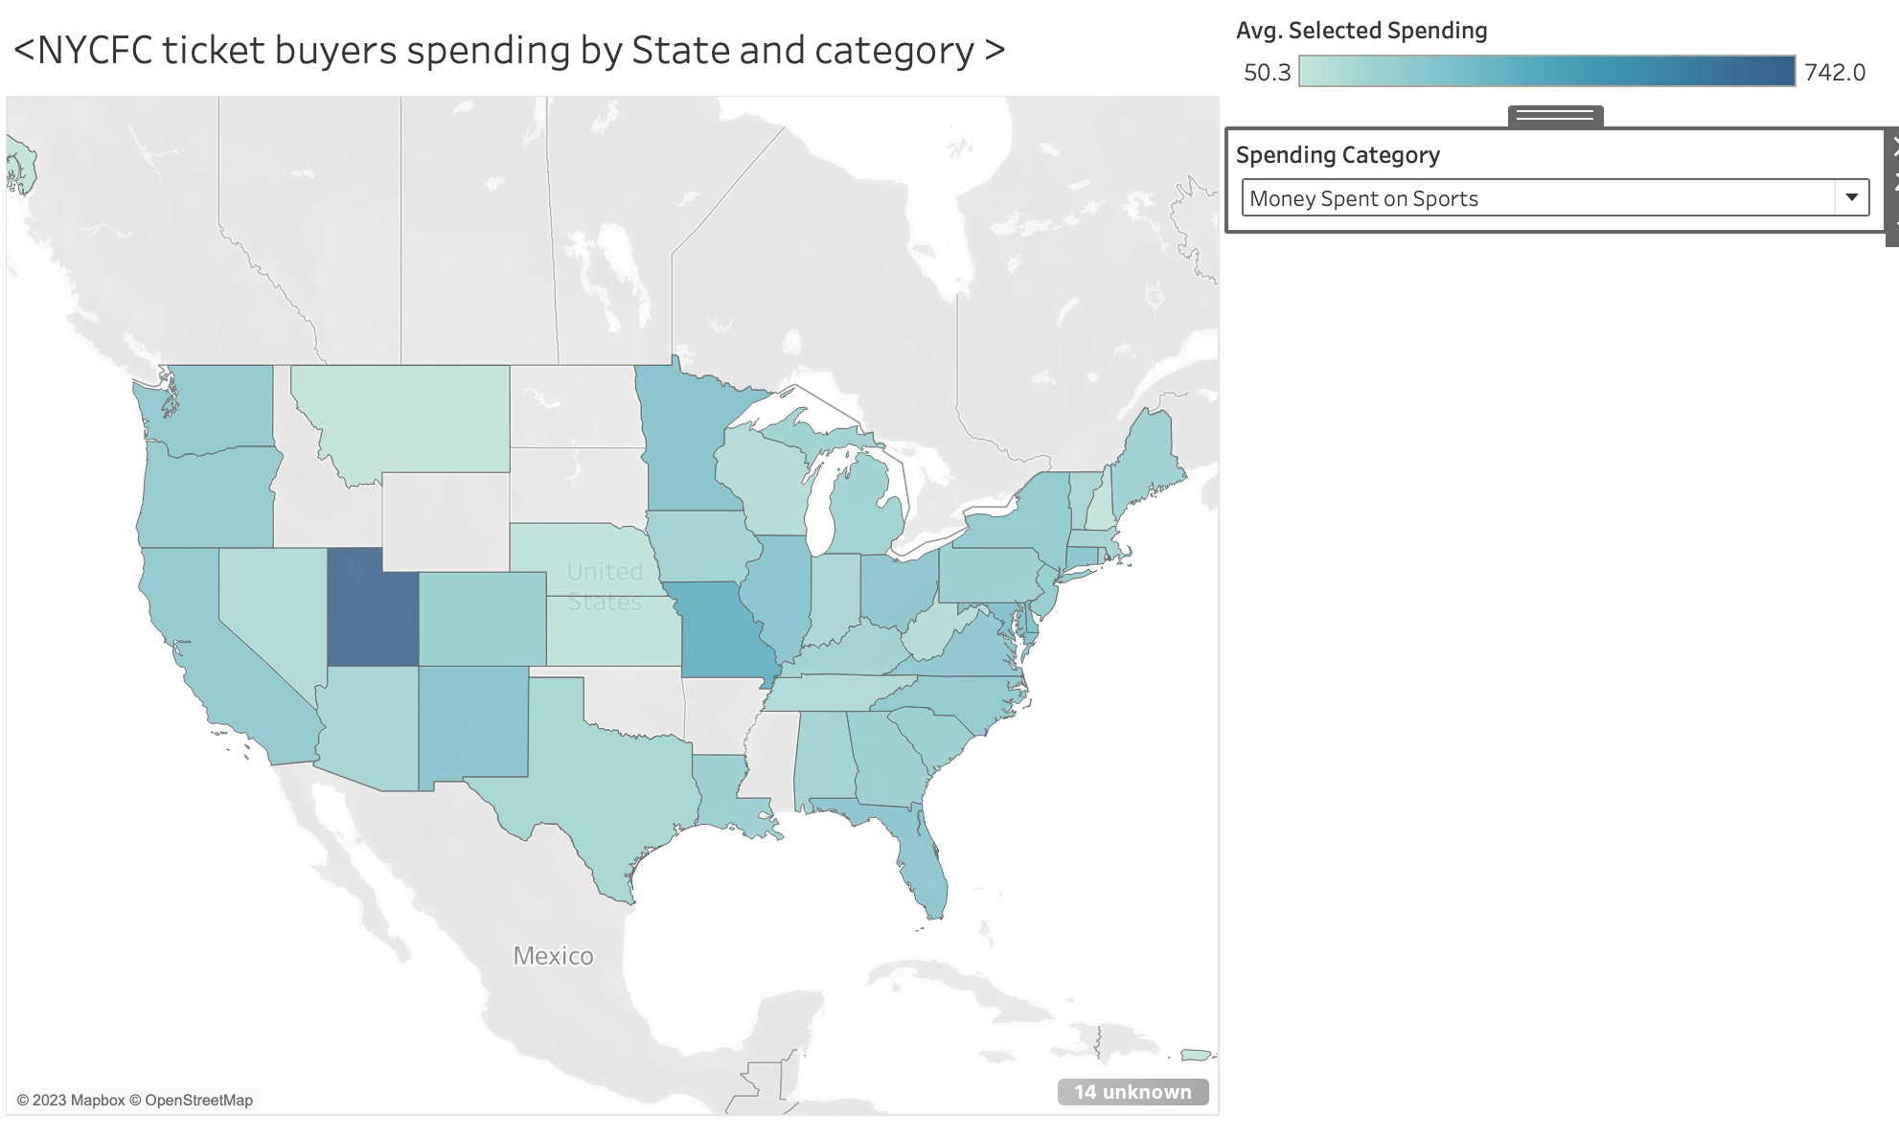
UT has the highest average $ spending of sports tickets.

Slide 10
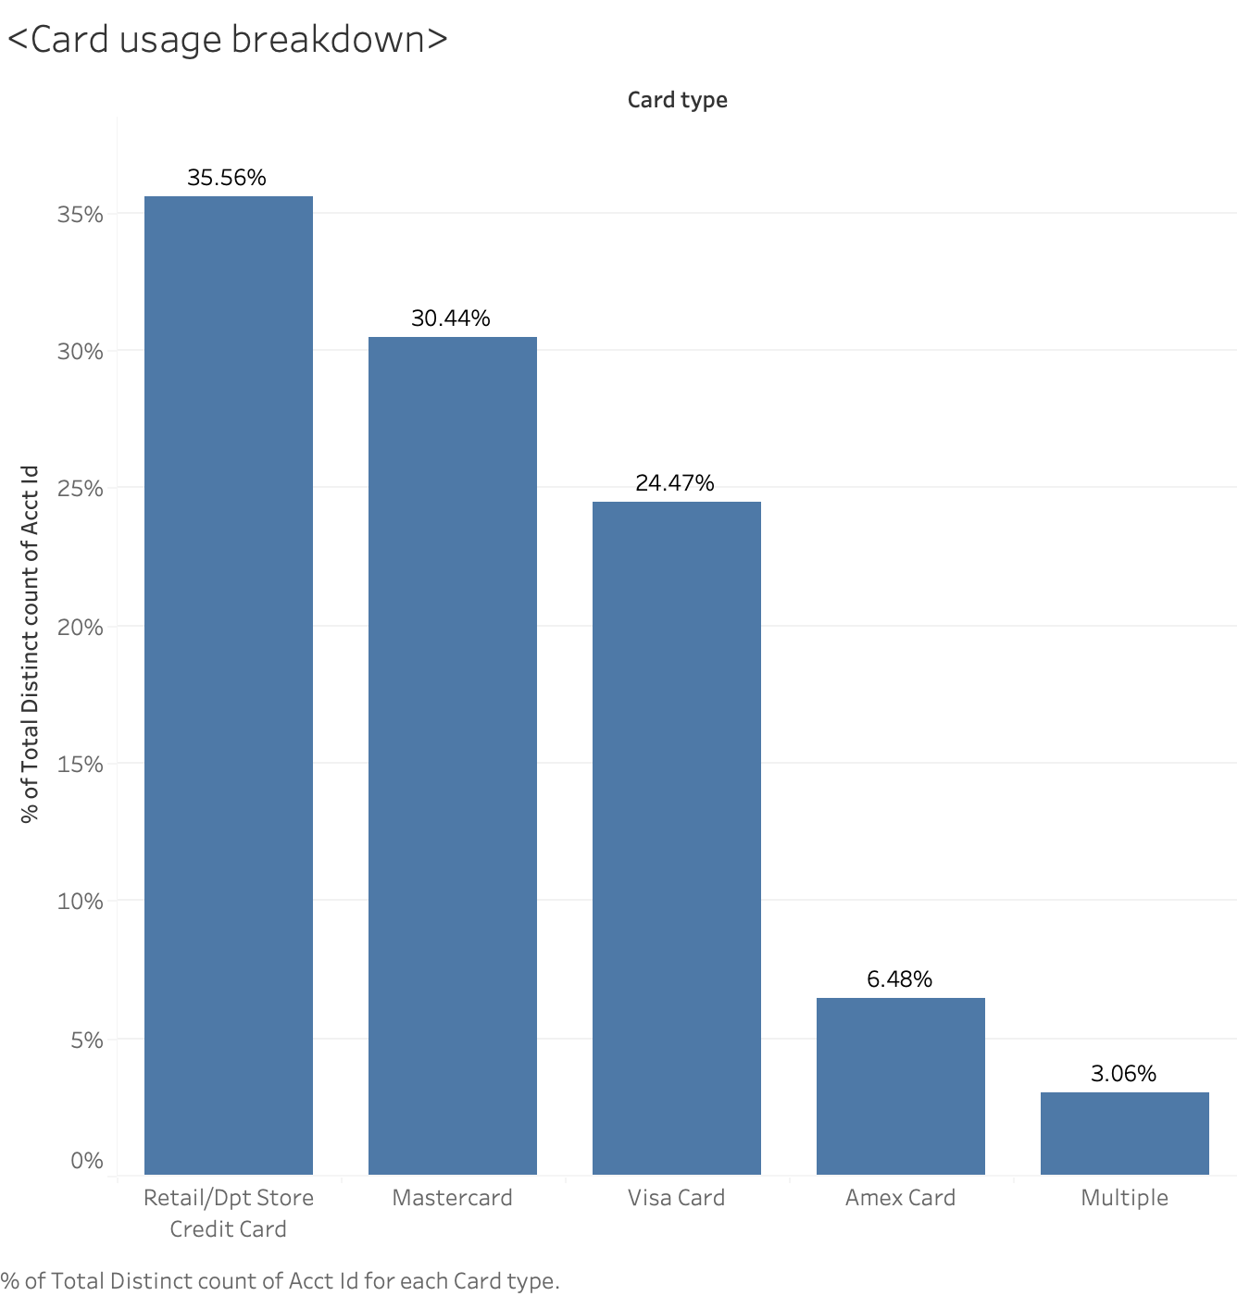
Amex card is used less frequently by ticket buyers. However, I found some account in the dataset with two and more card types.

Slide 11
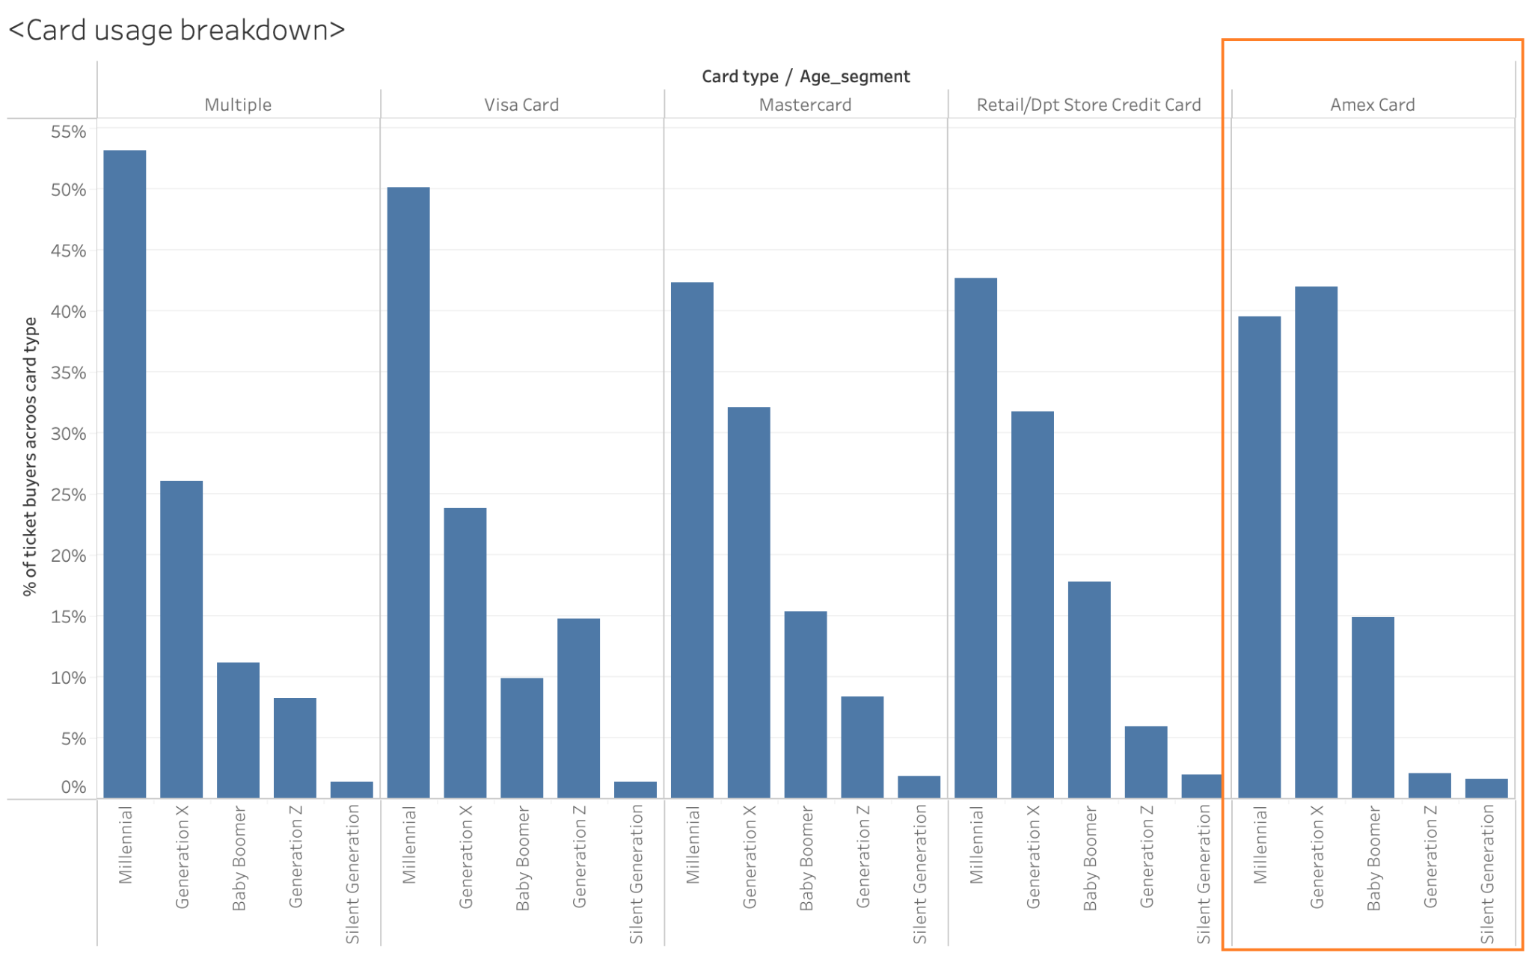
The age composition for buyers using Amex card is different from other buying options.

Slide 12
Insights
Ticket buyers have different spending patterns for sports tickets and concerts tickets.
Correlation between average $ spent on sports and average $ spent on concerts is around 0.27.
Maybe group state by college/league division, compute a weighted average based on # of buyers, and the pattern could be different.
Across all DII ranges, # of male buyers is 2-3x # of female buyers
But, female buyers are almost as engaged as male buyers attending last year event.
Potential opportunities of promoting tickets to this group of ticket buyers
The age composition for buyers using Amex card is different from other buying options.
If we want to have campaigns on Amex card, we should focus on different age group than the other card.

Slide 13
Q&A
Notes:
outro

