Slide 1

Transformer在计算机视觉领域的应用
汇报人：郎志远

Slide 2
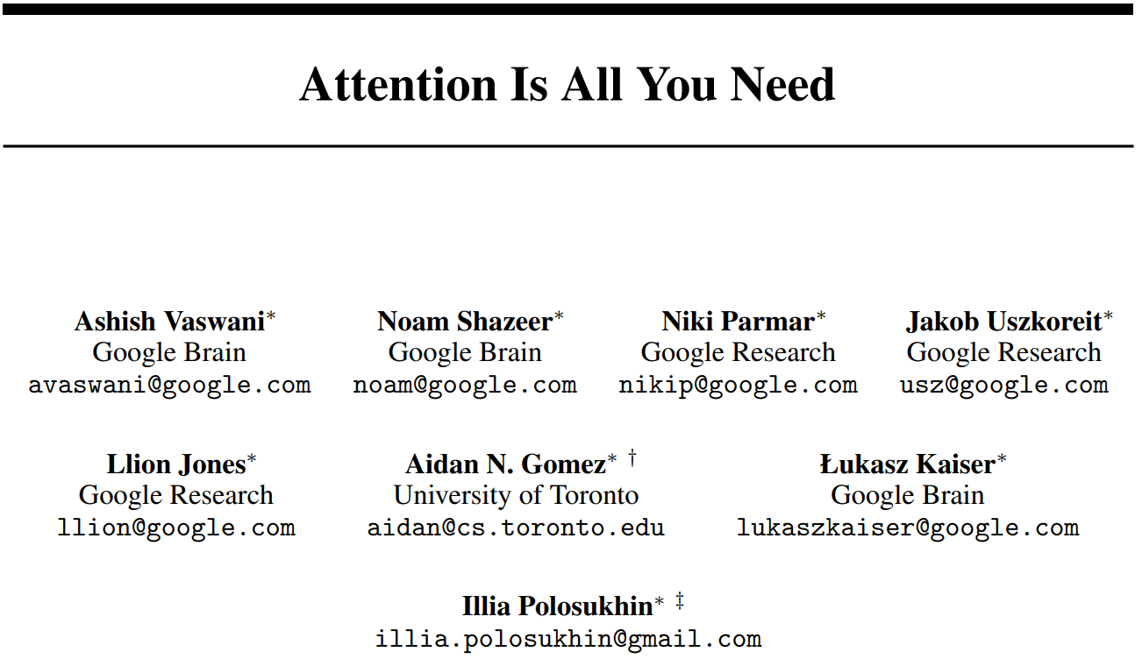

Transformer概述
Transformer 是一种深度学习模型
首次应用于NLP领域
具有强大的处理序列数据的能力
LLM采用Transformer作为核心架构
Notes:
Transformer 是一种深度学习模型架构，它在2017年由谷歌团队在《Attention is All You Need》这篇文章中首次提出，这个模型首次应用于自然语言处理领域用来解决机器翻译任务，Transformer在处理序列数据的能力非常优秀，现在比较热门大语言模型的都采用了Transformer作为其核心架构

Slide 3
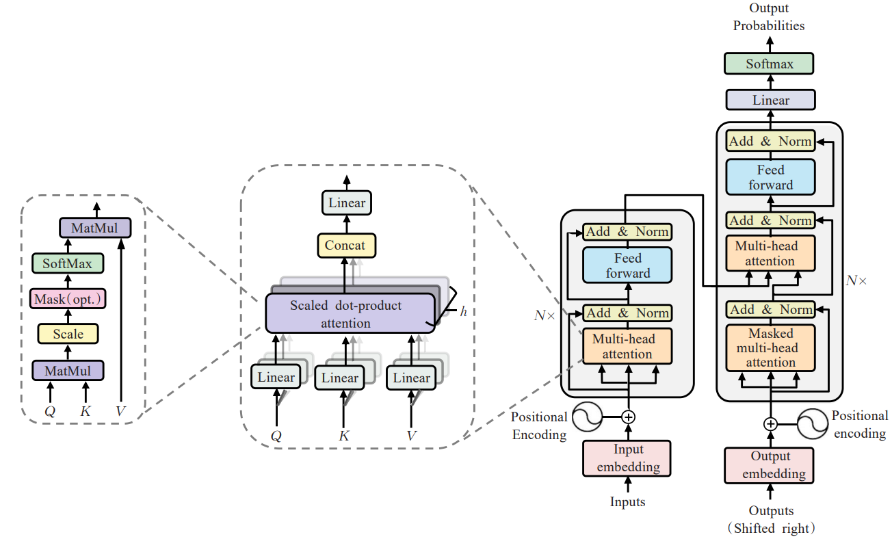
Transformer的网络结构
4.输出
多头注意力层
自注意力机制
2.编码器
3.解码器
1.输入
Notes:
Transformer由输入、编码器和解码器、输出4个部分组成。其核心是自注意力机制，通过多头注意力层并行处理序列中的元素来捕捉不同位置间的复杂关系。
每个子层包含自注意力和前馈神经网络，并通过残差连接和层归一化增强信息流动和训练稳定性。

Slide 4
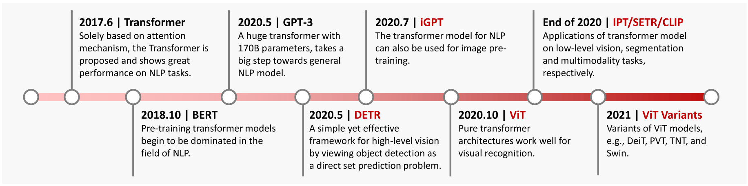
Transformer发展中的重要模型
Notes:
我们可以看一下Transformer发展中的比较重要的模型，标黑的是应用于NLP领域的基于Transformer模型，标红的是应用于计算机视觉领域的基于Transformer的模型，在2018年提出的BERT和2020提出的GPT-3都在NLP领域产生了深远的影响
Transformer强大的表示能力也引起了计算机视觉领域的关注，研究人员正探索将Transformer应用于计算机视觉任务的方法

Slide 5

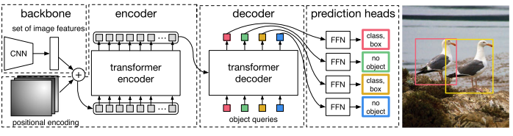
High/Mid-Level Vision
高/中层视觉领域：目标检测、语义分割等
最早的基于Transformer的方法进行目标检测的是DETR(Detection Transformer)DETR首先使用CNN作为骨干网络提取输入图像的特征，然后将这些特征输入到Transformer中，使用前馈神经网络（FFN）计算最终的预测边界框坐标和类别标签用于指示对象的特定类别
语义分割方面具有广泛应用的是SETR(semantic segmentation network )，它使用类似于Vision Transformer的编码器来从输入图像中提取特征，采用了多级特征聚合模块来进行逐像素分割

Slide 6
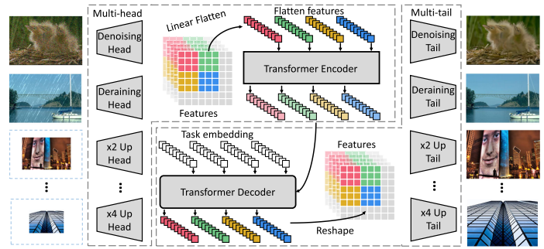
Low-Level Vision
低层视觉领域：图像超分、图像生成等
IPT(Image Processing Transformer )通过使用大型预训练数据集充分利用Transformer的优势，引入了多头、多尾部结构和任务嵌入以适应不同的图像处理任务，在训练完模型后，通过使用相应的头部、尾部和任务嵌入在每个任务上对模型进行微调，在图像超分、降噪等方面取得了显著的进展。
图像生成方面，OpenAI 提出了DALL-E，它能够理解和执行复杂的文本指令，生成与文本描述相符的图像。在2023 发布的 DALL-E 3在理解细微差别和细节方面有了显著提升，能够生成更高质量的图像，并且集成在 ChatGPT 中

Slide 7
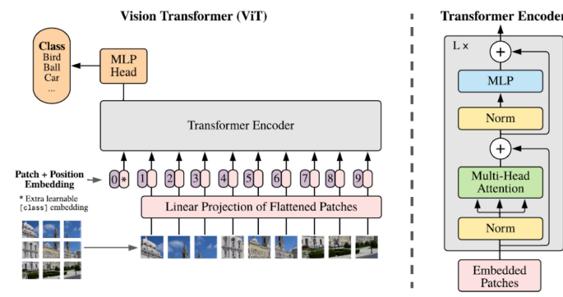
Other Task
Backbone：Transformer也可以作为图像分类的骨干网络，ViT(Vision Transformer) ，将纯Transformer直接应用于图像分类任务。DeiT(Data-efficient image transformer)参考ViT的网络结构，使用了8600万个参数。在强大的数据增强的支持下，DeiT-B在ImageNet上取得了83.1%准确率
Multi-Modal Tasks：许多研究人员热衷于利用Transformer来处理多模态任务，CLIP (Contrastive Language-Image Pre-training)是一个由 OpenAI 开发的多模态模型，它结合了自然语言处理和计算机视觉的能力，通过对比学习来学习图像和文本之间的关联。CLIP 的核心思想是利用大量的图像和文本对来训练一个模型，使得模型能够理解图像内容并生成相应的文本描述。

Slide 8
总结与展望
在解决计算机视觉任务上，研究人员已经提出了许多基于Transformer的模型，但这些成果只是该领域的第一步，仍有很大的改进空间。
与CNN相比，纯Transformer缺乏一些归纳偏差，并且严重依赖大规模训练数据进行训练。在更一般化的视觉任务上更好地推广预训练的Transformer仍有很长的路要走
Transformer模型通常庞大且计算量巨大，需要开发高效的Transformer模型，以便将将其部署在资源有限的设备上
大多数现有的视觉Transformer模型只涉及用于处理单个任务，接下来的研究可以尝试将更多的任务可以整合到一个模型中

Slide 9
参考文献
[1]Ariyaratne, Sisith, Karthikeyan. P. Iyengar, Neha Nischal, Naparla Chitti Babu, and Rajesh Botchu. “A Comparison of ChatGPT-Generated Articles with Human-Written Articles.” SKELETAL RADIOLOGY 52, no. 9 (September 2023): 1755–58.
[2] Augustine, Sijo, Mahesh K. Mishra, and N. Lakshminarasamma. “Adaptive Droop Control Strategy for Load Sharing and Circulating Current Minimization in Low-Voltage Standalone DC Microgrid.” IEEE TRANSACTIONS ON SUSTAINABLE ENERGY 6, no. 1 (January 2015): 132–41.
[3] Bello, Abayomi, Sin-Chun Ng, and Man-Fai Leung. “A BERT Framework to Sentiment Analysis of Tweets.” SENSORS 23, no. 1 (January 2023).
[4] Dalmaz, Onat, Mahmut Yurt, and Tolga Cukur. “ResViT: Residual Vision Transformers for Multimodal Medical Image Synthesis.” IEEE TRANSACTIONS ON MEDICAL IMAGING 41, no. 10 (October 2022): 2598–2614.
[5] Ge, Jin, and Jennifer C. Lai. “Artificial Intelligence-Based Text Generators in Hepatology: ChatGPT Is Just the Beginning.” HEPATOLOGY COMMUNICATIONS 7, no. 4 (April 2023).
[6] Han, Kai, Yunhe Wang, Hanting Chen, Xinghao Chen, Jianyuan Guo, Zhenhua Liu, Yehui Tang, et al. “A Survey on Vision Transformer.” IEEE TRANSACTIONS ON PATTERN ANALYSIS AND MACHINE INTELLIGENCE 45, no. 1 (January 1, 2023): 87–110.
[7] Huang, Pan, Peng He, Sukun Tian, Mingrui Ma, Peng Feng, Hualiang Xiao, Francesco Mercaldo, Antonella Santone, and Jing Qin. “A ViT-AMC Network With Adaptive Model Fusion and Multiobjective Optimization for Interpretable Laryngeal Tumor Grading From Histopathological Images.” IEEE TRANSACTIONS ON MEDICAL IMAGING 42, no. 1 (January 2023): 15–28.
[8] Jamali, Ali, Swalpa Kumar Roy, Avik Bhattacharya, and Pedram Ghamisi. “Local Window Attention Transformer for Polarimetric SAR Image Classification.” IEEE GEOSCIENCE AND REMOTE SENSING LETTERS 20 (2023).
[9] Khan, Salman, Muzammal Naseer, Munawar Hayat, Syed Waqas Zamir, Fahad Shahbaz Khan, and Mubarak Shah. “Transformers in Vision: A Survey.” ACM COMPUTING SURVEYS 54, no. 10S (January 2022).
[10] Li, Yehao, Ting Yao, Yingwei Pan, and Tao Mei. “Contextual Transformer Networks for Visual Recognition.” IEEE TRANSACTIONS ON PATTERN ANALYSIS AND MACHINE INTELLIGENCE 45, no. 2 (February 1, 2023): 1489–1500.
[11] Liang, Donglai, Jian Li, Ronghai Qu, and Wubin Kong. “Adaptive Second-Order Sliding-Mode Observer for PMSM Sensorless Control Considering VSI Nonlinearity.” IEEE TRANSACTIONS ON POWER ELECTRONICS 33, no. 10 (October 2018): 8994–9004.
[12] Lin, Ailiang, Bingzhi Chen, Jiayu Xu, Zheng Zhang, Guangming Lu, and David Zhang. “DS-TransUNet: Dual Swin Transformer U-Net for Medical Image Segmentation.” IEEE TRANSACTIONS ON INSTRUMENTATION AND MEASUREMENT 71 (2022).
[13] Liu, Mengxi, Zhuoqun Chai, Haojun Deng, and Rong Liu. “A CNN-Transformer Network With Multiscale Context Aggregation for Fine-Grained Cropland Change Detection.” IEEE JOURNAL OF SELECTED TOPICS IN APPLIED EARTH OBSERVATIONS AND REMOTE SENSING 15 (2022): 4297–4306.

Slide 10
参考文献
[14] Chen, Daoquan, Weicong Hong, and Xiuze Zhou. “Transformer Network for Remaining Useful Life Prediction of Lithium-Ion Batteries.” IEEE ACCESS 10 (2022): 19621–28.
[15] Cui, Yiming, Wanxiang Che, Ting Liu, Bing Qin, and Ziqing Yang. “Pre-Training With Whole Word Masking for Chinese BERT.” IEEE-ACM TRANSACTIONS ON AUDIO SPEECH AND LANGUAGE PROCESSING 29 (2021): 3504–14.
[16] Gong, Chao, Yihua Hu, Jinqiu Gao, Yangang Wang, and Liming Yan. “An Improved Delay-Suppressed Sliding-Mode Observer for Sensorless Vector-Controlled PMSM.” IEEE TRANSACTIONS ON INDUSTRIAL ELECTRONICS 67, no. 7 (July 2020): 5913–23.
[17] Gong, Hang, Tingkui Mu, Qiuxia Li, Haishan Dai, Chunlai Li, Zhiping He, Wenjing Wang, et al. “Swin-Transformer-Enabled YOLOv5 with Attention Mechanism for Small Object Detection on Satellite Images.” REMOTE SENSING 14, no. 12 (June 2022).
[18] He, Xin, Yong Zhou, Jiaqi Zhao, Di Zhang, Rui Yao, and Yong Xue. “Swin Transformer Embedding UNet for Remote Sensing Image Semantic Segmentation.” IEEE TRANSACTIONS ON GEOSCIENCE AND REMOTE SENSING 60 (2022).
[19] Lv, Pengyuan, Wenjun Wu, Yanfei Zhong, Fang Du, and Liangpei Zhang. “SCViT: A Spatial-Channel Feature Preserving Vision Transformer for Remote Sensing Image Scene Classification.” IEEE TRANSACTIONS ON GEOSCIENCE AND REMOTE SENSING 60 (2022).
[20] Pan, Donghua, Xiongfei Wang, Fangcheng Liu, and Rongliang Shi. “Transient Stability of Voltage-Source Converters With Grid-Forming Control: A Design-Oriented Study.” IEEE JOURNAL OF EMERGING AND SELECTED TOPICS IN POWER ELECTRONICS 8, no. 2 (June 2020): 1019–33.
[21] Zhang, Qiming, Yufei Xu, Jing Zhang, and Dacheng Tao. “ViTAEv2: Vision Transformer Advanced by Exploring Inductive Bias for Image Recognition and Beyond.” INTERNATIONAL JOURNAL OF COMPUTER VISION 131, no. 5 (May 2023): 1141–62.

