Slide 1

ChatGPT Chemistry Assistant for Text Mining and the Prediction of MOF Synthesis
presenter：Lang Zhiyuan

Slide 2
Contents
01 Background
02 Main Content
03 Summary

Slide 3
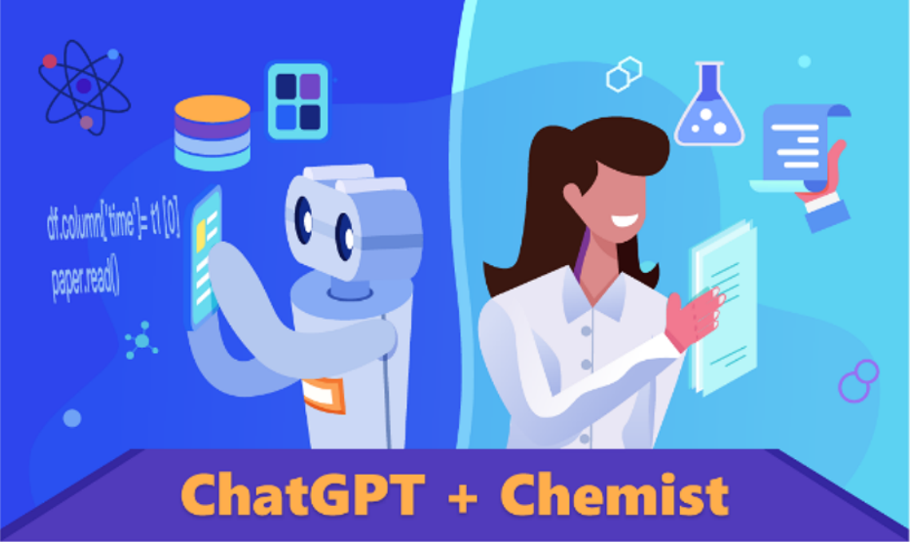
01
Background
At the age of artificial general intelligence(AGI), the potential for synergy between AI and chemistry is vast and promising.
AI powered chemistry assistants may revolutionize the landscape of chemistry research

Slide 4
01
Background
Traditional approaches to mine the vast amount of available literature to obtain valuable information and insights necessitate professional knowledge of data science.
LLMs can act as chemistry assistants to collaborate with researchers in text mining and data analysis

Slide 5
02
Main Content
Prompt Engineering
Minimizing hallucination
Implementing detailed instructions
Requesting structured output
Design Considerations for ChatGPT-Based Text Mining
ChatGPT-Assisted Python Code Generation and Data
Processing
Locating potential sections containing synthesis conditions with in the document.
Confirming the presence of synthesis conditions in the identified sections
Extracting synthesis parameters one by one.
Using ChatGPT create Python scripts
for parsing academic papers, generating prompts, executing text , and collating the responses into cleaned, tabulated data .

Slide 6
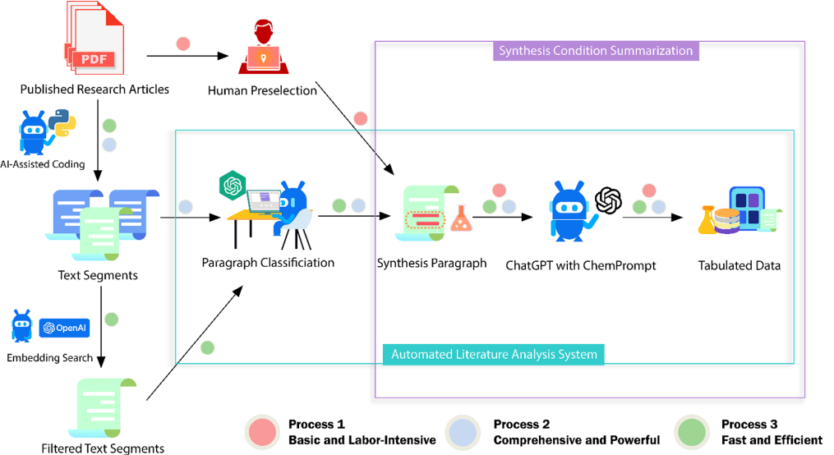
02
Main Content
Schematics of the ChatGPT Chemistry Assistant workflow

Slide 7
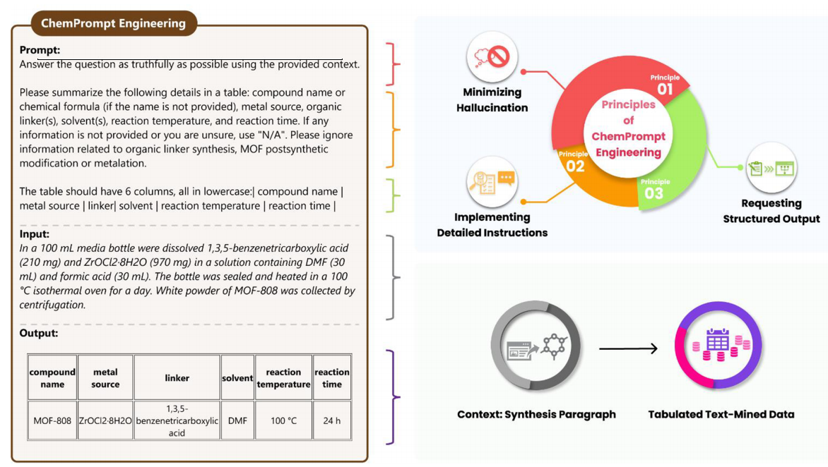
02
Main Content
Illustration of a carefully designed ChemPrompt encapsulating all three fundamental principles of ChemPrompt Engineering

Slide 8
03
Summary
This research has successfully demonstrated the potential of LLMs, particularly GPT models, in the domain of chemistry research. It presented a ChatGPT Chemistry Assistant that includes three different but connected approaches to text mining with ChemPrompt Engineering.
It elucidated two crucial insights from the data set of synthesis conditions.：
First, the data can be employed to construct predictive models for reaction outcomes, which shed light on the key experimental factors that influence the MOF crystallization process.
Second, it is possible to create an MOF chatbot that can provide accurate answers based on text mining.
On a fundamental level, this study provides guidance on interacting with LLMs to serve as AI assistants for chemists, accelerating research with minimal prerequisite coding expertise and thus bridging the gap between chemistry and the realms of computational and data science more effectively.

Slide 9
Thanks!

