Slide 1
郎志远 23724590 学术海报 作者: Sofia Leão Carvalho, Mauricio Martines Sales, André Luís Brasil Cavalcante 文献标题：Systematic literature review and mapping of the prediction of pile capacities 杂志名称：Soils and Rocks 年份：2023 卷号：46 期号：3

Slide 2

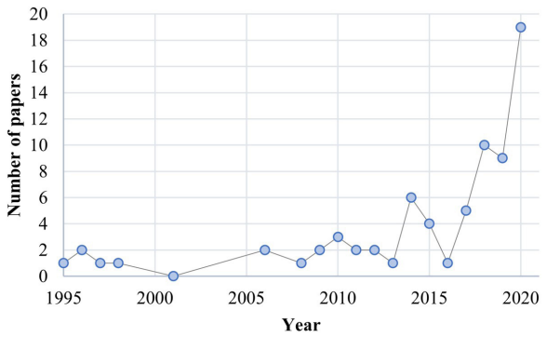
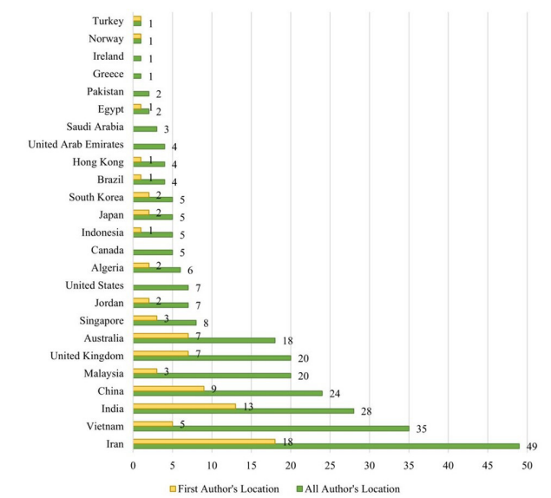
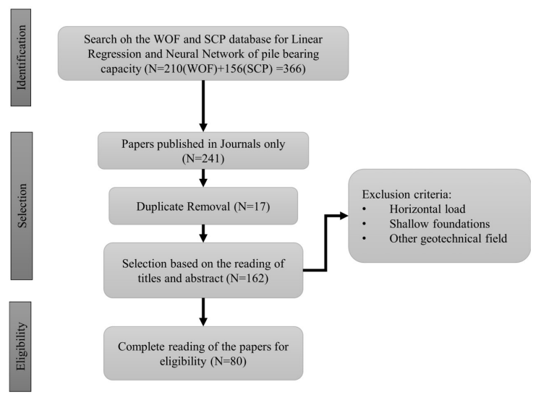
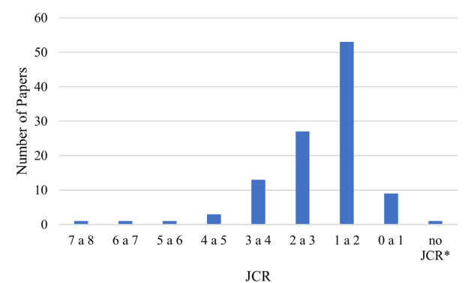
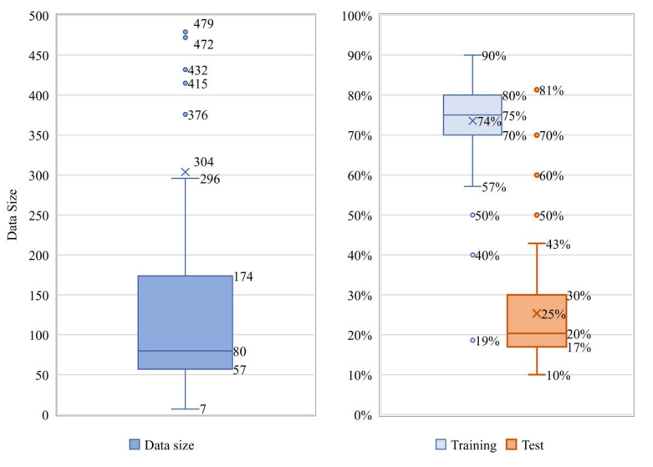
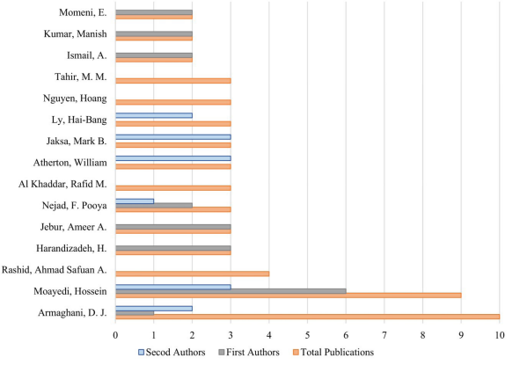
Systematic literature review and mapping of the prediction of pile capacities
Universidade de Brasilia
Sofia Leão Carvalho¹, Mauricio Martines Sales² , André Luís Brasil Cavalcante³
¹Lecturer (CCT), Federal University of Goias: GOIANIA, GO, BR
² Full Professor (School of Civil and Environmental Engineering), Federal University of Goias: GOIANIA, GO, BR
³Associate Professor (Civil and Environmental Engineering), Federal University of Goias: GOIANIA, GO, BR
Summary
Results
Recently the use of a new method has gained popularity in Geotechnics: Artificial Neural Network.
The aim of this paper was to determine the main methods used and lacks that can be fulfilled in future research.
The search on the database platforms, WOS and SCP, happened on May 12th of 2021. 366 papers were collected from both platforms.
From this analysis, after sorting and removing duplicates, 80 papers were eligible to be read and analyzed.
The results are presented as bibliometric results and protocol results.
The year 2021 was omitted from the figure as the data for this year was incomplete at the time of the search.
Introduction
Most of Semi-empirical methods might have limited information regarding imprecisions in the mobilization of the load by the pile.
Modern methods using artificial intelligence have become more popular
Machine Learning based methods have become more common in the literature because of their improved precision .
Figure 4 Distribution of papers per year
Methodology
Search on the WOF and SCP database .
Use PICOC to conduct the selection process.
Exclude all the duplicated documents.
Complete reading of the paper for eligibility.
Figure 5. Distribution of authors and first authors per country.
Figure 1. Flowchart of selection of papers for reading.
Figure 2. Papers per impact factor JCR
PICOC
In line with the PICOC methodology, the following questions regarding the methods used in each publication were addressed:
• Main methods used by the authors to predict the bearing capacity, among linear regression methods and Neuro network methods;
• Most used statistic methods;
• Geotechnical tests used to generate the methods and types of piles used;
• Size of the database split between training and testing;
• Use instrumented pile load tests in the methods.
Figure 6. Boxplot: (a) database size used by the authors;
(b) Training and Test share of the database.
Conclusion
This systematic literature review and mapping have shown that Machine Learning has become predominant in the prediction of pile bearing capacity over the last 25 years and has surpassed the most traditional regression-based methods both in number and performance.
This work showed also that the main type of pile that has been investigated is driven piles, corresponding to almost 63% of the papers, along with the main tests being CPT and PDA accordingly.
Figure 3. Main authors publishing as first authors, second authors, and total publications.
References
Alkroosh, I., & Nikraz, H. (2012). Predicting axial capacity of driven piles in cohesive soils using intelligent computing. Engineering Applications of Artificial Intelligence, 25(3), 618-627. http://dx.doi.org/10.1016/j.engappai.2011.08.009.
Alzabeebee, S., & Chapman, D.N. (2020). Evolutionary computing to determine the skin friction capacity of piles embedded in clay and evaluation of the available analytical methods. Transportation Geotechnics, 24, 100372. http://dx.doi.org/10.1016/j.trgeo.2020.100372.
Alzo’ubi, A.K., & Ibrahim, F. (2019). Predicting Loading– unloading pile static load test curves by using artificial neural networks. Geotechnical and Geological Engineering, 37(3), 1311-1330. http://dx.doi.org/10.1007/s10706- 018-0687-4.
Acknowlegments
This research was supported by the Brazilian sponsorship organizations CNPq, CAPES and FAPEG. We thank Prof. Marcus A. Siqueira Campos for his assistance with the methodology used on the systematic literature review.

