Slide 1
Differences between Cyclistic Members and Casual Riders bike use
Prepared by: Timothy Lim
Last Updated: 9 Dec 2023

Slide 2
Executive Summary
Investigation into differences between member and casual rider customer archetypes was performed using Cyclistic internal trip data from Jan 2023 – Nov 2023; ~5.5 million records
Differences were found in the (i) duration, (ii) time of use, (iii) day of use, and (iv) return likelihood of bikes to the same station
The (i) types of bikes used and (ii) month of use were found to be similar between members and casual riders

Slide 3
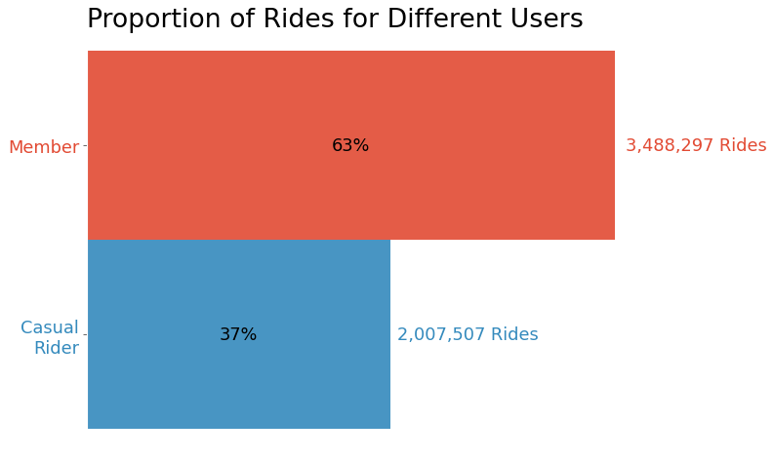
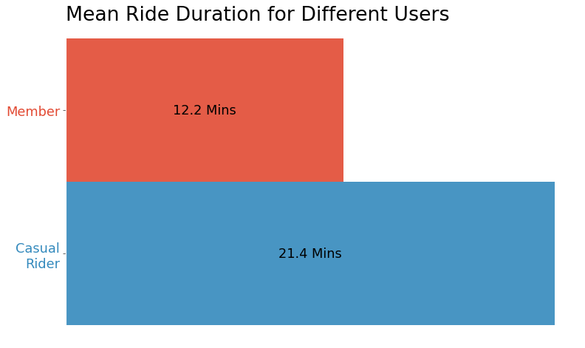
Difference: Members accounted 63% of all rides in 2023, but rode for a shorter mean duration compared to casual riders
Mean ride duration for members was consistently found to be shorter on different days, and different times of day (Refer to appendix A1 and A2)
Notes:
Cyclistic is relied upon for last-mile commute since the duration of use is quite little.
95th percentile of rides = 41.77 minutes

Slide 4
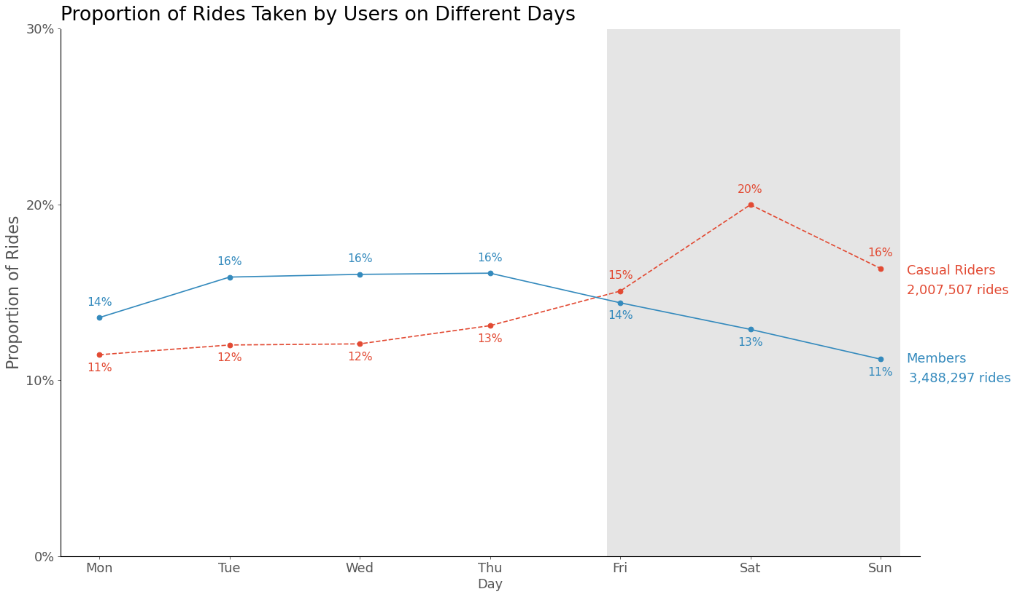
Difference: Members rode more on weekdays but less on weekends. Casual riders showed the opposite trend
Weekends
Casual Riders: 59% of rides were taken on Mon – Thu; 41% on Fri - Sun
Members: 62% of rides were taken on Mon – Thu; 38% on Fri - Sun

Slide 5
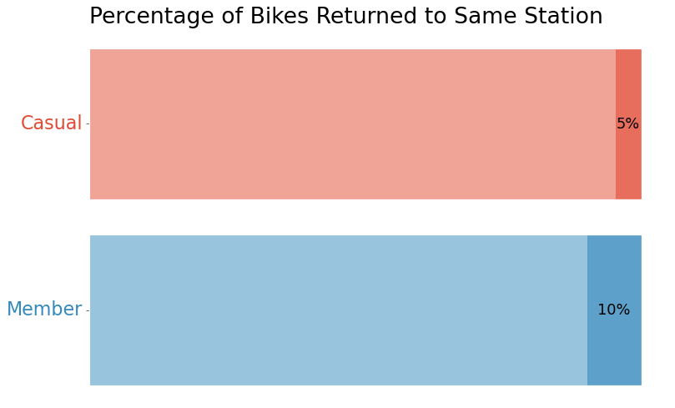
Difference: Casual riders were twice as likely to return bikes to the same station compared to members
Customers who commute will loan their bikes from one station and return their bikes at another station, and therefore are less likely to return bikes at the same station.

Slide 6
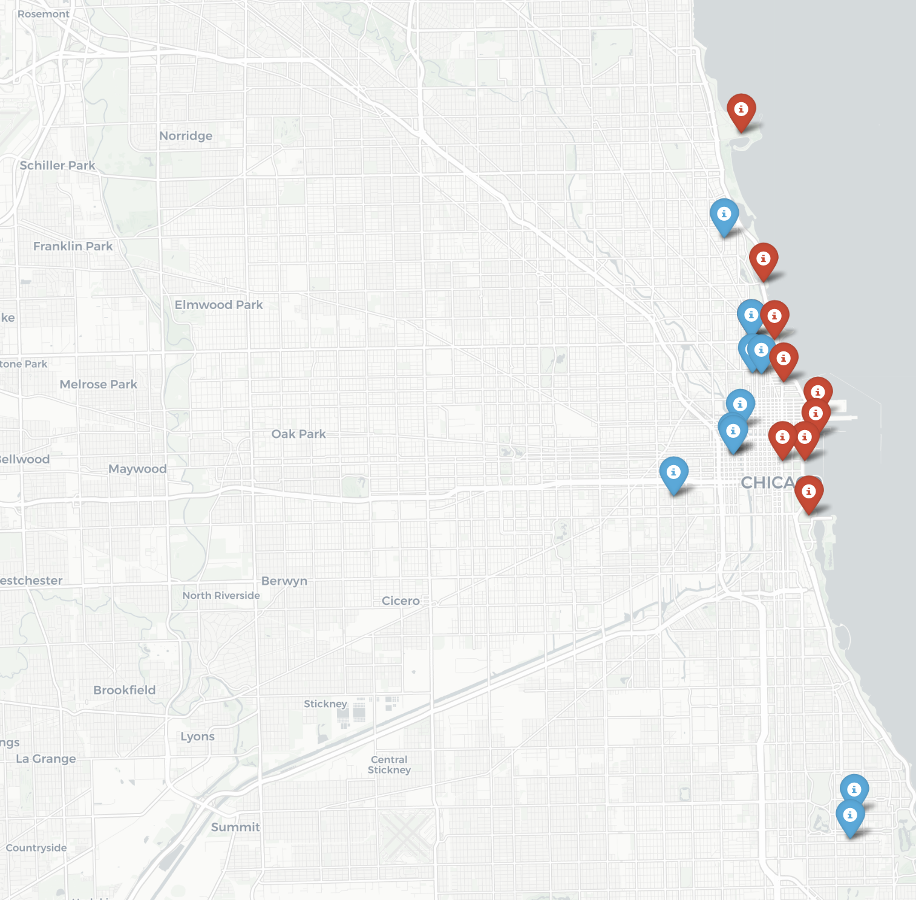
Difference: Top 10 Most Popular Stations for Members are Located Inland Compared to that for Casual Riders
Information can be used to plan for placements of physical marketing assets
Interactive Map

Slide 7
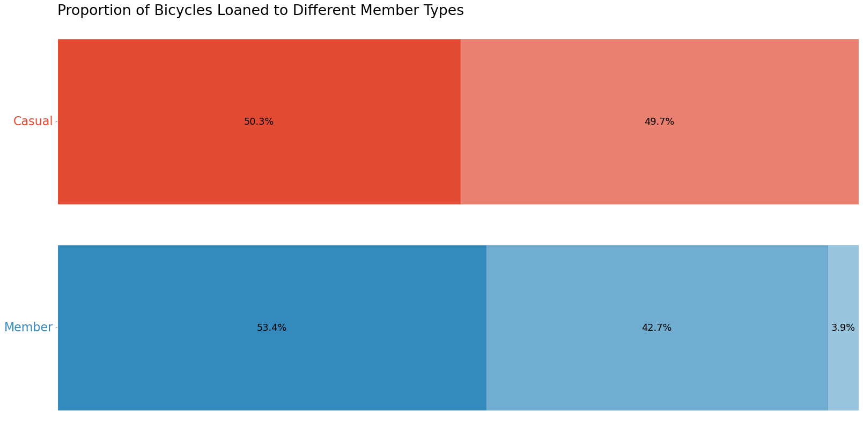
Similarity: Both members and casual riders preferred electric bikes. Casual members did not use docked bikes
Electric
Classic
Docked
Casual Riders: 50.3% of rides were on Electric, 49.7% on Classic
Members: 53.4% of rides were on Electric, 42.7% on Classic, 3.9% on Docked

Slide 8
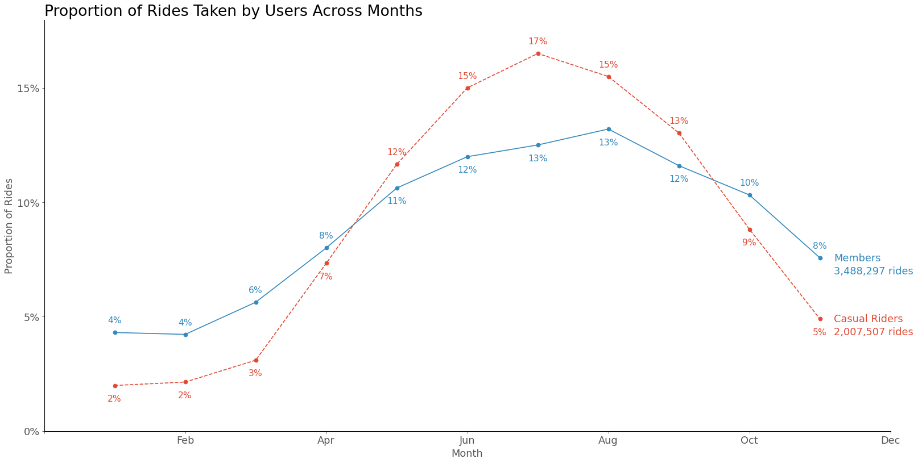
Similarity: Both members and casual riders rode more in the warmer late-spring to early-fall seasons (May – Sep).
Casual Riders: 74% of rides were between May – Sep
Members: 61% of rides were between May – Sep
Notes:
Consistent with the hypothesis that casual members use cyclistic for leisure purposes, and therefore the opportunity to enjoy the warmer weathers are between May – Sep. Members use cyclistic more for commuting purposes

Slide 9
Further Steps and Recommendations
Further analysis by studying customer information, e.g. proximity to a bike station, age, work location to understand why customers find value in purchasing annual memberships
Information difference between casual riders and members can potentially be used to formulate new subscription plans catered to leisure riders. E.g. Weekend passes, May – Sep passes
Information about most popular bike stations can be used to plan for placing physical marketing assets

Slide 10
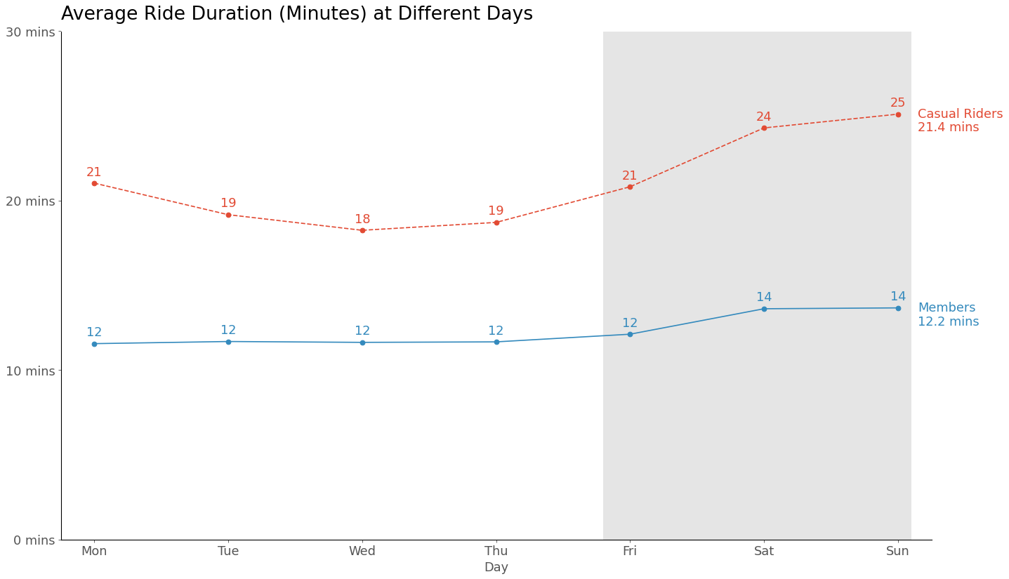
Appendix A1: Mean ride duration against days of week, differentiated by different user archetypes
Weekdays
Weekends

Slide 11
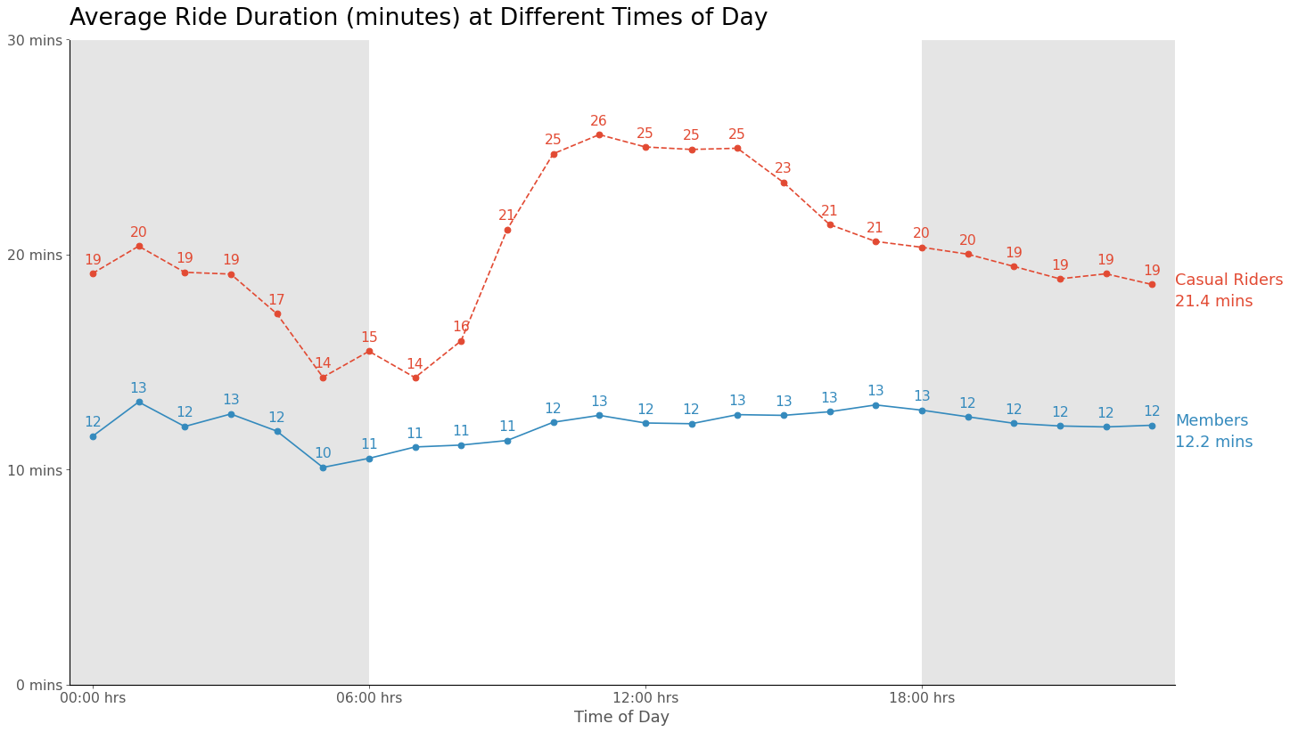
Appendix A2: Mean ride duration against times of day, differentiated by user archetypes
Night
Day
Night

Slide 12
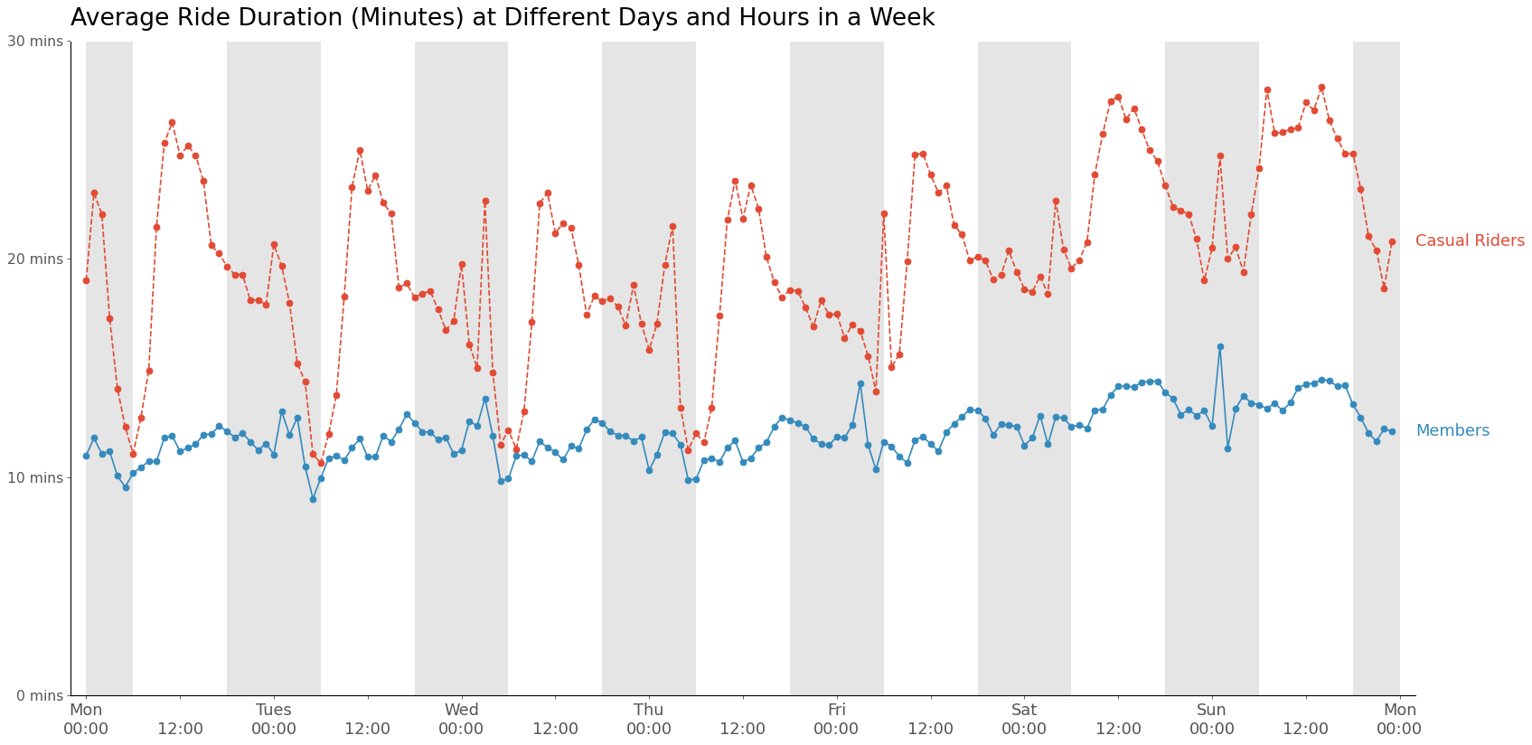
Appendix A3: Mean ride duration against times and day, differentiated by user archetypes

Slide 13
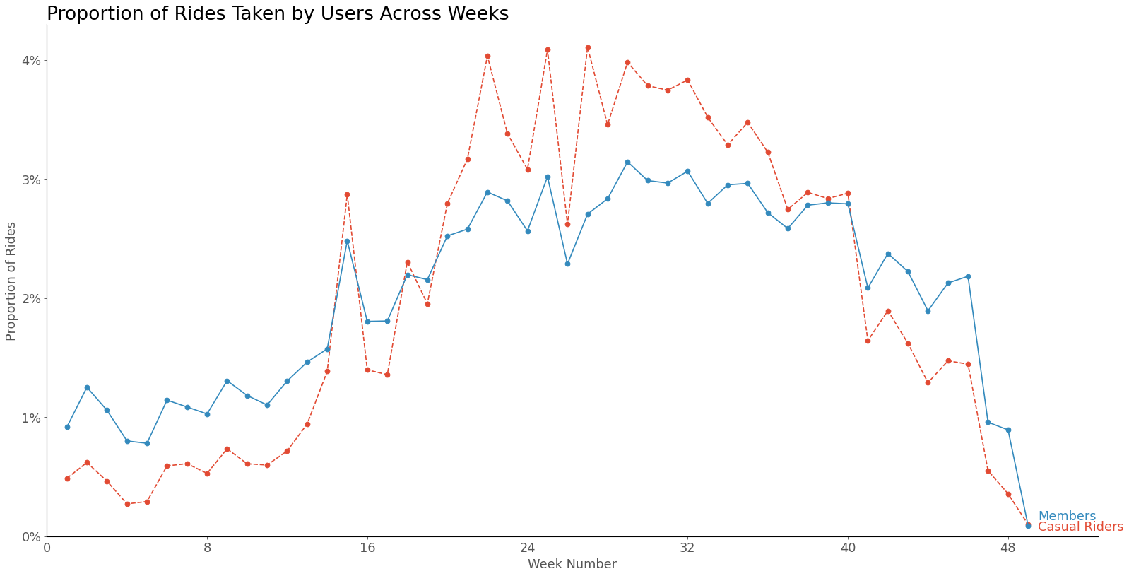
Appendix A4: Proportion of rides against weeks of 2023, differentiated by user archetypes

Slide 14
Appendix B: Data Cleaning and Feature Engineering
Data cleaning steps are shown in the file titled cyclistic.ipynb. Nonetheless, broad data cleaning steps are chronologically detailed below:
Combined Cyclistic trip data from Jan 2023 to Nov 2023
Converted the ‘started_at’ and ‘ended_at’ columns to datetime columns
Created the ‘duration’ column that measures the length of duration of the ride
Created the ‘hour_start’ column that specifies the hour at which the bike was rented
Created the ‘day_of_week_start’ column that specifies the day at which the bike was rented
6. Even though there are missing values in > 20% of the records, have decided not to remove any data from the dataset

Slide 15
Appendix C: Missing Information in records
Out of 5.5 million records, 1.33 million records contain null values, making up 24.2% of the dataset. These predominantly come from the ‘start_station_name’, ‘start_station_id’, ‘end_station_name’, and ‘end_station_id’ columns
It was also found that 99% of records with missing values come from electric bikes. Removing records with null values would therefore, which makes up ~45% of electric bike records prejudice available information relating to electric bikes
Taking this into account, I have decided not to remove any records from this dataset

Slide 16
Appendix D: Potential Duplicates in Station Names
Duplicity of station names were found in the dataset
Examples include:
Damen & 87th St, Damen & 81st St with their analogus public racks
'Damen Ave & Grand Ave' & 'Damen Ave/Coulter Avenue’
'Streeter Dr & Grand Ave' & 'Street Dr/Grand Ave’
Since each station name has a variety of (albeit very close) Latitude and Longitude values, it is not possible to conclude that they are different
Notwithstanding new information, we shall treat these similar-named stations distinct for the analysis

Slide 17
Step 1: Ask
Case Study Roadmap: Ask
Guiding Questions: What is the problem that you are trying to solve? We are trying to understand Cyclistic’s two major customer archetypes; the casual riders and members; specifically, on their usage of cyclistic bikes How can your insights drive business decisions? Understanding their similarities and differences helps us to develop marketing strategies to convert casual riders into annual members, and this in turn will fuel growth and revenue for the company
Key Tasks Identify the business task Identify similarities and differences between Cyclistic’s major customer archetypes. Consider key stakeholders Lily Moreno – Director of marketing, developer of campaigns and initiatives to promote bike share programme Marketing Analytics Team – Responsible for collecting, analysing, and reporting data to guide marketing strategy Executive Team – Decision maker to approve the recommended marketing programme; i.e. Moreno’s bosses
Deliverables A clear statement of the business task A presentation deck explaining the similarities and differences between the 2 customer archetypes

Slide 18
Step 2: Prepare
Case Study Roadmap: Prepare
Guiding Questions: Where is your data located? How is the data organized? Each record details a single trip made by a customer, including start/end time, location, and customer type Are there issues with bias or credibility in this data? Does your data ROCCC? Assuming that pipelines are in order and telemetry data is collected robustly, there is no concern about bias/ credibility of data since this is cyclistics internal data (first party data) How are you addressing licensing, privacy, security, and accessibility? How did you verify data integrity? How does it help you answer your question?
Key Tasks Download data and store it appropriately Identify how is it organized Sort and filter the data Are there any problems with the data? More than 20% of the records contain missing data. Information is presented in Appendix B of the slide deck.
Deliverables A description of all the data sources used 5,495,80 records used between Jan – Nov 2023. See Exec. Summary for more details
We assume that data is centrally stored in a data warehouse
Assume that cyclistic has a privacy agreement with customer
Checked for duplicates and null values. No duplicates found
Yes. It details ride info and each record is tagged by a customer archetype

Slide 19
Step 3: Process
Case Study Roadmap: Process
Guiding Questions: What tools are you using? Why? Have you ensured your data’s integrity? What steps have you taken to ensure that the data is cleaned? Checked for nulls and duplicates, converted datetime columns to the appropriate data type How can you verify that your data is clean and ready to analyse? Have you documented your cleaning process so you can review and share those results? Lines of code are ordered chronologically in ipynb file
Key Tasks Check the data for errors Choose your tools Transform the data so you can work with it effectively Document the cleaning process
Deliverables Documentation of any cleaning or manipulation of data A presentation deck explaining the similarities and differences between the 2 customer archetypes
Python and its dependencies pandas, numpy, matplotlib, and jupyter notebook
Checked for nulls and duplicates

Slide 20
Step 4: Analyse
Case Study Roadmap: Analyse
Guiding Questions: How should you organize your data to perform analysis on it? Have largely retained the dataframe structure. Converted time-date columns to appropriate fields Has your data been properly formatted? What surprises did you discover in the data? What trends or relationships did you find in the data? Refer to the main deck for details How will these insights help answer your business questions? Analysis performed here is only the first step in understanding our customer archetypes. We can further our analysis by studying customer information, such as their proximity to a bike station, age, work location, to understand why customers find value in purchasing annual memberships. Further studies may also lead to formulating new subscription plans to entice leisure-focused customer archetypes, which in turn fuels annual membership growth. Two potential plans include the weekend pass, and the summer
Key Tasks Aggregate your data so it’s useful and accessible Organise and format your data Perform calculations Identify trends and relationship
Deliverables A summary of your analysis

Slide 21
Step 5: Share
Case Study Roadmap: Share
Guiding Questions: Were you able to answer the question of how annual members and casual riders use cyclistic bikes differently? What story does your data tell? How do your findings relate to your original question? Who is your audience? What is the best way to communicate with them? Can data visualization help you share your findings? Is your presentation accessible to your audience?
Key Tasks Determine the best way to share your findings Create effective data visualisations Present your findings Ensure your work is accessible
Deliverables Supporting visualisations and key findings Refer to the main deck for details

Slide 22
Step 6: Act
Case Study Roadmap: Act
Guiding Questions: What is your conclusion based on your analysis? There are clear differences in the duration of use, time of use, day of use, and month of use. We may utilize such differences to create subscription plans better catered to the leisure-focused customer archetypes Physical marketing assets can be placed at locations with the largest crowd for efficient use of marketing budgets. How could your team and business apply your insights? What next steps would you and your stakeholders take based on your findings? Is there additional data you could use to expand your findings? Definitely. Our ultimate goal is to design marketing strategies to convert casual riders to annual members. We need to understand our customer demographics and effectively utilize marketing budget to attract them in the appropriate channel, such as social media apps, television, print, or physical marketing assets. We can take a poll to understand how and why existing members are inclined to join as a member, and use these insights to tailor a plan non-members
Key Tasks Create a portfolio Add your case study Practise presenting your case study to a friend/ family member
Deliverables Top 3 recommendations based on your findings
Further Questions
Why would casual buyers buy annual membership?
How can Cyclistic use digital media influence casual riders to become annual members

