Slide 1
Strategy: What is the big question we need to answer? (dependent on stage of the business)
Business Outcomes
Revenue
# of paid subscribers
Retention
% of total people using the product
Engagement
Blinks/books per active person
Weekly Active People
Input metrics
Constraints
New leads
Activation funnel rate
CAC
LTV
Customer Service tickets
Engineering time
# of available books
Content consumed per person
Product speed

Slide 3

Output metric
Input metrics
Retention rate
Books added to library in first 28 days
Number of media format consumed
Activation rate (complete sign-up flow)
Paid subscribers
Time spent per book
Books per topic
Newsletter signup rate
…

Slide 5
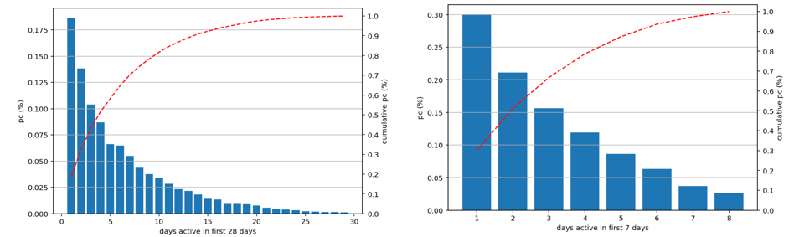
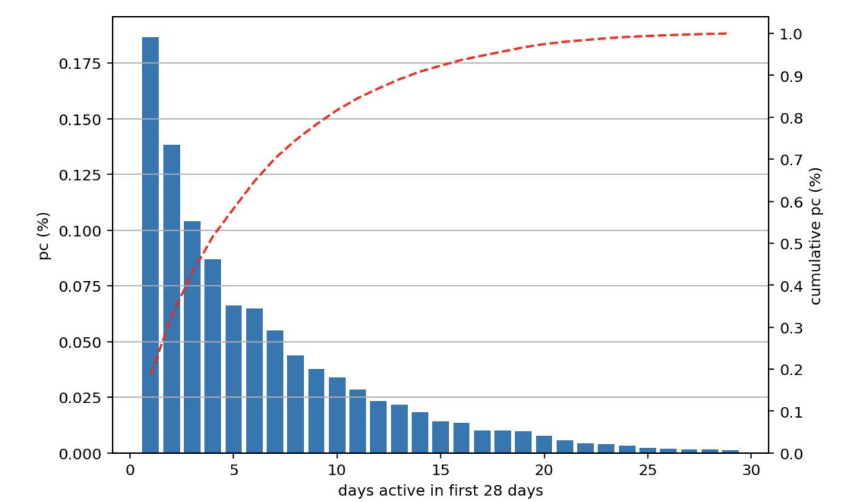
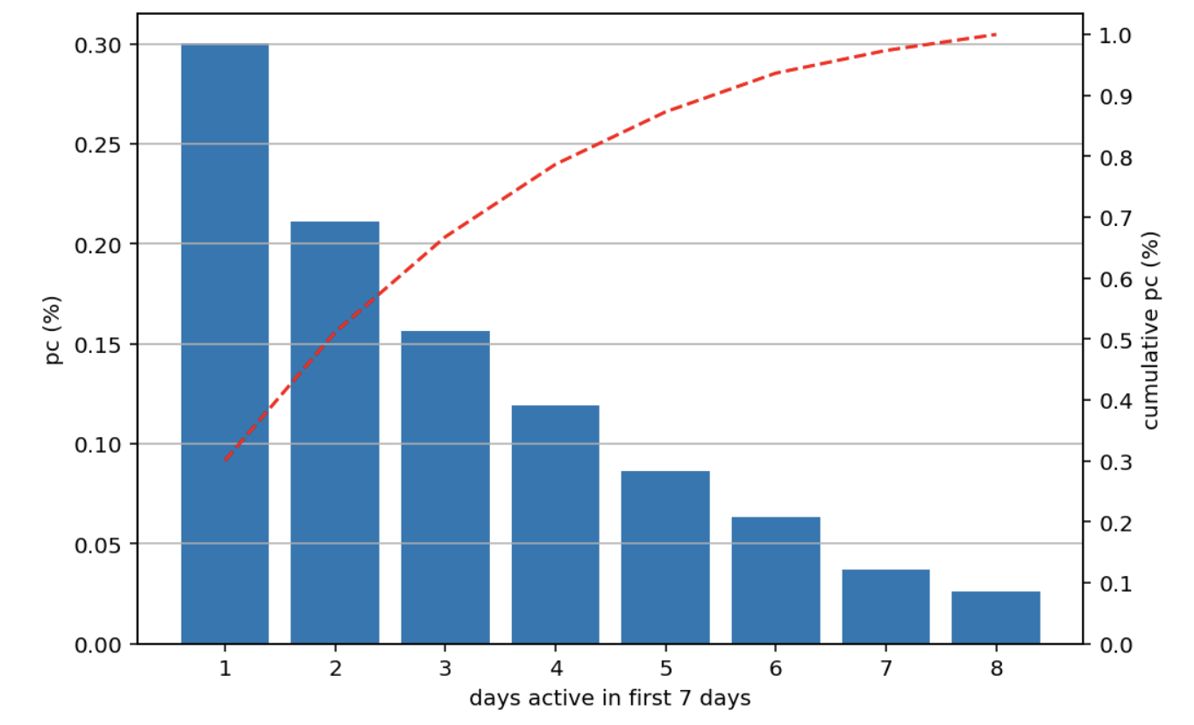

Slide 6
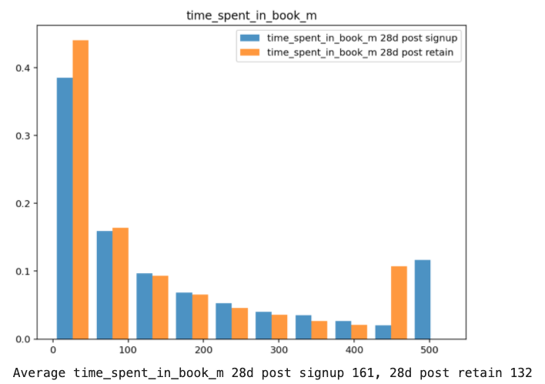
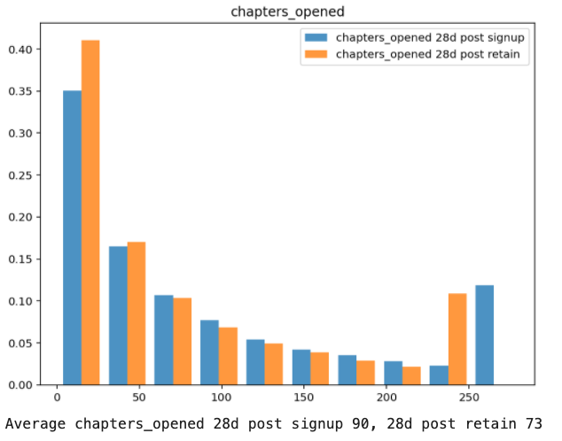
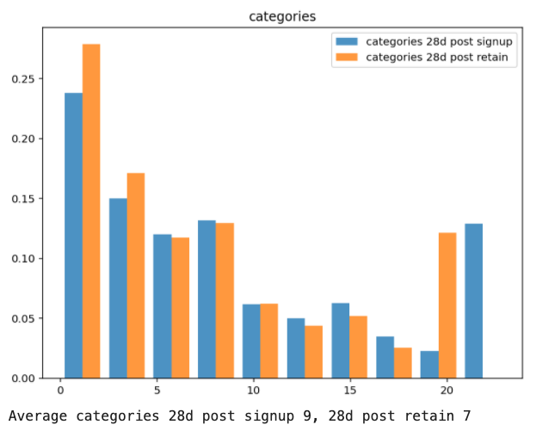
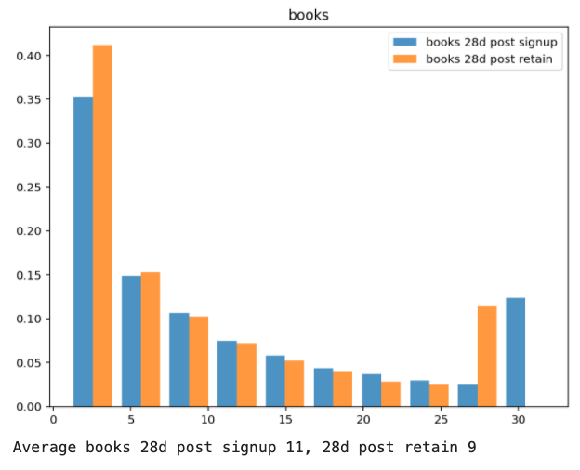
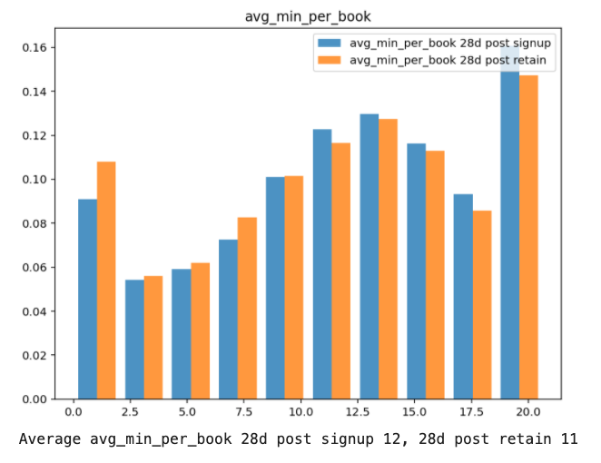
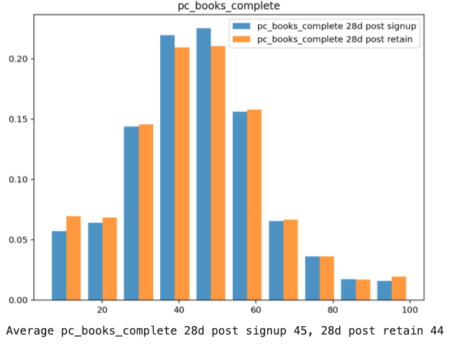

Slide 7
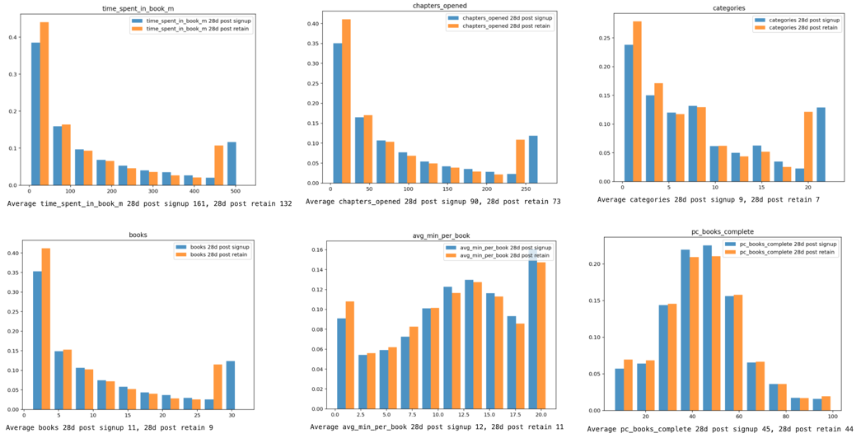

Slide 8
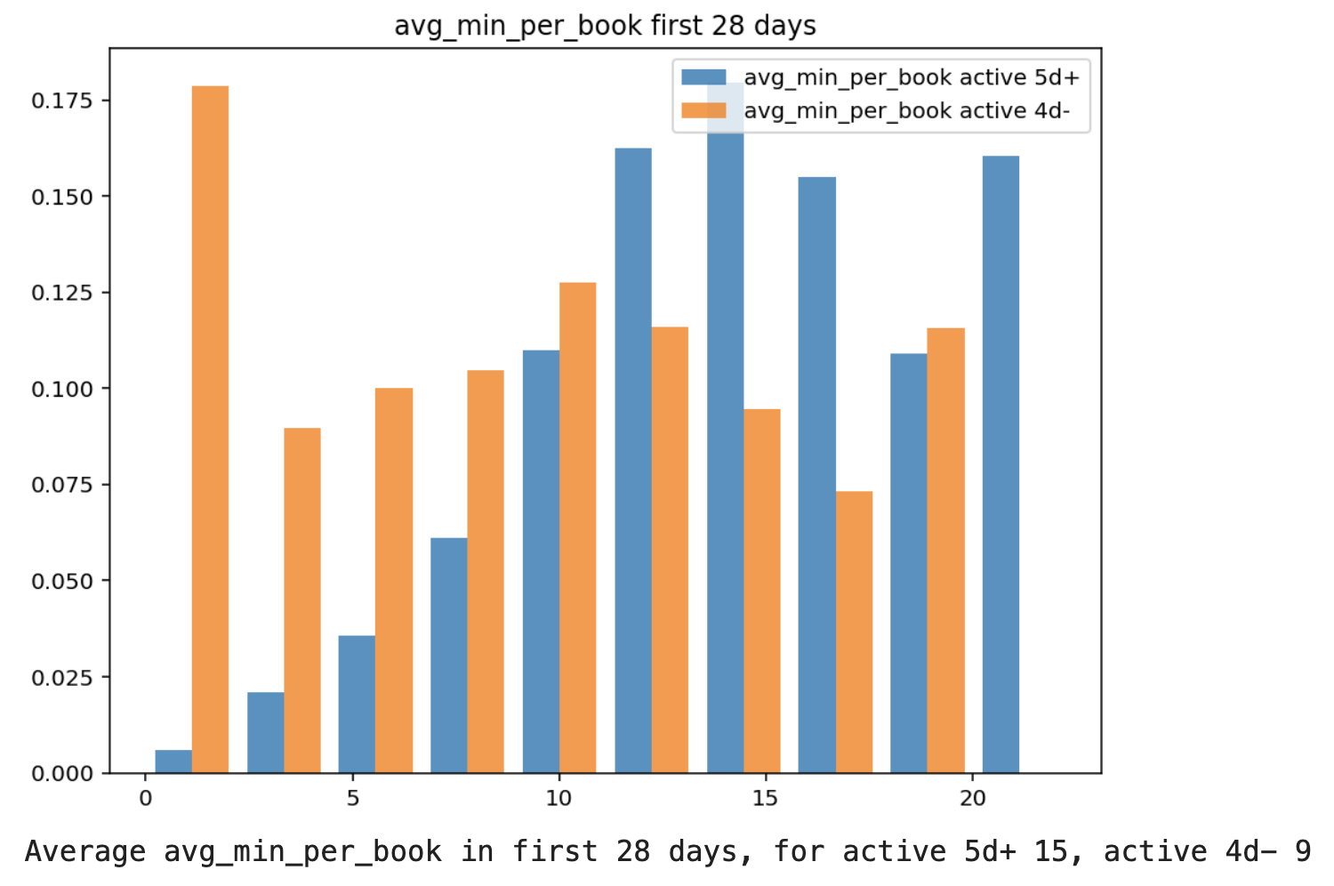
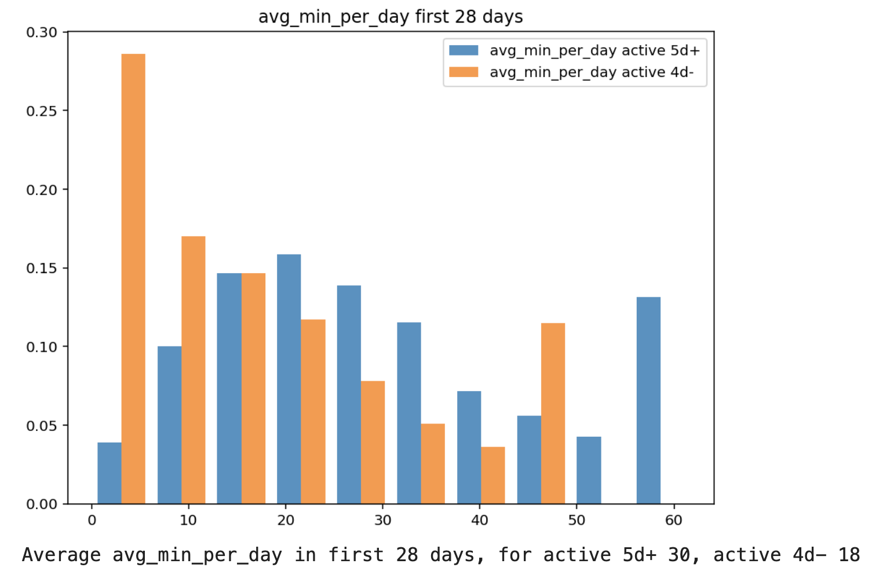
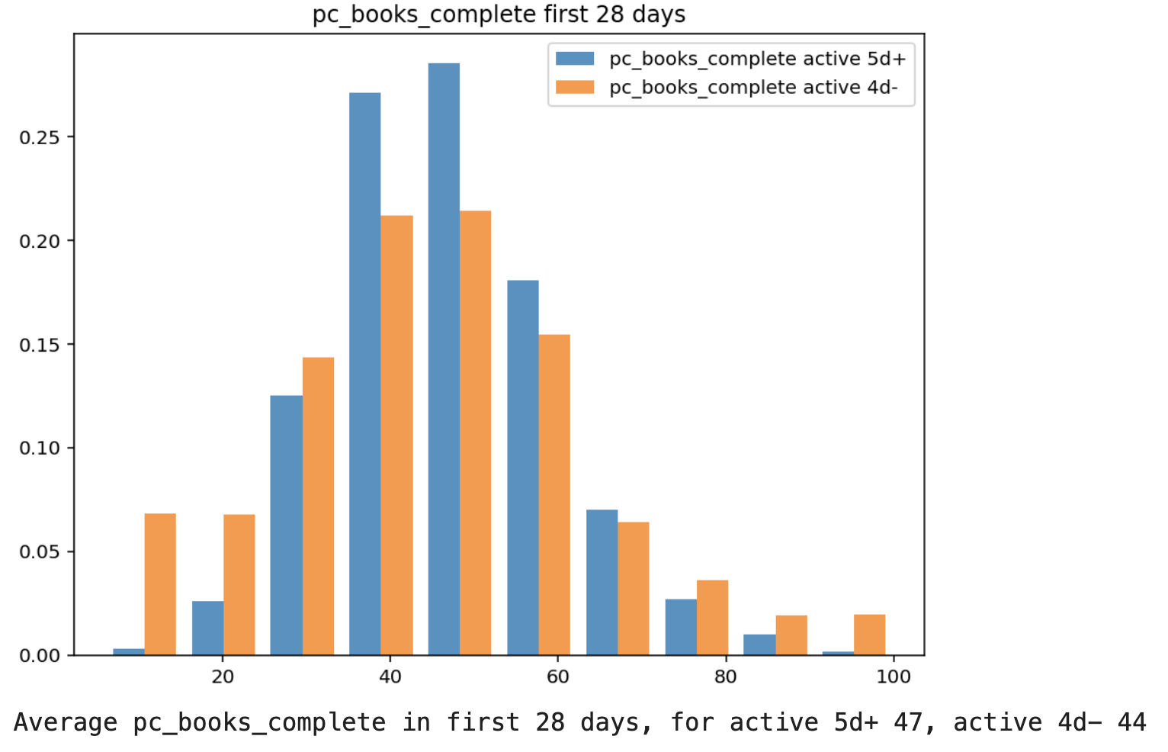
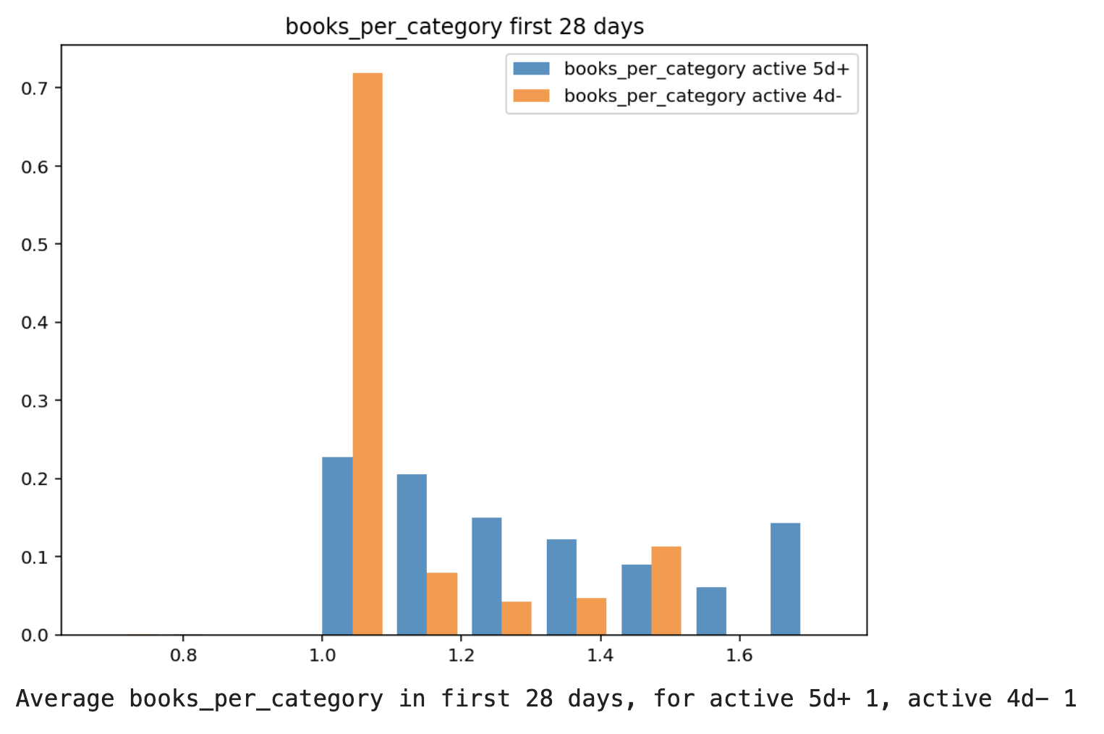

Slide 9
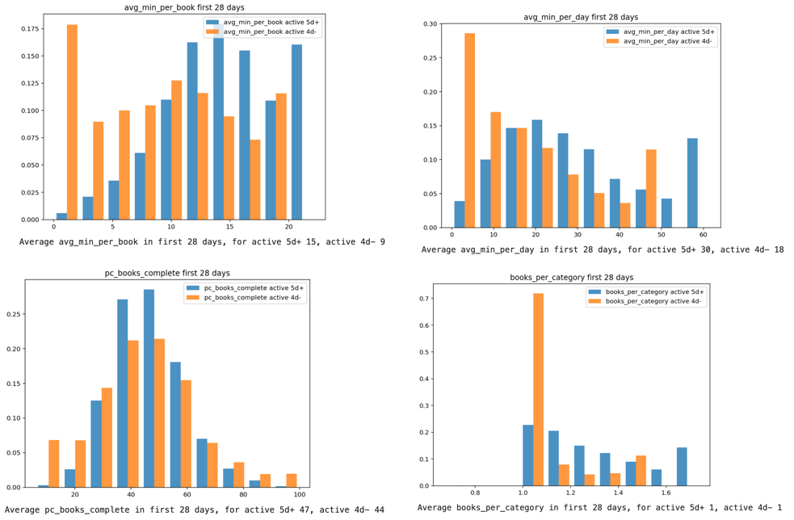

Slide 10
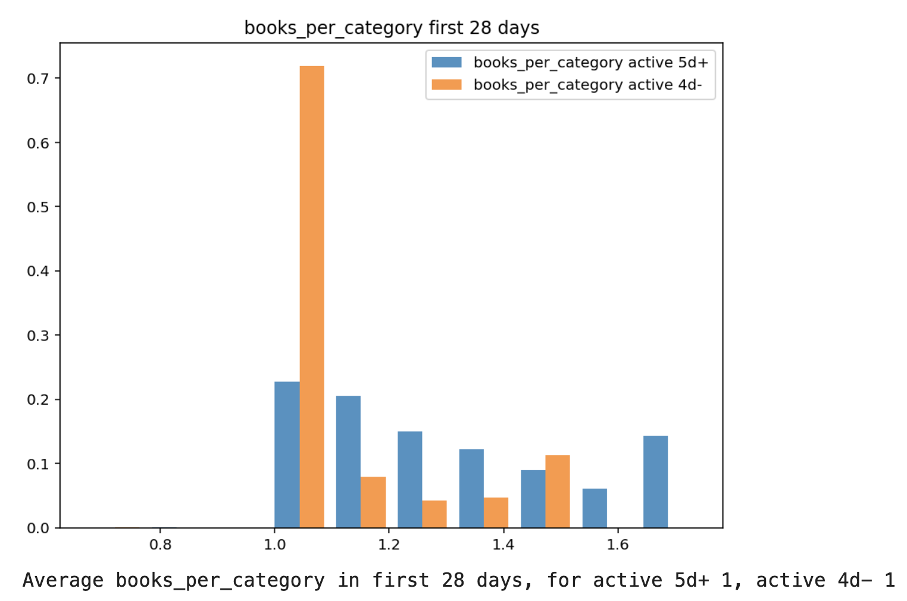
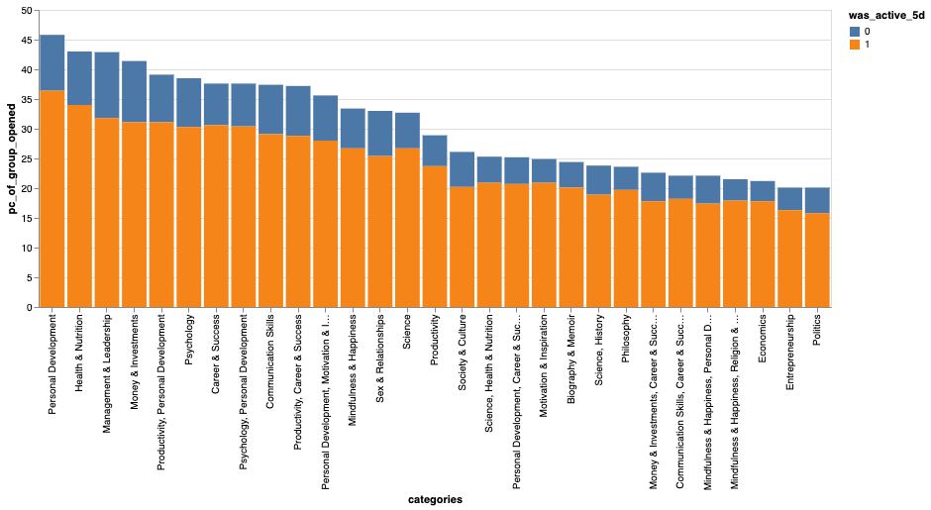
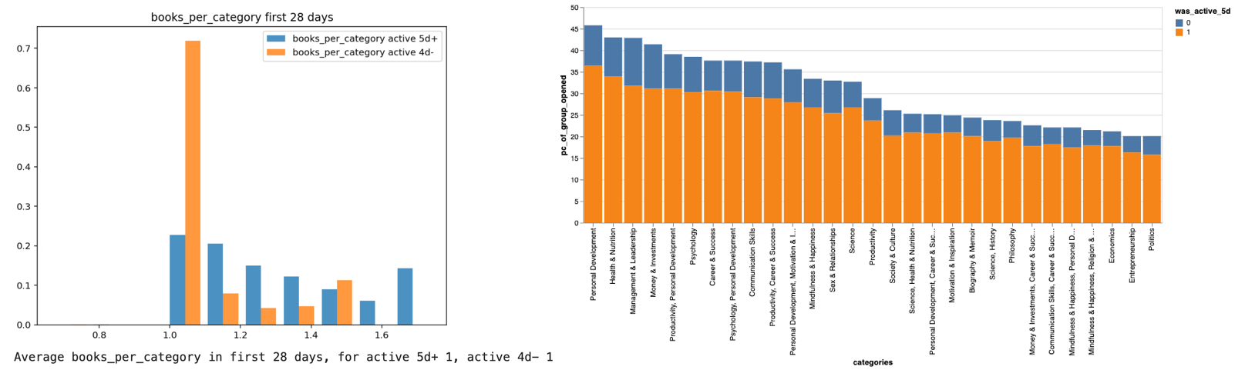

Slide 11
