Slide 1
CS 4476/6476 Project 3
[Manan Patel]
[mpatel608@gatech.edu]
[mpatel608]
[903748003]

Slide 2
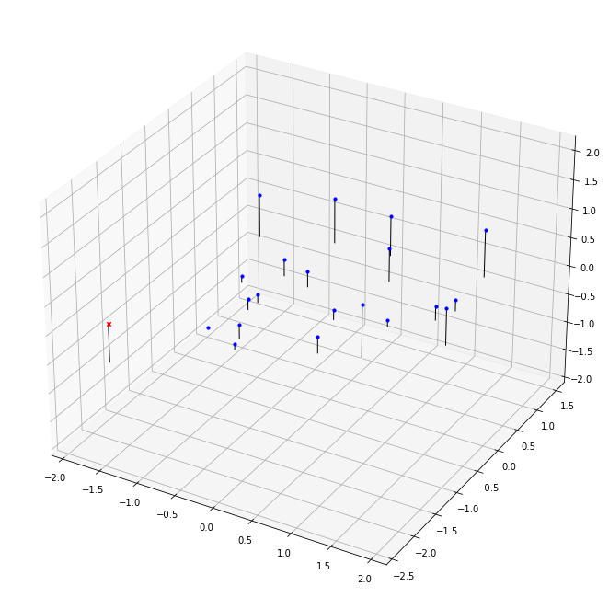
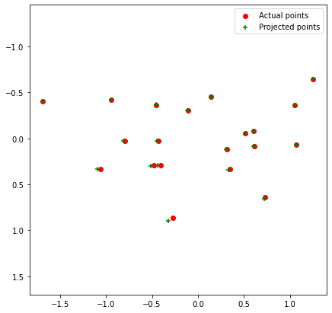
Part 1: Projection matrix
[insert visualization of projected 3D points and actual 2D points for the CCB image we provided here]
[insert visualization of camera center for the CCB image here]

Slide 3
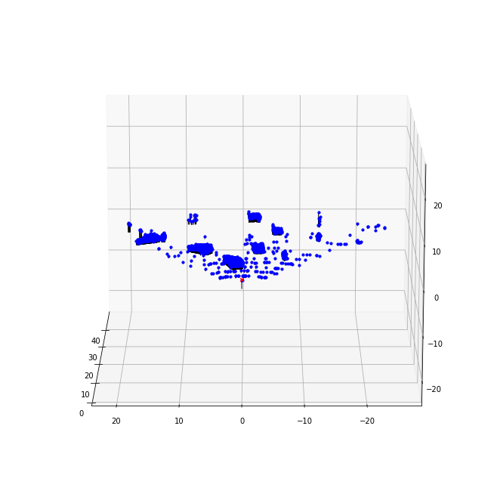
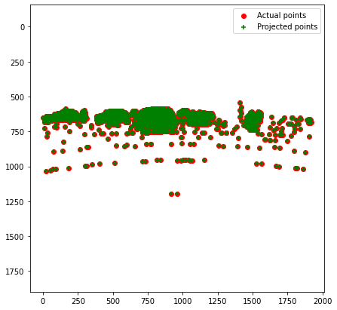
Part 1: Projection matrix
[insert visualization of projected 3D points and actual 2D points for the Argoverse image we provided here]
[insert visualization of camera center for the Argoverse image here]

Slide 4
Part 1: Projection matrix
[What two quantities does the camera matrix relate?]
- It realtes the world co-ordinates to the camera pixel co-ordinates
[What quantities can the camera matrix be decomposed into?]
It can be decomposed into the intrinsic matrix [K], and a concatenation of a Rotation matrix [R] and Translation matrix [t].
K[R t]
[List any 3 factors that affect the camera projection matrix.]
The focal length of the camera
The centre of the camera
Distance between the camera origin and world origin

Slide 5
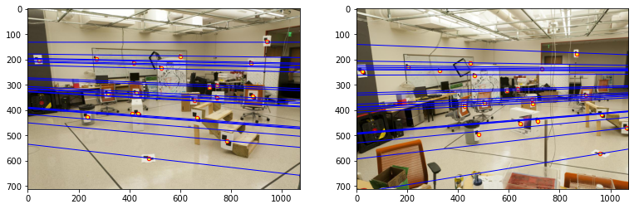
Part 2: Fundamental matrix
[insert visualization of epipolar lines on the CCB image pair]

Slide 6
Part 2: Fundamental matrix
[Why is it that points in one image are projected by the fundamental matrix onto epipolar lines in the other image?]
A point which is projected onto image A is a result of a ray. The point may have been on any point on the ray.
Therefore, all these points on the ray are possible locations of the point as seen from the other image. Thus, a point in image A is mpapped to a ray in other image, or an epipolar line in the other image.
[What happens to the epipoles and epipolar lines when you take two images where the camera centers are within the images? Why?]
When the camera centres are in the images, we find distinct epipoles in each image.
All the rays which make up the image1 pass through the camera centre1. Thus, all these rays which are projected onto image2 will coincide at a point, which is called the epipole. The epipolar lines will seem to originate from these epipoles.
Same case is true while going from image2 to image1.

Slide 7
Part 2: Fundamental matrix
[What does it mean when your epipolar lines are all horizontal across the two images?]
- If they are all horizontal, then we can estimate the rotation one image plane to another. In this case, they will be parallel to each other.
[Why is the fundamental matrix defined up to a scale?
The fundamental matrix maps a 3d point to a 2d point. Thus, we do not have information about how far away the point was, and hence the scale of the complete image.
Thus, due to this loss of information, the matrix is defined only upto a scale.
[Why is the fundamental matrix rank 2?]
The fundamental matrix is rank 2 because it is only defined upto a scale as explained previously.
When using the fundamental matrix to convert from 3d to 2d or vice-versa, we lose a degree of freedom in the depth of the point.
This causes the reduction in rank of the fundamental matrix.

Slide 8
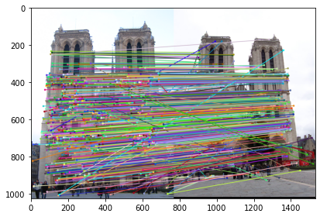
Part 3: RANSAC
[insert visualization of correspondences on Notre Dame after RANSAC]

Slide 9
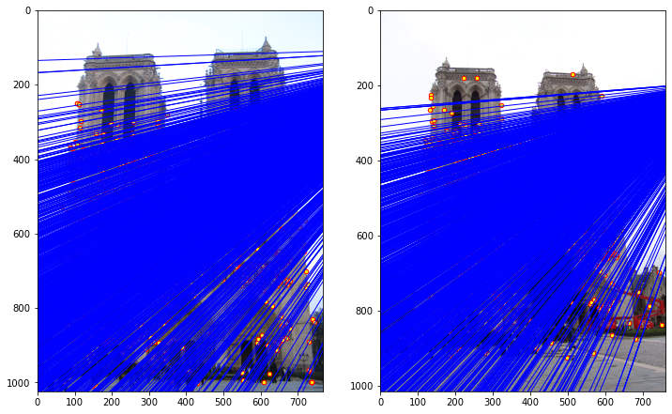
Part 3: RANSAC
[insert visualization of epipolar lines on the Notre Dame image pair]

Slide 10
Part 3: RANSAC
[How many RANSAC iterations would we need to find the fundamental matrix with 99.9% certainty from your Mt. Rushmore and Notre Dame SIFT results assuming that they had a 90% point correspondence accuracy?]
- 12
[One might imagine that if we had more than 9 point correspondences, it would be better to use more of them to solve for the fundamental matrix. Investigate this by finding the # of RANSAC iterations you would need to run with 18 points.]
42
[If our dataset had a lower point correspondence accuracy, say 70%, what is the minimum # of iterations needed to find the fundamental matrix with 99.9% certainty?]
116

Slide 11
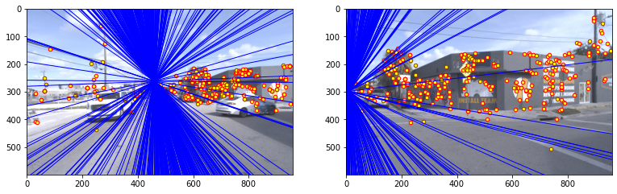
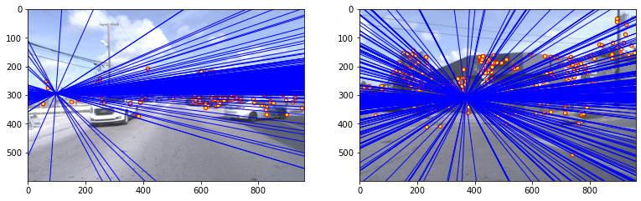
Part 4: Performance comparison
[insert visualization of epipolar lines on the Argoverse image pair using the linear method]
[insert visualization of epipolar lines on the Argoverse image pair using RANSAC]

Slide 12
Part 4: Performance comparison
[Describe the different performance of the two methods.]
Using the linear method, we do not get distinct epipoles as in the case of RANSAC.
[Why do these differences appear?]
- This is because, when we sample points randomly, we might get degenerate points which lie on the same epipolar line, thus leading to a bad estimation of the homography matrix
[Which one should be more robust in real applications? Why?]
- RANSAC will be more robust in real applications because, so that we can sample points which provide the most information while generating the homography matrix.

Slide 13
Part 5: Visual odometry
[How can we use our code from part 2 and part 3 to determine the “ego-motion” of a camera attached to a robot (i.e., motion of the robot)?]
Let us consider two images taken at two consecutive time stamps t0 and t1. Using these two images we can use the code from part 2 and part 3 to calculate the fundamental matrix.
Given we know the camera parameters, we can calculate the translation between the two image pairs which will give the motion of the camera.
[In addition to the fundamental matrix, what additional camera information is required to recover the ego-motion?]
- We need the focal length, and the offset between the pincipal point and camera plane origin

Slide 14
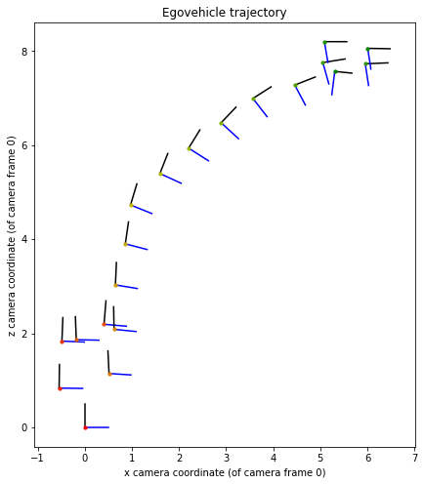
Part 5: Visual odometry
[Attach a plot of the camera’s trajectory through time]

Slide 15
Part 6: Panorama Stitching
[Please add a README style documentation here for your implementation of panorama stitching with: description of what you implemented, instructions on how to replicate the results in clear steps that can be followed by course staff. Failure to replicate results by following this documentation will result in point penalties on this question of the assignment.]

Slide 16
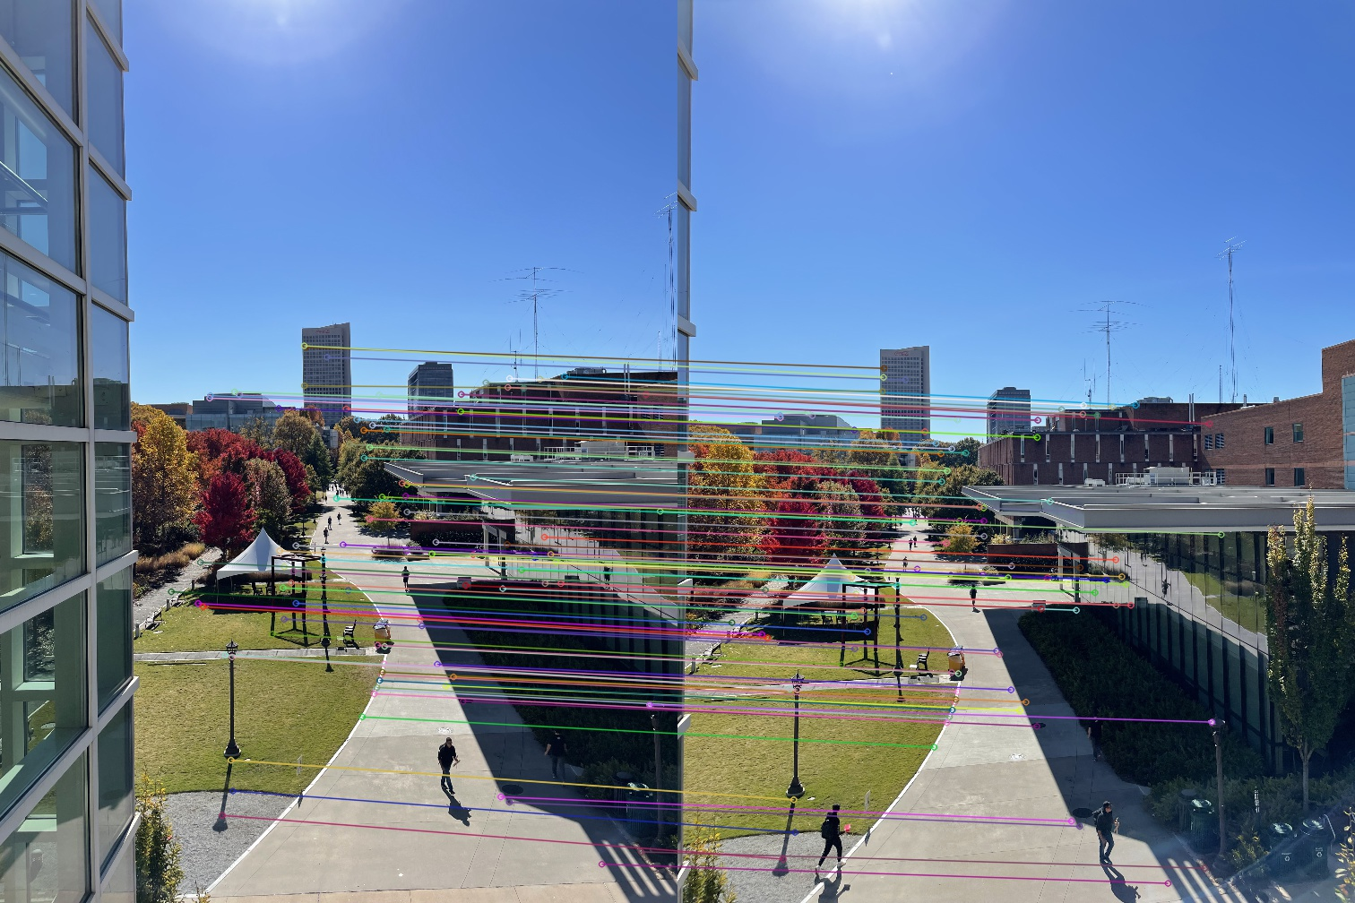
Part 6: Panorama Stitching
[Insert visualizations of your stitched panorama here along with the 2 images you used to stitch this panorama (there should be 3 images in this slide)].

