Slide 1
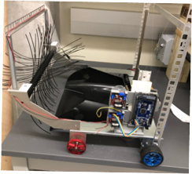
2.07 IEEE Robotics
Members: Uriel Lua, Lucia Sorto, Mack Starnes, Michael Tellez

Slide 2
Text to talk (60-75)
Hello everyone we are the Senior Design team 2.07, formed by Uriel Lua, Mack Starnes, Lucia Sorto, and Michael Tellez. Our project is an autonomous robot that can identify, collect, and dispose of litter.
This robot could be a precursor to a system that would be used to autonomously clean up the areas most affected by litter. A system like this would save on human effort needed to combat litter in natural areas around the world.
This robot utilizes a wheeled drive system to propel itself and rotary system to pick up the trash. The robot then executes a sweeping algorithm to efficiently collect trash. While traversing the field, the robot uses ultrasonic & LIDAR sensors to avoid the walls around the field and the litter-bot.
The robot then visually identifies the trash bin from any point on the field and progresses towards it until the wall is reached and then it delivers the trash to the trash bin.
Below Is a demonstration of the robot sweeping a replica of the competition field.

Slide 4
