Slide 1
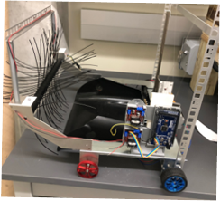
2.07 IEEE Robotics
Members: Uriel Lua, Lucia Sorto, Mack Starnes, Michael Tellez

Slide 2
Text to talk (60-75)
Hello everyone we are the team 2.07 formed by Mack Starnes, Uriel Lua, Michael Tellez, and Lucia Sorto. Our project is an autonomous robot that can identify, collect, and dispose of litter. The robot completes a sweeping algorithm to efficiently collect trash, while avoiding obstacles using ultrasonic,& lidar . The robot then visually identifies the trash bin from any point on the field and progresses towards it until the wall is reached. It utilizes a wheeled drive system to propel itself, a rotary trash intake, as well as ultrasonic, & lidar to assist the vision system in determining location. There are, on average, over 6000 pieces of litter per mile on roadways in the US. Cleanup costs average $11 billion a year. This robot could be a precursor to a system that would be used to autonomously clean up the areas most affected by litter. A system like this would save on human effort needed to combat litter in natural areas around the world.​

Slide 4
