Slide 1


Slide 2






Multiresolution Adaptive Numerical Scientific Simulation
Robert J. Harrison¹, Joel Anderson¹, Bryan Sundahl, Hideo Sekino¹,
George I. Fann², Gregory Beylkin⁴, Lucas Monzon³,
Edward Valeev⁴, Florian Bischoff⁵, Jakob Kottmann⁵
¹Stony Brook University, Brookhaven National Laboratory
²Oak Ridge National Laboratory
³University of Colorado
⁴Virginia Tech
⁴Humboldt-Universität zu Berlin
robert.harrison@stonybrook.edu

Slide 3

Tools in the tool box: fast and accurate computation
George I. Fann¹, Diego Galindo¹, Robert J. Harrison²,
Scott Thornton², Joel Anderson², Byran Sundahl²,
Judy Hill¹, and Jun Jia¹
¹Oak Ridge National Laboratory
²Stony Brook University, Brookhaven National Laboratory
In collaboration with
Gregory Beylkin⁴, Lucas Monzon⁴, Hideo Sekino⁵
and Edward Valeev⁶
⁴University of Colorado
⁵Toyohashi Technical University, Japan
⁶Virginia Tech
robert.harrison@gmail.com

Slide 4
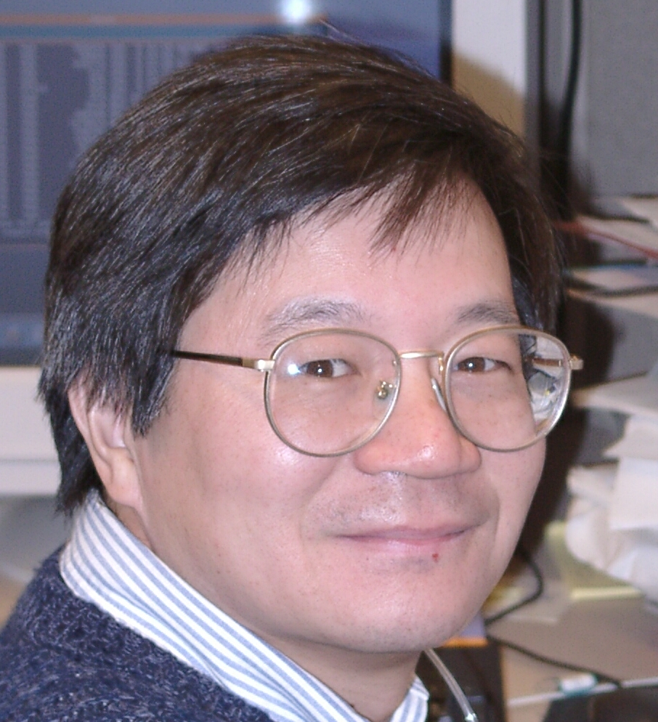
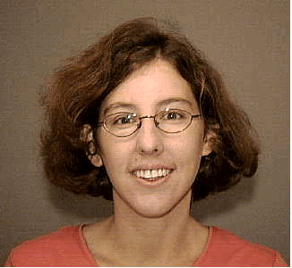
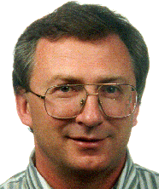
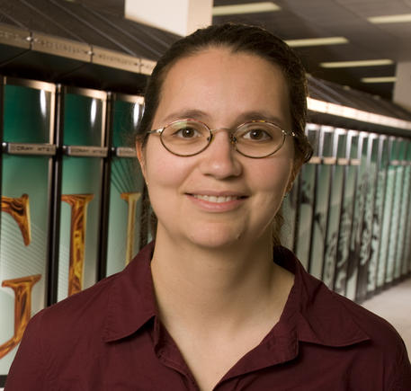
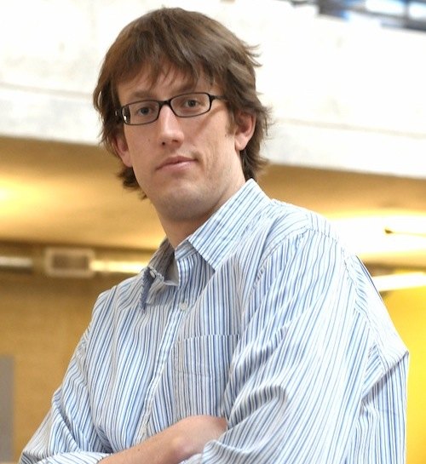



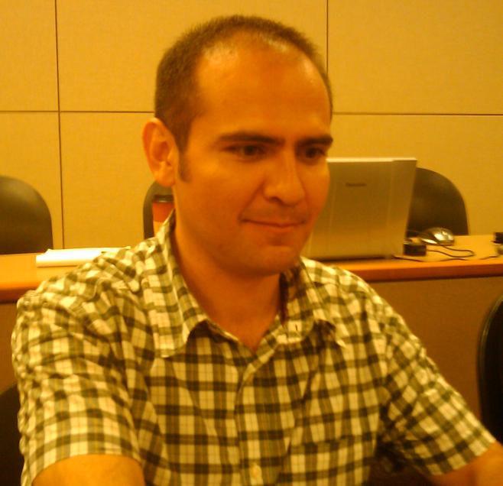

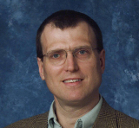

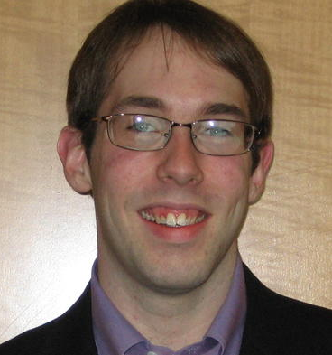
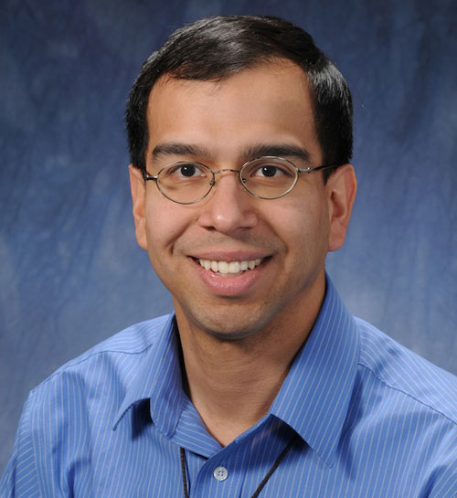
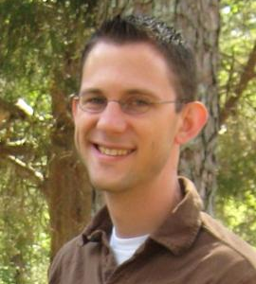


Judy Hill
Rebecca
Hartman-Baker
Jeff Hammond
Joel Anderson
George Fann
Gregory Beylkin
Eduard Valeyev
Robert Harrison
Bryan Sundahl
Ariana Beste
Alvaro Vasquez
Hideo Sekino
Matt Reuter
Nichols Romero
Takahiro Ii
Jia, Kato, Niimura, Calvin, Pei, ...
Nicholas Vence
Scott Thornton

Slide 5
Big picture
Want robust algorithms that scale correctly with system size and are easy to write
Robust, accurate, fast computation
  Gaussian basis sets: high accuracy yields dense matrices and linear dependence – O(N³)
  Plane waves: force pseudo-potentials – O(N³)
  O(N log^{m}N log^{k}ε) is possible with guaranteed ε
Semantic gap
  Why are our equations just O(100) lines but programs O(1M) lines?
Facile path from laptop to exaflop

Slide 6
“Fast” algorithms
Fast in mathematical sense
  Optimal scaling of cost with accuracy & size
Multigrid method – Brandt (1977)
  Iterative solution of differential equations
  Analyzes solution/error at different length scales
Fast multipole method – Greengard, Rokhlin (1987)
  Fast application of dense operators
  Exploits smoothness of operators
Multiresolution analysis
  Exploits smoothness of operators and functions

Slide 7
What is MADNESS?
A general purpose numerical environment for reliable and fast scientific simulation
  Chemistry, nuclear physics, atomic physics, material science, nanoscience, climate, fusion, ...
Want robust and fast algorithms that scale correctly with system size and are easy to write
Semantic gap
  Why are equations O(100) lines but codes O(1M) ?
Facile path from laptop to exaflop
Applications
Numerics
https://github.com/m-a-d-n-e-s-s/madness
Parallel Runtime

Slide 8
Why MADNESS?
Reduces S/W complexity
  MATLAB-like level of composition of scientific problems with guaranteed speed and precision
  Programmer not responsible for managing dependencies, scheduling, or placement
Reduces numerical complexity
  Solution of integral not differential equations
  Framework makes latest techniques in applied math and physics available to wide audience

Slide 9
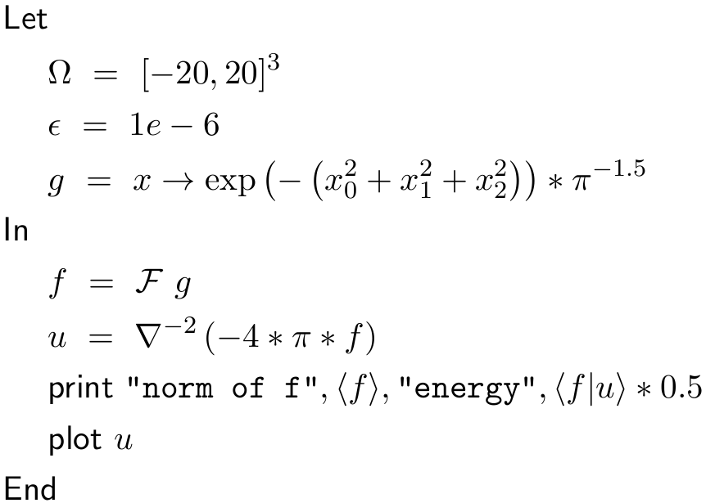
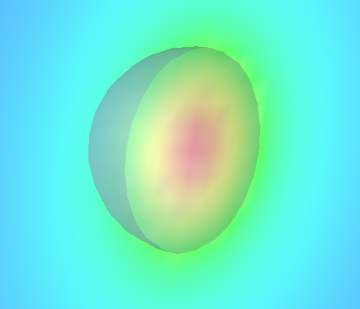
E.g., with guaranteed precision of 1e-6 form a numerical representation of a Gaussian in the cube [-20,20]³, solve Poisson’s equation, and plot the resulting potential
(all running in parallel with threads+MPI)
output: norm of f 1.00000000e+00 energy 3.98920526e-01
There are only two lines doing real work. First the Gaussian (g) is projected into
the adaptive basis to the default precision. Second, the Green’s function is applied.
The exact results are norm=1.0 and energy=0.3989422804.

Slide 10
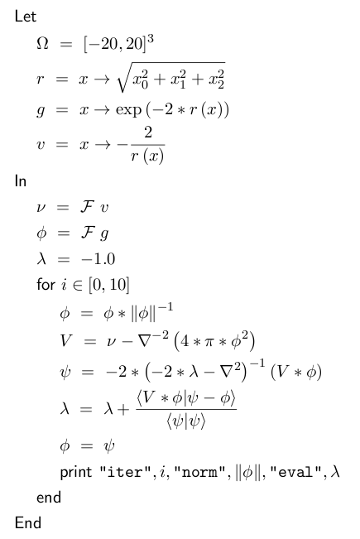
He atom
Hartree-Fock
Compose directly in terms of
functions and operators
This is a Latex rendering of a
program to solve the Hartree-Fock
equations for the helium atom
The compiler also outputs a C++
code that can be compiled without
modification and run in parallel

Slide 11
The math behind the MADNESS
Multiresolution
Low-separation
rank
Low-operator
rank

Slide 12
Why “think” multiresolution?
It is everywhere in nature/chemistry/physics
  Core/valence; high/low frequency; short/long range; smooth/non-smooth; atomic/nano/micro/macro scale
Common to separate just two scales
  E.g., core orbital heavily contracted, valence flexible
  More efficient, compact, and numerically stable
Multiresolution
  Recursively separates all length/time scales
  Computationally efficient and numerically stable
  Coarse-scale models that capture fine-scale detail

Slide 13
How to “think” multiresolution
Consider a ladder of function spaces
  E.g., increasing quality atomic basis sets, or finer resolution grids, …
Telescoping series
  Instead of using the most accurate representation, use the difference between successive approximations
  Representation on V₀ small/dense; differences sparse
  Computationally efficient; possible insights

Slide 14
Another Key Component
Trade precision for speed – everywhere
  Don’t do anything exactly
  Perform everything to O(ε)
  Require
    Robustness
    Speed, and
    Guaranteed, arbitrary, finite precision

Slide 15
Problem Setup
In 1-D solve on [0,1]
Tensor product in n-D
Periodic and infinite domains also feasible

Slide 16
Scaling Function Basis - I
Divide domain into 2^{n} pieces
  Referred to as level n
  Adaptive sub-division – local refinement
  Non-uniform division possible (not yet done)
  l^{th} sub-interval [l*2^{-n},(l+1)*2^{-n}] l=0,…,n-1
n=0
n=1
n=2
l=0
l=1
l=2
l=3

Slide 17
Scaling Function Basis - II
In each sub-interval define a polynomial basis
  Currently use the first k Legendre polynomials
  Other bases interesting (e.g, interpolating polynomials, non-polynomial functions)
  Zero outside of the sub-interval

Slide 18
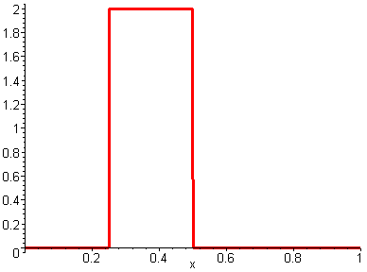
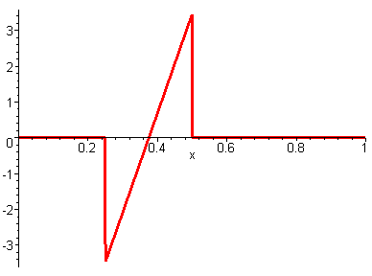
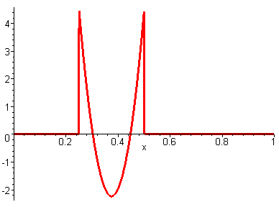
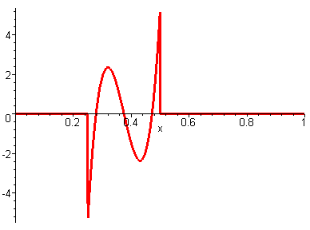
Scaling Function Basis - III
i=1
i=0
i=3
i=2

Slide 19
Scaling Function Basis - IV
Translation and
dilation
Orthonormal
Ladder of spaces
Complete basis for L₂ [0,1] in limit of either large k or large n.

Slide 20
Two-scale relationship
V₀ ⊂ V₁ – can represent coarse scale basis exactly in the fine scale basis
The filter coefficients (H) may be computed analytically or numerically.

Slide 21
Expansion of a function
Projection of a function into V_{n}
Local error is O(f^{(k)}(ξ)2^{-nk}) – high-order convergence
If a function is expanded in V_{n}, what is the error from truncating to V_{n-1}?
The error is contained in W_{n-1}=V_{n}- V_{n-1}

Slide 22
Multiwavelet Basis - I
An orthonormal basis to span
Also demand
  Disjoint support (important!)
  Dilation/translation of wavelets at level 0
Expand in V_{n}

Slide 23
Multiwavelet Basis - II
Basis not yet completely specified
  Currently use Alpert’s basis (which imposes additional constraints … more about this later)
The coefficients (G) may be evaluated analytically or numerically
  Numerical evaluation requires extended precision arithmetic (e.g., 208 bits used for k=12).
Constructive approach
  From scaling function make the wavelets
  Often the reverse (e.g., Daubechies wavelets)

Slide 24
Multiwavelet Basis - III
k=4
i=0
i=1
i=2
i=3

Slide 25
Multiwavelet Basis - IV
Translation and
dilation
Orthonormal
Direct sum of
sub-spaces
Complete basis for L₂ [0,1] in limit of either large k or large n.

Slide 26
Multiwavelet Basis - V
Vanishing moments
  Critically important property
  Since W_{n} is orthogonal to V_{n} the first k moments of functions in W_{n} vanish, i.e.,
In Alpert’s basis, additional moments of some of the multiwavelet components also vanish

Slide 27
Some Consequences of Vanishing Moments
Compact representation of smooth functions
  Consider Taylor series … the first k terms vanish and smooth implies higher order terms are small
Compact representation of integral operators
  E.g., 1/|r-s|
  Consider double Taylor series or multipole expansion
  Interaction between wavelets decays as r^{-2k-1}
Derivatives at origin vanish in Fourier space
  Diminishes effect of singularities at that point

Slide 28
Two-scale relationship - I
Orthonormal transformation – best possible numerical accuracy

Slide 29
Filter coefficients for k=1 (Haar)
Hence, coefficients of scaling functions and wavelets are often referred to as sum and difference coefficients.

Slide 30
Filter coefficients for k=4
7.0711e-01 0.0000e+00 0.0000e+00 0.0000e+00 H0
-6.1237e-01 3.5355e-01 0.0000e+00 0.0000e+00
0.0000e+00 -6.8465e-01 1.7678e-01 0.0000e+00
2.3385e-01 4.0505e-01 -5.2291e-01 8.8388e-02
7.0711e-01 0.0000e+00 0.0000e+00 0.0000e+00 H1
6.1237e-01 3.5355e-01 0.0000e+00 0.0000e+00
0.0000e+00 6.8465e-01 1.7678e-01 0.0000e+00
-2.3385e-01 4.0505e-01 5.2291e-01 8.8388e-02
0.0000e+00 1.5339e-01 5.9409e-01 -3.5147e-01 G0
1.5430e-01 2.6726e-01 1.7252e-01 -6.1237e-01
0.0000e+00 8.7867e-02 3.4031e-01 6.1357e-01
2.1565e-01 3.7351e-01 4.4362e-01 3.4233e-01
0.0000e+00 -1.5339e-01 5.9409e-01 3.5147e-01 G1
-1.5430e-01 2.6726e-01 -1.7252e-01 -6.1237e-01
0.0000e+00 -8.7867e-02 3.4031e-01 -6.1357e-01
-2.1565e-01 3.7351e-01 -4.4362e-01 3.4233e-01
The point being only that these are not mysterious or weird values.

Slide 31
Two-scale relationship II
May be rewritten without approximation as
Where

Slide 32
Compression of a function
Recursively apply the two-scale relation
The basis is the scaling functions at level 0 and the multiwavelets at all levels
Compression & reconstruction are O(NlogN) operations

Slide 33
Two equivalent representations
Scaling function basis (reconstructed)
Multi-wavelet basis (compressed)
Rapid compression/reconstruction
  Asymptotically faster than the FFT
  Use most appropriate basis for a given operation

Slide 34
A Third Equivalent Representation
The function tabulated at the Gauss-Legendre quadrature points in each of the adaptively refined boxes
  Enables rapid multiplication of functions and application of local functions (e.g., V_{xc})
  Diagonal transformation from interpolating polynomials

Slide 35
Attributes of the multiwavelet basis
Good stuff
  Disjoint support enables true local refinement
  Discontinuous polynomial basis can compactly represent sharp features
  High-order convergence for smooth functions
  Interpolating basis enables many operators
  Computational kernels highly efficient
Bad stuff
  Not strongly band limited
  High-order beneficial only when locally smooth

Slide 36
Truncation Error
To satisfy the global error condition
Truncate according to
This is rather conservative – often use

Slide 37
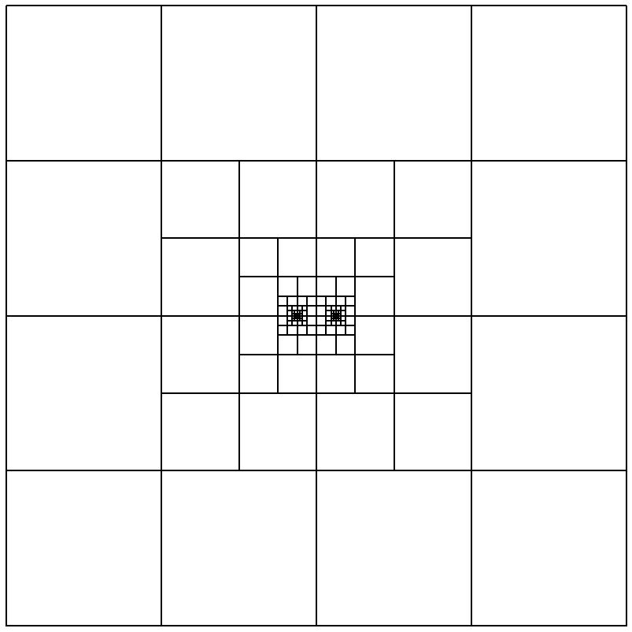
Slice thru grid used to represent the nuclear potential for H₂ using k=7 to a precision of 10⁻⁵.
Automatically adapts – it does not know a priori where the nuclei are.
Nuclei at dyadic points on level 5 – refinement stops at level 8
If were at non-dyadic points refinement continues (to level ??) but the precision is still guaranteed.
In future will unevenly subdivide boxes to force nuclei to dyadic points.

Slide 38
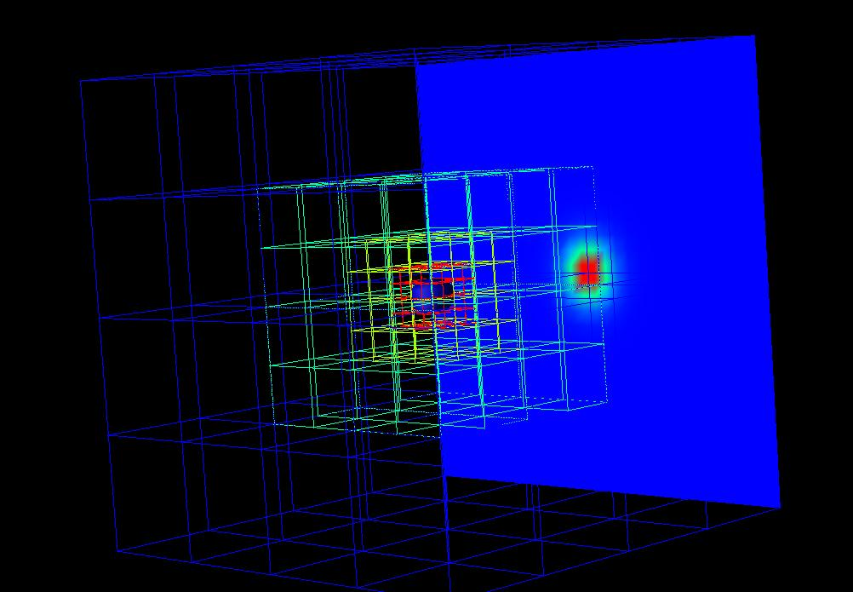

Slide 39
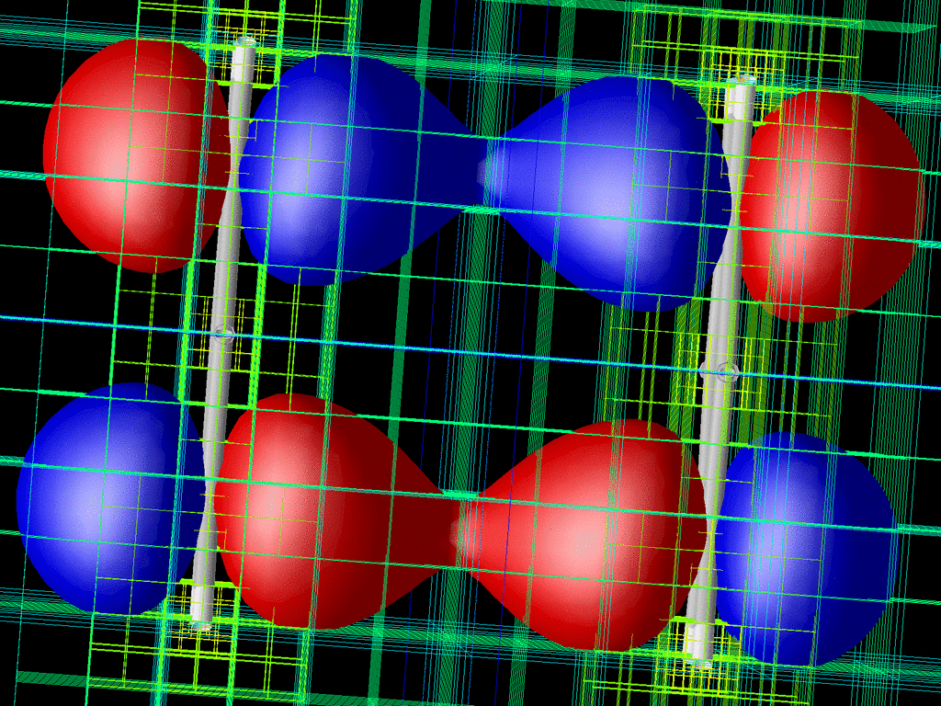

Slide 40
Summary so far
Scaling functions
  Familiar orthormal basis, easy to evaluate, integrate, …
Multi-resolution analysis
  Separates behavior between length scales
  Local truncation while preserving global error bound
  Vanishing moments
Multi-wavelets
  High-order convergence with adaptive representation
  Disjoint support – efficient description of singularities if located at faces/edges/corners (more efficient than smooth wavelets since they do not have disjoint support)
Fast compression and reconstruction
  Orthogonal transformations – numerically stable

Slide 41
Good place to look at the (now ancient) implementation notes
  Normalization, user/simulation cell, etc.
  Truncation modes
  Adaptive projection
  Addition
  Differentiation
  Multiplication with refinement

Slide 42
Compression of a Matrix
Compression is just a linear transformation
  Apply separately to each dimension
  Result is said to be in “standard form”

Slide 43
Extension to higher dimensions
Scaling function basis is tensor product
Wavelet basis – tensor product is one choice
  Standard form – compress each dimension just as for a matrix
  But cannot refine strictly locally since length scales are mixed between dimensions
To refine locally need to refine all dimensions simultaneously

Slide 44
Standard-Form basis in 2-D
Tensor product
basis on level 3
(level 3 scaling
functions ==
level 2 wavelets)
Red indicates
the support of
the function
Adaptive refinement
separately in each
dimension … global
not local refinement

Slide 45
Locally-refined form of functions
Construct local basis for W_{n-1}=V_{n}- V_{n-1}
n=0
n=1

Slide 46
Locally refined basis in 2-D
Red indicates function support

Slide 47
Non-standard form of operators - I
Standard form
  Matrix elements between different length scales
  Not very efficient on modern computers with deep memory hierarchies
  Potentially O(Nlog N) non-zero terms
  Hard to calculate matrix elements, high-memory use
Non-standard form
  No matrix elements between lengths scales
  O(N) terms
  Act on (modified) non-standard form of functions
  Easy to calculate matrix elements
  Translation invariant operators yield Topelitz matrices
  Derivation is instructive

Slide 48
Non-standard form of operators - II
P_{n} an orthogonal projection into V_{n}
Q_{n} an orthogonal projection into W_{n}=V_{n+1}-V_{n}
  P_{n}+ Q_{n}= P_{n+1}
Consider the projection of an operator T

Slide 49
NS Form of Operators III
Matrix elements in the scaling function basis
Matrix elements of the NS form

Slide 50
Vanishing Moments
Sparse integral operators
  If the derivatives decay rapidly (i.e., the kernel becomes smoother at long range)
  See this by Taylor expansion (multipole series)
Consider NS form of 3D Poisson kernel (1/r)

Slide 51
Integral operators - I
Consider

Slide 52
Integral operators - II
Matrix elements easy to evaluate from compressed form of kernel K(x)
Application in 1-d is fairly efficient
  O(k²) operations
In 3-d seems to need O(N_{box}k⁶) operations
  Prohibitively expensive
More intelligent approach
  O(N_{box}k⁴) operations for many “physical” kernels
  Even better is known to be possible

Slide 53
Relationship to the FMM
Greengard, Rokhlin
Separate the behavior on different length scales
Exploit low-rank form of off-diagonal blocks
Approaches each kernel as a special case
Highly-optimized, but complex
  E.g., latest FMM uses seven different representations
MRA approach is immediately general
  Simpler than FMM since don’t need to traverse up/down tree
  Not as fast unless use kernel-specific separated forms
  Perhaps more straightforward to parallelize

Slide 54
Please forget about wavelets
They are not central
Wavelets are a convenient basis to span V_{n}-V_{n-1} and for understanding its properties
But you don’t actually need to use them
  MADNESS does still compute wavelet coefficients, but Beylkin’s new code does not
Please remember this …
  Discontinuous spectral element with multi-resolution and separated representations for fast computation with guaranteed precision in many dimensions.

Slide 55
Summary so far
Extension to many-dimensions
  Locally-refined basis for functions enables true adaptive refinement
  Non-standard form for operators enables practical application of operators
Vanishing moments
  Turns smoothness into sparsity

Slide 56
Problem with Differential Form
Consider application of the Laplacian to a function with high-frequency numerical noise
Consider 30 levels of adaptive refinement
(and don't forget discontinuities, polynomials)
I.e., we just took numerical noise ( ) and amplified it to O(100)

Slide 57
Advantages of Integral Form
Condition number of inverse Laplacian just as bad (unbounded spectrum & zero eigenvalues)
  But for the inverse, large eigenvalues correspond to the smooth and usually interesting bits
  So the inverse operator damps out the noise
A key step in applying MADNESS to any problem is rewriting differential equations in integral form

Slide 58
Advantages of Integral Form
E.g.,
  Often soluble without any preconditioning and often without any iteration (as in this case)
  Can obtain higher accuracy
  In simple domains builds in correct asymptotics
  Potentially more computationally efficient
Challenge and solution
  In most bases integral operator is dense
  Multiresolution analysis provides fast algorithms with guaranteed precision

Slide 60
Integral Operator Formulation
Solving the integral equation
  Eliminates the derivative operator and related “issues”
  Converges as fixed point iteration with no preconditioner
Such Green’s Functions (bound state Helmholtz, Poisson) can be rapidly
and accurately applied with a single, sparse matrix vector product.

Slide 61
Integral operators beyond 1D
Consider a block of matrix elements in 3D
In d dimensions seems to require
memory and operations just for this one block
  This is not practical
If we can write in separated form
Then, cost of application reduces to
  Or better by exploiting structure of matrices

Slide 62
Low separation rank approximation of functions
For efficient approximation we want M to depend only weakly upon dimension, domain and accuracy
For many physically interesting kernels can construct from analytic expressions
  Efficient expansions may not exist globally, in which case would instead seek local approximations
Or numerically compute approximations

Slide 63
Separated form for integral operators
Approach
  Represent the kernel over a finite range as a sum of products of 1-D operators (often, not always, Gaussian)
  Only need compute 1D transition matrices (X,Y,Z)
  SVD the 1-D operators (low rank away from singularity)
  Apply most efficient choice of low/full rank 1-D operator
  G. Beylkin, R. Cramer, G. Fann and R. J. Harrison, Multiresolution separated representations of singular and weakly singular operators, Applied and Computational Harmonic Analysis, 23, (2007) 235-253
  G. Fann, G. Beylkin, R. Harrison and K. Jordan, Singular operators in multiwavelet bases, IBM Journal of Research and Development 48 (2) (2004) 161-171.

Slide 64
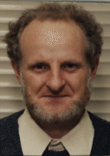
Quadratures for separated representations
James N. Lyness, ANL/MCS

Slide 65
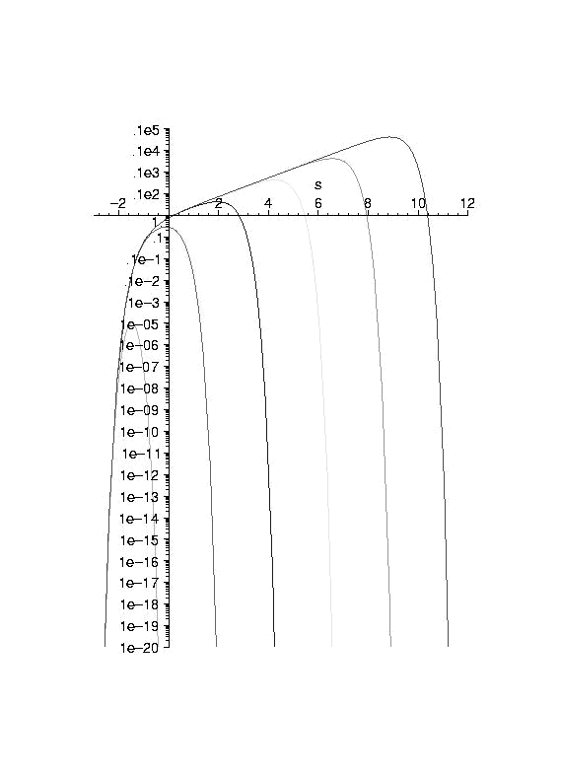
Accurate Quadratures
Trapezoidal quadrature
  Geometric precision for
  periodic functions with
  sufficient smoothness
Beylkin & Monzon
  Further reductions
Reuse and caching
The kernel for x=1e-4,1e-3,1e-2,1e-,1e0.
The curve for x=1e-4 is the rightmost

Slide 66
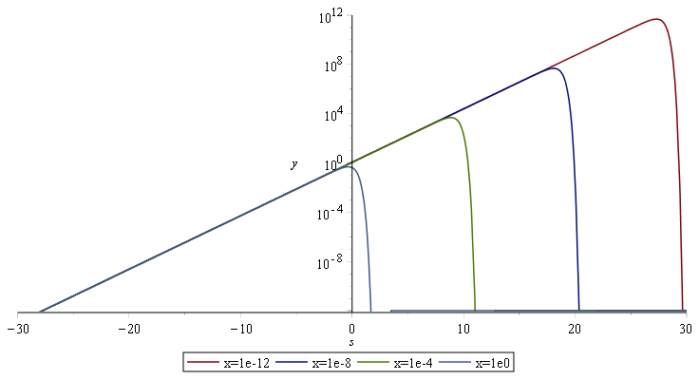
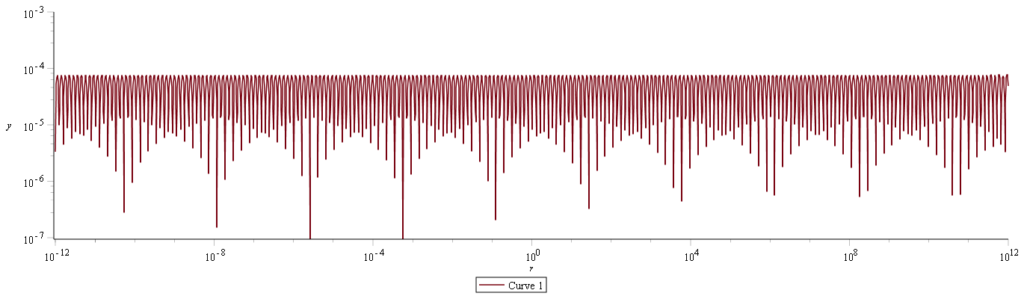
Sample fit for 1/x – relative error

Slide 67
Construction via Laplace Transform
To compute a Gaussian representation of given F(r²), substitute s=r² and invert for f(t)
E.g.,
  need inverse transform of
  A standard transform is
  Substituting s=r² and z=t²
  we obtain a familiar identity

Slide 68
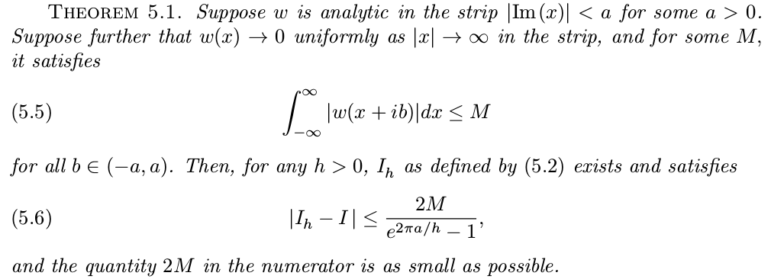
Approximation error
Trefethen and Weideman, “The Exponentially Convergent Trapezoidal Rule,”
SIAM Review 56, p385 2014

Slide 69
Approximation error 1/r

Slide 70
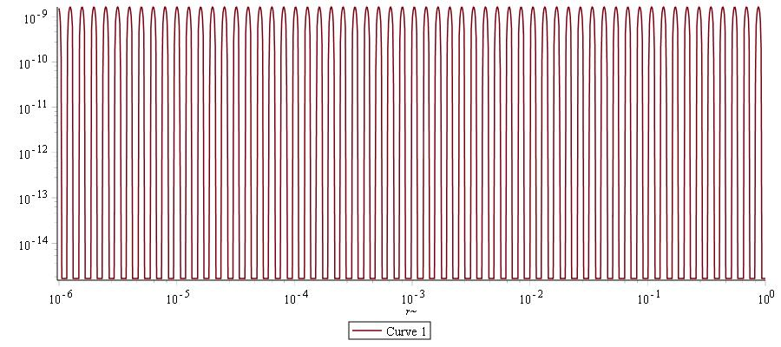
Approximation error 1/r
Error is relative
epsilon=1e-8 → h=0.236

Slide 71
Approximation error exp(-t r)/r

Slide 72
Approximation error exp(-t r)/r

Slide 73
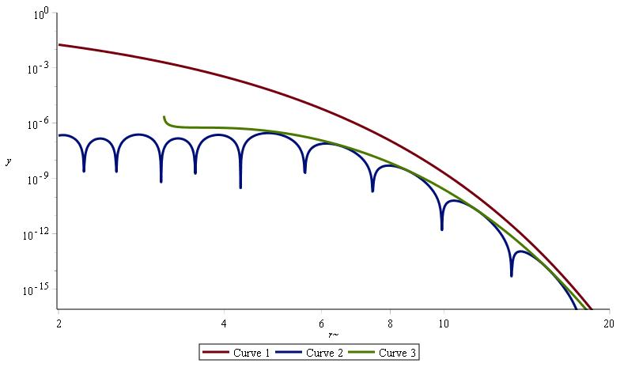
Approximation error – exp(-tr)/r
exp(-2r)
r*ε(h,r)
|exp(-2r) - r*fit(r)|

Slide 74
Non-linear approximation – incl. optimal Gaussian expansions
G. Beylkin and T.S. Haut, Nonlinear approximations for electronic structure calculations, Proceedings of the Royal Society A, 469, (2013) 20130231
G. Beylkin and L. Monzon, Approximation by exponential sums revisited, Applied and Computational Harmonic Analysis, 28, (2010) 131--149
G. Beylkin and L. Monzon, On approximation of functions by exponential sums, Applied and Computational Harmonic Analysis, 19 (2005) 17-48

Slide 75
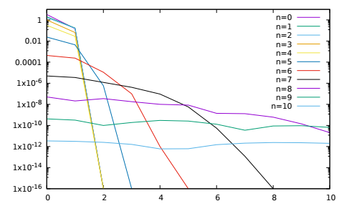
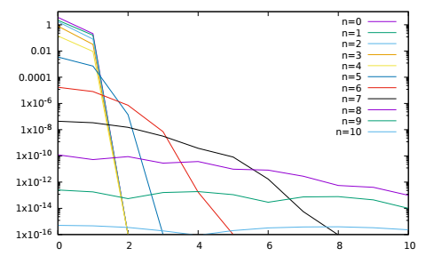
Norm of NS-form of convolution with Gaussian
k=6
k=8
l
l

Slide 76
Linear many-body expansions
G. Beylkin, M. J. Mohlenkamp and F. Perez, Approximating a Wavefunction as an Unconstrained Sum of Slater Determinants, Journal of Mathematical Physics, 49, (2008)
G. Beylkin, M. J. Mohlenkamp and F. Perez, Preliminary results on approximating a wavefunction as an unconstrained sum of Slater determinants, Proc. Appl. Math. Mech., 7, (2007)

Slide 77
Separated form of reciprocal
Quadrature:
Hard to control error over desired range
Approximation
Better control and more general kernels
Beylkin, Hackbush (/www.mis.mpg.de/scicomp/EXP_SUM)

Slide 78
Computational kernels
Discontinuous spectral element
  In each “box” a tensor product of coefficients
  Most operations are small matrix-multiplication
  Typical matrix dimensions are 2 to 30
  E.g., (20,400)^{T} * (20,20)

Slide 79
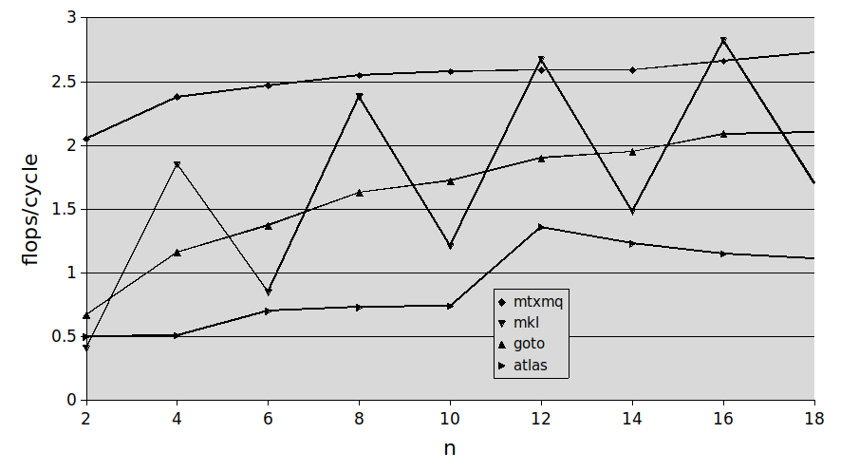
Comparison with MKL, Goto, ATLAS on Intel Xeon 5355 for (20,400)^{T}*(20,n).

Slide 80
Cray XT5 single core FLOPs/cycle
L2 cache is 512Kb = 2*32^3 doubles
- hence good multi-core scaling
- nested transform scales linearly to all cores

Slide 81
IBM BGQ Team
ANL
  Alvaro Vasquez, Jeff Hammond, Nichols Romero
OSU
  Kevin Stocks
SBU
  Robert Harrison, Scott Thornton
VT
  Ed Valeev, Justus Calvin
Toyohashi
  Hideo Sekino, Yukina Yokoi
ORNL
  George Fann

Slide 82
Early Science Project Activities
We are testing a new linear-response module to solve TDDFT equations.
Molecular properties (dipole polarizabilities, NMR chemical shifting, etc.)
Support for well known hard pseudopotentials (i.e. Krack, Goedecker,etc.)
Speedup of Hartree-Fock exchange evaluations via screening parameters.
Implementation of new DFT functionals.
Improving parallel scalability for current supercomputer architectures.

Slide 83
MtXM performance on BGQ
Kevin Stocks OSU
64 threads, best performance is
139.7 GFLOPS (trans(400,20,20))
* Theoretical peak is 204.8
* Linpack is approx. 166.3
(scaling top500 results to one node)

Slide 84
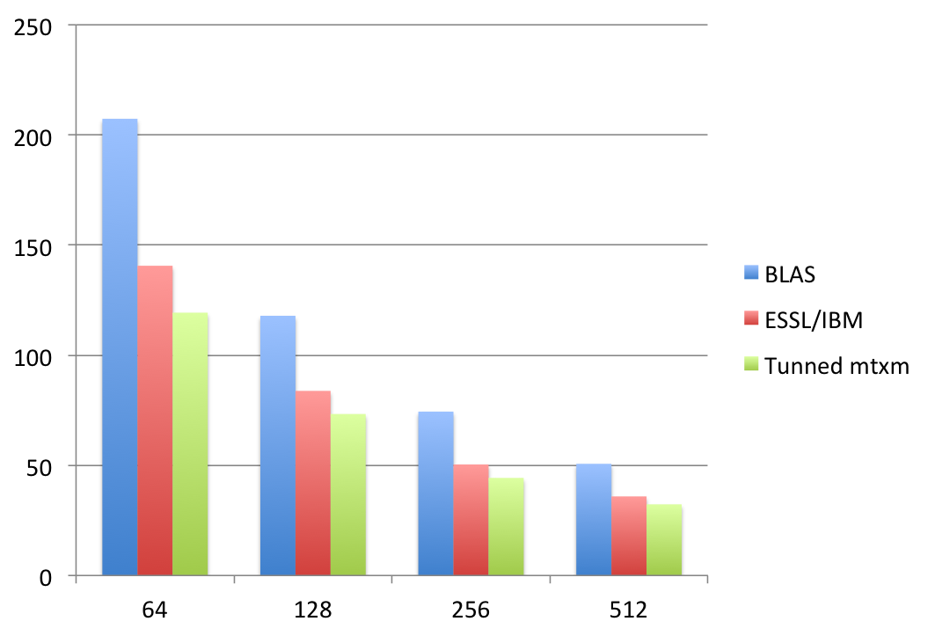
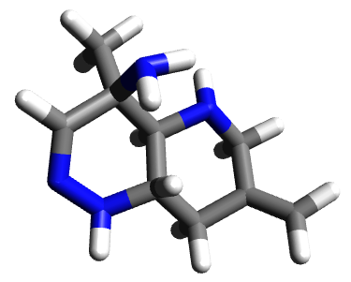
Benefit of tuned mTxm in BG/P Performance
Strong scaling
Molecular system with 13 heavy atoms, DFT, k=8, one iteration
Time /s
N CPUs

Slide 85
Preliminary scaling w.r.t # threads
128 nodes
Clearly a problem in task queue … it was designed for Cray XT5
Different memory architecture, max of 11 worker threads
Tests with Intel TBB suggest it is vastly more scalable

Slide 86
Current molecular capabilities
Hartree-Fock and DFT (LDA, GGA, Hybrid)
  Energies
  Derivatives
  Frequencies (Bischoff)
  Linear response (excited states, dynamic polarizability)
  Essentially complete basis – no problems with gauge and Hellmann-Feynman theorem applies directly
  (with a little care
In progress
  Quadratic response (Sundahl)
    Raman, hyper-Raman, excited state forces
  Relativistic Hamiltonians (Anderson)

Slide 87
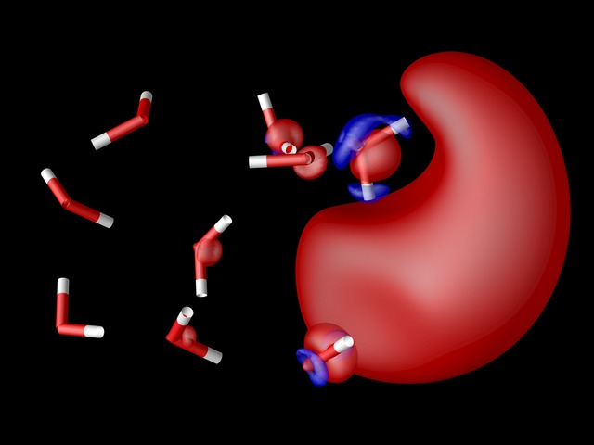
Molecular Electronic Structure
Energy and
gradients
ECPs coming
(Sekino, Kato)
Response
properties
(Vasquez and
Sekino)
Still not as
functional as
previous
Python version
Spin density
of solvated
electron

Slide 89
Path to linear scaling HF & DFT
Need speed and precision
  Absolute error cost
  Relative error cost
Coulomb potential
HF potential
Orbital update
Orthogonalization and or diagonalization
Linear response properties

Slide 90
HF Exchange (T. Yanai)
HF or exact exchange
  Features in the most successful XC functionals
  Invariant to unitary rotation of occupied states with same occupation number
  Localize the orbitals – only O(1) products but potential is still global
  Compute potential only where orbital non-zero
    Cost to apply to all orbitals circa O(N)

Slide 91
Orbital update
Directly solve for localized orbitals that span space of occupied eigenfunctions
  Rigorous error control from MRA refinement
  Never construct the eigenfunctions
  Update only diagonal multipliers
    Off diagonal from localization process

Slide 92
Inner products
The most expensive term for plane wave codes leading to cost O(N² M)
Much less expensive in MRA basis
  Orthogonal basis from local adaptive refinement implies zero/reduced work if
    Functions do not overlap
    Functions locally live at different length scales

Slide 93
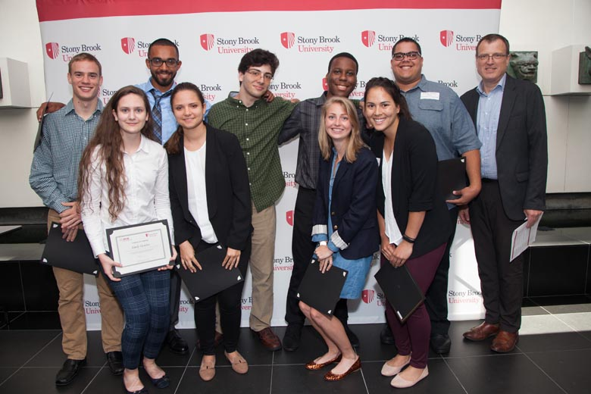
Comparing MRA and Gaussian basis results
Emily Gentles (U. Ark), Colin Bunner (U. MN),
Joel Anderson, Bryan Sundahl

Slide 94
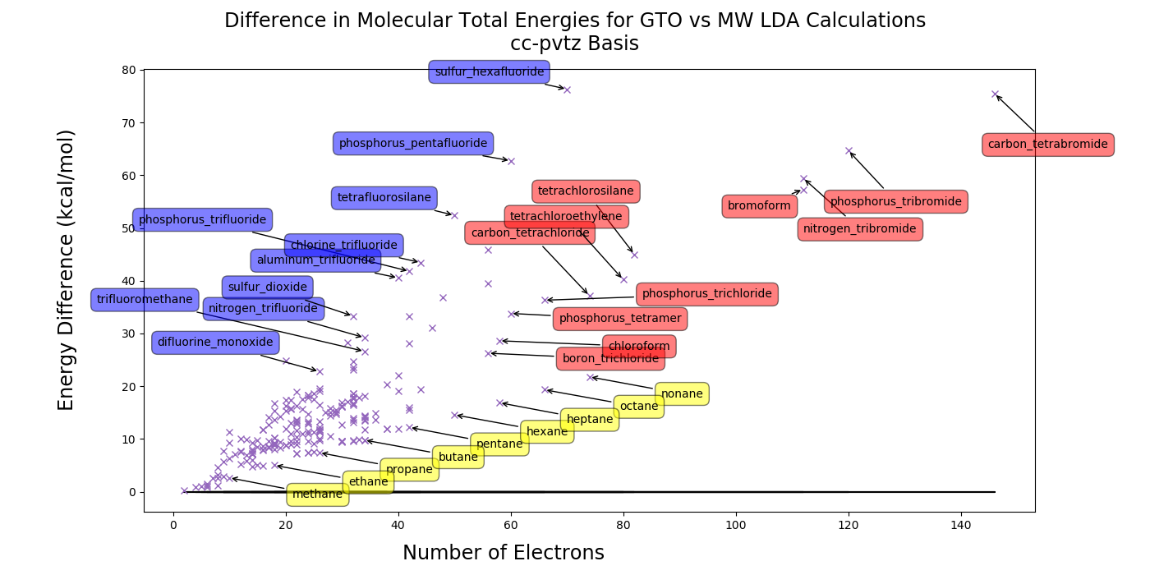

Slide 95
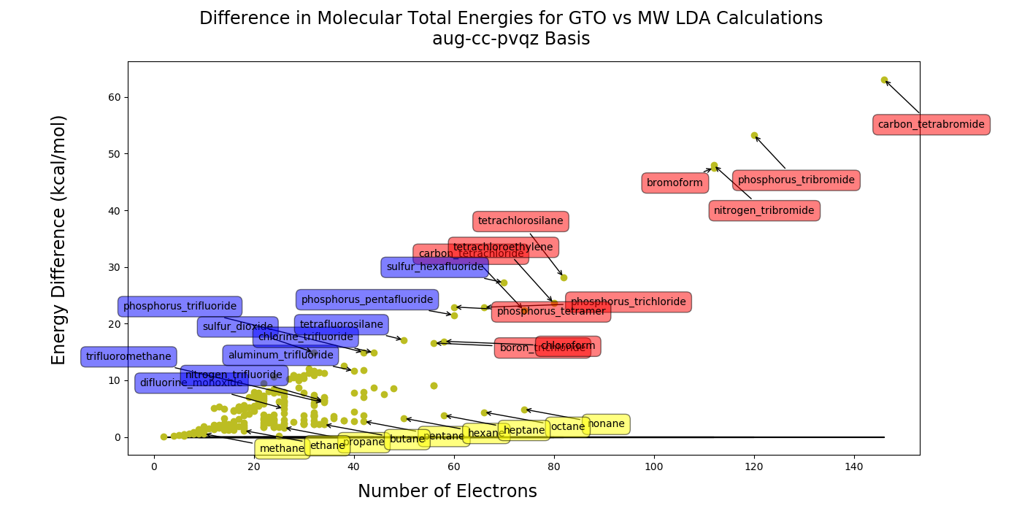

Slide 96
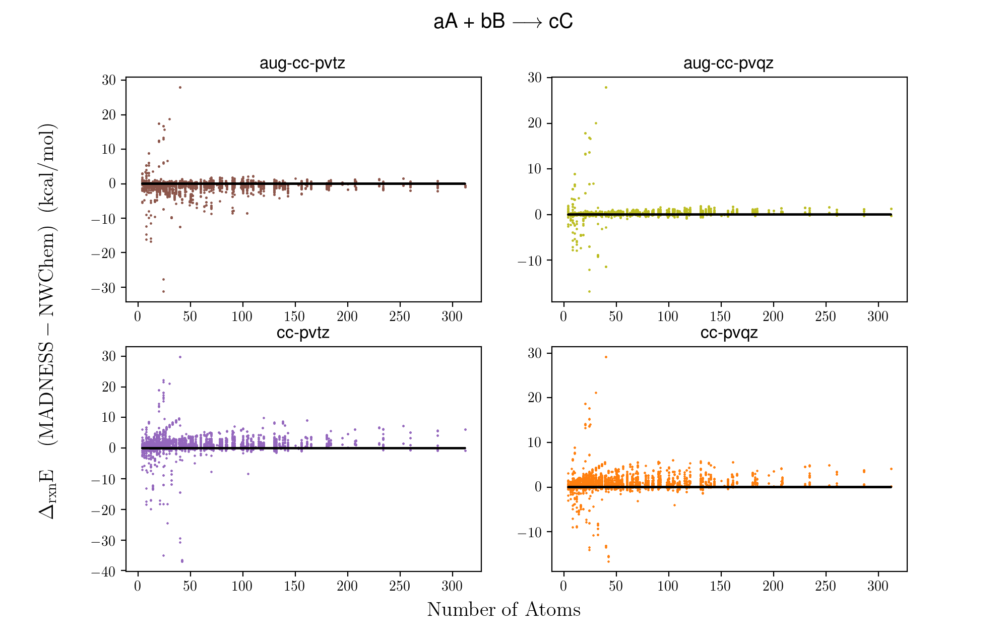

Slide 97
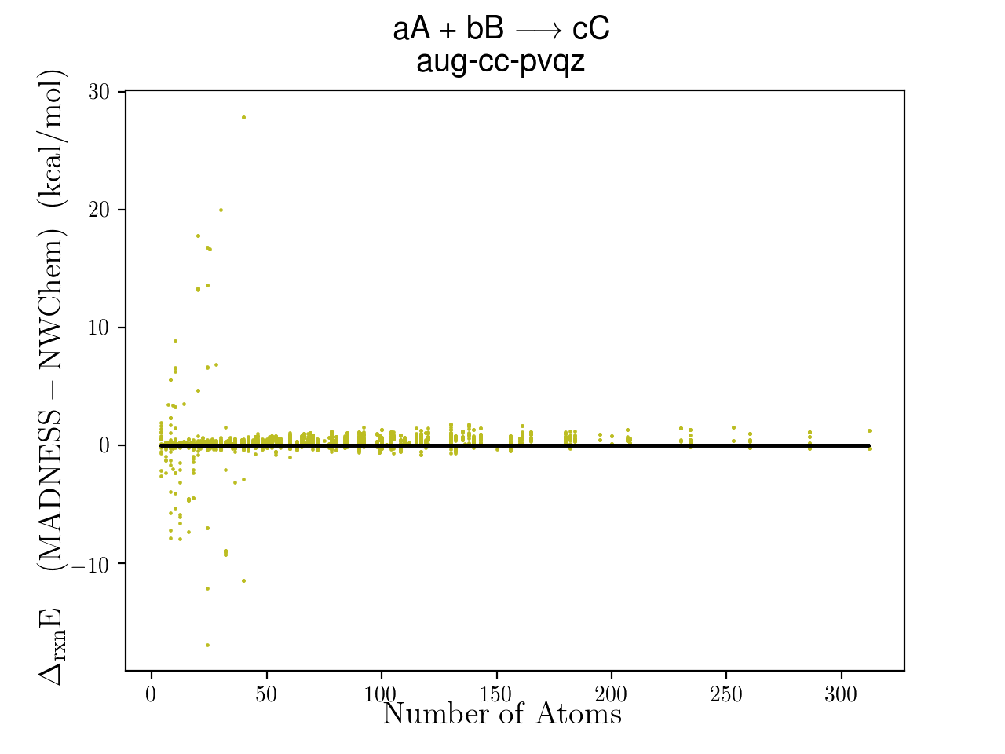

Slide 98
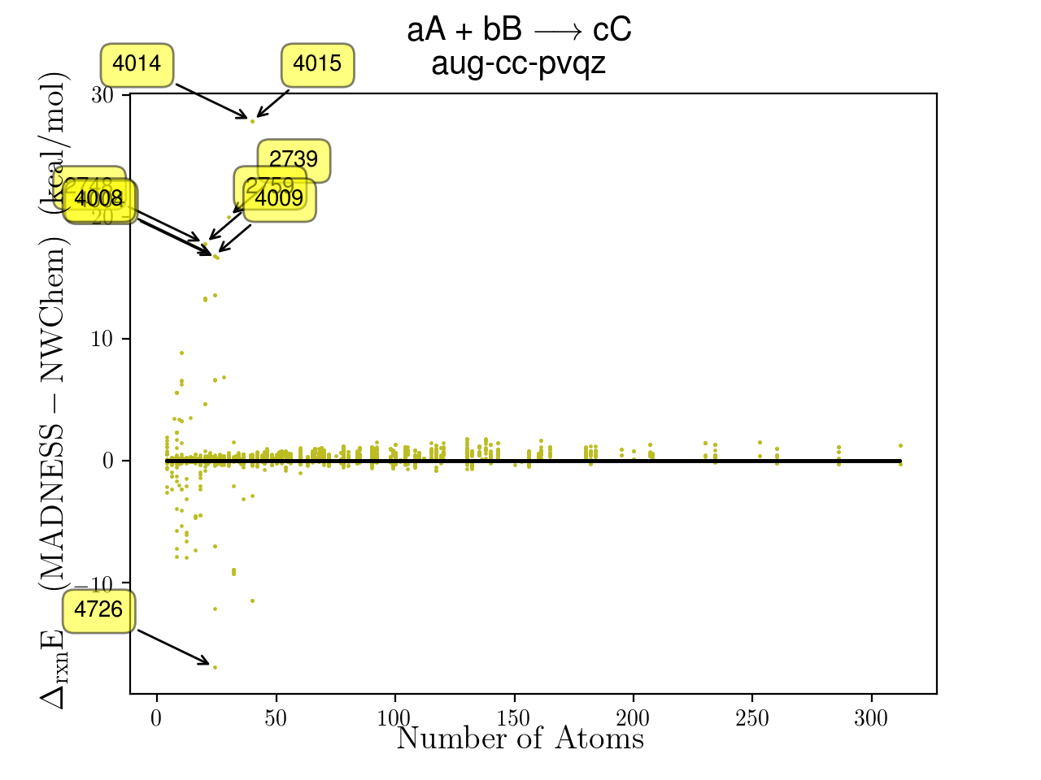
2739: 3 ethanol + ozone -->
6 methanol_radical 20.0409 kcal/mol
2748: 2 ethanol_radical + hydrogen_peroxide -->
4 methanol_radical 17.8414 kcal/mol
2759: 2 ethyl_radical + hydrogen_peroxide -->
4 methanol_radical 17.8414 kcal/mol
4004: 3 methanol + acetate_anion -->
5 methanol_radical 16.662 kcal/mol
4008: 3 methanol_radical + propene -->
3 ethanol_radical 16.837 kcal/mol
4009: 3 methanol_radical + propene -->
3 ethyl_radical 16.837 kcal/mol
4014: 5 methanol_radical + cyclopentane -->
5 ethanol_radical 27.890 kcal/mol
4015: 5 methanol_radical + cyclopentane -->
5 ethyl_radical 27.890 kcal/mol
4726: 5 sulfur_diatomic + 2 sulfur_hexafluoride -->
12 monosulfur_monofluoride -16.883 kcal/mol

Slide 99
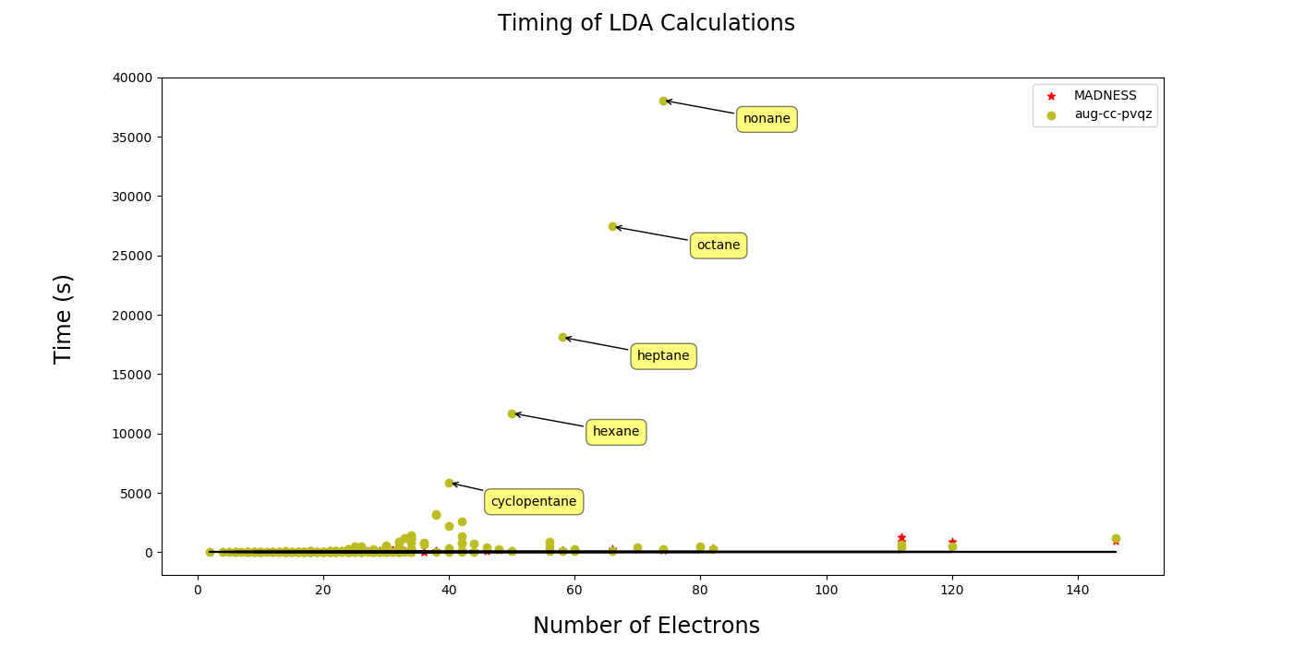

Slide 100
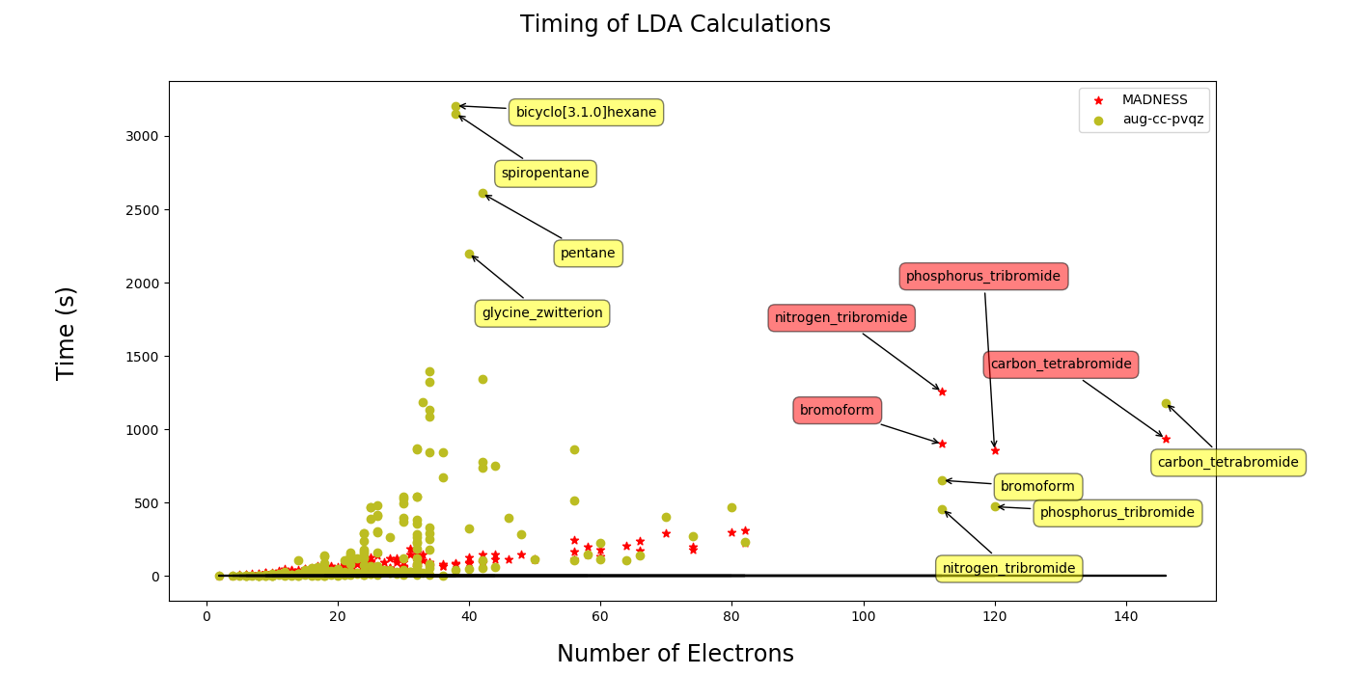

Slide 101
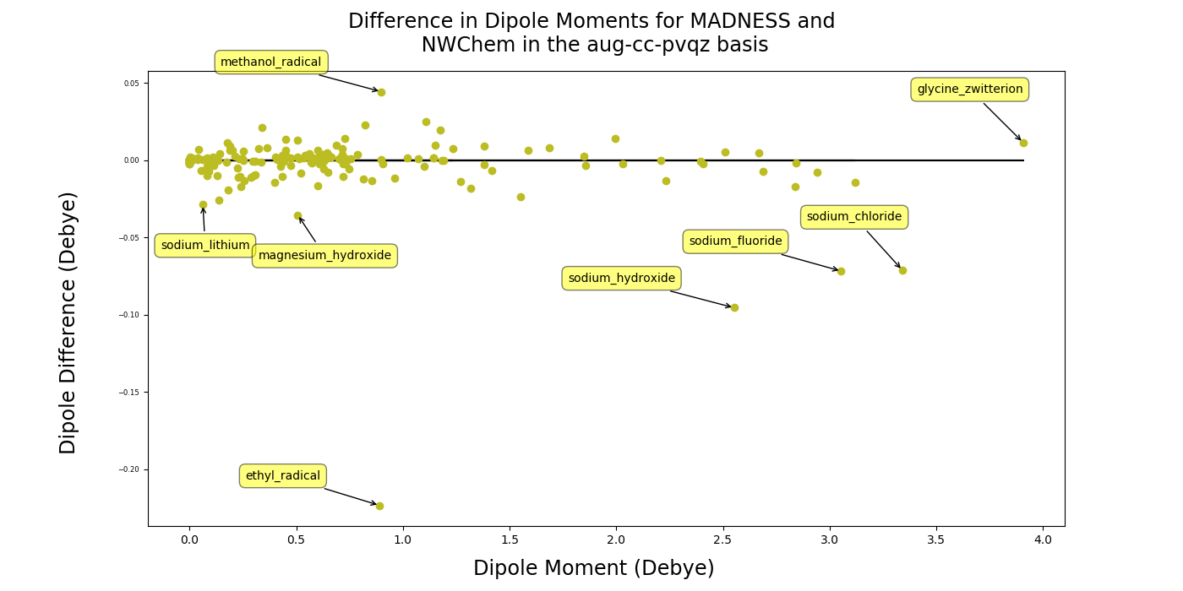
Notes:
This is the same plot, with annotations, as the small panel in the above dipole panel array.

Slide 102
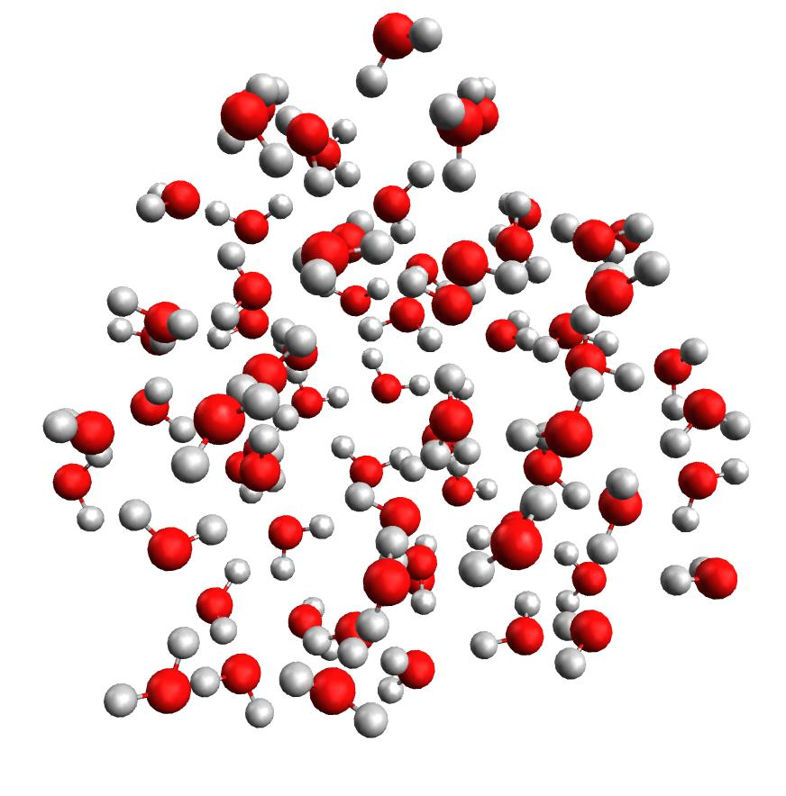
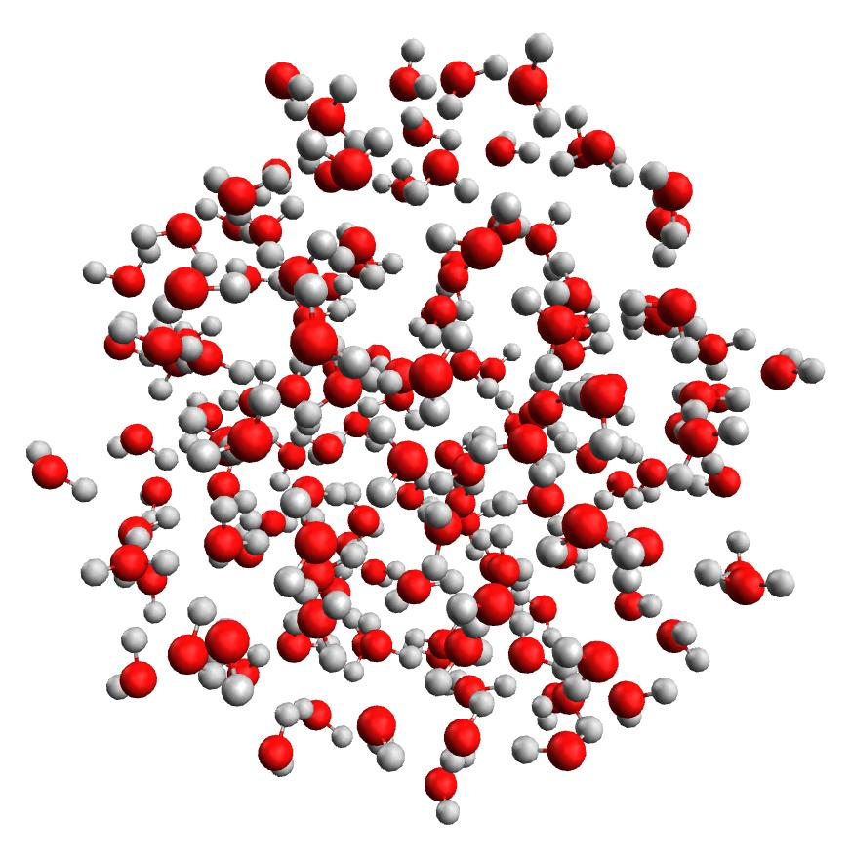
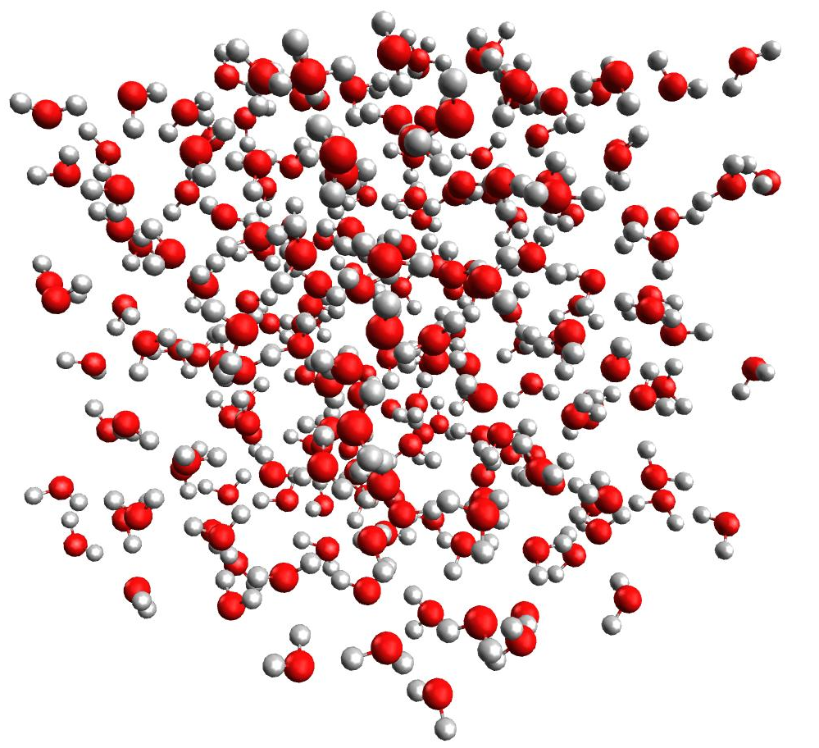
Water clusters
n=70
Classical STP MD simulation
with cube of 213 waters
  Smaller spherical clusters cut
  from interior
n=144
n=213

Slide 103
Scaling – LDA (H2O)n
n | Total | V*psi | Apply G | Tmat | Vmat | Orthog | Localize | Deriv
70 | 256 | 2.0 | 8.7 | 7.8 | 0.3 | 0.7 | 2.7 | 1.9
144 | 744 | 4.2 | 20.9 | 49.2 | 0.9 | 2.9 | 11.9 | 5.5
213 | 1537 | 7.3 | 30.8 | 79.4 | 2.2 | 5.7 | 26.2 | 8.8
α | 1.9 | 1.4 | 1.0 | 1.2 | 2.3 | 1.7 | 2.0 | 1.2
α fitted to points n=144,213
Times in seconds running on 120 nodes, dual socket Intel Haswell, 2GHz, Infiniband FDR 40Gbit
Total is full time for convergence+derivatives; component times from last full iteration

Slide 104
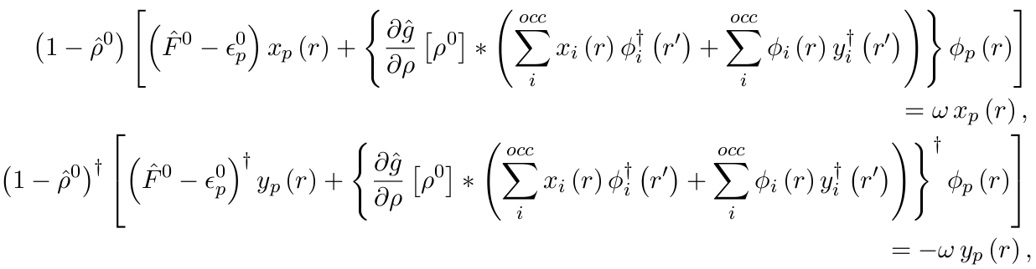
TDDFT and CIS
T. Yanai with N.C. Handy
Solve directly for the orbital response
  Neglect y for CIS or Tamm-Dancoff

Slide 105
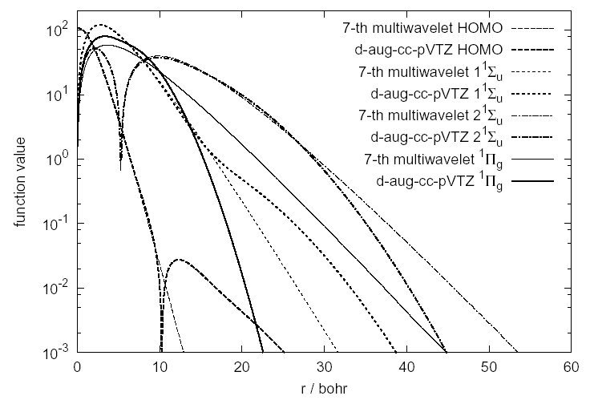
H₂ HOMO and CIS excited states

Slide 106
1³Σ_{u}
1³Σg
³Π_{u}
2³Σ_{u}
2³Σ_{g}
³Π_{g}
HF
aug-cc-pVTZ
9.5520
11.958
12.81
14.36
16.98
17.74
aug-cc-pVQZ
9.5529
11.961
12.59
14.29
16.32
16.79
d-aug-cc-pVQZ
9.5523
11.959
12.26
14.15
14.49
14.81
k=7, r< 3*10⁻⁴
9.55178
11.95491
12.26
14.11
14.48
14.66
k=9, r< 3*10⁻⁶
9.55176
11.95490
12.26
14.11
14.48
14.66
LSDA
aug-cc-pVTZ
9.94
10.65
12.46
12.40
15.76
16.37
aug-cc-pVQZ
9.95
10.61
12.07
12.10
14.85
15.22
d-aug-cc-pVQZ
9.93
10.31
10.94
10.72
11.19
11.98
LSDA(AC)
k=7, r< 3*10⁻⁴
10.53
12.26
12.35
14.11
14.45
14.53
HCTH
aug-cc-pVTZ
10.19
10.79
12.74
12.71
15.85
16.30
aug-cc-pVQZ
10.19
10.76
12.28
12.42
14.89
15.14
d-aug-cc-pVQZ
10.18
10.52
11.12
10.95
11.36
12.23
HCTH(AC)
k=7, r< 3*10⁻⁴
10.87
12.40
12.50
14.10
14.44
14.50
H₂ low-lying triplet excitation energies in eV

Slide 107
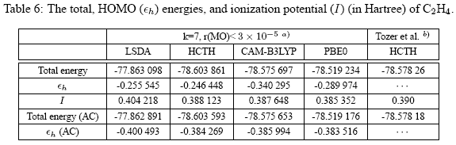


Slide 108
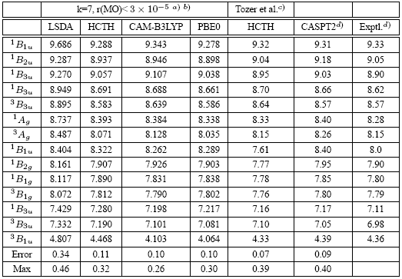
C₂H₄ excitation energies with asymptotically corrected potentials

Slide 109
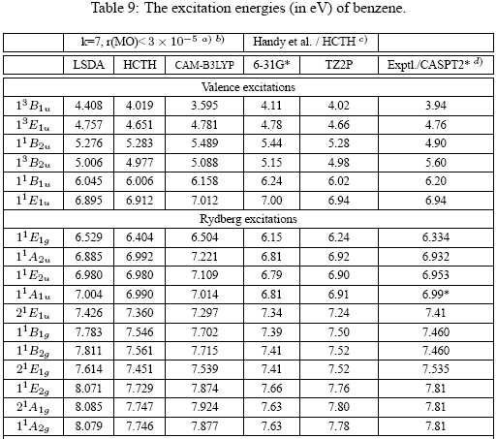

Slide 110


Mean abs. error of Gaussian results relative to MRA
augmented 6-31g* 0.14 eV
augmented TZ2P 0.05 eV
augmented TZ2P 0.01 eV (valence only)

Slide 111

Nuclear physics
J. Pei, G.I. Fann, Y. Ou,
W. Nazarewicz
UT/ORNL
DOE UNDEF
Nuclei & neutron matter
ASLDA
Hartree-Fock Bogliobulov
Spinors
Gamov states
Imaginary part of the seventh eigen function
two-well Wood-Saxon potential

Slide 112

Nuclear physics
J. Pei, G.I. Fann, W. Thornton
W. Nazarewicz
UT/ORNL
DOE UNDEF
Nuclei & neutron matter
ASLDA
Hartree-Fock Bogliobulov
Spinors
Gamov states

Slide 113


Slide 114


Slide 115


Slide 116

Solid-state electronic structure
Thornton, Eguiluz and Harrison (UT/ORNL)
  NSF OCI-0904972: Computational chemistry and physics beyond the petascale
Full band structure with LDA and HF for periodic systems
In development: hybrid functionals, response theory, post-DFT methods such as GW and model many-body Hamiltonians via Wannier functions
Coulomb potential isosurface in LiF

Slide 117
Lattice sums
(Thornton, Beylkin, Harrison)
Reduce range of integral to unit cell
Expand kernel in Gaussians
Diffuse components
  Trapezoidal rule on lattice points exact to machine precision for sufficiently diffuse Gaussians
  Hence replace with constant (G=0)
Real space sum out to
  Fast since is 1D due to separated representation

Slide 118

Lattice sum of Gaussians

Slide 119
Lattice sums - II
Fine scale structure inside any box, or molecule inside large box
  Cost of periodic same as free space inside volume
  Additional cost just at coarse scale and cell faces
Non-orthogonal axes increases rank of expansion
HF exchange with/without screening
  Similar, but with additional phase factor
  Presently implementing approach of Spencer
  (PRB 77, 193110, 2008)
  Periodic code presently not solving for localized orbitals

Slide 120
Periodic Kohn Sham
Solve for Bloch states
Kohn Sham equations
The latter form of the integral equation converges most robustly

Slide 121

Early Results
Thornton, William Scott, “Electronic Excitations in YTiO3 using TDDFT and electronic structure using a multiresolution framework,” PhD diss., University of Tennessee, 2011.
http://trace.tennessee.edu/utk_graddiss/1134

Slide 122
Time evolution
Vence, Harrison, Krstic, Jia, Fann (UT/ORNL)
Multiwavelet basis not optimal
  Not strongly band limited; explicit methods unstable
  * DG introduces flux limiters, we use filters
Semi-group approach
  Split into linear and non-linear parts
Trotter-Suzuki methods
  Time-ordered exponentials
  Chin-Chen gradient correction (JCP 114, 7338, 2001)

Slide 123
Exponential propagator
Imaginary time Schrodinger equation
  Propagator is just the heat kernel
  Wrap in solver to accelerate convergence

Slide 124

Exponential propagator
Free-particle propagator in real time

Slide 125


Exponential propagator
Combine with projector onto band limit
t=10*tcrit
t=tcrit

Slide 126

Time dependent electronic structure
Vence,
Krstic, Harrison
UT/ORNL
H2⁺ molecule in laser field
(fixed nuclei)

Slide 127


Slide 128

Dynamics of H2⁺ in laser
4D – 3 electronic + internuclear coordinate
  First simulation with quantum nuclei and
  non-collinear field (field below is transverse)
-2.032
Field
R a.u.
Electronic dipole a.u.
Time a.u.
-2.017

Slide 129
Interior boundary conditions I
Prototype equation
Diffuse boundary approximation
M. Reuter, J. Hill and R.J. Harrison, “Solving PDEs in Irregular Geometries with Multiresolution Methods I:
Embedded Dirichlet Boundary Conditions,” Computer Physics Communications, 183,1-7 (2012)

Slide 130
Interior boundary conditions II
Recast as integral equation
  Solved using GMRES
Analysis of simple test cases and numerical tests suggest best choice is
  Global first order convergence
  (suggestions in older literature sub-optimal)

Slide 131

Nanoscale photonics
(Reuter, Northwestern; Hill, Harrison ORNL)
Diffuse domain approximation for interior boundary value problem; long-wavelength Maxwell equations; Poisson equation; Micron-scale Au tip 2 nm above Si surface with H2 molecule in gap – 10⁷ difference between shortest and longest length scales.

Slide 132
Dielectric media (J. Fosso Tande)
For implicit solvation want to solve Posson equation in presence of dielectric medium
  Also want Poisson-Boltzmann
Dielectric defined via characteristic function
Effective surface
charge
(Gygi and later Skylaris
define via level set)
Use smooth approximation
switching over finite distance

Slide 133
Dielectric media in external electric field
(Neuman boundary conditions)
Provided GF have only free space or periodic Dirichlet boundary conditions
  Replace Neuman conditions by separately treating asymptotic form
E = external field
Total electric field

Slide 134


Slide 135
Electron correlation (6D)
r₁₂
r₂
All defects in mean-field model are ascribed to
electron correlation
Singularities in Hamiltonian imply for a two-electron atom
Include the inter-electron distance in the wavefunction
  E.g., Hylleraas 1938 wavefunction for He
  Potentially very accurate, but not systematically improvable, and (until recently) not computationally feasible for many-electron systems
Configuration interaction expansion – slowly convergent
r₁

Slide 136
Partitioned SVD representation
|x-y|
x-y
r = separation rank
|x-y|
x-y
y-x
|x-y|
In 3D, ideally must
be one box removed
from the diagonal
Diagonal box has
full rank
Boxes touching
diagonal (face, edge,
or corner) have
increasingly low rank
Away from diagonal
r = O(-log ε)
y
|x-y|
|x-y|
x-y
y-x
|x-y|
y-x
|x-y|
x

Slide 137
Preliminary results for He atom
(Yanai, 2005)
 | Variational E | E | residual
HF | -2.861 61
Iter. 0 | -2.871 08 |  | 0.414 73
1 | -2.894 92 | -0.023 84 | 0.017 28
2 | -2.900 43 | -0.005 51 | 0.007 94
3 | -2.902 18 | -0.001 75 | 0.003 84
4 | -2.902 88 | -0.000 70 | 0.002 02
5 | -2.903 20 | -0.000 32 | 0.001 25
6 | -2.903 39 | -0.000 20 | 0.000 91
… | … | … | …
12 | -2.903 73 | -0.000 04 | 0.000 36
13 | -2.903 73 | +0.000 004 | 0.000 32
14 | -2.903 77 | -0.000 04 | 0.000 28
Computational details:
5-th order multiwavelets
Wavelet threshold: 2×10⁻⁵
SVD threshold: 2×10⁻⁶
Exponential correlation factor
Perturbative wavefunction:
- Maximum refinement: n=4
- Memory: 132M in full partitioned SVD form
~10GB without SVD
Energy is variational
(small non-variational
is just truncation err)
exact | -2.903 724 (E(HF)=-2.861 68)
Hylleraas (6 terms) | -2.903 24
Löwdin and Redei | -2.895 4
cc-pV6Z | -2.903 48 (FCI) (E(HF)= -2.861 67)

Slide 138
Local separated approximations
Density matrix
  Local rank corresponds to number of products of localized occupied orbitals with significant variation in that volume
  Conventional concept: local natural orbitals
Pair correlated wave function
  Away from diagonal, local rank corresponds to number of products of localized low-lying virtual orbitals with significant variation
  Conventional concept: pair natural orbitals

Slide 139
Computing in separated representations
Operating on or combing tensors inflates the rank – must eventually reduce closer to optimal
Pair wave function separated by particles
  Just 2 directions
  Rank-revealing Gram-Schmidt, or reconstruct+SVD
For many dimensions no ideal solution
  Alternating least squares, other (Beylkin)

Slide 140
Douglas Kroll Hess 2nd order
Some
definitions

Slide 141
Douglas Kroll Hess 2nd order
The DKH2 one-electron Hamiltonian is
where W1 is the solution to

Slide 142
Douglas Kroll Hess 2nd order
The momentum space kernels are
and
noting that in these expressions all entities are not operators (i.e., are just numbers or vectors of numbers).

Slide 143
Need for separable kernels
The kernel of W1 is not easily transformed back into real space since p and p' are coupled through both the denominator and potential.
However, a separated representation of the denominator that can be analytically back transformed will solve the problem.
Hence, also need separable real space kernels for A(p), exp(-α E0(p)), and Pbar(p)

Slide 144
Separated form of reciprocal
Quadrature:
Hard to control error
over desired range
Approximation
Better control and more general kernels
Beylkin, Hackbush (/www.mis.mpg.de/scicomp/EXP_SUM)

Slide 145
Asymptotic properties

Slide 146




Functional forms

Slide 147

Approach 1 – Brute force for initial test
Weighted least squares fit to Gaussians in Fourier space
  Weight function p^2
  Weight accurate reproduction of value and first four derivatives at p=0, and to bias towards +ve coeffs

Slide 148

Approach 2 – Construct highly accurate Gaussian approximations
Subtract off asymptotic
decay to very high precision
Fit smooth localized remainder to very high precision using previous brute force approach
At least 17 significant figures for p in [0,1e10] and
an absolute error of 1e-24 or better across all space

Slide 149

Pbar in real space
Highly singular kernels require careful application
– cannot truncate large exponents
0.0507/r^2
Pbar(r)

Slide 150

Approach 3: Analytic transform
Analytic real space representations that produce accurate Gaussian approximations
(most are not closed form)
Pbar agrees to at least double precision arithmetic with both approaches

Slide 151

Example

Slide 152

Example (cont)

Slide 153

Example (cont.)

Slide 154
Operator | Momentum Space Representation | Real Space Representation [2]

Slide 155


Initial test with RK approximation
DK1 also done
60 term approximation to Tbar
Wullen, Chem. Phys. 356 (2009) 199

Slide 156
Multiresolution Solution of the Dirac Equation
Joel Anderson, Robert Harrison, Bryan Sundahl, Scott Thornton

Slide 157

The Schrödinger Equation

Slide 158

The Dirac Equation

Slide 159

Dirac Green’s Function
[4] Blackledge,J. On the Dirac Scattering Problem. Mathematica Aeterna, vol: 3, (7)

Slide 160

Initial Dirac results – Hyrdogenic atoms

Slide 161
High-level composition
Close to the physics
operatorT op = CoulombOperator(k, rlo, thresh);
functionT rho = psi*psi;
double twoe = inner(apply(op,rho),rho);
double pe = 2.0*inner(Vnuc*psi,psi);
double ke = 0.0;
for (int axis=0; axis<3; axis++) {
functionT dpsi = diff(psi,axis);
ke += inner(dpsi,dpsi);
}
double energy = ke + pe + twoe;

Slide 162

H atom
Energy

Slide 163
H atom actual source
Let
Omega = [-20, 20]^3
r = x -> sqrt(x_0^2 + x_1^2 + x_2^2)
g = x -> exp(-r(x))
v = x -> -r(x)^-1
In
psi = F g
nu = F v
S = < psi | psi >
V = < psi | nu * psi >
T = 1/2 * sum_i=0^2 < del_i psi | del_i psi >
print S, V, T, (T + V)/S
End

Slide 164

He atom
Hylleraas
2-term
6D

Slide 165
He atom
Hartree-Fock
Compose directly in terms of
functions and operators
This is a Latex rendering of a
program to solve the Hartree-Fock
equations for the helium atom
The compiler also output a C++
code that can be compiled without
modification and run in parallel

Slide 166
High-level composition
Express ALL available parallelism without burdening programmer
  Internally, MADNESS is looking after data and placement and scheduling of operations on individual functions
  Programmer must express parallelism over multiple functions and operators
    But is not responsible for scheduling or placement
    However, efficiency often demands that the programmer provide info about where data should be located

Slide 167
Current Issues
Load balancing
    Currently a heuristic not a performance model
    Work stealing prototype not in production code
Too much parallelism!
    Memory usage; need more than simple throttle
Manual closures/continuations
    Enables us to stay with standard C++
    User-space threading helps but need S2S tools
I/O
    HDF5 seems right choice but it’s so complicated!
Sequential kernels
    Compiler generated code too slow by ~3x

Slide 168
MADNESS architecture
MADNESS applications – chemistry, physics, nuclear, ...
MADNESS math and numerics
MADNESS parallel runtime
MPI
Global Arrays
ARMCI
GPC/GASNET
Intel Thread Building Blocks optional target for intranode runtime

Slide 169
Runtime Objectives
Scalability to 1+M processors ASAP
Runtime responsible for
    scheduling and placement,
    managing dependencies & hiding latency
Compatible with existing models (MPI, GA)
Borrow successful concepts from Cilk, Charm++, Python, HPCS languages

Slide 170
Why a new runtime?
MADNESS computation is irregular & dynamic
  1000s of dynamically-refined meshes changing frequently & independently (to guarantee precision)
Because we wanted to make MADNESS itself easier to write not just the applications using it
  We explored implementations with MPI, Global Arrays, and Charm++ and all were inadequate
MADNESS is helping drive
  One-sided operations in MPI-3, DOE projects in fault tolerance, ...

Slide 171
Key runtime elements
Futures for hiding latency and automating dependency management
Global names and name spaces
Non-process centric computing
  One-sided messaging between objects
  Retain place=process for MPI/GA legacy compatibility
Dynamic load balancing
  Data redistribution, work stealing, randomization

Slide 172
Runtime layers
Remote method invocation (RMI)
Shared thread pool to execute ready tasks
Futures for hiding latency and automating dependency management
World – parallel execution environment
  Wraps MPI communicator
  Independent task queue for each world
  Asynchronous global ops
  Active messages
Global names (WorldObject)
  With APIs to send messages/tasks between nodes
Global name spaces (WorldContainer)

Slide 173
Multi-threaded architecture
Application
logical main
thread
Task dequeue
RMI Server
(MPI or portals)
Outgoing active messages
Incoming active
messages
Incoming active
messages
Must augment with cache-aware
algorithms and scheduling
Work stealing

Slide 174
RMI
Not exposed to users
Handler routines have this type
typedef void (*rmi_handlerT)
(void* buf, size_t nbyte);
Send an asynchronous message
RMI::Request
RMI::isend(const void* buf, size_t nbyte,
int dest, rmi_handlerT func,
unsigned int attr=0)
Can probe/wait for completion

Slide 175
Active message interface
Class AmArg {
public:
unsigned char* buf() const;
ProcessID get_src() const;
World* get_world() const;
Archive& operator&(const T& t) const;
Archive& operator&(T& t) const;
};
typedef void (*am_handlerT) (const AmArg&);
void send(ProcessID dest, am_handlerT op,
const AmArg* arg, int attr);

Slide 176
Tasks
Basic API takes pointer to object derived from
class TaskInterface {
public:
virtual void run();
}
User implements run function and adds task to queue (that takes ownership of ptr) using
  Can add priority
world.taskq.add(pointer_to_task)

Slide 177
Futures
Result of an asynchronous computation
  Cilk, Java, HPCLs,
  C++0x
Hide latency due to communication or computation
Management of dependencies
  Via callbacks
int f(int arg);
ProcessId me, p;
Future<int> r0=task(p, f, 0);
Future<int> r1=task(me, f, r0);
// Work until need result
cout << r0 << r1 << endl;
Process “me” spawns a new task in process “p”
to execute f(0) with the result eventually returned
as the value of future r0. This is used as the argument
of a second task whose execution is deferred until
its argument is assigned. Tasks and futures can
register multiple local or remote callbacks to
express complex and dynamic dependencies.

Slide 178
Virtualization of data and tasks
Future:
MPI rank
probe()
set()
get()
Task:
Input parameters
Output parameters
probe()
run()
get()
Future Compress(tree):
Future left = Compress(tree.left)
Future right = Compress(tree.right)
return Task(Op, left, right)
Compress(tree)
Wait for all tasks to complete
Benefits: Communication latency & transfer time largely hidden
Much simpler composition than explicit message passing
Positions code to use “intelligent” runtimes with work stealing
Positions code for efficient use of multi-core chips
Locality-aware and/or graph-based scheduling

Slide 179
Global Names
class A : public WorldObject<A>
{
int f(int);
};
ProcessID p;
A a;
Future<int> b = a.task(p,&A::f,0);
Objects with global names with different state in each process
  C.f. shared[threads]
  in UPC; co-Array
Non-collective constructor;
deferred destructor
  Eliminates synchronization
A task is sent to the instance of a in process p.
If this has not yet been constructed the message
is stored in a pending queue. Destruction of a
global object is deferred until the next user
synchronization point.

Slide 180
Global Namespaces
Specialize global names
to containers
  Hash table, arrays, ...
Replace global pointer (process+local pointer) with more powerful concept
User definable map from keys to “owner” process
class Index; // Hashable
class Value {
double f(int);
};
WorldContainer<Index,Value> c;
Index i,j; Value v;
c.insert(i,v);
Future<double> r = c.task(j,&Value::f,666);
A container is created mapping indices
to values.
A value is inserted into the container.
A task is spawned in the process owning
key j to invoke c[j].f(666).
Namespaces are a large part of the elegance of Python and success of Charm++ (chares+arrays)

Slide 181
#define WORLD_INSTANTIATE_STATIC_TEMPLATES
#include <world/world.h>
using namespace madness;
class Foo : public WorldObject<Foo> {
const int bar;
public:
Foo(World& world, int bar) : WorldObject<Foo>(world), bar(bar)
{process_pending();}
int get() const {return bar;}
};
int main(int argc, char** argv) {
MPI::Init(argc, argv);
madness::World world(MPI::COMM_WORLD);
Foo a(world,world.rank()), b(world,world.rank()*10)
for (ProcessID p=0; p<world.size(); p++) {
Future<int> futa = a.send(p,&Foo::get);
Future<int> futb = b.send(p,&Foo::get);
// Could work here until the results are available
MADNESS_ASSERT(futa.get() == p);
MADNESS_ASSERT(futb.get() == p*10);
}
world.gop.fence();
if (world.rank() == 0) print("OK!");
MPI::Finalize();
} Figure 1: Simple client-server program implemented using WorldObject.

Slide 182
#define WORLD_INSTANTIATE_STATIC_TEMPLATES
#include <world/world.h>
using namespace std;
using namespace madness;
class Array : public WorldObject<Array> {
vector<double> v;
public:
/// Make block distributed array with size elements
Array(World& world, size_t size)
: WorldObject<Array>(world), v((size-1)/world.size()+1)
{
process_pending();
};
/// Return the process in which element i resides
ProcessID owner(size_t i) const {return i/v.size();};
Future<double> read(size_t i) const {
if (owner(i) == world.rank())
return Future<double>(v[i-world.rank()*v.size()]);
else
return send(owner(i), &Array::read, i);
};
Void write(size_t i, double value) {
if (owner(i) == world.rank())
v[i-world.rank()*v.size()] = value;
else
send(owner(i), &Array::write, i, value);
return None;
};
};
int main(int argc, char** argv) {
initialize(argc, argv);
madness::World world(MPI::COMM_WORLD);
Array a(world, 10000), b(world, 10000);
// Without regard to locality, initialize a and b
for (int i=world.rank(); i<10000; i+=world.size()) {
a.write(i, 10.0*i);
b.write(i, 7.0*i);
}
world.gop.fence();
// All processes verify 100 random values from each array
for (int j=0; j<100; j++) {
size_t i = world.rand()%10000;
Future<double> vala = a.read(i);
Future<double> valb = b.read(i);
// Could do work here until results are available
MADNESS_ASSERT(vala.get() == 10.0*i);
MADNESS_ASSERT(valb.get() == 7.0*i);
}
world.gop.fence();
if (world.rank() == 0) print("OK!");
finalize();
}
Complete example program illustrating the implementation and use of a crude,
block-distributed array upon the functionality of WorldObject.

Slide 183
Serialization
Convert an object (and containers thereof) into a serial stream of bytes
  Conceptually based on Boost serialization
  Symmetric & operator for input/outut
  ar & x & y & z;
  Asymmetric operators also (<<, >>)
Fundamental types and containers
User types provide supported through both intrusive and non-intrusive methods
Used to send objects between processes, to disk

Slide 184
Example symmetric seralization
class A {
float a;
public:
A(float a = 0.0) : a(a) {}
template <class Archive>
inline void serialize(Archive& ar) {ar & a;}
};
A a(99.0), b;
BinaryFstreamOutputArchive oar(ofile);
oar & a; // saves a to file
...
BinaryFstreamInputArchive iar(ifile);
iar & b; // loads b from file

Slide 185
C++ templates automate many things
Wrapping calls to functions or lambdas or object member functions inside a task
Managing dependencies by connecting futures and tasks through the dependency interface (callbacks)
Assisting programmers to avoid explicit use of futures as arguments to functions
(de)Serializing arguments to remote tasks
Templates don’t add additional runtime overhead (compile time)

Slide 186
Abstraction Overheads
If you are careful you win
  Increased performance and productivity
  This is the lesson of Global Arrays, Charm++, …
Creating, executing, reaping a local, null task – 350ns (100K tasks, 3GHz Core2, Pathscale 3.0, -Ofast) dominated by new/delete
Chain of 100K dependent tasks with the result of a task as the unevaluated argument of the previous task
  ~1 us per task
Creating a remote task adds overhead of inter-process communication which is on the scale of 5us (Cray XT).
  Aggregation can reduce this.
Switching between user-space threads <20ns

Slide 187
Success with tasks
Can readily compose parallel versions of many complex and irregular algorithms
Can obtain good performance
  On multi-threaded CPUs
  With attention to details
  Especially effective for irregular work loads and complex, even dynamic, dependencies

Slide 188
Problems with tasks without both compiler+intelligent runtime
Manual continuation passing - everywhere code may block need to partition into separate tasks (zillions of them!)
Rigid decisions made about granularity and decomposition
Hard to automatically aggregate many small tasks
Can make portability from CPU to GPU worse
Resource management – bounding buffers and not drowning/starving in parallelism: partially manage with task generators, data flow, task priorities
Efficient execution challenging esp. use of memory hierarchy, scheduling of critical path
Makes easy things harder (e.g., parallel for)
Task specification often distant from task use - very
effective for code obfuscation – partially fixed in modern C++
Interoperability with just about everything else is painful

Slide 189
Some issues
Excessive global barriers
  Termination detection for global algorithms on distributed mutable data structures
Messy, nearly redundant code expressing variants of algorithms on multiple trees
  Need some templates / code generation
Need efficient and easy way to aggregate data/work to exploit GPGPUs
Efficient kernels for GPGPUs (single SM)
  Non-square matrices, shortish loops – performance problem
Switching between single-/multi-thread tasks
Efficient multi-threaded code for thread units sharing L1
(e.g., BGQ, Xeon Phi)
Multiple interoperable DSLs embedded in or generating general purpose language
Need kitchen sink environment – full interoperability between runtimes, data structures, external I/O libraries, etc.

Slide 190



Summary
MADNESS is a general purpose framework for scientific simulation
  Conceived for the petascale to exascale era
  Increases HPC productivity by reducing many sources of complexity
  Deploys advanced math, numerics, and C/S
http://code.google.com/p/m-a-d-n-e-s-s

Slide 191
Summary
MADNESS
  High-level composition – functions and operators
  Fast computation with guaranteed precision
  Separated representations of operators (and functions)
DFT code nearing production quality
  GGAs, hybrid, TDDFT, derivatives, pseudopotentials
Efficient execution on parallel computers
  Cray XE, IBM BGQ, multithreading
High-productivity parallel programming framework
http://code.google.com/p/m-a-d-n-e-s-s

Slide 192
Summary
Exascale programming models
  Resilience, Power, Performance, Productivity
  Productivity is arguably the most important
  Enable innovation and discovery at scale
MADNESS and NWChem
  Frameworks – places for disciplines to meet to leverage investments and expertise
  Face different challenges in moving forward
Data and computation are inseparable challenges

Slide 193
Summary
We need radical changes in how we compose scientific S/W
  Complexity at limits of cost and human ability
  Need extensible tools/languages with support for code transformation not just translation
Students need to be prepared for computing and data in 2020+ not as it was in 2000 and before
  Pervasive, massive parallelism
  Bandwidth limited computation and analysis
  An intrinsically multidisciplinary activity

Slide 194
Summary
MADNESS
  High-level composition – functions and operators
  Fast computation with guaranteed precision
  Separated representations of operators (and functions)
DFT code nearing production quality
  GGAs, hybrid, TDDFT, derivatives, pseudopotentials
Efficient execution on parallel computers
  Cray XE, IBM BGQ, multithreading
High-productivity parallel programming framework

Slide 195
Funding
NSF ACI-1450344
DOE: SciDAC, Office of Science divisions of Advanced Scientific Computing Research and Basic Energy Science, under contract DE-AC05-00OR22725 with Oak Ridge National Laboratory, in part using the National Center for Computational Sciences.
DARPA HPCS2: HPCS programming language evaluation
NSF CHE-0625598: Cyber-infrastructure and Research Facilities: Chemical Computations on Future High-end Computers
NSF CNS-0509410: CAS-AES: An integrated framework for compile-time/run-time support for multi-scale applications on high-end systems
NSF OCI-0904972: Computational Chemistry and Physics Beyond the Petascale

Slide 196
References
B. Alpert, G. Beylkin, D. Gines, and L. Vozovoi, “Adaptive Solution of Partial Differential Equations in Multiwavelet Bases,” Journal of Computational Physics, v. 182, pp. 149-190, 2002
G.I. Fann, G. Beylkin, R.J. Harrison and K.E. Jordan, “Singular operators in multiwavelet bases,” IBM J. Res. Dev., 48 (2004) 161.
R.J. Harrison, G.I. Fann, T. Yanai, Z. Gan and G. Beylkin, “Multiresolution quantum chemistry: basic theory and initial applications,” J. Chem. Phys., 121 (2004) 11587.
T. Yanai, G.I. Fann, Z. Gan, R.J. Harrison, G. Beylkin, “Multiresolution quantum chemistry in multiwavelet bases: Analytic derivatives for Hartree-Fock and density functional theory,” J. Chem. Phys., 121 (2004) 2866.
T. Yanai, R.J. Harrison and N.C. Handy, “Multiresolution quantum chemistry in multiwavelet bases: time-dependent density functional theory with asymptotically corrected potentials in local density and generalized gradient approximations,” Mol. Phys., 103 (2004) 403.
R. Harrison, G. Fann, Z. Gan, T. Yanai, S. Sugiki, A. Beste, and G. Beylkin, “Multiresolution computational chemistry,” J. Physics, Conference Series, 16, 243-246, 2005.
T. Yanai, R.J. Harrison, G.I. Fann and G. Beylkin, “Multi-resolution quantum chemistry: linear response for excited states,” J. Chem. Phys., submitted for publication, 2005.
G. Beylkin, R. Cramer, G. Fann and R. J. Harrison, “Multiresolution separated representations of singular and weakly singular operators,” Applied and Computational Harmonic Analysis, 23 (2007) 235-253
H. Sekino, Y. Maeda, T. Yanai, and R.J. Harrison, “Basis set limit Hartree-Fock and density functional theory response property evaluation by multiresolution multiwavelet basis,” J. Chem. Phys,129(3):034111 , 2008
G.I. Fann, J.C. Pei, R.J. Harrison ,J. Jia, J.C. Hill, M.J. Ou, W. Nazarewicz, W.A. Shelton and N. Schunck., “Fast multiresolution methods for density functional theory in nuclear physics,” Journal of Physics, 180, 012080, 2009
M. Reuter, J. Hill and R.J. Harrison, “Solving PDEs in Irregular Geometries with Multiresolution Methods I: Embedded Dirichlet Boundary Conditions,” Computer Physics Communications, submitted March 2010

Slide 197






Molecular orbitals of water
2-d contour plot
Iso-surfaces are 3-d contour plots – they show the surface upon which the function has a particular value
Water has 10 electrons (8 from oxygen, 1 from each hydrogen).
It is closed-shell, so it has 5 molecular orbitals each occupied with two electrons.
H
O
-1.31
-0.53
-20.44
-0.67
-0.48
The energy of each orbital in atomic units

Slide 198
Linear Combination of Atomic Orbitals (LCAO)
Molecules are composed of (weakly) perturbed atoms
  Use finite set of atomic wave functions as the basis
  Hydrogen-like wave functions are exponentials
E.g., hydrogen molecule (H₂)
Smooth function of
molecular geometry
MOs: cusp at nucleus
with exponential decay

Slide 199
LCAO with Gaussian Functions
Cannot compute integrals over exponential orbitals
Boys (1950) noted that Gaussians are feasible
  6D integral reduced to 1D integrals which are tabulated once and stored (related to error function)
Gaussian functions form a complete basis
  With enough terms any radial function can be approximated to any precision using a linear combination of Gaussian functions

Slide 200
LCAO
A fantastic success, but …
Basis functions have extended support
  causes great inefficiency in high accuracy calculations (functions on different centers overlap)
  origin of non-physical density matrix
Basis set superposition error (BSSE)
  incomplete basis on each center leads to over-binding as atoms are brought together
Linear dependence problems
  accurate calculations require balanced approach to a complete basis on every atom
  molecular basis can have severe linear dependence
Must extrapolate to complete basis limit
  unsatisfactory and not feasible for large systems

Slide 201

MADNESS deploys advanced math and C/S to enable robust
solution of diverse physical problems on the largest
supercomputers with a very high level of composition
Chemistry: coupled non-linear
Schrodinger equations
Solid state: band structure
including lattice sums
Nanoscience: electrostatics
with 7 decades of length scale
Adaptive discontinuous
spectral element
Separated representations
Multiresolution analysis

Slide 202

Example tree in Haar basis
Haar basis is a piecewise constant (like a histogram)
Not useful for real calculations but easy to visualize and of fundamental importance
Adaptive local refinement until local error measure is satisfied
Smaller boxes where rate of change is high and value not negligible
Conventional adaptive mesh corresponds to boxes
Construct tree connecting fine-scale to coarser-scale boxes
Boxes labeled with level (n=0,1,...) and translation (l=0,1,...,2^{n}-1)
0,0
1,0
1,1
2,0
2,1
2,2
2,3
3,2
3,3
3,4
3,5
3,6
3,7

Slide 203
Reconstructed
Tree in reconstructed form. Scaling function (sum)
coefficients at leaf nodes. Interior nodes empty.
Empty
Difference coefficients
Compressed
Sum coefficients
Sum and difference coefficients
Compression algorithm. Starting from leaf nodes, scaling function
(sum) coefficients are passed to parent. Parent “filters” the
childrens' coefficients to produce sum and wavelet (difference)
coefficients at that level, then passes sum coefficients to its parent.
Reconstruction is simply the reverse processes.
To produce the non-standard form the compression algorithm is
run but scaling function coefficients are retained at the leaf and
interior nodes.
Tree in compressed form. Wavelet (difference)
coefficients at interior nodes, with scaling functions
coefficients also at root. Leaf nodes empty.

Slide 204
+
Empty
Difference coefficients
Sum coefficients
Sum and difference coefficients
Addition is (most straightforwardly) performed in the compressed
form. Coefficients are simply added with missing nodes being
treated as if zero.

Slide 205
Differentiation (for simplicity here using central differences and Dirichlet boundary
conditions) is applied in the scaling function basis. To compute the derivative of the function
in the box corresponding to a leaf node, we require the coefficients from the neighboring
boxes at the same level.
If the neighboring leaf nodes exist, all is easy.
If it exists at a higher level,we can make the coefficients by recurring down from the parent
using the two-scale relation.
If the neighbor exists at a finer scale, we must recur down until both neighbors are at the
same level.
Hence, phrased as parallel computation on all leaf nodes , differentiation must search for
neighbors in the tree at the same and higher levels, and may initiate computation at lower
levels. It can also be phrased as a recursive descent of the tree, which can have advantages in
reducing the amount of probes up the tree for parents of neighbors (esp. in higher dimensions).

Slide 206
1.0
0.0
2e-5
1e-2
0.3
1e-2
2e-5
0.0
Convolution The first step is to compress into non-standard form with scaling function and
wavelet coefficients at each interior node. Then, we can independently compute the
contribution of each box (node) to the result at the same level of the tree. Depending upon
dimensionality, accuracy, and the kernel (K), we usually only need to compute the
contributions of a box to itself and its immediate neighbors. The support (i.e., level of
refinement) of the result is very dependent on the kernel. Here we consider convolution
with a Gaussian (Green's function for the heat equation) which is a smoothing operator.
After the computation is complete, we must sum down the tree to recover the standard form.
Hence, phrased as computation on all the nodes in non-standard form, convolution requires
compression and reconstruction, and during the computation communicates across the tree at
the same level to add results into neighboring boxes and up to connect new nodes to parents.

