Slide 1


Akhuwat Pearl’s of Wisdom
Library Management System
Advisor: Dr. Bilal Shoaib
Akhuwat College Kasur

Slide 2
Presented by:
Name: Kashif Mehmood Jilani
Registration No: 20F-BSIT-05
Name: Muhammad Asamullah Ulfat
Registration No: 20F-BSIT-17

Slide 3

Agenda
Problem Statement
Objective
Project Overview
Architecture of project
Project Plan and Design (system architecture)
Development methodology (Technologies use)
Implementation and Testing
Project Demo
Conclusion

Slide 4
Problem Statement:
There are some problems faced by the AIK librarian while using KOHA like:-
Lack of customization
Limited archives management
Limited user records management
Technical complexity issues (Installing, configuring, and maintaining)
No audit and report
Dual record-keeping
Staff training requirements

Slide 5
Objective
Develop library management system(LMS)
User-friendly system
Enhances the efficiency of library operations
Dashboard (admin, librarian, users)
Facilitates easy book access for users
Reducing the manual workload
Inventory tracking
Audit management

Slide 6
Project Overview
Our library management system is designed to
simplified library operations
Minimize manual tasks
Improve accessibility for users
Book management
User authentication

Slide 7
Architecture of project :
Admin Dashboard:
Admin login
Librarian and user account management
Digital media(pdf) books management
Audit records
Password update
Librarian Dashboard:
Librarian login
Librarian and user account management
Digital media(pdf) books management
Book Management
Audit records
Password update
User Dashboard:
User login
Profile Management
Read Digital media(pdf) books
Audit records

Slide 8
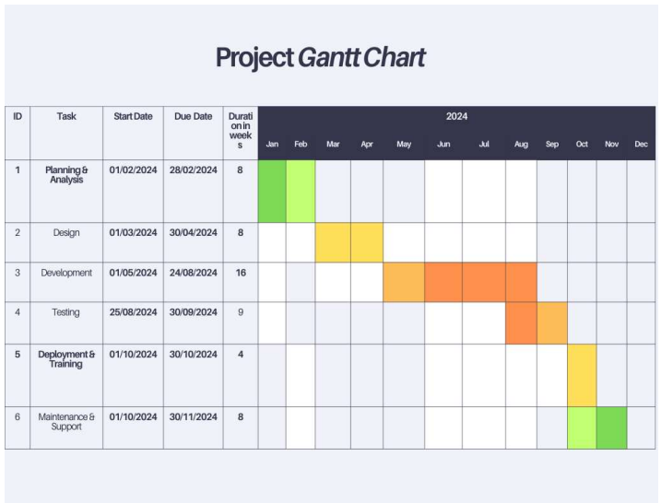
PROJECT PLAN

Slide 9
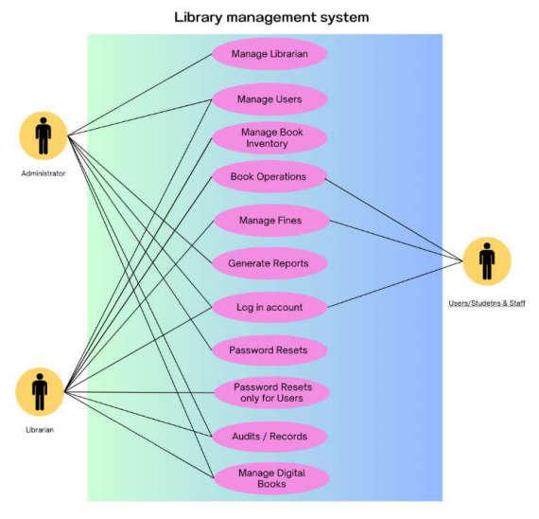
Use case diagram

Slide 10
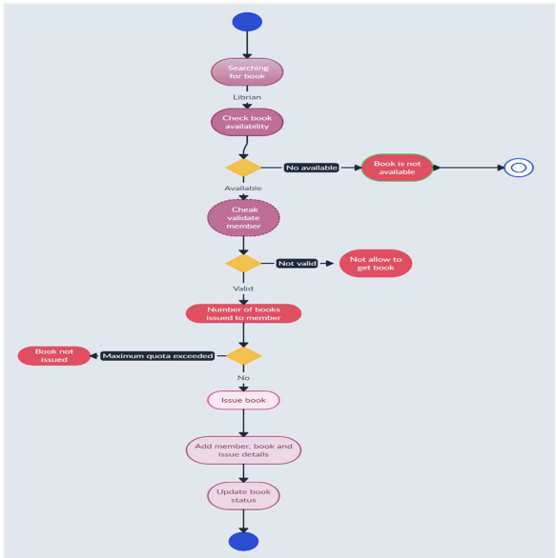
Activity diagram

Slide 11
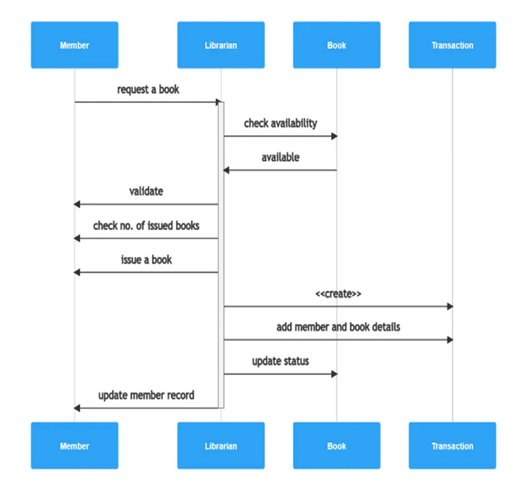
Sequence diagram

Slide 12
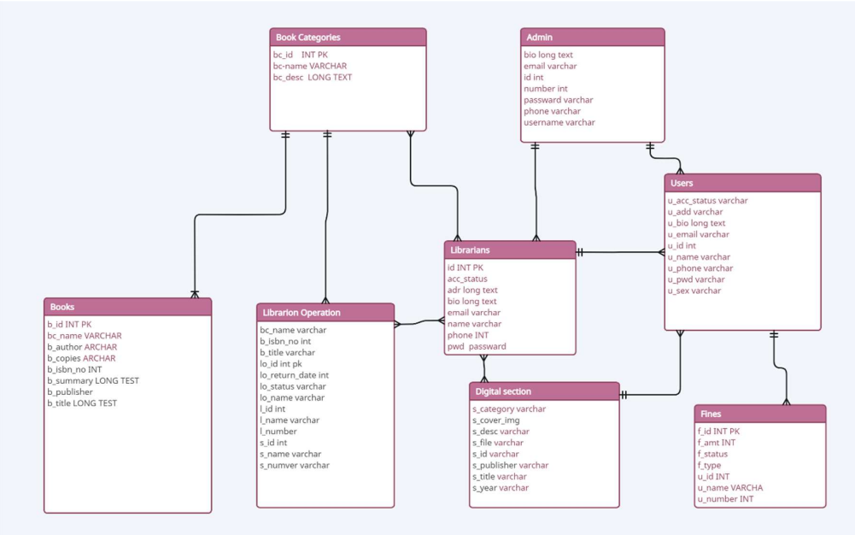
Database schema

Slide 13
Technologies used
Programming languages:-
HTML
CSS
JS
SQL
PHP
Tools:-
Visual studio code
Figma
MySQL
XAMPP

Slide 14
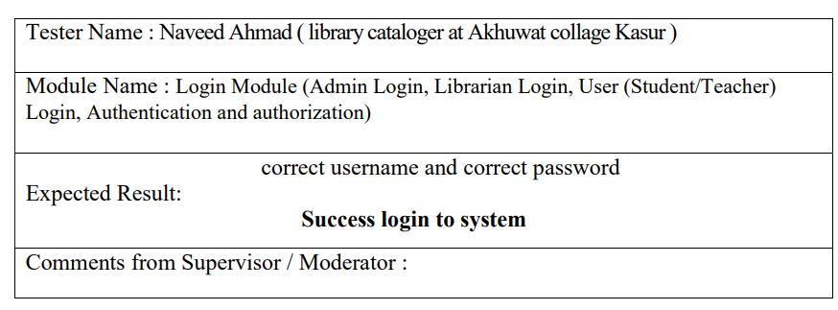
Test case for login

Slide 15
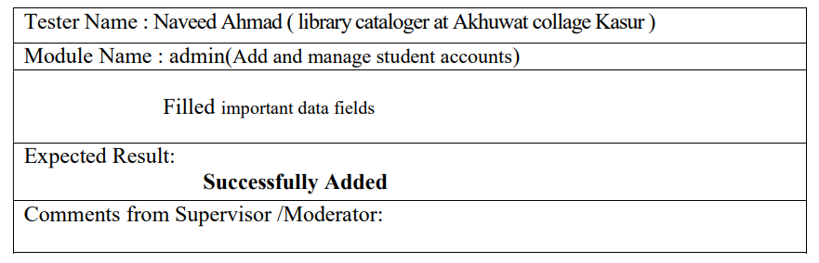
Test case for add user management

Slide 16
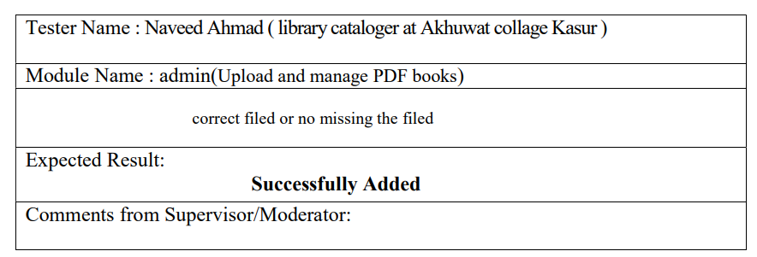
Test case for upload pdf book

Slide 17
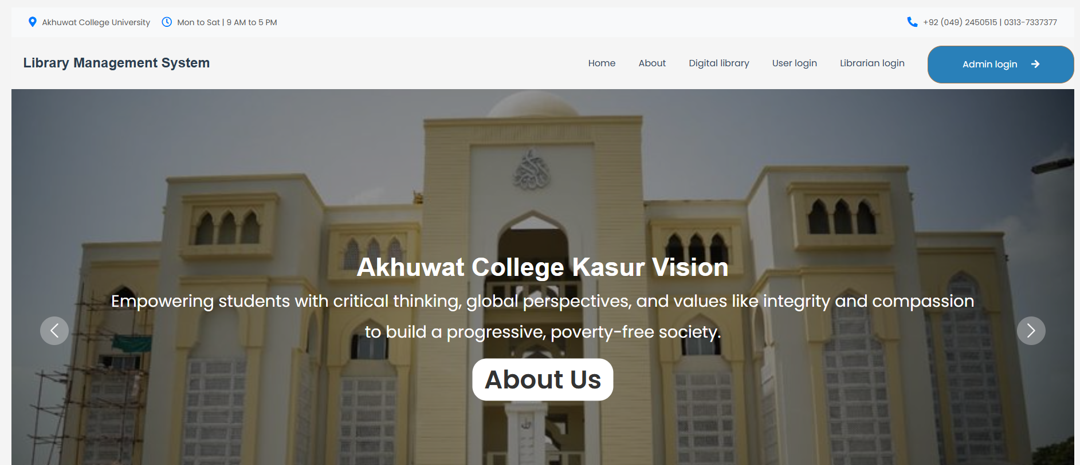
Project demo

Slide 18
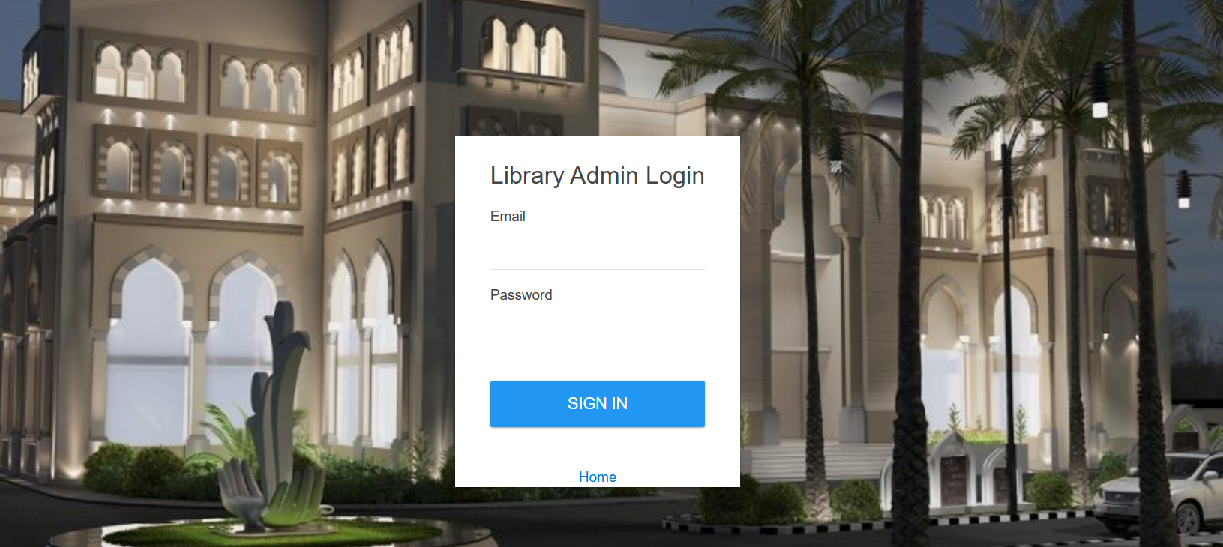
Project demo

Slide 19
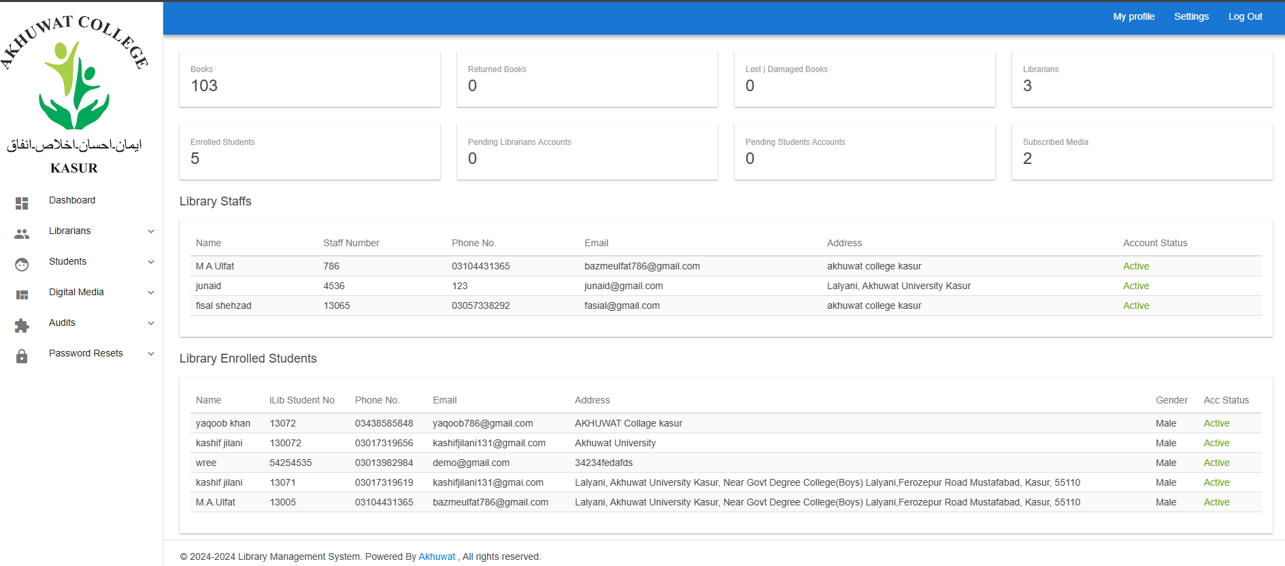
Project demo

Slide 20
Conclusion:
Successfully developed a web-based system with a user-friendly interface.
Implemented features such as real-time form validation, user role management, and secure login.
Optimized system performance, ensuring smooth and efficient management of library resources.
Achieved a high level of usability, making it easier for users to access and interact with library services.

Slide 21


