Slide 1
FINAL PROJECT TEMPLATE

Slide 2
THREAT SUMMARY
Summary of Situation: A new healthcare legislation was announced this morning that negatively impacts millions of patients around the world, and masses are outraged. Soon after the announcement, three different hospitals in our partner network were hit with ransomware attacks that shut down their entire operations. The FBI believes that this is not the last in the string of hits. All hospitals should be prepared for a potential attack. The hospitals have disclosed that each incident started with a user in the technology department opening an email attachment resource.
Asset: Control Systems, Patient Records, The Hospital Servers, Personal Documents, and files of Hospital log management systems.
Impact: Availability
Threat Actor: FIN4 Group and Internal threat actors which are also involved in this threat by clicking on the phishing link intentionally or unintentionally post reviewing the attack situation
Threat Actor Motivation: FIN4 is a financially-motivated threat group that has targeted confidential information related to the public financial market, particularly regarding healthcare and pharmaceutical companies, since at least 2013.
Common Threat Actor Techniques: FIN4 is unique in that they do not infect victims with typical persistent malware, but rather they focus on capturing credentials authorized to access email and other non-public correspondence.
Hint: Carefully check the ransom note for additional clues.

Slide 3
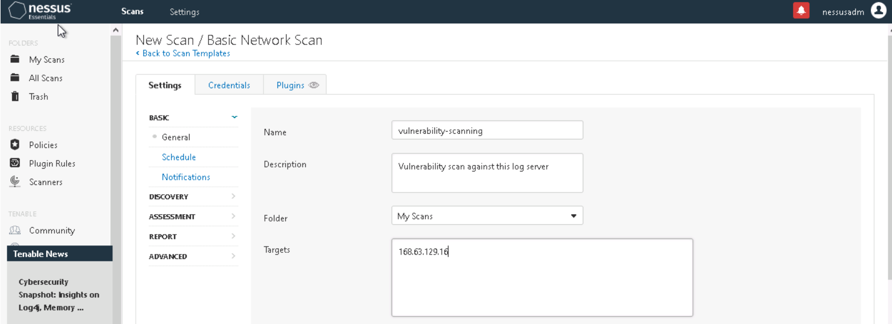

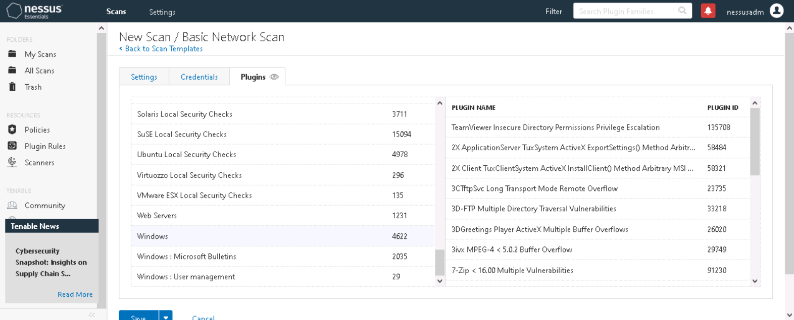
VULNERABILITY SCANNING TARGETS
Summary of scan targets:
Number of devices scanned: 1
Device type: Microsoft Windows 10 Pro – Version: 10.0.18363 Build 18363
Primary purpose of device: Windows system that may contain centralized log files and backups.

Slide 4
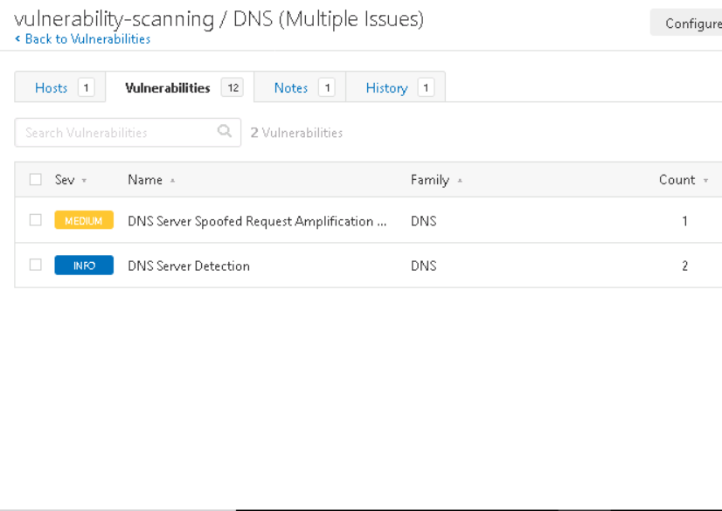
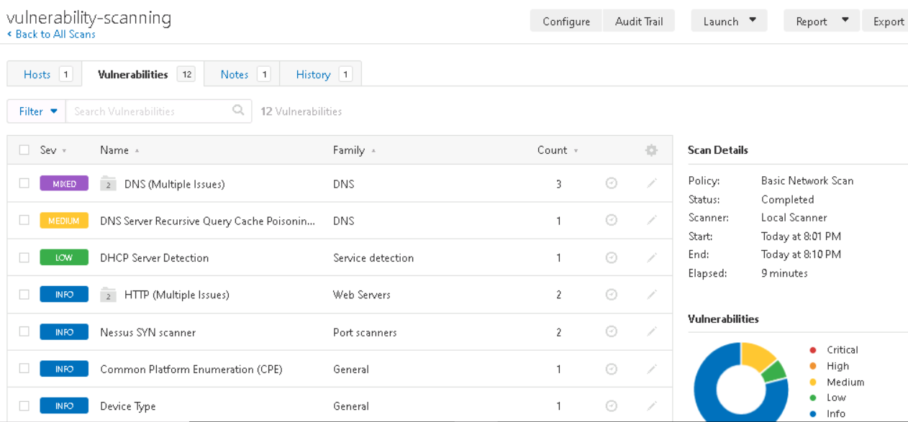
VULNERABILITY SCAN RESULTS
Summary of findings:
Total number of actionable findings: 3
Critical: 0
High: 0
Medium: 2
Low: 1

Slide 5
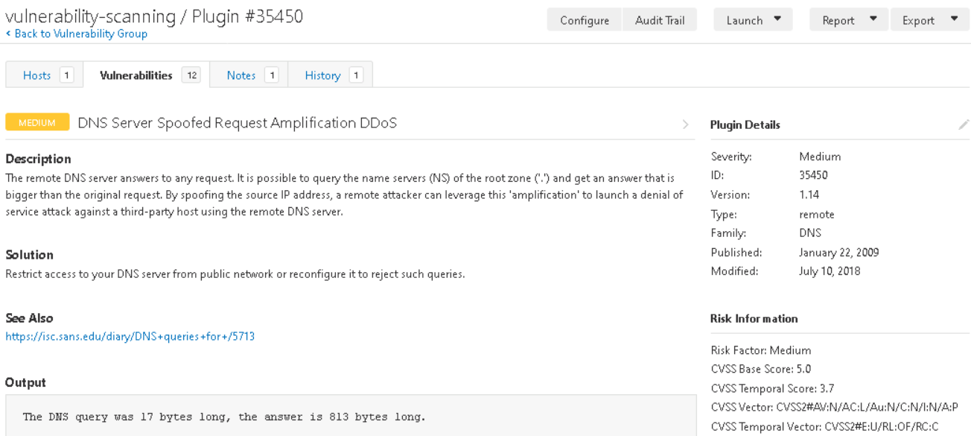
VULNERABILITY SCAN RESULTS

Slide 6
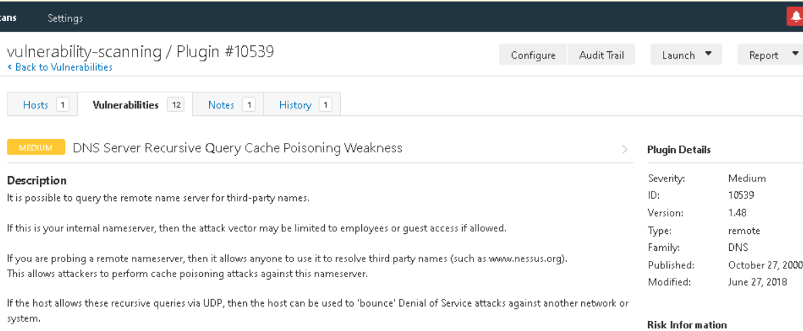
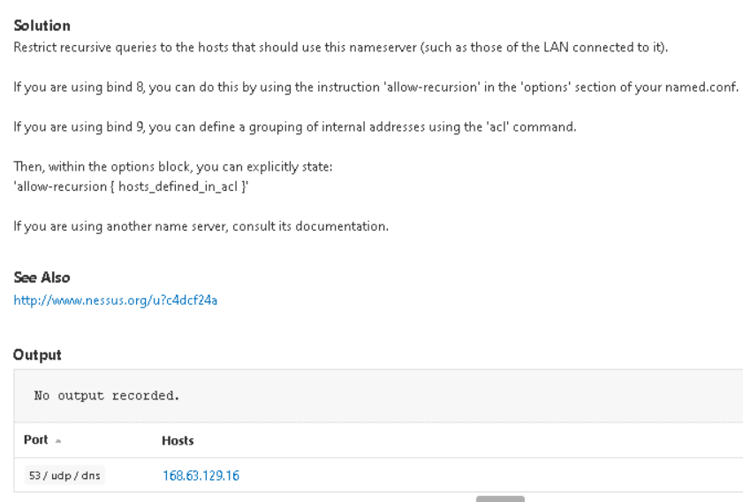
VULNERABILITY SCAN RESULTS

Slide 7
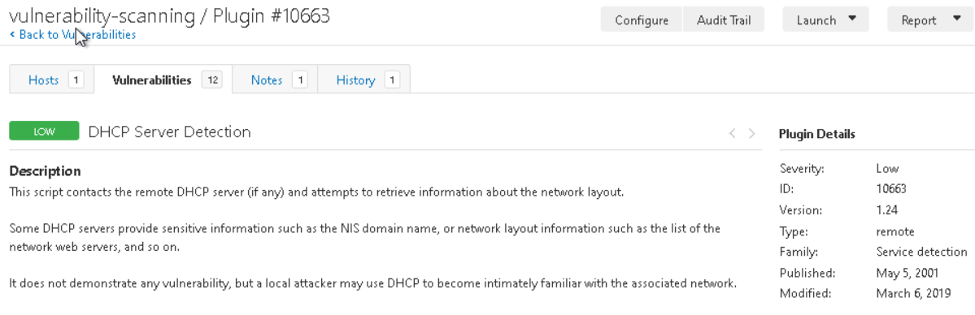
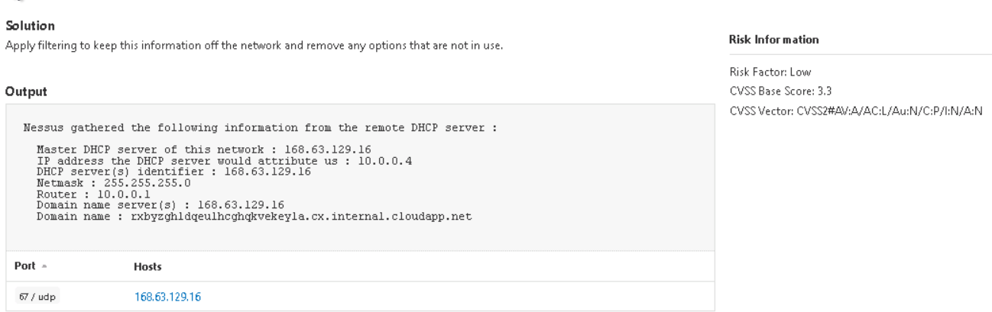
VULNERABILITY SCAN RESULTS

Slide 8
REMEDIATION RECOMMENDATION
Fix within 7 days
Finding | Severity Rating | Recommended Fix
DNS Server Spoofed Request Amplification DDoS | Medium | Restrict access to our DNS server from public network or reconfigure it to reject such queries.
DNS Server Recursive Query Cache Poisoning Weakness | Medium | Restrict recursive queries to the hosts that should use this nameserver (such as those of the LAN connected to it).
Fix within 30 days
We can fix both medium vulnerabilities in the first week and then fix the low vulnerability within thirty days.
Finding | Severity Rating | Recommended Fix
DHCP Server Detection | Low | Apply filtering to keep this information off the network and remove any options that are not in use.
Fix within 60 days
Finding | Severity Rating | Recommended Fix

Slide 9
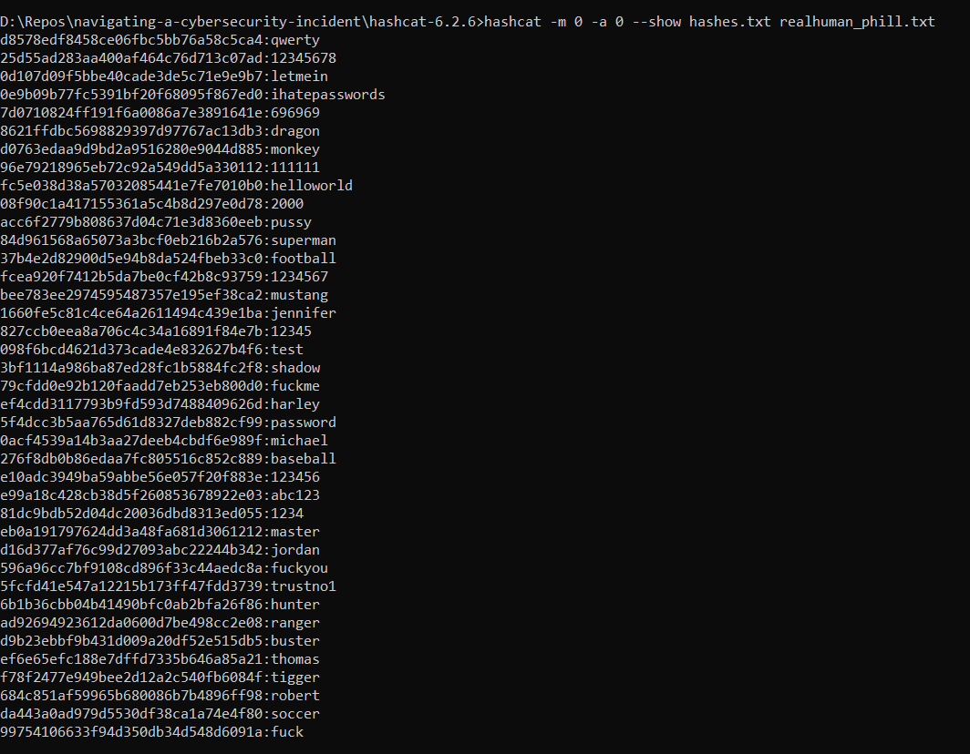
PASSWORD PENETRATION TEST OUTCOME
Methodology: Dictionary password attack using the HashCat tool.
Number of passwords tested: 40
Number of passwords cracked: 39
Command:
hashcat -m 0 -a 0 --show hashes.txt realhuman_phill.txt
Evidence of weak passwords:
Recommended steps to improve passwords security:
Long - at least 12 characters - Complex - Use numbers and special symbols - Passphrases are better - Not anything about you

Slide 10
INCIDENT RESPONSE PRELIMINARY ASSESSMENT
Summarize ongoing incident:
Several doctors, nurses, and administrative staff have called in noting that they are being asked to pay one million dollars in Bitcoin to access their systems. The control systems used to monitor patient stats are no longer available through the standard user interface. Some doctors report being unable to render treatments because they cannot view detailed information about patient status. security leader has declared this a critical security incident.
Document actions or notes from the following steps of the initial incident response checklist
Step 1: Document the entity who discovers the incident.
Several doctors, nurses, and administrative staff
Step 2: Determine if the incident should be escalated based on impact.
What is the indicator of compromise?
The control systems used to monitor patient stats are no longer available through the standard user interface.
What is the potential impact of the incident?
Some doctors report being unable to render treatments because they cannot view detailed information about patient status.
Name of system being targeted, the operating system, and the IP address.
Microsoft Windows 10 Pro – Version: 10.0.18363 Build 18363
IP: 168.63.129.16

Slide 11
INCIDENT RESPONSE PRELIMINARY ASSESSMENT
Incident response checklist
Step 3: Answer the following questions on triage.
Is the incident confirmed? Or an indicator of compromise that’s not yet verified?
Yes, confirmed.
Is the incident contained already or still in progress?
In progress.
Is the response urgent?
Yes, urgent.
Will any response alert the attacker and if so, do we care?
No, we won’t alert the attacker and we don’t care.
What type of incident is this? Example: virus, worm, intrusion
Ransomware.
Step 4: Is safety or human life at immediate risk?
Yes, human life is at immediate risk as the control systems used to monitor patient stats are no longer available through the standard user interface. Also, some doctors reported being unable to render treatments because they cannot view detailed information about patient status.
Step 6: Which category ticket should be opened and why?
Category one - A threat to public safety or life.
Because human life is at immediate risk.

Slide 12
INCIDENT RESPONSE RECOMMENDED ACTION
Summarize recommendation to contain, eradicate, and recover:
Isolate the infected systems from the rest of the network.
Take a copy of the ransomware malware as an evidence for analysis.
Format the infected systems.
Restore backups of the monitor systems and patients' health data so that doctors can continue their work as soon possible.
Documented actions and notes from the IR checklist
Step 7: Which applicable procedure should the IR team follow based on their understanding of the incident?
Malware response procedure
Step 8: Document whether you’re able to check the logs. If unable, document alternatives to understand what caused the incident.
If the system logs were not infected by the malware, we can review the system logs and check computer activities.
If they were infected, we can start interviewing witnesses to determine how the incident was caused

Slide 13
INCIDENT RESPONSE RECOMMENDED ACTION
Documented actions and notes from the IR checklist
Step 9: Which recommended changes should the IR team make to prevent the occurrence from happening again or infecting other systems.
Re-install the affected system(s) from scratch and restore data from backups if necessary. Preserve evidence before doing this.
Make users change passwords if passwords may have been sniffed.
Ensure the system has been hardened by turning off or uninstalling unused services.
Ensure the system is fully patched.
Be sure real time virus protection and intrusion detection is running.
Step 12: Review response and update policies—plan and take preventative steps so the intrusion can't happen again. Which updates do you recommend and why?
Consider whether an additional policy or technology could have prevented the intrusion.
We can use the following technologies:
EDR: Endpoint Detection and Response.
IPS: Intrusion Prevention System.
Was the incident response appropriate? How could it be improved?
It would be appropriate if we have very recent backups and restored them in time.
Were the incident-response procedures detailed and did they cover the entire situation? How can they be improved?
Yes, the procedures were details. We can improve them by keeping them up to date with the recent discovered security technologies and new malwares.
What changes can be made to prevent a re-infection?
We can harden our systems and educate the staff regarding how ransomwares infect systems.
What lessons have been learned from this experience?
I learned how to navigate a cybersecurity incident.

