Slide 1
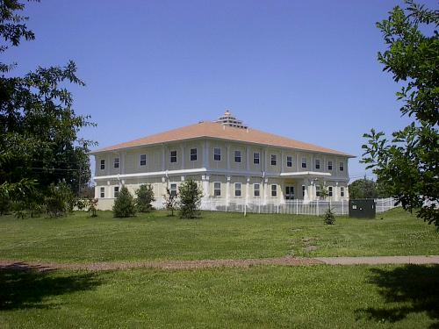

MAHARISHI UNIVERSITY of MANAGEMENT
Engaging the Managing Intelligence of Nature
Computer Science Department

Slide 2
© 2015 Maharishi University of Management, Fairfield, Iowa
All rights reserved. No part of this slide presentation may be reproduced or utilized in any form or by any means, electronic or mechanical, including photocopying or recording, or by any information storage and retrieval system, without permission in writing from Maharishi University of Management.

Slide 3
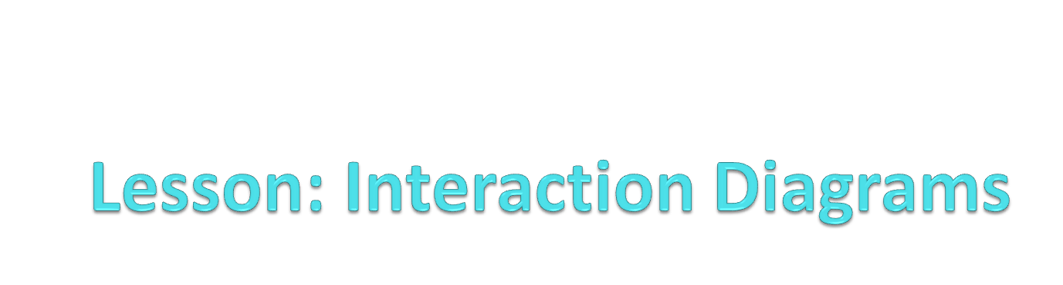
Appreciating Dynamism in Silence

Slide 4
Wholeness Statement
In an OO program, objects collaborate with other objects to achieve the objectives of the program. Sequence diagrams document the sequence of calls among objects for a particular operation. Object diagrams show relationships among objects and the associations between them; they clarify the role of multiple instances of the same class. The principle of propagation and delegation clarifies responsibilities of each class and its instances: Requests that arrive at a particular object but cannot properly be handled by the object are propagated to other objects; the task is said to be delegated to others. Finally, polymorphism makes it possible to add new functionality without modifying existing code (as per the Open-Closed Principle). In these ways, we use UML diagrams to capture the dynamic features of the system; representing dynamism in the form of a static map illustrates the principle that dynamism has its basis in, and arises within, silence.

Slide 5
Interaction Diagrams
Interaction diagrams describe how groups of objects collaborate in some behavior.
The UML defines several forms of interaction diagram, of which the most common is the sequence diagram.
Typically, a sequence diagram captures the behavior of a single scenario of a use case (like “deposit money”, “open account”, “calculate total price of an order”).
The diagram shows a number of example objects and the messages that are passed between these objects within the use case.

Slide 6
Interaction Diagrams: Overview
Sequence Diagrams
Object Diagrams
Delegation and Propagation
Polymorphism

Slide 7
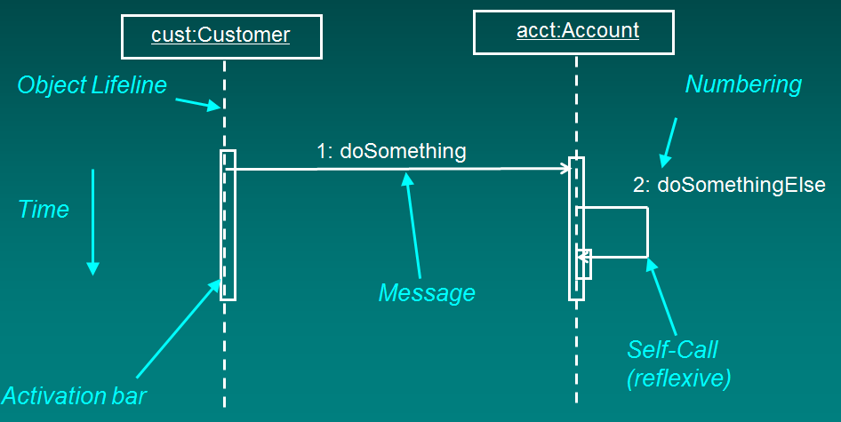
Anatomy of Sequence Diagram

Slide 8
Sequence Diagrams
A sequence diagram shows interaction between objects
  Horizontal arrows indicate calls (sending messages)
  Every arrow has a number, name
  Activation bars indicate method call duration
  Vertical dotted line shows lifetime of object
  Is a dynamic view of a scenario through a Use Case
  Typically, a sequence diagram begins with an action by an Actor. Subsequent steps occur as one object after another are accessed to accomplish the actor’s request

Slide 9
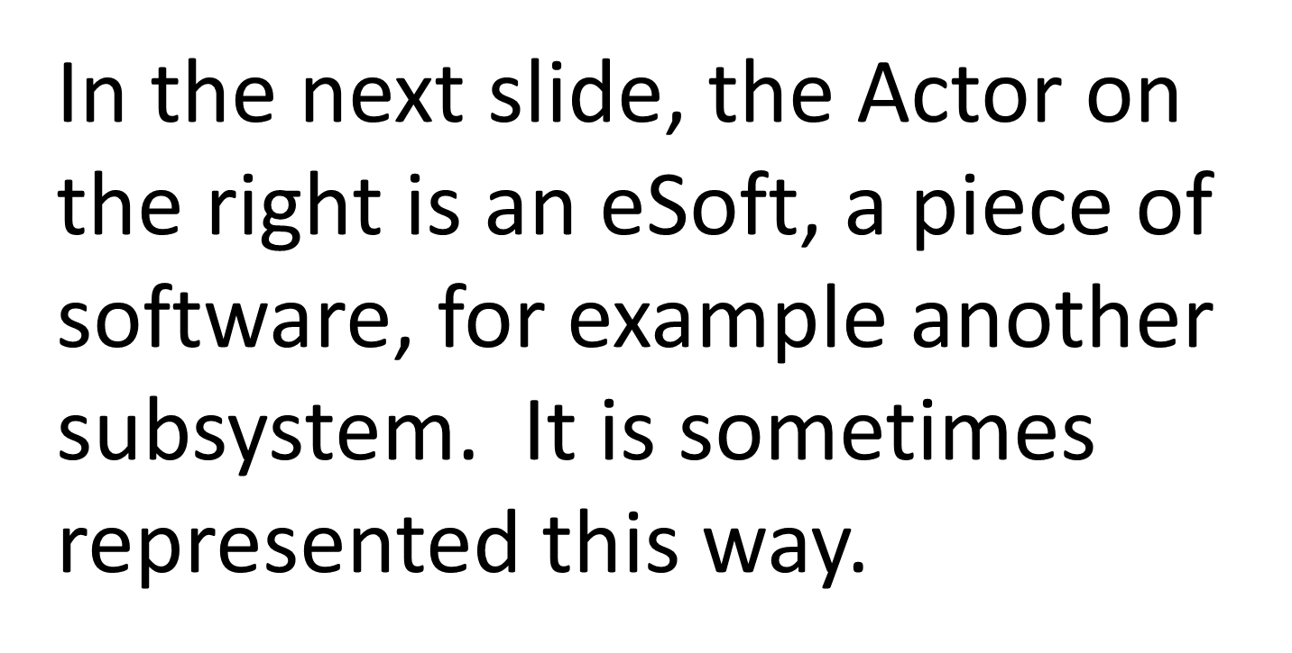
Notes:
ID Course Overview
Be sure to walk through this interaction diagram, emphasizing the responsibility allocation. Emphasize the application of the guidelines provided earlier.
Another option is to NOT show this slide immediately and to build the interaction diagram interactively with the students on the white board, demonstrating proper allocation of responsibility. When finished, you can compare the results with this slide.
Note: The use of “//” as the first two characters of the message name. This naming convention indicates that the operation is being used to describe the responsibilities of the analysis class and that these “analysis” operations WILL PROBABLY change/evolve in design).
k levi:
go through this quickly
on slide, then work
checkout book with
class--e.g., have them
start, then work out on
board? (make sure
have done on own first)

Slide 10
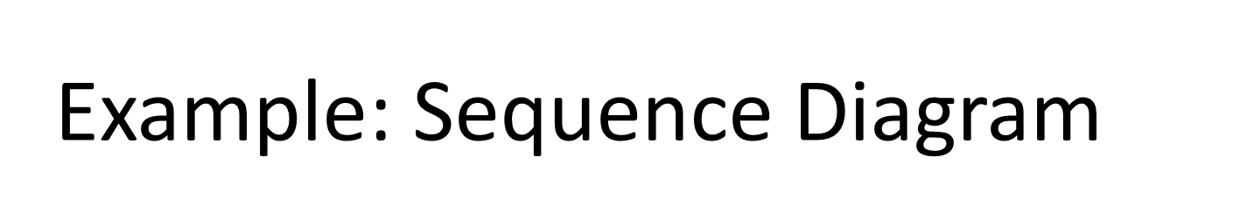
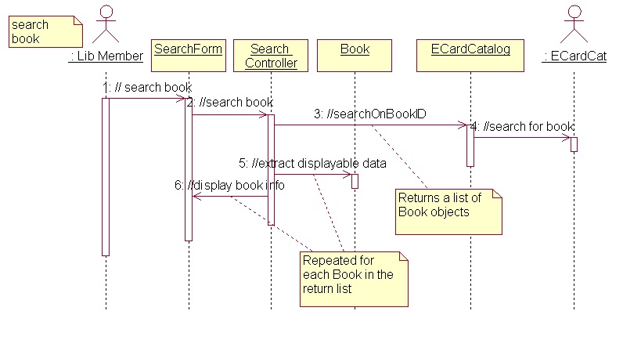
Notes:
ID Course Overview
Be sure to walk through this interaction diagram, emphasizing the responsibility allocation. Emphasize the application of the guidelines provided earlier.
Another option is to NOT show this slide immediately and to build the interaction diagram interactively with the students on the white board, demonstrating proper allocation of responsibility. When finished, you can compare the results with this slide.
Note: The use of “//” as the first two characters of the message name. This naming convention indicates that the operation is being used to describe the responsibilities of the analysis class and that these “analysis” operations WILL PROBABLY change/evolve in design).
k levi:
go through this quickly
on slide, then work
checkout book with
class--e.g., have them
start, then work out on
board? (make sure
have done on own first)

Slide 11
Real-World Example
We have an order and we are going to invoke a command on it to calculate its price.
To do that, the order needs to look at all the line items on the order and determine their prices, which are based on the pricing rules of the order line's products.
Having done that for all the line items, the order then needs to compute an overall discount, which is based on rules tied to the customer.

Slide 12
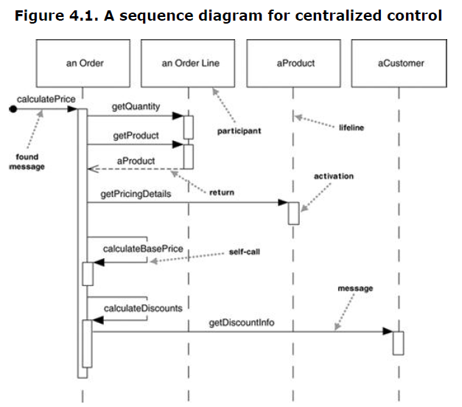
Centralized Control Solution

Slide 13
About the Diagram
Activation bars. These always mark the beginning and end of a “method call”
Actor not shown. In modeling full systems, actions are always initiated by an actor (could be person or system). However, to model only a portion of a system, a“point” is used as a starting point at the far left, as shown here, indicating some other object is initiating the action.
Indicating Loops: The sequence of messages getQuantity, getProduct, getPricingDetails, and calculateBasePrice needs to be done for each order line on the order, while calculateDiscounts is invoked just once.
How to show looping is occurring. There are several UML ways to do this:
  Use Notes. To indicate an operation is repeated, a simple note can be used.
  Use an Iteration Marker. Marking an operation with an asterisk (*) indicates that the operation repeats. This is an economical way, but gives no information other than a loop is occurring. [UML2 considers this approach to be deprecated – but it is still used sometimes anyway]
  Use an Interaction Frame. Introduced in UML2.0. An interaction frame marks off a piece of a sequence diagram to indicate that a loop is occurring there. One objection to this approach is that it makes the diagram harder to read – in this course we do not use interaction frames.

Slide 14
Centralized Control. Solutions in which there is one primary controlling class are often used for understanding a problem domain (during analysis), but during design, control is distributed so that different objects handle different parts of the scenario according to their responsibilities
Note: The processes of analysis and design are evolutionary processes . A class diagram in analysis may be bare at first and as the problem is studied, more and more information is shown. During analysis, the main concern is with domain classes. As we turn attention to design, additional classes and systems are introduced to facilitate the process of building a system. These are incorporated into our sequence and class diagrams.

Slide 15
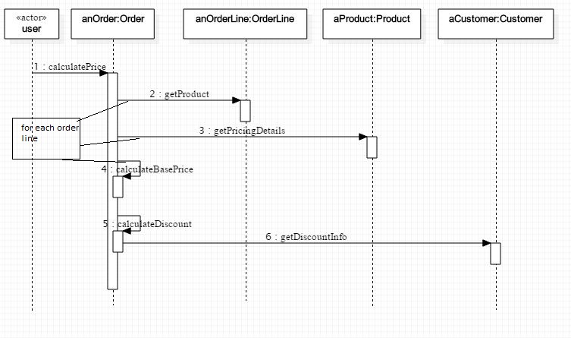
Showing Looping with Notes

Slide 16
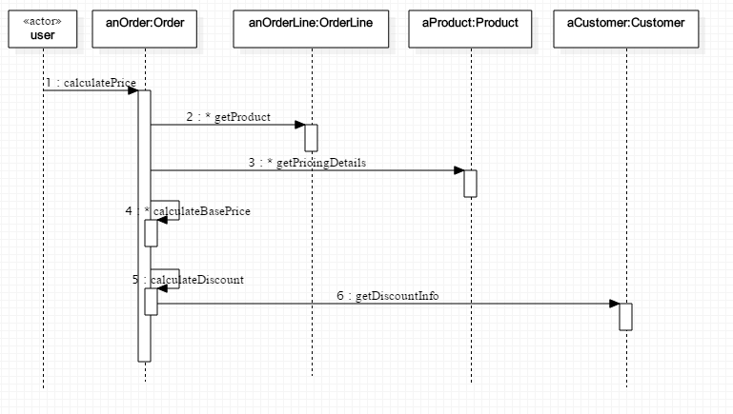
Showing Looping with Iteration Marker

Slide 17
About These Diagrams
The previous diagrams show two ways to indicate looping
They also show proper UML syntax for indicating objects along the top. The syntax is:
instanceName:className
Both can be included, or one or the other can be
dropped
They also show one of the ways to indicate that an Actor is initiating action, using the actor stereotype.
The StarUML modeling tool does not support the use of Notes – for this course, iteration markers will be sufficient.

Slide 18
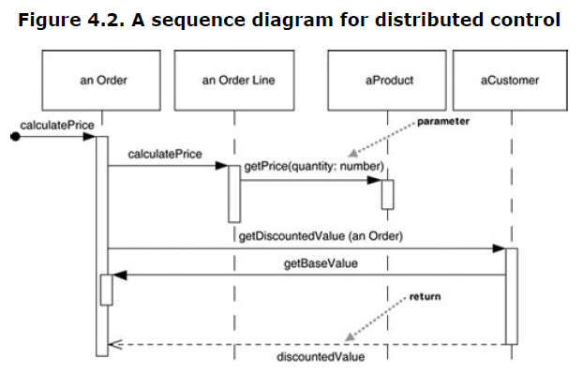
Distributed Control Solution

Slide 19
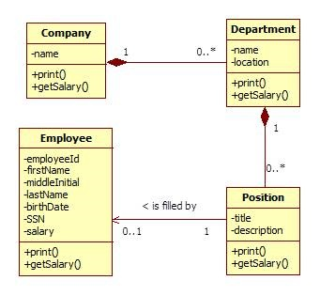
The Class Diagram

Slide 20
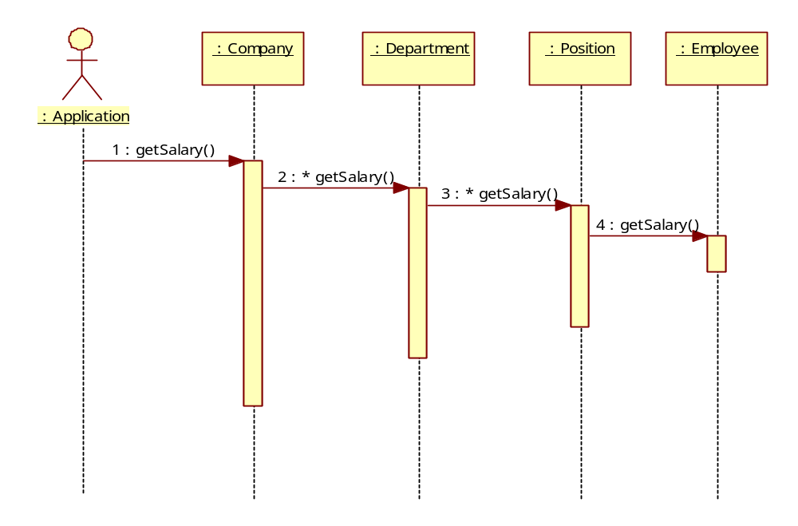
A Distributed Control Solution
Note: Here, the responsibility of computing salary is delegated to more and more fine-grained objects that carry out the task according to their own level of responsibility. Ultimately, the computation depends on each Employee salary. It is obvious and natural for control to be distributed in this case.

Slide 21
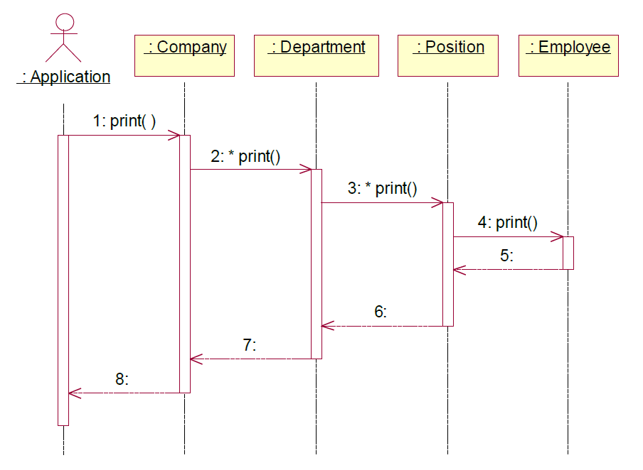
Return Arrows
Return arrows may be shown, optionally
When a return value makes the diagram more understandable, it is good to show it
Showing all return arrows is bad practice because it clutters the diagram
Sometimes a Note is used to indicate an important return value
The example here shows what a waste of space return arrows can be – and they do not add anything valuable
Bad use of returns

Slide 22
Main Point 1
Sequence Diagrams document the sequence of calls different objects (should) make to accomplish a specific task.
Likewise, harmony exists in diversity: Even though each object is specialized to only perform tasks related to itself, objects harmoniously collaborate to create functionality far beyond each object’s individual scope.
Tell class of SCI question on Midterm

Slide 23
Interaction Diagrams: Overview
Sequence Diagrams
Object Diagrams
Delegation and Propagation
Polymorphism

Slide 24
Object Diagrams
An object diagram is a snapshot of the objects in a system at a point in time.
Because it shows instances rather than classes, an object diagram is often called an instance diagram.
You can use an object diagram to show an example configuration of objects.
You can include all of the objects in the snapshot that are useful for understanding what you are trying to convey.

Slide 25
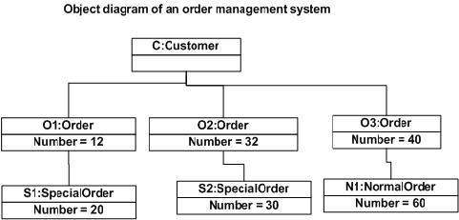
A very simple example from Joseph

Slide 26
Object Diagram Syntax
Underlining indicates it’s an object
Usually shows colon separated name and type
Associations in object diagrams don’t have multiplicities
Associations may or may not display an arrowhead
As in previous diagram, the state of each object is shown
Frank : Student
Advises
Mary : Student
Advises
Michael : Faculty
Advises
John : Student

Slide 27
Exercise
Create an object diagram that captures a scenario for the computeSalary problem.
Assume there is one instance
of Company, which
has two Departments,
each with two
positions, each filled
with one employee.
Invent salaries for
the employees.

Slide 28
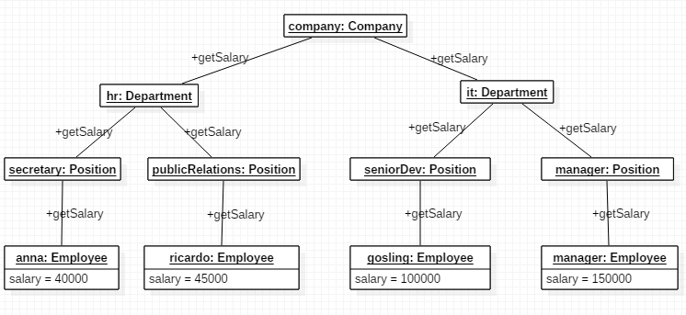
Solution

Slide 29
Main Point 2
Object Diagrams show the relationships between objects, where each object is an instance of a class, and each reference is represented by a single arrow or line.
This phenomenon illustrates the principle that the whole is greater than the sum of the parts: The objects (parts) on their own are not the important focus for an object diagram. What is important is how the objects relate; together, objects and their relationships form a whole that is more than just the sum of individual objects collected together.

Slide 30
Interaction Diagrams: Overview
Sequence Diagrams
Object Diagrams
Delegation and Propagation
Polymorphism

Slide 31
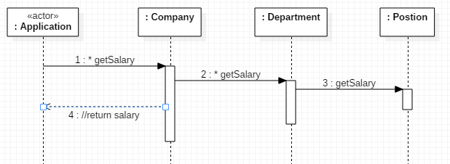
Delegation & Propagation
A class can express functionality in its interface, but it may delegate some or all of the responsibility to an associated class to carry out the action
The responsibility for the action can propagate through a hierarchy.

Slide 32
Main Point 3
OO Systems use delegation and propagation. An individual object only works with its own properties, acts only on what it knows, and then asks related objects to do what they know.
When individual actions are on the basis of self-referral dynamics, individual actions are automatically in harmony with each other because all arise from the dynamics of the single unified field.

Slide 33
Interaction Diagrams: Overview
Sequence Diagrams
Object Diagrams
Delegation and Propagation
Polymorphism

Slide 34
Polymorphism
Polymorphism = many forms
  Objects of a particular type can take different forms
  Achieved through dynamic binding (late binding)
  Implies that a type has subtypes (extends, implements)
Account act = new CheckingAccount();
act.toString();
CheckingAccount
The method call first checks
the class of the actual object
to find a toString() method;
if not found, it checks suc-
cessive superclasses, rising
finally to Object
Account
Object Class

Slide 35
Late Binding
Binding is the connection of a method call to a method implementation.
Late binding, or dynamic binding, occurs at run-time.
  the JVM method-call mechanism finds the correct method body and invokes it at run-time.
    by traversing the inheritance chain, starting at the runtime type of the object
  late binding is the implementation mechanism that makes polymorphism work
Notes:
Private methods have early binding because they are implicitly final, they can never be overwritten, so, no polymorphism!

Slide 36
Early Binding
Static, private, final methods are bound to the correct method body at compile time – this is called early binding.
Static methods. When a call is made to a static method, the method body may not be in the current class – it may be in a super class or some more distant ancestor. The compiler will climb the inheritance chain till it finds the first occurrence of an implemented version of the method and creates the binding
Private methods. When a private method is called on an object of type A, there is no possibility it was overridden in a subclass, and because of the visibility rules for overriding, it could not have been inherited from a superclass. The binding is uniquely determined in this case
Final methods. When a final method is called, it could not have been overridden in a subclass. The compiler climbs the inheritance chain till it finds the first place where this method has an implementation and performs the binding to that one.

Slide 37
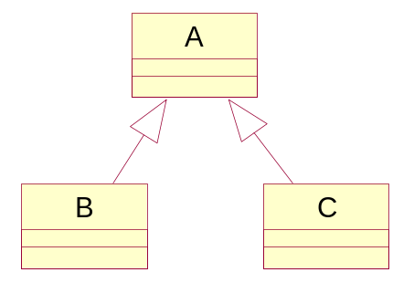
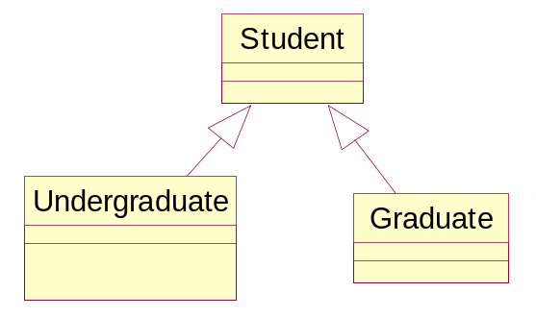

Static Typing
Objects of type B or C can be cast as type A
public class Student { ... }
public class Undergraduate extends Student { ... }
public class Graduate extends Student { ... }
Student st1, st2, st3;
Graduate st4;
st1 = new Student();
st2 = new Undergraduate();
st3 = new Graduate();
st4 = new Student();
Where is the Compiler Error?

Slide 38
(continued)
Objects of type B or C can be cast as type A
public class Student { ... }
public class Undergraduate extends Student { ... }
public class Graduate extends Student { ... }
Student st1, st2, st3;
Graduate st4;
st1 = new Student();
st2 = new Undergraduate();
st3 = new Graduate();
st4 = new Student(); //error
NOTE: In the first three cases, the Student class
is the static type of the object created. The runtime types
are, respectively, Student, Undergraduate, and
Graduate.

Slide 39
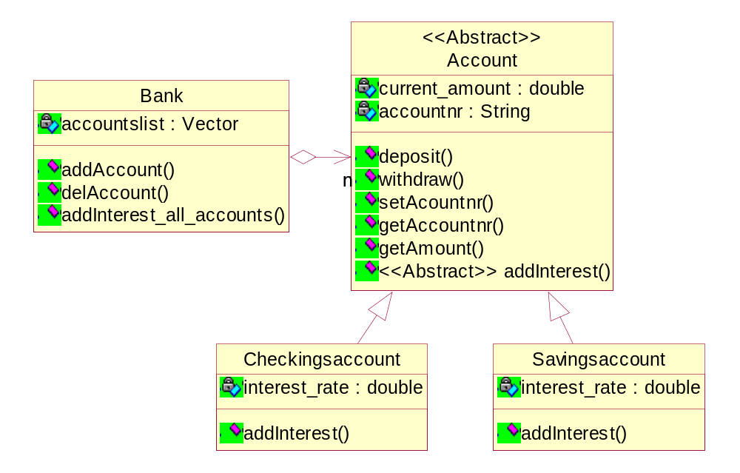
Polymorphism Example

Slide 40
public abstract class Account {
private double current_amount;
private String accountnr;
public void deposit(double amount) {
current_amount += amount;
}
public void withdraw(double amount) {
current_amount -= amount;
}
public void setAccountnr(String anr) {
accountnr = anr;
}
public String getAccountnr() {
return accountnr;
}
public double getAmount() {
return current_amount;
}
public abstract void addInterest();
}
public class CheckingAccount extends Account {
private double interest_rate = 0.01;
@Override
public void addInterest() {
deposit(getAmount() * interest_rate / 2);
}
}
public class SavingsAccount extends Account {
private double interest_rate = 0.0425;
@Override
public void addInterest() {
deposit(getAmount() * interest_rate);
}
}

Slide 41

public class Bank {
private Map<String, Account> accounts =
new HashMap<String, Account>();
public void addInterest_all_accounts() {
for (Account a : accounts.values()) {
a.addInterest();
}
}
public void addAccount(String type, String accountnr) {
Account account;
if (type.equals("checking")) {
account = new CheckingAccount();
} else {
account = new SavingsAccount();
}
account.setAccountnr(accountnr);
accounts.put(accountnr, account);
}
public void delAccount(String accountnr){
accounts.remove(accountnr);
}
}
P2I
Polymorphism

Slide 42
public class BankApp {
public static void main(String[] args) {
Bank mybank = new Bank();
mybank.addAccount("checking", "1");
mybank.addAccount("checking", "2");
mybank.addAccount("savings", "3");
mybank.addInterest_all_accounts();
}
}

Slide 43
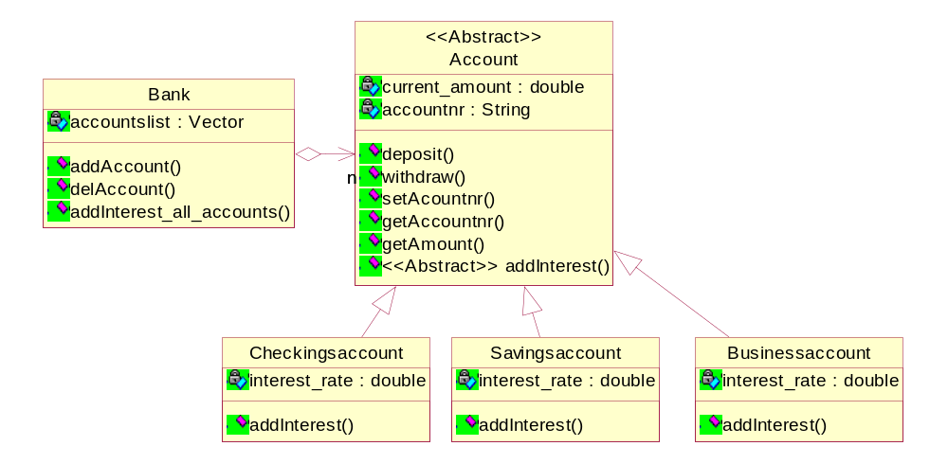
Why do we want polymorphism?
It allows us to extend our program with new features without changing existing (already tested)code.

Slide 44
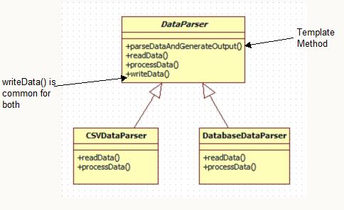

Polymorphism and the Template Method Pattern
Sometimes a class at the top of an inheritance hierarchy needs to carry out a sequence of tasks, some of which need to be implemented by subclasses. This situation is an example of the Template Method Design Pattern

Slide 45
Define the skeleton of an algorithm in an operation, deferring some steps to client subclasses. Template Method lets subclasses redefine certain steps of an algorithm without changing the algorithm's structure.
Base class declares algorithm 'placeholders', and derived classes implement the placeholders.

Slide 46
Open-Closed Principle
Software should be designed so that it is open for extension, but closed for modification.
All systems change during their life cycle, but when a single change results in a cascade of changes, the program becomes fragile and unpredictable. When requirements change, you implement these changes by adding new code, not by changing old code that already works.
Software modules can never be 100% closed for modification. Programmer has to decide what aspects should be closed.

Slide 47
Main Point 5
Polymorphism supports use of the Open-Closed Principle: The part of our code that is established and tested is closed to modification (change), but at the same time the system remains open to changes, in the form of extensions (adding new child classes).
In a similar way, progress in life is vitally important, and progress requires continual change and adaptation. But change stops being progressive if it undermines the integrity of life. Adaptability must be on the ground of stability.

Slide 48
Summary
Today we looked at modeling Object Collaboration and the uses of Polymorphism.
Sequence diagrams document the sequence of method calls between objects
Object diagrams show the relationships between objects. It is important to know how a class diagram translates into an Object Diagram (take a snapshot)
The OO tools of association, delegation, propagation, and polymorphism allow us to build software solutions that reflect accurately the system we are modeling and are efficient, flexible and extensible.

Slide 49
Connecting the Parts of Knowledge With the Wholeness of Knowledge
Sequence Diagrams and Object Diagrams both show how objects relate to each other.
To preserve encapsulation, objects should only act on their own properties, and to accomplish tasks that are the responsibility of other objects, they should send messages (delegation)
Transcendental Consciousness: by its very nature, has the fundamental association of self-referral – the Self being aware of the Self
Impulses Within The Transcendental Field: These impulses are totally within the Transcendental field, the Transcendent interacting with itself
Wholeness moving within itself: In Unity Consciousness one feels intimately associated with all other things in creation as a result of perceiving all things in terms of one’s Self

