Slide 1
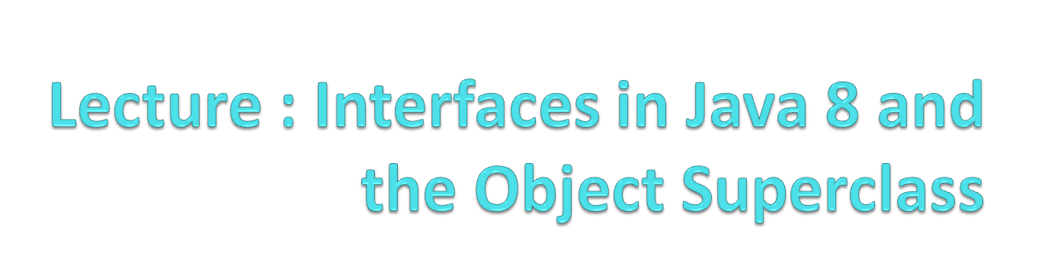

Slide 2
Wholeness Statement
Java supports inheritance between classes in support of the OO concepts of inherited types and polymorphism. Interfaces support encapsulation, play a role similar to abstract classes, and provide a safe alternative to multiple inheritance. Likewise, relationships of any kind that are grounded on the deeper values at the source of the individuals involved result in fuller creativity of expression with fewer mistakes.

Slide 3
Overview
Java 8 introduces many new features in interfaces and applications of these features to the collections library
The Object class is the superclass of all Java classes. It offers several important methods (usable by any Java class), but to be useful, they must be overridden (in the right way)

Slide 4
Java 8 Features of Interfaces
Before Java 8, none of the methods in an interface had a method body; all were unimplemented.
In Java 8, two kinds of implemented methods are now allowed: default methods and static methods. Both can be added to legacy interfaces without breaking code.

Slide 5
  A default method is a fully implemented method within an interface, whose declaration begins with the keyword default
  A static method in an interface is a fully implemented static method having the same characteristics as any static method in a class.

Slide 6
New Programming Style
Default Methods in an interface eliminate the need to create special classes that represent a default implementation of the interface.
Examples from pre-Java 8 of default implementations of interfaces: WindowListener / WindowAdapter,
List / AbstractList.
Now, in developing new code, it is possible in many cases to place these default implementations in the interface directly.
Static Methods in an interface eliminate the need to create special utility classes that naturally belong with the interface.
Examples from pre-Java 8 of how interfaces sometimes have companion utility classes (consisting of static methods):
Collection / Collections.
Path / Paths.

Slide 7
Solution to Evolving API Problem
When you need to add new methods to an existing interface, provide them with default implementations using the new Java 8 default feature. Then
  legacy code will not be required to implement the new methods, so existing code will not be broken
  new functionality will be available for new client projects.

Slide 8
Other Uses
First Set of Examples:
enums can now “inherit” from another type
Second Set of Examples:
forEach – default method in Iterable

Slide 9
First Set of Examples:
Review of Enums
An enumerated type is a Java class all of whose possible instances are explicitly enumerated during initialization.
Example:
public enum Size { SMALL, MEDIUM, LARGE};
//usage:
if(requestedSize==Size.SMALL)
applyDiscount();
The enum Size (which is a special kind of Java class) has been declared to have just three instances, named SMALL, MEDIUM, LARGE.

Slide 10
Review of Enums
Two important applications for enums:
Provide a list of related “constants” for an application
  Weak programming practice: Create a class (or interface) containing constants, stored as public static final values
  Problem. No compiler control over usage of constants
  Better approach when constants are related to each other: Represent constants as instances of an enumerated type.

Slide 11
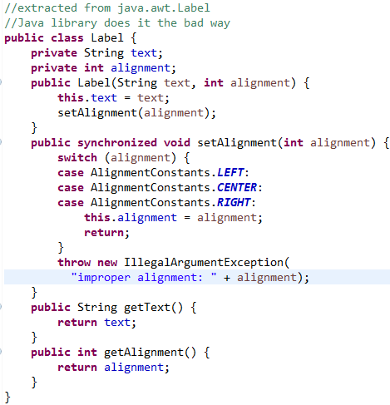
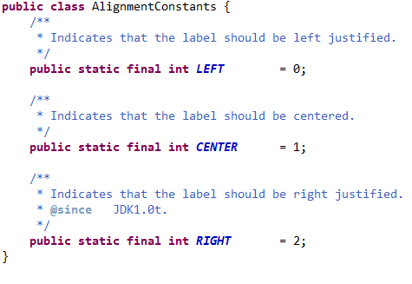
Example: Improve style of managing constants with enums
In the java.awt package there is a class Label, used to represent a label in a UI (built from the old AWT). It makes use of constants to designate alignment properties: left, center, right. This use of constants is flawed, but it is a commonly used style

Slide 12
Problem: No compiler control over use of these constants. Could make the following call:
Label label = new Label(“Hello”, 23);
You won’t know till you run the code that “23” is meaningless. The compiler sees that a value of the correct type has been used, but 23 should not be used here.
It is better to control the values passed in with the help of the compiler. This is accomplished using an enum to store constants, rather than collecting together a bunch of public static final integers.

Slide 13
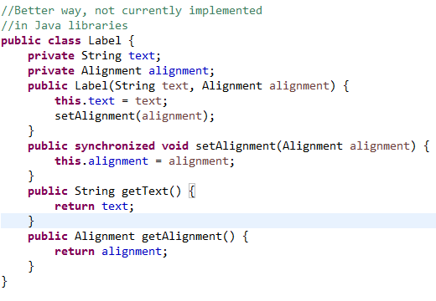
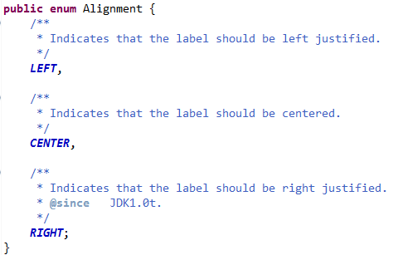
Improved Label Using enums
See the demo: lesson7.lecture.enums.*

Slide 14
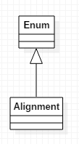
Review of Enums
In the example, each of the instances declared within the Alignment enum has type Alignment, which is a subclass of Enum. Therefore
  Alignment is itself a class
  Alignment may not inherit from any other class ( since there is no multiple inheritance).

Slide 15
Second Set of Examples: forEach
The Iterable interface is part of the Collections API that is implemented by all collection classes, and supports iteration through a collection
The only abstract method in Iterable is iterator(), which returns an Iterator
Iterator has two abstract methods:
  hasNext()
  next()
When a class (even user-defined) implements the Iterable interface, the “for each” construct can be used (and of course, an instance of Iterator is available).

Slide 16
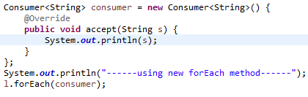

New (Java 8) in the Iterable interface is a default method:
forEach
Sample usage:
Output:
Review inner classes

Slide 17
The forEach method applies the Consumer method accept to each element of the list.
In this example, the accept method just prints the value to the console.
Consumer is a new interface in Java 8, with just one abstract method accept, which accepts a single argument and produces no return value.

Slide 18
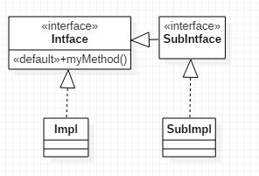
Rules for Default Methods in an Interface
If a class implements an interface with a default method, that class inherits the default method (or can override it).
Potential clash if
  two interfaces have the same method, or
  one interface and a superclass have the same method

Slide 19
Interface vs Interface – clash! When two interfaces each have a method with the same signature:
  If one of these is a default method, any implementer of both interfaces must override the method (or declare it as an abstract method) – can’t simply do nothing.
  If one of these is a default method, any subinterface of both interfaces must provide a default method (i.e. an implementation) of this method, or declare the method (even if unimplemented). (This rule requires no special effort.)
  Note: Even in Java 7, it is not possible to implement two interfaces each of which has a method with the same signature but different return types.

Slide 20
Superclass vs Interface – superclass wins! When a class extends a superclass and also implements an interface, and both super class and interface have a method with the same name, the superclass implementation wins – this is the version that is inherited by the class. The subclass/implementer is not required to override the shared method.

Slide 21
Static Methods Do Not Clash
Static methods defined in an interface are not inherited by implementers (this differs from the behavior for subclasses of a class)
Therefore, if two interfaces implement static methods with the same signature, there is no clash to address when a class implements these interfaces.
Static methods can always be accessed in a static way in such cases, but it is not related to inheritance.

Slide 22
Main Point 1
Interfaces are used in Java to specify publicly available services in the form of method declarations. A class that implements such an interface must make each of the methods operational. Interfaces may be used polymorphically, in the same way as a superclass in an inheritance hierarchy. Because many interfaces can be implemented by the same class, interfaces provide a safe alternative to multiple inheritance. Java 8 now supports static and default methods in an interface, which make interfaces even more flexible: For instance, new public operations can be added to legacy interfaces without breaking code (as was done with the forEach method in the Iterable interface).
The concept of an interface is analogous to the creation itself – the creation may be viewed as an “interface” to the undifferentiated field of pure consciousness; each object and avenue of activity in the creation serves as a reminder and embodiment of the ultimate reality.

Slide 23
Overriding Methods in the Object Class
The Object class is the superclass of all Java classes, and contains several useful methods
-- in most cases, they are useful only if they are overridden.
  toString
  equals
  hashCode
  clone

Slide 24
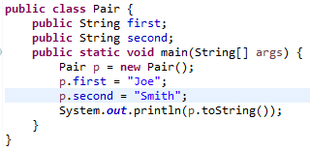
The toString() Method
Every class automatically is equipped with a toString method (by inheritance), but the default implementation simply prints out the class name followed by a code for a memory location.
Example:
(Useless) output: tostring.Pair@19e0bfd

Slide 25
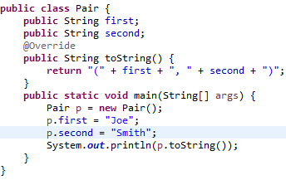
When toString() is overridden, it is possible to capture the state of the current instance of the class and send it to a log file or to the console. This can help in solving a problem after the code has been released, and in debugging during development. Note the @Override annotation.
Output: (Joe, Smith)

Slide 26

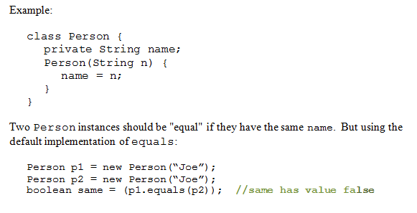
Overriding equals()
Default implementation in Java is same as ==

Slide 27
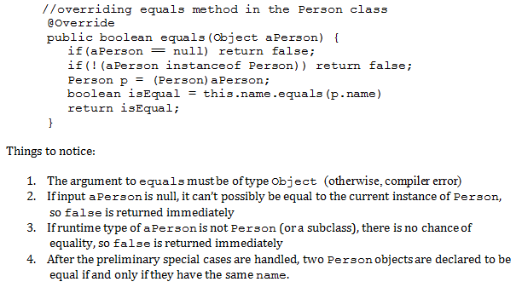
Correct Way to Do It

Slide 28
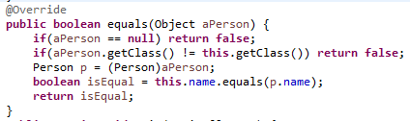
Alternative Approach
To check that the aPerson object is of the right type we used instanceof operator. This is called the instance-of strategy for overriding equals.
An alternative is to call getClass on aPerson to see if it matches the value of getClass for the current object, called the same-classes-strategy for overriding equals

Slide 29
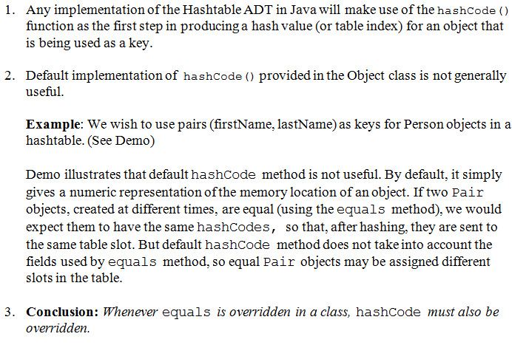
Overriding hashCode()

Slide 30
hashCode() Rules
To use an object as a key in hashtable,
  you must override equals() and hashCode()
  the class on which object is based should be immutable
If k₁,k₂ are keys and k₁.equals(k₂) then it must be true that [k₁.hashCode() == k₂.hashCode()]
This means that you must include the same information in your hashCode definition as you include in your implementation of equals.

Slide 31
Writing hashCode is one line!
int hashCode()
{ return Objects.hash(variable1, var2, etc.)
}
If only one variable is used then do :
int hashCode()
{ return variable1.hashCode();
}

Slide 32
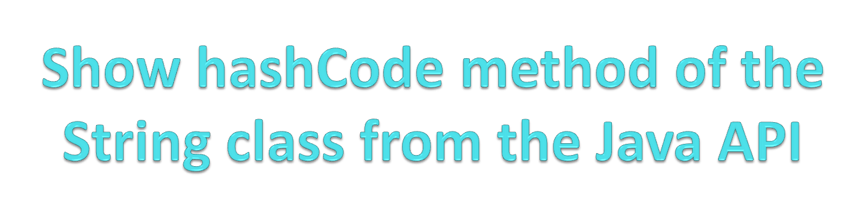

Slide 33
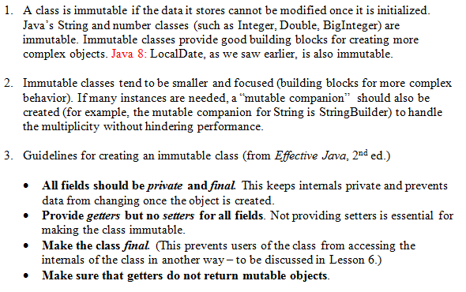
Review: Making Your Classes Immutable

Slide 34
Do the clone() method with:
(See the other file) class Employee
{String name; double salary;
Date hireDate;

Slide 35
Main Point
All classes in Java belong to the inheritance hierarchy headed by the Object class.
Likewise, all individual consciousnesses inherit from the single unified field.

Slide 36
Connecting the Parts of Knowledge With the Wholeness of Knowledge
Inheritance in Java makes it possible for a subclass to enjoy (and re-use) the features of a superclass.
All classes in Java – even user defined classes – automatically inherit from the class Object
Transcendental Consciousness is the field of pure awareness, beyond the active thinking level, that is the birthright and essential nature of everyone. Everyone “inherits” from pure consciousness
Impulses Within the Transcendental Field: These infinitely diverse impulses which create the whole universe, flow within the one holistic field of pure consciousness, transcendental consciousness
Wholeness moving within itself: In Unity Consciousness, there is an even deeper realization: The only data and behavior that exist in the universe is that which is “inherited from” pure consciousness – everything in that state is seen as the play of one’s own consciousness.

