Slide 1
HCI & Computer Graphics (CSC-2079L)

Slide 2
Semester Project
Title:
CubeLand (3D Open-World Terrain using OpenGL)

Slide 3
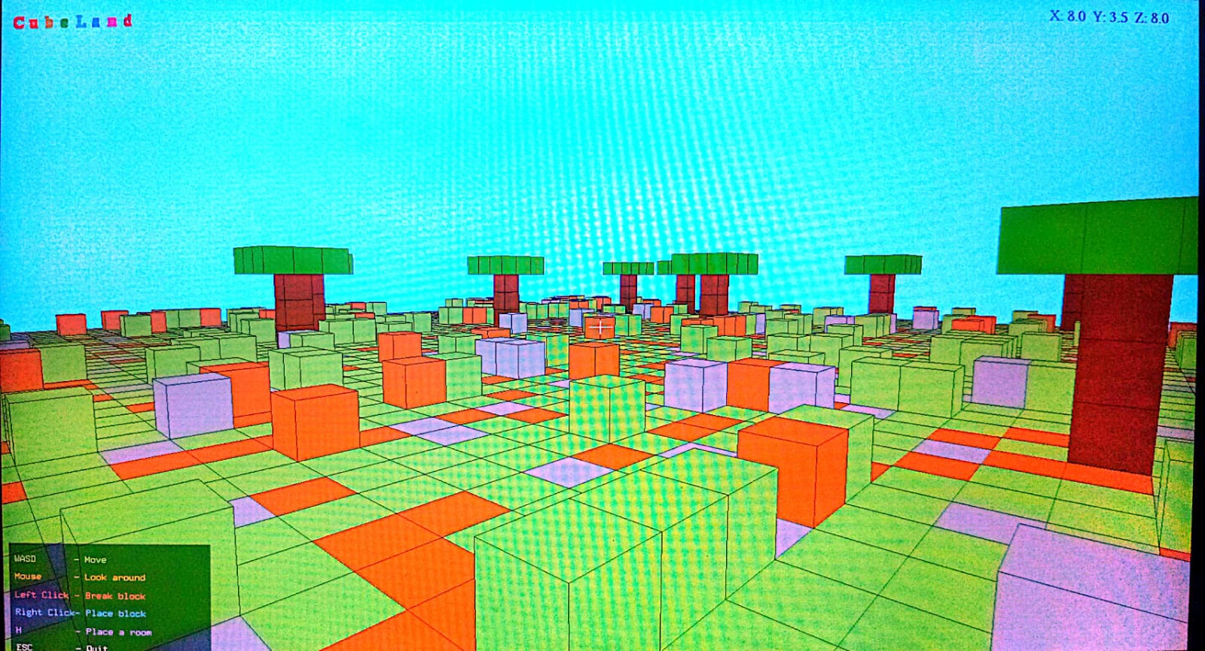
Main Interface

Slide 4
Tools Used:
VS Code
OpenGL
C++
Libraries Used:
Glfw3
Glu
Glut
Cmath
Ctime
cstdio

Slide 5
Key Features:
Blocky Theme
Trees
Player can move (WASD)
Player can Look Around(Mouse)
Player can place rooms (H)
Player can place Blocks (Right Click)
Player can delete Blocks (Left Click)
XYZ Coordinates (Top Right)

Slide 6
Extra Tweaks (Hardcoded):
We can change size of world (100)
We can change how much pixels to render (100)
We can change sensitivity of mouse (0.1) and WASD movement (7.0)
We can change structure of Room
We can change number of trees in terrain (25)
We can change player speed (7.0)
We can change default height of Camera (1.5)

Slide 7
Computer Graphics Concepts Used:
Translation
Pivot Point Concept
Yaw
Pitch
Flat Shading
Ambient Lighting (0.3 intensity)
Diffused Lighting (1.0 intensity)

Slide 8
Lighting Equation:
I = Iₐ·kₐ + I_d·k_d·(N̂·L̂) + I_s·k_s·(R̂·V̂)ⁿ
Put Iₐ = 0.3, I_d = 1.0, I_s = 0
I = (0.3)(kₐ) + (1.0)(K_d)(N̂·L̂) + 0
Where,
kₐ = K_d = Block’s Colour
N̂·L̂ = Dot Product of Face normal and Direction to Light

Slide 9
Basic Process
The Basic Building Block of everything is a Cube
First design a drawCube function, then:
Call it in drawTerrain with X, Y, and Z coordinates and color in RGB
Call it in drawTree with X, Y, and Z coordinates and color in RGB
Call it in drawRoom with X, Y, and Z coordinates and color in RGB
Call it in placeBlock with X, Y, and Z coordinates and color in RGB

Slide 10
Rendering PipeLine
Clear Screen
Camera View Setup
Start 3D mode
Draw World including terrain, trees, blocks, rooms
Switch to 2D Mode
Draw Text and Crosshair
Swap Buffers
Poll Events for mouse and keyboard

Slide 11
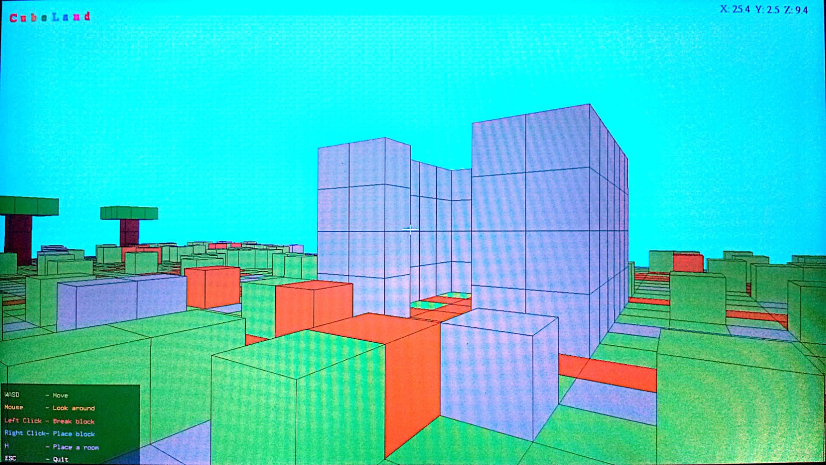
Place Room (H)

Slide 12
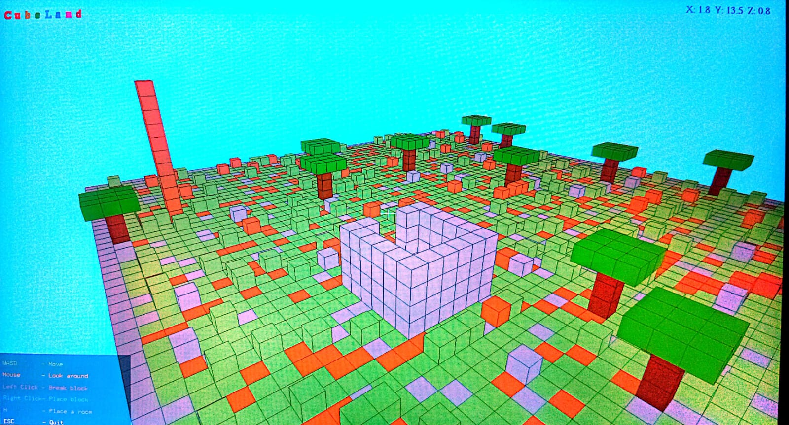
Top View

Slide 13
Thank you

