Slide 1
AMIRIS Germany2027
Progress Report: From Brainpool's 2027 Data to a Calibrated Model
Muideen Oladayo Ajiboye | 17 August 2026

Slide 2
Executive Summary
• Built a full AMIRIS Germany2027 scenario from Brainpool's real 2027 data (capacities, demand, fuel/carbon prices)
• Refined the demand model (V1 -> V2) and added cross-border imports
• Obtained Brainpool's own real 2027 hourly price forecast and ran the first AMIRIS-vs-Brainpool comparison
• First result looked alarming: AMIRIS's average price was 3-7x higher than Brainpool's
• Diagnosed the real cause, fixed it, and calibrated it - AMIRIS's price forecasts now land close to Brainpool's own numbers
Build | Shortage hours (before -> after) | Mean price (before -> after)
V1, with-import | 11.78% -> 0.83% | 400.04 -> 75.46 EUR/MWh
V2, with-import | 5.35% -> 0.03% | 219.81 -> 57.34 EUR/MWh
Brainpool's own real 2027 forecast | 0.00% (reference) | 68.04 EUR/MWh (reference)
AMIRIS Germany2027 Progress | 2

Slide 3
Roadmap of This Work
1. Resolve data gaps in Brainpool's 2027 Excel data
2. Build V1 (BDEW demand, no import) - find and fix 2 real bugs
3. Produce full build documentation (PDF + Word + Q&A)
4. Build V2 (component-split demand) - refine the demand model
5. Add cross-border imports (ImportTrader) to both demand versions
6. Obtain Brainpool's real 2027 price and run the first comparison
7. Diagnose the shortage-hour / import-timing mismatch
8. Fix the import model and calibrate it against Brainpool's real price
AMIRIS Germany2027 Progress | 3

Slide 4
The Four Model Versions
Two demand models x two cross-border assumptions - referenced throughout everything that follows
No cross-border trade
With cross-border trade (ImportTrader)
V1
BDEW demand: one household profile applied to the WHOLE economy's demand
V1, no-import
The first, simplest build.
Shortage hours: 15.88%
Mean price: 519 EUR/MWh
V1, with-import
BDEW demand + import added.
Final ceiling: 37,650 MW (flat)
Shortage hours: 0.83%
Mean price: 75 EUR/MWh
V2
Component-split demand: real base load + heat-pump + electrolysis + EV shapes
V2, no-import
Refined demand, no import.
Shortage hours: 7.52%
Mean price: 286 EUR/MWh
V2, with-import (FINAL)
Refined demand + import,
calibrated. Ceiling: 30,000 MW
Shortage hours: 0.03%
Mean price: 57 EUR/MWh
Closest to Brainpool's real
forecast of 68 EUR/MWh

Slide 5
Phase 1: Data Sources & Gap Resolution
Gap | How it was resolved
Outages / must-run rates | AMIRIS's own validated historical (2015-2019) data, redated to 2027
Wind offshore profile | AMIRIS's own data, cross-checked against renewables.ninja
Renewable subsidy rates | Researched from real EEG / BNetzA auction sources
Battery storage duration | Researched from MaStR (Marktstammdatenregister) project data
Cross-border trade | Initially assumed zero; built as a separate variant later (Phase 5)
Every input traced to one of four labels:
Brainpool (direct) / Brainpool (converted) / AMIRIS's own validated data / real external research - kept consistent through the whole build for auditability.
AMIRIS Germany2027 Progress | 5

Slide 6
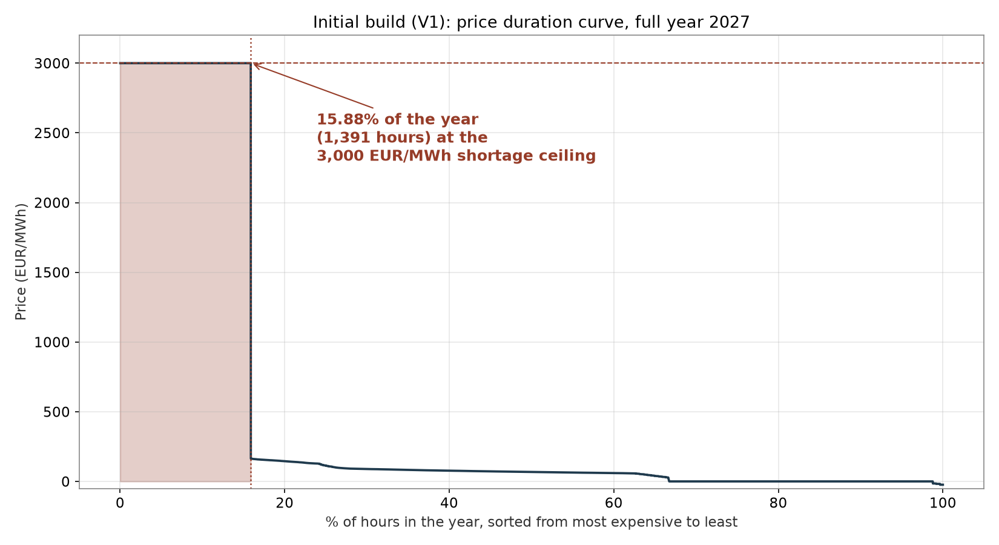
Phase 2: Initial Build (V1) - Where the 15.9% Comes From
• This is a price DURATION CURVE: every hour of the year, sorted from most to least expensive
• The flat plateau at 3,000 EUR/MWh is AMIRIS's shortage ceiling - the price it assigns whenever the market can't fully meet demand
• 1,391 of 8,760 hours (15.88%) sit on that plateau
• This is what "shortage pricing hit 15.9% of the year" actually looks like
AMIRIS Germany2027 Progress | 6

Slide 7
Phase 2: Two Real Bugs Found and Fixed
Bug 1: missing subsidy configuration
The Biogas agent needed an explicit SupportInstrument attribute once given a real MPVAR subsidy rate. Fixed by adding it.
Bug 2: four renewable profiles never updated to the 2027 calendar
Diagnosed by checking a specific shortage hour: Wind Offshore, Run-of-River, and Biomass were all zero simultaneously with no physical reason. Their files still had 2019 timestamps and never overlapped the simulated year. Fixed by redating all four.
Result of fixing Bug 2 (the file with the real before/after run no longer exists to re-chart, but the numbers were recorded at the time):
Shortage hours fell from 25.3% to 15.9% of the year (2,216 -> 1,391 hours), and negative prices appeared for the first time (108 hours) - a healthy sign that the market was now clearing realistically.
AMIRIS Germany2027 Progress | 7

Slide 8
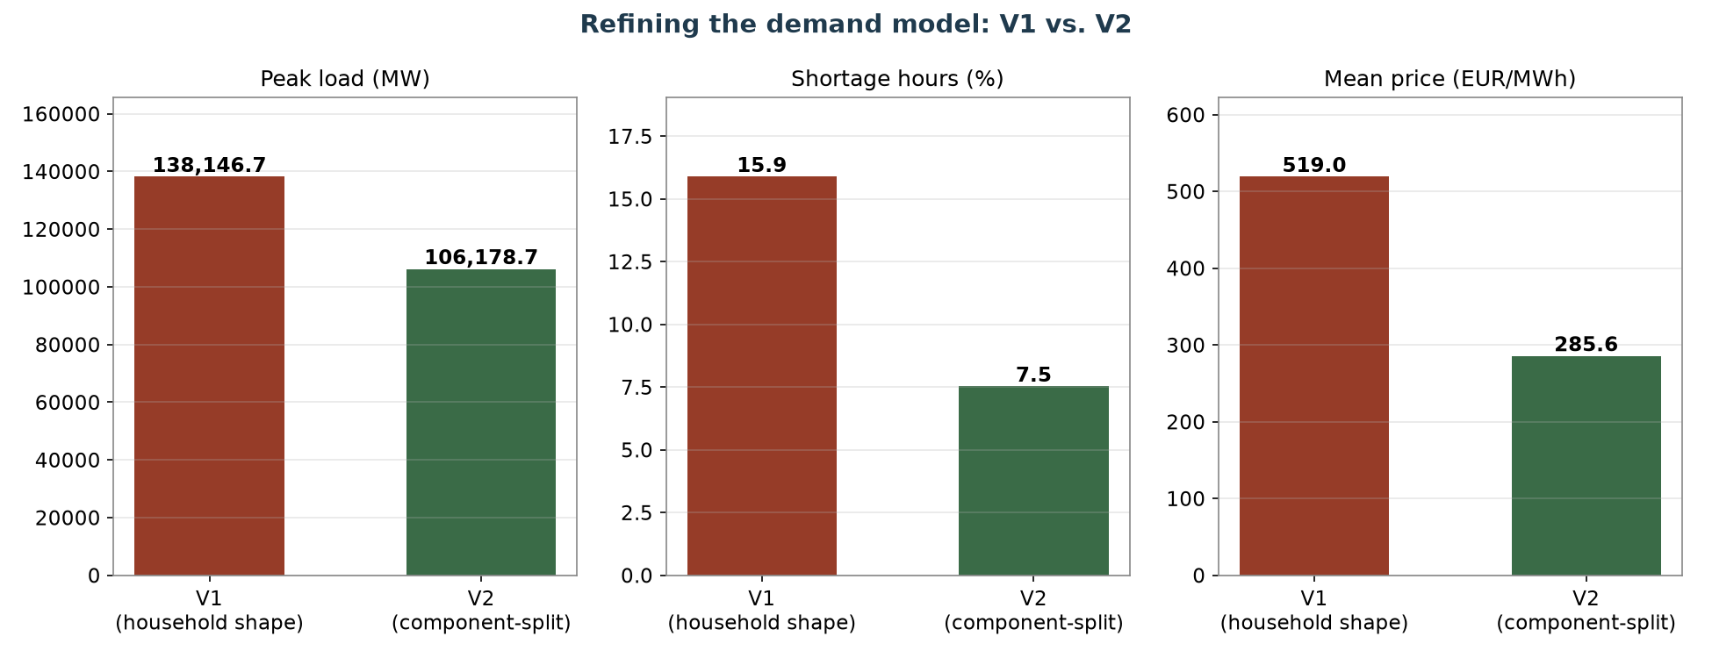
Phase 4: Refining the Demand Model (V1 -> V2)
AMIRIS Germany2027 Progress | 8

Slide 9
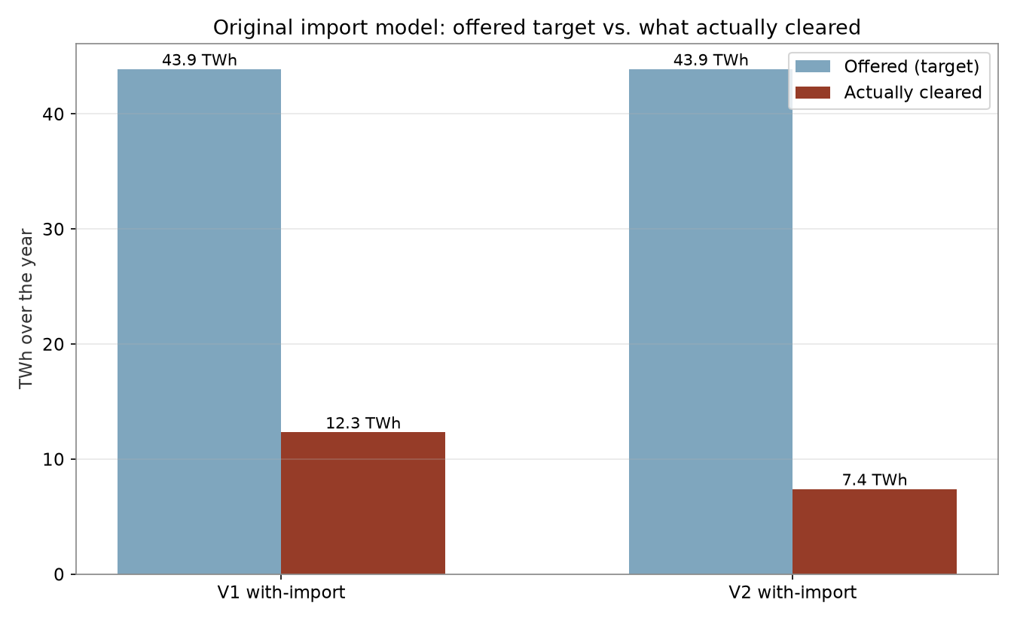
Phase 5: Adding Cross-Border Imports (First Attempt)
• Both demand versions got an ImportTrader offering Brainpool's 43.90 TWh net-import figure
• Priced at real 2023 French day-ahead prices
• Helped reduce shortage hours further - but only a small fraction of the offered volume ever actually cleared
• V1: 28% cleared. V2: only 17% cleared
• At the time, this was reported as a market-clearing finding, not yet identified as something broken
AMIRIS Germany2027 Progress | 9

Slide 10
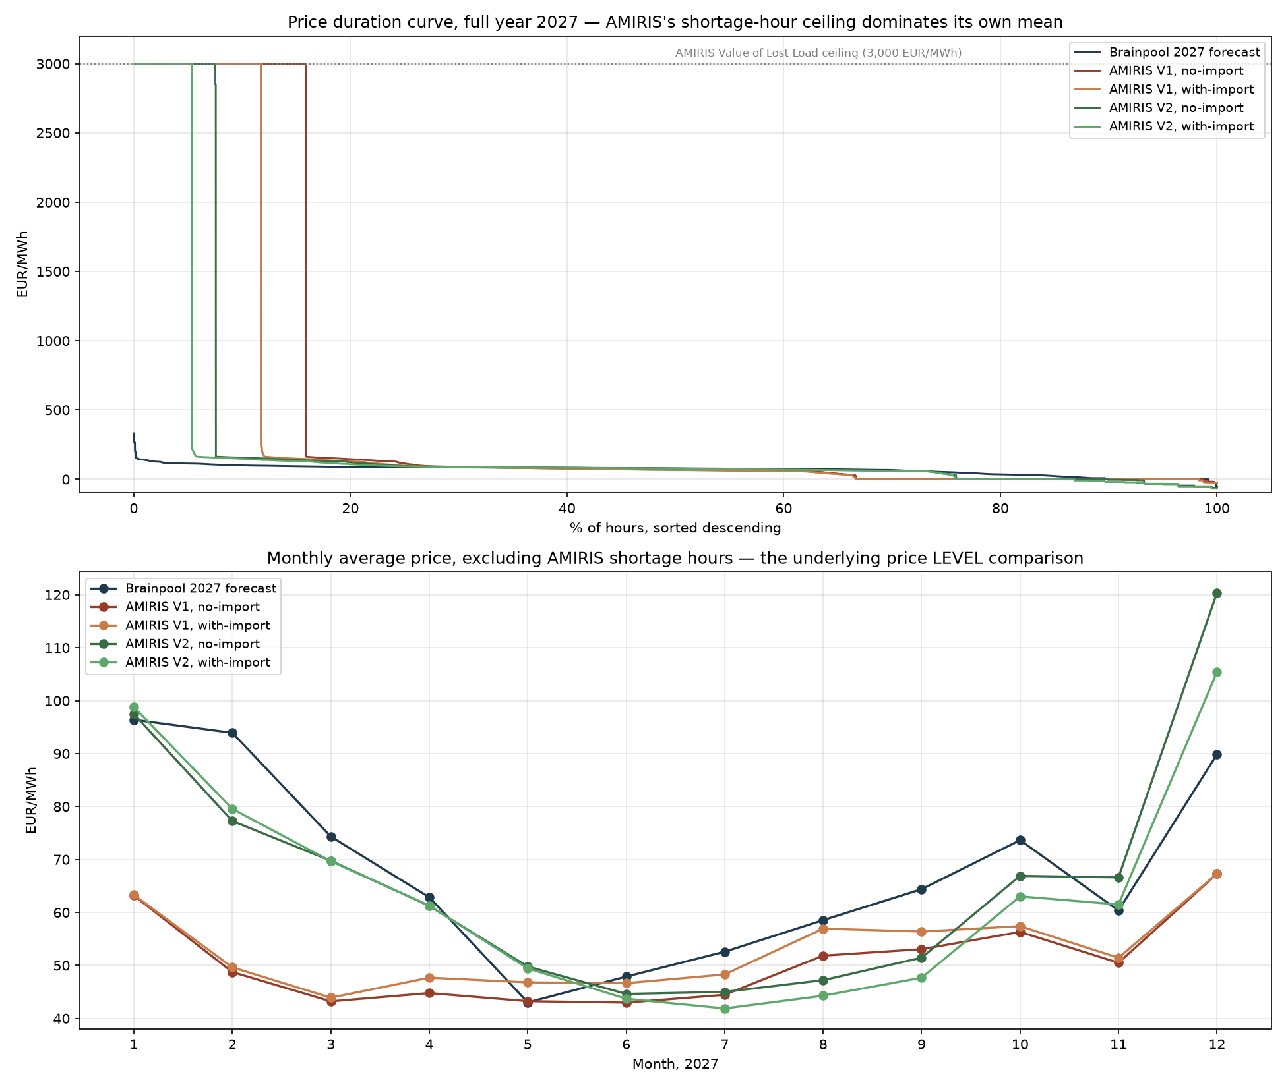
Phase 6: Comparing Against Brainpool's Real 2027 Price
AMIRIS Germany2027 Progress | 10

Slide 11
The Gap Was Not What It Looked Like
Build | AMIRIS mean price | Brainpool mean price | Ratio
V1, no-import | 519.02 | 68.04 | 7.6x
V2, with-import (original) | 219.81 | 68.04 | 3.2x
The "average salary" problem:
A small number of extreme shortage hours (priced at 3,000 EUR/MWh) drag the whole-year average up - just like one very high salary skewing a company's average pay. It doesn't mean everyone earns that much.
Excluding those hours, the picture flips:
V2's price level on ordinary (non-shortage) hours was already close to Brainpool's - mean of 64.76 EUR/MWh vs. Brainpool's 68.04, a gap of well under 1 EUR/MWh (bias -0.39). The disagreement was never really about price level - it was about how often the model thought Germany ran short of supply.
AMIRIS Germany2027 Progress | 11

Slide 12
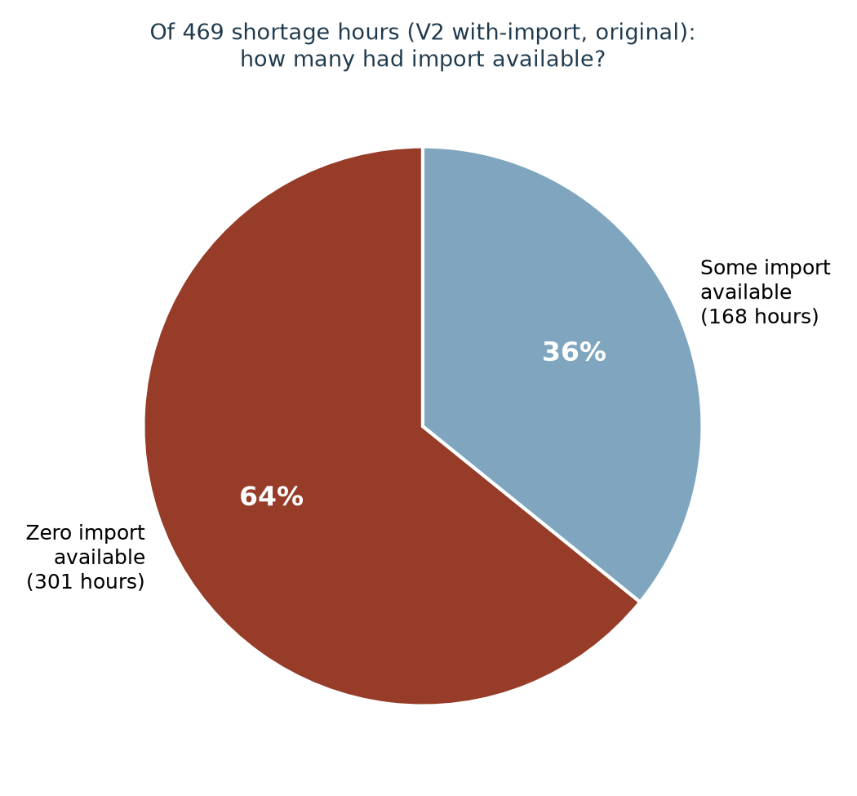
Phase 7: Diagnosing the Root Cause
• Picked a real shortage hour (2027-11-08, 13:00) and checked every agent
• Demand requested 91,890 MWh; only 89,015 MWh awarded - a genuine physical shortfall
• Every conventional plant fully dispatched - no spare capacity anywhere
• The battery storage agent was already empty
• The import trader had ZERO MW available that hour
• Checking all 469 shortage hours: 64% had zero import available
• Import timing was copied from real 2023 flows - an unrelated year, with no reason to line up with THIS build's own scarcity pattern
AMIRIS Germany2027 Progress | 12

Slide 13
Phase 8: The Fix - Decouple Imports from Historical Timing
• Replace the shaped, often-zero import series with a FLAT, constant hourly ceiling
• No historical timing pattern involved at all
• The real French price series still decides, hour by hour, how much actually clears
• No annual import total is pre-targeted - the realized volume is a genuine market outcome
First pass: flat 37,649.98 MW (the real observed 2023 peak import hour)
Eliminated V2's shortage hours completely (0.00%) - but overshot Brainpool's average price (bias -12.59 EUR/MWh). The ceiling was generous enough to also flood many ordinary hours with cheap import.
AMIRIS Germany2027 Progress | 13

Slide 14
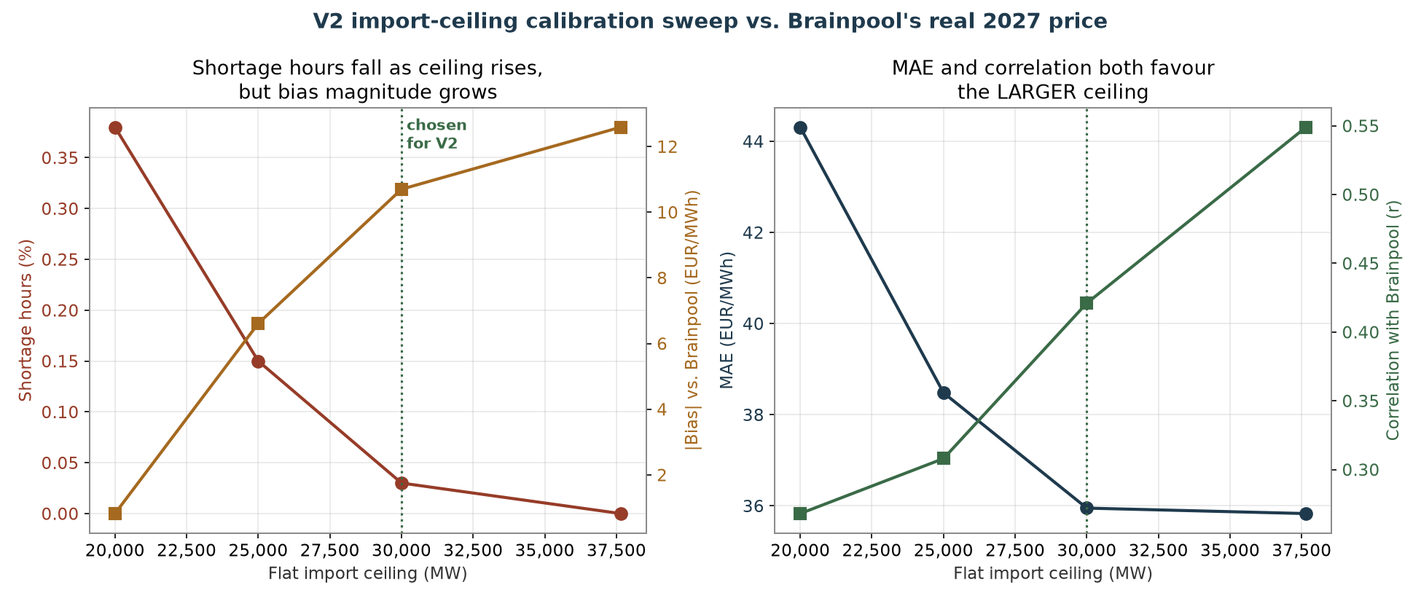
Calibrating the Ceiling: a Real Trade-Off
AMIRIS Germany2027 Progress | 14

Slide 15
Bias Alone Would Have Picked the Wrong Ceiling
• 20,000 MW looks best on bias (+0.82, nearly zero)
• But bias can hide a lot: positive and negative hourly errors cancel out even when the underlying tracking is poor
• MAE (which doesn't let errors cancel) and correlation both say the SMALLER ceilings are actually LESS reliable hour to hour
• 30,000 MW chosen for V2: MAE and correlation nearly match the most generous ceiling, shortage hours are essentially eliminated, and bias is meaningfully improved
Ceiling | Shortage hrs | Bias | MAE | Correlation
20,000 MW | 0.38% | +0.82 | 44.31 | 0.268
25,000 MW | 0.15% | -6.61 | 38.48 | 0.308
30,000 MW (chosen) | 0.03% | -10.70 | 35.95 | 0.421
37,650 MW | 0.00% | -12.59 | 35.83 | 0.549
AMIRIS Germany2027 Progress | 15

Slide 16
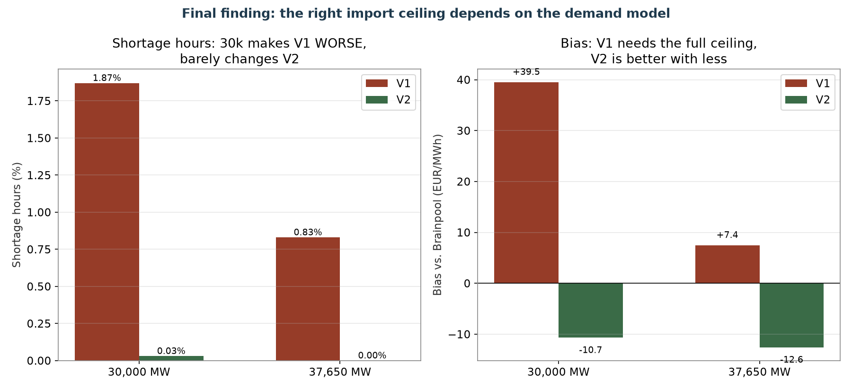
A Further Finding: V1 and V2 Need Different Ceilings
AMIRIS Germany2027 Progress | 16

Slide 17
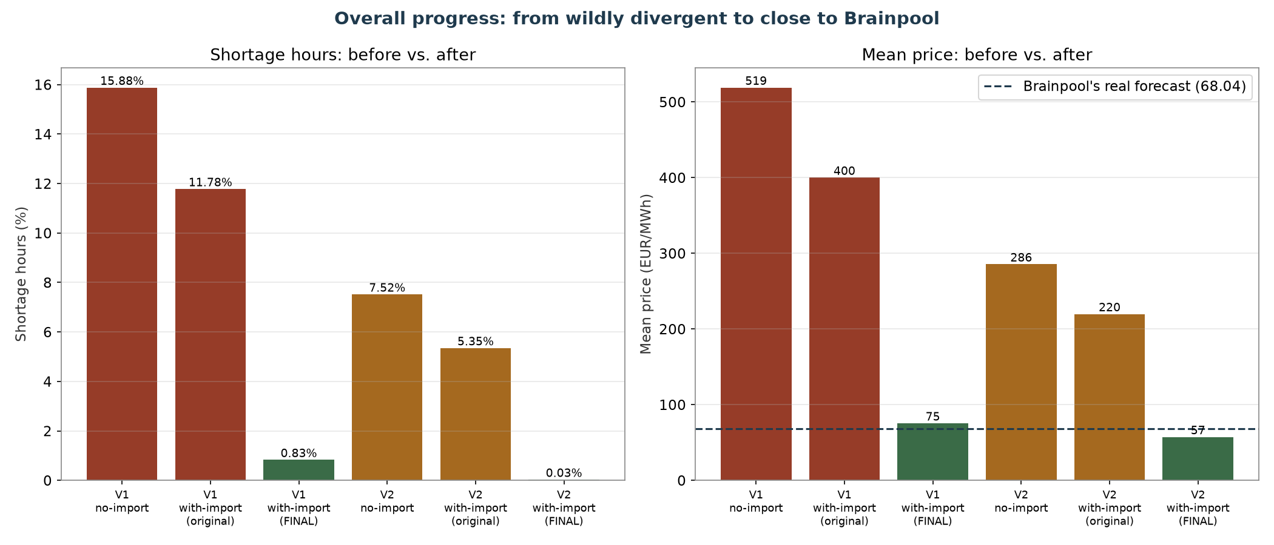
Where Things Stand Now
AMIRIS Germany2027 Progress | 17

Slide 18
Next Steps
• Validate out-of-sample: build Germany2028 the same way, apply the same calibrated import approach WITHOUT re-tuning it, and check the fit against Brainpool's real 2028 price once available
• Fold the import-fix and calibration story into the formal build documentation
• Build the with-import variant as a completed comparison set for both demand versions vs. Brainpool
• Revisit remaining open items: wind offshore subsidy placeholder, solar rooftop FIT's exposure to a draft 2026 reform, heat-pump constant-COP simplification
AMIRIS Germany2027 Progress | 18

Slide 19
Thank you
Questions & discussion

