Slide 1
Detailed Walkthrough:
Germany 2027 Model Validation, after the last meeting
Every step, finding, and fix - day by day
Presented by: Muideen Oladayo Ajiboye (471583)

Slide 2
1. Does Heat-Pump Weather Timing Matter?
• Question: would using real 2009 temperature (instead of a generic typical-year climate profile) for heat-pump demand change the result?
• Built and tested it directly
• Result: essentially no effect on the overall comparison
• Why: heat pumps are under 3% of total demand - too small a slice to move the whole picture, even if modelled perfectly
4

Slide 3
2. Diagnosing the Midday Price Gap
• AMIRIS predicts noticeably lower prices than Brainpool specifically around midday
• Inspected one real midday hour, agent by agent, to find out why
• Finding 1: two renewable subsidy types behave differently under oversupply - one type switches off when prices crash, the other keeps running regardless
• Finding 2 (the bigger one): the model has no way to sell EXTRA power abroad - it can only import, never export
• When Germany produces more solar/wind than it needs, the only options are: switch off, fill batteries, or let the price crash
5

Slide 4
3. Attempting to Build an Export Option
• Tried building a way for the model to sell surplus power abroad, using the closest available tool (built for battery-like devices)
• Kept as its own separate, clearly labelled test
• Result: it never activated once, in any of the 8,760 hours of the year
• Why: the tool only acts when there's an eventual payoff - a device that never sells anything back has no such payoff
• Confirmed as a real, structural limit - not a mistake, and not fixed that day
6

Slide 5
4. Verifying Assumptions Against Reality
• Two of our biggest assumptions had never actually been confirmed - checked directly rather than continuing to guess
• Confirmed: Brainpool's real forecast IS built on real 2009 weather
• Found: Brainpool's real model covers ~30 European countries with price coupling - not just one neighbour (we had been using France alone)
7

Slide 6
5. A Fairer Stand-In for the Neighbouring Price
• A full 30-country model is far too big a job to replicate
• Next best option: blended real prices from all 11 of Germany's actual neighbouring countries, instead of France alone
• Result: a small, genuine improvement - France's price alone wasn't wildly different from the 11-country blend to begin with
8

Slide 7
6. How Big a Job Would a Real Export Feature Be?
• AMIRIS does have the real tools needed for two markets to trade in both directions
• A working example already exists showing how two markets can be connected
• But making real use of it means building an entire second, simplified country-model and connecting it properly
• Assessment: achievable in principle, but comparable in size to the work that went into the German side in the first place
9

Slide 8
7. Checking the Public-Holiday Angle
• Idea: our weekday/weekend fix doesn't know that a Thursday might be a public holiday with much lower real usage
• Germany's real 2027 public holidays were checked directly against the price comparison
• First look was promising - but didn't hold up under closer checking (controlling for season, comparing against normal day-to-day variation)
• Result: a genuine null result - ruled out, not pursued further
10

Slide 9
8. Why 3,000 EUR/MWh for the Shortage Price?
• Question: is this number arbitrary, or does it mean something real?
• Researched directly rather than assumed
• Confirmed: this is the real, legally-binding EU-wide price ceiling that applied across Europe's electricity markets from November 2017 to May 2022
• Our reference year (2019) sits right in the middle of that period - the number was correctly copied from a real regulatory fact
• Found: the real ceiling has since risen twice, to 5,000 EUR/MWh today - flagged as worth revisiting, not acted on immediately
12

Slide 10
9 & 10. Making Two Demand Pieces "Smart"
• Hydrogen production (electrolysis) and EV charging used to draw power flat, every hour, regardless of price
• Rebuilt both as their own agents: same total electricity used across the year, but free to choose WHEN
• Electrolysis result: shortage hours fell from 4 to 1
• EV charging result: shortage hours reached ZERO for the first time in this whole project
• Verified directly: both genuinely shift toward cheap and negative-price hours, and specifically the midday sunny-hour surplus
13

Slide 11
11. Checking the Big Battery/Storage Units Too
• Question: should these be made "smart" the same way?
• Checked first: they were already found to be genuinely price-driven by design - no fix needed
• But found: the reservoir hydro dam was hitting its own size limit 35% of the year
• Tested a bigger size: real, modest improvement, but never fully solves it even at triple the real size
• Since the real size is Brainpool's own stated figure, kept as a documented finding rather than a change made to the model
14

Slide 12
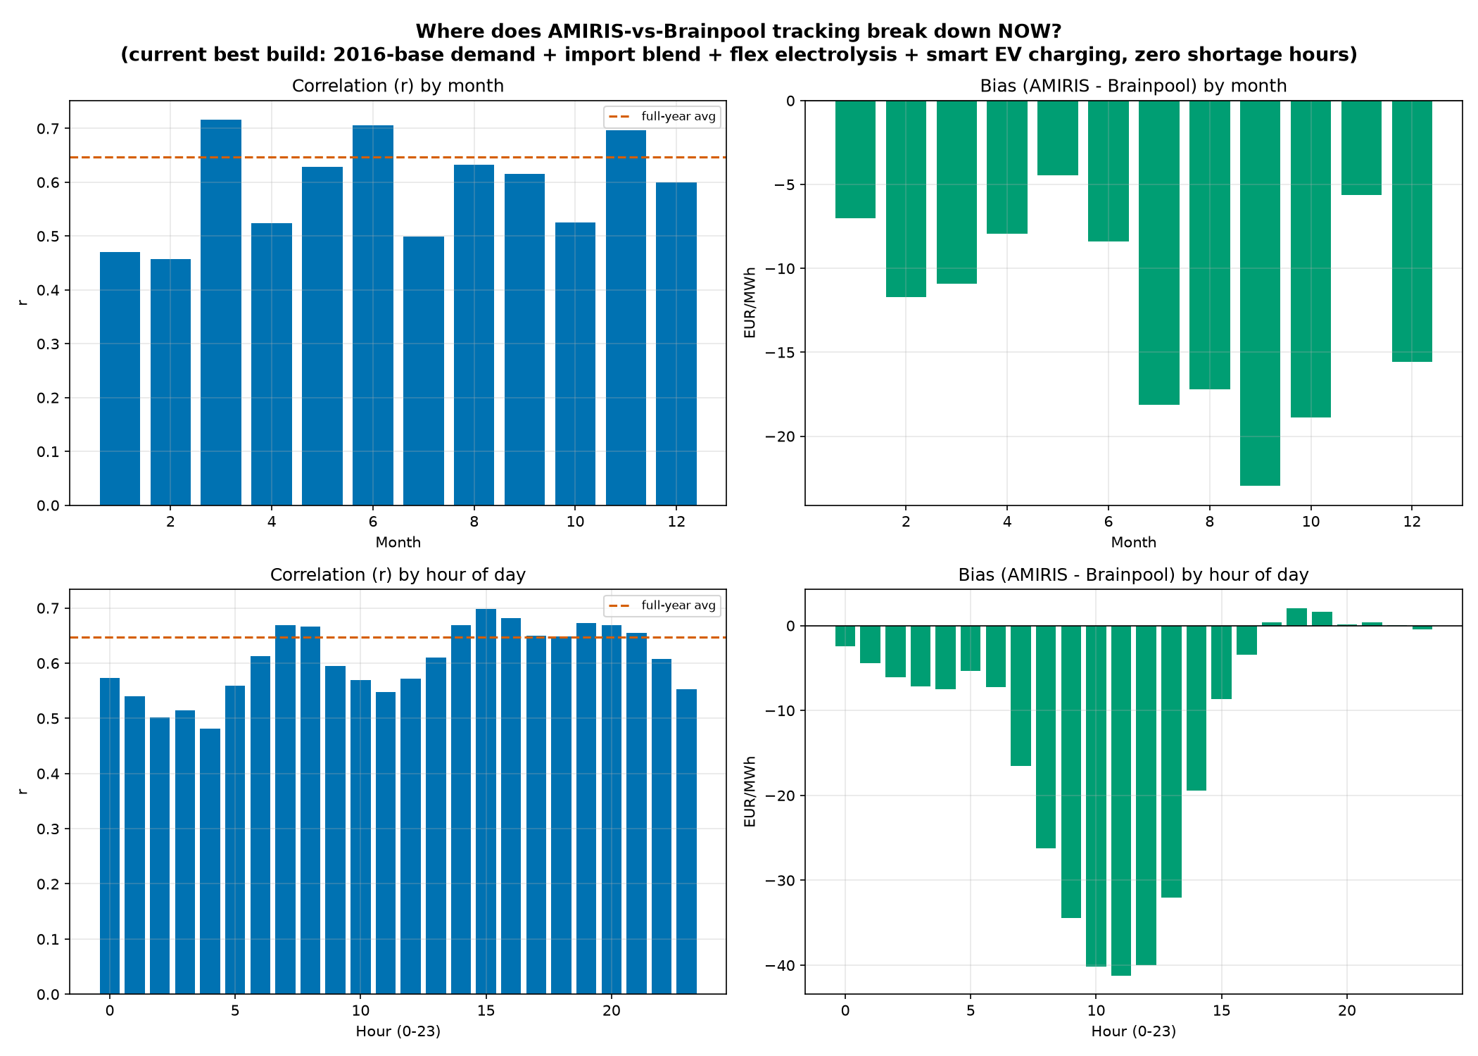
12. Finding Out What's Left to Fix
Re-ran the 'where exactly does the mismatch happen' check on the best-yet model - the midday problem was still there, almost unchanged
15

Slide 13
13. A New Seasonal Puzzle, Investigated and Ruled Out
• The same check also showed July-October prices consistently further off than any other time of year
• Five specific, sensible explanations were checked directly, one at a time: extra solar/wind, different renewable mix, cheaper imports, extra demand, plant maintenance
• All five ruled out
• What was actually found: Brainpool assumes a steady price climb through summer that our single-country model simply can't see
• Traced back to the same known limitation: our model only sees Germany; Brainpool's real tool watches ~30 countries at once
16

Slide 14
14. Testing on Years the Model Was Never Tuned For
• New Brainpool data arrived, covering 2028 and 2029 too - a chance to test generalisation
• Built 2028 and 2029 the exact same way as 2027 - zero re-tuning of any setting
• Genuine surprise: the simulation software doesn't understand true leap years at all
• It always treats every year as exactly 365 days, and for a leap year skips December 31st instead of adding a day in February
• Every part of the 2028 build was adjusted to work the way the software actually expects
17

Slide 15
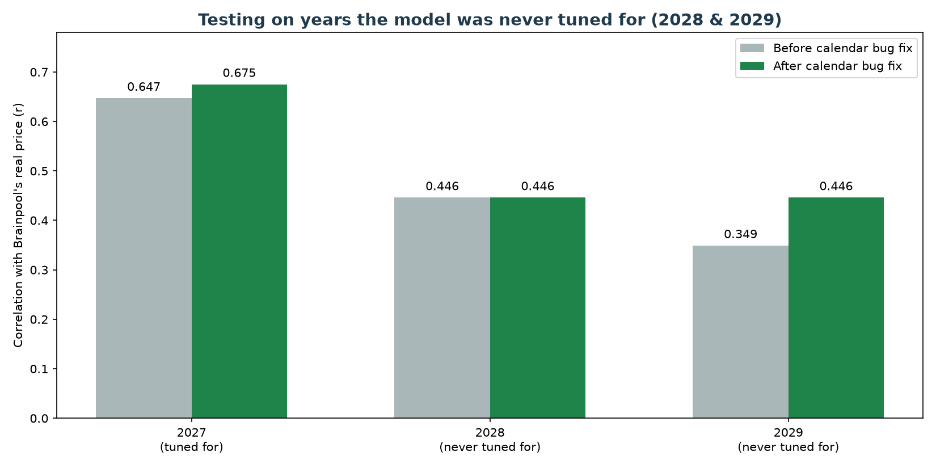
15. First Out-of-Sample Result
Average price level held up well in both new years; the hour-to-hour matching quality got fuzzier the further from 2027
18

Slide 16
16. Adopting a Smaller Import Amount
• Question: would re-tuning the import amount specifically for each year recover the lost matching quality?
• Tested directly: YES, dramatically - smaller import amounts gave far better hour-to-hour matching for both new years
• Decision made: adopt a smaller amount (20,000 MW) for both 2028 and 2029
• The original (30,000 MW) results were kept fully on file, not deleted
19

Slide 17
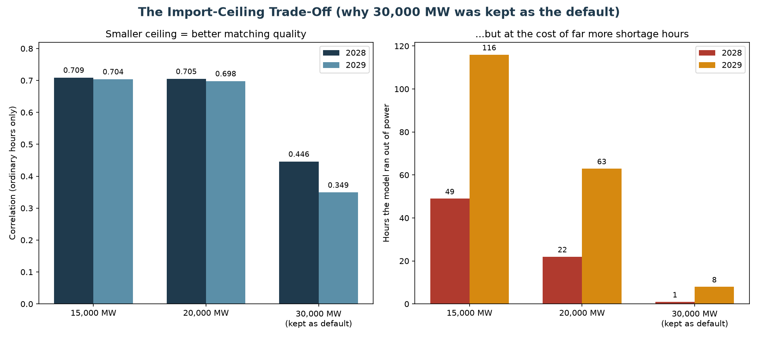
17. A Fuller Check Changes the Picture
A third option (15,000 MW) was added, and this time the FULL year was checked, not just the 'ordinary hours only' view
21

Slide 18
18. Reversing Yesterday's Decision
• The fuller check showed the smaller import amount makes the OVERALL picture worse, not better
• More unrealistic 'ran out of power' hours, and the average price badly overshoots Brainpool's real number (up to 53% too high)
• Decision: reverted both 2028 and 2029 back to the original 30,000 MW default
• All four tested amounts were kept on file - nothing thrown away, full evidence trail preserved
• This is exactly the kind of careful, evidence-first process this project has followed throughout
22

Slide 19
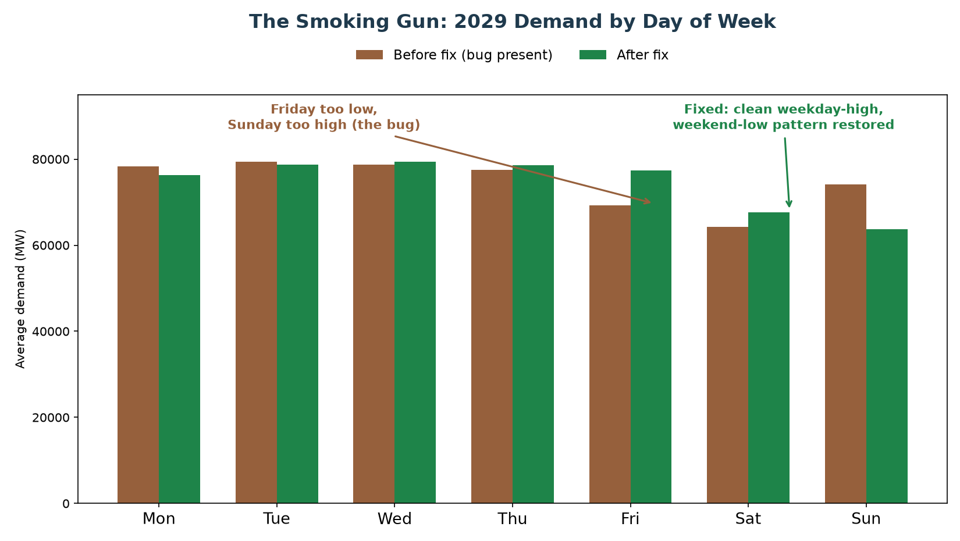
19. A Genuine Surprise in the Weekday Pattern
Checking WHERE 2028/2029 disagreed with Brainpool most revealed real demand numbers with Friday too low, Sunday too high
23

Slide 20
20. The Root Cause: A Hidden Calendar Bug
• Our demand shape borrows a real year's usage pattern (2016) and trims it to fit the target year
• 2016 has one extra day (leap year) that has to be removed
• The day removed was February 29th - sitting in the MIDDLE of the year
• Removing a day from the middle quietly shifts every day after it by one weekday, for the rest of the year (84% of it)
• This had been sitting undetected in the project's main 2027 build since it was first built
• The fix: remove December 31st instead - the very END of the year, which disturbs nothing before it
24

Slide 21
21. Result: A Clean, Genuine Improvement
Both matching quality AND average error improved together, with almost no downside
 | 2027 | 2029
Matching quality - before fix | 0.647 | 0.349
Matching quality - after fix | 0.675 | 0.446
Average error - before fix | 28.19 | 29.59
Average error - after fix | 26.91 | 29.14
25

Slide 22
22. Double-Checking: Was the Ceiling Puzzle Actually the Bug?
• Question: now that the calendar bug is fixed, does the import-amount pattern from Day 2/3 still show up?
• Re-ran the same import-amount comparison on the newly-fixed 2029 model
• Found: the exact same pattern as before - smaller amounts still give better matching, at the same shortage-hour cost
• Fixing the calendar bug gave every import-amount setting a small, genuine boost across the board
• Confirmed: these are two real, independent findings - not one mistake masquerading as two
26

Slide 23
23. Building the Supervisor Progress Presentation
• Prepared a full progress-update slide deck covering the last-meeting tasks and everything done since
• Structured around: load profile comparisons, 2009 renewable profiles, the smart-demand fixes, out-of-sample testing, and the calendar bug
• Later expanded with four additional slides diving deeper into the 2028/2029 story and the bug fix, inserted directly into the already-edited deck without disturbing existing edits
28

Slide 24
24. Clarifying: Did We Really Get 2009 Offshore Wind Data?
• Yes - pulled the same way as onshore wind and solar, from a real weather-simulation service
• The low match score reported earlier isn't a mistake in that work
• There was never a real reference profile for offshore wind to compare against in the first place - a data gap flagged since the very start of the project
• Comparing real 2009 weather against a generic placeholder naturally gives a low score - that's expected, not a failure
29

Slide 25
25. Clarifying: What Does "Shaped With Suited Data" Mean?
• V1's problem: one generic household shape stretched to represent all of Germany's demand - caused an unrealistic evening spike
• V2's fix: four separate pieces, each built from the data that actually explains it
• Base demand: real historical grid data. Heat pumps: real temperature data. Electrolysis: a steady industrial pattern. EV charging: a typical daily charging curve
• Using the right kind of data for each piece, instead of forcing one shape to cover everything
30

Slide 26
26. Clarifying: Why 2016 as the Demand-Source Year?
• We don't have real electricity usage data for 2009 itself
• But Brainpool's forecast IS built on real 2009 weather - confirmed directly
• So: find a year we DO have real usage data for, whose weather most resembled 2009's, and borrow its shape
• Checked every candidate year directly rather than guessing - 2016 was the genuine best match
• Our own two guesses (2023, then 2019) both turned out to be poor choices - 2023 was actually the worst match of all six years checked
31

Slide 27
27. Clarifying: The Three Correlation Numbers
• All-hours: every single hour of the year - can be distorted by a handful of extreme hours
• Excluding-shortage (our main, trusted number): the same measurement, leaving out those rare emergency-price hours
• Weekday / weekend split: the same trusted number, split further into Monday-Friday and Saturday-Sunday
• This detailed split is what twice now has directly led to finding a real, fixable problem
32

Slide 28
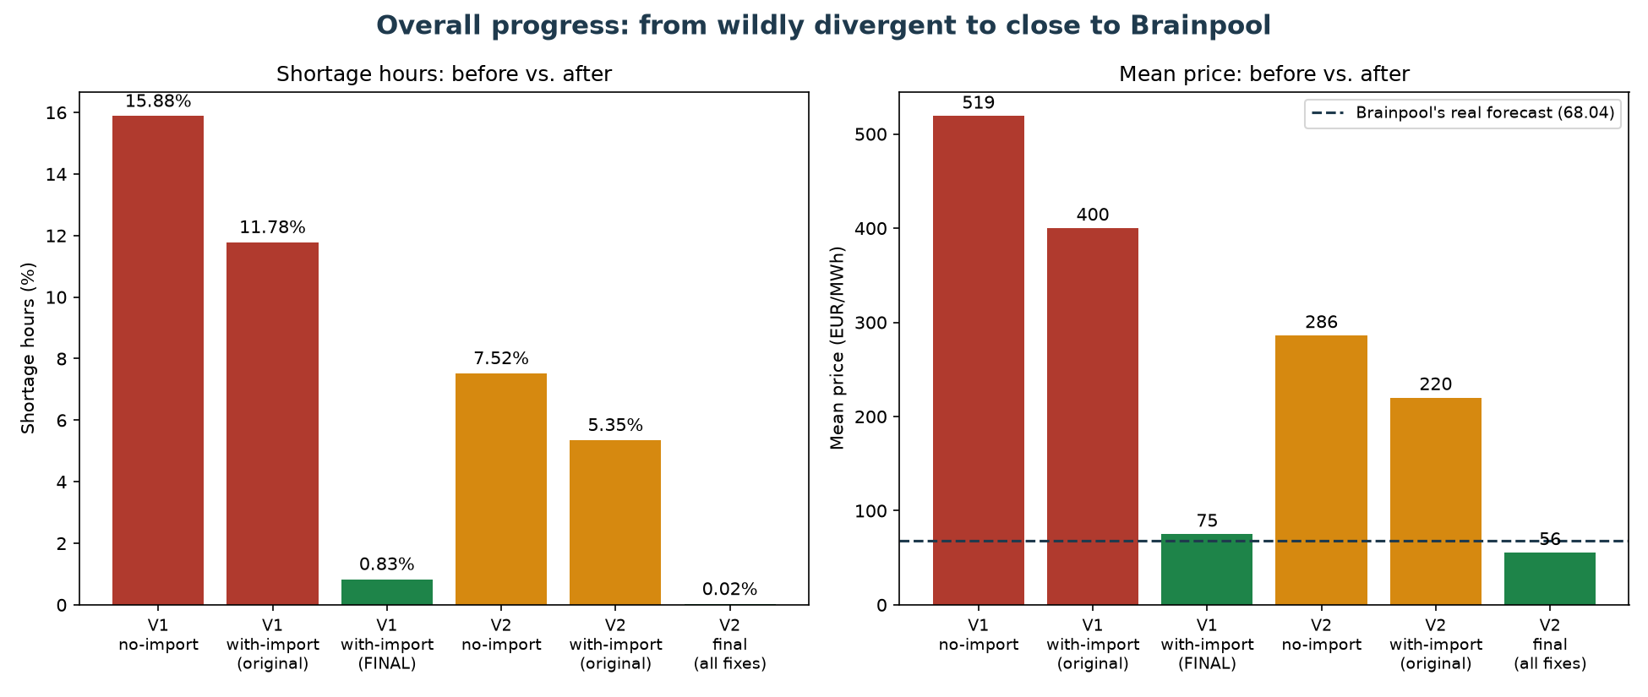
Overall Summary: The Full Journey
From wildly divergent (7.6x too high, 16% shortage hours) to close to Brainpool's real forecast
33

Slide 29
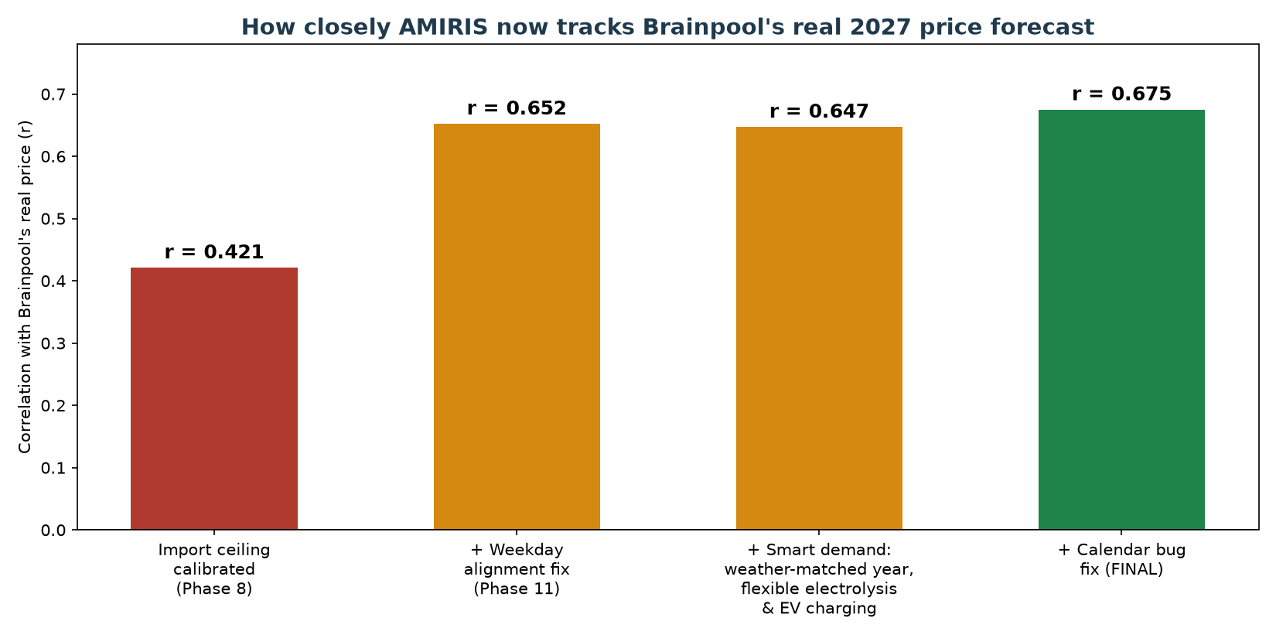
Overall Summary: Matching Quality Over Time
Every major fix, in order, and its effect on how closely AMIRIS tracks Brainpool's real price
34

Slide 30
What's Still Open
• A full cross-border export model - the midday-price gap is the main remaining issue and needs this
• Whether to update the shortage price (3,000 EUR/MWh) to reflect today's real EU cap (5,000 EUR/MWh)
• Why the import ceiling behaves so differently across years - a real, still-unexplained pattern
• Continuing to fold every finding into the formal thesis documentation
35

Slide 31
Questions & Discussion
36

