Slide 1

Progress Report & Thesis Plan: Evaluating AMIRIS as a Substitute for Purchased Electricity Price Time Series
Supervisor: Rohith Krishnan Bala Krishnan
Presented by:
Muideen Oladayo Ajiboye (471583)
Date : 13 July 2026

Slide 2
Progress & Plan

Slide 3
Motivation & Research Question
The need: the department’s Thuringia energy model requires hourly day-ahead electricity price time series (8,760 prices per year, German bidding zone) as an input.
Status quo: these series are purchased from Energy Brainpool (Power2Sim scenario data).
The candidate: AMIRIS – DLR’s open-source, agent-based electricity market model – produces the same kind of series at no cost, with full transparency.
Research question: To what extent can AMIRIS reproduce German day-ahead price time series, and how does its accuracy compare with the commercially procured scenarios?
Proposed working title (for approval): “Can Open-Source Market Simulation Substitute Purchased Electricity Price Time Series? Backtesting and Benchmarking AMIRIS for a Regional Energy Model”

Slide 4
Approach: Two Comparisons
Comparison 1 – Backtesting: AMIRIS vs. real EPEX/SMARD prices for historical years – establishes model credibility against known ground truth.
Comparison 2 – Benchmarking: AMIRIS vs. Energy Brainpool for a year covered by the department’s data, plus actual prices where that year already lies in the past.
Metrics: mean/baseload price, MAE, RMSE, correlation, price duration curves, daily and seasonal profiles, negative-price and peak hours, wind/PV capture prices.
Key principle: both models compute conditional scenarios, not forecasts – the comparison targets how faithfully each translates assumptions into realistic hourly price structure.

Slide 5
Work Completed: Pipeline Operational
Environment: AMIRIS 4.1.2 (Java) with amirispy/fameio toolchain set up and working locally.
Simulation: Germany2018 backtest scenario executed successfully – full year, 8,760 hours, all agent outputs (market price, dispatch, storage, traders).
Real data: SMARD day-ahead prices obtained and merged across the 1 Oct 2018 bidding-zone split (DE-AT-LU → DE-LU); complete series with one negligible DST artifact.
Analysis tooling: reusable Python scripts (merge + compare) reporting MAE, RMSE, correlation, split-period metrics, and overlay plots – applicable to every future run.
Bonus finding: AMIRIS ships ready-made backtest scenarios for Germany 2015–2019 and Austria 2019 – multi-year validation is feasible within the timeline.

Slide 6
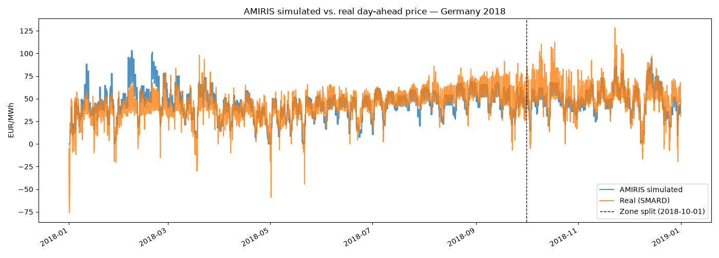
First Results: Germany 2018 Backtest
Annual mean: simulated 45.1 vs. real 44.5 EUR/MWh – bias only +0.6 EUR/MWh (≈1.4%).
Full year: MAE 8.84, RMSE 11.72 EUR/MWh, correlation 0.773. After the Oct zone split (like-for-like DE-LU): correlation 0.847, MAE 8.25.
Quality is comparable to DLR’s own published backtests – level, seasonal shape and spike timing match; spike magnitude is damped.

Slide 7
Error Analysis: Three Explainable Patterns
A – Public holidays (1 Jan, 1 May): model floors at 0 EUR/MWh while real prices reach −49 to −76; renewable bidding logic currently does not bid negative (134 real negative hours vs. 0 simulated).
B – Cold spell 5–19 Feb: simulated 92–103 vs. real 45–53 EUR/MWh; suspected availability/must-run or fuel-cost input for that week.
C – Damped spikes: spike timing correct but peak height undershot (e.g. 9 Oct 19:00: 62 vs. 110 EUR/MWh) – a known agent-based signature without scarcity mark-ups.
Each pattern points to a concrete, testable model setting – these are findings, not defects in the workflow.

Slide 8
Immediate Next Steps
1. Negative-price experiment: inspect renewable trader outputs for the holiday hours; enable/verify negative-bidding strategy in scenario.yaml; re-run and compare duration-curve tails.
2. February check: identify the price-setting plant/fuel on 5–19 Feb and cross-check its availability and cost inputs.
3. Multi-year backtests: repeat the identical workflow for Germany 2015–2017 and 2019 (all single-zone years) to test whether the patterns are consistent.
4. Writing: draft the model description and methodology chapters in parallel – the pipeline knowledge is fresh now.

Slide 9
Remaining Timeline (~9 Weeks)
Weeks 1–2 Negative-price and February experiments; multi-year backtests 2015–2019; model description chapter.
Weeks 3–4 Consolidate backtesting results; methodology chapter; obtain and verify Brainpool data.
Weeks 5–6 Benchmarking: AMIRIS vs. Brainpool vs. actuals for the agreed comparison year; results chapter.
Weeks 7–8 Discussion (substitution verdict), introduction, conclusion.
Week 9 Formatting, references, final buffer (3–4 days reserved).
Writing rule: ~40% of total time on writing, distributed across all phases.

Slide 10
Inputs Needed Today
1. Approval of the working title and the scoped plan (backtesting + one benchmarking year).
2. Brainpool data: which years/vintages do we hold? Hourly or aggregated? Which scenario(s)? Real or nominal EUR? Format, access, licensing for thesis use?
3. Which quantities does the Thuringia model actually consume – full hourly series or derived values (annual means, capture prices)? This selects the decisive metrics.
4. Preferred comparison year – ideally a projected year that has since become the past, enabling the three-way test (AMIRIS vs. Brainpool vs. actuals).
5. Check-in cadence – proposal: short bi-weekly progress updates.

Slide 11
Summary & Requests
Working pipeline: AMIRIS runs, real data merged, comparison tooling built and reusable.
First backtest (Germany 2018): bias +0.6 EUR/MWh, correlation 0.77 (0.85 post zone-split) – quality comparable to DLR’s published backtests.
Clear next experiments: negative-price bidding, February inputs, multi-year runs 2015–2019.
Requested today: title approval, Brainpool data access and specification, choice of comparison year.

