Slide 1

Progress Report & Thesis Plan: Evaluating AMIRIS as a Substitute for Purchased Electricity Price Time Series
Supervisor: Rohith Krishnan Bala Krishnan
Presented by:
Muideen Oladayo Ajiboye (471583)
Date : 13 July 2026

Slide 2
Progress & Plan

Slide 3
Motivation & Research Question
The need: the department’s Thuringia energy model requires hourly day-ahead electricity price time series (8,760 prices per year, German bidding zone) as an input.
Status quo: these series are purchased from Energy Brainpool (Power2Sim scenario data).
The candidate: AMIRIS – DLR’s open-source, agent-based electricity market model – produces the same kind of series at no cost, with full transparency.
Research question: To what extent can AMIRIS reproduce German day-ahead price time series, and how does its accuracy compare with the commercially procured scenarios?
Proposed working title (for approval): “Can Open-Source Market Simulation Substitute Purchased Electricity Price Time Series? Backtesting and Benchmarking AMIRIS for a Regional Energy Model”

Slide 4
Approach: Two Comparisons
Comparison 1 – Backtesting: AMIRIS vs. real EPEX/SMARD prices for historical years – establishes model credibility against known ground truth.
Comparison 2 – Benchmarking: AMIRIS vs. Energy Brainpool for a year covered by the department’s data, plus actual prices where that year already lies in the past.
Metrics: mean/baseload price, MAE, RMSE, correlation, price duration curves, daily and seasonal profiles, negative-price and peak hours, wind/PV capture prices.
Key principle: both models compute conditional scenarios, not forecasts – the comparison targets how faithfully each translates assumptions into realistic hourly price structure.

Slide 5
Work Completed: Pipeline Operational
Environment: AMIRIS 4.1.2 (Java) with amirispy/fameio toolchain set up and working locally.
Simulation: Germany2018 backtest scenario executed successfully – full year, 8,760 hours, all agent outputs (market price, dispatch, storage, traders).
Real data: SMARD day-ahead prices obtained and merged across the 1 Oct 2018 bidding-zone split (DE-AT-LU → DE-LU); complete series with one negligible DST artifact.
Analysis tooling: reusable Python scripts (merge + compare) reporting MAE, RMSE, correlation, split-period metrics, and overlay plots – applicable to every future run.
Multi-year validation: completed for Germany 2015–2019 (5 of 5 available years) – all runs and comparisons executed, not merely feasible.

Slide 6
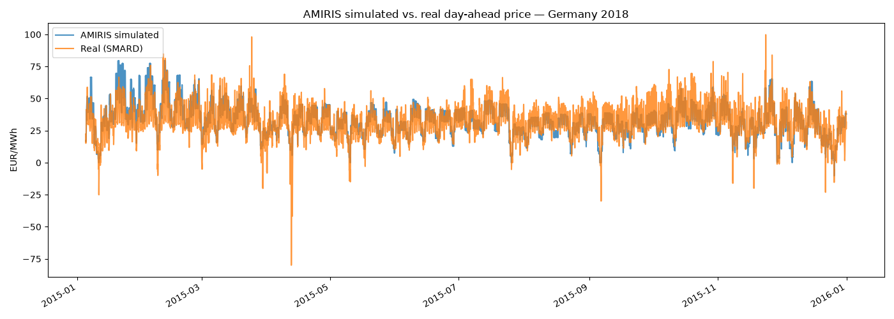
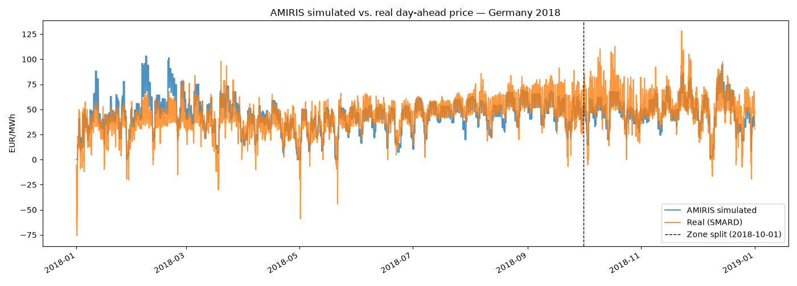
First Results: Germany 2015 Backtest
Annual mean: simulated 33.06 vs. real 31.84 EUR/MWh – bias +1.22 EUR/MWh (≈3.8%).
Full year: MAE 6.64, RMSE 8.67 EUR/MWh, correlation 0.774.
Note: Weakest correlation of the non-2018 years – a candidate for the same root-cause treatment applied to 2018 (see Next Steps). Real series starts 5 Jan (SMARD export gap).

Slide 7
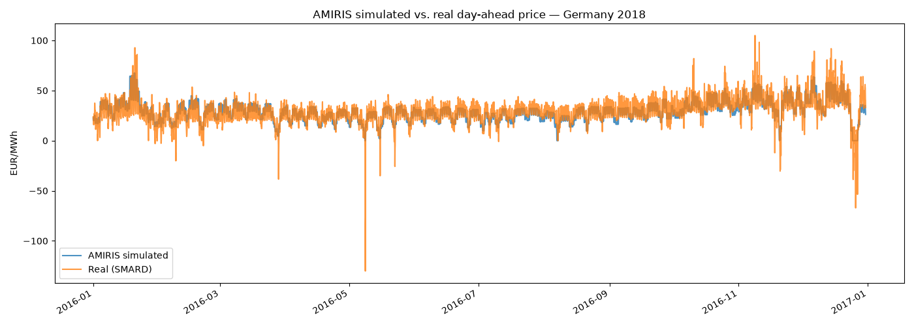
First Results: Germany 2016 Backtest
Annual mean: simulated 29.16 vs. real 28.96 EUR/MWh – bias +0.19 EUR/MWh (≈0.7%).
Full year: MAE 4.96, RMSE 6.92 EUR/MWh, correlation 0.833.
Note: Best absolute-error fit of all five years – a clean, single-zone, no-split year.

Slide 8
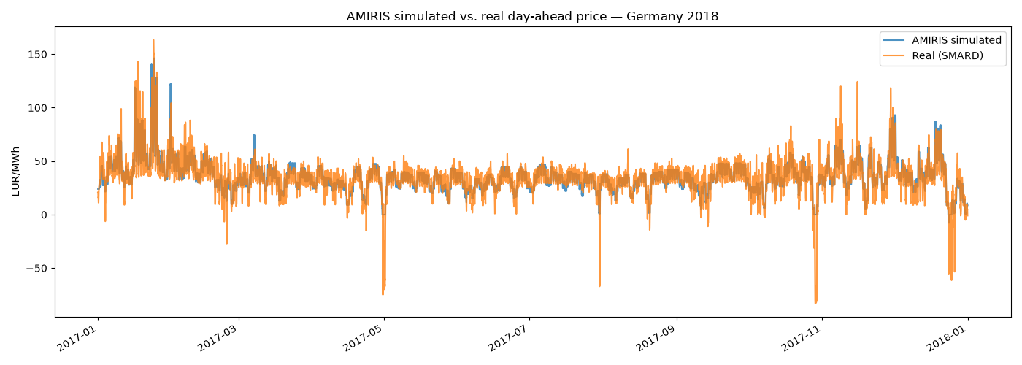
First Results: Germany 2017 Backtest
Annual mean: simulated 35.32 vs. real 34.20 EUR/MWh – bias +1.12 EUR/MWh (≈3.3%).
Full year: MAE 5.70, RMSE 8.76 EUR/MWh, correlation 0.871.
Note: Highest correlation of all five years, despite this scenario covering the Jan 2017 'Kalte Dunkelflaute' cold-and-calm event.

Slide 9
First Results: Germany 2018 Backtest
Annual mean: simulated 45.1 vs. real 44.5 EUR/MWh – bias only +0.6 EUR/MWh (≈1.4%).
Full year: MAE 8.84, RMSE 11.72 EUR/MWh, correlation 0.773. After the Oct zone split (like-for-like DE-LU): correlation 0.847, MAE 8.25.
Quality is comparable to DLR’s own published backtests – level, seasonal shape and spike timing match; spike magnitude is damped.

Slide 10
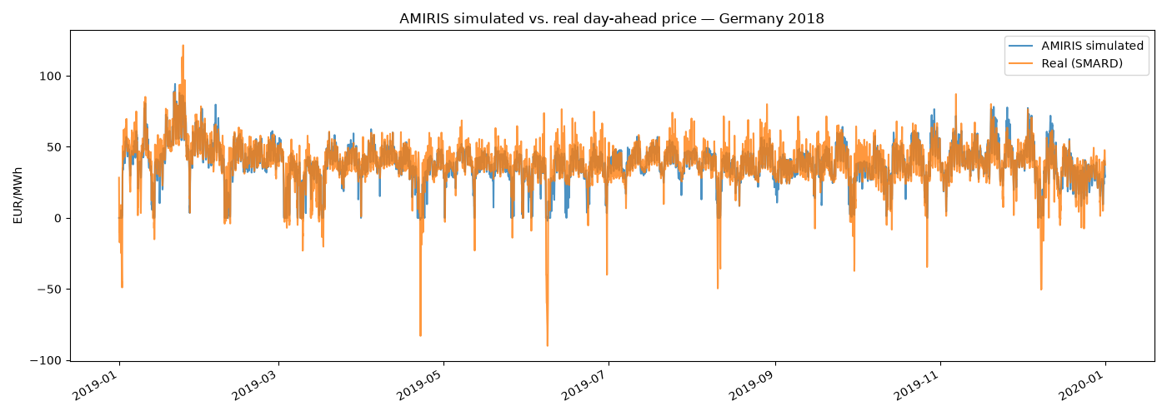
First Results: Germany 2019 Backtest
Annual mean: simulated 37.98 vs. real 37.67 EUR/MWh – bias +0.31 EUR/MWh (≈0.8%).
Full year: MAE 5.37, RMSE 8.01 EUR/MWh, correlation 0.857.
Note: Most structurally complex scenario (18 competing storage units, split must-run/outage inputs) – yet fits nearly as well as 2016/2017.

Slide 11
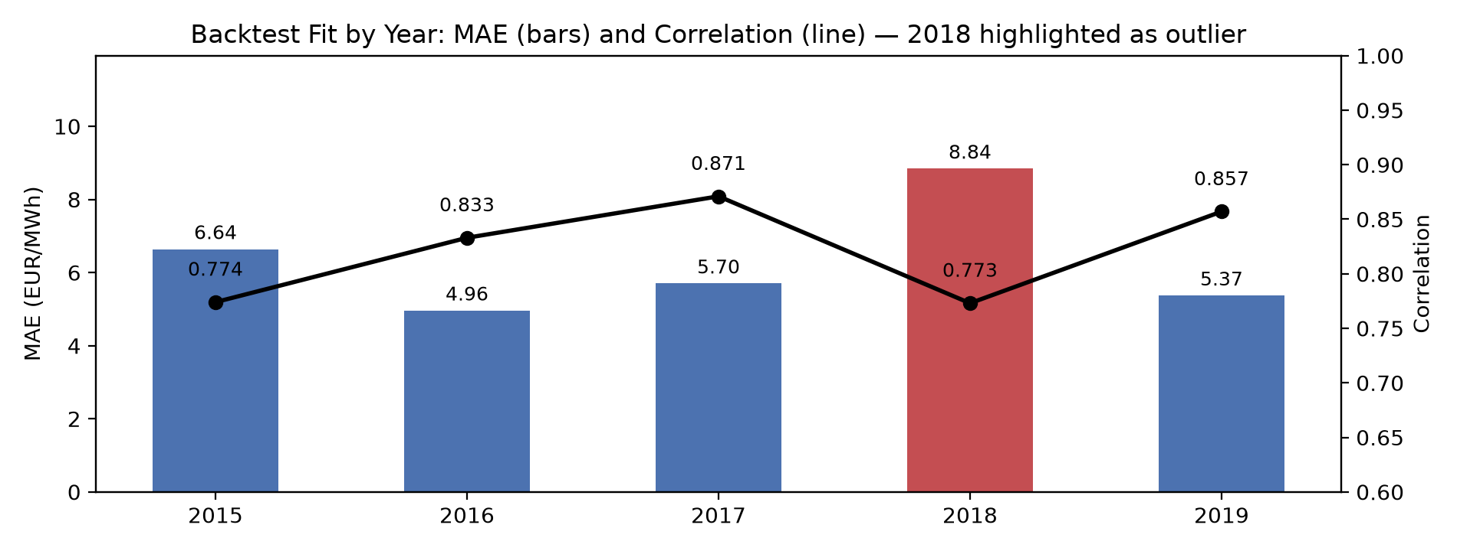
Multi-Year Backtest Results (2015–2019)
All five years now backtested: identical run → extract → compare workflow repeated for Germany 2015–2017 and 2019, using amirispy and SMARD.de real prices for each year.
Best fit: 2016 and 2017 (MAE 4.96 / 5.70 EUR/MWh, correlation 0.83 / 0.87) – both clean single-zone years with no bidding-zone split.
Worst fit: 2018 (MAE 8.84, correlation 0.77) – the one year straddling the Oct 2018 DE-AT-LU → DE-LU zone split, confirming it as a genuine structural driver of error.
2019 holds up well: MAE 5.37, correlation 0.857, despite being the most complex scenario (18 competing storage units) – added detail does not hurt the fit.

Slide 12
Root-Cause Analysis: Two Confirmed Model Gaps
Holiday zero-price floor (confirmed): on 1 Jan/1 May, renewable traders are genuinely curtailed yet still clear at exactly 0 EUR/MWh (real: −49 to −76) – their bid is fixed at zero variable cost, not negative, unlike nuclear/lignite which do have negative bid bands.
Feb cold-snap overshoot (confirmed): checked CO2 price (–47% vs. annual avg), fuel prices (~normal) and outages (better than average) for 5–19 Feb – none explain the overshoot; the real driver is demand +14% above average with no cross-border import relief in this single-zone model.
Damped spikes: spike timing correct but peak height undershot (e.g. 9 Oct 19:00: 62 vs. 110 EUR/MWh) – consistent with the same no-import-relief limitation.
Two distinct, independent model limitations, not one bug – both point to concrete, testable model changes.

Slide 13
Immediate Next Steps
Implement negative-bid experiment: extend RenewableTrader/NoSupportTrader bidding to allow negative markups on curtailment hours; re-run Germany2018 and re-check the holiday duration-curve tail.
Cross-border sensitivity test: add a simple net import/export adjustment to load for high-demand periods; re-test the Feb 2018 window to see if the overshoot shrinks.
Investigate 2015: apply the same root-cause approach to its weaker (0.774) correlation, once a complete Jan 1–4 real-price series is available.
Writing: draft the model description and methodology chapters now, using the five-year backtest as the core evidence base.

Slide 14
Remaining Timeline (~9 Weeks)
Weeks 1–2 Negative-price and cross-border experiments (multi-year backtests 2015–2019 completed ahead of schedule); model description chapter.
Weeks 3–4 Consolidate backtesting results; methodology chapter; obtain and verify Brainpool data.
Weeks 5–6 Benchmarking: AMIRIS vs. Brainpool vs. actuals for the agreed comparison year; results chapter.
Weeks 7–8 Discussion (substitution verdict), introduction, conclusion.
Week 9 Formatting, references, final buffer (3–4 days reserved).
Writing rule: ~40% of total time on writing, distributed across all phases.

Slide 15
Inputs Needed Today
1. Approval of the working title and the scoped plan (backtesting + one benchmarking year).
2. Brainpool data: which years/vintages do we hold? Hourly or aggregated? Which scenario(s)? Real or nominal EUR? Format, access, licensing for thesis use?
3. Which quantities does the Thuringia model actually consume – full hourly series or derived values (annual means, capture prices)? This selects the decisive metrics.
4. Preferred comparison year – ideally a projected year that has since become the past, enabling the three-way test (AMIRIS vs. Brainpool vs. actuals).
5. Check-in cadence – proposal: short bi-weekly progress updates.

Slide 16
Summary & Requests
Working pipeline: AMIRIS runs, real data merged, comparison tooling built and reusable – now validated across all five available years.
Five-year backtest complete: correlation 0.77–0.87, best in 2016/2017, weakest in 2018 (confirmed: zone-split year) – quality comparable to DLR’s published backtests.
Two confirmed root causes: renewable bidding cannot go negative (holiday events); no cross-border trade modelled (cold-snap overshoot) – concrete, testable fixes identified.
Requested today: title approval, Brainpool data access and specification, choice of comparison year.

