Slide 1

Progress Report & Thesis Plan: Evaluating AMIRIS as a Substitute for Purchased Electricity Price Time Series
Supervisor: Rohith Krishnan Bala Krishnan
Presented by:
Muideen Oladayo Ajiboye (471583)
Date : 20 July 2026

Slide 2
Progress & Plan

Slide 3
Motivation & Research Question
The need: the department’s Thuringia energy model requires hourly day-ahead electricity price time series (8,760 prices per year, German bidding zone) as an input.
Status quo: these series are purchased from Energy Brainpool.
The candidate: AMIRIS – DLR’s open-source, agent-based electricity market model – produces the same kind of series at no cost, with full transparency.
Research question: To what extent can AMIRIS reproduce German day-ahead price time series, and how does its accuracy compare with the commercially procured scenarios?
Proposed working title (for approval): “Can Open-Source Market Simulation Substitute Purchased Electricity Price Time Series? Backtesting and Benchmarking AMIRIS for a Regional Energy Model”

Slide 4
Approach: Two Comparisons
Comparison 1 – Backtesting: AMIRIS vs. real EPEX/SMARD prices for historical years – establishes model credibility against known ground truth.
Comparison 2 – Benchmarking: AMIRIS vs. Energy Brainpool for a year covered by the department’s data, plus actual prices where that year already lies in the past.
Metrics: mean/baseload price, MAE, RMSE, correlation, price duration curves, daily and seasonal profiles, negative-price and peak hours, wind/PV capture prices.
Key principle: both models compute conditional scenarios, not forecasts – the comparison targets how faithfully each translates assumptions into realistic hourly price structure.

Slide 5
How the Backtest Pipeline Works
Real Historical Data
AMIRIS Engine
Simulated Price
load · weather · fuel & CO2 prices · outages
virtual plants & traders bid, hour by hour
DayAheadMarketSingleZone.csv
Real Price (SMARD.de)
Compare, hour by hour: mean absolute error, root-mean-square error and correlation quantify how closely the simulated price tracks reality – this is what ‘backtesting’ means throughout this project.
actual historical German day-ahead auction

Slide 6
Work Completed: Pipeline Operational
Environment: AMIRIS 4.1.2 (Java) with amirispy/fameio toolchain set up and working locally.
Simulation: Germany2018 backtest scenario executed successfully – full year, 8,760 hours, all agent outputs (market price, dispatch, storage, traders).
Real data: SMARD day-ahead prices obtained and merged across the 1 Oct 2018 bidding-zone split (DE-AT-LU → DE-LU); complete series.
Analysis tooling: reusable Python scripts (merge + compare) reporting MAE, RMSE, correlation, split-period metrics, and overlay plots – applicable to every future run.
Multi-year validation: completed for Germany 2015–2019 (5 of 5 available years) – all runs and comparisons executed.

Slide 7
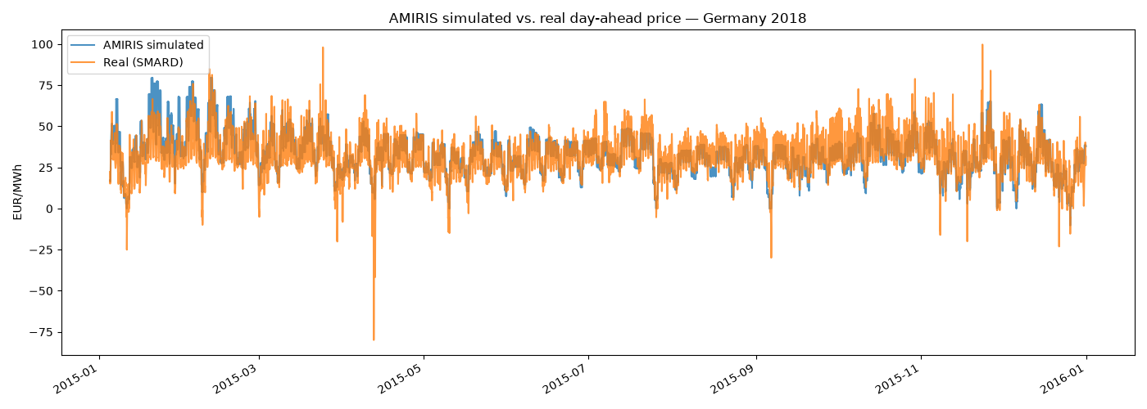
First Results: Germany 2015 Backtest
Annual mean: simulated 33.06 vs. real 31.84 EUR/MWh – bias +1.22 EUR/MWh (≈3.8%).
Full year: MAE 6.64, RMSE 8.67 EUR/MWh, correlation 0.774.
Note: Weakest correlation of the non-2018 years – a candidate for the same root-cause treatment applied to 2018 (see Next Steps). Real series starts 5 Jan (SMARD export gap).

Slide 8
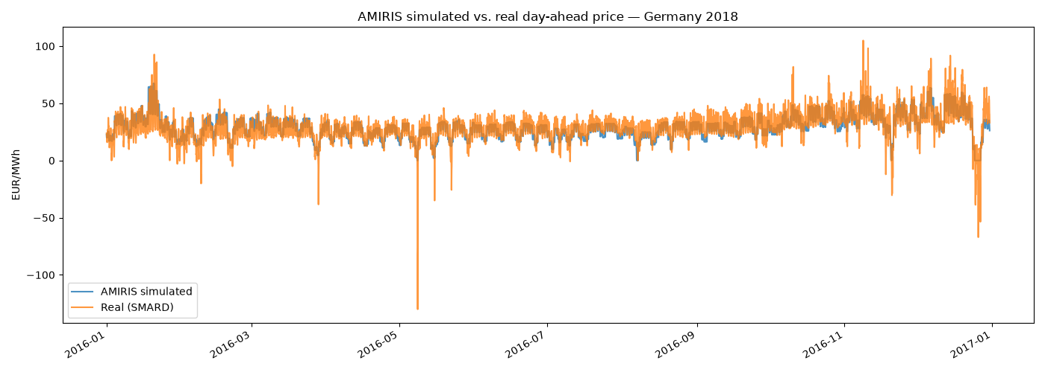
First Results: Germany 2016 Backtest
Annual mean: simulated 29.16 vs. real 28.96 EUR/MWh – bias +0.19 EUR/MWh (≈0.7%).
Full year: MAE 4.96, RMSE 6.92 EUR/MWh, correlation 0.833.
Note: Best absolute-error fit of all five years – a clean, single-zone, no-split year.

Slide 9
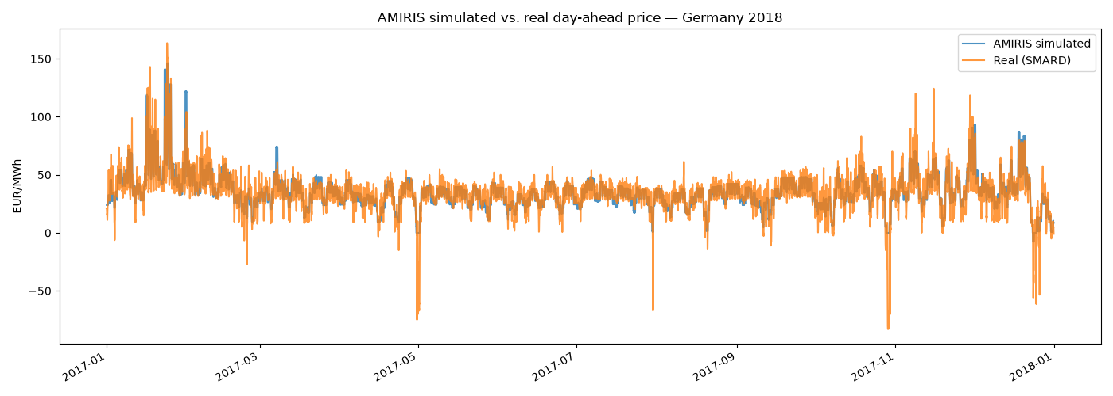
First Results: Germany 2017 Backtest
Annual mean: simulated 35.32 vs. real 34.20 EUR/MWh – bias +1.12 EUR/MWh (≈3.3%).
Full year: MAE 5.70, RMSE 8.76 EUR/MWh, correlation 0.871.
Note: Highest correlation of all five years, despite this scenario covering the Jan 2017 'Kalte Dunkelflaute' cold-and-calm event.

Slide 10
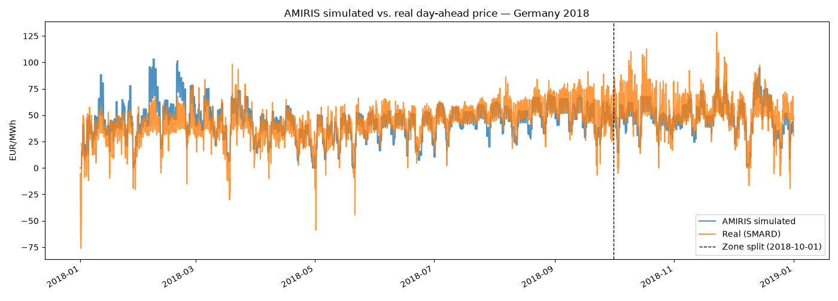
First Results: Germany 2018 Backtest
Annual mean: simulated 45.1 vs. real 44.5 EUR/MWh – bias only +0.6 EUR/MWh (≈1.4%).
Full year: MAE 8.84, RMSE 11.72 EUR/MWh, correlation 0.773. After the Oct zone split (like-for-like DE-LU): correlation 0.847, MAE 8.25.
Quality is comparable to DLR’s own published backtests – level, seasonal shape and spike timing match; spike magnitude is damped.

Slide 11
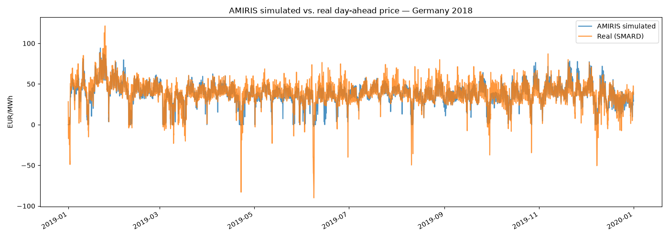
First Results: Germany 2019 Backtest
Annual mean: simulated 37.98 vs. real 37.67 EUR/MWh – bias +0.31 EUR/MWh (≈0.8%).
Full year: MAE 5.37, RMSE 8.01 EUR/MWh, correlation 0.857.
Note: Most structurally complex scenario (18 competing storage units, split must-run/outage inputs) – yet fits nearly as well as 2016/2017.

Slide 12
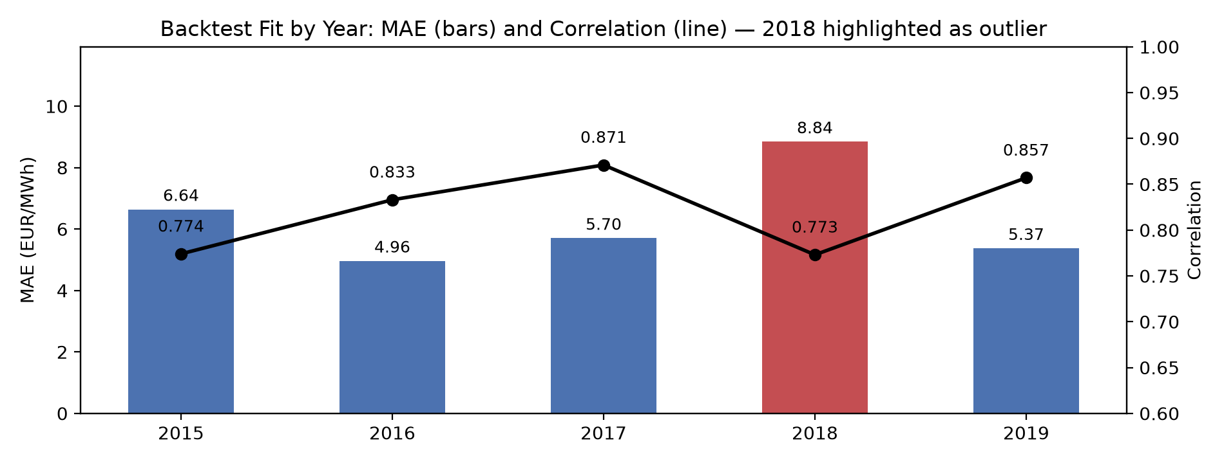
Multi-Year Backtest Results (2015–2019)
All five years now backtested: identical run → extract → compare workflow repeated for Germany 2015–2017 and 2019, using amirispy and SMARD.de real prices for each year.
Best fit: 2016 and 2017 (MAE 4.96 / 5.70 EUR/MWh, correlation 0.83 / 0.87) – both clean single-zone years with no bidding-zone split.
Worst fit: 2018 (MAE 8.84, correlation 0.77) – the one year straddling the Oct 2018 DE-AT-LU → DE-LU zone split, confirming it as a genuine structural driver of error.
2019 holds up well: MAE 5.37, correlation 0.857, despite being the most complex scenario (18 competing storage units) – added detail does not hurt the fit.

Slide 13
Root-Cause Analysis: Two Confirmed Model Gaps
Holiday zero-price floor (confirmed): on 1 Jan/1 May, renewable traders are genuinely curtailed yet still clear at exactly 0 EUR/MWh (real: −49 to −76) – their bid is fixed at zero variable cost, not negative, unlike nuclear/lignite which do have negative bid bands.
Feb cold-snap overshoot (confirmed): checked CO2 price (–47% vs. annual avg), fuel prices (~normal) and outages (better than average) for 5–19 Feb – none explain the overshoot; the real driver is demand +14% above average with no cross-border import relief in this single-zone model.
Damped spikes: spike timing correct but peak height undershot (e.g. 9 Oct 19:00: 62 vs. 110 EUR/MWh) – consistent with the same no-import-relief limitation.
Two distinct, independent model limitations, not one bug – both point to concrete, testable model changes.

Slide 14
Phase 2: Building Germany2023 - Data Pipeline
API access secured: ENTSO-E RESTful API token obtained (after a support request, since it was not self-service) and verified live before any data pipeline was built on top of it.
Full data pipeline built and run: installed capacity, hourly load, 6 renewable generation profiles, 3 conventional outage series (nuclear/lignite/hard coal) and 3 fuel prices (oil/gas/coal) - all fetched, cleaned, and saved in AMIRIS's native scenario format.
Capacity check confirms real-world trends: e.g. nuclear -57% (down to the last 3 reactors), solar +44%, hard coal -28% vs. the 2019 scenario - matching well-known German energy-transition data, a strong sanity check on the whole pipeline.
Nuclear phase-out handled without restructuring the scenario: modelled as an hourly outage-factor step function (0% unavailable before 15 April 2023, 100% after) rather than splitting the year into two separate sub-scenarios.

Slide 15
Phase 2: Data Limitations Found, and What's Left
Outage data limitation (confirmed, documented): Germany's ENTSO-E outage reports for conventional plants cover only planned maintenance, not forced outages - 2023 coal/lignite unavailability is likely understated, a disclosed caveat rather than a hidden gap.
CO2 price: no free bulk-download source found for EU ETS allowance prices; handed off as an open item rather than guessed at for a thesis-grade input (see Inputs Needed).
Remaining before Germany2023 can run: source CO2 price, assemble the scenario.yaml/agents/contracts files by adapting Germany2019's structure with the 2023 data gathered, then run and validate.
Every problem hit this phase was caught and fixed before affecting a result: 11 additional obstacles logged this phase (18 total project-wide) in the technical report, same discipline as the 2015-2019 phase.

Slide 16
Immediate Next Steps
Finish Germany2023: source CO2 price, assemble the scenario config, run it, and backtest against real 2023 SMARD prices - the immediate priority.
Negative-bid experiment: extend RenewableTrader/NoSupportTrader bidding to allow negative markups on curtailment hours; re-run Germany2018 and re-check the holiday duration-curve tail.
Cross-border sensitivity test: add a simple net import/export adjustment to load for high-demand periods; re-test the Feb 2018 window to see if the overshoot shrinks.
Writing: draft the model description and methodology chapters now, using the five-year backtest and the 2023 build as the evidence base.

Slide 17
Remaining Timeline (~9 Weeks)
Weeks 1–2 Finish and backtest Germany2023 (CO2 price, scenario assembly, run); negative-price and cross-border experiments; model description chapter.
Weeks 3–4 Consolidate backtesting results; methodology chapter; obtain and verify Brainpool data.
Weeks 5–6 Benchmarking: AMIRIS vs. Brainpool vs. actuals for the agreed comparison year; results chapter.
Weeks 7–8 Discussion (substitution verdict), introduction, conclusion.
Week 9 Formatting, references, final buffer (3–4 days reserved).

Slide 18
Inputs Needed Today
Approval of the working title and the scoped plan (backtesting + one benchmarking year).
2. Brainpool data (still pending): which years/vintages do we hold? Hourly or aggregated? Which scenario(s)? Real or nominal EUR? Format, access, licensing for thesis use?
3. CO2 (EU ETS) price data access: does the department have Bloomberg/Refinitiv/S&P Platts access? No free bulk source was found for this one input, needed to finish the Germany2023 build.
4. Preferred comparison year - ideally a projected year that has since become the past, enabling the three-way test (AMIRIS vs. Brainpool vs. actuals).

Slide 19
Summary & Requests
Five-year backtest complete: correlation 0.77-0.87, best in 2016/2017, weakest in 2018 (confirmed: zone-split year) - quality comparable to DLR's published backtests.
Two confirmed root causes: renewable bidding cannot go negative (holiday events); no cross-border trade modelled (cold-snap overshoot) - concrete, testable fixes identified.
2023 data pipeline built: capacity, load, generation, outages and fuel prices gathered and validated against known trends; only CO2 price and final scenario assembly remain.
Requested today: Brainpool year (still pending), CO2 price data access, title approval.
5
YEARS BACKTESTED
0.77–0.87
CORRELATION RANGE
2023
BUILD IN PROGRESS

