Slide 1
From Commercial to Open-Source: Evaluating AMIRIS as a Cost-Free Alternative to Energy Brainpool for Electricity Price Forecasting
Supervisor: Rohith Krishnan Bala Krishnan
Presented by: Muideen Oladayo Ajiboye (471583)
Date: 27 August 2026

Slide 2
Agenda
• Tasks from the last meeting - status update
• What we've done since: building, testing, and validating the Germany 2027 model
• Where things stand now
• Next steps
2

Slide 3
PART 1
Tasks From the Last Meeting
3

Slide 4
Three Tasks From Last Time
• 1. Submit the filled thesis form for endorsement
• 2. Load profile comparisons - AMIRIS vs. our different model versions, with charts
• 3. Use the 2009 renewable weather profiles
4

Slide 5
Task 1: Thesis Form
• Administrative item - status to confirm at this meeting
5

Slide 6
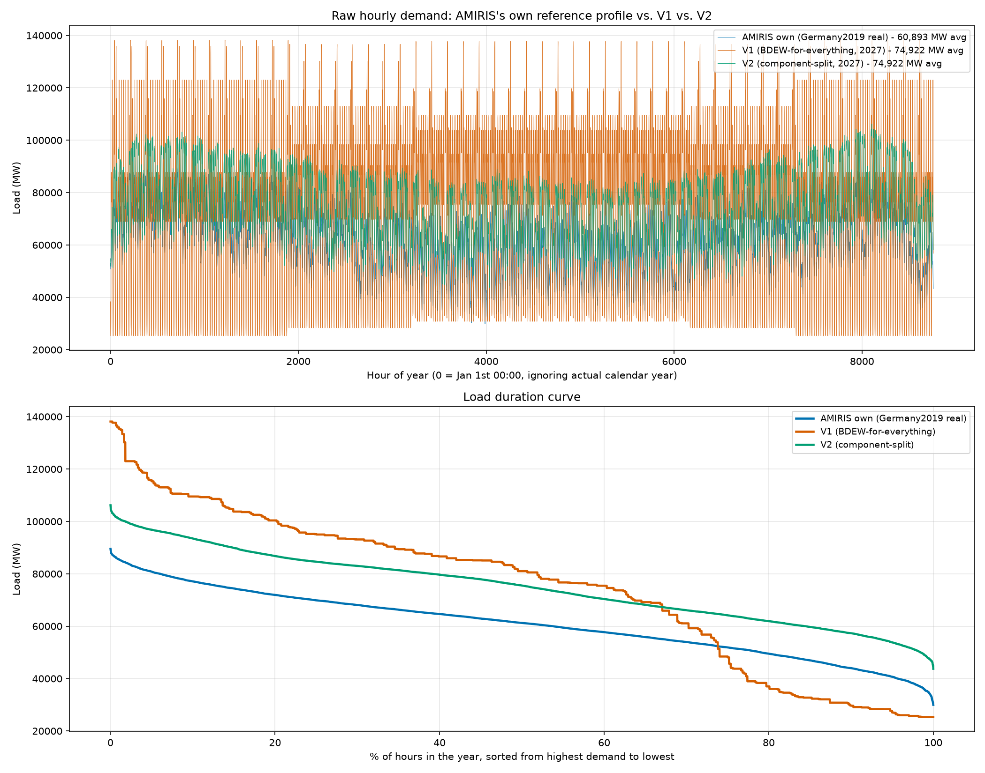
Task 2: Load Profile Comparison
AMIRIS's own reference profile vs. V1 (single household-shape demand) vs. V2 (component-split demand)
6

Slide 7
Task 2: What the Comparison Showed
• V1 (one shape for all demand): peak too high, unrealistic evening spike
• V2 (split into 4 real components): much closer to AMIRIS's own real reference shape
• This finding directly motivated switching the whole project to V2
• V2 became the foundation for everything that followed
7

Slide 8
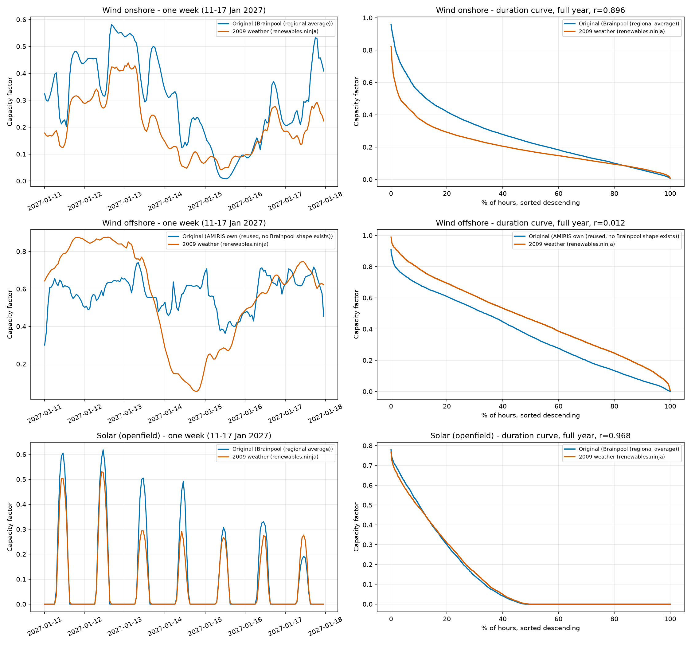
Task 3: 2009 Renewable Weather Profiles
Real 2009 weather (renewables.ninja) vs. our original profiles - one week detail + full-year duration curves
8

Slide 9
Task 3: What We Found
• Brainpool's forecast is built on real 2009 weather - confirmed directly from their published methodology
• Rebuilt wind & solar using real 2009 weather data
‒ Onshore wind and solar: strongly correlated with our original profiles (r = 0.90 and 0.97)
‒ Offshore wind: no real correlation (r = 0.01) - a genuine, separate gap
• This 2009 weather basis was later reused for heat-pump temperature too
9

Slide 10
PART 2
What We've Done Since
10

Slide 11
The Big Picture
• Built a full AMIRIS model of Germany's 2027 electricity market, from Brainpool's real input data
• Compared it hour-by-hour against Brainpool's own real 2027 price forecast
• Diagnosed and fixed the gap, one verified step at a time
• Tested whether the fixes hold up on years we never tuned for (2028, 2029)
• Found and fixed a genuine bug along the way
11

Slide 12
Building the Model (V1 -> V2)
• V1: one household-shaped demand curve for all of Germany's electricity use
• V2: split demand into 4 real components - base load, heat pumps, electrolysis, e-mobility
• Each component shaped using the real data suited to it
• Result: shortage hours (the model 'running out of power') fell from 15.9% to 7.5% of the year
12

Slide 13
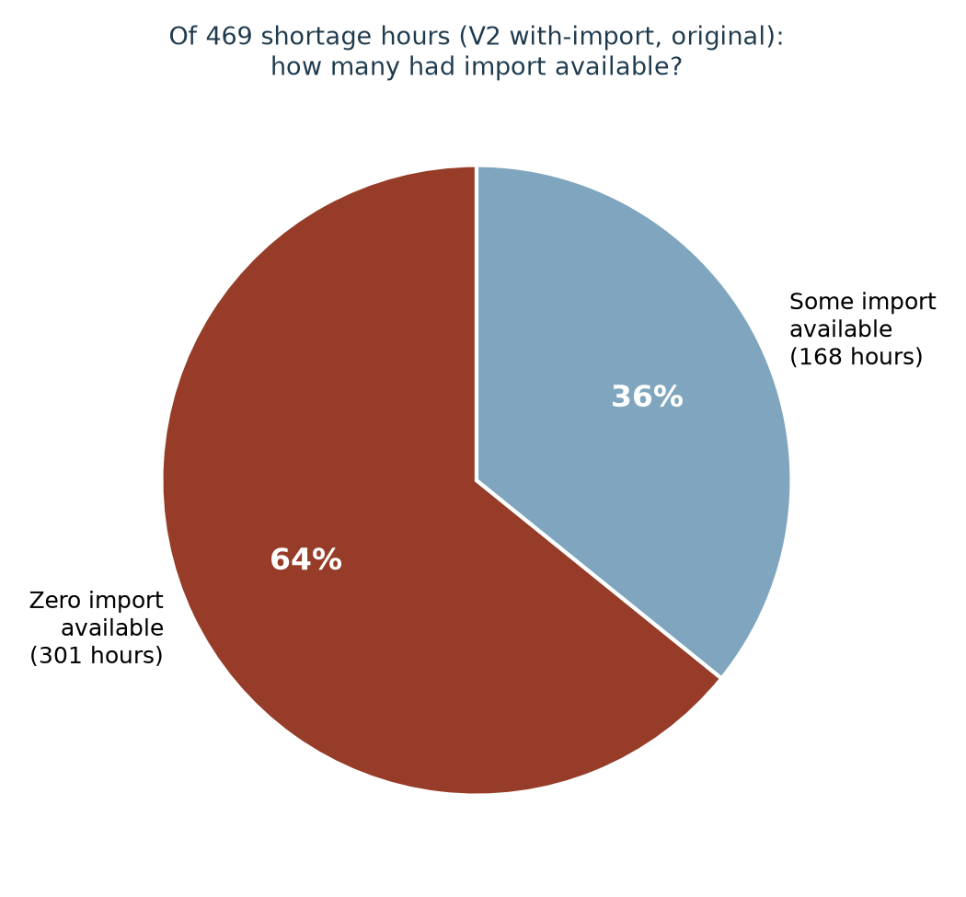
Fixing the Import Mechanism
Diagnosed directly: 64% of shortage hours had ZERO import available - import timing was copied from an unrelated year
13

Slide 14
Verifying Our Assumptions Against Reality
• Rather than assume, we checked Brainpool's real published methodology directly
• Confirmed: 2009 weather year - correct
• Confirmed: Brainpool's real model covers ~30 European countries with price coupling, not one neighbour
• Rebuilt our import price as a blend of 11 real neighbouring countries instead of France alone
• Result: a small, genuine improvement
14

Slide 15
Making Demand "Smart"
• Hydrogen production (electrolysis) and EV charging used to draw power flat, every hour
• Rebuilt both as price-responsive: they now choose WHEN to draw power
• Verified directly: both shift toward cheap and negative-price hours
• EV charging result: shortage hours reached ZERO for the first time this project
15

Slide 16
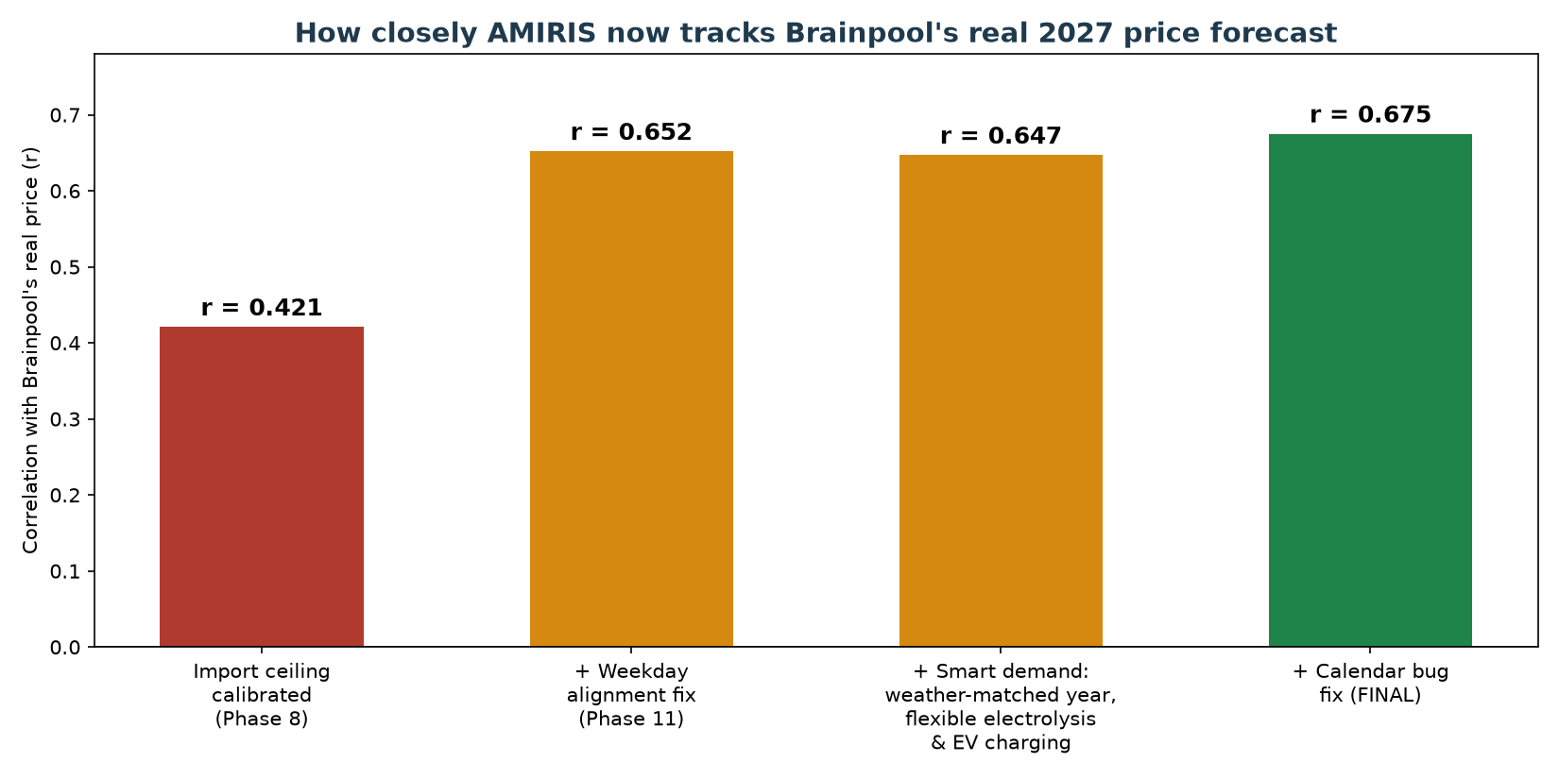
The Correlation Journey
How closely AMIRIS tracks Brainpool's real 2027 price, step by step, from initial calibration to the final fix
16

Slide 17
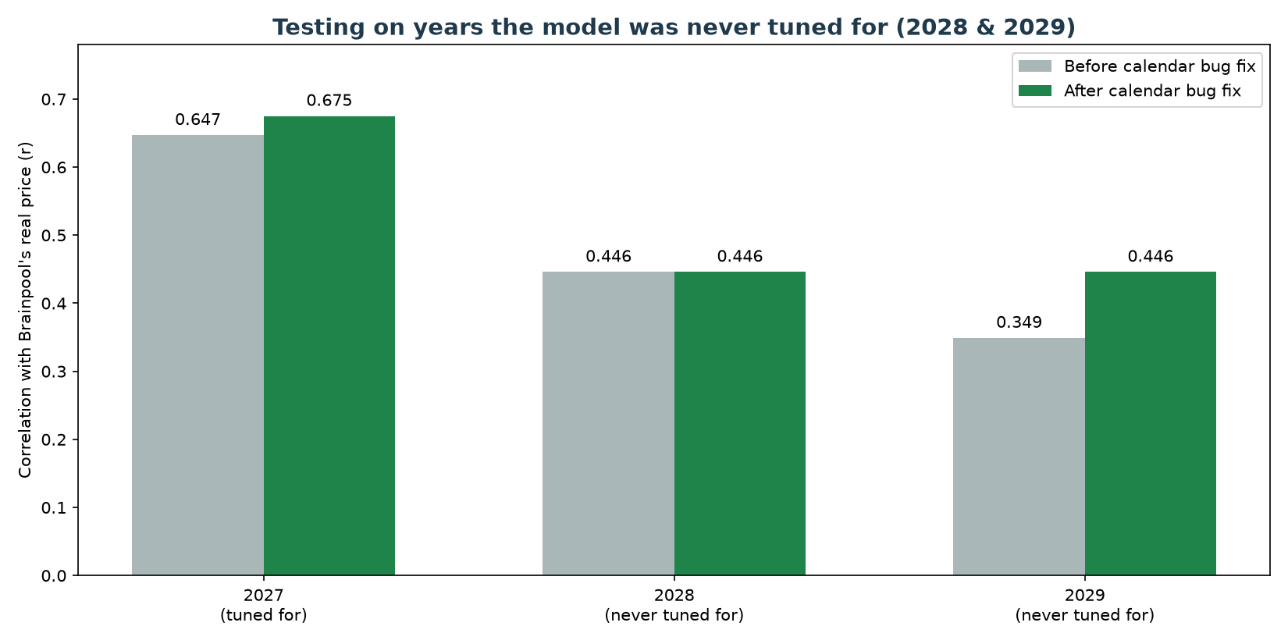
Testing Years We Never Tuned For
Built 2028 and 2029 the same way as 2027, with zero re-tuning, using Brainpool's newly-supplied multi-year data
17

Slide 18
A Genuine Bug, Found and Fixed
• Checking WHERE 2028/2029 disagreed with Brainpool most revealed a real calendar bug
• Our demand shape borrows a real year's usage pattern (2016) and trims it to fit the target year
• The trimming method silently misaligned the days of the week for 84% of the year
• Clean result: both 2027 and 2029 improved on accuracy AND average error, with no downside
18

Slide 19
Where We Stand Now
Build | Shortage hours | Mean price | vs. Brainpool's real 68.04
V1, no import | 15.88% | 519 EUR/MWh | 7.6x too high
V1, final | 0.83% | 75 EUR/MWh | almost exact
V2, no import | 7.52% | 286 EUR/MWh | 4.2x too high
V2, final (all fixes) | 0.02% | 56 EUR/MWh | close, slightly below
19

Slide 20
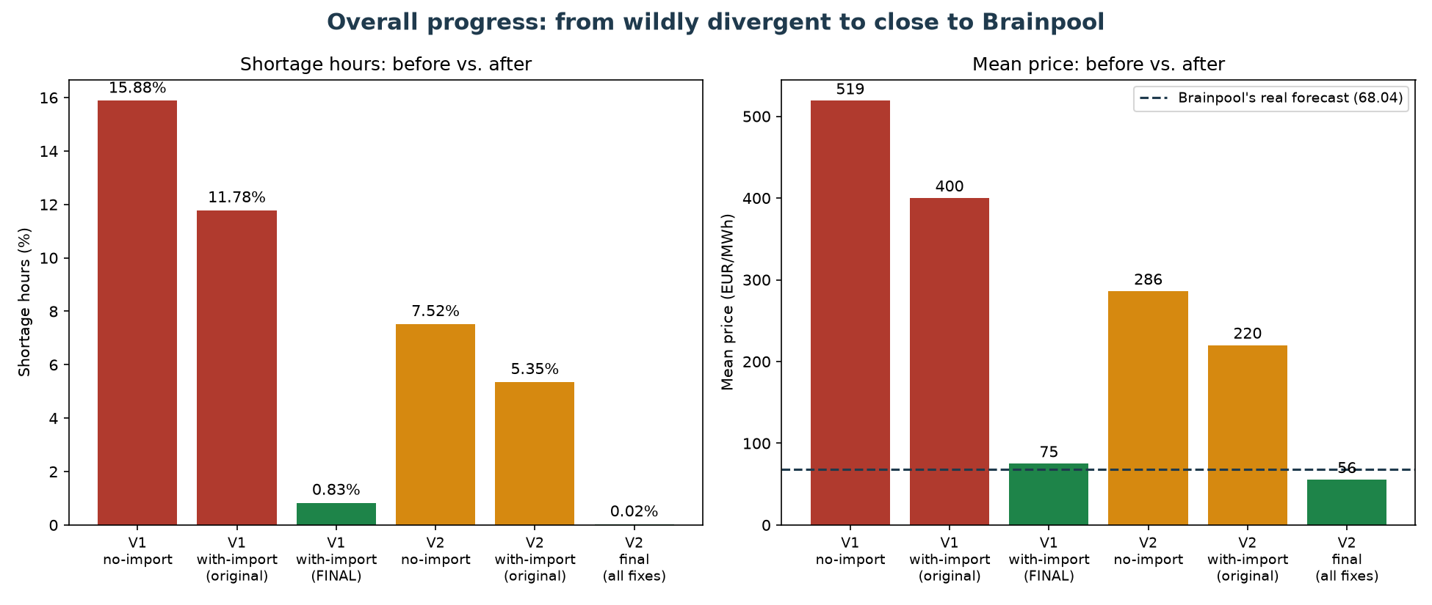
The Overall Journey
From wildly divergent (7.6x too high, 16% shortage hours) to close to Brainpool's real forecast
20

Slide 21
Next Steps
• Decide whether to pursue a full cross-border export model (a large undertaking) - the midday-price gap is the main remaining issue and needs this
• Consider whether to update the shortage price (3,000 EUR/MWh) to reflect today's real EU cap (5,000 EUR/MWh)
• Investigate WHY the import ceiling behaves differently across years - a real, still-unexplained pattern
• Continue folding all findings into the formal thesis documentation
21

Slide 22
Questions & Discussion
22

