Slide 1

Progress Report & Thesis Plan: Evaluating AMIRIS as a Substitute for Purchased Electricity Price Time Series
Supervisor: Rohith Krishnan Bala Krishnan
Presented by:
Muideen Oladayo Ajiboye (471583)
Date : 20 July 2026

Slide 2
Progress & Plan

Slide 3
Motivation & Research Question
The need: the department’s Thuringia energy model requires hourly day-ahead electricity price time series (8,760 prices per year, German bidding zone) as an input.
Status quo: these series are purchased from Energy Brainpool.
The candidate: AMIRIS – DLR’s open-source, agent-based electricity market model – produces the same kind of series at no cost, with full transparency.
Research question: To what extent can AMIRIS reproduce German day-ahead price time series, and how does its accuracy compare with the commercially procured scenarios?
Proposed working title (for approval): “Can Open-Source Market Simulation Substitute Purchased Electricity Price Time Series? Backtesting and Benchmarking AMIRIS for a Regional Energy Model”

Slide 4
Approach: Two Comparisons
Comparison 1 – Backtesting: AMIRIS vs. real EPEX/SMARD prices for historical years – establishes model credibility against known ground truth.
Comparison 2 – Benchmarking: AMIRIS vs. Energy Brainpool for a year covered by the department’s data, plus actual prices where that year already lies in the past.
Metrics: mean/baseload price, MAE, RMSE, correlation, price duration curves, daily and seasonal profiles, negative-price and peak hours, wind/PV capture prices.
Key principle: both models compute conditional scenarios, not forecasts – the comparison targets how faithfully each translates assumptions into realistic hourly price structure.

Slide 5
How the Backtest Pipeline Works
Real Historical Data
AMIRIS Engine
Simulated Price
load · weather · fuel & CO2 prices · outages
virtual plants & traders bid, hour by hour
DayAheadMarketSingleZone.csv
Real Price (SMARD.de)
Compare, hour by hour: mean absolute error, root-mean-square error and correlation quantify how closely the simulated price tracks reality – this is what ‘backtesting’ means throughout this project.
actual historical German day-ahead auction

Slide 6
Work Completed: Pipeline Operational
Environment: AMIRIS 4.1.2 (Java) with amirispy/fameio toolchain set up and working locally.
Simulation: Germany2018 backtest scenario executed successfully – full year, 8,760 hours, all agent outputs (market price, dispatch, storage, traders).
Real data: SMARD day-ahead prices obtained and merged across the 1 Oct 2018 bidding-zone split (DE-AT-LU → DE-LU); complete series.
Analysis tooling: reusable Python scripts (merge + compare) reporting MAE, RMSE, correlation, split-period metrics, and overlay plots – applicable to every future run.
Multi-year validation: completed for Germany 2015–2019 (5 of 5 available years) – all runs and comparisons executed.

Slide 7
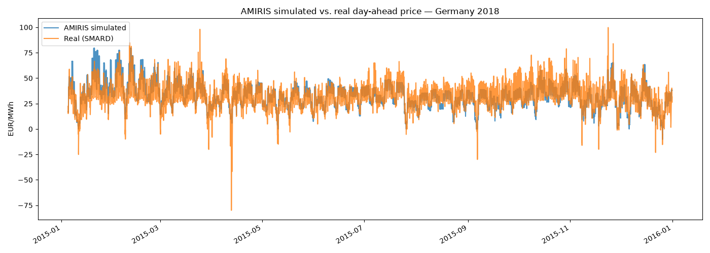
First Results: Germany 2015 Backtest
Annual mean: simulated 33.06 vs. real 31.84 EUR/MWh – bias +1.22 EUR/MWh (≈3.8%).
Full year: MAE 6.64, RMSE 8.67 EUR/MWh, correlation 0.774.
Note: Weakest correlation of the non-2018 years – a candidate for the same root-cause treatment applied to 2018 (see Next Steps). Real series starts 5 Jan (SMARD export gap).

Slide 8
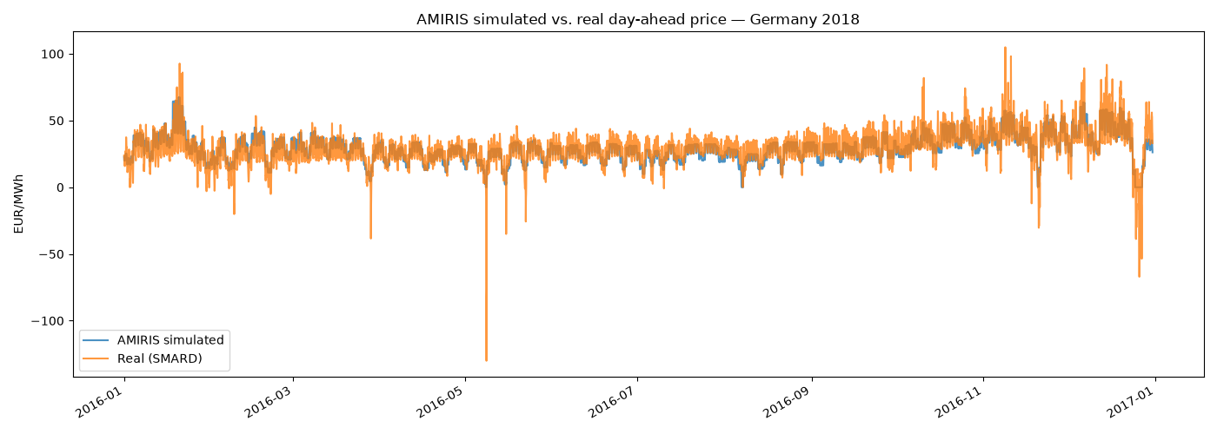
First Results: Germany 2016 Backtest
Annual mean: simulated 29.16 vs. real 28.96 EUR/MWh – bias +0.19 EUR/MWh (≈0.7%).
Full year: MAE 4.96, RMSE 6.92 EUR/MWh, correlation 0.833.
Note: Best absolute-error fit of all five years – a clean, single-zone, no-split year.

Slide 9
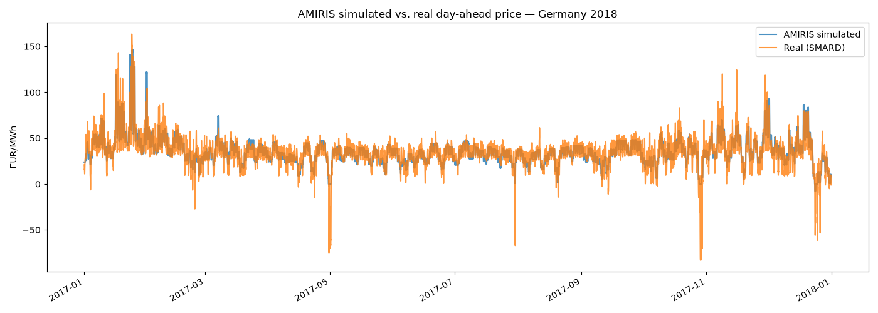
First Results: Germany 2017 Backtest
Annual mean: simulated 35.32 vs. real 34.20 EUR/MWh – bias +1.12 EUR/MWh (≈3.3%).
Full year: MAE 5.70, RMSE 8.76 EUR/MWh, correlation 0.871.
Note: Highest correlation of all five years, despite this scenario covering the Jan 2017 'Kalte Dunkelflaute' cold-and-calm event.

Slide 10
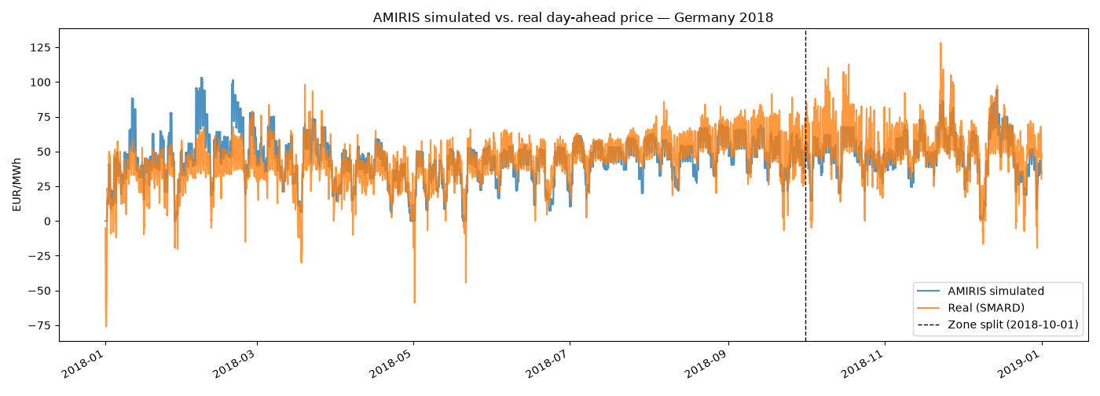
First Results: Germany 2018 Backtest
Annual mean: simulated 45.1 vs. real 44.5 EUR/MWh – bias only +0.6 EUR/MWh (≈1.4%).
Full year: MAE 8.84, RMSE 11.72 EUR/MWh, correlation 0.773. After the Oct zone split (like-for-like DE-LU): correlation 0.847, MAE 8.25.
Quality is comparable to DLR’s own published backtests – level, seasonal shape and spike timing match; spike magnitude is damped.

Slide 11
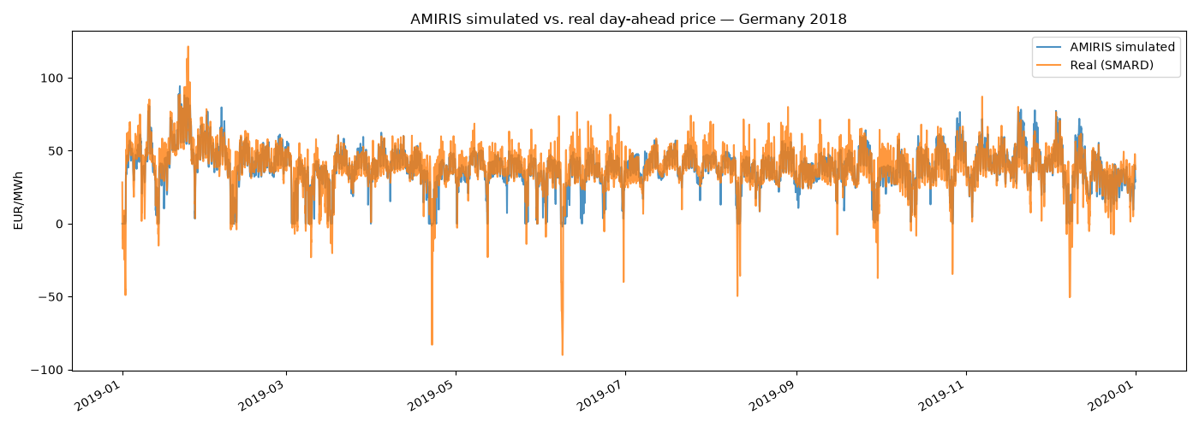
First Results: Germany 2019 Backtest
Annual mean: simulated 37.98 vs. real 37.67 EUR/MWh – bias +0.31 EUR/MWh (≈0.8%).
Full year: MAE 5.37, RMSE 8.01 EUR/MWh, correlation 0.857.
Note: Most structurally complex scenario (18 competing storage units, split must-run/outage inputs) – yet fits nearly as well as 2016/2017.

Slide 12
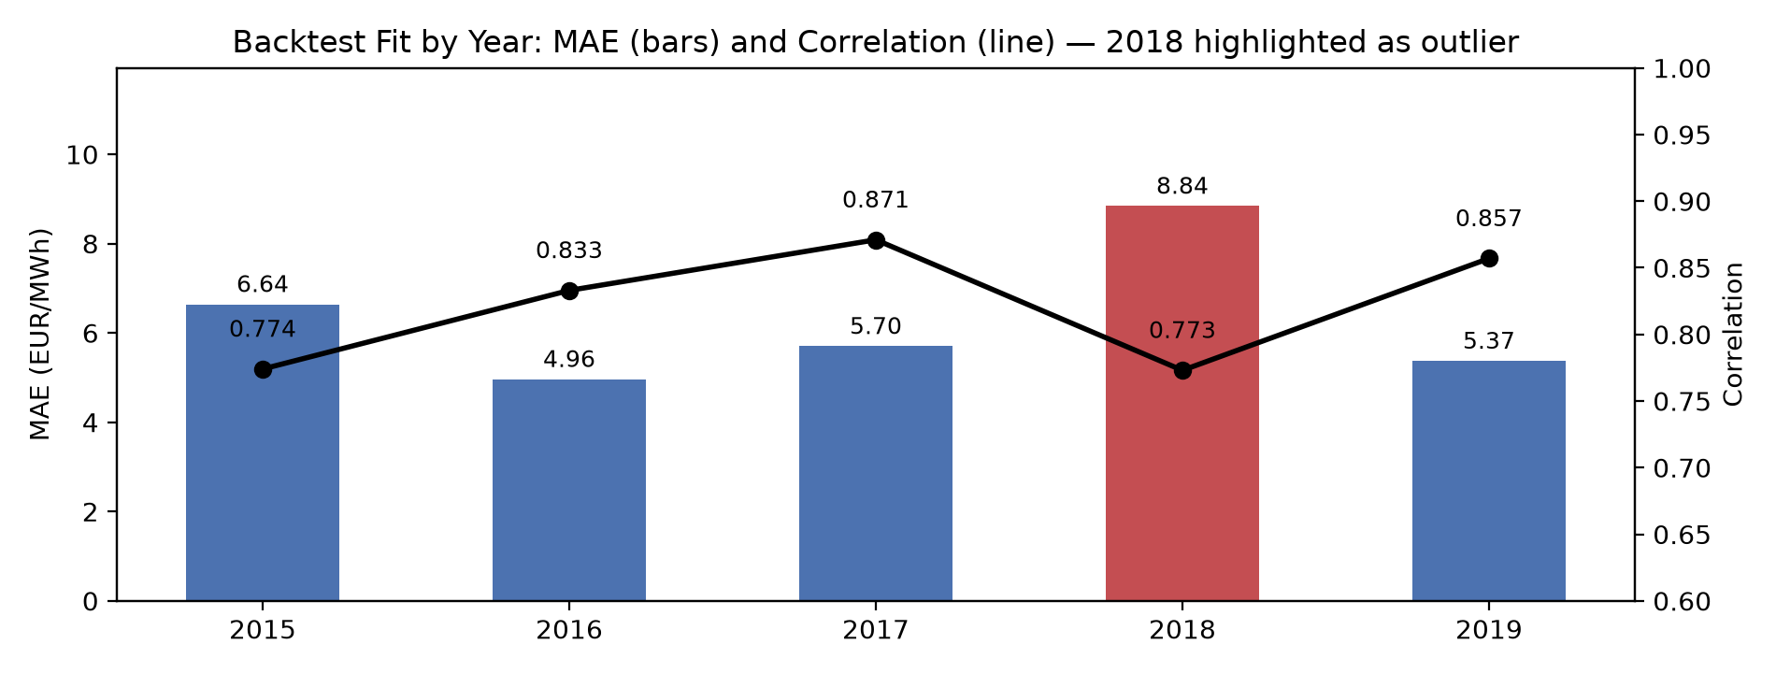
Multi-Year Backtest Results (2015–2019)
All five years now backtested: identical run → extract → compare workflow repeated for Germany 2015–2017 and 2019, using amirispy and SMARD.de real prices for each year.
Best fit: 2016 and 2017 (MAE 4.96 / 5.70 EUR/MWh, correlation 0.83 / 0.87) – both clean single-zone years with no bidding-zone split.
Worst fit: 2018 (MAE 8.84, correlation 0.77) – the one year straddling the Oct 2018 DE-AT-LU → DE-LU zone split, confirming it as a genuine structural driver of error.
2019 holds up well: MAE 5.37, correlation 0.857, despite being the most complex scenario (18 competing storage units) – added detail does not hurt the fit.

Slide 13
Root-Cause Analysis: Two Confirmed Model Gaps
Holiday zero-price floor (confirmed): on 1 Jan/1 May, renewable traders are genuinely curtailed yet still clear at exactly 0 EUR/MWh (real: −49 to −76) – their bid is fixed at zero variable cost, not negative, unlike nuclear/lignite which do have negative bid bands.
Feb cold-snap overshoot (confirmed): checked CO2 price (–47% vs. annual avg), fuel prices (~normal) and outages (better than average) for 5–19 Feb – none explain the overshoot; the real driver is demand +14% above average with no cross-border import relief in this single-zone model.
Damped spikes: spike timing correct but peak height undershot (e.g. 9 Oct 19:00: 62 vs. 110 EUR/MWh) – consistent with the same no-import-relief limitation.
Two distinct, independent model limitations, not one bug – both point to concrete, testable model changes.

Slide 14
Phase 2: Building Germany2023 - Data Pipeline
API access secured: ENTSO-E RESTful API token obtained (after a support request, since it was not self-service) and verified live before any data pipeline was built on top of it.
Full data pipeline built and run: installed capacity, hourly load, 6 renewable generation profiles, 3 conventional outage series (nuclear/lignite/hard coal) and 3 fuel prices (oil/gas/coal) - all fetched, cleaned, and saved in AMIRIS's native scenario format.
Capacity check confirms real-world trends: e.g. nuclear -57% (down to the last 3 reactors), solar +44%, hard coal -28% vs. the 2019 scenario - matching well-known German energy-transition data, a strong sanity check on the whole pipeline.
Nuclear phase-out handled without restructuring the scenario: modelled as an hourly outage-factor step function (0% unavailable before 15 April 2023, 100% after) rather than splitting the year into two separate sub-scenarios.

Slide 15
Phase 2: Data Limitations Found, and What's Left
Outage data limitation (confirmed, documented): Germany's ENTSO-E outage reports for conventional plants cover only planned maintenance, not forced outages - 2023 coal/lignite unavailability is likely understated, a disclosed caveat rather than a hidden gap.
CO2 price: no free bulk-download source found for EU ETS allowance prices; handed off as an open item rather than guessed at for a thesis-grade input (see Inputs Needed).
Remaining before Germany2023 can run: source CO2 price, assemble the scenario.yaml/agents/contracts files by adapting Germany2019's structure with the 2023 data gathered, then run and validate.
Every problem hit this phase was caught and fixed before affecting a result: 11 additional obstacles logged this phase (18 total project-wide) in the technical report, same discipline as the 2015-2019 phase.

Slide 16
New Direction: A Cleaner Comparison with Brainpool
Original design conflated two variables: comparing AMIRIS's own independently-sourced data against real prices cannot separate 'wrong input data' from 'AMIRIS's internal logic differs from reality' as the explanation for any mismatch.
New design isolates model logic: feed AMIRIS the exact same assumptions Energy Brainpool used (capacity figures, fuel prices, etc.) for an agreed year, then compare AMIRIS's price directly against Brainpool's price - a standard 'model inter-comparison' technique in energy research.
2019 is the natural candidate year: already backtested against real prices (MAE 5.37, correlation 0.857, one of the best-fitting years) - reusing it completes a genuine three-way comparison (AMIRIS vs. Brainpool vs. reality) on existing infrastructure.
A stronger result either way: close agreement supports AMIRIS as a substitute; a gap becomes a precisely diagnosable finding, using the same root-cause method already proven on the 2018 results.

Slide 17
Data Request Sent - Plan Going Forward
Delivered to the department: a complete AMIRIS input-data requirements document - demand, conventional fleet (capacity/efficiency/cost/emissions/outages per fuel type), renewable fleet (capacity, generation profile, subsidy scheme), storage, fuel & CO2 prices, plus structural questions (cross-border trade, bidding behaviour, negative pricing).
Key gap flagged up front: Brainpool's data likely includes capacity totals but may not include the hourly weather-driven generation shape AMIRIS also needs - any such gap will be backfilled with AMIRIS's own sourced data and documented per item, not glossed over.
Once data returns: gap analysis (supplied / partial / backfilled) becomes a methodology table; build the 2019 scenario on Brainpool's assumptions; run AMIRIS; compare three ways.
Running in parallel, not blocked on this: the Germany2023 backtest build (CO2 price, scenario assembly) continues as independent backtesting evidence.

Slide 18
Immediate Next Steps
Awaiting department reply: the data request cross-reference is the current critical path for the Brainpool comparison.
Finish Germany2023 in parallel: source CO2 price, assemble the scenario config, run it, and backtest against real 2023 SMARD prices.
Negative-bid experiment: extend RenewableTrader/NoSupportTrader bidding to allow negative markups on curtailment hours; re-run Germany2018 and re-check the holiday duration-curve tail.
Writing: draft the model description and methodology chapters now, including the new same-assumptions comparison design.

Slide 19
Remaining Timeline (~9 Weeks)
Weeks 1–2 Data request cross-reference with department; finish and backtest Germany2023; negative-price experiment; model description chapter.
Weeks 3–4 Consolidate backtesting results; methodology chapter; obtain and verify Brainpool data.
Weeks 5–6 Benchmarking: AMIRIS vs. Brainpool vs. actuals for the agreed comparison year; results chapter.
Weeks 7–8 Discussion (substitution verdict), introduction, conclusion.
Week 9 Formatting, references, final buffer (3–4 days reserved).

Slide 20
Inputs Needed Today
1. Brainpool data cross-reference: which items in the data request document does the department's Brainpool package actually cover, for 2019?
2. CO2 (EU ETS) price data access: does the department have Bloomberg/Refinitiv/S&P Platts access? Needed to finish the Germany2023 build.
3. Confirmation this is the agreed comparison year: 2019 is proposed since AMIRIS already has real-price backtest results for it - please confirm or redirect.
4. Approval of the working title and the scoped plan (backtesting + same-assumptions benchmarking).
5. Check-in cadence - proposal: short bi-weekly progress updates.

Slide 21
Summary & Requests
Methodology sharpened: benchmarking now compares AMIRIS against Brainpool using Brainpool's own assumptions - isolates model logic from data-quality differences.
Data request delivered: complete AMIRIS input list sent to the department for cross-reference against their Brainpool holdings.
Five-year backtest complete, 2023 build in progress: correlation 0.77-0.87 across 2015-2019; Germany2023 pipeline built, CO2 price and final assembly remaining.
Requested today: Brainpool cross-reference reply, CO2 price data access, confirmation of 2019 as the comparison year.
5
YEARS BACKTESTED
0.77–0.87
CORRELATION RANGE
2023
BUILD IN PROGRESS

