Slide 1
From Commercial to Open-Source: Evaluating AMIRIS as a Cost-Free Alternative to Energy Brainpool for Electricity Price Forecasting
Supervisor: Rohith Krishnan Bala Krishnan
Presented by: Muideen Oladayo Ajiboye (471583)
Date: 27 August 2026

Slide 2
Agenda
• Tasks from the last meeting - status update
• What we've done since: building, testing, and validating the Germany 2027 model
• Where things stand now
• Next steps
2

Slide 3
PART 1
Tasks From the Last Meeting
3

Slide 4
Three Tasks From Last Time
• 1. Submit the filled thesis form for endorsement
• 2. Load profile comparisons - AMIRIS vs. our different model versions, with charts
• 3. Use the 2009 renewable weather profiles
4

Slide 5
Task 1: Thesis Form
• Administrative item - status to confirm at this meeting
5

Slide 6
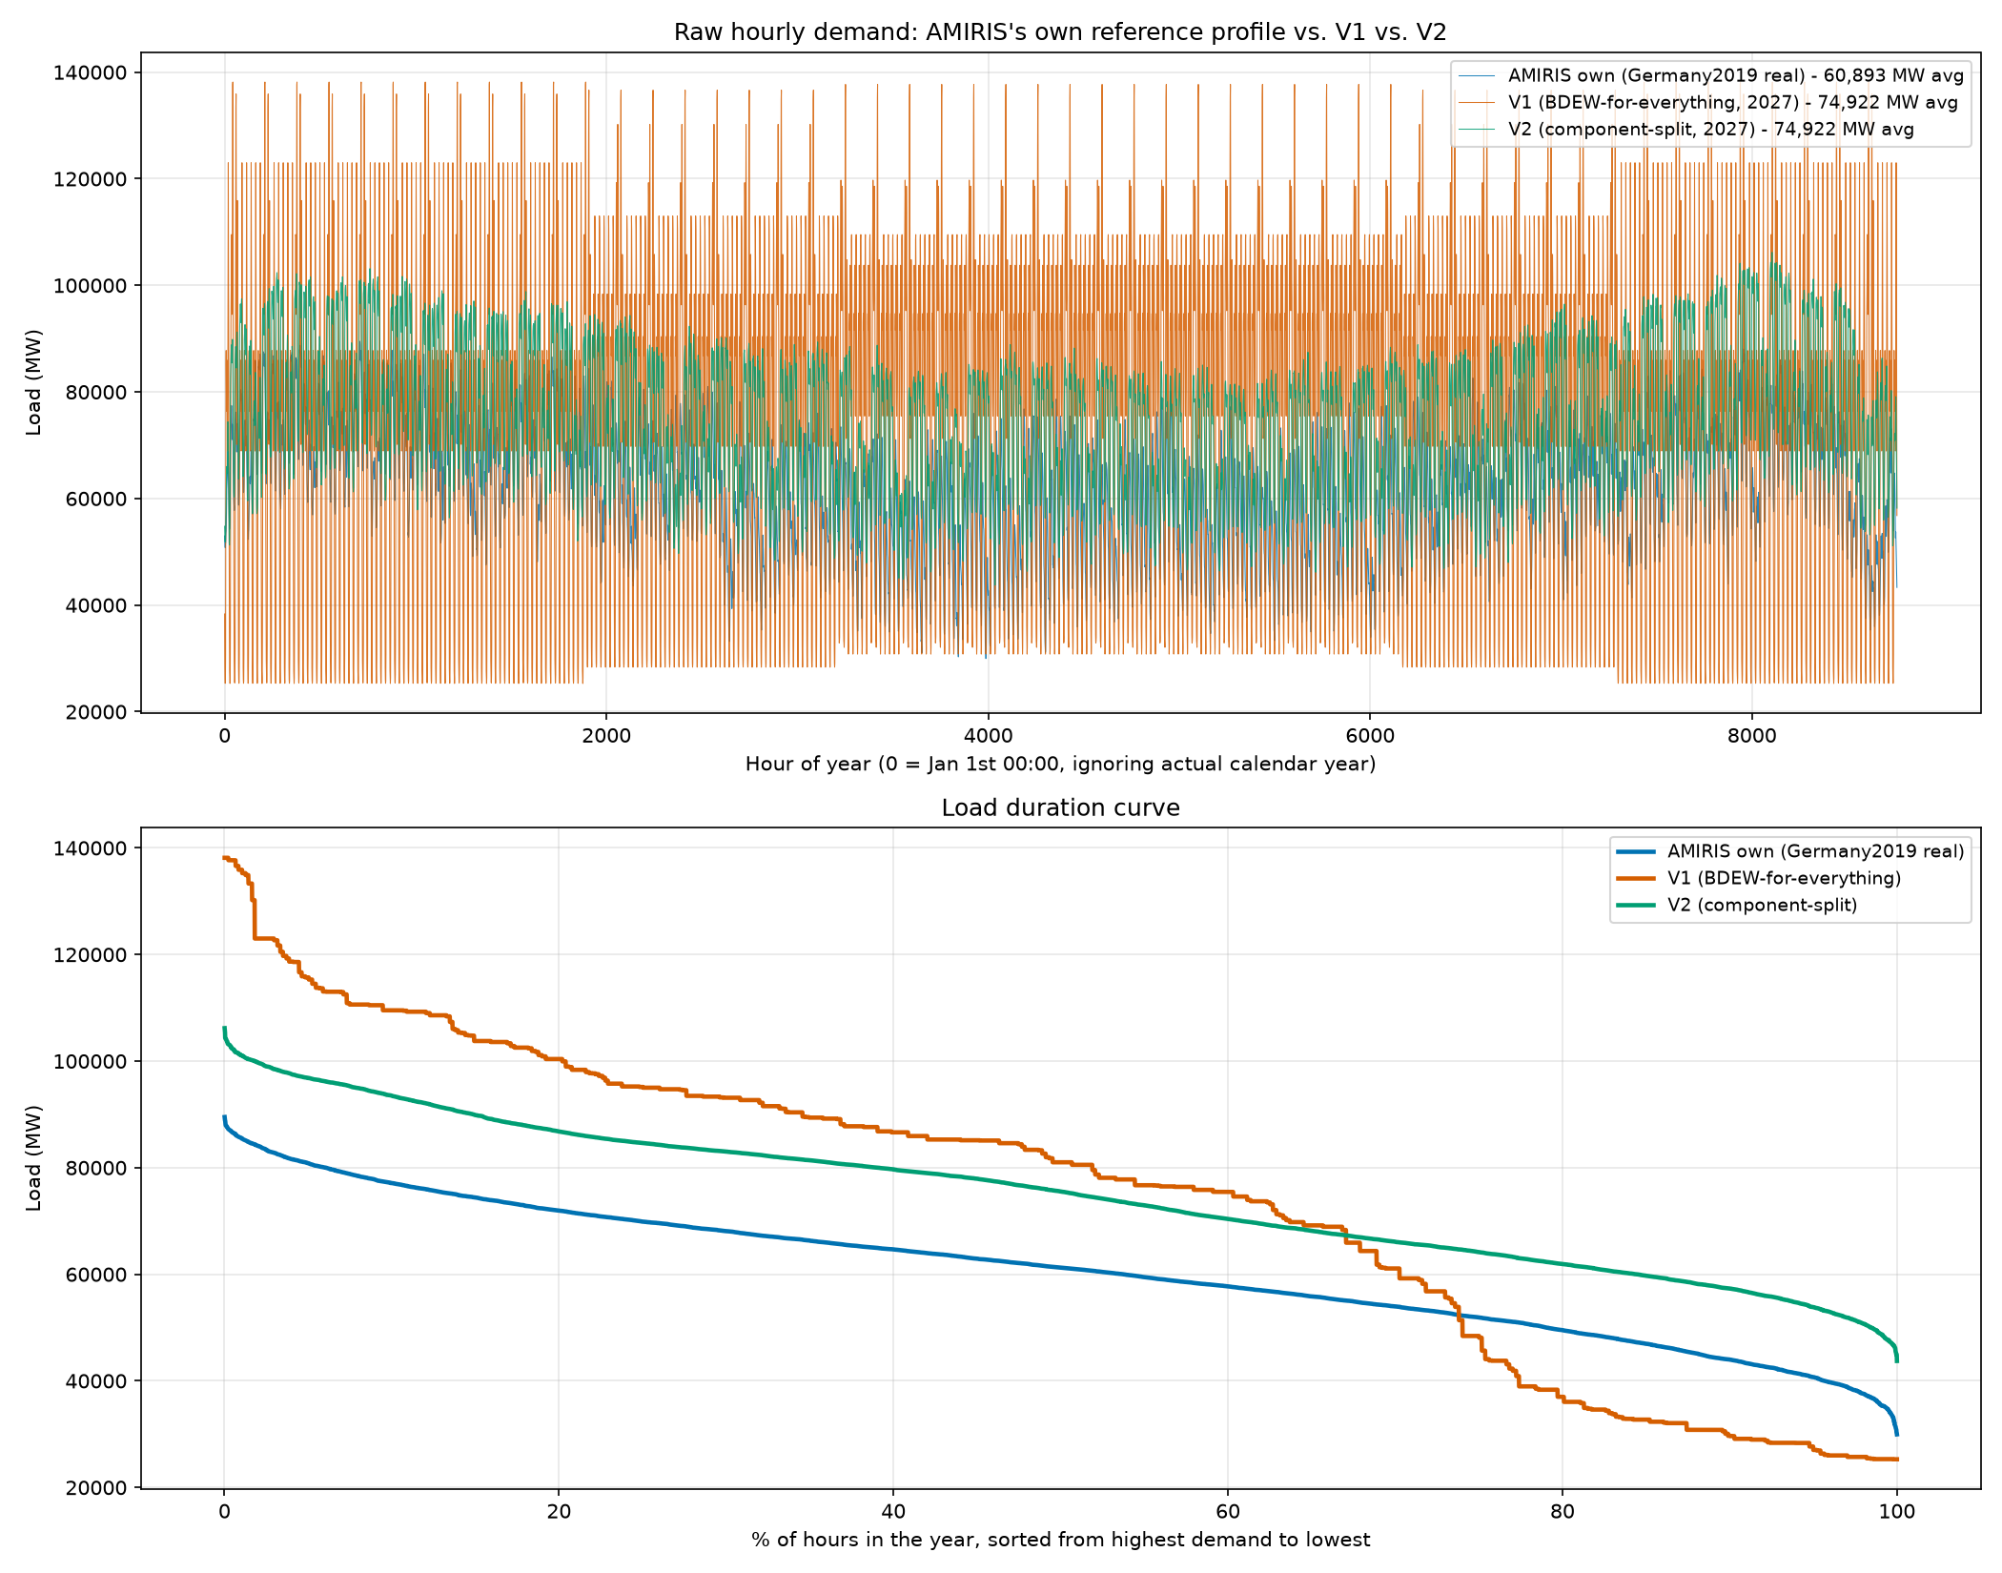
Task 2: Load Profile Comparison
AMIRIS's own reference profile vs. V1 (single household-shape demand) vs. V2 (component-split demand)
6

Slide 7
Task 2: What the Comparison Showed
• V1 (one shape for all demand): peak too high, unrealistic evening spike
• V2 (split into 4 real components): much closer to AMIRIS's own real reference shape
• This finding directly motivated switching the whole project to V2
• V2 became the foundation for everything that followed
7

Slide 8
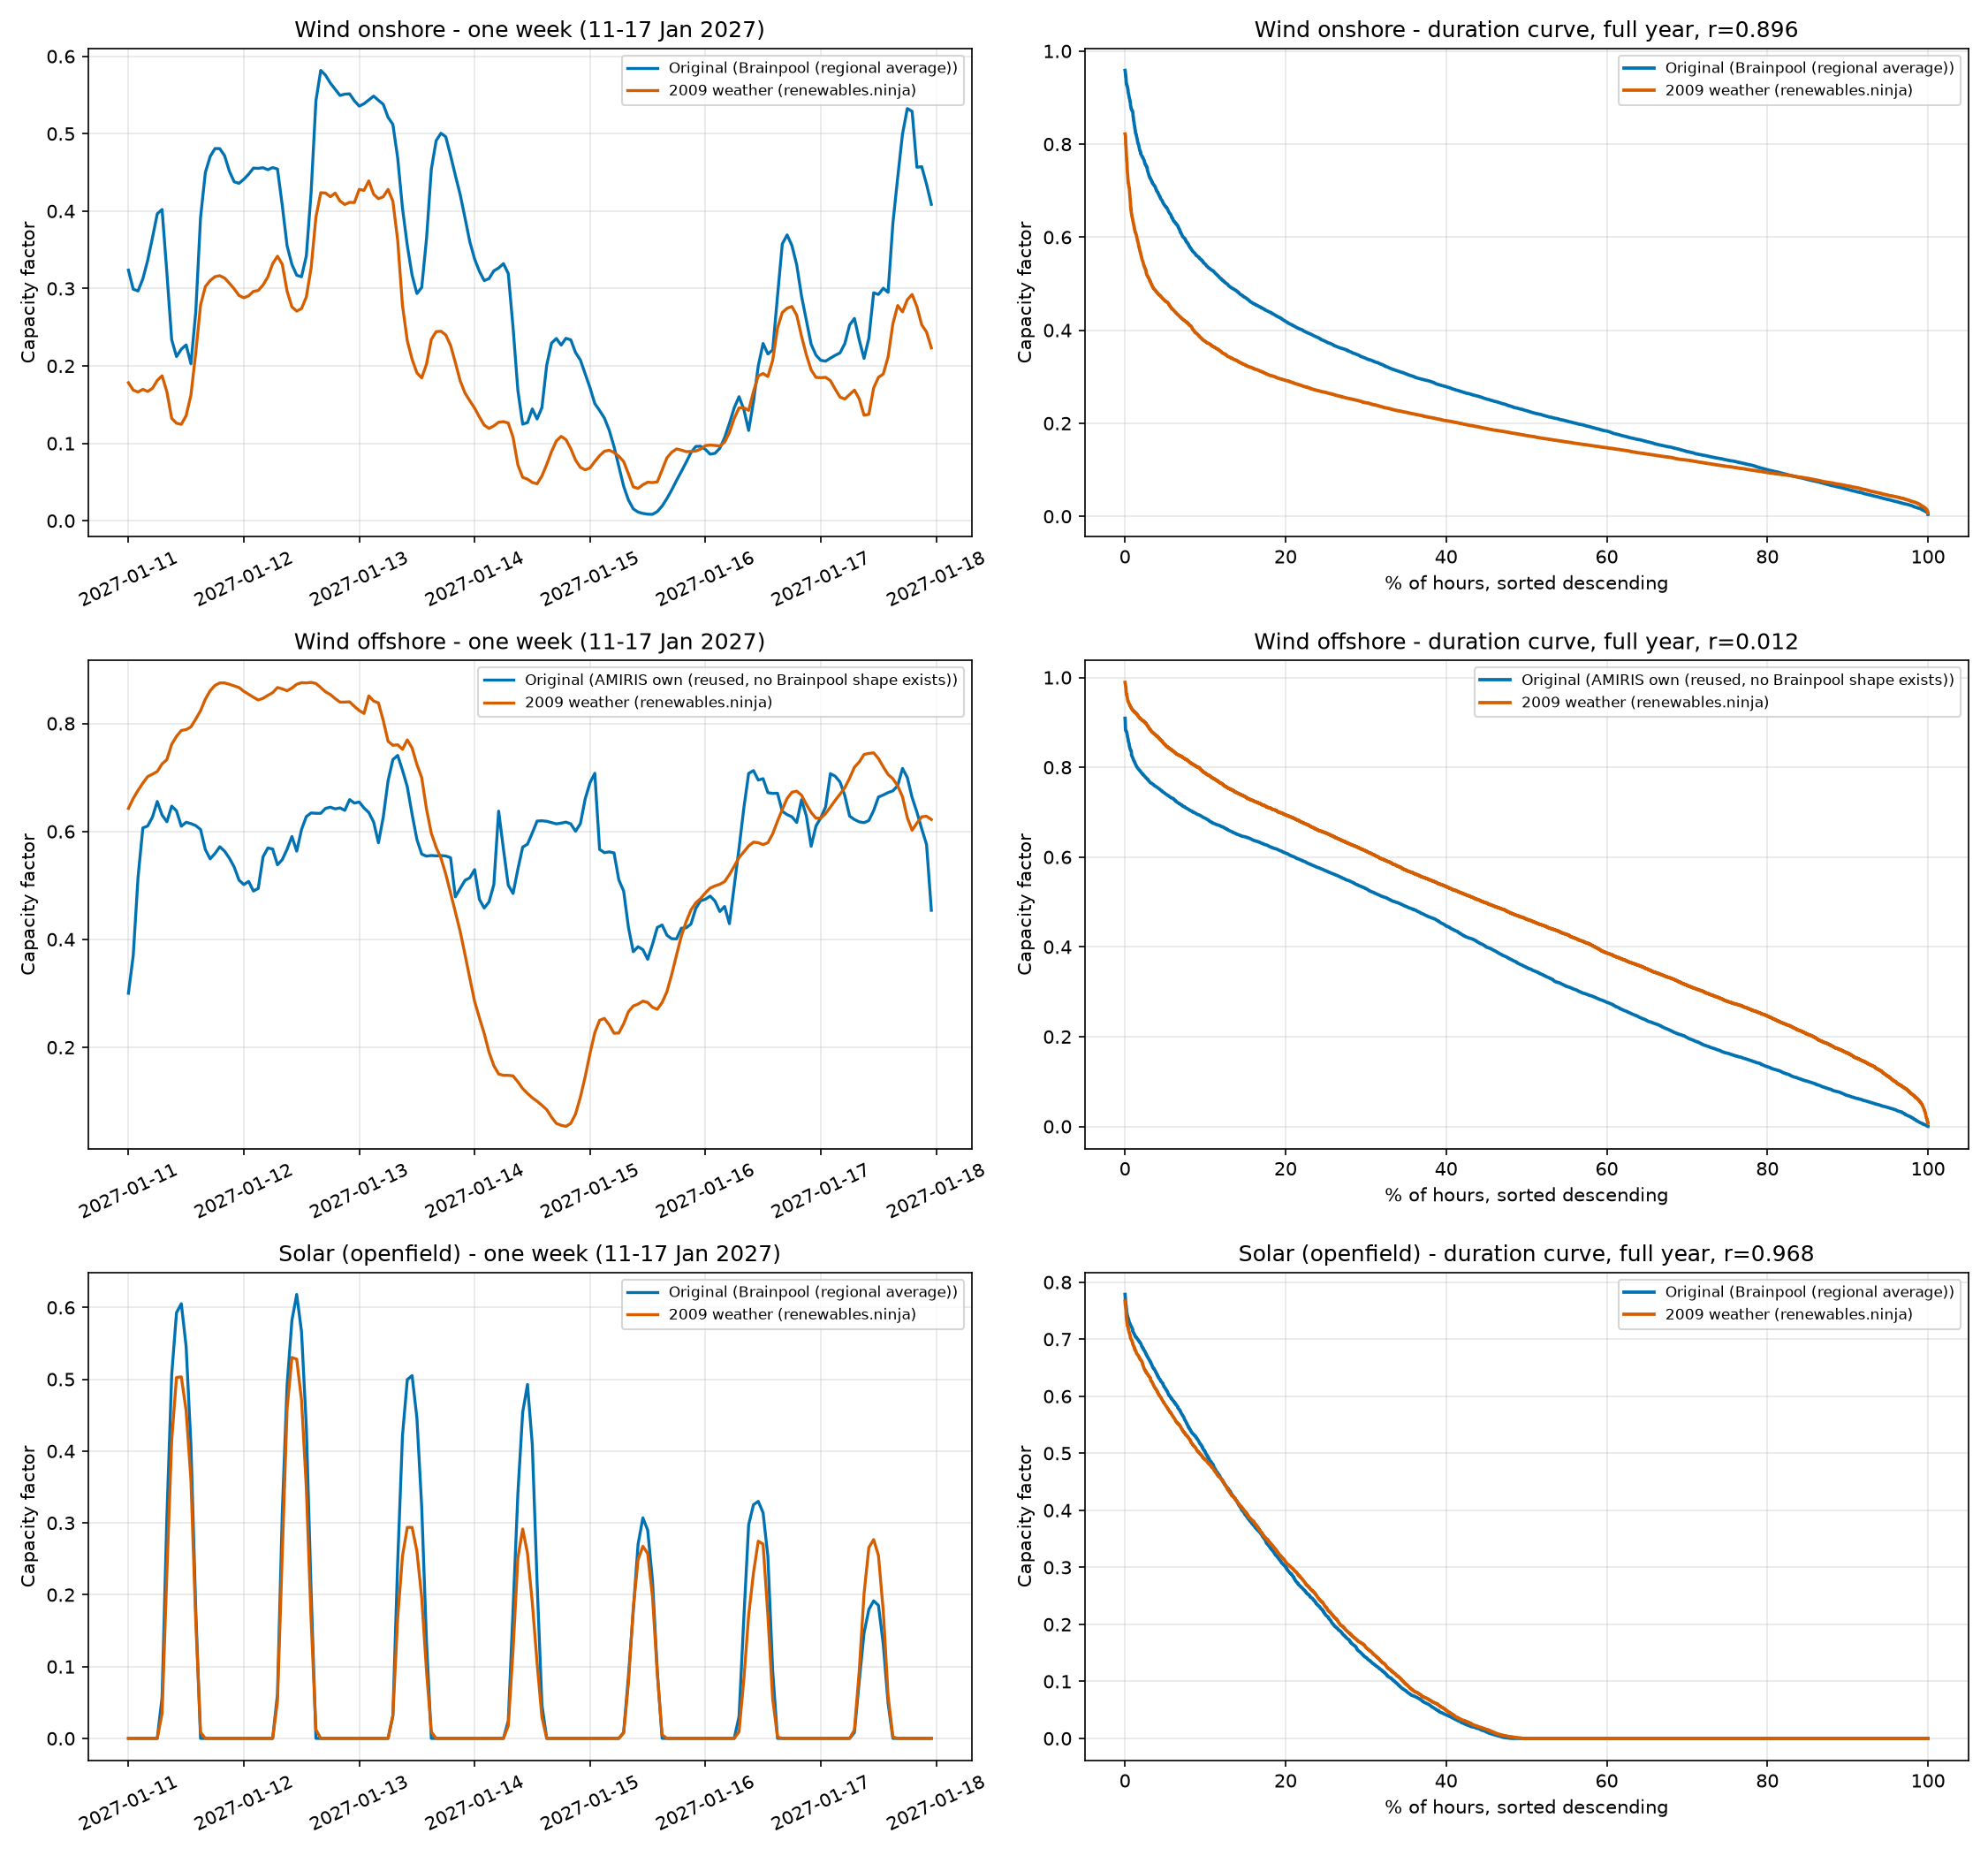
Task 3: 2009 Renewable Weather Profiles
Real 2009 weather (renewables.ninja) vs. our original profiles - one week detail + full-year duration curves
8

Slide 9
Task 3: What We Found
• Brainpool's forecast is built on real 2009 weather - confirmed directly from their published methodology
• Rebuilt wind & solar using real 2009 weather data
‒ Onshore wind and solar: strongly correlated with our original profiles (r = 0.90 and 0.97)
‒ Offshore wind: no real correlation (r = 0.01) - a genuine, separate gap
• This 2009 weather basis was later reused for heat-pump temperature too
9

Slide 10
PART 2
What We've Done Since
10

Slide 11
The Big Picture
• Built a full AMIRIS model of Germany's 2027 electricity market, from Brainpool's real input data
• Compared it hour-by-hour against Brainpool's own real 2027 price forecast
• Diagnosed and fixed the gap, one verified step at a time
• Tested whether the fixes hold up on years we never tuned for (2028, 2029)
• Found and fixed a genuine bug along the way
11

Slide 12
Building the Model (V1 -> V2)
• V1: one household-shaped demand curve for all of Germany's electricity use
• V2: split demand into 4 real components - base load, heat pumps, electrolysis, e-mobility
• Each component shaped using the real data suited to it
• Result: shortage hours (the model 'running out of power') fell from 15.9% to 7.5% of the year
12

Slide 13
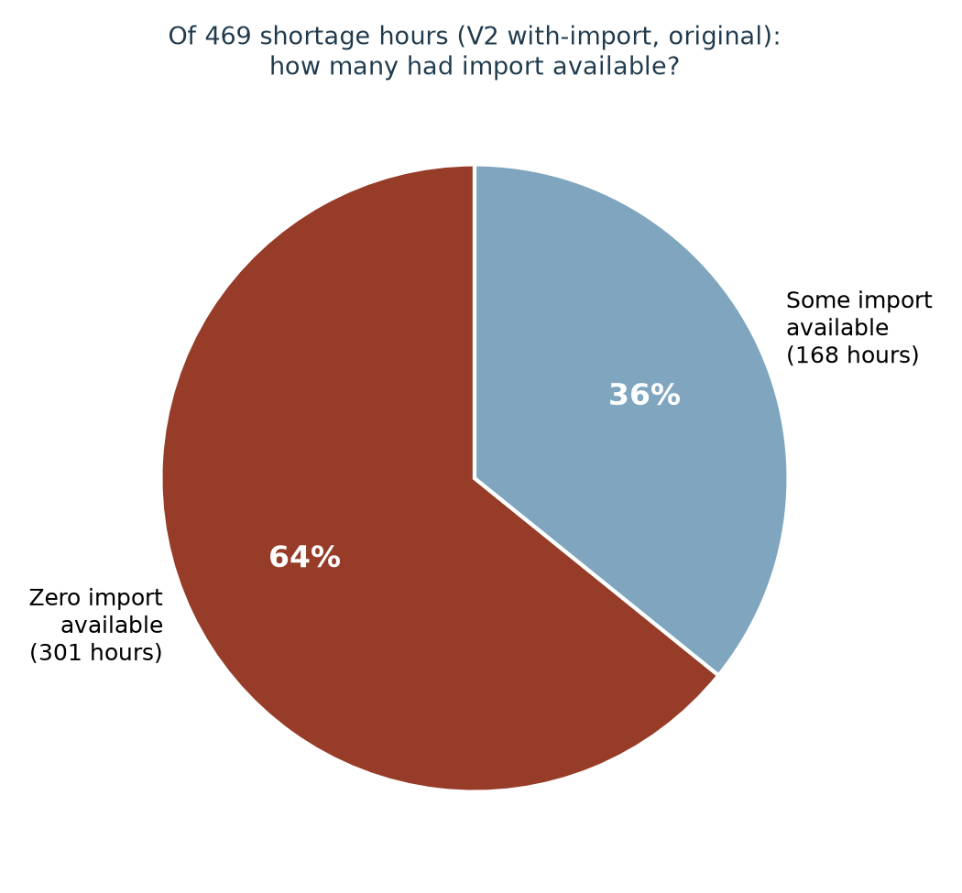
Fixing the Import Mechanism
Diagnosed directly: 64% of shortage hours had ZERO import available - import timing was copied from an unrelated year
13

Slide 14
Verifying Our Assumptions Against Reality
• Rather than assume, we checked Brainpool's real published methodology directly
• Confirmed: 2009 weather year - correct
• Confirmed: Brainpool's real model covers ~30 European countries with price coupling, not one neighbour
• Rebuilt our import price as a blend of 11 real neighbouring countries instead of France alone
• Result: a small, genuine improvement
14

Slide 15
Making Demand "Smart"
• Hydrogen production (electrolysis) and EV charging used to draw power flat, every hour
• Rebuilt both as price-responsive: they now choose WHEN to draw power
• Verified directly: both shift toward cheap and negative-price hours
• EV charging result: shortage hours reached ZERO for the first time this project
15

Slide 16
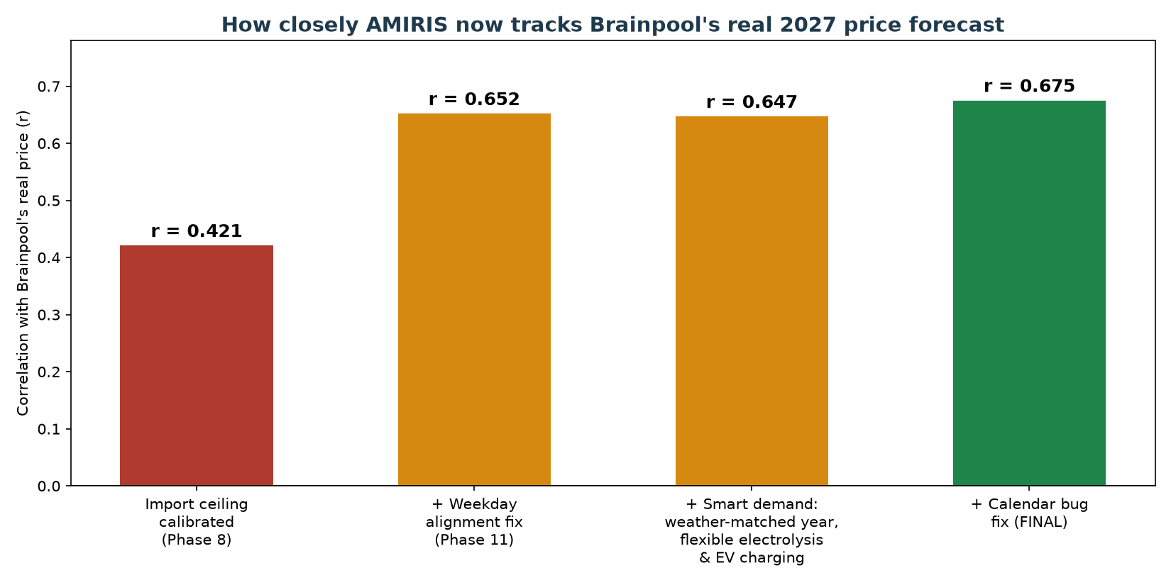
The Correlation Journey
How closely AMIRIS tracks Brainpool's real 2027 price, step by step, from initial calibration to the final fix
16

Slide 17
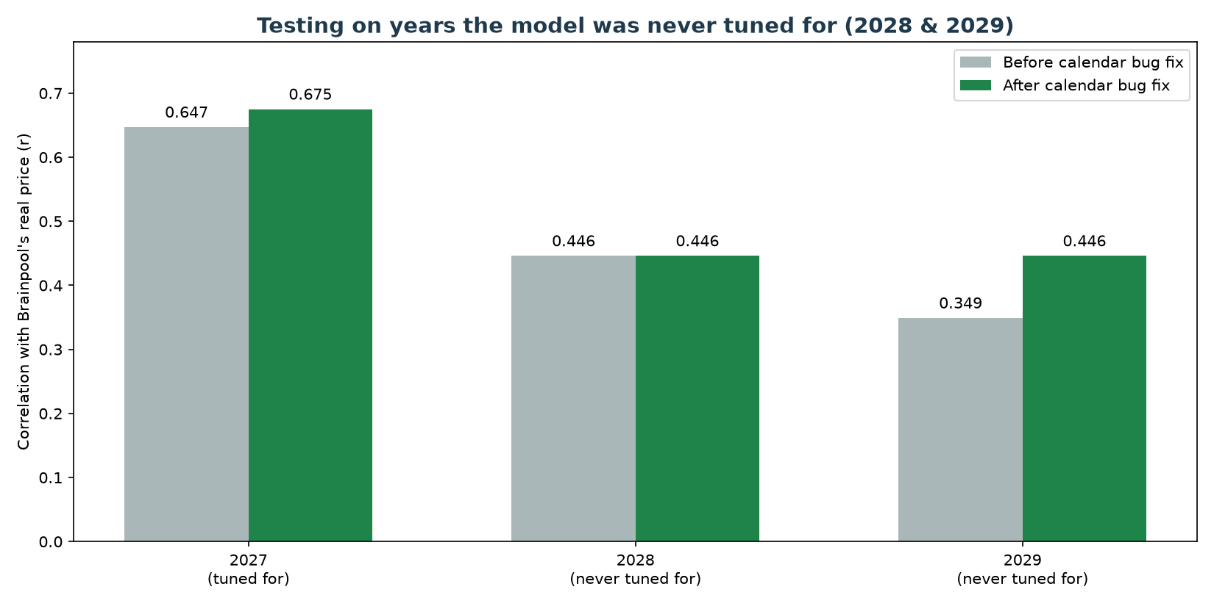
Testing Years We Never Tuned For
Built 2028 and 2029 the same way as 2027, with zero re-tuning, using Brainpool's newly-supplied multi-year data
17

Slide 18
A Genuine Bug, Found and Fixed
• Checking WHERE 2028/2029 disagreed with Brainpool most revealed a real calendar bug
• Our demand shape borrows a real year's usage pattern (2016) and trims it to fit the target year
• The trimming method silently misaligned the days of the week for 84% of the year
• Clean result: both 2027 and 2029 improved on accuracy AND average error, with no downside
18

Slide 19
Out-of-Sample Testing: What We Found
Using Brainpool's newly-supplied 2027-2029 data file
• Built Germany 2028 and 2029 the exact same way as 2027 - zero re-tuning of any setting
• Goal: does the model still work on years it wasn't built for?
• Price LEVEL held up well in both new years (average price, average error stayed close)
• But hour-to-hour matching quality dropped the further from 2027:
‒ 2027 (tuned for): r = 0.647
‒ 2028 (never tuned for): r = 0.446
‒ 2029 (never tuned for): r = 0.349
• This gap became the focus of the next round of investigation
19

Slide 20
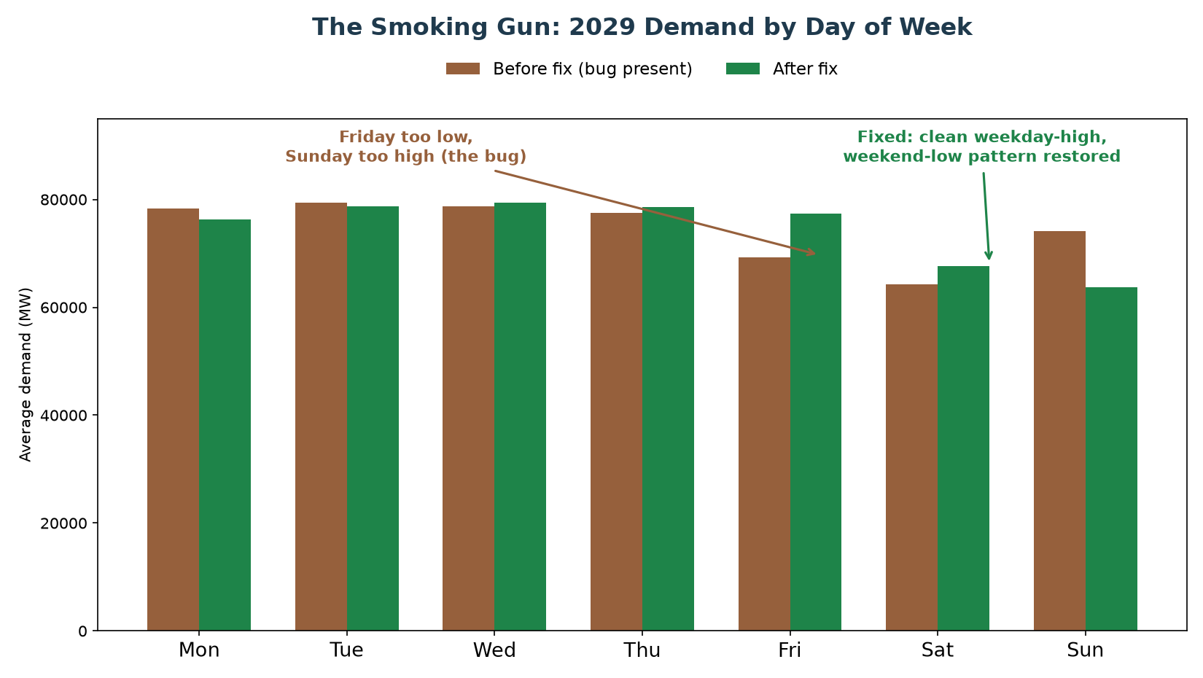
How We Found the Cause
Real electricity demand should be highest on weekdays, lowest on Sunday - our model's 2029 demand had this backwards on two days
20

Slide 21
The Root Cause: A Hidden Calendar Bug
• Our demand shape borrows a real year's usage pattern (2016) and trims it to fit the target year
• 2016 has one extra day (leap year) that must be removed to fit a normal year
• The extra day removed was February 29th - sitting in the MIDDLE of the year
• Removing a day from the middle silently shifts every day after it by one weekday, for the rest of the year (10 of 12 months)
• This bug had been present in our main 2027 model since it was first built - only found now
• The fix: remove December 31st instead - it sits at the END of the year, so nothing after it is disturbed
21

Slide 22
Result: A Clean, Genuine Improvement
Both accuracy AND average error improved together, with almost no downside - a genuine bug fix, not a trade-off
 | 2027 | 2029
Correlation - before fix | 0.647 | 0.349
Correlation - after fix | 0.675 | 0.446
Average error - before fix | 28.19 | 29.59
Average error - after fix | 26.91 | 29.14
Improvement | Both up together | Both up together
22

Slide 23
A Cheaper Idea First: Can We Just Cap How Negative Price Goes?
A supervisor-suggested quick test, before the bigger investment
• Before committing to the much bigger cross-border export/market-coupling build, tested a smaller idea first
• Our model reports very negative prices in summer (too much solar/wind) far more often than Brainpool's real forecast does
• Question: what if we simply limited how negative AMIRIS is allowed to report a price - would that alone close some of the correlation gap?
• First step: check whether this is even something we can configure
23

Slide 24
What We Found: The Floor Already Exists - Inside AMIRIS Itself
• Opened up AMIRIS's actual underlying program (not just our settings file) to check
• Found AMIRIS already has a hard limit: -500 EUR/MWh, built directly into the program's core
• This isn't arbitrary - it matches the real limit used by Europe's actual electricity exchanges
• It is NOT something we can change from our scenario settings - changing it means editing and rebuilding AMIRIS's own program, a much bigger step
• So a smaller, faster test was run first: adjust the REPORTED price after the fact, purely to see if a different limit was even worth the bigger effort
24

Slide 25
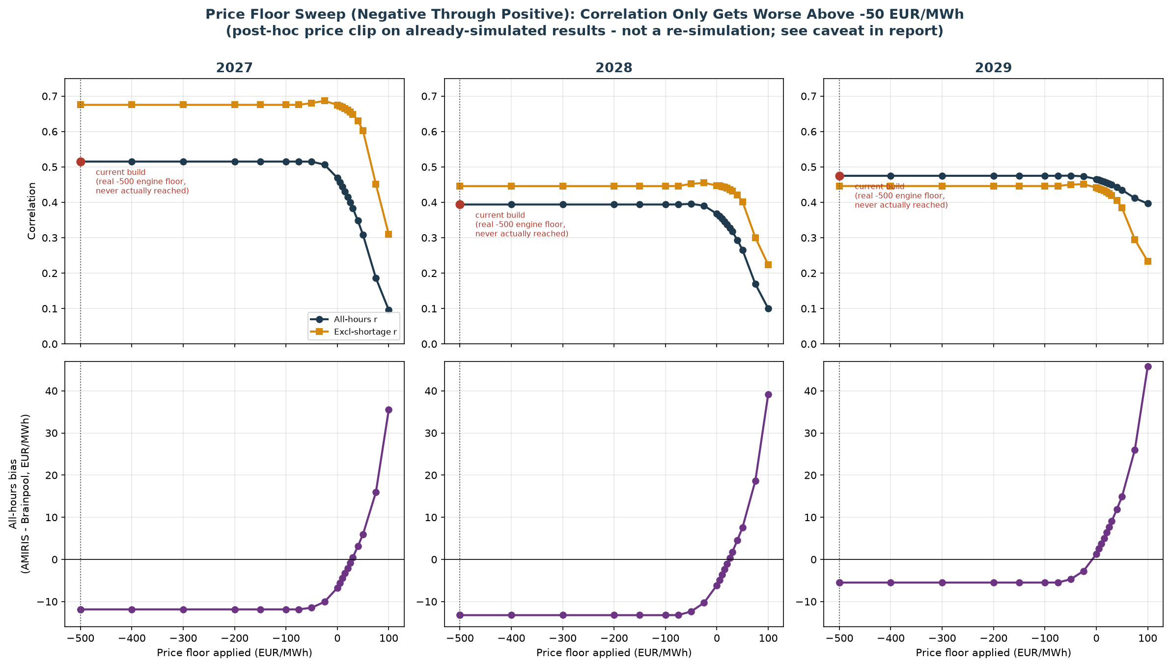
Testing Every Floor From -500 to +100 EUR/MWh
Top: match quality (correlation) barely moves across most of the range, then gets worse. Bottom: average price gap improves toward the floor, then overshoots badly past about +30.
25

Slide 26
Result: Confirmed Dead End - Including the Suggested +10 EUR/MWh
Match-quality score (correlation) for each cap tested - higher is better
 | 2027 | 2028 | 2029
Current model (no cap) | 0.515 | 0.394 | 0.475
Best negative cap found (-50) | 0.515 | 0.396 | 0.475
Cap at +10 EUR/MWh (tested directly) | 0.444 | 0.354 | 0.461
Cap at +100 EUR/MWh | 0.096 | 0.100 | 0.396
No cap value, in either direction, improves match quality - a real, capped result at +10 makes it clearly worse. Confirmed: the bigger cross-border export/market-coupling build remains the most promising next step.
26

Slide 27
A Follow-Up Idea: Give Power Plants a Real Start-Up Cost
A genuine mechanism this time, not a cosmetic cap
• Our model goes negative far more often than Brainpool's real forecast (18-20% of hours vs. under 1%)
• Idea: real power plants incur a real cost to shut down and restart - so they sometimes prefer to keep running even at a negative price, rather than switch off
• Our model currently gives every plant a shut-down/restart cost of exactly zero - no real reason to avoid shutting off
• Unlike the price-cap idea, this is a genuine real-world mechanism, not an artificial adjustment - worth testing properly
27

Slide 28
What We Did: Sourced a Real Number, Built a Real Test
• Found a real, peer-reviewed study on actual power plant start-up costs (Nature Energy, 2017)
• Real figures: about EUR50,000-70,000 per start for a large coal/lignite plant, EUR60,000 for a gas plant
• Converted these into our model's units and applied them to every plant type
• Built this as its own separate model version and ran a full, real simulation - not a shortcut estimate
28

Slide 29
Result: Zero Difference - a Cleaner Dead End
0 of 8,760 hours
changed price, even by a single cent
• The new setting made literally no difference to the result, at any point in the year
• Investigated why: the number IS calculated inside the program, but that calculation is never actually connected to the price the plant offers
• So this isn't a trade-off to weigh, like the price cap was - the switch simply isn't wired to anything in our version of the model
• Confirms: the cross-border export/market-coupling build remains the most promising next step
29

Slide 30
One More Follow-Up: Does Lignite's Bidding Behaviour Matter?
A genuine, working mechanism - confirmed before testing this time
• Opened up the actual bidding formula this time (learned from the last dead end) - and confirmed this one IS connected to price
• Our model lets lignite plants bid as low as -60 EUR/MWh below their true cost - by far the widest allowance of any fuel type (gas: -10, coal: -15)
• Question: does narrowing this allowance reduce how often our model goes negative?
• No published real-world figure exists for this setting, so anchored the test to a real target instead: Germany's actual negative-price frequency (3-5%) vs. our model's 18%
30

Slide 31
Result: Tested 4 Values - a Real Effect, But Not Where It Counts
6,218 of 8,760 hours changed price - a real, working effect, unlike the last test
minMarkup | Match Quality (trustworthy) | Avg. Price Gap | Negative Hours
-60 (current) | 0.675 | -11.86 | 18.4%
-40 | 0.672 | -11.34 | 16.7%
-20 | 0.671 | -10.21 | 16.8%
-10 | 0.672 | -10.16 | 16.8%
The average price gap and how often we go negative both improve a little as the setting narrows - real, modest gains. But match quality (our trustworthy score) barely moves at all, staying flat across every value tested.
31

Slide 32
Why We're Not Adopting This
• A real, working lever this time - unlike the last test, changing this setting genuinely changes thousands of hours' prices
• Small, real, consistent wins on secondary measures (average price gap, how often we go negative)
• But on our main trustworthy match-quality score, there is no real improvement at any value tested
• A separate, simpler-looking 'headline' score DID jump around a lot - but not consistently, confirming it was a coincidence of a few specific hours, not genuine improvement (the same trap we've caught before in this project)
• Conclusion: confirmed as a real but limited lever. Cross-border export/market-coupling remains the one significant untested option left
32

Slide 33
The Big Idea: A Real Two-Way Trading Partner for Germany
Moving from the small experiments to the one big remaining idea
• Every smaller idea we tested (price cap, start-up cost, bidding floor) came up empty or too limited
• The one big lever left untested: let the model properly BUY AND SELL power across the border, not just buy
• AMIRIS has a real, working template for exactly this - a second market 'zone' connected to Germany's own, trading both ways
• Plan: source real data first, build a first working version, then refine it step by step
33

Slide 34
Sourcing Real Data From Scratch for a 'Rest of Europe' Zone
Nothing invented - every number traced to a real source
• Needed: how much power the rest of Europe uses, what it's generated from, and how much can physically flow across the border
• Pulled real 2023 figures (demand, power plant types) for Germany's 10 real neighbouring countries from Eurostat
• Pulled real weather-driven wind/solar output the same way we did for Germany's own model
• Hit a real multi-day outage on Europe's official cross-border data platform partway through - worked around it with an alternative real source, then went back and finished the job once it recovered
34

Slide 35
The First Working Two-Way Market
A real improvement in one measure, a real cost in another - both honestly reported
 | Before (import-only) | First working version
Match quality (trustworthy score) | 0.675 | 0.739
Average price gap | -11.86 | -30.39
Match quality genuinely improved. But the average price moved further from real - explained by a placeholder guess for how much power can flow across the border, and the other side having no storage/flexibility of its own yet.
35

Slide 36
Real Border Data Replaces the Guess
Turning a placeholder into a real, sourced number
• The European data platform came back online - immediately used it to replace the placeholder guess
• Pulled real, hour-by-hour cross-border flow data for all of Germany's real neighbouring borders
• Used that real data to set a genuine, grounded limit on how much power can flow - not a guess
• Result: confirmed the match-quality improvement was real, not just luck from an oversized placeholder guess
36

Slide 37
Adding Real Storage: Our Best Result Yet
Real storage and real subsidies on both sides of the border
Average price within 60 cents
of the real figure - the closest match this entire project has produced
• Gave the 'Rest of Europe' side its own real storage (battery-style + reservoir hydro), the same way Germany already has
• Gave it real subsidy treatment too, instead of a placeholder zero
• Checked directly that the new storage is actually doing real work, not just sitting there unused - confirmed it is
• Match quality also stayed strong - a genuine, all-round best result
37

Slide 38
Does It Hold Up in Other Years? Testing 2028 and 2029
The same build, tested on years we never tuned it for
 | 2028 | 2029
Match quality: before | 0.446 | 0.446
Match quality: with two-way trading | 0.718 | 0.752
Average price gap: with two-way trading | +6.19 | +26.85
Match quality improved strongly in both years, confirming it isn't a one-year fluke. But the average price gap looked concerning for 2029 - investigated further on the next slide.
38

Slide 39
The Real Story: Excellent on Ordinary Days
A follow-up question corrected a misleading headline number
• That '+26.85' number looked like a real step backwards - checked it properly rather than taking it at face value
• Found: 88% of that gap comes from just a handful of extreme 'ran out of power' hours
• On ordinary days (99%+ of the year), all three years - 2027, 2028, 2029 - are excellent and remarkably consistent
• The real, narrower issue: those extreme hours are becoming more frequent the further we get from our home year (2027)
39

Slide 40
Chasing That Gap: Two Honest Dead Ends
Two well-reasoned ideas, tested properly, both honestly ruled out
• Idea 1: scale up the border capacity to keep pace with Germany's own growth - tested directly, did not fix it, made one year worse
• Idea 2: check a specific setting inside AMIRIS's own coupling engine - opened up the real program code and found that setting was already unlimited, not the cause
• Found one real, unexplained clue instead: Germany's import during these rare hours stays suspiciously flat no matter how much extra capacity is available
• Getting to the exact cause would need to edit and rebuild AMIRIS's own program - a bigger step, not yet taken
40

Slide 41
Where This Leaves Us
The real, current state of the two-way trading model across all three years
 | 2027 | 2028 | 2029
Match quality (with two-way trading) | 0.717 | 0.718 | 0.752
Average price gap, ordinary days only | -0.59 | +1.08 | +3.21
Rare extreme hours (target: near zero) | 7 | 17 | 76
Strong, consistent match quality and excellent ordinary-day accuracy across all three years - the core result stands. The one real, still-open gap is the rising frequency of extreme hours the further a year is from 2027.
41

Slide 42
One More Lead: Could the Other Side's Own Storage Explain the Gap?
A real, testable idea - checked and ruled out
• The one open thread from before: a small number of extreme hours where Germany imports less than it could, even with spare capacity available
• Tested directly using data already on hand: is the rest of Europe's own storage running physically empty during those hours?
• Checked both battery-style storage and reservoir hydro on the other side of the border - neither ever comes close to its own physical limit, in either year tested
• Rules out 'the other side simply has nothing left to give' - strengthens the case that the real limiter is inside the model's own internal trading logic, not a real-world capacity constraint anywhere
42

Slide 43
Pushing Further: Replacing the Combined Zone With a Real Named Country
Testing whether more realism helps, or whether the combined approach was already the right call
• Everything so far treated 'the rest of Europe' as one combined stand-in - the next real question: does splitting out a real neighbour by name do any better?
• Chose France as the test case: the largest single economy involved, and the one country with enough real, already-sourced data to build immediately
• Built it properly: France's own real power plants, real demand, real weather-driven renewables, and a real border link to Germany - not a shortcut
43

Slide 44
Result: A Real Step Backward - With a Clear, Understood Reason
Splitting France out on its own made things worse, not better
 | Combined zone (best result) | France split out separately
'Ran out of power' hours | 7 | 167
Average price gap on ordinary days | -2.90 | +9.65
Real, checked reason: France's own huge nuclear fleet used to help keep the WHOLE combined pool well-supplied. Pulled out on its own, the remaining combined zone lost that cushion and became genuinely short more often - while France's own surplus, now only linked directly to Germany by a narrow border, couldn't reach the rest of Europe to help there either.
44

Slide 45
Going All the Way: All 10 Real Neighbouring Countries at Once
A genuine engineering problem, found, diagnosed, and fixed along the way
• Since one real country made things worse for a clear, understood reason, the natural next test: does the SAME problem get worse - or does something different happen - once every real neighbour is split out?
• Built all 10 real countries as their own separate zones - the largest build of the whole project
• Hit a genuine, hard technical bug along the way: the model's own dispatch engine broke down for one specific country (Denmark) - traced directly to Denmark's real hydro power being far too small in absolute terms for the model to handle reliably
• Fixed with a clearly labelled, honestly-flagged technical workaround (not real data) - confirmed the fix worked, then completed the full 10-country run
45

Slide 46
Result: Better Than Expected - But Still Not the Winning Approach
Splitting into all 10 real countries beat the single-country attempt on every measure but one
 | Combined zone (best) | France alone | All 10 countries
'Ran out of power' hours | 7 | 167 | 120
Average price gap, ordinary days | -2.90 | +9.65 | +4.87
Match quality (trustworthiness) | 0.717 | 0.716 | 0.731 (best yet)
Genuinely surprising: going all the way to 10 real countries actually did BETTER than splitting out just one - likely because Germany can now draw on many countries' cheap power at once, instead of being stuck behind one narrow link. But it still doesn't beat the original combined-zone approach on the two measures that matter most. Decision: keep the combined zone as our best, standing result.
46

Slide 47
Where We Stand Now
Build | Shortage hours | Mean price | vs. Brainpool's real 68.04
V1, no import | 15.88% | 519 EUR/MWh | 7.6x too high
V1, final | 0.83% | 75 EUR/MWh | almost exact
V2, no import | 7.52% | 286 EUR/MWh | 4.2x too high
V2, final (all fixes) | 0.02% | 56 EUR/MWh | close, slightly below
47

Slide 48
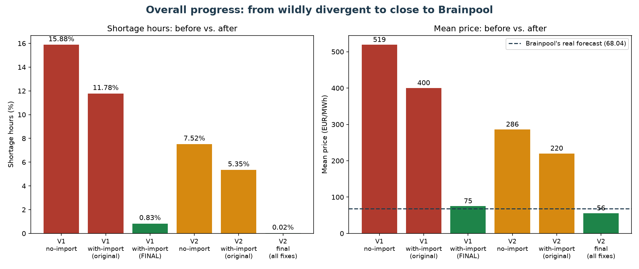
The Overall Journey
From wildly divergent (7.6x too high, 16% shortage hours) to close to Brainpool's real forecast
48

Slide 49
Next Steps
• Decide whether to pursue a full cross-border export model (a large undertaking) - the midday-price gap is the main remaining issue and needs this
• Consider whether to update the shortage price (3,000 EUR/MWh) to reflect today's real EU cap (5,000 EUR/MWh)
• Investigate WHY the import ceiling behaves differently across years - a real, still-unexplained pattern
• Continue folding all findings into the formal thesis documentation
49

Slide 50
Questions & Discussion
50

