Slide 1
AMIRIS Progress Update
What's Changed Since the 27 August Supervisor Meeting
Supervisor: Rohith Krishnan Bala Krishnan
Presented by: Muideen Oladayo Ajiboye (471583)
Date: 7 September 2026

Slide 2
Agenda - Since 27 August
• Quick recap: where we left off
• Out-of-sample testing and a genuine bug fix
• Three more ideas tested (price floor, cycling cost, lignite markup)
• The big build: real cross-border market coupling
• Extending to 2028 and 2029
• Chasing the last gap: four more real tests
• Where we stand now, and next steps
2

Slide 3
Quick Recap: Where We Left Off on 27 August
For orientation - the full detail is in the comprehensive deck
• Built and validated AMIRIS against Brainpool's real 2027 forecast, diagnosing and fixing a genuine import-timing bug
• Refined demand modelling and fixed a real weekday/weekend calendar mismatch
• Added price-responsive electrolysis and e-mobility - the strongest result at the time, eliminating shortage hours entirely
• Correlation to Brainpool's forecast reached 0.647, up from 0.439 at the start of that work
3

Slide 4
Out-of-Sample Testing: What We Found
Using Brainpool's newly-supplied 2027-2029 data file
• Built Germany 2028 and 2029 the exact same way as 2027 - zero re-tuning of any setting
• Goal: does the model still work on years it wasn't built for?
• Price LEVEL held up well in both new years (average price, average error stayed close)
• But hour-to-hour matching quality dropped the further from 2027:
‒ 2027 (tuned for): r = 0.647
‒ 2028 (never tuned for): r = 0.446
‒ 2029 (never tuned for): r = 0.349
• This gap became the focus of the next round of investigation
4

Slide 5
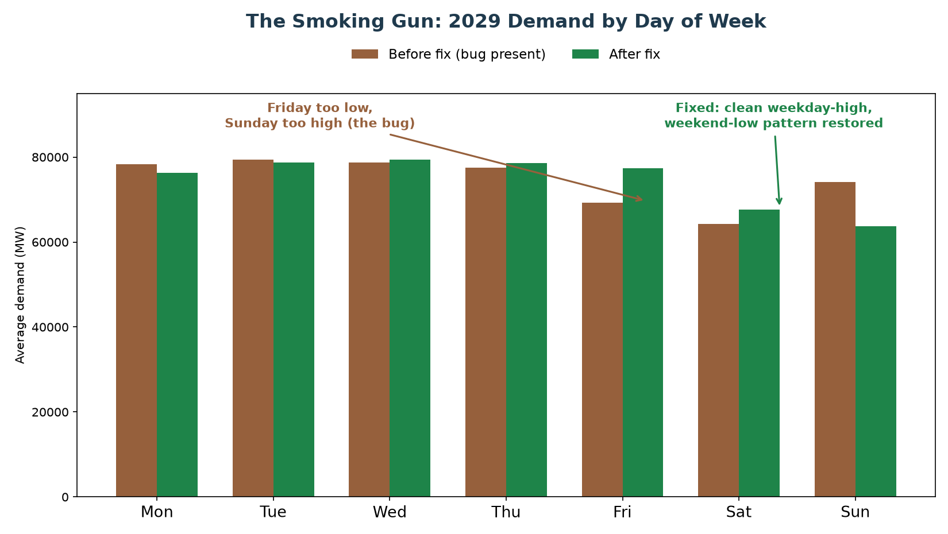
How We Found the Cause
Real electricity demand should be highest on weekdays, lowest on Sunday - our model's 2029 demand had this backwards on two days
5

Slide 6
The Root Cause: A Hidden Calendar Bug
• Our demand shape borrows a real year's usage pattern (2016) and trims it to fit the target year
• 2016 has one extra day (leap year) that must be removed to fit a normal year
• The extra day removed was February 29th - sitting in the MIDDLE of the year
• Removing a day from the middle silently shifts every day after it by one weekday, for the rest of the year (10 of 12 months)
• This bug had been present in our main 2027 model since it was first built - only found now
• The fix: remove December 31st instead - it sits at the END of the year, so nothing after it is disturbed
6

Slide 7
Result: A Clean, Genuine Improvement
Both accuracy AND average error improved together, with almost no downside - a genuine bug fix, not a trade-off
 | 2027 | 2029
Correlation - before fix | 0.647 | 0.349
Correlation - after fix | 0.675 | 0.446
Average error - before fix | 28.19 | 29.59
Average error - after fix | 26.91 | 29.14
Improvement | Both up together | Both up together
7

Slide 8
A Cheaper Idea First: Can We Just Cap How Negative Price Goes?
A supervisor-suggested quick test, before the bigger investment
• Before committing to the much bigger cross-border export/market-coupling build, tested a smaller idea first
• Our model reports very negative prices in summer (too much solar/wind) far more often than Brainpool's real forecast does
• Question: what if we simply limited how negative AMIRIS is allowed to report a price - would that alone close some of the correlation gap?
• First step: check whether this is even something we can configure
8

Slide 9
What We Found: The Floor Already Exists - Inside AMIRIS Itself
• Opened up AMIRIS's actual underlying program (not just our settings file) to check
• Found AMIRIS already has a hard limit: -500 EUR/MWh, built directly into the program's core
• This isn't arbitrary - it matches the real limit used by Europe's actual electricity exchanges
• It is NOT something we can change from our scenario settings - changing it means editing and rebuilding AMIRIS's own program, a much bigger step
• So a smaller, faster test was run first: adjust the REPORTED price after the fact, purely to see if a different limit was even worth the bigger effort
9

Slide 10
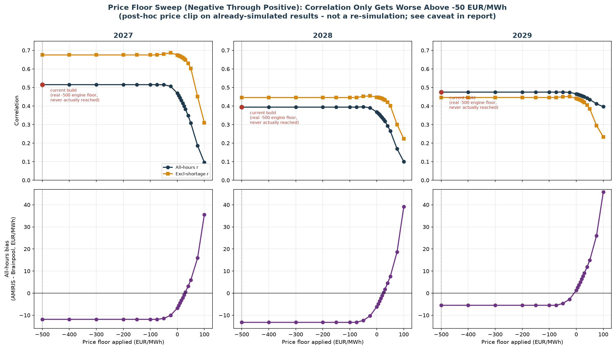
Testing Every Floor From -500 to +100 EUR/MWh
Top: match quality (correlation) barely moves across most of the range, then gets worse. Bottom: average price gap improves toward the floor, then overshoots badly past about +30.
10

Slide 11
Result: Confirmed Dead End - Including the Suggested +10 EUR/MWh
Match-quality score (correlation) for each cap tested - higher is better
 | 2027 | 2028 | 2029
Current model (no cap) | 0.515 | 0.394 | 0.475
Best negative cap found (-50) | 0.515 | 0.396 | 0.475
Cap at +10 EUR/MWh (tested directly) | 0.444 | 0.354 | 0.461
Cap at +100 EUR/MWh | 0.096 | 0.100 | 0.396
No cap value, in either direction, improves match quality - a real, capped result at +10 makes it clearly worse. Confirmed: the bigger cross-border export/market-coupling build remains the most promising next step.
11

Slide 12
A Follow-Up Idea: Give Power Plants a Real Start-Up Cost
A genuine mechanism this time, not a cosmetic cap
• Our model goes negative far more often than Brainpool's real forecast (18-20% of hours vs. under 1%)
• Idea: real power plants incur a real cost to shut down and restart - so they sometimes prefer to keep running even at a negative price, rather than switch off
• Our model currently gives every plant a shut-down/restart cost of exactly zero - no real reason to avoid shutting off
• Unlike the price-cap idea, this is a genuine real-world mechanism, not an artificial adjustment - worth testing properly
12

Slide 13
What We Did: Sourced a Real Number, Built a Real Test
• Found a real, peer-reviewed study on actual power plant start-up costs (Nature Energy, 2017)
• Real figures: about EUR50,000-70,000 per start for a large coal/lignite plant, EUR60,000 for a gas plant
• Converted these into our model's units and applied them to every plant type
• Built this as its own separate model version and ran a full, real simulation - not a shortcut estimate
13

Slide 14
Result: Zero Difference - a Cleaner Dead End
0 of 8,760 hours
changed price, even by a single cent
• The new setting made literally no difference to the result, at any point in the year
• Investigated why: the number IS calculated inside the program, but that calculation is never actually connected to the price the plant offers
• So this isn't a trade-off to weigh, like the price cap was - the switch simply isn't wired to anything in our version of the model
• Confirms: the cross-border export/market-coupling build remains the most promising next step
14

Slide 15
One More Follow-Up: Does Lignite's Bidding Behaviour Matter?
A genuine, working mechanism - confirmed before testing this time
• Opened up the actual bidding formula this time (learned from the last dead end) - and confirmed this one IS connected to price
• Our model lets lignite plants bid as low as -60 EUR/MWh below their true cost - by far the widest allowance of any fuel type (gas: -10, coal: -15)
• Question: does narrowing this allowance reduce how often our model goes negative?
• No published real-world figure exists for this setting, so anchored the test to a real target instead: Germany's actual negative-price frequency (3-5%) vs. our model's 18%
15

Slide 16
Result: Tested 4 Values - a Real Effect, But Not Where It Counts
6,218 of 8,760 hours changed price - a real, working effect, unlike the last test
minMarkup | Match Quality (trustworthy) | Avg. Price Gap | Negative Hours
-60 (current) | 0.675 | -11.86 | 18.4%
-40 | 0.672 | -11.34 | 16.7%
-20 | 0.671 | -10.21 | 16.8%
-10 | 0.672 | -10.16 | 16.8%
The average price gap and how often we go negative both improve a little as the setting narrows - real, modest gains. But match quality (our trustworthy score) barely moves at all, staying flat across every value tested.
16

Slide 17
Why We're Not Adopting This
• A real, working lever this time - unlike the last test, changing this setting genuinely changes thousands of hours' prices
• Small, real, consistent wins on secondary measures (average price gap, how often we go negative)
• But on our main trustworthy match-quality score, there is no real improvement at any value tested
• A separate, simpler-looking 'headline' score DID jump around a lot - but not consistently, confirming it was a coincidence of a few specific hours, not genuine improvement (the same trap we've caught before in this project)
• Conclusion: confirmed as a real but limited lever. Cross-border export/market-coupling remains the one significant untested option left
17

Slide 18
The Big Idea: A Real Two-Way Trading Partner for Germany
Moving from the small experiments to the one big remaining idea
• Every smaller idea we tested (price cap, start-up cost, bidding floor) came up empty or too limited
• The one big lever left untested: let the model properly BUY AND SELL power across the border, not just buy
• AMIRIS has a real, working template for exactly this - a second market 'zone' connected to Germany's own, trading both ways
• Plan: source real data first, build a first working version, then refine it step by step
18

Slide 19
Sourcing Real Data From Scratch for a 'Rest of Europe' Zone
Nothing invented - every number traced to a real source
• Needed: how much power the rest of Europe uses, what it's generated from, and how much can physically flow across the border
• Pulled real 2023 figures (demand, power plant types) for Germany's 10 real neighbouring countries from Eurostat
• Pulled real weather-driven wind/solar output the same way we did for Germany's own model
• Hit a real multi-day outage on Europe's official cross-border data platform partway through - worked around it with an alternative real source, then went back and finished the job once it recovered
19

Slide 20
The First Working Two-Way Market
A real improvement in one measure, a real cost in another - both honestly reported
 | Before (import-only) | First working version
Match quality (trustworthy score) | 0.675 | 0.739
Average price gap | -11.86 | -30.39
Match quality genuinely improved. But the average price moved further from real - explained by a placeholder guess for how much power can flow across the border, and the other side having no storage/flexibility of its own yet.
20

Slide 21
Real Border Data Replaces the Guess
Turning a placeholder into a real, sourced number
• The European data platform came back online - immediately used it to replace the placeholder guess
• Pulled real, hour-by-hour cross-border flow data for all of Germany's real neighbouring borders
• Used that real data to set a genuine, grounded limit on how much power can flow - not a guess
• Result: confirmed the match-quality improvement was real, not just luck from an oversized placeholder guess
21

Slide 22
Adding Real Storage: Our Best Result Yet
Real storage and real subsidies on both sides of the border
Average price within 60 cents
of the real figure - the closest match this entire project has produced
• Gave the 'Rest of Europe' side its own real storage (battery-style + reservoir hydro), the same way Germany already has
• Gave it real subsidy treatment too, instead of a placeholder zero
• Checked directly that the new storage is actually doing real work, not just sitting there unused - confirmed it is
• Match quality also stayed strong - a genuine, all-round best result
22

Slide 23
Does It Hold Up in Other Years? Testing 2028 and 2029
The same build, tested on years we never tuned it for
 | 2028 | 2029
Match quality: before | 0.446 | 0.446
Match quality: with two-way trading | 0.718 | 0.752
Average price gap: with two-way trading | +6.19 | +26.85
Match quality improved strongly in both years, confirming it isn't a one-year fluke. But the average price gap looked concerning for 2029 - investigated further on the next slide.
23

Slide 24
The Real Story: Excellent on Ordinary Days
A follow-up question corrected a misleading headline number
• That '+26.85' number looked like a real step backwards - checked it properly rather than taking it at face value
• Found: 88% of that gap comes from just a handful of extreme 'ran out of power' hours
• On ordinary days (99%+ of the year), all three years - 2027, 2028, 2029 - are excellent and remarkably consistent
• The real, narrower issue: those extreme hours are becoming more frequent the further we get from our home year (2027)
24

Slide 25
Chasing That Gap: Two Honest Dead Ends
Two well-reasoned ideas, tested properly, both honestly ruled out
• Idea 1: scale up the border capacity to keep pace with Germany's own growth - tested directly, did not fix it, made one year worse
• Idea 2: check a specific setting inside AMIRIS's own coupling engine - opened up the real program code and found that setting was already unlimited, not the cause
• Found one real, unexplained clue instead: Germany's import during these rare hours stays suspiciously flat no matter how much extra capacity is available
• Getting to the exact cause would need to edit and rebuild AMIRIS's own program - a bigger step, not yet taken
25

Slide 26
Where This Leaves Us
The real, current state of the two-way trading model across all three years
 | 2027 | 2028 | 2029
Match quality (with two-way trading) | 0.717 | 0.718 | 0.752
Average price gap, ordinary days only | -0.59 | +1.08 | +3.21
Rare extreme hours (target: near zero) | 7 | 17 | 76
Strong, consistent match quality and excellent ordinary-day accuracy across all three years - the core result stands. The one real, still-open gap is the rising frequency of extreme hours the further a year is from 2027.
26

Slide 27
One More Lead: Could the Other Side's Own Storage Explain the Gap?
A real, testable idea - checked and ruled out
• The one open thread from before: a small number of extreme hours where Germany imports less than it could, even with spare capacity available
• Tested directly using data already on hand: is the rest of Europe's own storage running physically empty during those hours?
• Checked both battery-style storage and reservoir hydro on the other side of the border - neither ever comes close to its own physical limit, in either year tested
• Rules out 'the other side simply has nothing left to give' - strengthens the case that the real limiter is inside the model's own internal trading logic, not a real-world capacity constraint anywhere
27

Slide 28
Pushing Further: Replacing the Combined Zone With a Real Named Country
Testing whether more realism helps, or whether the combined approach was already the right call
• Everything so far treated 'the rest of Europe' as one combined stand-in - the next real question: does splitting out a real neighbour by name do any better?
• Chose France as the test case: the largest single economy involved, and the one country with enough real, already-sourced data to build immediately
• Built it properly: France's own real power plants, real demand, real weather-driven renewables, and a real border link to Germany - not a shortcut
28

Slide 29
Result: A Real Step Backward - With a Clear, Understood Reason
Splitting France out on its own made things worse, not better
 | Combined zone (best result) | France split out separately
'Ran out of power' hours | 7 | 167
Average price gap on ordinary days | -2.90 | +9.65
Real, checked reason: France's own huge nuclear fleet used to help keep the WHOLE combined pool well-supplied. Pulled out on its own, the remaining combined zone lost that cushion and became genuinely short more often - while France's own surplus, now only linked directly to Germany by a narrow border, couldn't reach the rest of Europe to help there either.
29

Slide 30
Going All the Way: All 10 Real Neighbouring Countries at Once
A genuine engineering problem, found, diagnosed, and fixed along the way
• Since one real country made things worse for a clear, understood reason, the natural next test: does the SAME problem get worse - or does something different happen - once every real neighbour is split out?
• Built all 10 real countries as their own separate zones - the largest build of the whole project
• Hit a genuine, hard technical bug along the way: the model's own dispatch engine broke down for one specific country (Denmark) - traced directly to Denmark's real hydro power being far too small in absolute terms for the model to handle reliably
• Fixed with a clearly labelled, honestly-flagged technical workaround (not real data) - confirmed the fix worked, then completed the full 10-country run
30

Slide 31
Result: Better Than Expected - But Still Not the Winning Approach
Splitting into all 10 real countries beat the single-country attempt on every measure but one
 | Combined zone (best) | France alone | All 10 countries
'Ran out of power' hours | 7 | 167 | 120
Average price gap, ordinary days | -2.90 | +9.65 | +4.87
Match quality (trustworthiness) | 0.717 | 0.716 | 0.731 (best yet)
Genuinely surprising: going all the way to 10 real countries actually did BETTER than splitting out just one - likely because Germany can now draw on many countries' cheap power at once, instead of being stuck behind one narrow link. But it still doesn't beat the original combined-zone approach on the two measures that matter most. Decision: keep the combined zone as our best, standing result.
31

Slide 32
Where We Stand Now
Build | Shortage hours | Mean price | vs. Brainpool's real 68.04
V1, no import | 15.88% | 519 EUR/MWh | 7.6x too high
V1, final | 0.83% | 75 EUR/MWh | almost exact
V2, no import | 7.52% | 286 EUR/MWh | 4.2x too high
V2, final (all fixes) | 0.02% | 56 EUR/MWh | close, slightly below
32

Slide 33
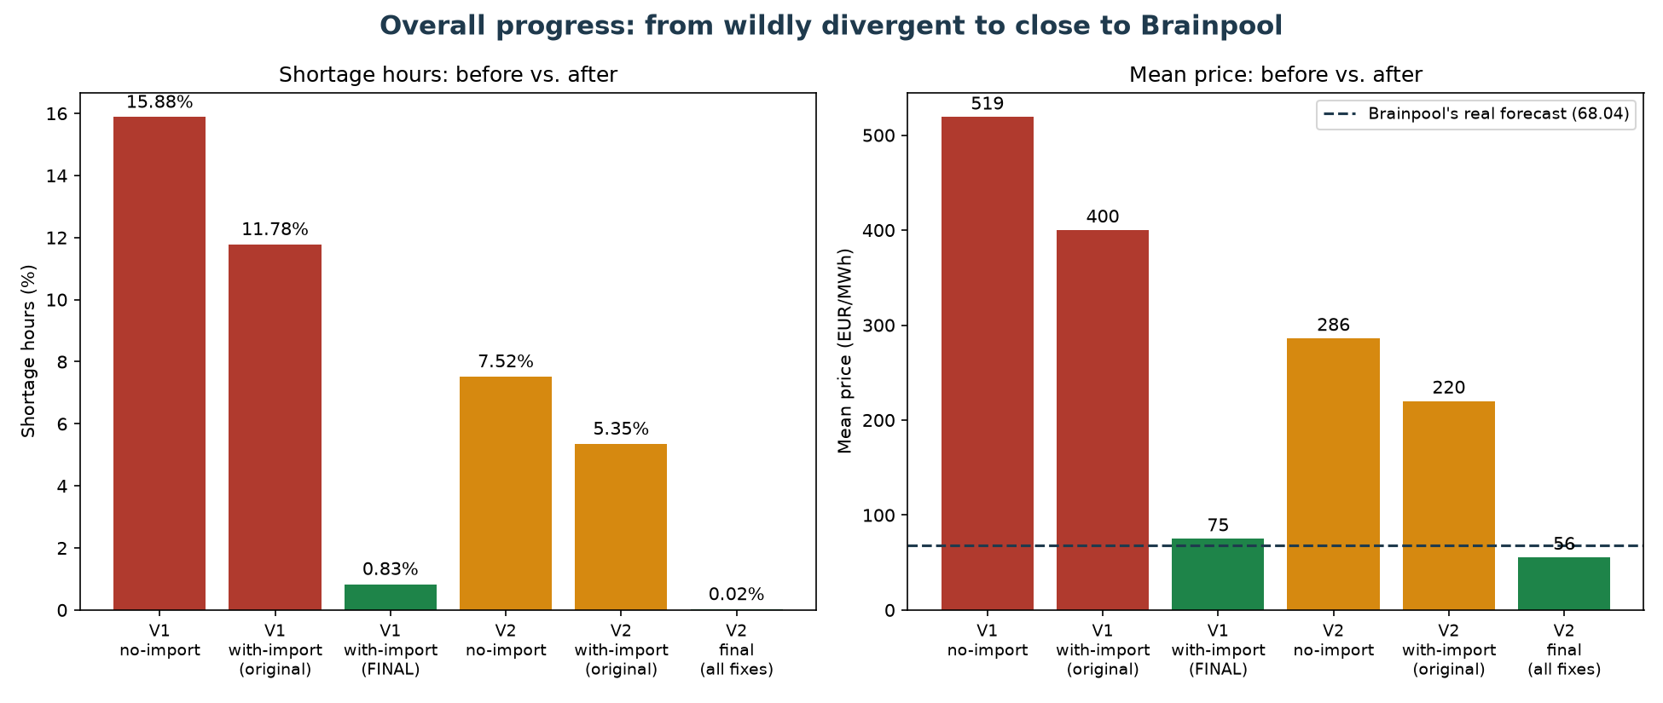
The Overall Journey
From wildly divergent (7.6x too high, 16% shortage hours) to close to Brainpool's real forecast
33

Slide 34
Next Steps
• Decide whether to pursue a full cross-border export model (a large undertaking) - the midday-price gap is the main remaining issue and needs this
• Consider whether to update the shortage price (3,000 EUR/MWh) to reflect today's real EU cap (5,000 EUR/MWh)
• Investigate WHY the import ceiling behaves differently across years - a real, still-unexplained pattern
• Continue folding all findings into the formal thesis documentation
34

Slide 35
Questions & Discussion
35

