Slide 1



Problem Statement Title – EZ Reports
Decoding Health Reports for Everyone
Theme – Health care
Team Name - Nehru
Team members – L . Prasanna
M . Akhil Reddy
M .Dheeraj
M . Shanker

Slide 2




Project Over View :-
Problem Statement:
Patients often struggle to understand their medical test reports because they are filled with complex medical terms, unclear values, and inconsistent formats from different hospitals. This makes it difficult for them to know whether their results are normal or require attention.
Proposed Solution:
An AI-powered system that reads and interprets medical test reports, extracts key health parameters, and converts them into simple, patient-friendly summaries. It also compares current and past reports to show health progress clearly.
Our Model Premises:
AI Report Simplifier
Easy Health Insights
Automated Report Analysis
Patient-Friendly Summaries
Challenges:
Medical Report Complexity
Patient Understanding
Inconsistent Report Formats
Health Awareness
Targeted Audiences:-
Link’s:-
Patients Doctors

Slide 3
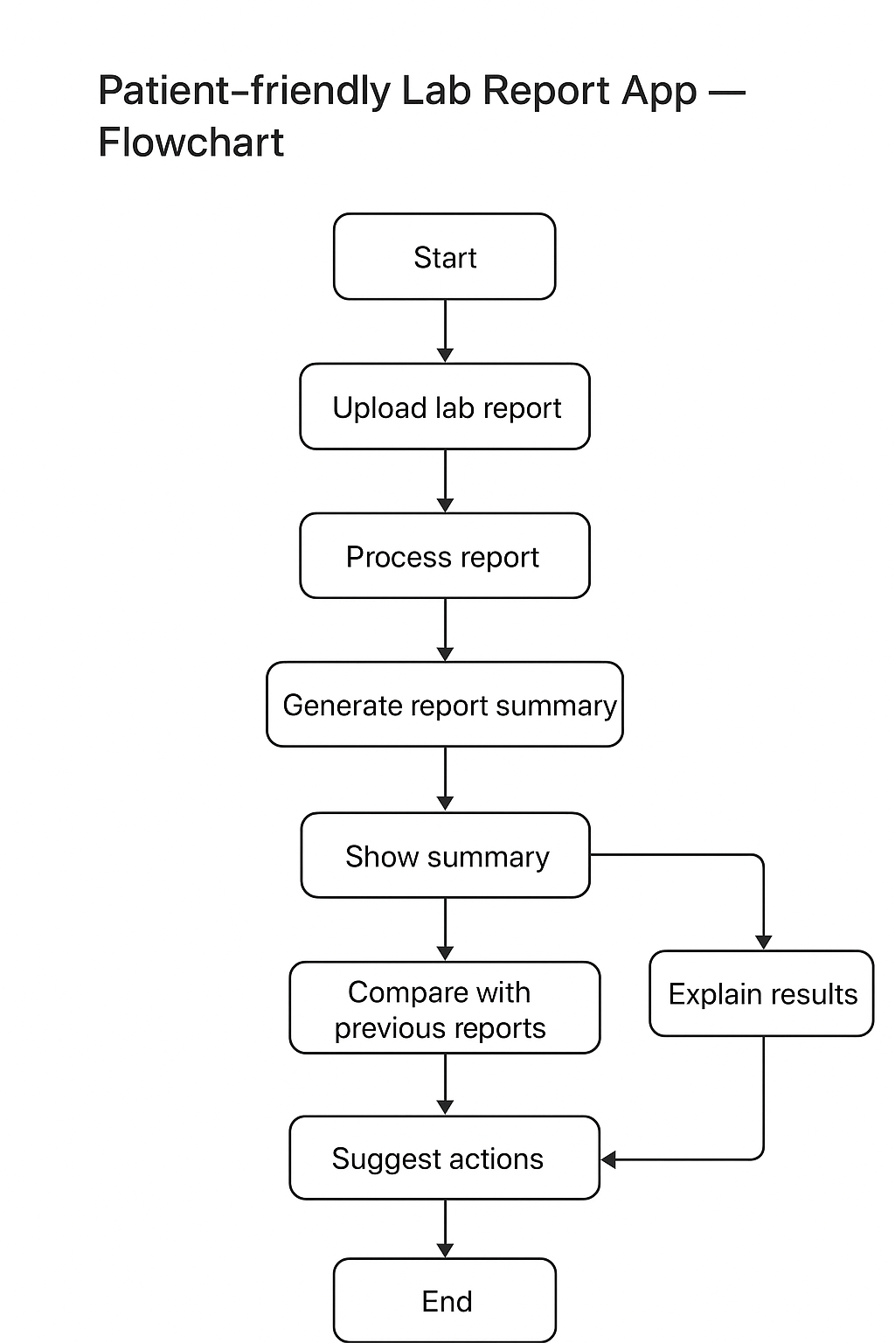
Flow chart:-
Start & Upload: The process begins when a patient uploads their lab report into the app.
Process Report: The app processes the uploaded report to extract key information and test results.
Generate & Show Summary: A simplified, patient-friendly summary of the report is generated and displayed, making it easier to understand.
Explain Results (Optional): The app can provide explanations for specific test results if the patient wants more details.
Compare with Previous Reports: The app compares the current report with the patient’s past reports to track changes and trends.
Suggest Actions & End: Based on the analysis, the app suggests possible actions (like lifestyle changes or doctor consultation), and the process ends.
Tech Used :-
1)Python 4)SQL
2)Flutter 5)Express.js
3)Node.js 6)TensorFlow

Slide 4
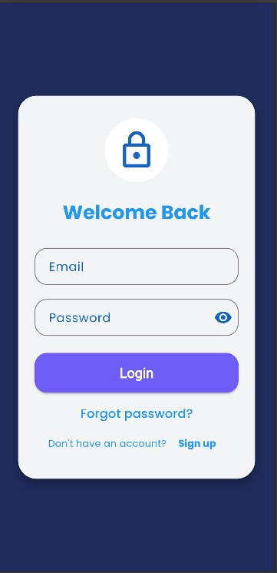
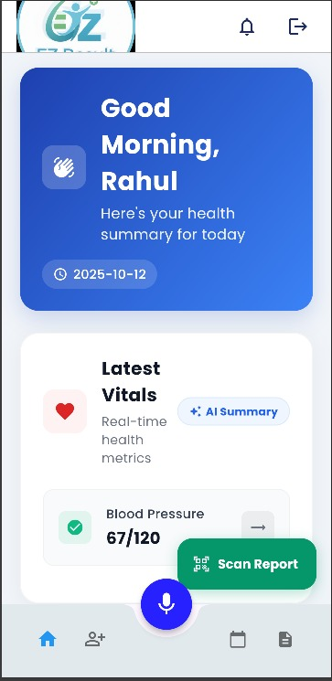
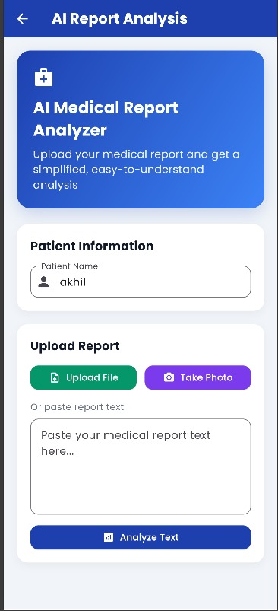
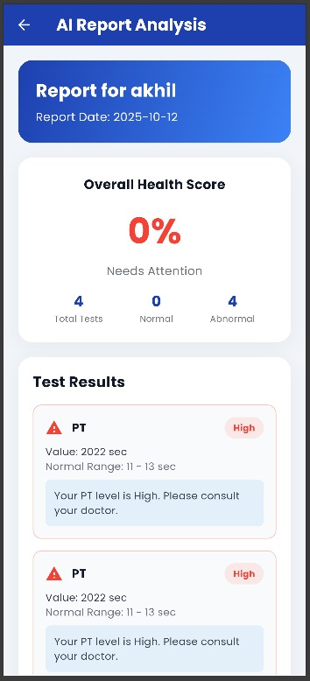

Prototype :
Login Page Home Page Ai Report Analysis After Analysis
User login in the user press on the “scan select the report file The report will
App Report” to analysis to from device storage generated
simple form

Slide 5
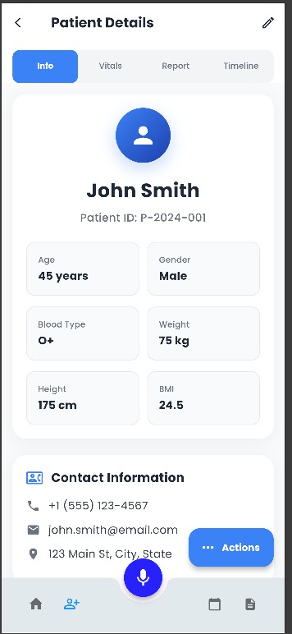
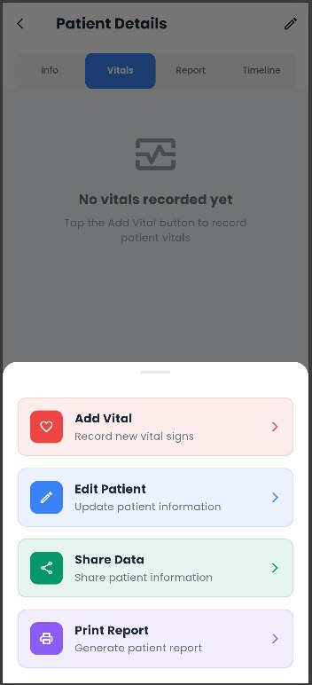
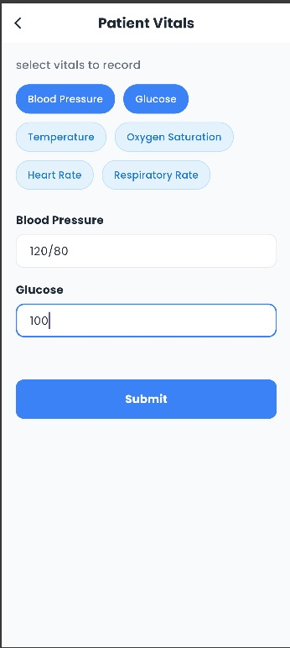
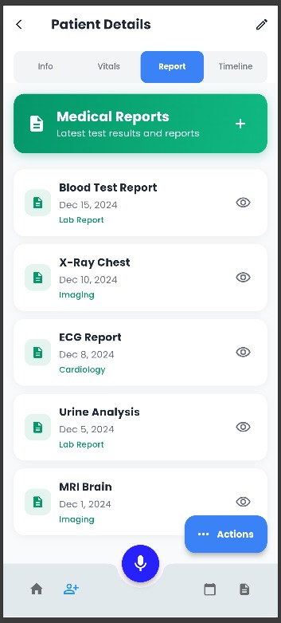
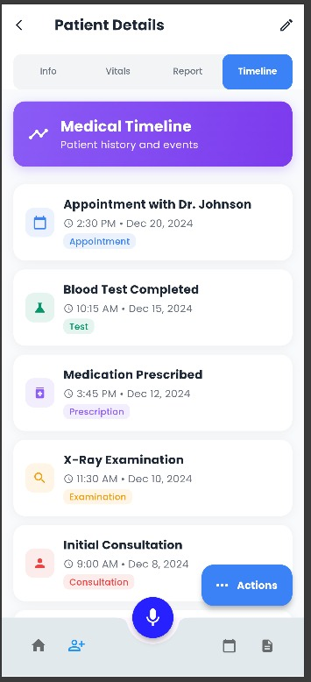
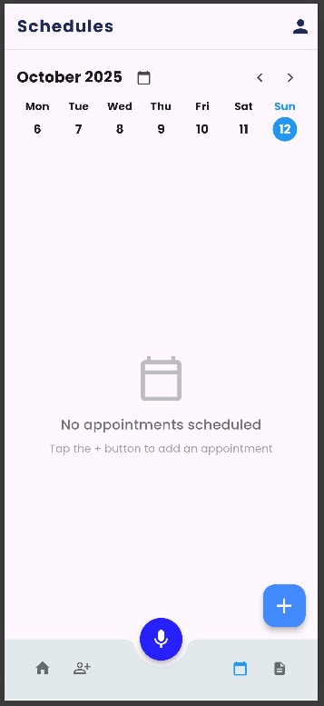
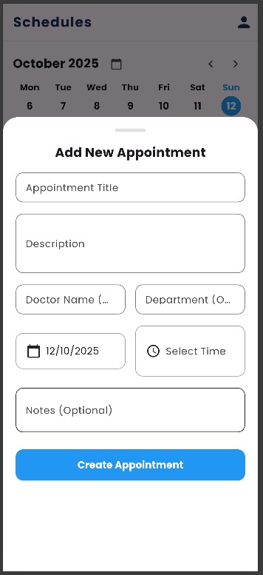
Feature Appointments and scheduling
User/ Patient vitals upload the regular All the report all the appointment
Details test will be stored details

Slide 6
FEASIBILITY AND VIABILITY
Strategies to Overcome :
Use pretrained models like LayoutLMv3 and a medical term dictionary to handle different report styles.
Apply Tesseract OCR with image cleanup (brightness, contrast) to improve text extraction.
Use BioClinicalBERT or similar models to recognize and interpret medical terms correctly.
Encrypt patient data using AES/Fernet and store it securely in SQLite or Firebase.
Combine verified rule-based data with AI summaries for accurate, easy-to-understand explanations.
Potential Challenges:
1. Report Format Variation :- Different hospitals and labs use unique layouts and terminology, making it difficult for the AI to extract information uniformly.
2. OCR Accuracy :- Scanned or blurry reports may cause errors during text extraction, leading to incorrect data interpretation.
3. Medical Terminology Understanding :- The system must correctly identify and interpret complex medical terms and abbreviations used in reports.
4. Data Privacy and Security :- Patient health data is highly sensitive, requiring strict encryption and secure storage methods.
5. Explanation Reliability :- AI-generated summaries must be accurate, easy to understand, and free from misleading medical interpretations.

Slide 7
Impact And Benefits
Improved Patient Understanding:
Helps patients easily understand complex medical reports in simple
language.
Better Health Awareness:
Encourages users to track and monitor their health regularly through
clear summaries.
Time-Saving for Doctors :
Reduces time spent explaining reports, allowing doctors to focus on
treatment.
Consistent Health Tracking :
Compares old and new reports to show progress and trends clearly.
Accessible Healthcare :
Makes medical information understandable for all age groups,
improving overall health literacy

Slide 8
RESEARCH AND REFERENCES
RESEARCH
REFERENCES
Studies show over 65% of patients struggle to read lab reports. Visual aids, plain-language summaries, and trend comparisons greatly improve patient understanding and engagement. Digital health record systems like ABDM (Ayushman Bharat Digital Mission) in India support secure data sharing, while DPDP Act 2023 ensures privacy and consent.
Key Features:
AI explanation of test reports 🧠
Health trend charts 📊
Smart alerts & reminders 🔔
Doctor dashboard 👨‍⚕️
Digital health locker (ABHA-linked) 📁
Multilingual & voice support 🗣️
India: Ayushman Bharat Digital Mission (ABDM) / ABHA. National health identifier and digital records initiative.
— official site describing ABHA and record sharing. Ayushman Bharat Digital Mission+1
— assessment of ABDM progress & architecture. Taylor & Francis Online+1
— linked health records and benefits of interoperable health ecosystem. PMC+1
Boyd JL, et al. Communicating and Understanding Laboratory Test Results. Lab Medicine, 2007.

