Slide 1
Introduction to computer programming using javascript 😁
Prepared for ellehacks @ York University
Marwan Alani - 2019

Slide 2
Who is this for?
Curious, awesome peeps who have no coding experience but wanna learn how to speak to robots after they (the 🤖) take over the universe!
Have an idea about programming? This will be a good opportunity to reinforce the basics

Slide 3
Why should you listen to me?
Cause you got nothing better to do!
I tell SICK dad jokes
And also I might know a thing or two about computer programming…
Seriously though, you think you know what a dad joke is?

Slide 4
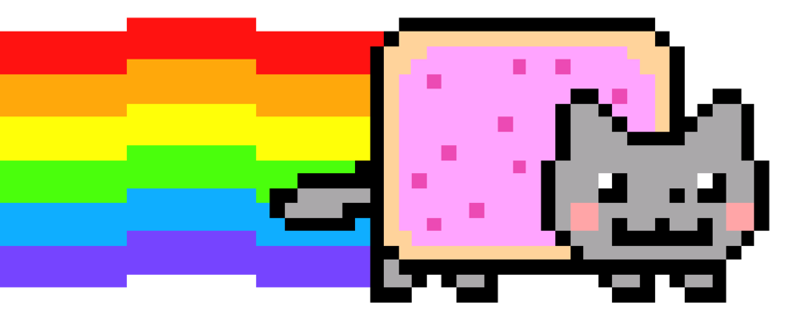
Q: How many lives does a cat have?
A: nyan!

Slide 5

Ok, ok … no more jokes …

Slide 6
questions answered today (hopefully)
What is Coding/Programming?
What is a Programming Language?
What is JavaScript & what is it used for?
I’m falling asleep, can we write some code?

Slide 7

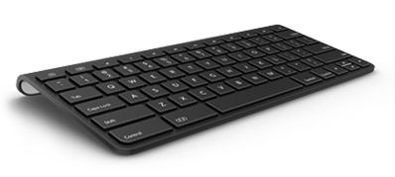
Computer Programming

Slide 8
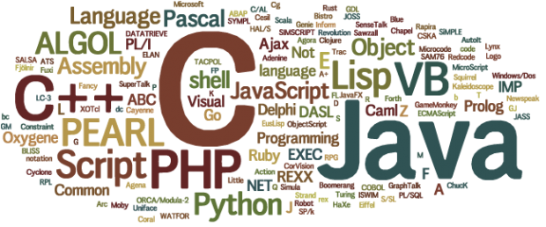
Programming Languages

Slide 9

JavaScript

Slide 10
Cool 😃
Let’s write some code, maybe?

Slide 11
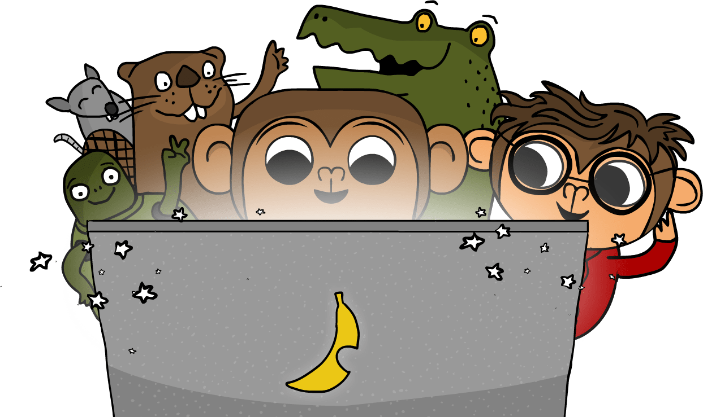
Let’s code!
Statements
Variables
Famous first words
Expressions
Conditionals
Loops
Functions

Slide 12
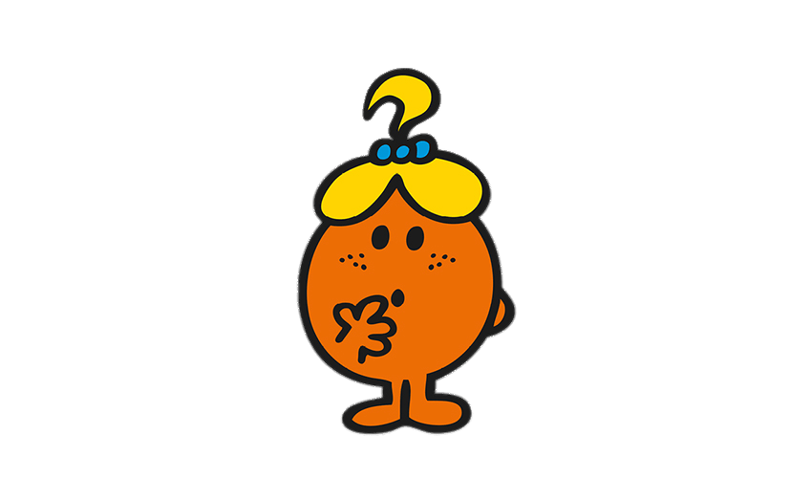
Questions?
Pssst, it doesn’t have to be about the code we just played around with… Ask me anything on your mind that I might be able to help with!
Image Source: www.stickpng.com/img/at-the-movies/cartoons/mr-men/little-miss-curious

Slide 13

Next steps
Check the workshop’s GitHub link for resources on becoming awesome[r] with programming!

Slide 14
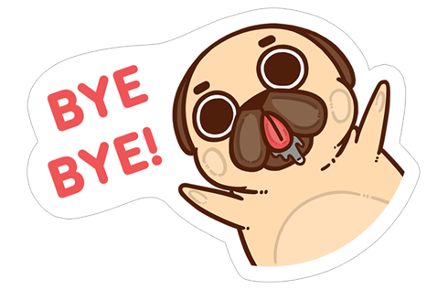
🤗 Thank you 🤗

