Slide 1
ECE 667
Spring 2013
Synthesis and Verification of Digital Circuits
Introduction
Design Flow
Notes:
ECE 667

Slide 2
Course Outline
Introduction to logic synthesis
  VLSI design flow, target technologies
High level synthesis, basics
  Scheduling, resoource allocation, binding
Boolean functions and their representations
  Sum of products, factored form representations
  Canonical representations, BDDs, BMDs, others
Two-level logic optimization
  Exact logic minimization (Quine)
  Heuristic logic optimization (Espresso)
Functional decomposition
  Asenhurst-Curtis method
  BDD based decomposition, bi-decomposition
Multi-level logic synthesis (technology independent)
  Kernel-based algebraic decomposition (SIS)
  AIG-based optimization (ABC)
Technology mapping
  Graph based, standard cell mapping (ASICs)
  Cut-based (FPGAs)
Sequential optimization
  Retiming; integrating synthesis, retiming and mapping (ABC)
Satisfiability (SAT)
  Application to synthesis and verification
Formal verification
  Equivalence checking, property checking
  Sequential verification, FSM reachability
ECE 667 Synthesis & Verification - Design Flow

Slide 3
Outline – today’s lecture
Intro: synthesis flow
  DataPath (high level synthesis)
  Control and steering logic (logic synthesis)
Target technology
  PLA, ASIC, FPGA
Logic optimization, objectives
  Two-level (PLA)
  Multi-level (standard cells, FPGAs)
  Technology independent + mapping
  Combinational vs sequential logic synthesis
Representations
  Truth tables, K-maps
  SoP, factored forms, BDDs
ECE 667 Synthesis & Verification - Design Flow

Slide 4
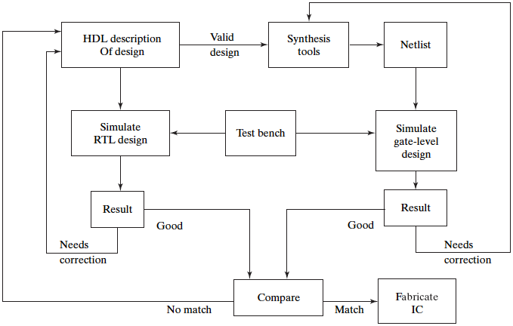
Electronic Design Automation (EDA)
Synthesis
Design &
simulation
Verification
ECE 667 Synthesis & Verification - Design Flow

Slide 5
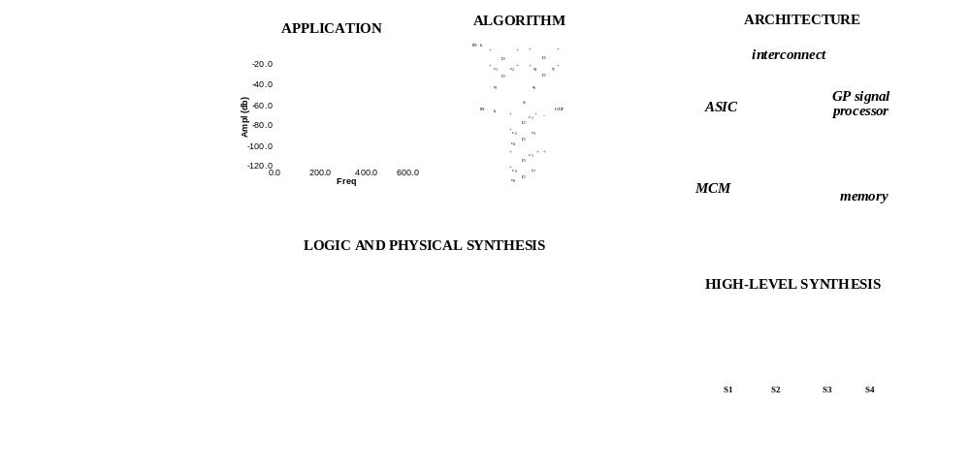
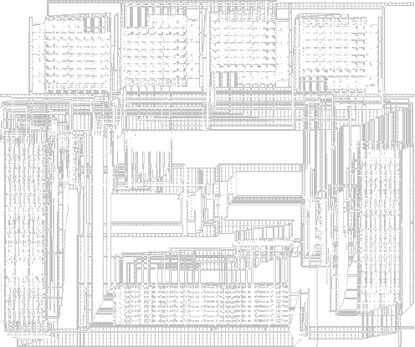
Synthesis Process (high-level view)
ECE 667 Synthesis & Verification - Design Flow

Slide 6
High Level Synthesis (HLS)
The process of converting high-level design description to RTL
  Input:
    High-level languages (C, system C, system Verilog)
    Hardware description languages (Verilog, VHDL)
    State diagrams / logic networks
  Tools:
    Parser, compiler
    Library of modules
  Constraints:
    Resource constraints (no. of modules of a certain type)
    Timing constraints (Latency, delay, clock cycle)
  Output:
    Operation scheduling (time) and binding (resource)
    Control generation
    RTL architecture
ECE 667 Synthesis & Verification - Design Flow

Slide 7
Design Compilation
Separation into
DataPath (arithmetic)
Control (Boolean logic)
Lex
Compilation
front-end
Parse
Behavioral
Optimization
Intermediate
form
Arch synth
Logic synth
HLS backend
Lib Binding
ECE 667 Synthesis & Verification - Design Flow

Slide 8
Behavioral Optimization
Techniques used in software compilation
  Expression tree height reduction
  Constant and variable propagation
  Common sub-expression elimination
  Dead-code elimination
  Operator strength reduction (e.g., *4 → << 2)
Hardware transformations
  Conditional expansion
    If c then x = A
    else x = B;
    Compute A and B in parallel: x = C ? A : B (MUX)
  Loop unrolling
    Replace k iterations of a loop by k instances of the loop body
Data Flow Graph (DFG) transformations
x = a + b × c + d
+
+
+
×
+
×
a
b
c
d
a
d
b
c
c
A
x
B
ECE 667 Synthesis & Verification - Design Flow

Slide 9
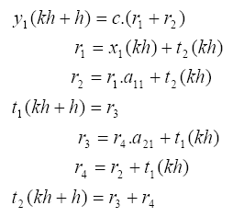
Example – Digital Filter design
A second-order digital filter
Verilog code:
/* A behavioral description of a digital filter
module digital_filter(x1,y1);
input x1;
output y1;
wire [7:0] r1,r2,r3,r4,t1,t2,c,a11,a21;
assign r1 = x1 + t2;
assign r2 = r1 * a11 + t2;
assign r4 = r2 + t1;
assign r3 = r4 + a21 + t1;
assign y1 = c* (r1 + r2);
assign t1 = r3;
assign t2 = r3 + r4;
endmodule
Algorithm:
ECE 667 Synthesis & Verification - Design Flow

Slide 10
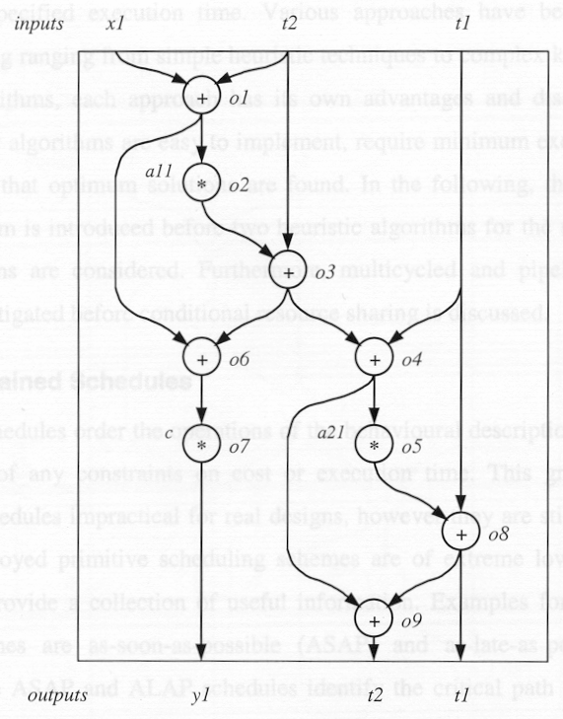
Digital Filter – Unscheduled DFG
input x1;
output y1;
wire [7:0] r1,r2,r3,r4,t1,t2,c,a11,a21;
assign r1 = x1 + t2;
assign r2 = r1 * a11 + t2;
assign r4 = r2 + t1;
assign r3 = r4 + a21 + t1;
assign y1 = c* (r1 + r2);
assign t1 = r3;
assign t2 = r3 + r4;
endmodule
ECE 667 Synthesis & Verification - Design Flow

Slide 11
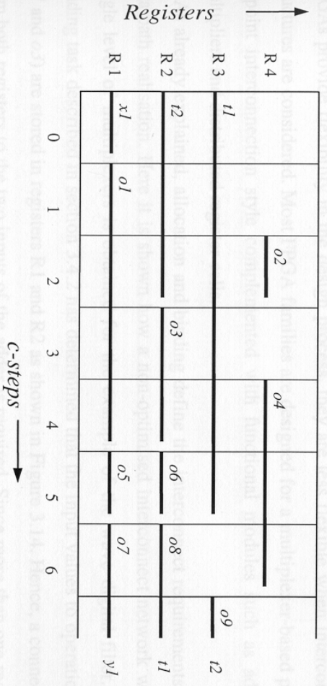
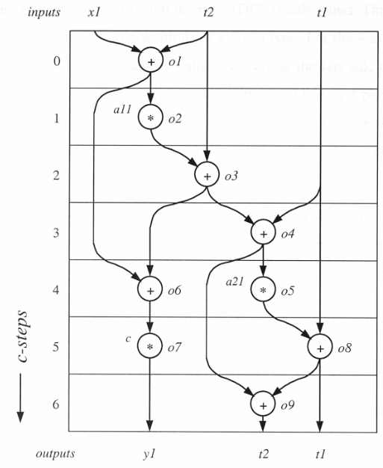
Digital Filter – Scheduling and Regs mapping
Resource-constraint scheduling ( 1 adder , 1 multiplier)
Register mapping (left-edge algorithm)
ECE 667 Synthesis & Verification - Design Flow

Slide 12
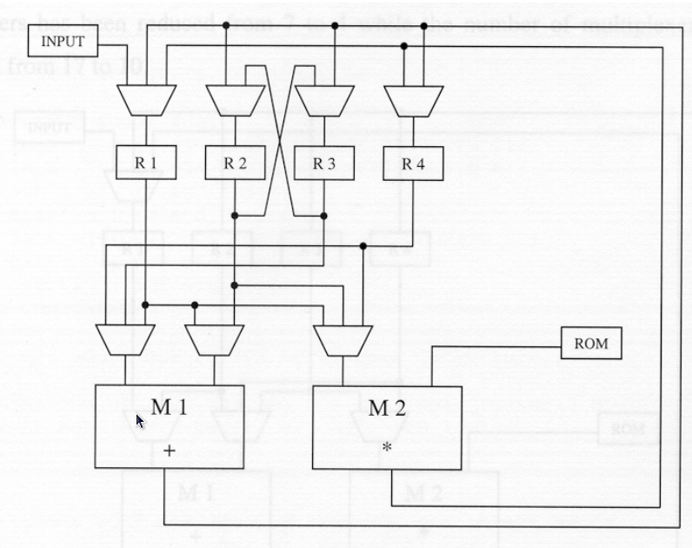
Example – Final Architecture
FSM
controller
t1
x1
t2
c0,c1, …, c6
y1
const a11, a21, c
ADD
MULT
t1
t2
Arithmetic components (structured) → design ware (DC)
Control + steering logic (unstructured) → logic synthesis
ECE 667 Synthesis & Verification - Design Flow

Slide 13
Data Flow Graph (DFG) Transformations
Transformation
F = a*(b + c)
F = a*b + a*c
a
b
c
b
a
c
+
x
x
x
+
F
F
ECE 667 Synthesis & Verification - Design Flow

Slide 14
Optimization in Temporal Domain
Scheduling:
  Mapping of operations to time slots (cycles)
  Uses sequencing graph (data flow graph, DFG)
  Goal: minimize latency (s.t. resource constraints)
NOP
NOP
1
×
×
×
×
+
1
×
×
+
2
×
×
+
<
2
×
×
<
3
-
3
-
×
×
-
-
+
4
4
NOP
NOP
[©Gupta]
ECE 667 Synthesis & Verification - Design Flow
Notes:
ECE 667
In the left schedule, how many multipliers do we need? How many ALU’s?
What about the schedule on the right?

Slide 15
Optimization in Spatial Domain
Resource allocation & binding
  Assigning operations to hardware units
  Allocating registers
  Binding operations to same resource
  Goal: minimize resource utilization (s.t. latency constraints)
NOP
1
×
×
×
×
+
2
×
×
+
<
3
-
-
4
NOP
[©Gupta]
ECE 667 Synthesis & Verification - Design Flow

Slide 16
Logic (RTL) Synthesis
- HDL input
- control/data flow analysis
RTL to Network Transformation
- basic logic restructuring
- crude measures for goals
Technology independent Optimizations
- use logic gates from target
cell library
Technology Mapping
- timing optimization
- physically driven optimizations
Technology Dependent Optimizations
- improve testability
- test logic insertion
Test Preparation
ECE 667 Synthesis & Verification - Design Flow

Slide 17
Synthesis Flow (logic level)
a multi-stage process
Specification
Logic Extraction
module example(clk, a, b, c, d, f, g, h)
input clk, a, b, c, d, e, f;
output g, h; reg g, h;
always @(posedge clk) begin
g = a | b;
if (d) begin
if (c) h = a&~h;
else h = b;
if (f) g = c; else a^b;
end else
if (c) h = 1; else h ^b;
end
endmodule
a
Technology-Independent Optimization
b
a
Technology-Dependent Mapping
h
e
g1
0
G
b
g0
f
h5
G
g
c
d
g
h3
b
H
d
e
f
a
h1
H
h
c
e
clk
c
d
f
clk
ECE 667 Synthesis & Verification - Design Flow
Notes:
ECE 667
*Multilevel synthesis is a step in the automated circuit design process, whose goal is to translate behavioral description of a design into a form which is ready for fabrication.
*Typically, the behavioral description of a design is entered in a textual for.
*It is then translated into RTL level.
At this point multilevel logic synthesis becomes one of the areas in which combinational parts of a design are manipulated at the logic level.
In the very abstract form this manipulation involves
*(1) Optimization, which operates on the technology independent network
*(2) and Binding, which maps optimized network into a specific set of a library primitives.
Thus, multilevel logic synthesis can be described as a 2 stage process which spans TI and TD transformations. The approach is been dominant in the multilevel synthesis. It is been used in the SIS synthesis system.

Slide 18
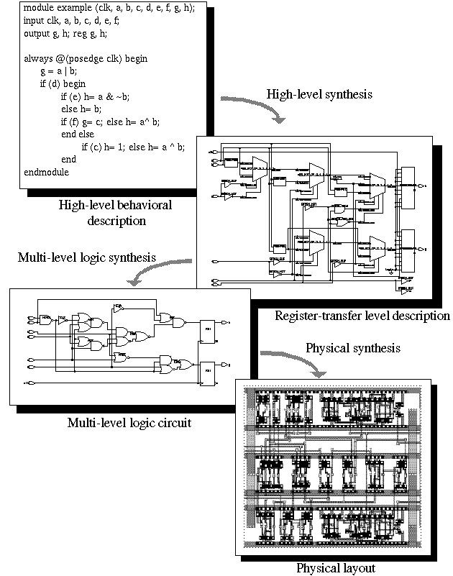
RTL Synthesis
ECE 667 Synthesis & Verification - Design Flow

Slide 19
Implementation Choices (target technology)
Digital Circuit Implementation Approaches
Custom
Semicustom
Cell-based
Array-based
Standard Cells
Ma
cro Cells
Pre-diffused
Pre-wired
(Gate Arrays)
(FPGAs, PLDs)
ECE 667 Synthesis & Verification - Design Flow

Slide 20
Logic Optimization methods
Depend on target technology
Logic Optimization
Two-level logic (PLA)
Multi-level logic
(standard cells)
Heuristic
(espresso)
Exact (QM)
Boolean
Structural
(SIS,ABC)
Functional
(AC, Kurtis)
Functional
(BDD-based)
algebraic
Boolean
ECE 667 Synthesis & Verification - Design Flow

Slide 21
Two-level Logic: PLA
Logic represented as a two-level AND-OR structure
Product terms
x
0
x
1
AND
x
2
OR
plane
plane
f
0
f
1
x
0
x
1
x
2
ECE 667 Synthesis & Verification - Design Flow

Slide 22
Programmable Logic Array (PLA)
Pseudo-NMOS PLA
V
DD
GND
GND
GND
GND
GND
GND
GND
V
DD
X
0
X
0
X
1
X
1
X
2
X
2
f
0
f
1
AND-plane
OR-plane
ECE 667 Synthesis & Verification - Design Flow

Slide 23
Two-level logic minimization
Representation (which are canonical ?)
  Truth tables
  Karnaugh maps
  Sum of Products (SOP) form
    Represents number of lines in PLA
  Binary Decision Diagrams (BDD)
Objective
  Minimize number of product terms in SOP
  Challenge: multiple-output functions
Optimization techniques
  Quine McCluskey (optimal)
  Espresso logic minimizer (heuristic)
  Ashenhust-Curtis functional decomposition (~optimal)
  BDD-based (heuristic)
ECE 667 Synthesis & Verification - Design Flow

Slide 24
Truth Table
abcd f
m₀ 0000 0
m₁ 0001 1
m₂ 0010 0
m₃ 0011 1
m₄ 0100 0
m₅ 0101 1
m₆ 0110 0
m₇ 0111 0
The truth table of a function f : B^{n} → B is a tabulation of
its values at each of the 2^{n} vertices of B^{n}. (all mintems)
Example: f = a’b’c’d + a’b’cd + a’bc’d +
ab’c’d + ab’cd + abc’d +
abcd’ + abcd
  (Notation for complement: a’ = a )
  The truth table representation is
  - canonical: if two functions are the same, their representations are the same (isomorphic).
  - intractable for large n
m₈ 1000 0
m₉ 1001 1
m₁₀ 1010 0
m₁₁ 1011 1
m₁₂ 1100 0
m₁₃ 1101 1
m₁₄ 1110 1
m₁₅ 1111 1
ECE 667 Synthesis & Verification - Design Flow

Slide 25
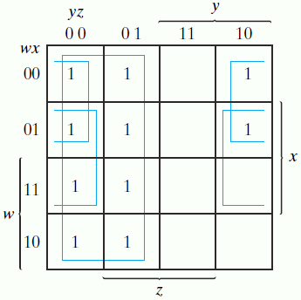
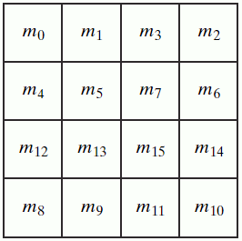
Karnaugh Maps
Graphical representation of collection of minterms
  Two adjacent cells differ in one bit
  F(w,x,y,z)= Σ(0,1,2,4,5,6,8,9,12,13,14) = y’+w’z’+xz’
1
  K-map representation is
  - canonical
  - impractical for number of variables n > 5
ECE 667 Synthesis & Verification - Design Flow

Slide 26
Sum of Products (SOP)
Example:
abc’+a’bd+b’d’+b’e’f (sum of cubes)
Advantages:
  easy to manipulate and minimize
  many algorithms available
  two-level theory applies
Disadvantages:
  Not representative of logic complexity. For example: f = ad+ae+bd+be+cd+ce f’ = a’b’c’+d’e’
  The two differ in their implementation by an inverter.
  Not easy to estimate logic size and performance
  Difficult to estimate progress during logic manipulation
ECE 667 Synthesis & Verification - Design Flow

Slide 27
Two-level minimization - basic idea
Initial representation:
x y z
0 – 0
0 1 –
– 1 1
1 – 1
f₁ f₂
0 1
0 1
1 0
1 0
f₁
f₂
011
111
011
111
001
101
001
101
010
110
010
110
000
100
000
100
Minimized function:
f₁
011
111
f₂
011
111
x y z
0 – 0
0 1 1
1 – 1
f₁ f₂
0 1
1 1
1 0
001
001
101
101
z
010
010
y
110
110
x
000
100
000
100
ECE 667 Synthesis & Verification - Design Flow

Slide 28
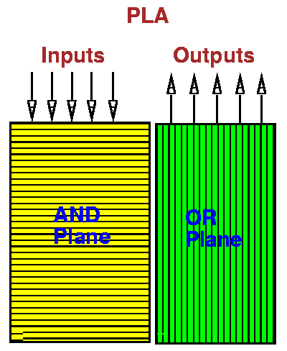
Two-Level (PLA) vs. Multi-Level
Standard Cell Layout
PLA
control + random logic
constrained layout, PLA
goal: minimize # prod. terms
Multi-level Logic
all logic
standard cells, FPGAs
Minimize # gates, transistors (~literals)
ECE 667 Synthesis & Verification - Design Flow

Slide 29
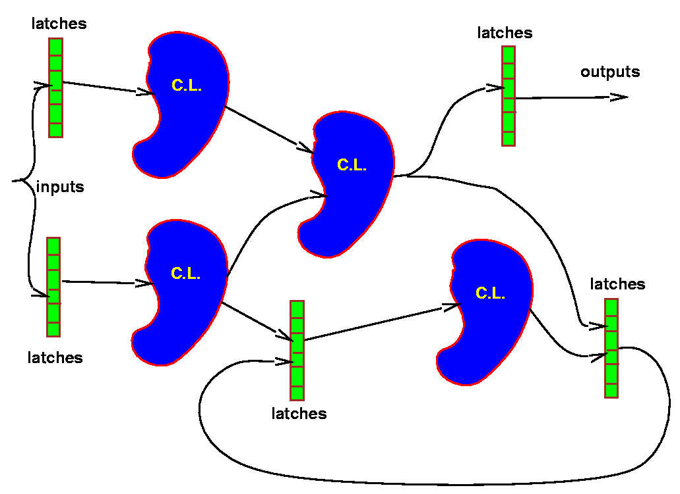
General Multi-level Logic Structure
Combinational optimization
  keep latches/registers at current positions, keep their function
  optimize combinational logic between register boundaries
Sequential optimization
  change latch position/function (retiming) + other transformations
ECE 667 Synthesis & Verification - Design Flow

Slide 30
Multi-level logic - Synthesis Flow
HDL specification
Front-end
parsing
Techn-independent
optimization
Logic
synthesis
Technology
mapping
Cell library
Manufacturing
ECE 667 Synthesis & Verification - Design Flow

Slide 31
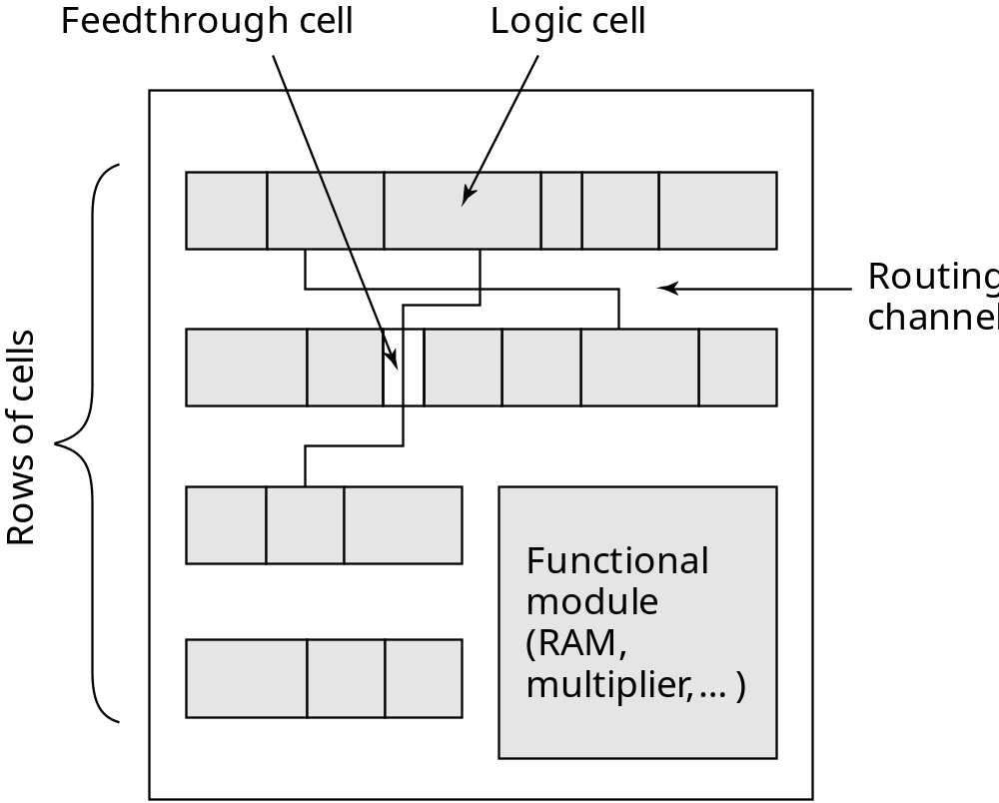
Cell-based Design (standard cells)
Routing channel
requirements are
reduced by presence
of more interconnect
layers
ECE 667 Synthesis & Verification - Design Flow

Slide 32
Standard Cell Layout Methodology – 1980s
Routing
channel
V_{DD}
signals
GND
ECE 667 Synthesis & Verification - Design Flow
Notes:
ECE 667
Contacts and wells not shown.
What does this implement??

Slide 33
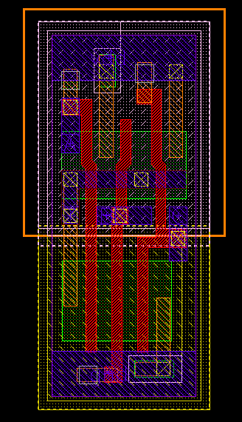
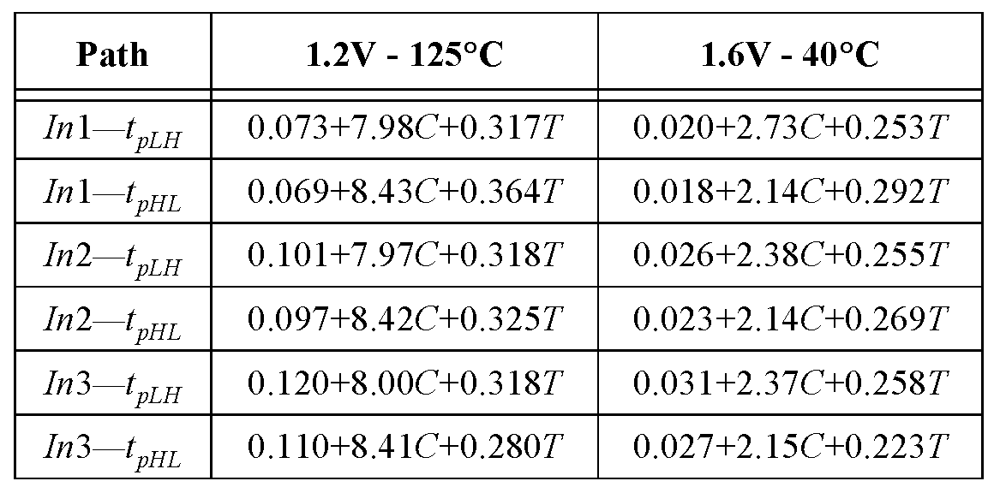
Standard Cell - Example
3-input NAND cell (ST Microelectronics):
C = Load capacitance
T = input rise/fall time
ECE 667 Synthesis & Verification - Design Flow

Slide 34
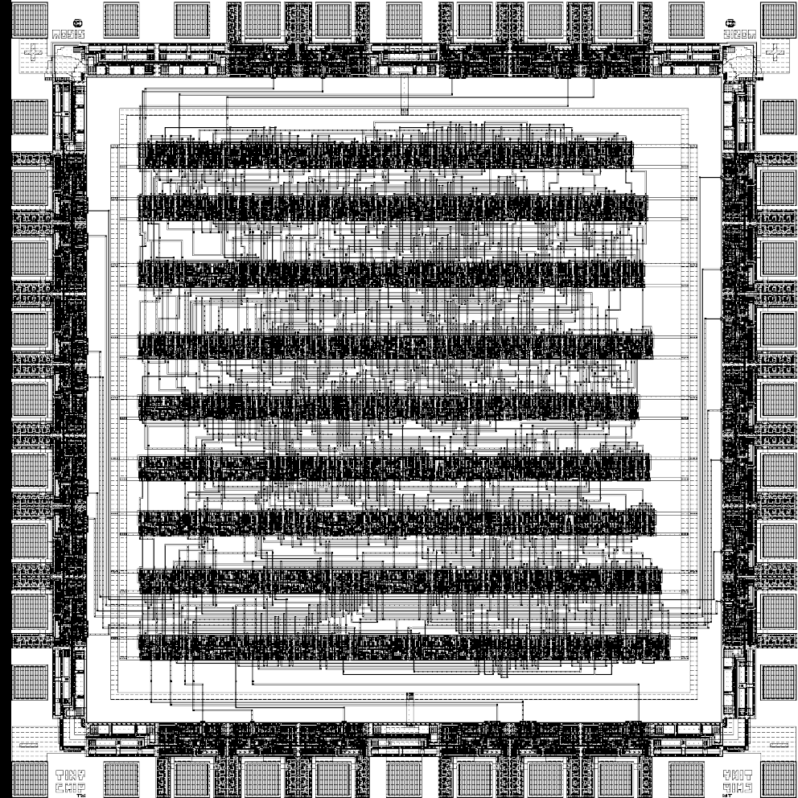
Standard Cell layout — Example
[Brodersen92]
ECE 667 Synthesis & Verification - Design Flow

Slide 35
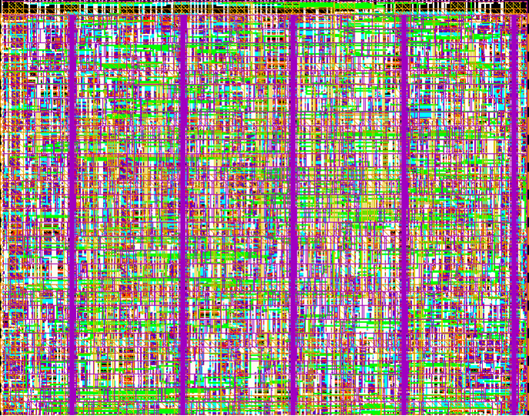
Standard Cell – New Generation
Cell-structure
hidden under
interconnect layers
ECE 667 Synthesis & Verification - Design Flow

Slide 36
Integrating Synthesis with Physical Design
RTL
(Timing) Constraints
Physical Synthesis
Macromodules
Fixed netlists
Netlist with
Place-and-Route Info
Place-and-Route
Optimization
Layout
ECE 667 Synthesis & Verification - Design Flow

Slide 37
Semicustom Design Flow
Design Capture
Behavioral
HDL
Pre-Layout Simulation
Structural
Logic Synthesis
Design Iteration
Floorplanning
Post-Layout Simulation
Placement
Physical
Circuit Extraction
Routing
Tape-out
ECE 667 Synthesis & Verification - Design Flow

Slide 38
Field Programmable Gate Arrays (FPGA)
Field Programmable Gate Array (FPGA)
  An array of identical, programmable logic function blocks
  Manufactured ahead of time (prefabricated)
    Each block has a fixed number of inputs (k)
    Each block is able to implement an arbitrary logic function
  Customer programs FPGA after manufacturing, “in field”
    provides logic functions and interconnections
    Re-programmable
  Easier to debug and cheaper in smaller quantity than ASIC
An alternative to ASIC
  High production cost amortized over large quantity of chips
    ASIC (Application Specific Integrated Circuit) – high volume of custom design chip
    FPGAs – high volume of programmable, flexible chips
ECE 667 Synthesis & Verification - Design Flow

Slide 39
Look-up Table based FPGA
Look-up Table
  Truth table implemented in hardware
  Can implement arbitrary function with fixed number of inputs (typically 4-5) by programming the storage bits (customizing the truth table)
Programming bit P
F = x₁’x₂’ + x₁x₂
2-Input LUT
x1 x2 F
0 0 1
0 1 0
1 0 0
1 1 1
1
0
0
1
0/1
0/1
F
0/1
0/1
x1 x2
ECE 667 Synthesis & Verification - Design Flow

Slide 40
Logic Element
Logic Element: the basic programmable element of FPGA
  Contains LUT
Programming is a domain of specialized technology mapping onto device specific structure
Inputs
Look-Up
Out
Table
(LUT)
Clock
State
Enable
ECE 667 Synthesis & Verification - Design Flow

Slide 41
FPGA Architecture
Logic Element
Tracks
LE
LE
LE
LE
LE
LE
LE
LE
LE
LE
LE
LE
  Each programmable logic element outputs one data bit
  Interconnects are also programmable
  A domain of physical synthesis (place and route)
ECE 667 Synthesis & Verification - Design Flow

Slide 42
Multi-level logic minimization
Objective
  Minimize number of literals
  Literals represent inputs to CMOS gates
Representation
  Factored form
  Compatible with CMOS
Optimization techniques
  Algebraic factorization and decomposition (heuristic)
    Technology independent
  Requires mapping onto target architecture
    Standard cells
    FPGAs (LUT)
ECE 667 Synthesis & Verification - Design Flow

Slide 43
Optimization Criteria for Synthesis
Objective: minimize some function of:
  Area occupied by the logic gates and interconnect (approximated by literals = transistors in technology independent optimization)
  Critical path delay of the longest path through logic
  Degree of testability of the circuit
  Power consumed by the logic gates
  Placeability, Wireability
ECE 667 Synthesis & Verification - Design Flow

Slide 44
Transformation-based Synthesis
Synthesis = sequence of transformations that change network topology and its characteristics
  All modern synthesis systems are build that way
    work on uniform network representation
    use scripts, lists of transformations forming a strategy
  Transformations are mostly algebraic !
    (very little is based on Boolean factorization)
Representation
  Cube notation, BDDs, AIGs
The underlying algorithms
  Algebraic transformations
  Collapsing, decomposition
  Factorization, substitution
  Transformations differ in scope
    Local (node optimizattion)
    Global (network restructuring)
ECE 667 Synthesis & Verification - Design Flow

Slide 45
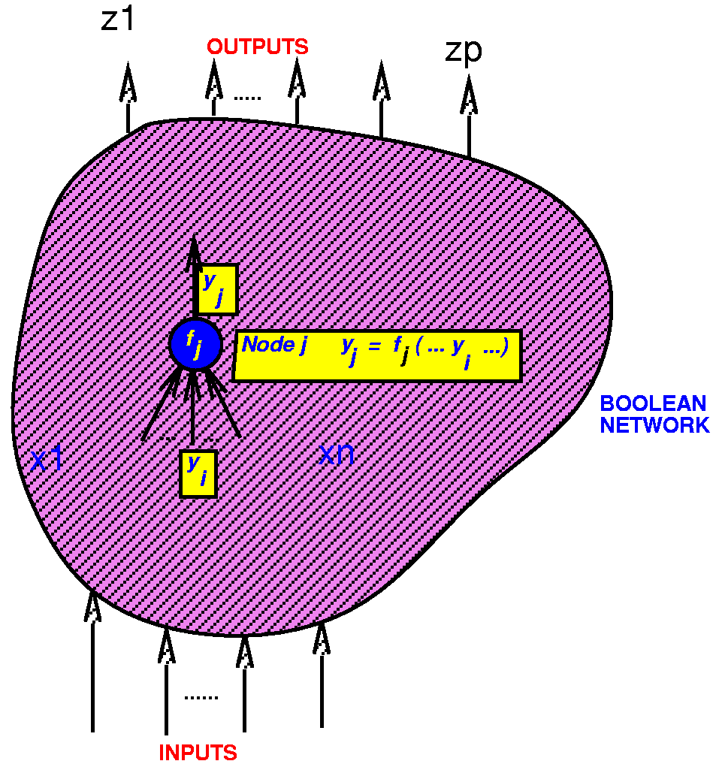
Network Representation
Boolean network:
  directed acyclic graph (DAG)
  node logic function representation f_{j}(x,y)
  node variable y_{j}: y_{j}= f_{j}(x,y)
  edge (i,j) if f_{j} depends explicitly on y_{i}
Inputs x = (x₁, x₂,…,x_{n} )
Outputs z = (z₁, z₂,…,z_{p} )
External don’t cares: d₁(x), …, d_{p}(x)
ECE 667 Synthesis & Verification - Design Flow

Slide 46
Multi-level logic representation: Boolean network
8
1
7
4
2
6
9
5
Outputs
Inputs
3
Internal nodes,
single-output functions
Goal: minimize some measure of network complexity
  number of 2-input gates
  number of literals (variables)
Eventually, the nodes must be mapped to standard cells
(technology mapping)
ECE 667 Synthesis & Verification - Design Flow

Slide 47
Sum of Products (SOP)
Used to represent local Boolean functions (nodes)
abc’+a’bd+b’d’+b’e’f (sum of cubes)
Advantages:
  easy to manipulate and minimize
  many algorithms available (e.g. AND, OR, TAUTOLOGY)
Disadvantages:
  Not representative of logic complexity. For example: f = ad+ae+bd+be+cd+ce f’ = a’b’c’+d’e’
  These differ in their implementation by an inverter.
  Not easy to estimate logic size and performance
ECE 667 Synthesis & Verification - Design Flow

Slide 48
Factored Forms
Example:
(ad+b’c)(c+d’(e+ac’))+(d+e)fg
Advantages
  good representative of logic complexity f=ad+ae+bd+be+cd+ce ⇒ f=(a+b+c)(d+e)
  in many designs (e.g. complex gate CMOS) the implementation of a function corresponds directly to its factored form
  good estimator of logic implementation complexity
  doesn’t blow up easily
Disadvantages
  not as many algorithms available for manipulation
  often just converted into SOP before manipulation
ECE 667 Synthesis & Verification - Design Flow

Slide 49
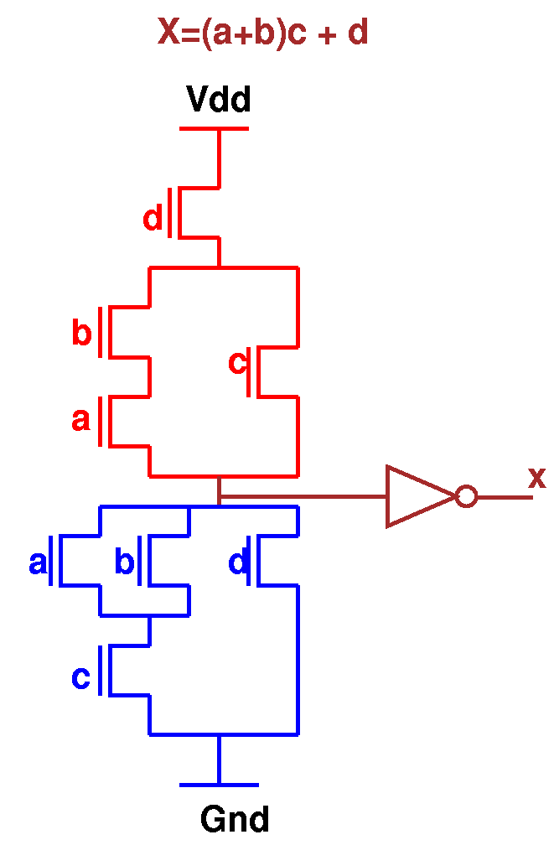
Factored Forms
Good approximation for multi-level logic implemented in CMOS
Literal count ≈ transistor count ≈ area
However, area also depends on
  wiring
  gate size etc.
X = (a+b)c + d
ECE 667 Synthesis & Verification - Design Flow

Slide 50
AND-INVERTER Graphs (AIG)
New representation, for state of the art synthesis (ABC system)
Base data structure uses two-input AND function for vertices and Inverter attributes at the edges (individual bit)
  use De’Morgan’s law to convert OR operation etc.
Hash table to identify and reuse structurally isomorphic circuits
f
f
g
g
complement
AND node
ECE 667 Synthesis & Verification - Design Flow

Slide 51
Logic Optimization (techn-independent)
Goal: given initial network, find best factored form representation.
Example: f₁ = abcd+abce+ab’cd’+ab’c’d’+a’c+cdf+abc’d’e’+ab’c’df’
f₂ = bdg+b’dfg+b’d’g+bd’eg
SOP minimization (2-level)
f₁ = bcd+bce+b’d’+a’c+cdf+abc’d’e’+ab’c’df’
f₂ = bdg+dfg+b’d’g+d’eg
Factoring
f₁ = c(b(d+e)+b’(d’+f)+a’)+ac’(bd’e’+b’df’)
f₂ = g(d(b+f)+d’(b’+e))
Decomposition
f₁ = c(x+a’)+ac’x’ , f₂ = gx
x = d(b+f)+d’(b’+e)
Logic optimization tasks:
    find good common subfunctions
    effect the division
ECE 667 Synthesis & Verification - Design Flow

Slide 52
Technology dependent Optimization
Logic represented as a network of logic gates
  Logic decomposition (multi-level network)
  Technology mapping onto standard cells (library)
NAND21i
NAND3
AOI21
NAND2i
ECE 667 Synthesis & Verification - Design Flow

Slide 53
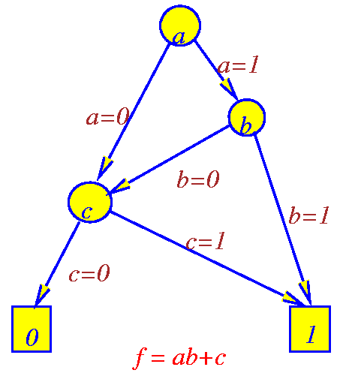
Binary Decision Diagrams (BDDs)
  Like factored form, represents both function and complement
  Like network of muxes, but restricted since controlled by primary input variables
    not really a good estimator for implementation complexity
  Given an ordering, reduced BDD is canonical, hence a good replacement for truth tables
  For a good ordering, BDDs remain reasonably small for complicated functions (e.g. not multipliers)
  Manipulations are well defined and efficient
  True support (dependency) is displayed
ECE 667 Synthesis & Verification - Design Flow

Slide 54
Basic Model of Sequential Circuit: FSM
X=(x₁,x₂,…,x_{n})
Y=(y₁,y₂,…,y_{n})
M(X,Y,S,S₀,δ,λ):
X: Inputs
Y: Outputs
S: Current State
S₀: Initial State(s)
δ: X × S → S (next state function)
λ: X × S → Y (output function)
λ
S=(s₁,s₂,…,s_{n})
δ
S’=(s’₁,s’₂,…,s’_{n})
D
Sequential synthesis:
find (multi-level) implementation of δ (X) and λ(X) that minimize its cost (area, delay, power)
Delay elements:
  Clocked: synchronous
    single-phase clock, multiple-phase clocks
  Unclocked: asynchronous
ECE 667 Synthesis & Verification - Design Flow

Slide 55


Sequential Logic Synthesis (FSM view)
Given: Finite-State Machine F(X,Y,Z, , ) where:
X
Y
X: Input alphabet
Y: Output alphabet
Z: Set of internal states
: X x Z Z (next state function, Boolean)
: X x Z Y (output function, Boolean)
D
Combinational logic
Sequential elements
Circuit composed of interconnected set of Boolean gates, flip-flops, latches, registers, etc.
ECE 667 Synthesis & Verification - Design Flow

Slide 56
Verification
Design verification = ensuring correctness of the design
  against its implementation (at different levels)
  against alternative design (at the same level)
≡ ?
model
Design 1
Design 2
≡ ?
behavior
HDL / RTL
RTL
≡ ?
function
Logic level
Logic level
≡ ?
≡ ?
structure
Gate level
Gate level
≡ ?
≡ ?
layout
Mask level
Mask level
ECE 667 Synthesis & Verification - Design Flow

Slide 57
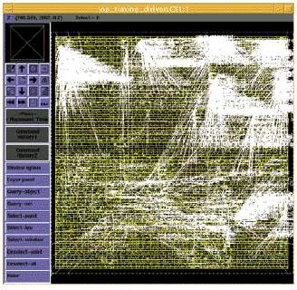
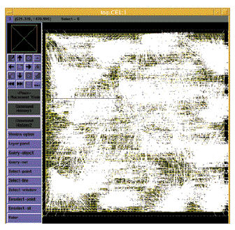
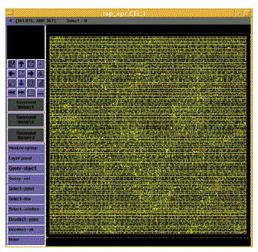
The “Design Closure” Problem
Iterative Removal of Timing Violations (white lines)
ECE 667 Synthesis & Verification - Design Flow
Courtesy Synopsys

