Slide 1


Slide 2
Introduction
A text editor is a tool that allows a user to create and edit documents in a computer. Though this task can be carried out in other modes, the word text editor commonly refers to the tool that does this interactively.

Slide 3
Motivation
A text editor is one of the most versatile system software applications that is found on all computers today. They are used for text manipulation functions like cut, copy,paste,delete and save. The text editor strives to implement a fresh user interface with a number of functions to make the editor useful and simple for the user.

Slide 4
Functional Capabilities
Create File
Read File
Delete File
Copy File
Empty File
Add to File

Slide 5
Adopted Methodology
File Handling :
File handling in C++ is a mechanism to store the output of a program in a file and help perform various operations on it.Files help store these data permanently on a storage device. The term “Data” is commonly referred to as known facts or information
ios::app | Append: Adding Data in the End of Existing file (eof)
std::string::c_str | Returns a pointer to an array that contains a null-terminated sequence of characters (i.e., a C-string) representing the current value of the string object.
cin.ignore | The cin. ignore() function is used which is used to ignore or clear one or more characters from the input buffer.

Slide 6
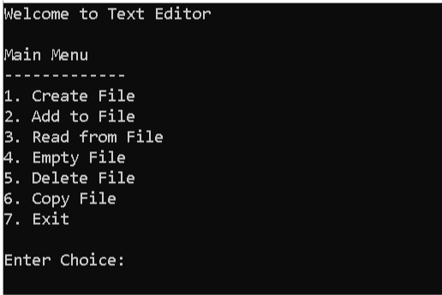
Menu Screenshot

Slide 7
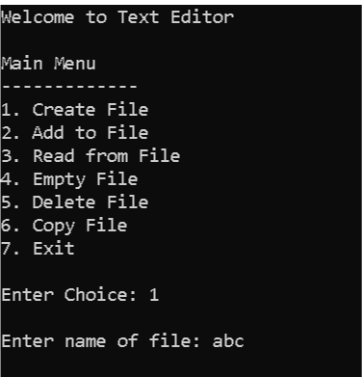
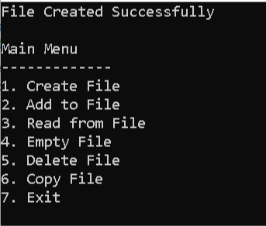
Creating A file

Slide 8
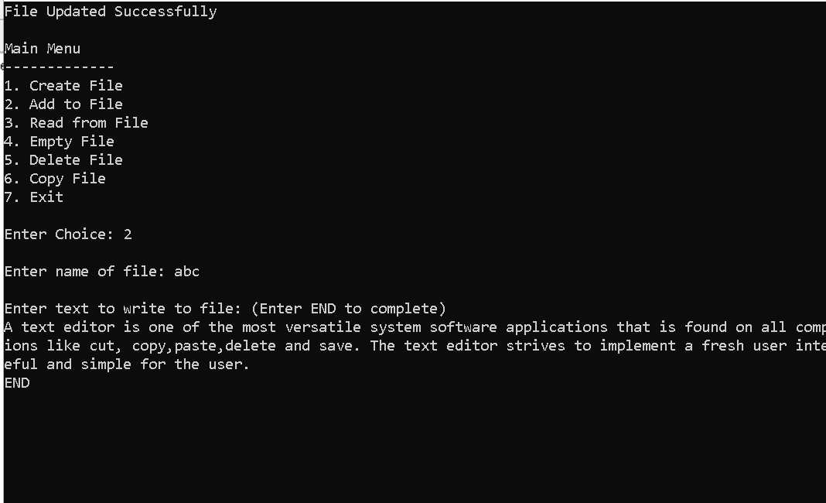
Adding DAta

Slide 9

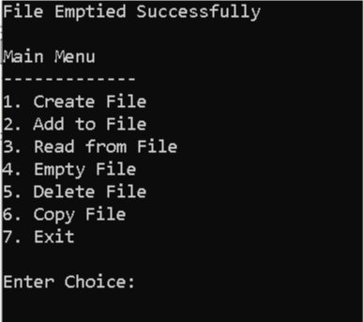
Empty File

Slide 10

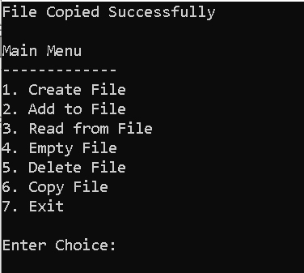
Copy

Slide 11
Thankyou!
Any Questions?

