Slide 1

Music Recommender Algorithm
By: Michael Altali

Slide 2
Objective
An algorithm that can recommend 5 different genres of music based on user traits (like age and gender), based on a small machine learning project I found online that does the same
Currently can recommend based on these two traits, but will soon be upgraded
Upgrades include:
Much wider range of genres prediction
Can recommend music based on what’s popular in cultures/regions/countries around the world
Current data set is general example with assumptions, upgraded data set will be based on real music genre popularities by world region, age and gender

Slide 3
Data Set
age | gender | genre
20 | 1 | HipHop
23 | 1 | HipHop
25 | 1 | HipHop
26 | 1 | Jazz
29 | 1 | Jazz
30 | 1 | Jazz
31 | 1 | Classical
33 | 1 | Classical
37 | 1 | Classical
20 | 0 | Dance
21 | 0 | Dance
25 | 0 | Dance
26 | 0 | Acoustic
27 | 0 | Acoustic
30 | 0 | Acoustic
31 | 0 | Classical
34 | 0 | Classical
35 | 0 | Classical
Using a simple data set temporarily to test the algorithm and if idea works, will upgrade it to be much more complex and in depth
The simple data set (to be upgraded) uses around 20 rows, with certain ages and genders of the users, and their favorite genres
My upgraded data set will attempt to include a much larger variety of music than the 5 genres included here, and could possibly incorporate the geographic region (like country) the user is from when recommending music to them

Slide 4
How the algorithm looks like
Is age <=30.5?
The algorithm set up is a decision tree of logistic regression decisions
If the input values fall over or under a certain characteristic, the algorithm and make a decision based on their age and gender
It’ll essentially ‘cross off’ genres that the user likely wouldn’t enjoy based on their age and gender
Visualized on the right
Yes, < 30
No, >30
Is gender <=0.5?
Y = classical music
No, 0=female
Yes, 1 = male
Is age <=25.5?
Is age <=25.5?
Yes, <25
No, >25
Yes, <25
No, >25
Y= Dance
Y= Acoustic
Y=HipHop
Y=Jazz

Slide 5
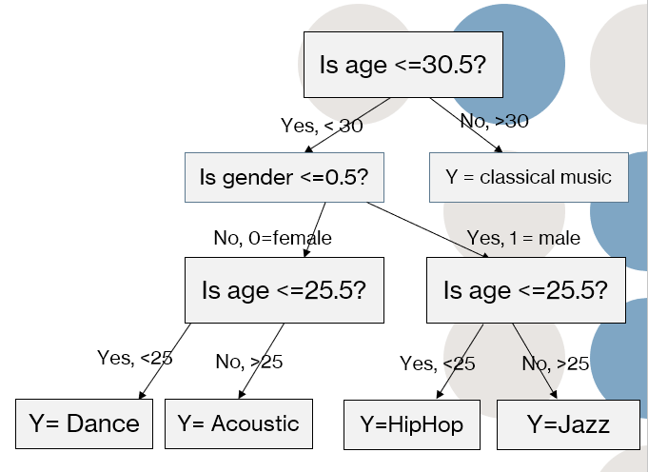
How it will change
Region?
Right now, the algorithm is only limited to 5 genres but successfully works. I will upgrade the algorithm to work with many more genres and evaluate its accuracy as it goes
The dataset will expand as well, and I will try to include extra inputs such as country/region
The information for the data set the algorithm will be trained and tested on will try to be realistic, meaning I’m going to use internet findings and studies on most popular genres across the world and by age and gender
I’m open to more changes and upgrades I can make to this music recommendation as well
Not quite sure yet how to incorporate age and gender with things like region, but the decision tree from the last page will likely become a branch on a much larger tree that begins by looking at the user's country/region
Canada
North America

Slide 6
Challenges
Incorporating all 3+ user profile traits together (age, gender, country, and any other traits that may be added as the project progresses)
Finding the most popular genres for a lot of countries has been a surprisingly tricky task, as I haven’t been able to find many sites that list each countries favorite music genres, aside from big countries like the US, Brazil, China, South Korea, etc..
Having the music recommender work with every country is going to be very difficult, especially since a lot of countries don’t have much information on their music preferences, if not none. So, I will only be doing a select amount of countries, anywhere from 10-50 countries

Slide 7
Progress so far
So far, the algorithm is able to successfully recommend a music genre (of the 5 it has data on) based on their age and gender
It’s working with a limited data set of around 20 rows (with 80%train/ 20% test split), so its accuracy varies anywhere from 50-100% everytime, this will be upgraded and improved along with the data set becoming larger and more complex
Currently obtaining more information on music genres popular around the world and amongst certain ages of people.

Slide 8
Thanks for watching!
I am very much open to suggestions, improvements, or even if you think a certain other algorithm would work better for this case than a decision tree with logistic regressions at each decision (might have to use linear regression for country sorting or several extra decision branches to ‘cross off’ countries and narrow it down to one)
If you have any questions, please let me know! Email is altalim@mcmaster.ca

