Slide 1
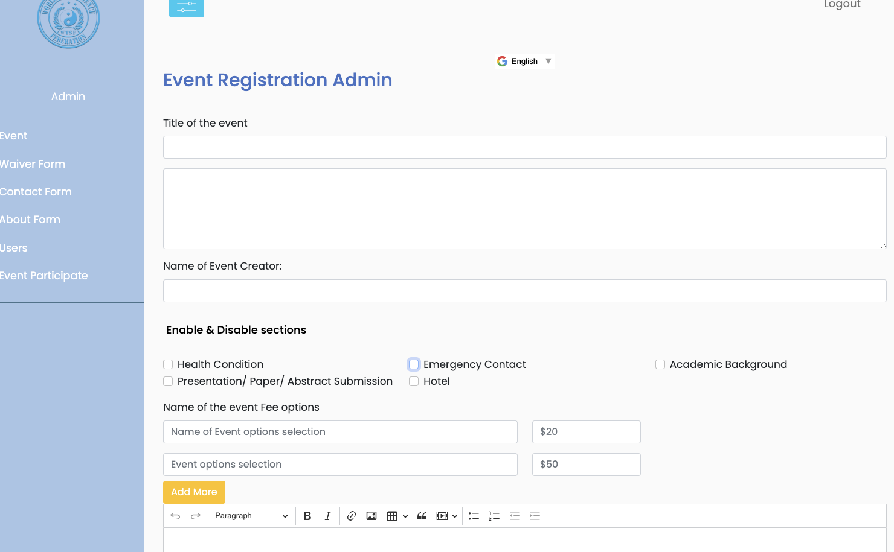
Admin Page Name of event Fee optional， need have add and remove, edit and Save function give us sensibility to change it
We also need option to remove all of it. So people don’t need to pay any fee.
Add, remove ,edit, Save
Add, remove ,edit, Save

Slide 2
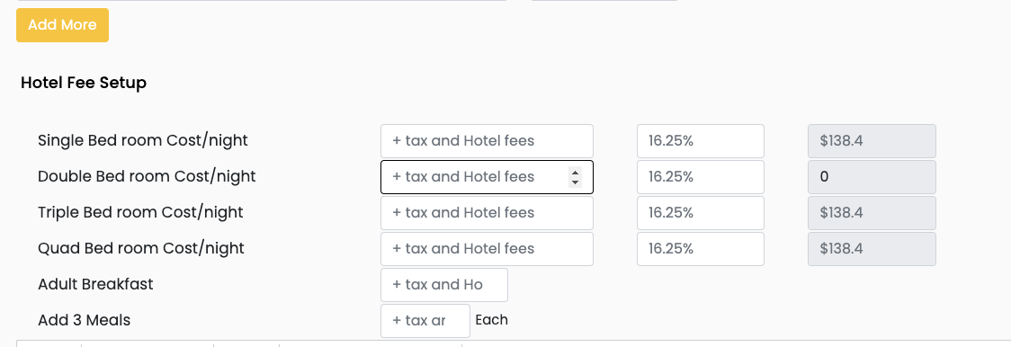
Admin Page content of Hotel room list we need to have edit function, some time we need to change it, for example “Book Site”
Or King bed only, or King with sofa bed….. So we have option to change the text.
2. And Also: Please give me option to add or remove the list
“some time only Single bed room available
Add, remove ,edit, Save
Add, remove ,edit, Save
Add, remove ,edit, Save
Add, remove ,edit, Save
Update the copyright to Copyright © World Taiji Science Federation

Slide 3
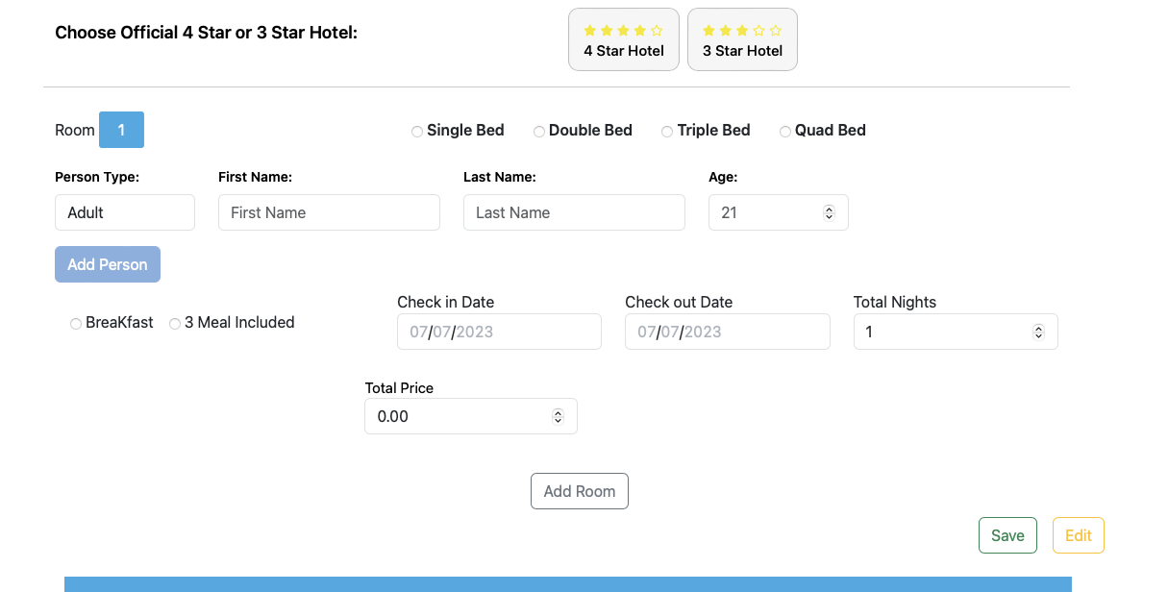
Admin Page and User page
If people don’t need hotel, just simply click skip to go to next
Skip

Slide 4
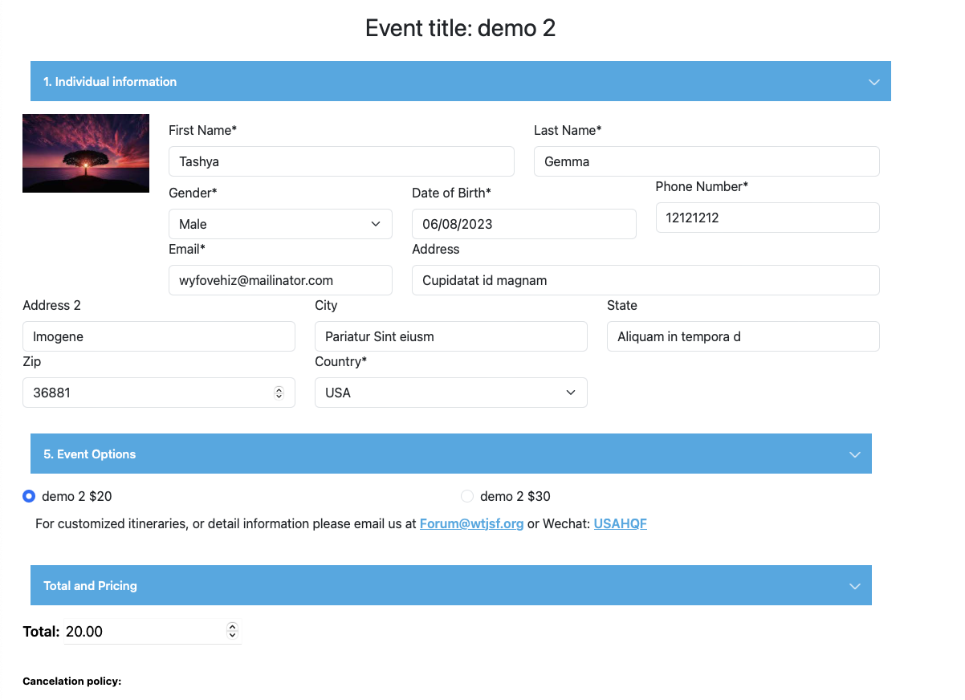
User Page
We don’t need the Number shows in the front, please remove the Numbers

Slide 5
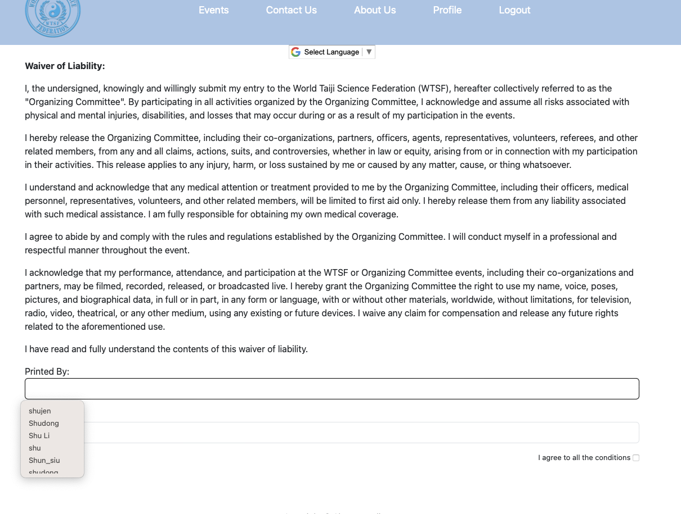
People only needed to file ones, next time login will will direct, go to the personal information page,

Slide 6
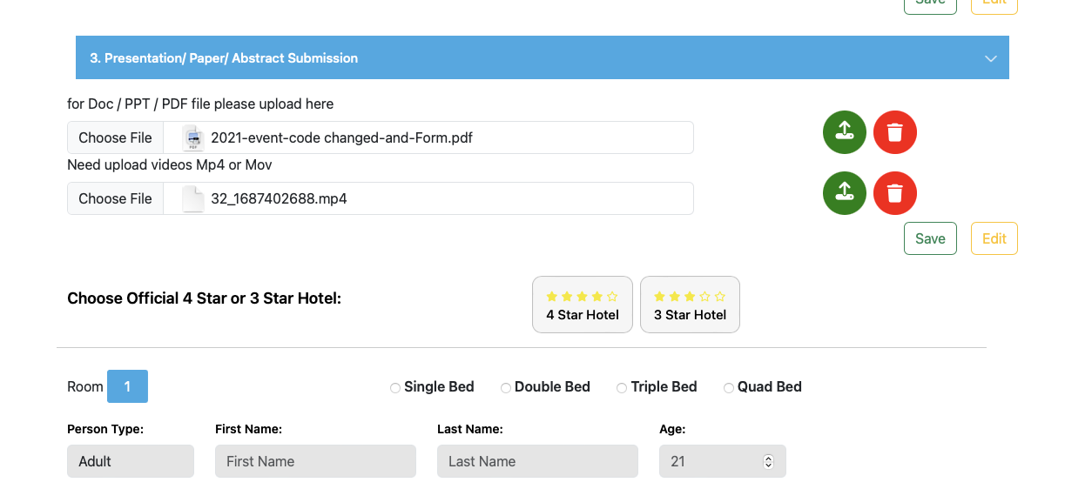
4. Admin and User page
Please change the content to ”Choose Official Hotel”
And also remove the four-star hotel and three star hotel symbol (sometime our office, your hotel maybe 5star or only 2 star)

Slide 7
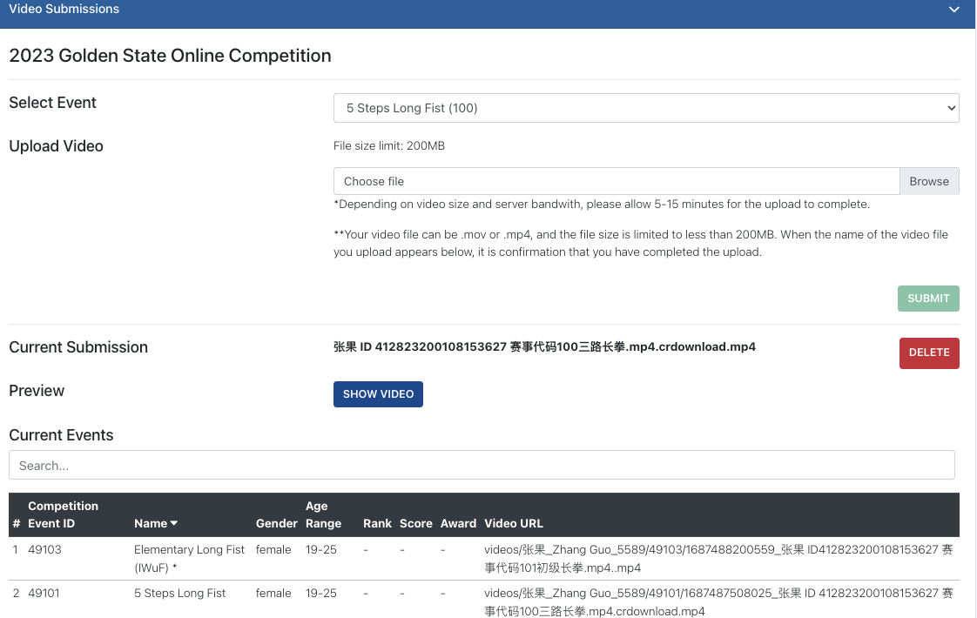
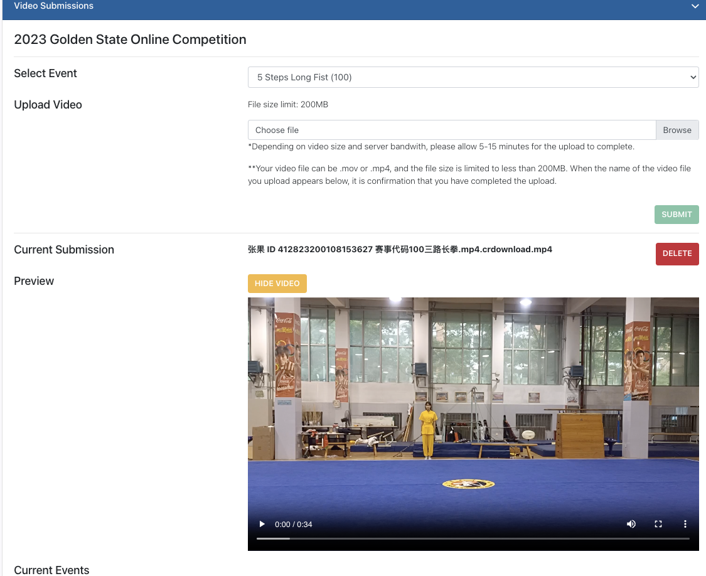
Upload file
Is possible to show the upload a files, and show process of upload. Also be able to delete files too
This is my Competition registration website

Slide 8
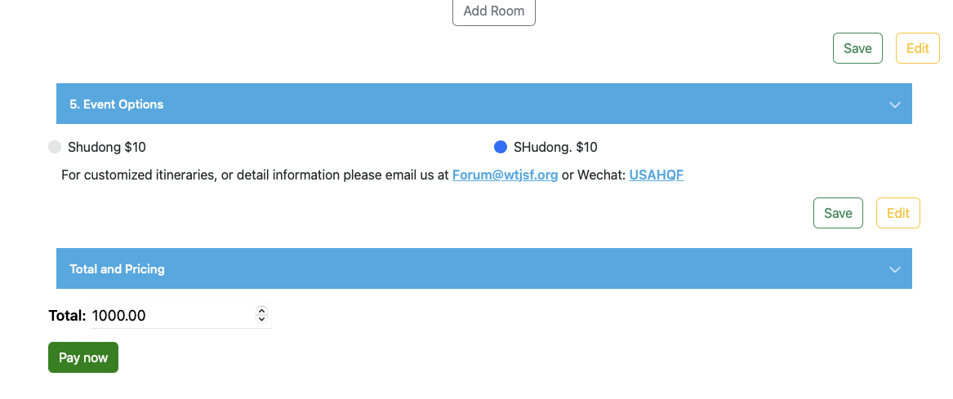
If they are not payment need can we just show the “submit button” if have fee need to pay, we can show “ Pay Now” button
submit button

