Slide 1
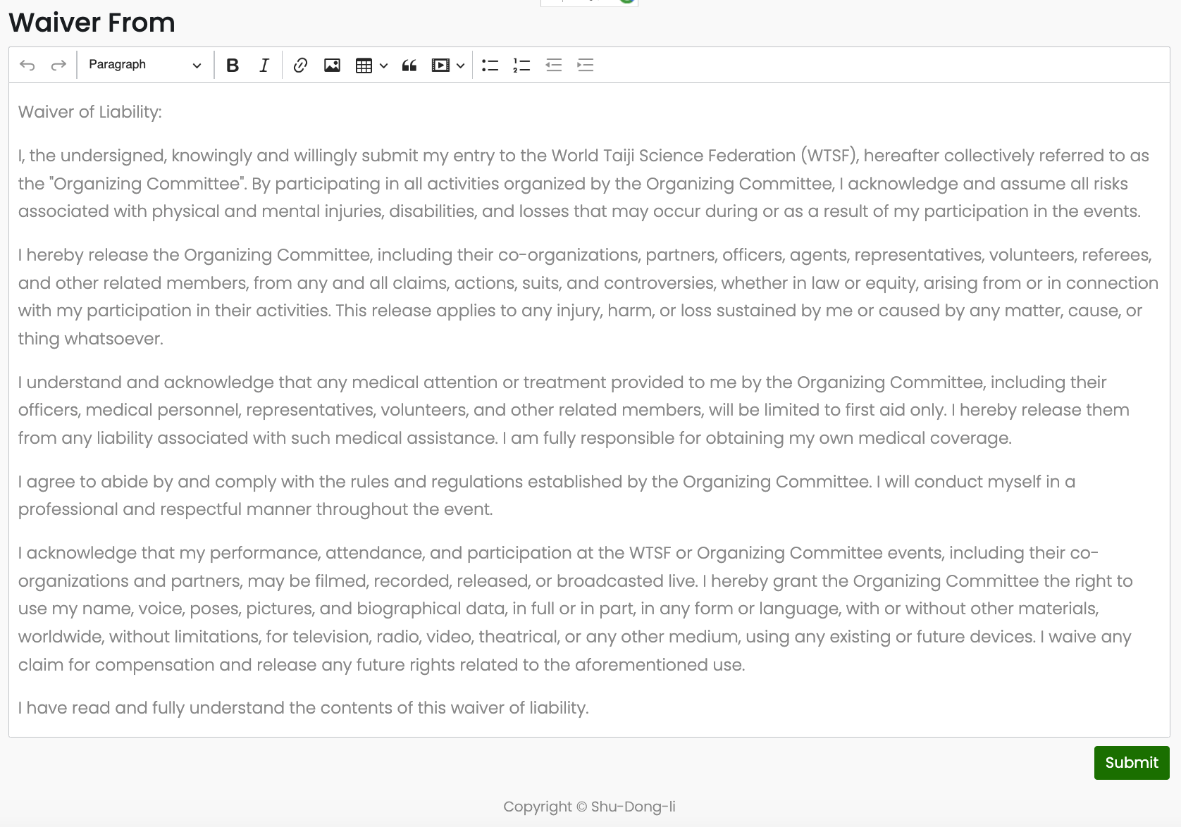
Admin Page design
Design 1
Waiver From design
Design notes: Admin Dashboard show following information
Admin Dashboard
Waiver From Edit
Design notes: We can setup Waiver From for all events with same Compton. With editing and I update option
List of Events
Create Event
User Admin
Even participants
Log Out
Design notes: When Click “Waiver From Edit” show below information
Admin Dashboard
Waiver From Edit
List of Events
Create Event
User Admin
Even participants
Log Out

Slide 2
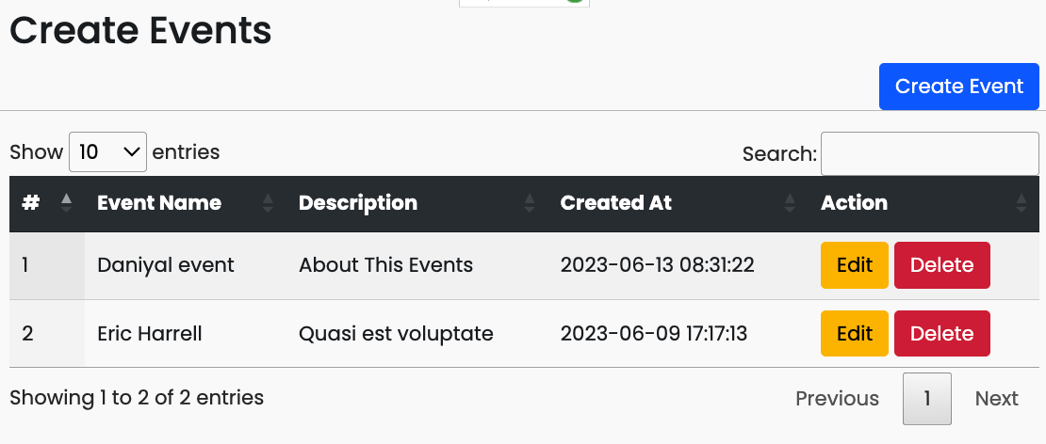
Admin Page design
Design 2
Standard Info collect and list of the event Admin
Admin Dashboard
Waiver From Edit
Design notes: Standard Event Set up included following Standard Contacts for all Users Name* / gender * / date of birth * /email * /phone * / Picture upload *, Address And waiver form *). * Meaning is required info， with out * Meaning is Optional. Can leave as empty
List of Events
Create Event
User Admin
Even participants
Log Out
Design notes: Need add “Active” and “inactive” option, When check the “Active” box. The event will show in User account , Uncheck it, will no show.
Admin Dashboard
Waiver From Edit
Change to “List of Events”
Don’t nee d show here
List of Events
Create Event
Event Form Link
User Admin
Even participants
Active
Log Out
Active
Design notes: Don’t nee d show description here change to “Event Form Link” So I can capy the link to create a sign-up button at my website.

Slide 3
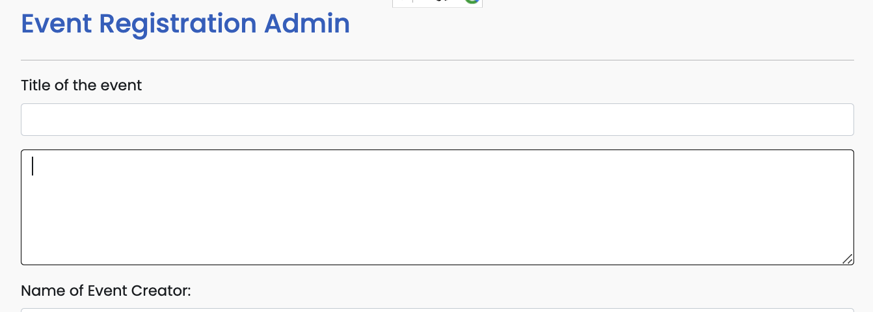
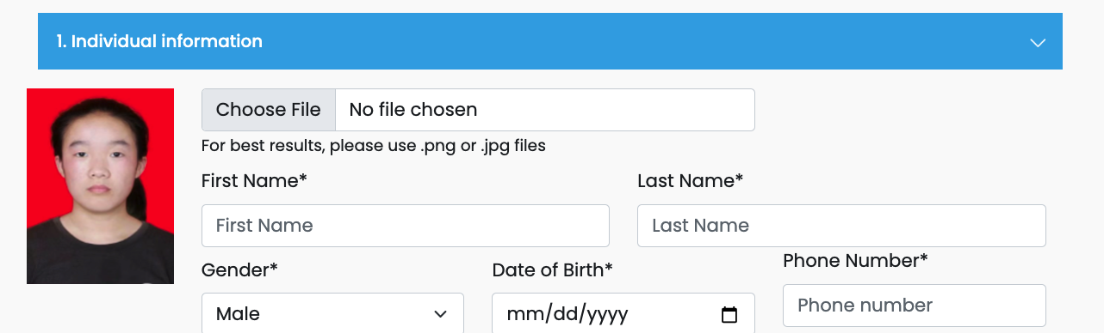

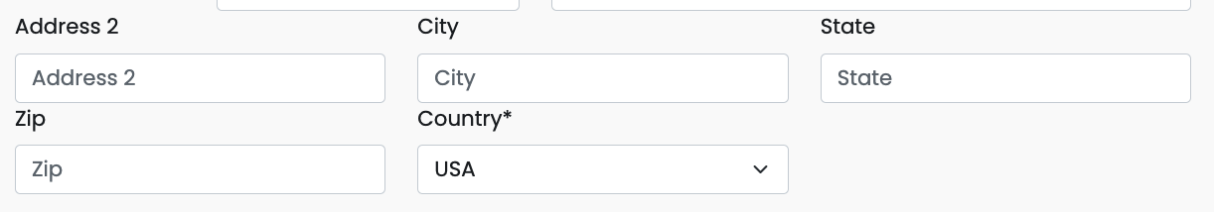
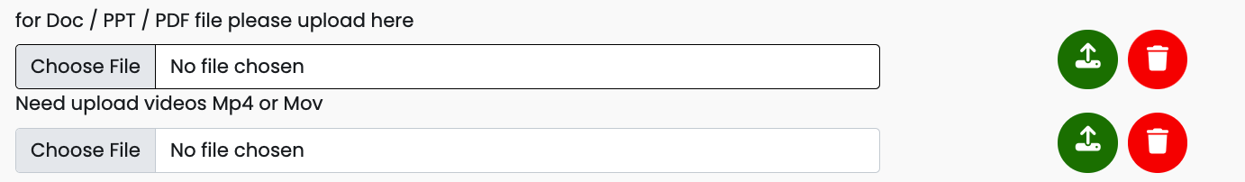
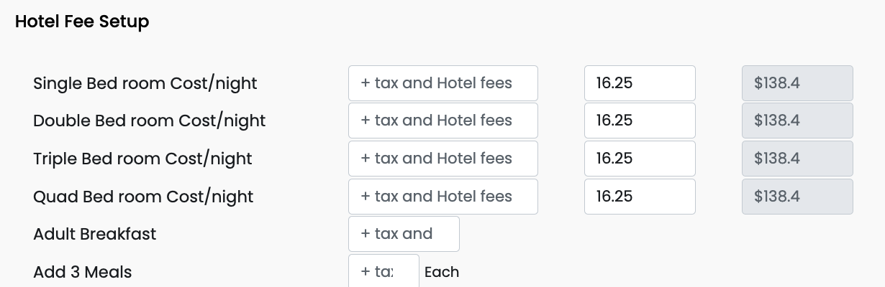

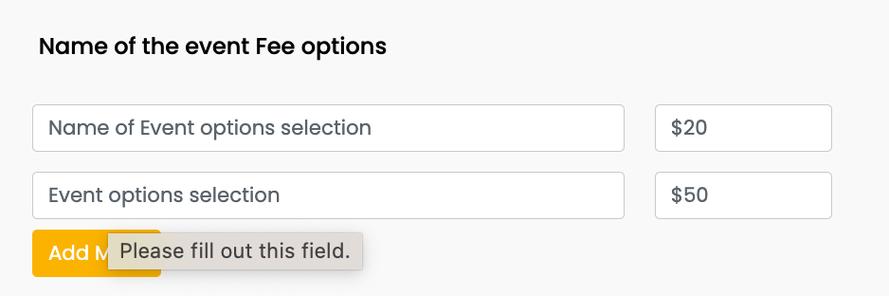
Admin Page design
Design 3
Standard Info collect and list of the event Admin
Admin Dashboard
Waiver From Edit
List of Events
Create Event
User Admin
Even participants
Design notes: individual info section, Don’t need edit here, can automatically in all form
Log Out
Health Condition
By Check this box, this section will show in user account
Health Condition (If you want us to know)*
Dietary Choices
Emergency Contact:
By Check this box, this section will show in user account
Name
Relationship
Phone
Email
Academic Background
By Check this box, this section will show in user account
Institution/Group
Position
Professional Title
Research Field/Major
Website
Short bio
Presentation/ Paper/ Abstract Submission
Check box will show in user account
Hotel Options
Check box will show in user account
Edit
Save
Edit
Save
Edit
Save
Edit
Save
Check box will show in user account
Edit
Edit
Save
Edit
Save
Save

Slide 4
Admin Page design
Design 4
Design notes: List all the users with name/Data of birds/ gender/ email/ phone number, and can click it link to individual User Account ,
Admin Dashboard
Waiver From Edit
No | Name | Gender | Date of birth | Phone | Email
1 | xxxxxxxxx | m | xxxxxxxxx | zzzzzzzzzzzz | zzzzzzzzzzzzzzz
2 | ffxxxxxxxxxx | f | xxxxxxxxxxxx | zzzzzzzzzzzzzz | zzzzzzzzzzzzzzz
List of Events
Create Event
User Admin
Design notes: click it link to individual User Account
Even participants
Log Out

Slide 5
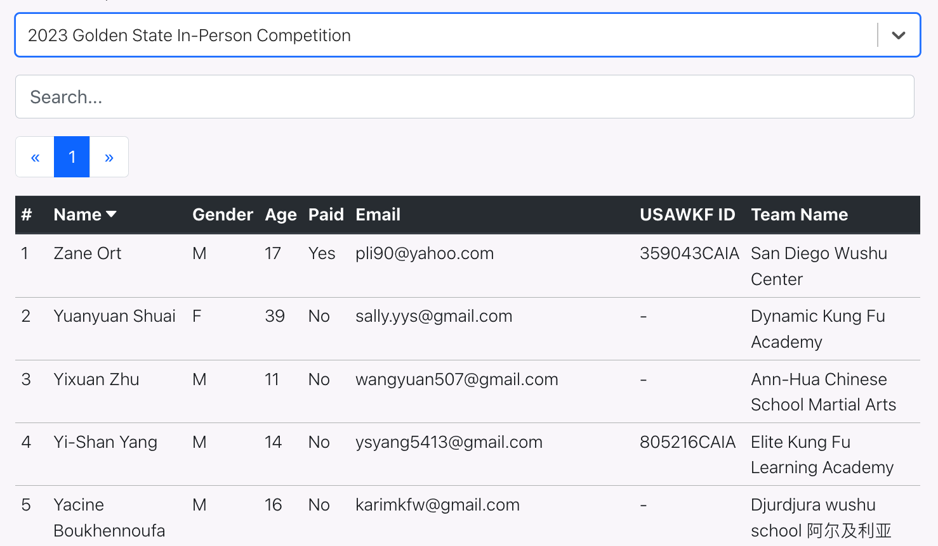
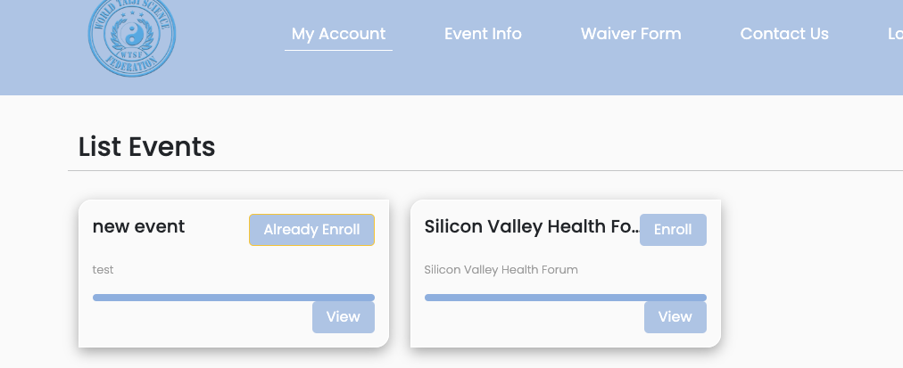
Admin Page design
Design 4
Design notes: List all the users with name/Data of birds/ gender/ email/ phone number, and can click it link to individual User Account ,
Admin Dashboard
Waiver From Edit
List of Events
Select events
ALL live Events list here
Create Event
User Admin
Even participants
Log Out
#. Name Gender date of birth phone Email TEAM Paid
Link to individual account, Click to see all the information input Like (User’s front )
Export to Excel sheet
people can view and edit all the information under My Account like reset the username password; edit all information and files, before make a payment. after make payment, participant should get confirmation email, and also need to add limitation “cannot edit event options their select with paid amount, but other information still can update and re-save it, such as name address… nonpayment information
Organization, community contact information I can add it in the admin page
Under event info people can view their all the event has it been participating in. Also can add edit some of nonpayment related information’s too
Saved the PDF waiver form review only
Copyright © World Taiji Science Federation (WTSF)
All Information We can export to Excel file, by each event
Files and videos can export link

