Slide 1
1. Introduction
1 / 5
DebrisInsight studies what hurricane debris ticket records can tell us about collection activity.
Main questions
When was debris collected? How much was recorded? Where did pickups occur, and which materials and contractors appear on tickets?
Scope
Use the Pinellas County and St. Petersburg records as separate sources. Their dates, fields, and coverage differ.
ADD BEFORE FINAL Team names, approved project goal, and the final research questions.
Notes:
Opening draft: explain the project in plain language. Pinellas has 18,278 ticket rows dated October 2, 2024–April 10, 2025. The separate St. Petersburg static snapshot has 6,694 rows dated October 3–23, 2024. Confirm the team-approved purpose and source coverage before presenting.

Slide 2
2. Motivation
2 / 5
Collection records can help the team see when work was concentrated and where questions remain.
Timing
Weekly volume shows surges and gaps in recorded tickets. That can guide questions about staffing, weather, and reporting coverage.
Place and material
Pickup locations and debris types show where recorded work occurred and what crews handled.
ADD BEFORE FINAL Who will use the results and which planning decisions they support.
Notes:
Example: Pinellas figure F05 peaks in the week beginning October 28, 2024 at 112,592.90 recorded cubic yards. A low or blank week does not establish why collection changed. Potential causes require operational or weather evidence.

Slide 3
3. Data dictionary and standardization
3 / 5
Define each field before comparing figures or combining records.
Ticket stage and date
Identify pickup, unloading, haulout, and special-service records. State whether each figure uses LoadDate or TicketDate and the local time zone.
Volume and location
Expand cubic yards (CY). Define which GPS field marks a pickup, which address or boundary identifies an area, and how unmatched locations are handled.
Labels and missing values
Keep original material and receiving-site labels. Separate truly blank cells from the literal value MISSING and document any category grouping.
ADD BEFORE FINAL City field definitions, category crosswalk, and approved location rules.
Notes:
The St. Petersburg DisposalSite and DisposalSiteGPS fields contain the literal MISSING value for 3,601 special-service records. Do not describe those cells as blank. Ordinary collection is an analyst grouping, not a source field. Keep Pinellas and St. Petersburg totals separate.

Slide 4
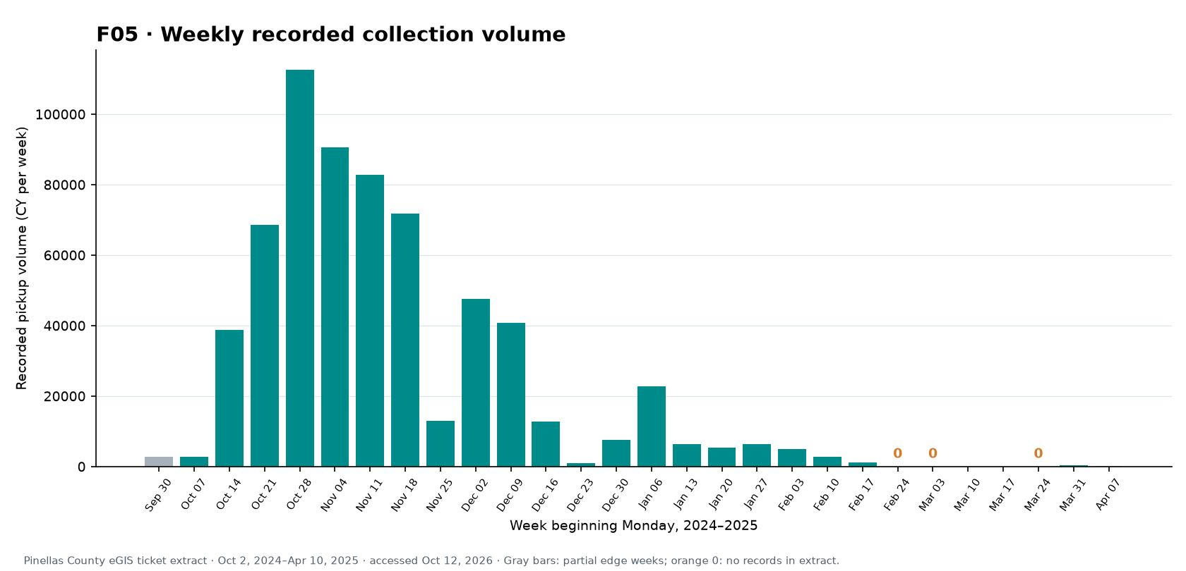
4. Key figures
4 / 5
Example: F05
Recorded cubic yards by week. The highest week began October 28, 2024: 112,592.90 CY.
Final shortlist: trends, material mix, pickup locations, neighborhood activity, receiving sites, and estimates.
ADD BEFORE FINAL Choose the final 5–10 figures and link each to a research question.
Notes:
Example F05: https://m-ark-han.github.io/Ticket-Data-Visualizations/#figure-F05 . The chart shows recorded ticket volume, not all debris generated. The figure shortlist should be chosen with the team and captioned with a question, takeaway, and limitation.

Slide 5
5. Evidence limits and next steps
5 / 5
What tickets can show
Observed dates, pickup locations, recorded volume, material labels, and stated receiving-site labels.
What needs another source
A last ticket does not verify that a neighborhood was cleared. A named site does not prove arrival, recycling, or final disposal.
Next team decisions
Confirm the field dictionary, request official clearance dates and linked unload records, and agree on the figures for the report and dashboard.
ADD BEFORE FINAL Owners, dates, and source links for these follow-ups.
Notes:
Do not label ticket-based first-to-last timing or 90% of recorded volume as cleanup completion. Official area status or sign-off is needed. Also confirm estimate methods and units before putting initial and remaining debris on a progress chart.

