Slide 1
DebrisInsight
Visual evidence from hurricane debris tickets
Draft team presentation
Recorded pickups • data quality • neighborhood activity • open questions
ADD BEFORE FINAL Team member names, presentation date, and approved project subtitle.
Notes:
Introduce the team and its research goal. The subtitle and presenter list are placeholders for team approval.

Slide 2
Why study debris collection?
2 / 10
Planning
Ticket dates and locations show where collection activity was recorded and how it changed over time.
Accountability
Debris type, volume, contractor, and site labels help identify patterns and records that need review.
Limits of the records
A pickup ticket does not prove that an area is clear or that a load reached its final destination.
ADD BEFORE FINAL Insert the team-approved motivation and who will use the findings.
Notes:
Motivation is a proposed framing. The team should approve its audience and intended decisions. Pickup tickets document an operational stage; later status and disposal need separate evidence.

Slide 3
Research questions
3 / 10
When and how much? Q001, Q003
How did recorded volume change, and when did it reach cumulative milestones?
Where and what? Q011, Q016
Which debris types and pickup areas account for the recorded activity?
For how long? Q025 partial
How long were tickets recorded in each neighborhood or debris zone?
Where did loads go?
What receiving sites do tickets name, and what later movement records are available?
ADD BEFORE FINAL Replace or confirm IDs from the finalized team question list.
Notes:
Ranbir Q IDs refer to the Pinellas question guide: https://m-ark-han.github.io/Ticket-Data-Visualizations/question-guide.html . The neighborhood and destination questions may need different IDs in the final matrix. Q025 is only partially addressed by existing area duration figures.

Slide 4
Data sources and scope
4 / 10
Pinellas County pickup-ticket extract
18,278 tickets • 644,952.65 recorded cubic yards • October 2, 2024–April 10, 2025.
St. Petersburg static ticket snapshot
6,694 records • October 3–23, 2024. This short snapshot cannot establish when city cleanup ended.
Keep the sources separate
Their coverage, stages, and labels require separate definitions. Do not combine their totals.
ADD BEFORE FINAL Confirm coverage, extraction dates, incident IDs, and source owners in the data dictionary.
Notes:
Pinellas figures: https://m-ark-han.github.io/Ticket-Data-Visualizations/ . St. Petersburg figures and source layer: https://m-ark-han.github.io/Ticket-Data-Visualizations/st-petersburg.html . Pinellas dates use Eastern time after conversion. Static St. Petersburg snapshot ends October 23, 2024.

Slide 5
Data dictionary and standardization
5 / 10
Dates and volume
State which date is used: LoadDate for volume trends; TicketDate for the city neighborhood calendar. Expand CY as cubic yards.
Categories and ticket stage
Preserve raw debris and hazard labels. Confirm whether a record describes pickup, unloading, haulout, or a special service.
Places and quality
Define coordinate meaning, neighborhood boundaries, address normalization, blank values, and unmatched records.
ADD BEFORE FINAL Insert the city field dictionary, approved category crosswalk, and standardization rules.
Notes:
City column definitions are pending. In the current St. Petersburg analysis, ordinary collection is an analyst grouping of construction-and-demolition or vegetative/woody tickets; it is not a source field. The receiving-site chart treats a blank DisposalSite value as blank in that column only.

Slide 6
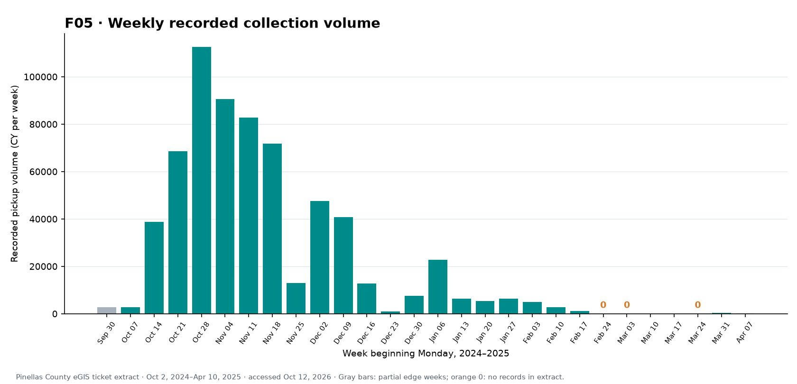
Recorded collection over time
6 / 10
Peak week
Oct 28, 2024
112,592.90 CY
Three complete weeks in late February and March have no ticket rows. A blank week does not prove no field work.
ADD BEFORE FINAL Add a separately labeled St. Petersburg time series if its full date range becomes available.
Notes:
F05: https://m-ark-han.github.io/Ticket-Data-Visualizations/#figure-F05 . The peak is a Monday-start week. The last and first weeks are partial. The source is recorded tickets, not all debris generated or verified staffing.

Slide 7
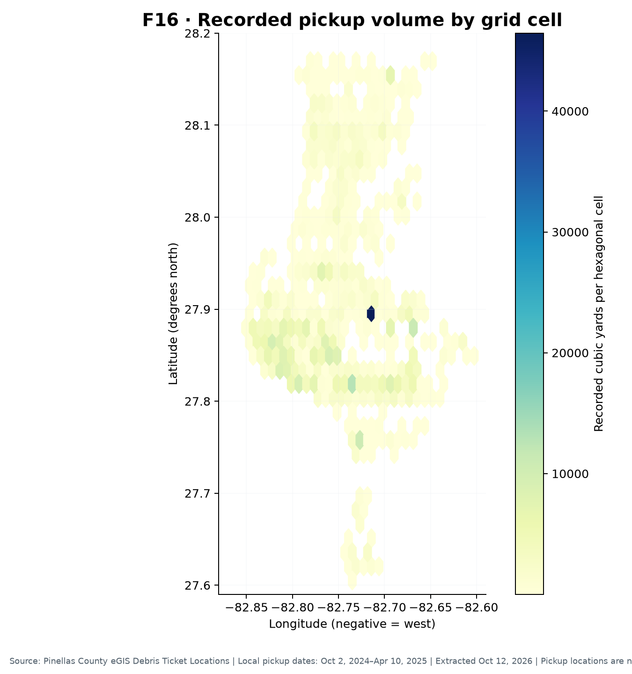
Where pickup volume was recorded
7 / 10
Pinellas County map cells
The map sums recorded cubic yards at pickup coordinates within equal-size cells.
The highest-volume plotted cell contains 46,453.90 CY. It is a concentration of ticket locations.
ADD BEFORE FINAL Confirm the operational meaning and positional accuracy of pickup coordinates.
Notes:
F16: https://m-ark-han.github.io/Ticket-Data-Visualizations/#figure-F16 . This map is for the Pinellas ticket extract. High pickup volume does not measure debris remaining or unmet need. Map-cell scale affects hotspot appearance.

Slide 8
Neighborhood activity is not clearance
8 / 10
St. Petersburg ordinary collection tickets
Shore Acres
Coquina Key
20-day first-to-last span
17 dates with tickets
Longest internal gap: 3 days
20-day first-to-last span
10 dates with tickets
Longest internal gap: 9 days
The same span can contain very different patterns of recorded activity.
ADD BEFORE FINAL Insert official neighborhood final-pass dates or signed clearance records.
Notes:
Source figure: https://m-ark-han.github.io/Ticket-Data-Visualizations/st-petersburg.html#neighborhood-dates . The neighborhood layer matched 1,743 of 1,923 eligible ordinary collection tickets to one association polygon; 180 did not match. Neither first-to-last span nor days to 90% of recorded CY verifies clearance.

Slide 9
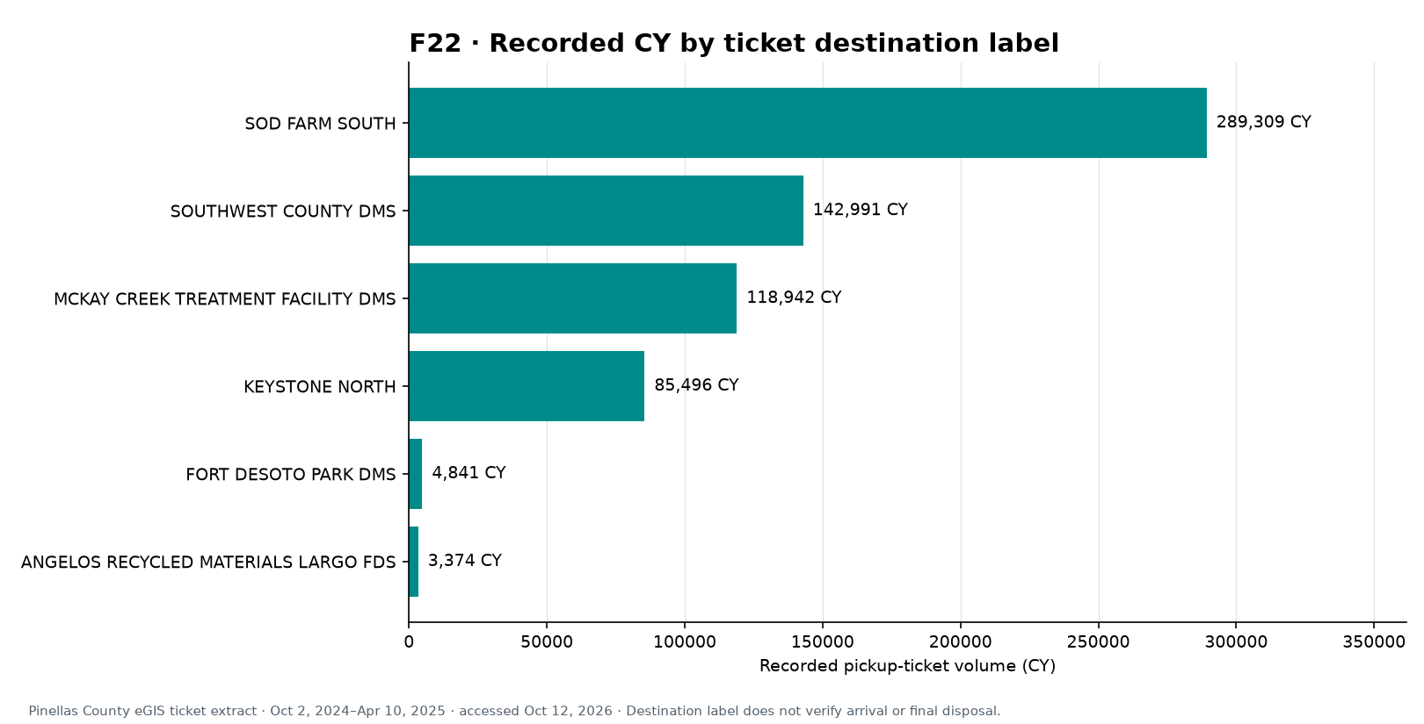
Receiving-site labels and later movement
9 / 10
Pinellas
Six ticket destination labels. SOD FARM SOUTH has 289,309.45 recorded CY.
St. Petersburg
DisposalSite is blank on 3,601 of 6,694 tickets, mostly special services.
ADD BEFORE FINAL Check city field definitions and linked unload/haulout records before calling a destination final.
Notes:
Pinellas F22: https://m-ark-han.github.io/Ticket-Data-Visualizations/figures/F22-destination-label-volume.png . St. Petersburg field coverage: https://m-ark-han.github.io/Ticket-Data-Visualizations/st-petersburg.html#receiving-sites . Blank means blank in the DisposalSite column. A stated ticket destination is not verified arrival or final disposal.

Slide 10
Dashboard and next decisions
10 / 10
Dashboard shortlist
Use around ten key visuals: trends, debris mix, pickup maps, neighborhoods, receiving sites, estimates, and official status.
Status and estimates
Show “completed” only from agency work-area status or clearance records. Reconcile initial and remaining estimate units, areas, dates, and methods.
Team handoff
Use Mark’s caption-and-takeaway page as the figure list; compare it with Sai’s three current app figures.
ADD BEFORE FINAL Add Sai’s app link, final question matrix, live API, and approved report figure order.
Notes:
Figure handoff: https://m-ark-han.github.io/Ticket-Data-Visualizations/mark-handoff.html . Official Esri debris-management workflow distinguishes pickup load tickets, unload tickets, haulout, work-area status, and provider/site charts: https://doc.arcgis.com/en/arcgis-solutions/12.0/reference/use-emergency-debris-management.htm . Final slide should state owners and deadlines once agreed.

