Slide 1
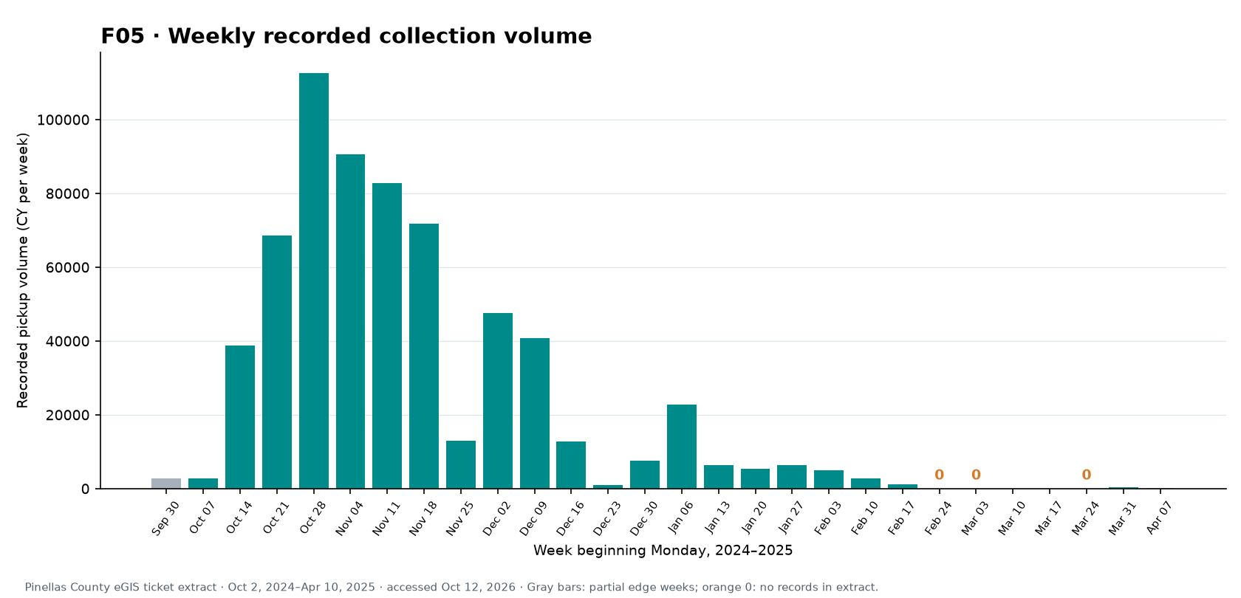
DebrisInsight presentation plan
One draft slide for the team to refine
1 Introduction
What DebrisInsight studies and the questions the team aims to answer.
2 Motivation
Why collection timing, locations, material mix, and progress matter for planning.
3 Data dictionary and standardization
Define ticket stages, date fields, cubic yards, location keys, type labels, and missing values.
4 Key figures
Example figure: weekly recorded pickup volume
Use a focused set: trends, maps, neighborhood activity, receiving sites, and estimates.
Keep Pinellas County and St. Petersburg results separate. Ticket activity and stated destinations do not establish verified cleanup or final disposal.
5 Evidence limits and next steps
Check city field definitions, unload records, and official area status before claiming completion.
Notes:
Purpose: propose the main sections for next week’s DebrisInsight presentation. This is a one-slide structure draft; the team can choose the final figures and wording.
The Pinellas County extract has 18,278 public pickup tickets dated October 2, 2024 to April 10, 2025. The separate St. Petersburg static layer has 6,694 records dated October 3–23, 2024. Do not combine totals.
Figure F05 source and explanation: https://m-ark-han.github.io/Ticket-Data-Visualizations/#figure-F05 . Source data: Pinellas County eGIS Debris Ticket Locations, linked from that site.
Data dictionary: confirm meanings of LoadDate, TicketDate, Volume in cubic yards, DisposalSite, type labels, source coverage, and whether records are pickup, unload, or haulout stages.
Agency completion status needs an official work-area status or verification date. Ticket dates and 90% of recorded volume describe observed activity only.

