Slide 1
Topic
Historical perspective, Moore’s law and current technological Trends

Slide 2
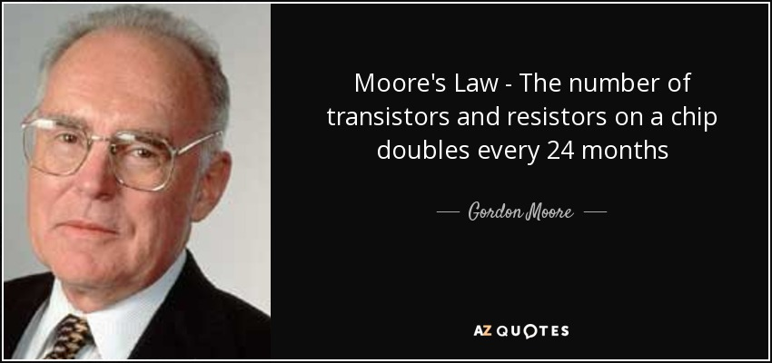

Slide 3
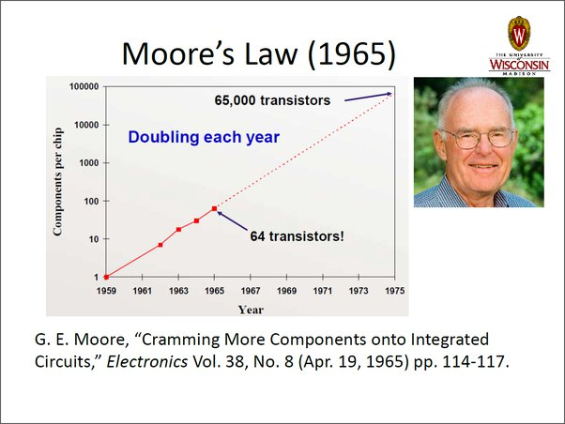

Slide 4
Moore's law is the observation that over the history of computing hardware, the number of transistors on integrated circuits doubles approximately every two years.
This law is named after Intel co-founder Gordon Moore's who describe the trend in his paper.
His prediction has been proven to be accurate, because this law is now used in semiconductor industry to guide long term planning and to set targets for research and development.

Slide 5
The capabilities of many electronic devices are strongly linked with Moore's law:
Processing speed
Memory Capacity
Sensors and even the number and size if pixels in digital cameras.
Moore's law describes the driving force of technological and social change.

Slide 6
How Has Moore’s Law Impacted Computing?
Moore’s Law has had a direct impact on the progress of computing power. Transistors in integrated circuits have become faster. Transistors conduct electricity, which contain carbon and silicon molecules that can make the electricity run faster across the circuit. The faster the integrated circuit conducts electricity, the faster the computer operates.

Slide 7
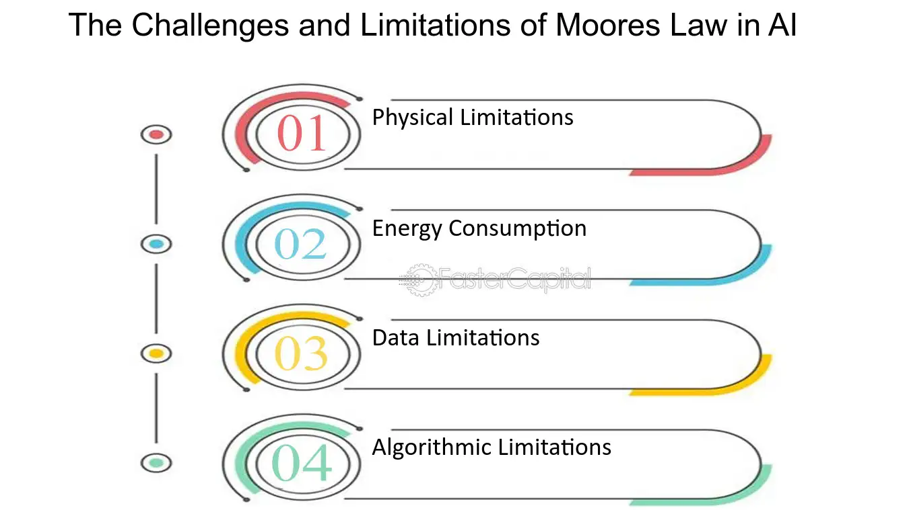

Slide 8
Topic:
Bipolar junction transistor (BJT) Structure, Common base, Common Emitter, Common Collector

Slide 9
HISTORY NOTE OF TRANSISTOR
The transistor was invented in 1947 by a team of scientists from Bell Laboratories. William Shockley, Walter Brattain, and John Bardeen developed the solid-state device that replaced the vacuum tube. Each received the Nobel prize in 1956. The transistor is the most significant invention of the twentieth century.

Slide 10
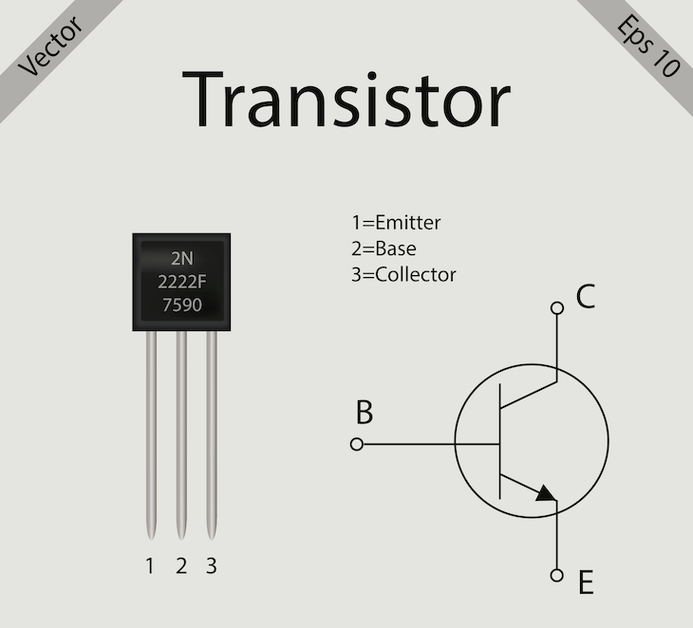
TRANSISTOR
A transistor is a type of semiconductor device that can be used to conduct and insulate electric current or voltage. A transistor basically acts as a switch and an amplifier. In simple words, we can say that a transistor is a miniature device that is used to control or regulate the flow of electronic signals.

Slide 11
Bipolar Junction Transistors (BJT)
The Bipolar junction transistor is a solid state device and in BJTs current flow in two terminals:
Emitter and collector
The amount of current controlled by the third terminal,
Base terminal
It is different to the other type of transistor i.e. Field effect transistor which is the output current is controlled by the input voltage .

Slide 12
Components of a BJTs
A BJTs composed of three main layers of semiconductor material and has three terminals.
1-Emitter(source of electrons)
The emitter is one of the three semiconductor layers in a transistor.
It is heavily doped.
For npn transistor emitter supply holes and for pnp transistor emitter supply electrons to its junction.
The emitter serves as the source of electrons.
Emitter is always forward bias w.r.t base so it can supply carriers.
Electrons or holes are emitted from the emitter region into the rest of the transistor structure.

Slide 13
2-Base(Control terminal)
The base is the central semiconductor layer sandwiched between the emitter and
collector.
It is lightly doped compared to the emitter and collector.
The base controls the flow of charge carriers (electrons or holes) between the
emitter and collector.
3-Collector(Collects the charge carriers)
The collector is the third semiconductor layer in the transistor and always reverse bias w.r.t base.
It is moderately doped and is larger in size compared to the emitter.
The collector collects the charge carriers (electrons or holes) emitted by the emitter.
The current flows from the base to the emitter in NPN transistors and from the emitter to the base in PNP transistors.

Slide 14
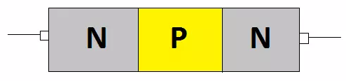
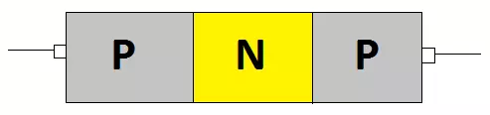
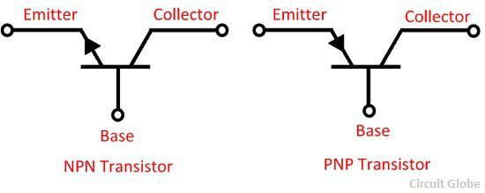
Types of BJTs
There are two types of BJTs, namely NPN junction transistor and PNP junction transistor.
The transistor which has two blocks of N-type material and one block of P-type material is known as NPN transistor.
The transistor which has one layer of N-type material and two layers of P-type material then it is called PNP transistor.

Slide 15
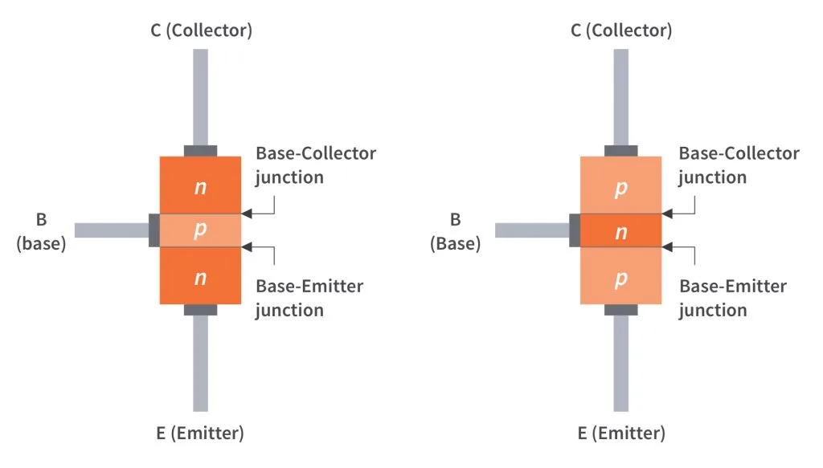

Slide 16
The junction between emitter and base is called base-emitter junction.
The junction between base and collector is called base-collector junction.
The emitter-base junction is always forward biased and collector-base junction is reverse biased.
The resistance of emitter diode is very small and resistance of collector diode is high.
Basic BJT Operation
In order for a BJT to operate properly as an amplifier, the two pn junctions must be correctly biased with external dc voltages.
The operation of the pnp is the same as for the npn except that the roles of the electrons and holes, the bias voltage polarities, and the current directions are all reversed.

Slide 17
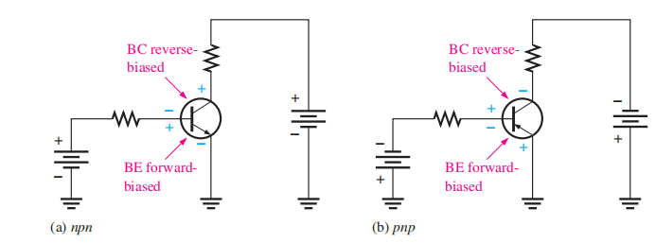
Biasing
Figure shows a bias arrangement for both npn and pnp BJTs for operation as an amplifier.
Notice that in both cases the base-emitter (BE) junction is forward-biased and the base-collector (BC) junction is reverse-biased. This condition is called forward-reverse bias.

Slide 18
Operation
Inside the npn structure The heavily doped n-type emitter region has a very high density of conduction-band (free)
electrons, as indicated in Figure.
These free electrons easily diffuse through the forward based BE junction into the lightly doped and very thin p-type base region, as indicated by the wide arrow. The base has a low density of holes, which are the majority carriers, as represented by the white circles. A small percentage of the total number of free electrons injected into the base region recombine with holes and move as valence electrons through the base region and into the emitter region as hole current, indicated by the red arrows.
When the electrons that have recombined with holes as valence electrons leave the crystalline structure of the base, they become free electrons in the metallic base lead and produce the external base current. Most of the free electrons that have entered the base do not recombine with holes because the base is very thin. As the free electrons move toward the reverse-biased BC junction, they are swept across into the collector region by the attraction of the positive collector supply voltage. The free electrons move through the collector region, into the external circuit, and then return into the emitter region along with the base current, as indicated. The emitter current is slightly greater than the collector current because of the small base current that splits off from the total current injected into the base region from the emitter.

Slide 19
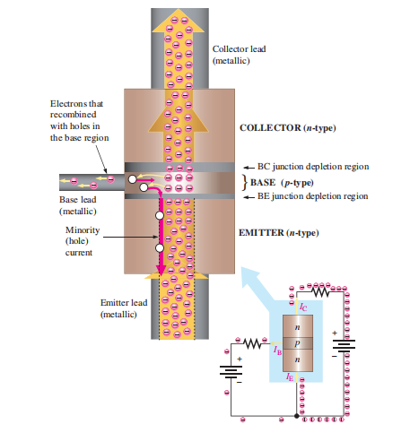

Slide 20
Transistor Configuration
We know that transistor has three terminals namely emitter (E), base (B), and collector (C).
But to connect a transistor in the circuit, we need four terminals:
Two terminals for input and other two terminals for output.
But the transistor does not have four terminals, then how do we connect transistor in a circuit.
One of the three terminals is used as common to both input and output.
When a transistor is to be connected in a circuit, one terminal is used as the input terminal, the other terminal is used as the output terminal and the third terminal is common to the input and output.
That means here input is applied between the input terminal and common terminal, and the corresponding output is taken between the output terminal and common terminal.

Slide 21
Depending upon the terminal which is used as a common terminal to the input and output terminals, the transistor can be connected in the following three configurations. They are:
Common collector (CC) configuration
Common base (CB) configuration
Common emitter (CE) configuration
In every configuration, the base-emitter junction J_{E} is always forward biased and the collector-base junction J_{C} is always reverse biased to operate the transistor as a current amplifier.

