Slide 1

Smart EV Delivery System
Using A* with Battery Constraint
Munaga Asritha
Reg. No. 128179033 | B.Tech Robotics & AI
Course: EIE115R01 – Introduction to Artificial Intelligence
Guided By: Dr. K. Ghousiya Begum, Assistant Professor III
(School of Electrical and Electronics Engineering)
Notes:
Good [morning/afternoon]. I am Munaga Asritha. Today I am presenting my final project titled Smart EV Delivery System Using A* with Battery Constraint.

Slide 2
Problem Statement & Objectives
Problem Statement
Objectives
Normal delivery systems fully rely on human decision making — they cannot automatically respond to new orders or low battery situations.
Electric vehicles introduce battery constraints: vehicles must recharge mid-route without missing deliveries.
Order priorities must be managed intelligently across multiple Evs.
Develop a multi EV Delivery simulation
Implement A* for finding shortest path
Design priority based order management.
Enable real time battery monitoring & charging
Build an interactive simulation using Pygame.
2
Notes:
Normal delivery systems rely heavily on human decision-making. When routes change, it requires manual intervention — a dispatcher deciding which vehicle to assign or when to reroute. This is where the normal system fails.
Let me explain with two situations.
The first situation is battery. EVs have limited charge unlike fuel vehicles. If battery drops during delivery, someone has to decide — continue, go to a charger, or reassign the order. A traditional system has no automatic way to handle this. A human has to make that call every time.
The second situation is urgent orders. A new high-priority order can arrive while all EVs are already delivering. A dispatcher has to manually check which EV is free, how much battery it has, what it is carrying — and then reassign. That takes time. In real delivery, that delay matters.
So in this project, I developed a fully autonomous delivery system where EVs make decisions in real time. It uses A* pathfinding for optimal routes, priority-based scheduling with aging so Express orders are always picked first when an EV is available, and battery-aware rerouting — all without human intervention.

Slide 3
System Architecture
IDLE
LOADING
DELIVERING
RETURNING
IDLE
(If charge is low)
CHARGING
Modules :
main.py controls simulation loop | world.py creates grid and map | ev.py ev agent logic movement, battery, states | orders.py order management system | ui.py visualization dashboard | config.py stores parameters
3
Notes:
"My system is built in Python using Pygame and structured into six modules. Each EV operates as an autonomous agent cycling through six states: idle, loading, delivering, returning, charging, and in edge cases — stranded. The transitions between these states are all driven by real-time conditions: battery level, order availability, and path feasibility.
config.py stores all constants — grid dimensions, battery limits, EV speed, batch size. world.py generates the city map — roads, warehouses, chargers, houses — and contains the A* pathfinding algorithm. orders.py manages the priority queue with the aging mechanism. ev.py is the brain of each EV — it controls the full state machine. ui.py handles all Pygame rendering. And main.py is the game loop tying everything together.

Slide 4
A* Pathfinding Algorithm
A* Cost Function
Manhattan Distance
f(n)=g(n)+h(n)
h = |x1 – x2| + |y1 – y2|
4 – directional movement only (no diagonal)
g(n) = actual cost from start node to current node
h(n) = Manhattan distance to goal
EVs travel on roads only
No path → Blocked route dialog displayed, alternate nearby node suggested
Why A*?
Finds the shortest path efficiently
Uses both: Actual cost (g) and Estimated cost (h)
Faster than traditional methods like Dijkstra, BFS, DFS
4
Notes:
The core AI algorithm powering this system is A* — A-star — pathfinding. Let me explain exactly how it works in my code. A* finds the shortest path between two points using this formula: f(n) equals g(n) plus h(n). g(n) is the actual number of steps taken from the start node to the current node. h(n) is the estimated distance from the current node to the goal — I use Manhattan distance for this, which is the absolute difference in rows plus the absolute difference in columns. Why Manhattan? Because in my grid, EVs can only move in four directions — up, down, left, right. No diagonal movement is allowed. This means the true shortest path between any two points can never be less than the Manhattan distance. This property is called admissibility — the heuristic never overestimates — and it guarantees A* always finds the optimal path. If A* returns an empty path — meaning no road connects the EV to the delivery house — a blocked-route dialog appears. It shows the five nearest road nodes around that house so the user can manually select an alternate delivery point. If nobody selects within 6 seconds, the order is auto-skipped. Why A* over alternatives? Dijkstra expands all nodes equally in every direction — it doesn't know where the goal is. BFS finds shortest hopes but treats all paths as equal. A* is faster than both because the heuristic guides the search toward the goal, skipping nodes that are clearly in the wrong direction.

Slide 5
Key Features
Battery Management
Battery decreases 1 unit per cell
If charge < 25 units auto reroute to charger
If stranded, orders added back to queue
Priority Order Scheduling
Express (Red) – highest priority
Standard (Green) – normal queue + aging
Scheduled (Blue) – activates at specified time
Order Batching
Groups up to 5 nearby orders
Queue re-sorted during each assignment
Reduces total travel distance and time
Auto & Manual Modes
Auto : Orders generated randomly
Manual : User clicks a house to place an order. Select delivery type: Express / Standard / Scheduled
Aging Mechanism
Priority increases as waiting time increases
Ensures no order is delayed
5
Notes:
My system has four intelligent features that go beyond basic pathfinding. 1st— Battery Management. Each EV starts at 100 battery units. Every grid cell the EV moves costs exactly 1 unit. When battery falls to 25 or below — that is the Low_Battery threshold — the EV automatically runs A* again to find the nearest charger. If a charger is reachable, it reroutes there. If not, it tries to return to the warehouse. If neither is reachable, the EV is stranded, its loaded orders are re-queued with a priority boost, and it waits for a reset.
2nd— Priority Order Scheduling. There are three delivery modes. Express orders are marked with red pins and get the highest priority — any EV mid-delivery can be rerouted when a new Express order arrives. Standard orders go into a normal queue. Scheduled orders are created with a user-defined time delay and only activate when that time is reached.
3rd— Order Batching. Instead of one delivery per trip, each EV picks up to 5 orders grouped by location. The highest-priority order becomes the anchor, and then the 4 nearest orders by Manhattan distance are added. This reduces total travel distance significantly — the EV makes fewer trips to cover the same number of deliveries.
4th— Auto and Manual Modes The system works in two modes. In Auto mode, orders are generated automatically, which helps test large-scale behavior. In Manual mode, the user can click on houses and create orders with different priorities. This makes it easy to test specific scenarios and understand how the system reacts.
5th— Aging Mechanism. Standard orders start with a priority score of 2.0. Every 5 simulation seconds, this score decreases by 0.30. Express orders start at 1.0 and decrease by 0.10. Lower score means higher priority in the sorted queue. So a Standard order waiting long enough will eventually overtake a fresh Express order. This guarantees no order is permanently delayed — which is called preventing starvation.

Slide 6
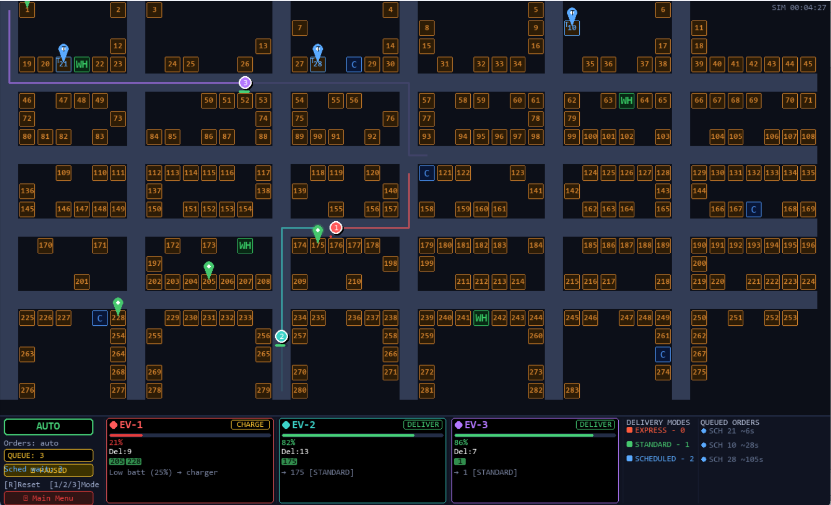
Simulation - Demo
AUTO mode - EV-1 low battery(21%) | EV – 3, EV – 2 delivering Standard orders
WH – Warehouse | C – Charger | Coloured pins – order type | Circles – EVs | Numbered cells - Houses
6
Notes:
In the Auto mode screenshot — point at EV-1 — this EV has only 21% battery remaining. You can see it has automatically left its delivery route and is heading toward the nearest charger. Meanwhile EV-2 and EV-3 are actively delivering Standard orders — the green pins show their destinations.

Slide 7
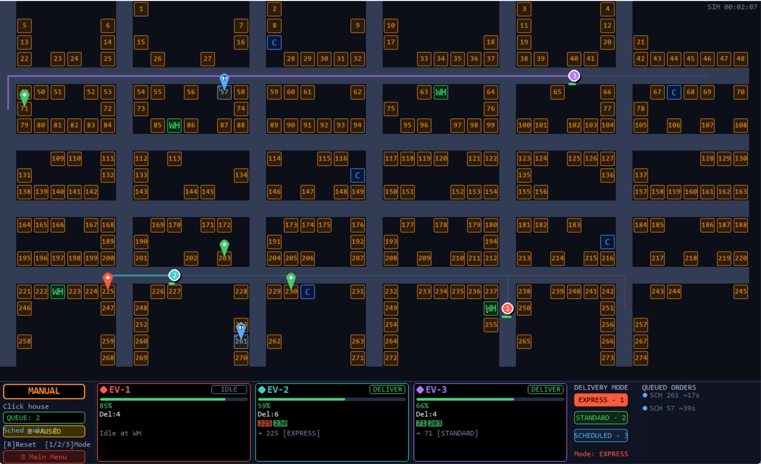
Simulation - Demo
MANUAL mode – EV-1 IDLE at Warehouse| EV – 3, EV – 2 delivering orders
WH – Warehouse | C – Charger | Coloured pins – order type | Circles – EVs | Numbered cells - Houses
7
Notes:
In the Manual mode screenshot — the system is paused at a moment where EV-1 is idle at the warehouse. I have selected Express delivery mode and clicked a house. The system immediately assigned the nearest available EV and it began loading. The bottom panel shows each EV's battery level, current phase, number of deliveries completed, and the orders currently loaded.

Slide 8
Results
Efficient delivery completion
Reduced travel distance using batching
No order starvation due to aging
Handles low battery scenarios
Optimal routing using A*
Dynamic rerouting for priority orders
8
Notes:
The system is able to complete deliveries efficiently using multiple EVs working together.
The priority system with aging ensures fair scheduling and avoids delays.
Batching improves efficiency by recucing travel distance.
Battery handling is automatic — EVs go to charging stations when battery is low and then continue delivery.
A-star ensures optimal routing by always finding the shortest path on the grid.
So overall, the system performs efficiently and adapts well to real-time conditions

Slide 9
Conclusion
3 EVs navigate, pick up & deliver orders automatically
A* algorithm finds optimal paths on the road grid
Automatic charging happens when battery depletes
Priority based queue + aging ensures no order is delayed
Batching (up to 5 orders/trip) improves efficiency
Both Auto and Manual modes work seamlessly
9
Notes:
“In conclusion, this project shows a fully autonomous multi-EV delivery system.
Three EVs can independently handle delivery tasks without human intervention.
A-star is used for optimal pathfinding, and battery management is handled automatically.
Also, the system handles dynamic situations like high-priority orders and rerouting effectively.
Finally, both Auto and Manual modes make the system flexible for testing and control.
Overall, this project proves that intelligent routing, battery management, and priority handling can be combined into one system.

Slide 10
THANK YOU

