Slide 1
Optimized CNN Acceleration on FPGA through Pattern-oriented Pruning
Guided by: Dr. Velmathi G (SENSE)
Team Members:
Lemuel Pon Whitson J - 21BEC1178
Aishwaryakopika R U - 21BEC1275
Soma Neha Saranya - 21BEC1693

Slide 2
Introduction
Accelerators: Specialized hardware component designed to speed up specific tasks, such as computations, more efficiently than a general-purpose CPU.
CNN based accelerator: Specialized hardware device designed to perform the computations required by Convolutional Neural Networks more quickly and efficiently than general-purpose processors.
Pruning: Technique used in machine learning to reduce the model's size by removing less important parameters or weights.
Pattern-Aware Pruning: Advanced form of pruning that selectively removes weights in a neural network based on specific patterns.
Notes:
Pruning: This helps in making the model more efficient, faster, and less memory-intensive without significantly affecting its accuracy.
pattern aware pruning: It ensures that the remaining connections follow a certain structure, which can be more efficiently processed by specialized hardware, like FPGAs, leading to improved performance and resource utilization.

Slide 3
Problem Statement
Problem addressed: Optimizing FPGA-based CNN accelerators while dealing with resource constraints, particularly for sequential designs limited by external memory access
Proposed solution: A dataflow CNN architecture enriched with structured sparsity through pattern pruning at the tile level

Slide 4
Literature Survey

Slide 5
Kamel Abdelouahab. Reconfigurable hardware acceleration of CNNs on FPGA-based smart cameras. Electronics. Université Clermont Auvergne [2017-2020], 2018
Objective: Accelerate CNN computations using FPGA-based hardware in smart cameras for real-time image processing, addressing the computational challenges of CNNs in embedded systems.
Proposed Methodology:
Implement CNNs on FPGA hardware for parallel processing.
Use a reconfigurable architecture to adapt to various CNN models.
Integrate the FPGA with smart cameras for real-time data processing.
Focus on improving energy efficiency for battery-operated systems.
Limitations: Limited hardware resources of FPGAs can restrict the complexity of CNN models that can be implemented.

Slide 6
L. Pradels, S. -I. Filip, O. Sentieys, D. Chillet and T. L. Calloch, "FPGA-based CNN Acceleration using Pattern-Aware Pruning," 2024 IEEE 6th International Conference on AI Circuits and Systems (AICAS), Abu Dhabi, United Arab Emirates, 2024
Objective: Enhance the efficiency of CNNs on FPGAs through pattern-aware pruning, aiming to reduce computational load and memory usage while maintaining model accuracy for real-time applications.
Proposed Methodology:
Implement pattern-aware pruning to selectively remove less important filters and weights, using metrics like normalized L2-norm.
Tailor the pruning process to optimize the architecture and data flow for FPGA hardware, improving performance and reducing power consumption.
Limitations:
Limited generalization across different CNN architectures, potentially restricting applicability.
Effectiveness depends on the specific FPGA design, leading to variable results based on hardware configuration

Slide 7
Wu, Di & Zhang, Yu & Jia, Xijie & Tian, Lu & Li, Tianping & Sui, Lingzhi & Xie, Dongliang & Shan, Yi. (2019). A High-Performance CNN Processor Based on FPGA for MobileNets.
Objective: Design a high-performance CNN processor optimized for MobileNets on FPGA to enhance efficiency in mobile and embedded applications.
Proposed Methodology: Specialized architecture that leverages a combination of hardware acceleration techniques, including weight pruning and low-precision computation, to reduce resource consumption while maintaining performance.
Limitations:
Potential trade-offs in accuracy due to low-precision arithmetic
Adapting the architecture to other types of CNNs beyond MobileNets

Slide 8
V. H. Kim and K. K. Choi, "A Reconfigurable CNN-Based Accelerator Design for Fast and Energy-Efficient Object Detection System on Mobile FPGA," in IEEE Access, vol. 11, pp. 59438-59445, 2023, doi: 10.1109/ACCESS.2023.3285279
Objective: Design a reconfigurable accelerator for Convolutional Neural Networks (CNNs) on mobile FPGAs to enable fast, energy-efficient object detection suitable for devices with limited resources, such as IoT devices, drones, and electric vehicles​
Proposed Methodology: Designing an FPGA-based CNN accelerator using register-transfer level (RTL) optimization techniques. This includes applying clock gating and modularizing key components like multipliers and adders to reduce power consumption.
Limitations: Limited memory and processing power of mobile FPGAs make real-time processing difficult

Slide 9
X. Chen, J. Li and Y. Zhao, "Hardware Resource and Computational Density Efficient CNN Accelerator Design Based on FPGA," 2021 IEEE International Conference on Integrated Circuits, Technologies and Applications (ICTA), Zhuhai, China, 2021, pp. 204-205, doi: 10.1109/ICTA53157.2021.9661886.
Objective: Design a resource-efficient CNN accelerator using FPGA for improved computational density and performance in edge AI scenarios​.
Proposed Methodology: Utilizes a modified line buffer, tiling, and DSP48 optimization to enhance resource usage, performing multiple convolutions with minimal hardware​.
Limitations: Limited flexibility for larger feature maps and challenges with non-linear function implementation due to hardware constraints.

Slide 10
X. Guan, Z. Wang and H. Fang, "Design and Implementation of CNN Accelerator Based on FPGA," 2024 43rd Chinese Control Conference (CCC), Kunming, China, 2024, pp. 8969-8974, doi: 10.23919/CCC63176.2024.10661893
Objective: To design and implement an efficient CNN accelerator using FPGA for improved performance in deep learning applications.
Proposed Methodology: The paper presents a hardware design that maps CNN computations to FPGA resources, optimizing dataflow, memory access, and parallelism to accelerate inference speeds.
Limitations: The implementation may be limited by FPGA resource constraints, impacting scalability and flexibility for more complex CNN models.

Slide 11
Proposed Work
Latency-Guided Pruning and Mapping:
→ Develop a latency-guided pruning method to determine optimal tile shapes and per-layer pruning percentages.
→ Focus on achieving target latency by selectively pruning and mapping tiles, ensuring efficient resource utilization.
Accuracy-Aware Pattern Pruning Refinement:
→ Introduce a refinement step to reduce accuracy loss by varying the number of optimal patterns per layer.
→ Apply a pattern-based pruning approach at the tile level in a pipelined setting to balance latency and accuracy effectively.

Slide 12
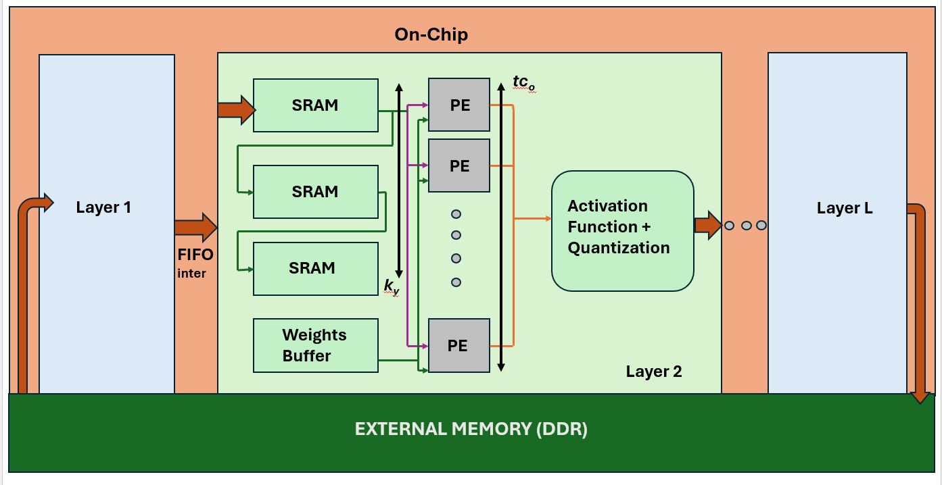
Proposed Work

Slide 13
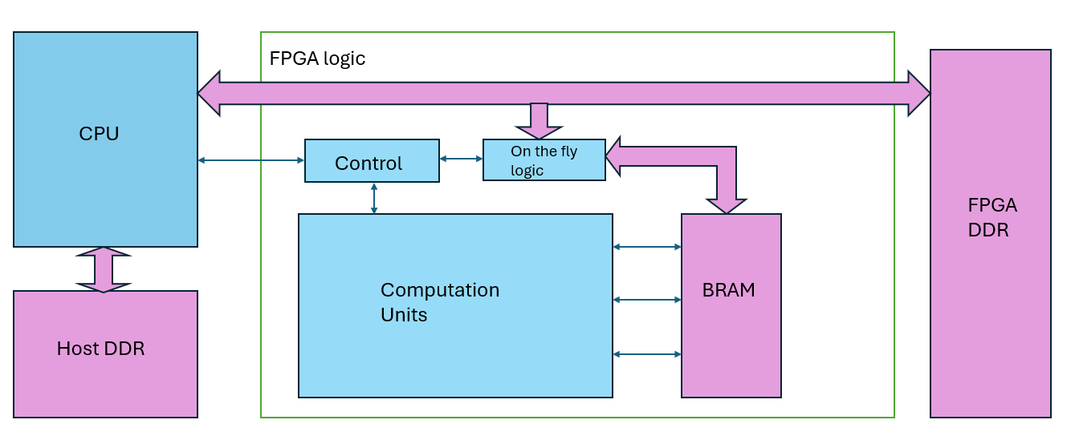
Proposed Work

Slide 14
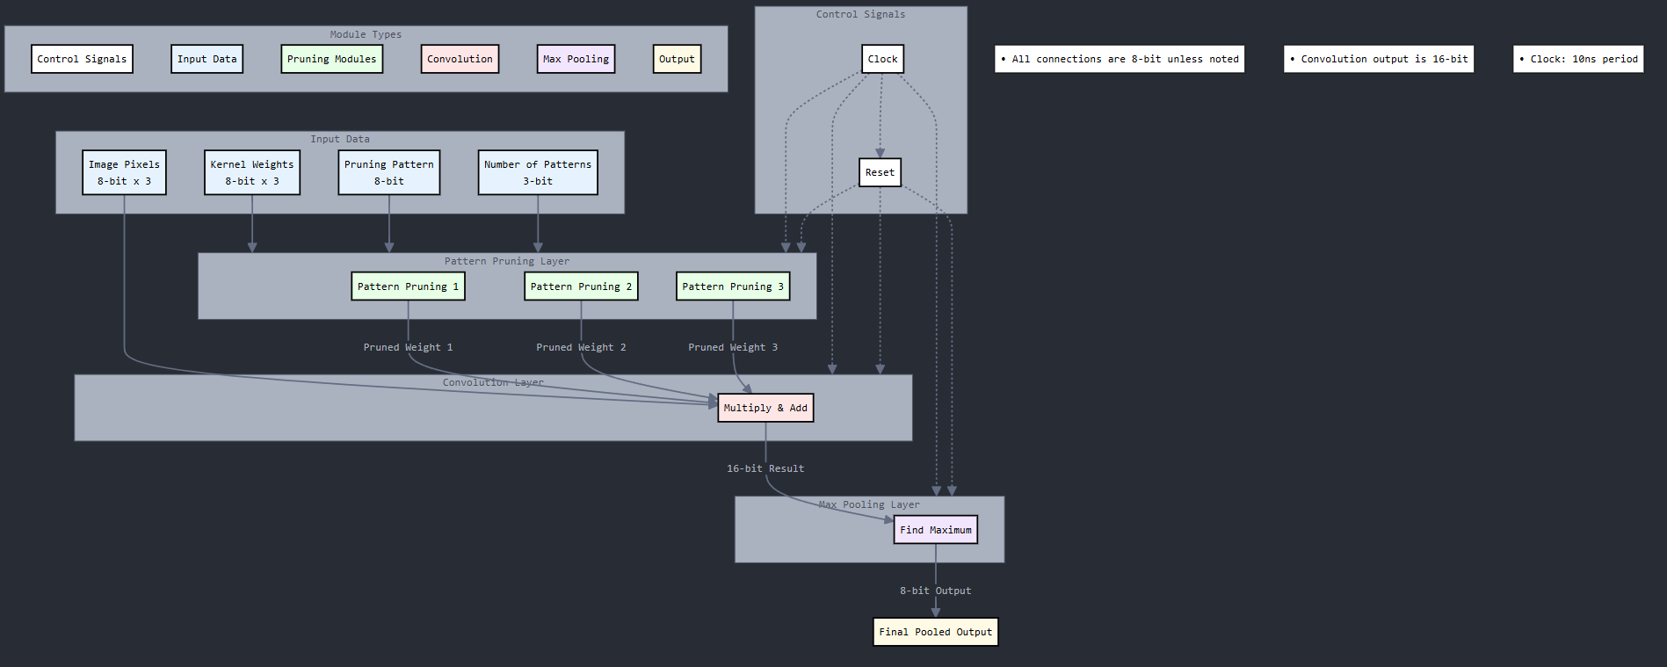

Slide 15
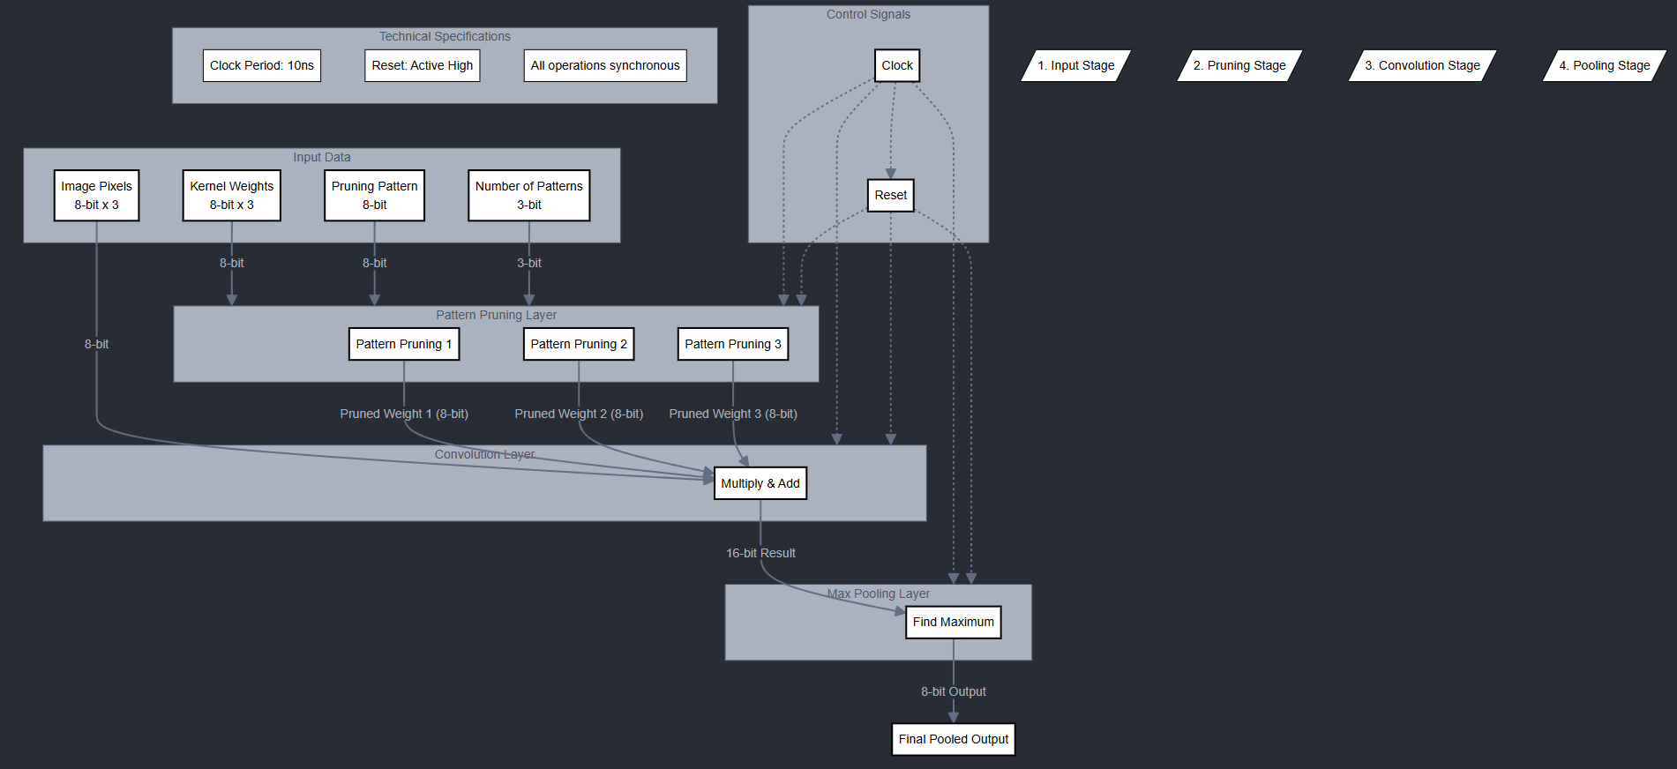

Slide 16
Modules
Softmax-like Layer
Module Purpose:
This module mimics the functionality of a softmax layer, but simplified as a comparison-based decision logic to select the largest output among three classes.
Functionality:
It compares the three inputs (in_0, in_1, in_2), and based on the largest value, assigns a class (0, 1, or 2).
This can be useful in classification tasks where the network outputs are converted into class predictions.
2. ReLU Activation Function
Module Purpose:
The ReLU (Rectified Linear Unit) activation function replaces all negative inputs with zero and keeps positive inputs unchanged.
Functionality:
If the input value (in_data) is less than 0, it outputs 0. Otherwise, it outputs the input value.
This helps introduce non-linearity in the network and improves learning.

Slide 17
Modules
Fully Connected Layer (FC Layer)
Module Purpose:
This module simulates a fully connected (FC) layer of a neural network. The FC layer takes multiple inputs, applies weights to them, and outputs a weighted sum.
Functionality:
On each clock cycle (posedge clk), the module computes the weighted sum of the inputs. It resets to 0 on reset (posedge reset).
This module simulates how neurons in a fully connected layer of a neural network are connected and compute their output.
4. Upsampling Module (Super-resolution)
Module Purpose:
This module performs a simple 2x2 upsampling (replication-based) operation, which is used in image processing for tasks like super-resolution..
Functionality:
It replicates the input pixel into a 2x2 grid.
This is a simple upsampling technique where the input pixel is expanded into multiple pixels to increase image resolution.

Slide 18
Modules
Convolution Module with Pruning
Module Purpose:
This module performs a convolution operation on an input image with a kernel (filter), and applies pruning to the kernel based on a pruning pattern. Pruning refers to zeroing out some of the kernel weights.
Input/Output:
Inputs:
Three 8-bit pixels from the image (image_0, image_1, image_2).
Three 8-bit kernel values (kernel_0, kernel_1, kernel_2).
A pruning pattern (pruning_pattern), which determines which kernel values are kept or pruned.
Output: A 16-bit convolution result (result).
Functionality:
The module applies the pruning pattern to each kernel. If a corresponding bit in the pruning pattern is set to 1, the kernel value is kept; otherwise, it is pruned (set to 0).
The convolution operation is performed by multiplying the pruned kernel values with the input pixels and summing the results.
Pruning helps reduce the computational cost and improve efficiency by eliminating redundant or less important weights.

Slide 19
Modules
CNN Accelerator Module
Module Purpose:
The CNN Accelerator integrates all the previous modules to create a simple Convolutional Neural Network (CNN) with pruning functionality.
Input/Output:
Inputs:
8-bit pixel inputs (image_0, image_1, image_2).
8-bit kernel values (kernel_0, kernel_1, kernel_2).
Fully connected layer weights (fc_weight_0, fc_weight_1, fc_weight_2).
Pruning pattern (pruning_pattern_0).
A mode signal (mode) to switch between classification and super-resolution tasks.
Outputs:
A 2-bit class output (class_out) for classification.
Four 8-bit upsampled pixels (upsampled_0, upsampled_1, upsampled_2, upsampled_3) for super-resolution.

Slide 20
Modules
Functionality:
First Convolution Layer: The module performs the first convolution operation with pruning. The result is passed through a ReLU activation function and a max-pooling operation.
Second Convolution Layer: Similar to the first layer, but operates on the pooled output from the first layer.
Fully Connected Layer: After the second convolution, the output is passed through a fully connected layer.
Softmax Layer: This layer converts the output of the fully connected layer into class predictions for classification tasks.
Upsampling for Super-resolution: If the mode is set to 1 (super-resolution), the module performs upsampling on the pooled output from the first convolution layer.

Slide 21
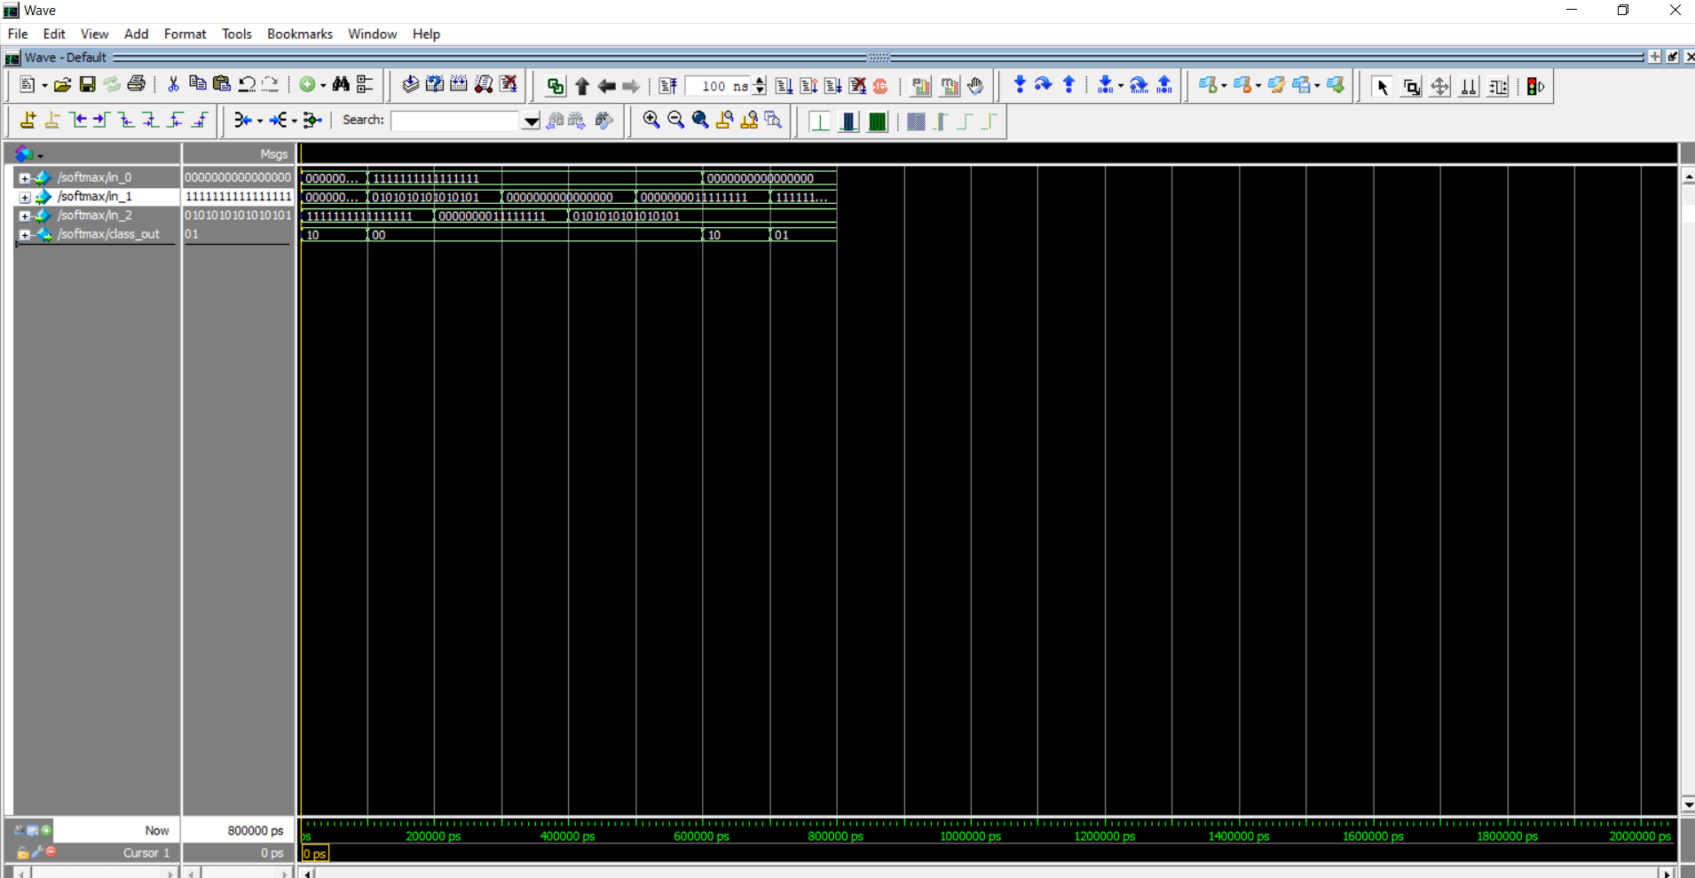
Software Outputs

Slide 22
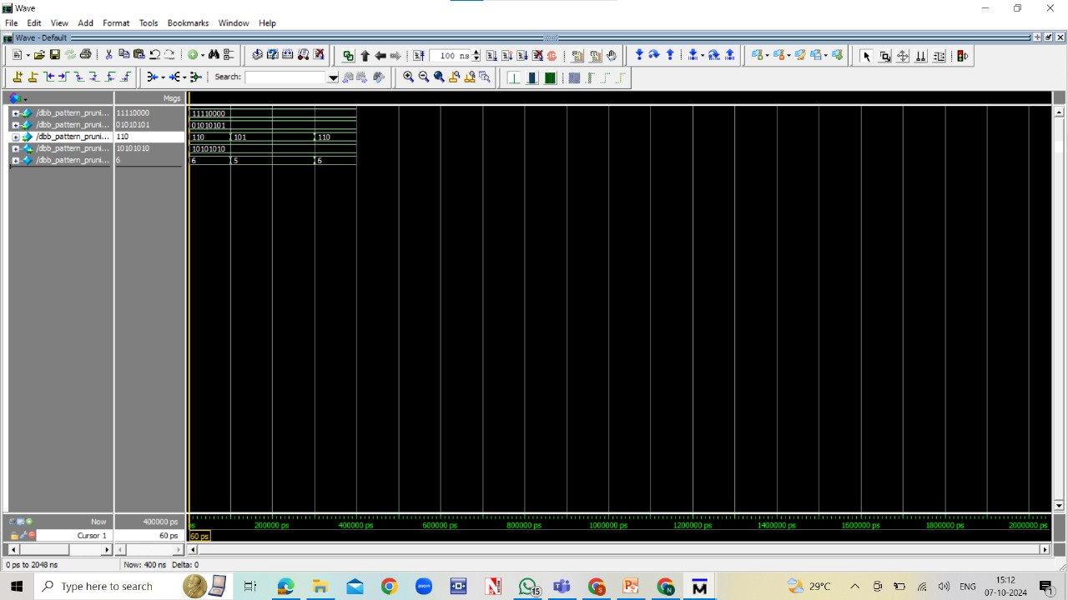
Software Outputs

Slide 23
Output Explanation
This CNN accelerator has two primary modes of operation: Classification and Super-Resolution. Each mode produces different outputs:
1. Classification Mode (mode = 0):
class_out [1:0]: This is the primary output for classification. It's a 2-bit value indicating which of the three classes the input likely belongs to.
00: Class 0
01: Class 1
10: Class 2
2. Super-Resolution Mode (mode = 1):
upsampled_0, upsampled_1, upsampled_2, upsampled_3 [7:0]: These outputs represent the upsampled image. Each output corresponds to a pixel in a 2x2 upsampled block generated from a single input pixel. This achieves a simple 2x super-resolution effect.

Slide 24
References
L. Pradels, S. -I. Filip, O. Sentieys, D. Chillet and T. L. Calloch, "FPGA-based CNN Acceleration using Pattern-Aware Pruning," 2024 IEEE 6th International Conference on AI Circuits and Systems (AICAS), Abu Dhabi, United Arab Emirates, 2024, pp. 228-232, doi: 10.1109/AICAS59952.2024.10595865.
Kamel Abdelouahab. Reconfigurable hardware acceleration of CNNs on FPGA-based smart cameras. Electronics. Université Clermont Auvergne [2017-2020], 2018. English. NNT : 2018CLFAC042. tel-02066643
Wu, Di & Zhang, Yu & Jia, Xijie & Tian, Lu & Li, Tianping & Sui, Lingzhi & Xie, Dongliang & Shan, Yi. (2019). A High-Performance CNN Processor Based on FPGA for MobileNets. 136-143. 10.1109/FPL.2019.00030.
V. H. Kim and K. K. Choi, "A Reconfigurable CNN-Based Accelerator Design for Fast and Energy-Efficient Object Detection System on Mobile FPGA," in IEEE Access, vol. 11, pp. 59438-59445, 2023, doi: 10.1109/ACCESS.2023.3285279

Slide 25
X. Chen, J. Li and Y. Zhao, "Hardware Resource and Computational Density Efficient CNN Accelerator Design Based on FPGA," 2021 IEEE International Conference on Integrated Circuits, Technologies and Applications (ICTA), Zhuhai, China, 2021, pp. 204-205, doi: 10.1109/ICTA53157.2021.9661886.
L. Xie, X. Fan, W. Cao and L. Wang, "High Throughput CNN Accelerator Design Based on FPGA," 2018 International Conference on Field-Programmable Technology (FPT), Naha, Japan, 2018, pp. 274-277, doi: 10.1109/FPT.2018.00052.
X. Guan, Z. Wang and H. Fang, "Design and Implementation of CNN Accelerator Based on FPGA," 2024 43rd Chinese Control Conference (CCC), Kunming, China, 2024, pp. 8969-8974, doi: 10.23919/CCC63176.2024.10661893.
W. You and C. Wu, "RSNN: A Software/Hardware Co-Optimized Framework for Sparse Convolutional Neural Networks on FPGAs," in IEEE Access, vol. 9, pp. 949-960, 2021, doi: 10.1109/ACCESS.2020.3047144
D. Parikh, S. Li, B. Zhang, R. Kannan, C. Busart and V. Prasanna, "Accelerating ViT Inference on FPGA through Static and Dynamic Pruning," 2024 IEEE 32nd Annual International Symposium on Field-Programmable Custom Computing Machines (FCCM), Orlando, FL, USA, 2024, pp. 78-89, doi: 10.1109/FCCM60383.2024.00018.

Slide 26
Thank you
Lemuel Pon Whitson J - 21BEC1178
Aishwaryakopika R U - 21BEC1275
Soma Neha Saranya - 21BEC1693

