Slide 1







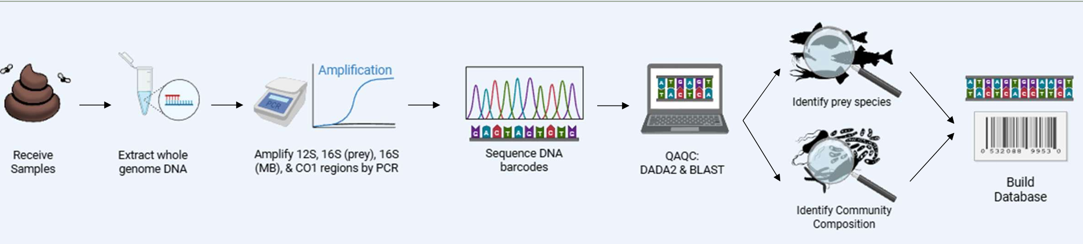
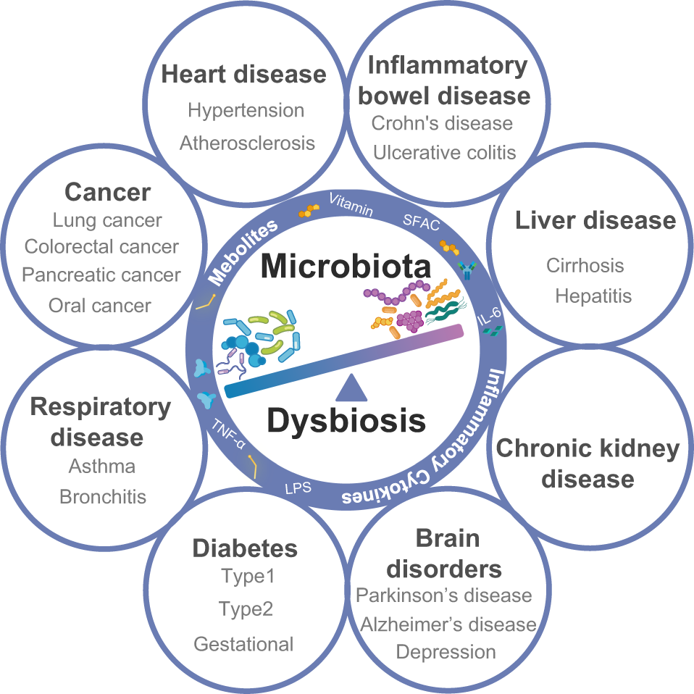
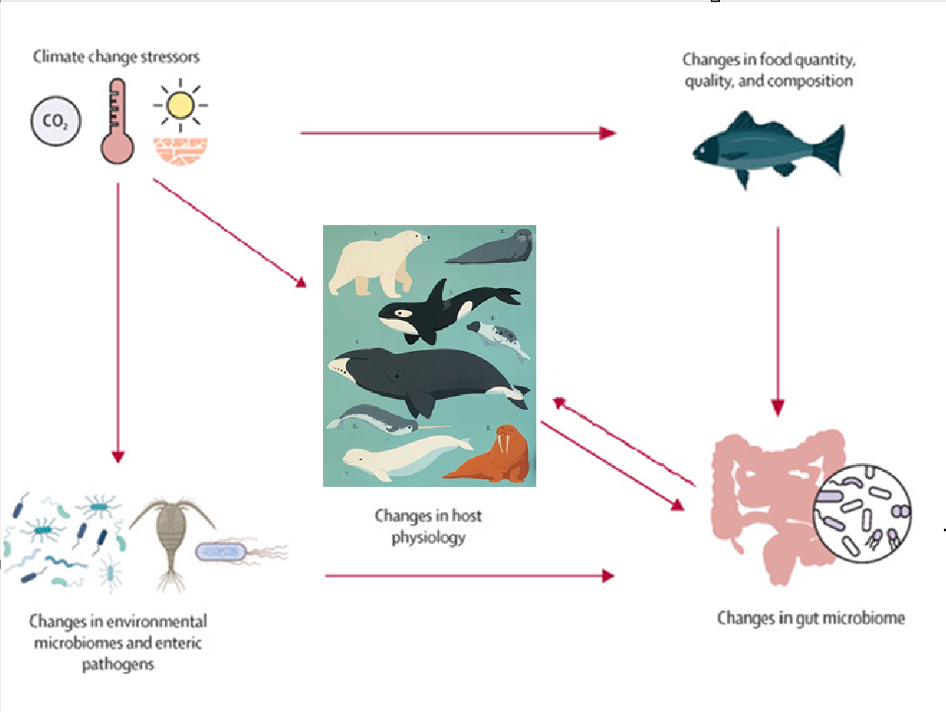
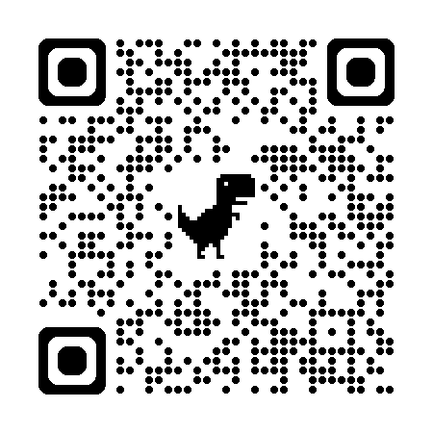
Gut Check for Ocean Health:
Characteristic Harbor Seal (Phoca vitulina) Gut Microbiota
Mollie Ball, Amy Van Cise
School of Aquatic and Fishery Sciences , University of Washington, Seattle, WA
Background
Methods
Conclusions
Marine mammals contribute billions of dollars to the blue economy through tourism, ecosystem services, and cultural identity.
However, health assessments remain costly, invasive, and logistically challenging, all of which limit our ability to anticipate individual-, population-, and ecosystem-level impacts.
The five main groups present in the GUT WERE are Firmicutes, Proteobacteria, Fusobacteria, Actinobacteria, and Bacteroidetes.
DIFFERENCES ARE DRIVEN BY
Gut microbes play essential roles in digestion, immunity, and stress response, making them a powerful indicator of marine mammal and ecosystem health.
The microbiome is emerging as a powerful non-invasive tool for health screening.
Figure 3. P. vitulina hauled out on rocks.
Future Directions
As the science of using the microbiome as a health index matures, we look towards
expanding this analysis to more marine mammal taxa
integrating this information into monitoring to improve management to support the persistence of marine mammals as vital drivers of ocean and economic health.
Figure 2. Stacked bar plot of the eleven most abundant broad taxonomic groups of gut microbes found in P. vitulina samples taken from NCBI SRA. The broad group Other includes both unclassified sequences and lesser groups (n = 833 samples)
Table 1. Functions of gut microbes from the five most abundance phyla in the human gut (from Bhargava et al., 2022)
Figure 1. Possible consequences of dysbiosis of gut microbial communities in humans. (From Hou et al., 2022)
Figure 4. Circular impacts of climate change stressors and gut microbiome on host physiology. (Adapted from Litchman, 2025)
References
1. Bhargava, S., Merckelbach, E., Noels, H., Vohra, A. & Jankowski, J. Toxins 14, 648 (2022).
2. Hou, K. et al. Sig Transduct Target Ther 7, 135 (2022).
3. Litchman, E. The Lancet Planetary Health 9, e134–e144 (2025).
4. Nelson, T. M., Apprill, A., Mann, J., Rogers, T. L. & Brown, M. V. Microbiol. Aust. 36, 8 (2015).
5. Sonnega, S. & Sheriff, M. J. Front Vet Sci 11, 1474028 (2024).

