Slide 1
Transformers for Timeseries Turbulence

Slide 2
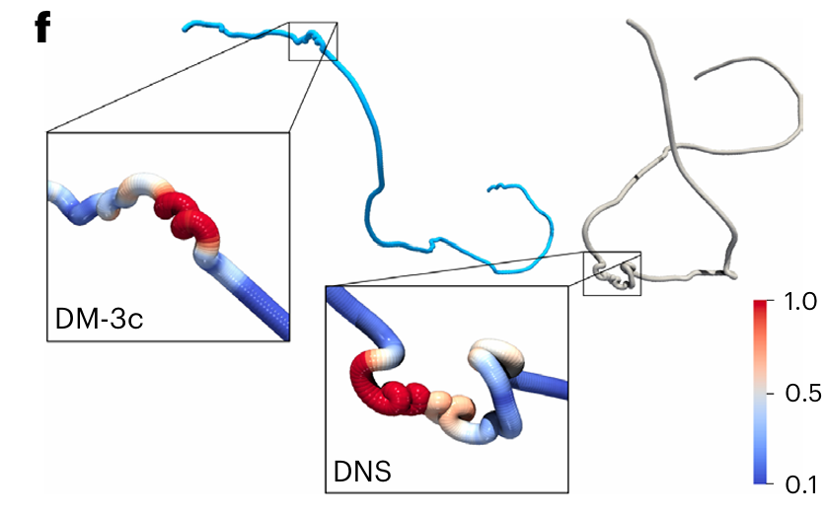
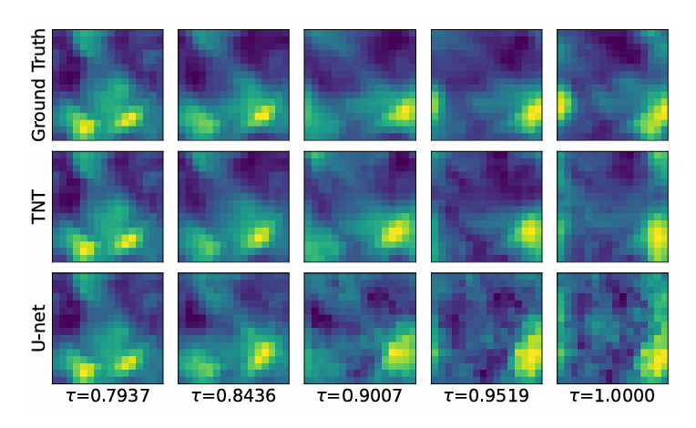
The Task
Images from: TNT: Vision Transformer for Turbulence Simulations, Dang, Y et al
Synthetic Lagrangian turbulence by generative diffusion models. Li, T et al

Slide 3
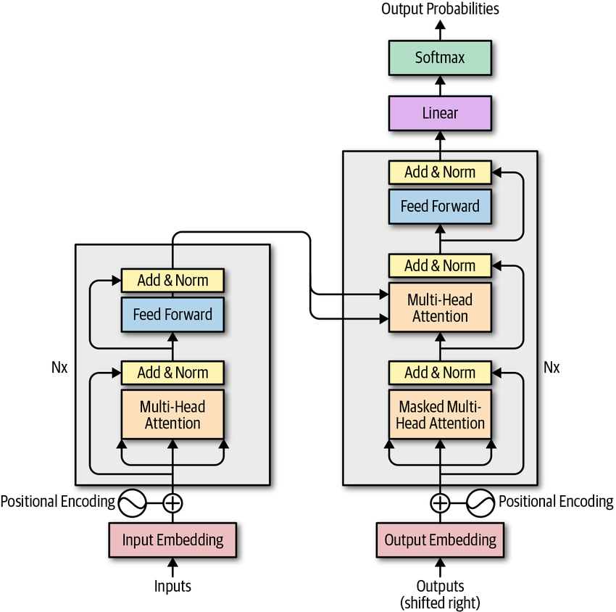
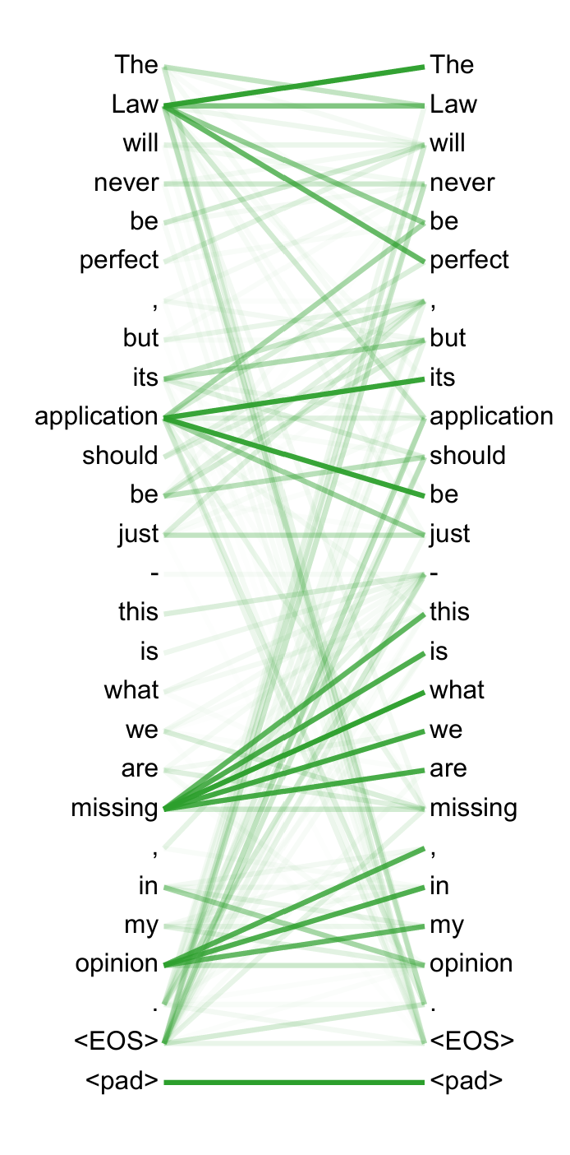
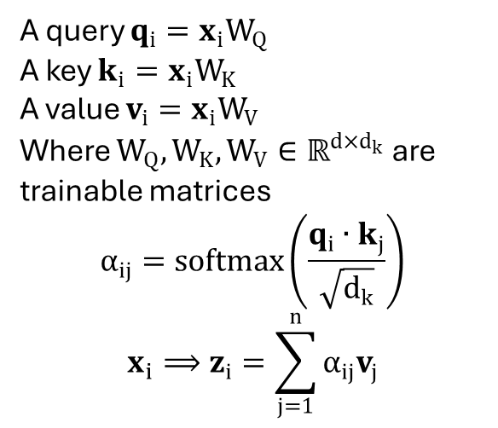
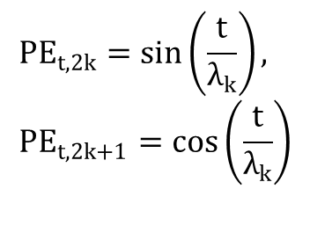
A query $q_{i}=x_{i}W_{Q}$
A key $k_{i}=x_{i}W_{K}$​
A value $v_{i}=x_{i}W_{V}$​
Where $W_{Q},W_{K},W_{V}∈ℝ^{d×d_{k}}$ are trainable matrices
$$α_{ij}=softmax\left(\frac{q_{i}∙k_{j}}{\sqrt{d_{k}}}\right)$$
$${x_{i}⟹z}_{i}=\sum_{j=1}^{n}{α_{ij}v_{j}}$$
Images From: Attention is all
you need, Vaswani et al
Not really relevant to me, only used in teacher forcing like in translation or forecasting.
$$PE_{t,2k}=\sin\left(\frac{t}{λ_{k}}\right), PE_{t,2k+1}=\cos\left(\frac{t}{λ_{k}}\right)$$

Slide 4
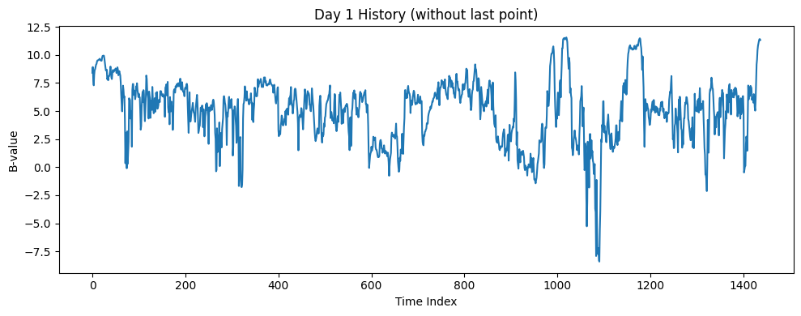
Challenges with Turbulence
Multi Scale
Long Range Dependence
Stochasticity

Slide 5
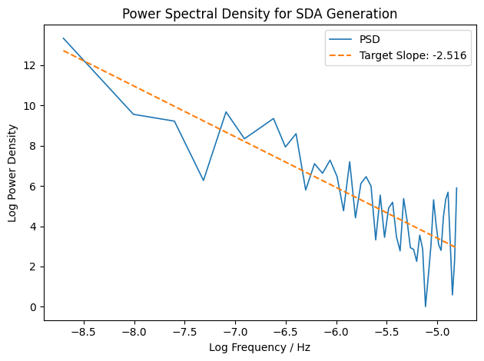
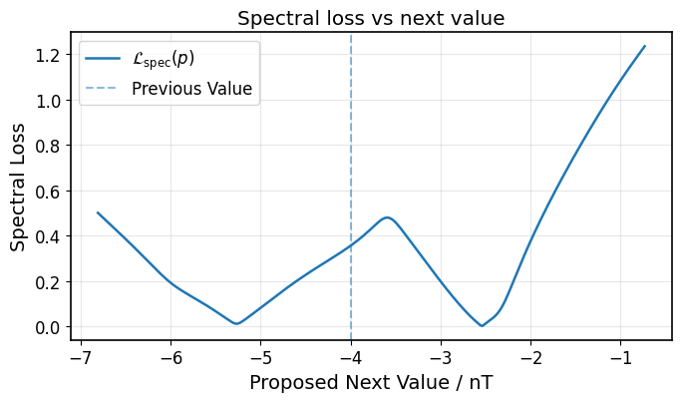
The spectral reinforcement loss
Analyses change to spectrum
Punishes Deviations in the fitted line

Slide 6
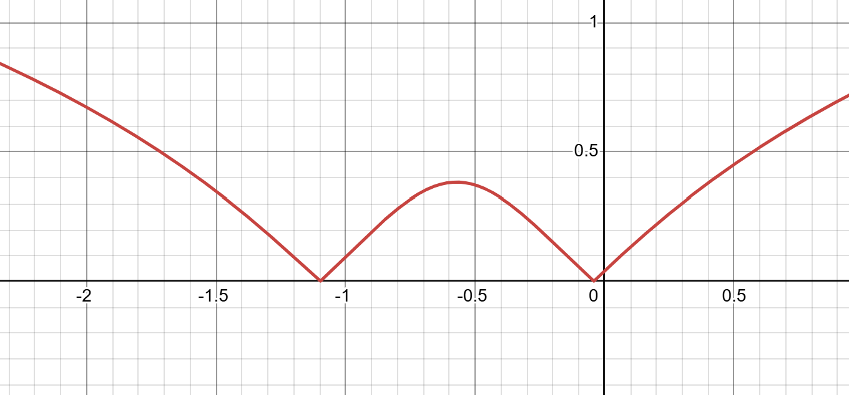

SR loss maths
For sequence: $z_{n}≡z\left[n\right]=z\left[0\right],z\left[1\right],z\left[2\right],…,z\left[T−1\right]∈ℝ$
Fitting a power law to the PSD → fitting a linear fit to the log-log space
By appending a point p, we get a shift to the slope:
$Δα\left(p\right)=\sum_{k∈𝒦_{T+1}}{a_{k}^{T+1}}\log\left(ρ_{k}^{2}+2ρ_{k}\cos\left(ϕ\right)p+p^{2}\right)−constant$ (similar for intercept)
Where $a_{k}^{T+1}$, $ρ_{k}$, $ϕ$ are constants dependent only on the sequence, $z_{n}$.
Essentially a sum of log-quadratics in the prediction variable.
This would have a gradient of $O\left(T^{−\frac{1}{2}}\right)$ near the minima, great for scaling to large sequences!

Slide 7
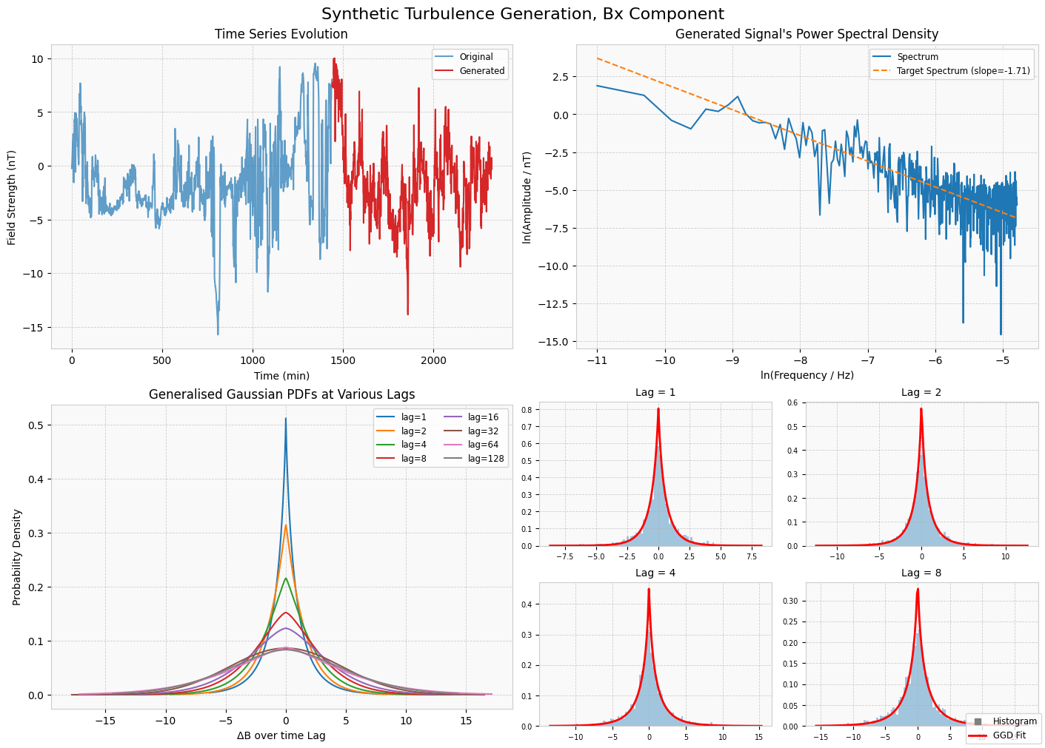

Slide 8
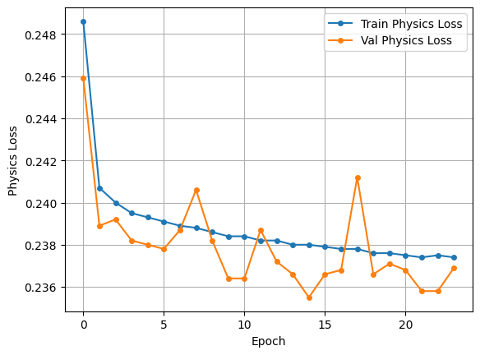
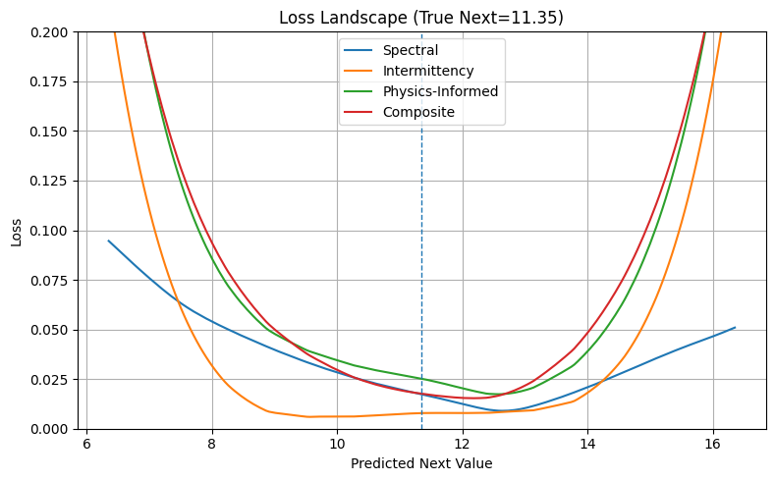
The transformer model
Training Windows: 7,740,129 over 20 years, with filtering
Sequence Length – 240 minutes
Input dimension – 96
Feedforward dimension- 384
Number of heads – 8
Number of layers – 8

Slide 9
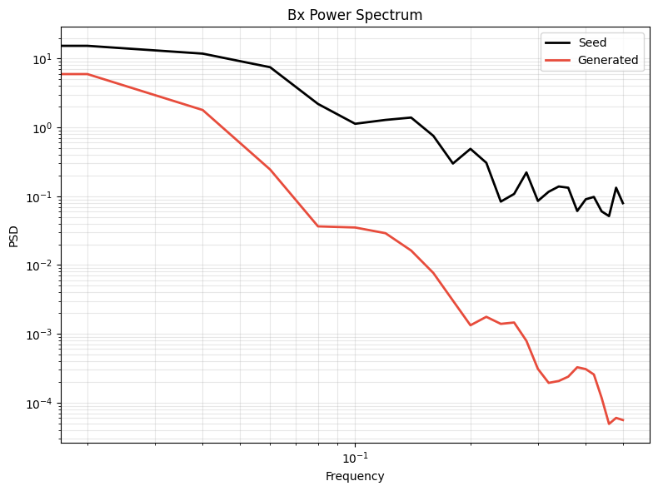
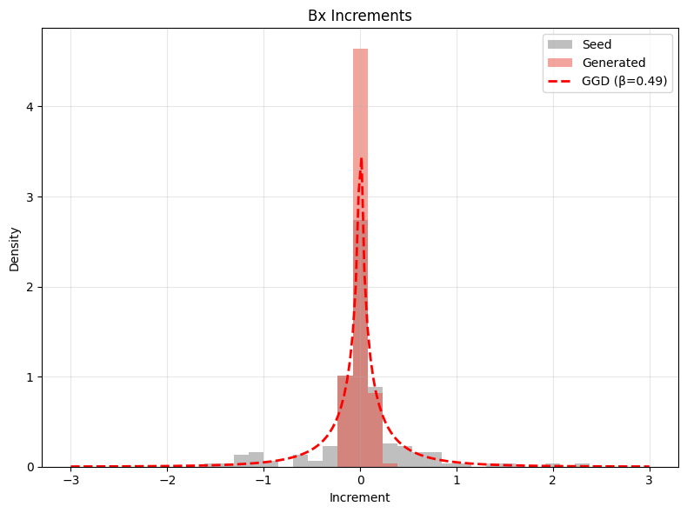
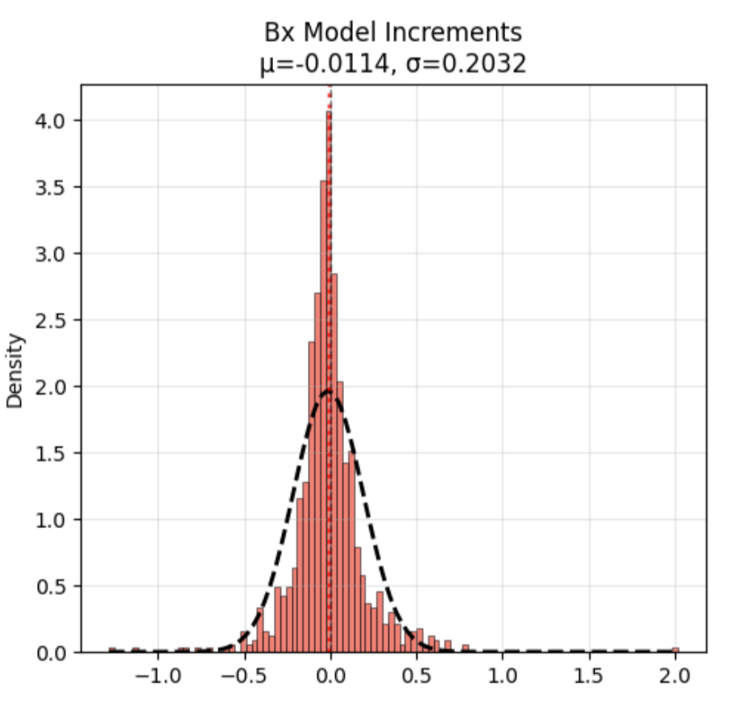
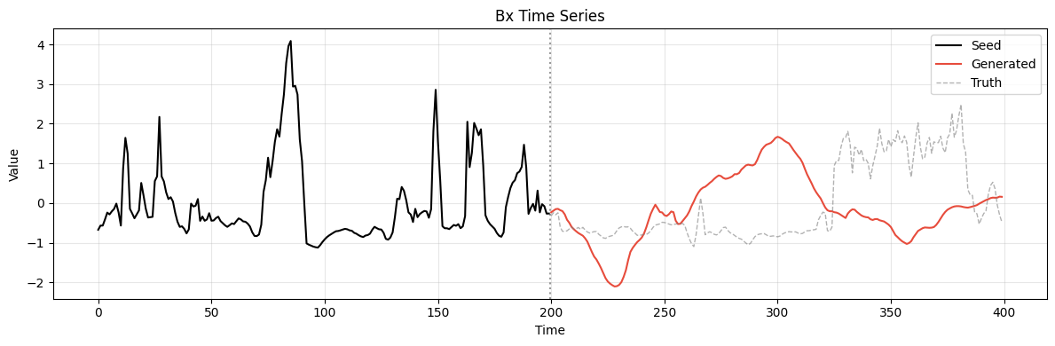
Challenges with the transformer model
But first step analysis shows the model doing quite well? =>

Slide 10
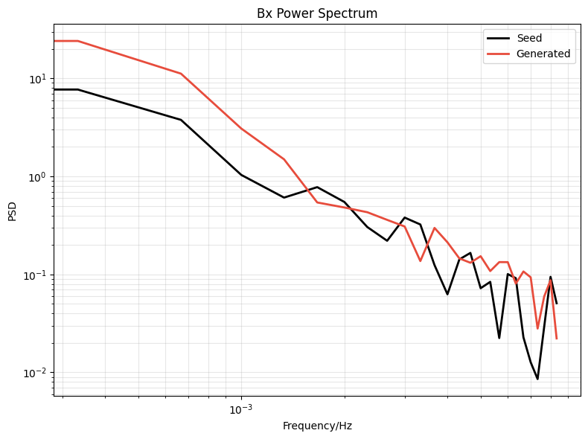
The use of noise in a feedback
Fundamentally a random process
Helps ‘prop up’ the lower side of the spectrum
Distribution selected such that the output distribution of model remains consistent
Noise Injected
Models Prediction

Slide 11
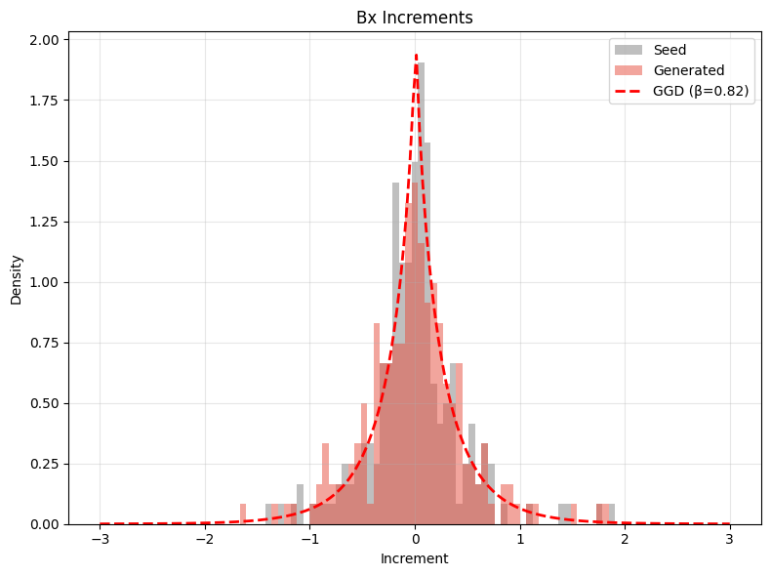
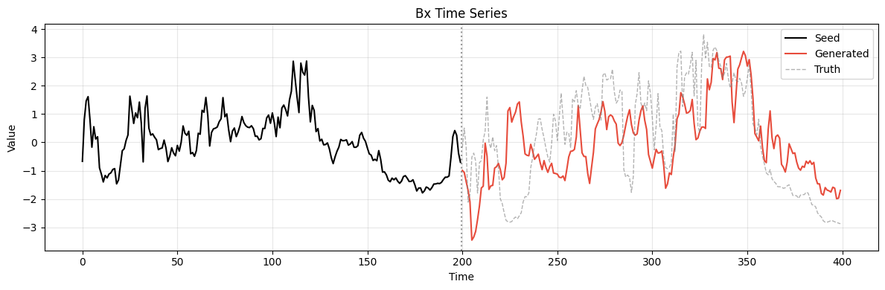
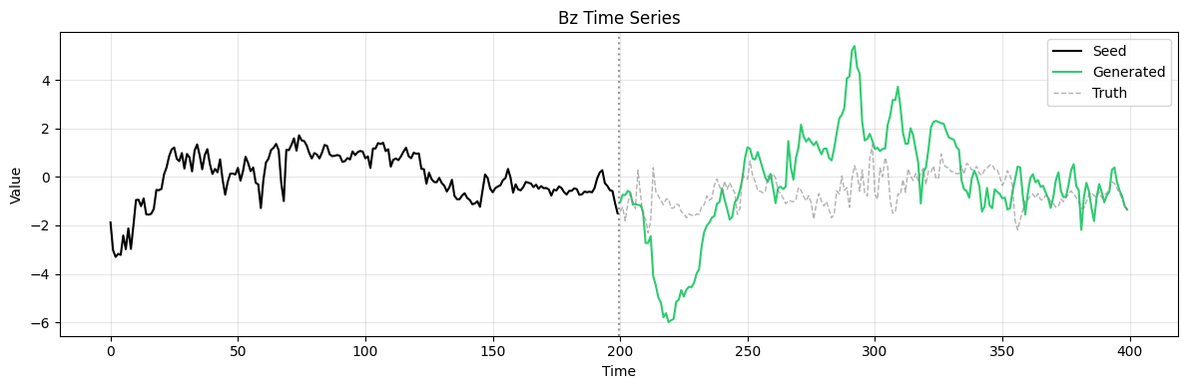
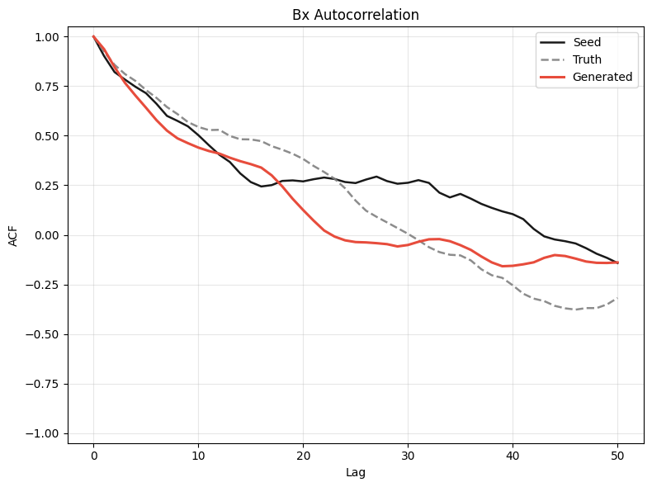
Latest Model Results
Note the shocks

Slide 12
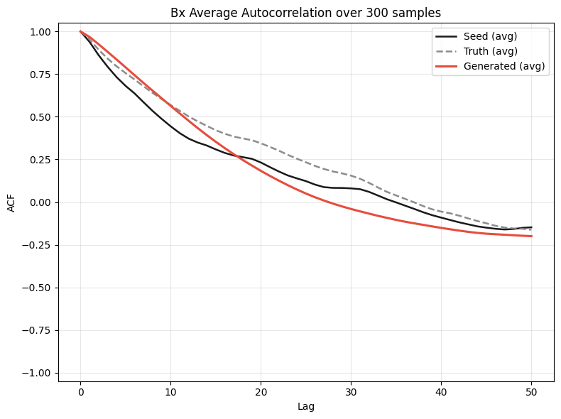
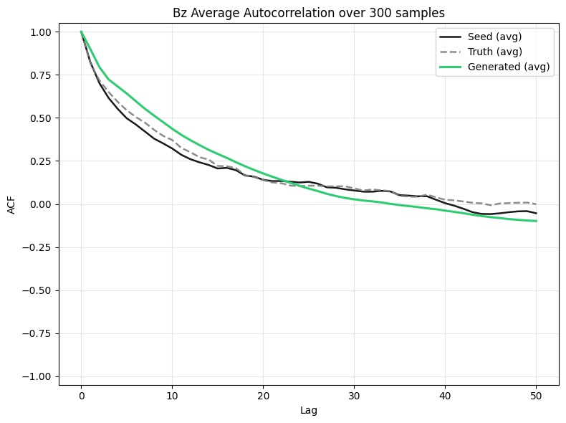
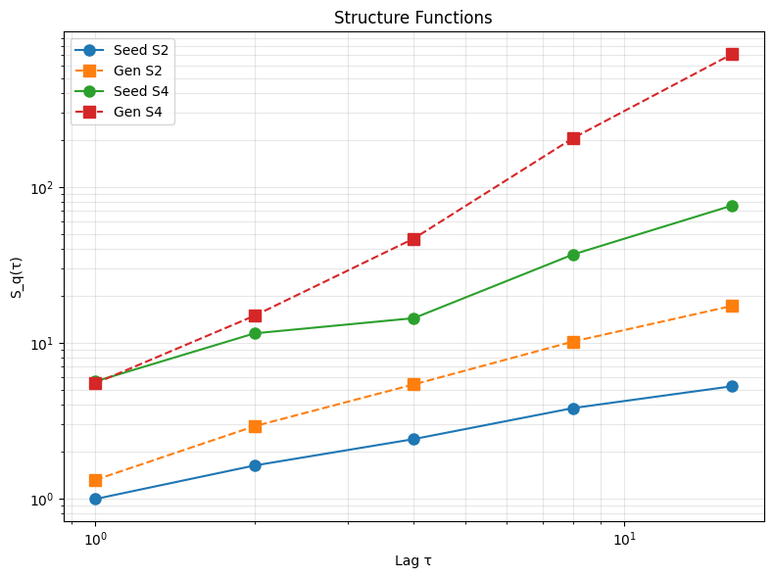
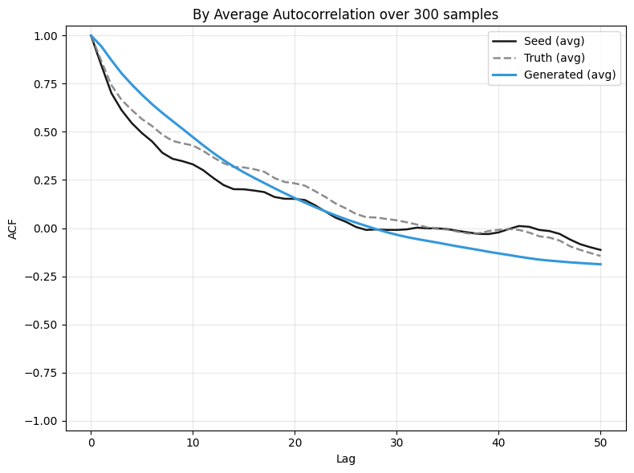
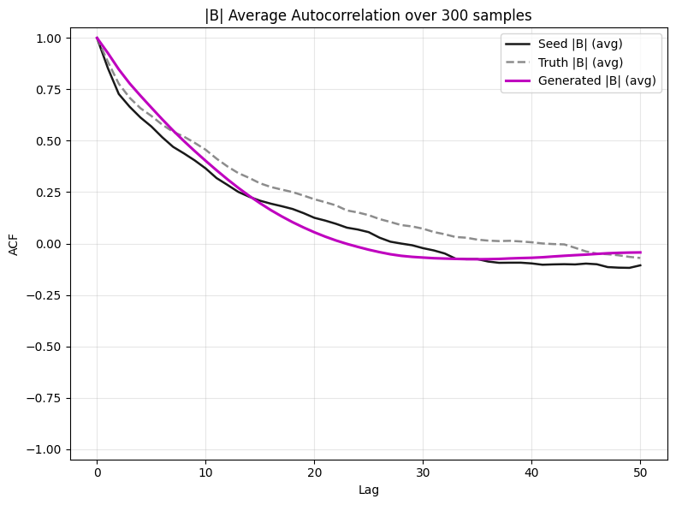
Average Auto Corrolation Function

Slide 13
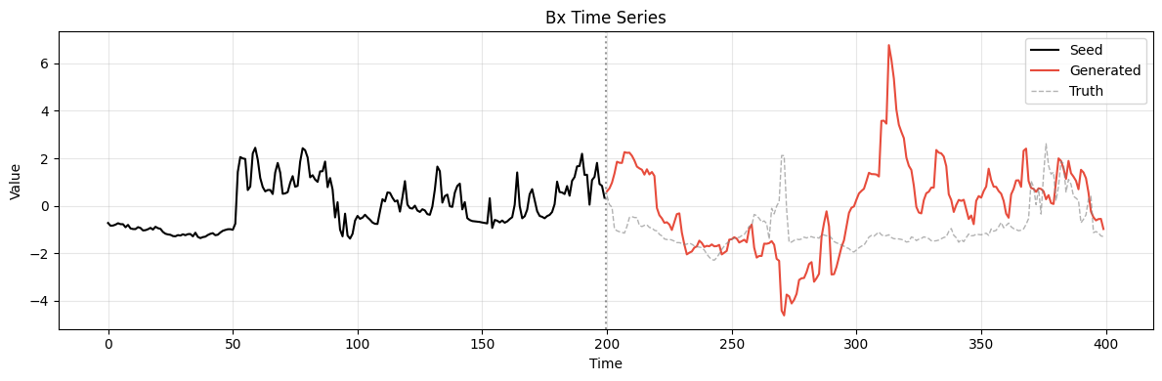
Failings of the model
Very temperamental! The same generator that produced the good sample on the previous slide also produces things like the below!
Long range structure functions are slightly lost, was supposed to be the point of the transformer!
The noise addition feels like cheating, even if it is necessary for the feedback, can we do better (cleaner)?

Slide 14
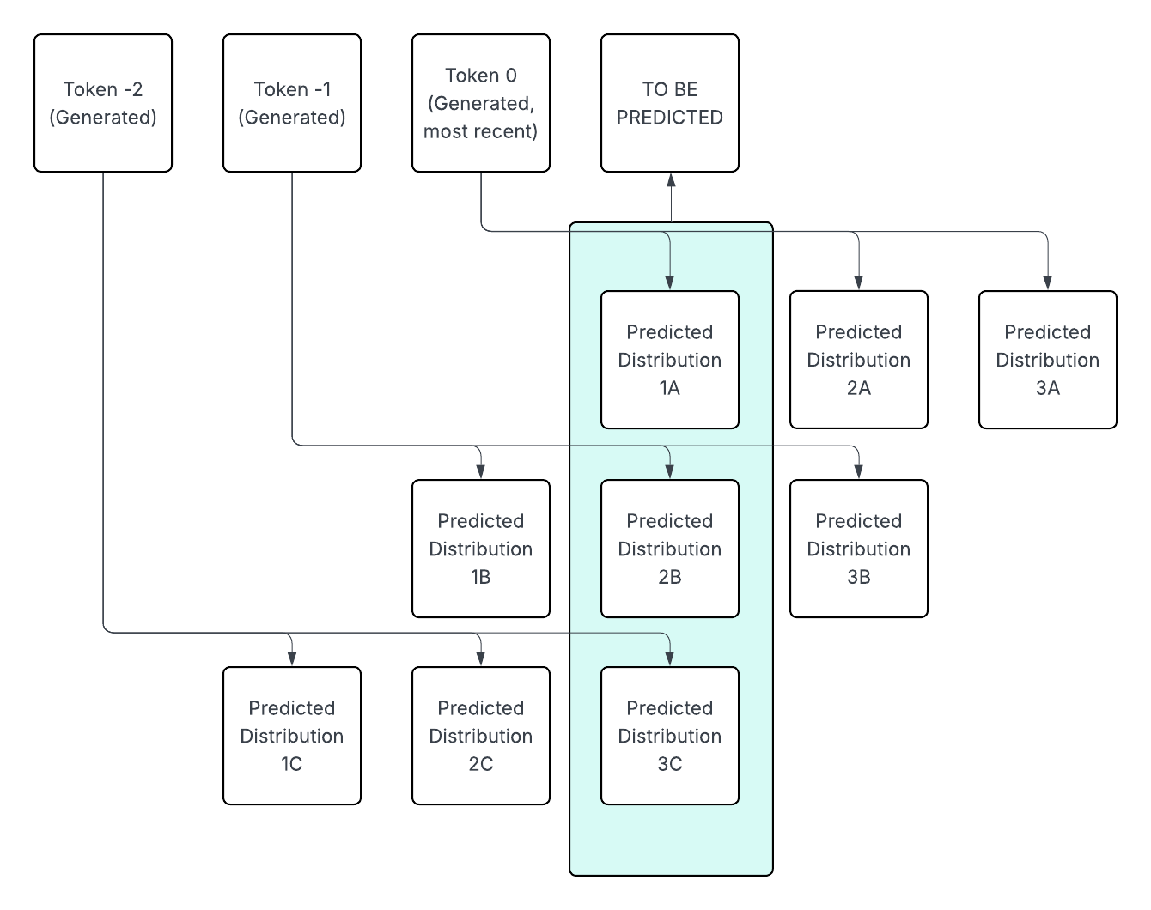
My next model: multi point rollout with distributions

