Slide 1
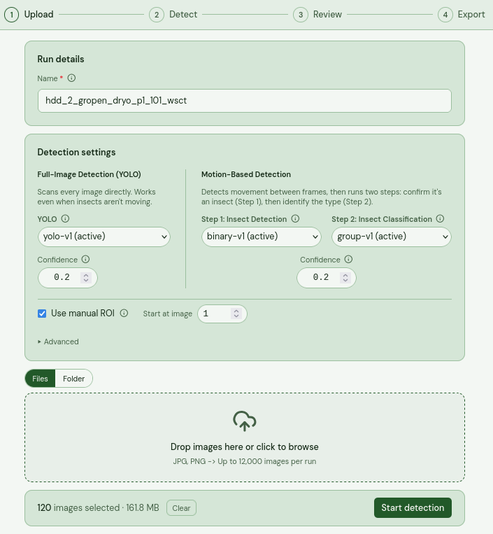



Pollinator module
Running an inference run
Typing in a name for the run is mandatory (1). For detection 0.2 is standard, if you lower it to 0.05 the motion-based detection pipeline will detect a lot of more noise. Once models become better (higher recall results) this threshold can be raised.
You can decide to set a region of interest, ROI (2) that will open a pop up window. Clicking on “Start detection” (3) will take you to a popup-window shown on next page, if ROI box is checked.

Slide 2
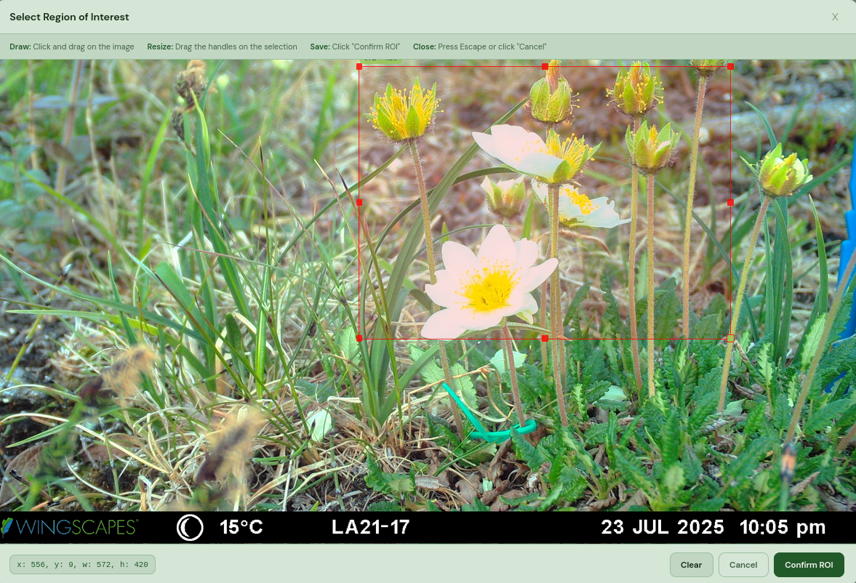
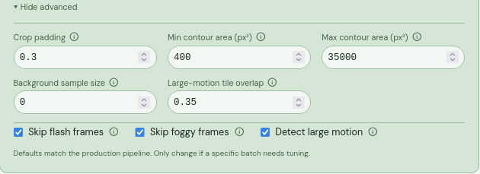
This window will let you draw a rectangle, nothing outside of it will be caught.
The advanced section on the upload page:
Affect both pipelines:
Skip flash/foggy frames: skips images if flash taken or it is too foggy
Large-motion tile overlap: important when the two pipelines merges detections. Lower means fewer duplicated boxes that overlap each other. Tied to “Detect large motion” checkbox.
Only has effect on motion-based pipeline:
Crop padding: adds a bit extra context around each bbox
Min/max contour area: smallest and largest areas detected
Background sample size: samples 0 (default) images to use as a median image that is used to compare first image against something. Turned off for now as it makes the inference run take longer in larger datasets.

Slide 3
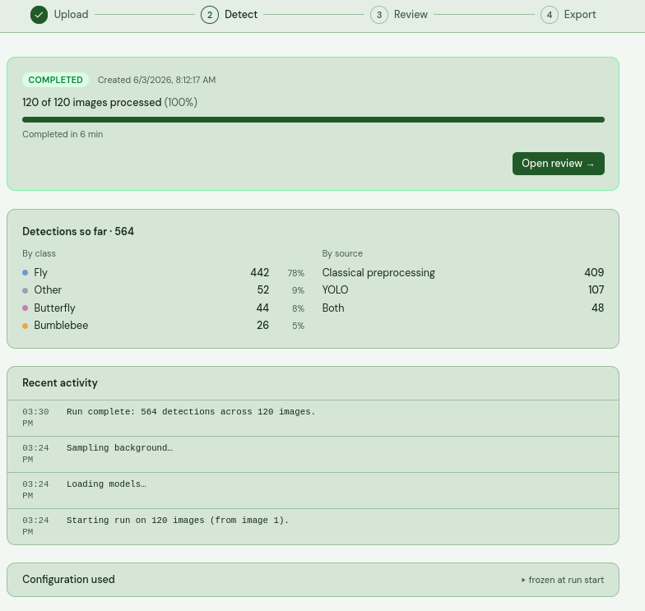


When images has been uploaded you are automatically taken to the Detection page where you find the progress. Today that process is around 100 images per 5 minutes, but it does vary depending on if using ROI and the confidence score used. It will say “completed” when it is done but you can go into the Review page (4) or (5) immediately and start reviewing if you want to - just know that there is no auto-refresh built in, so you will have to manually refresh that page to get updated images and crops shown.

Slide 4
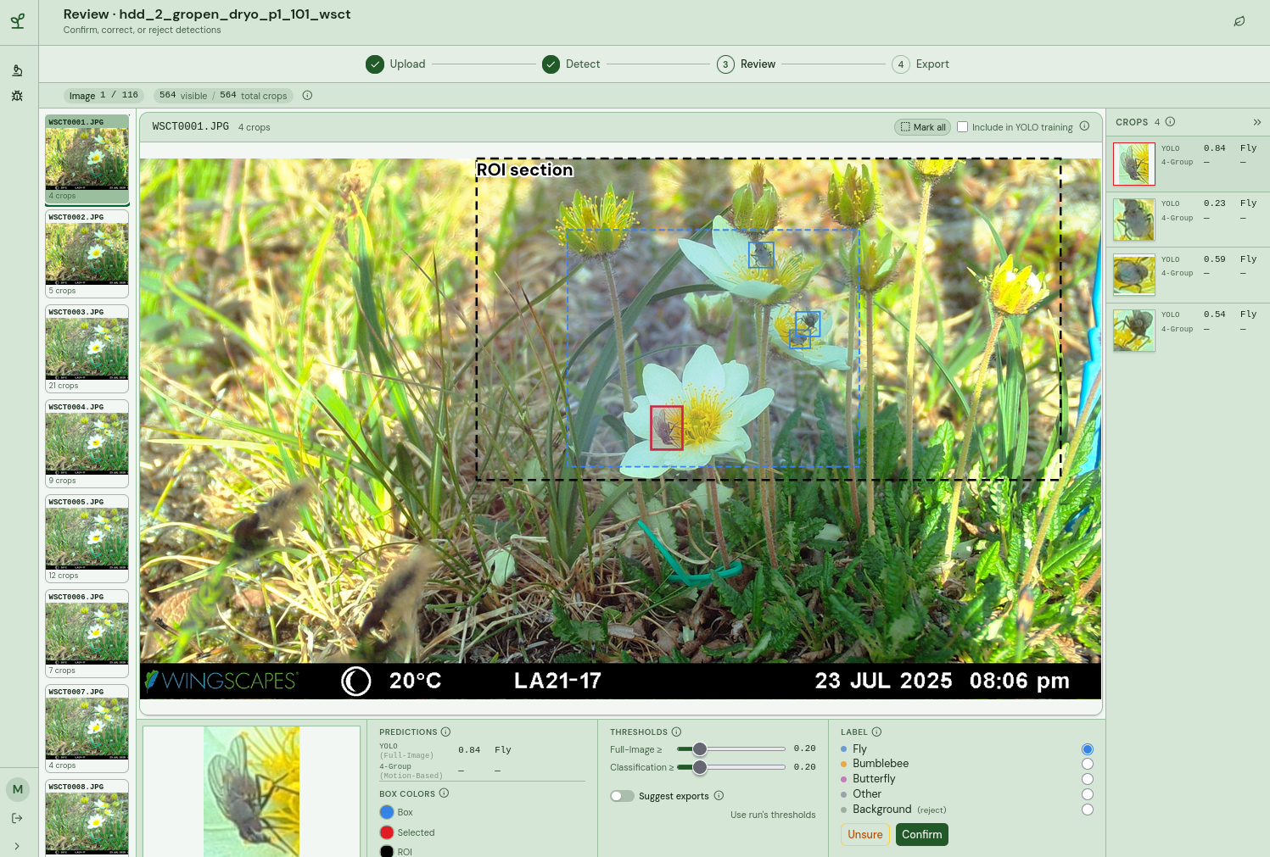


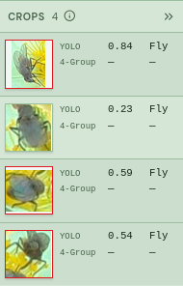
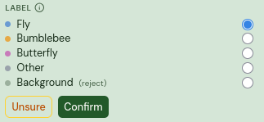



In the Review page there are several ways to select crops.
Selecting crops:
You can click on a box directly in the image (6) or drag to select several boxes (7). You can also select crops directly in the right column, either through normal click, shift-click or ctrl/cmd-click (8).
To the bottom right you can confirm what label the selected crop(s) should get (9) (10).

Slide 5
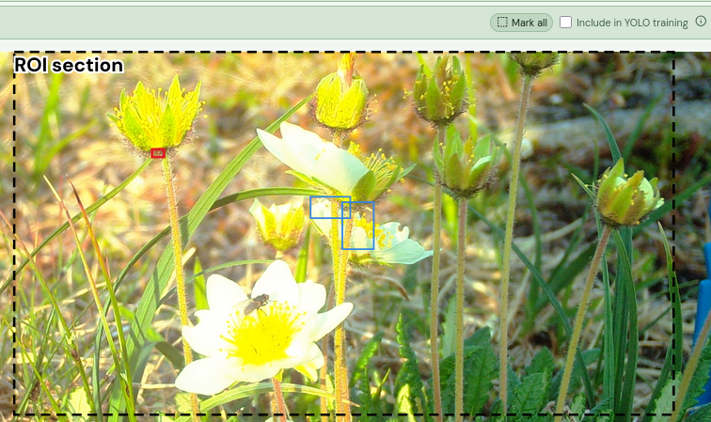

Using keys to quickly label crops:
Left and right arrow will let you move through crops in an image, left to right. Up and down arrow lets you go through the list of images.
You can type 1-4, x, d, y and u for quick labeling and shortcuts.
1 = Fly
2 = Bumblebee
3 = Butterfly
4 = Other
x = Background
u = Unsure (will not label at all)
y = Include image in YOLO training
d = remove selected image from slide (all visible crops still in the image are labeled as Background)
You can batch label anything that is selected. In case you make a mistake there is a rewind option with ctrl-z.
Selecting crops for retraining of pollinator models
Crops that you label will automatically be available to retrain the motion-based models, but not automatically for YOLO. In order to get quality data for the YOLO model to learn on you specifically select the “Include in YOLO training” (11) checkbox. Make sure that all pollinators on those images are annotated, as that image is treated as ground-truth.

Slide 6
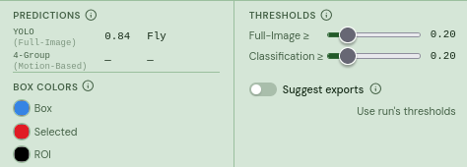





Reading the data and adjusting thresholds
In (12) you will see how much confidence each model has to what label it has set. Often the models complement each other. Where YOLO missed a pollinator the Group classifier may have found one. If they both agree with high certainty that it is a fly then that is likely also the case.
(13) decides what color all boxes should have on the Review page. You may need to adjust these colors depending on what plot is explored, as they vary in color.
You can tinker with thresholds in (14), this can be useful once the models has been trained with lots more data and reaches a recall rate near 0.80-0.90 at a threshold over 0.5. Then it also pairs well with (15) where everything over the thresholds limits are moved to the Export page (those crops are shown blue and you have an option to accept or remove them there).
You can go to the Export page by clicking the stepper (16).

Slide 7


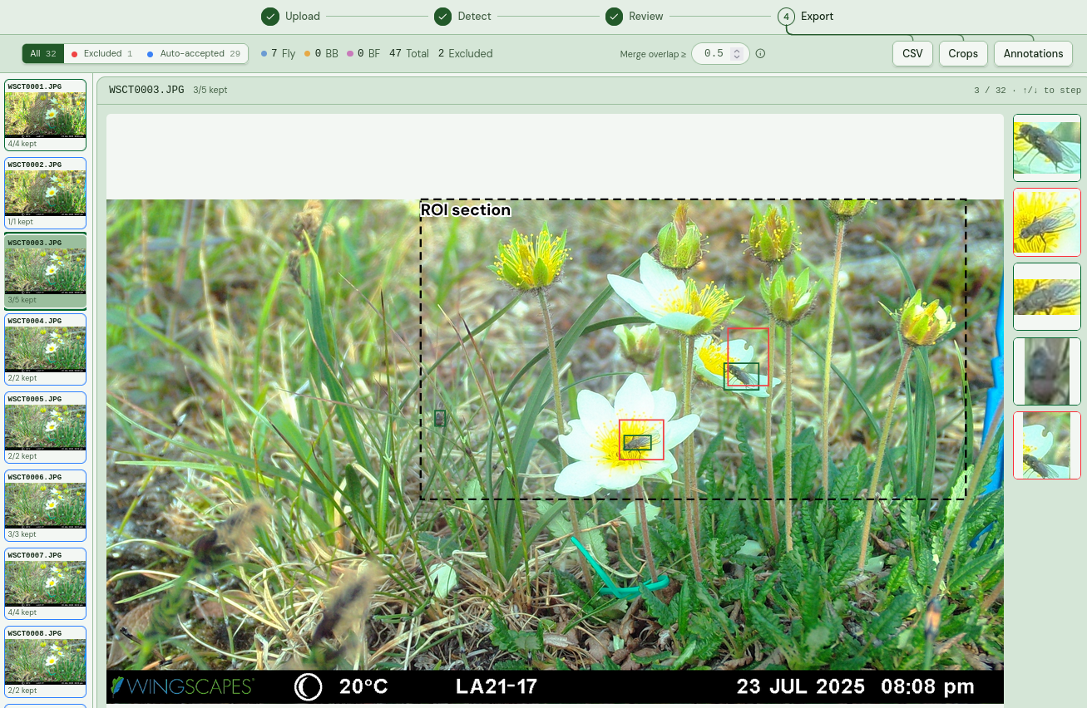

Export page
In the Export page, what is green is confirmed by you as a user. When there is overlap, the larger box is marked red (17) and will not be exported unless you as a user click on it and mark it as OK on the right column, or directly on a box line in the image. This is in place so the tool does not count a pollinator more than once.
Images in the slider are green if all OK or red if there is at least one overlap. If you have enabled the “Suggest exports” toggle in Review page, all detections over the threshold limit are exported to this page and shown as blue.
“Merge overlap” is related to intersection over union (IoU), lower value here will merge more aggressively (outer rectangle will be red). Also worth noting that if one rectangle has its middle point inside another rectangle, that rectangle becomes red (18).
IoU of 0.5
Exporting CSV gives two options, either “per image” which will include counts of all insect types, or “per crop”, which will include confidence scores per crop.
Exporting crops will download a folder with all crops separated into subfolders based on what type they belong to, which is useful if you wish to train models outside of the application with Jupyter Notebooks.
Annotations can also be exported, it will save images with drawn boxes and ROI if it exists.

Slide 8
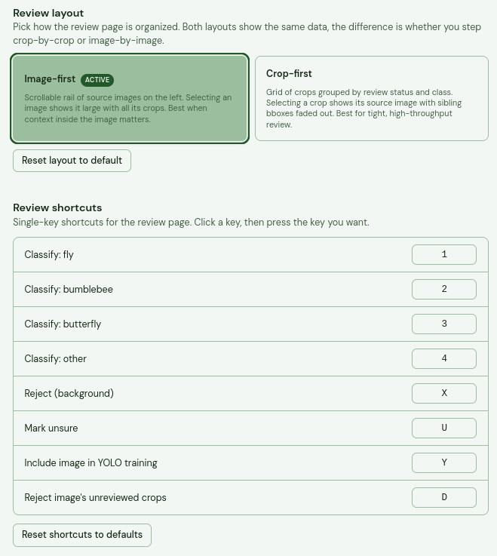
Review layout has two different views: “image-first” and “crop-first”. Image-first is the newest edition and in general what you want to use. Using crop-first will get really messy if you are running on 1000+ images, but it can be useful to filter detections into classes.
You can also change key shortcuts if you want to set it up in a way you prefer.

