Slide 1
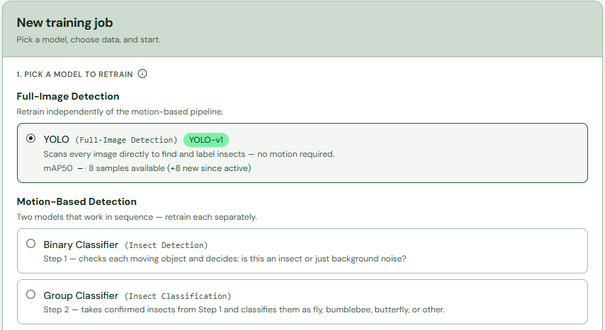

Pollinator Module
Retraining a model
Choose which model you want to retrain. Click (1) to train YOLO

Slide 2
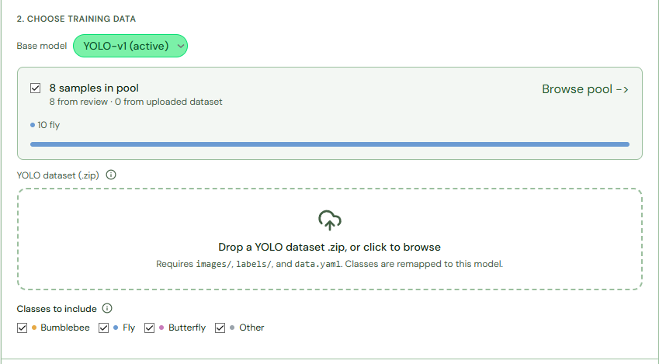






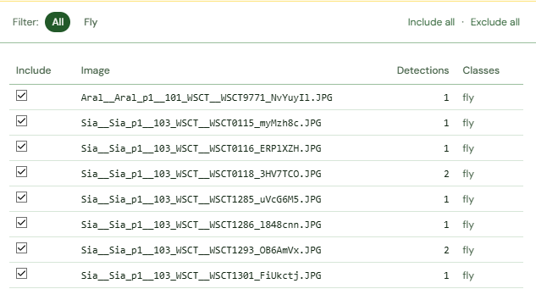

Choose which model to train from (2). Click (3) to browse images/crops. Tick/untick (4) to exclude/include in training. (5) Exclude or include all images. Untick (6) to only use uploaded dataset. (7) Upload images and labels. (8) Choose which classes should be included in training.

Slide 3
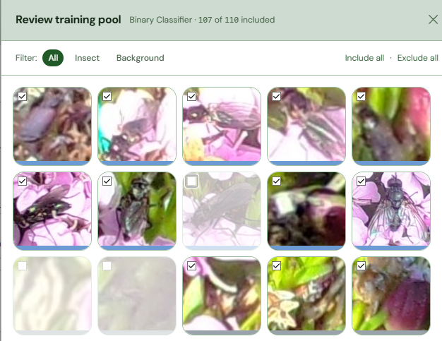

Click (9) to select/unselect for training. Blue underline means fly and gray means background. Make sure they match what is actually in the crops.
The model benefits from more data if it is high quality. Review the output thoroughly to ensure the best training data. It is recommended that you don’t train with less than 500 images/crops as it can lead to catastrophic degradation of the model. 500 should be view as the minimum amount and further increasing the amount of data will be beneficial.

Slide 4

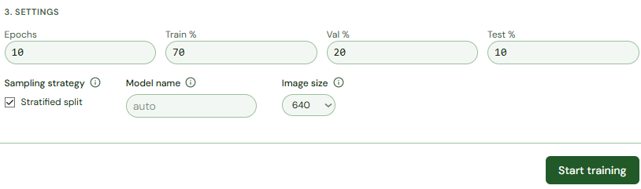





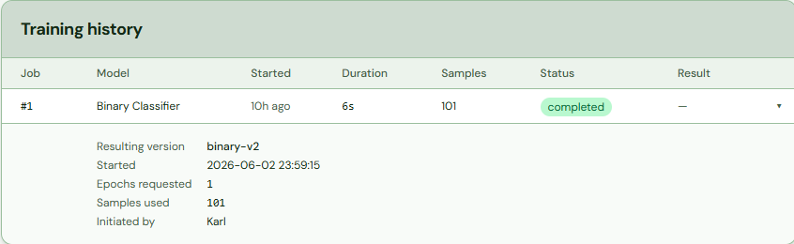

(10) Increase for bigger datasets. (11)Train/val/test % change the % of images used for each category. Tick (12) to keep class distribution equal in the splits.(13) Name the output model. (14) Adjust the image slice size. (15) Begins the retraining
Further information on the settings. High amount of epochs is good for large datasets due to the model requiring more epochs in order to learn a lot of data. However, if the dataset is small alot of epoch can lead to overfitting. The Train/val/Test split should generally stay around these percentages. It is recommended that the image slice size is kept at the size the model was trained on. In the case of this system the initial model was trained on 640
Click (16) to view training stats.

