Slide 1
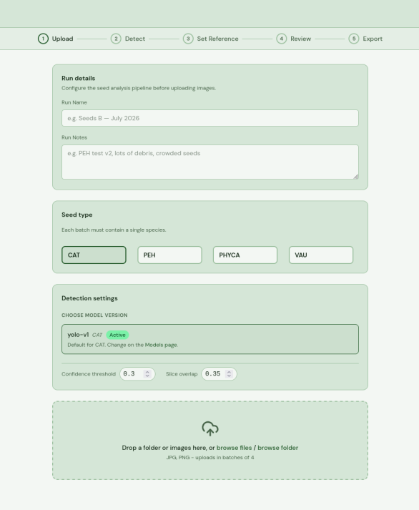





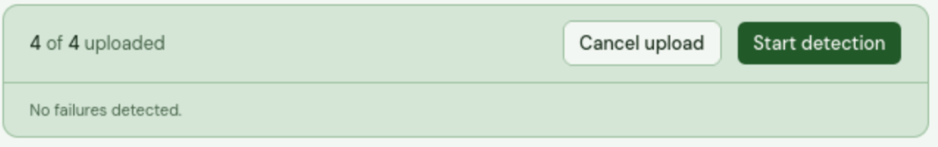
Seed module
Uploading images and running inference
Set a name for the batch and optionally add a small description/notes for the run.
Note: The default settings are the settings found to produce the best results from the models used during the research phase.
Then, select a desired model to use for the run by first clicking the correct species name(1) and then selecting an available model for that species(2). Since the models are trained on specific species, it is important to pick a model which matches the species of the batch.
Once a model is selected, optionally adjust the settings (confidence threshold(3), SAHI slice overlap(4)).
Proceed to upload your images by clicking “browse files/browse folder”. Once the pictures are uploaded, proceed to inference by clicking “Start Detection” (5).
Note: Make sure that the image either contains a label with the species name or contains the species name in the image file title. Otherwise, the file may need to be force uploaded which can cause worse prediction results.

Slide 2
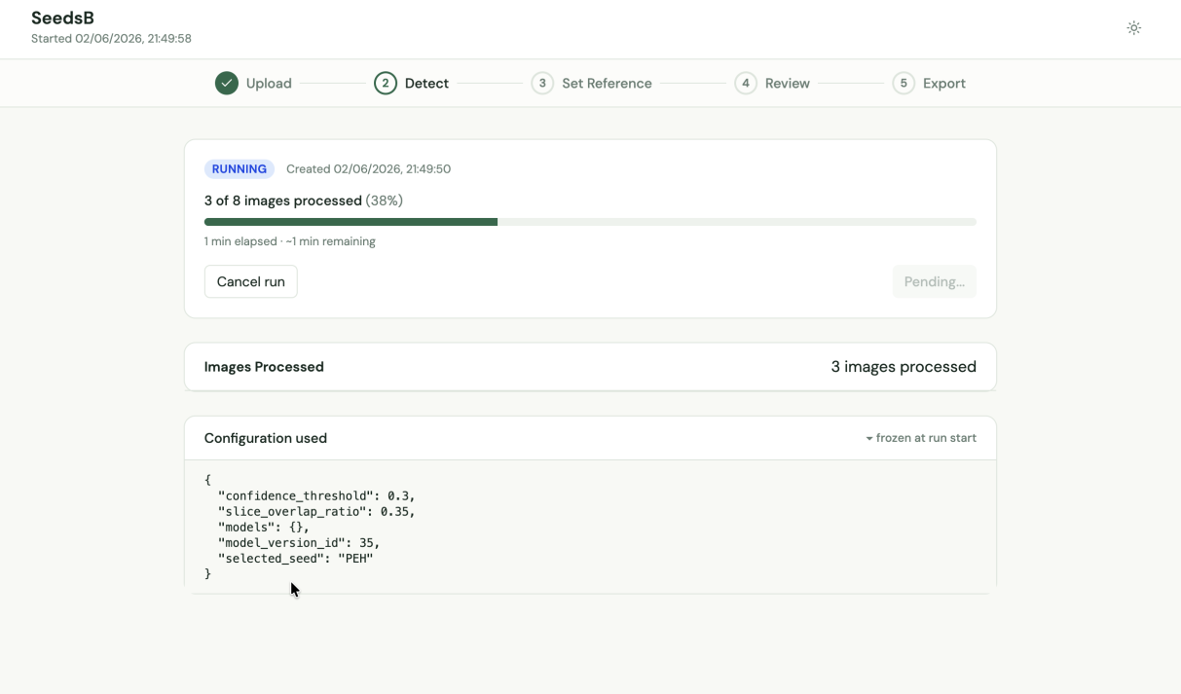
Following the detection process
Once the image batch is uploaded and inference begins, the user is redirected to the “Detect” page where they can view the inference process through a progress bar. No options to navigate forward are available until a run is complete.

Slide 3
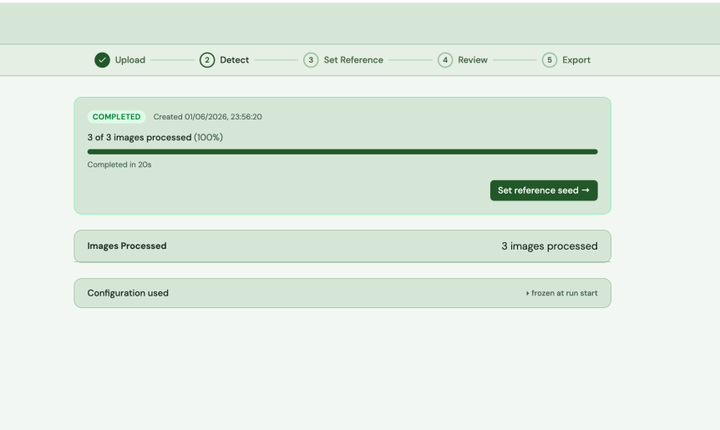


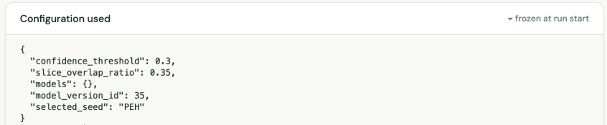
Once the inference run is complete, click “Set Reference Seed” (6) in order to be redirected to the next page where a reference seed is selected for each image in the batch.
If the user wishes to see the configurations set for the current Inference run, click “configurations used” (7) to unfold and view the settings selected in upload page.

Slide 4
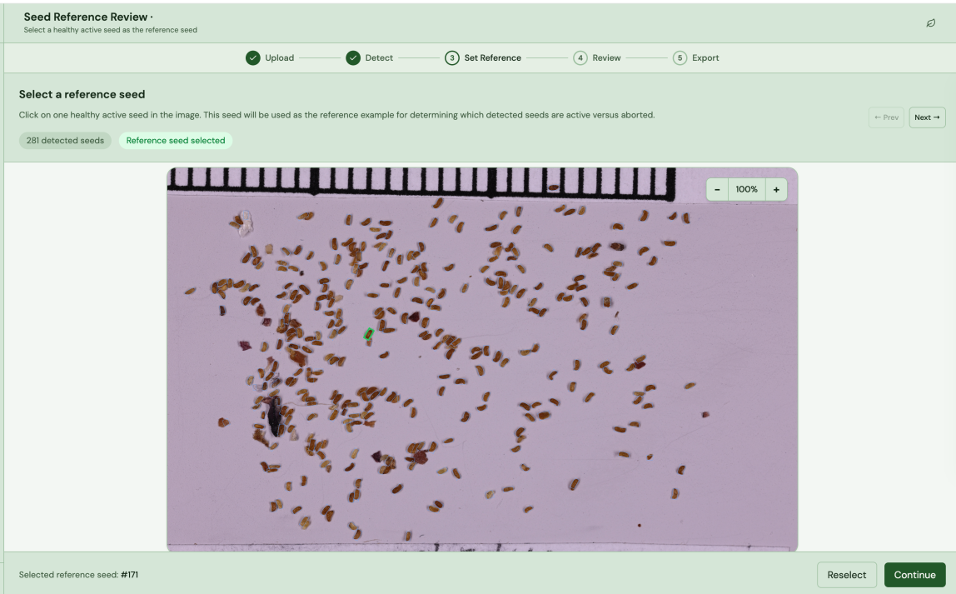




Selecting a Reference Seed
In the first review page, select a reference seed which acts as the threshold deciding which seeds are kept and which seeds are aborted based on seed size. Seeds with a size smaller than 30% of the reference seed are not counted in the final result.
Pick a reference seed by clicking on a desired seed in the image, like the example below (8). The reference seed for that image is automatically bound with a green box upon being clicked and saved as reference seed. If there are more than 1 image in the batch, the user needs to navigate to the next image and pick a reference seed for each image in the batch. To get to the next image, click “Next” (9).
If the user wants to re-select a reference seed, click “Reselect” (10) and the old reference is overwritten.
Once all images have a reference seed selected, click “Continue” (11) to run the images through the reference seed calculation and navigate to the second part of the review where the result is manually reviewed.

Slide 5
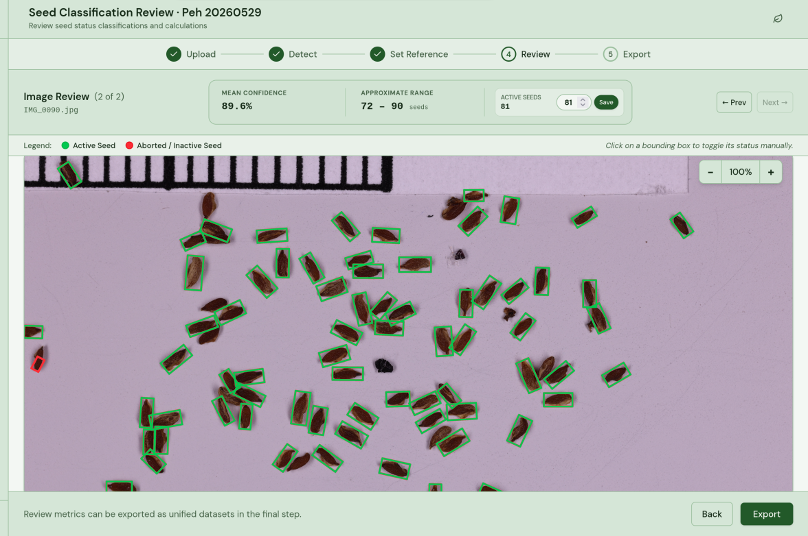



Manually reviewing the result
In the “Review” page the user manually reviews the resulting seed count after the Inference run and the abortion of the seeds smaller than the reference seed threshold. Aborted seeds are bound with a red box(12) and the counted seeds with green. To toggle the status of a seed manually, click on the seed bounding box and the option to change it appears. To adjust the total count of active seeds manually, use the arrows in the “active seeds” tab in the data bar(13) and click save.
Just like in the page with reference seed selection, each image in the batch is reviewed separately and the user can navigate between the images of the batch using then “next” and “prev” buttons in the right corner.
Once all images have been reviewed and the count manually changed if needed, click “Export” (14) in order to proceed to the next page to save the results.

Slide 6
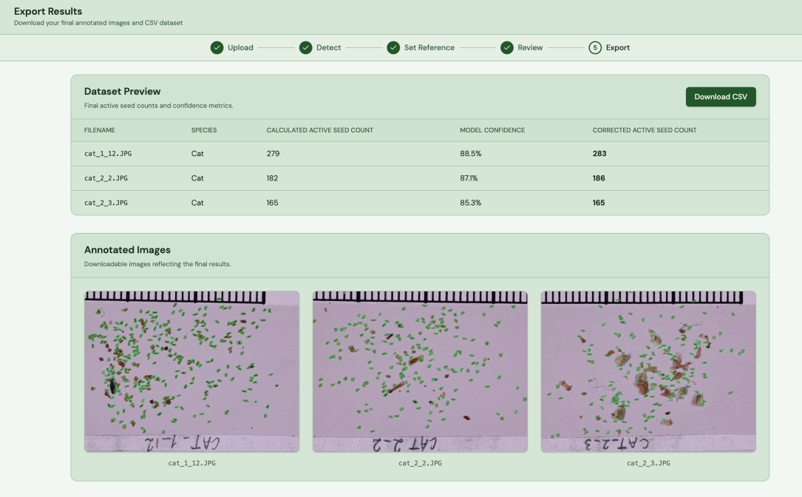

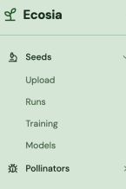
Exporting the Result
The user is presented with statistics from each image prediction:
image name
Species
The calculated seed count before the manual review
Prediction confidence score for each image
The reviewed final seed count.
To download the statistics into csv format, click “Download CSV” (15).
To download the predicted images including bounding boxes around the active seeds, hover over the desired image and the option to download it appears.
The results from the current run is also saved to the “Runs” page which can be found in the left side bar.

