Slide 1
URBAN CRIME PREDICTION FROM MULTIFACETED SOCIOECONOMIC FACTORS
Long Nguyen, Jennifer Negron, Mauricio Bermudez, Nguyen Huong Tra (Camellia) Le ISM 6562: Big Data for Business Prof. Kaushik Dutta

Slide 2
INTRODUCTION
1

Slide 3
ABOUT THE PROJECT
Choosing a dataset that allowed for scalability and prediction:
Relevant to today
Helps predict and prevent crime
Allows us to tackle the solution in a meaningful way
UCI Machine Learning Communities and Crime.

Slide 4
DATASET
UCI ML Communities and Crime Dataset:
1.9k+ instances (scalable)
Over 100 features
Mix of categorical and numerical values
This dataset allowed us to implement a mix of techniques to understand and manipulate the data in an impactful way.

Slide 5
DATA PREPROCESSING
2

Slide 6
DATA CLEANING
String columns: ? To NULL
Separate state, county, community name into second data frame.
Convert datatypes for numeric columns.
After utilizing VectorAssembler, use StandardScaler to avoid overshadowing by features with larger numeric ranges.

Slide 7
FEATURE SELECTION
3

Slide 8
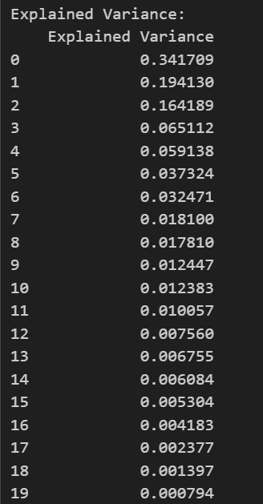
PRINCIPAL COMPONENTS ANALYSIS (PCA)
Main method for dimensionality reduction
Created principal components (PC) – linear combinations of variables, capturing the most variance in the dataset.
Select 10 features based on their loadings regarding first 3 PC’s:

Slide 9
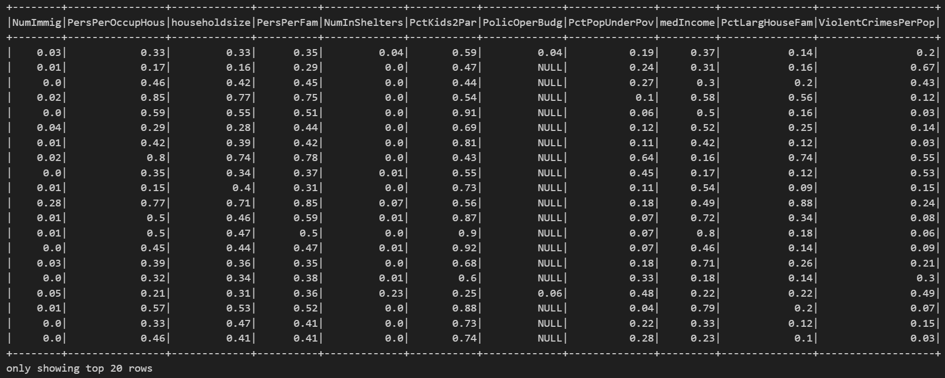
PRINCIPAL COMPONENTS ANALYSIS (PCA)
Final look of the data frame

Slide 10
DATA EXPLORATORY QUERIES
4

Slide 11
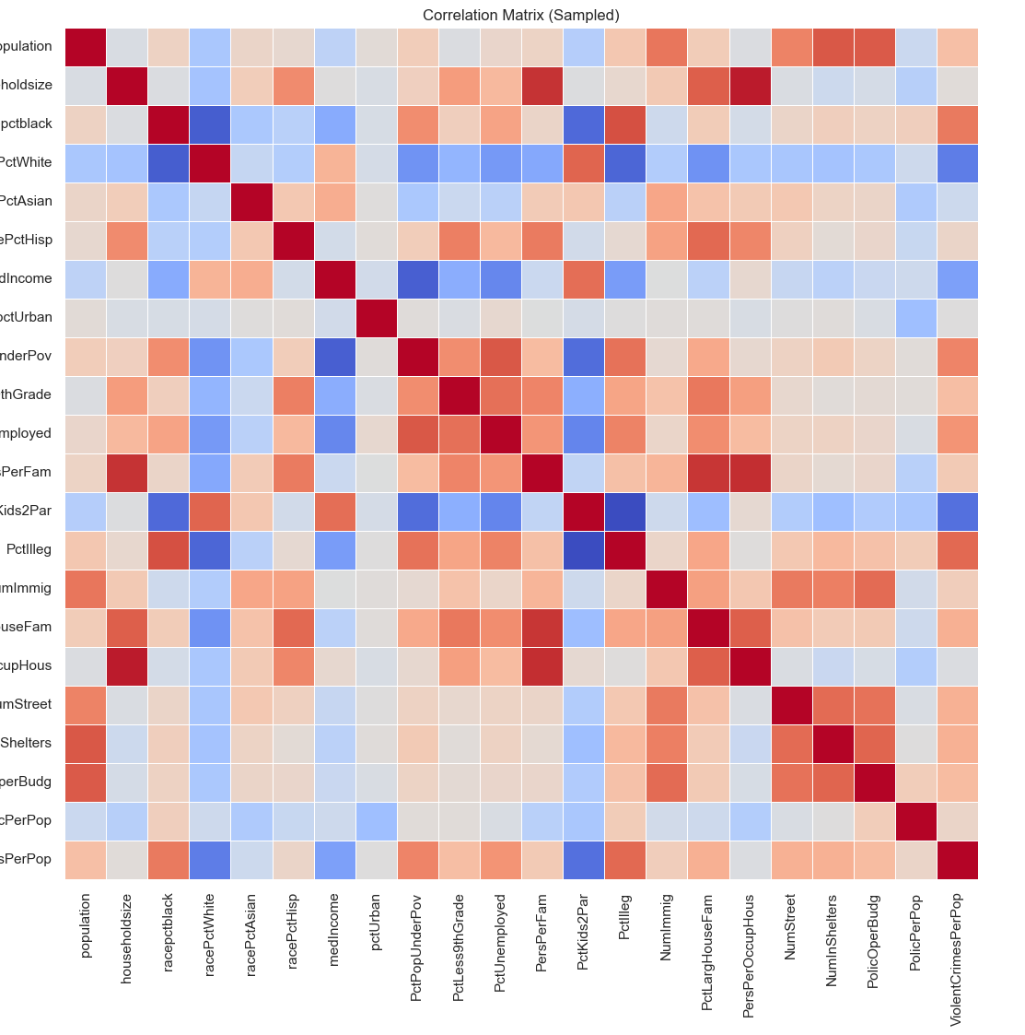
CORRELATION HEATMAP
Gave us a meaningful look into what features of the cleaned dataset would make the highest impact on our predictions
Notes:
"Once the data was cleaned and scaled, we ran exploratory queries to better understand trends and relationships. This helped us identify which variables were most closely associated with crime rates."
"The correlation heatmap revealed several strong relationships—especially between crime rate and factors like poverty, education, and policing. These insights guided which features we prioritized in modeling."

Slide 12
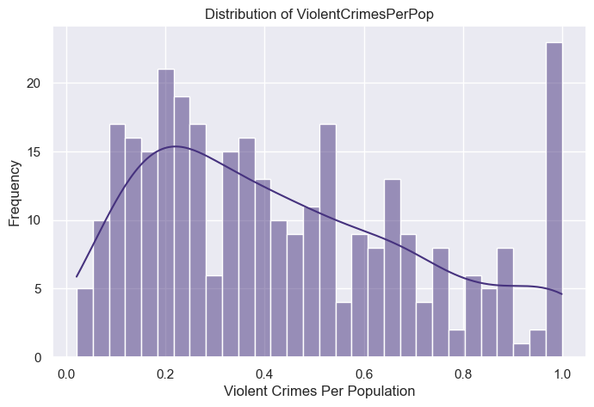
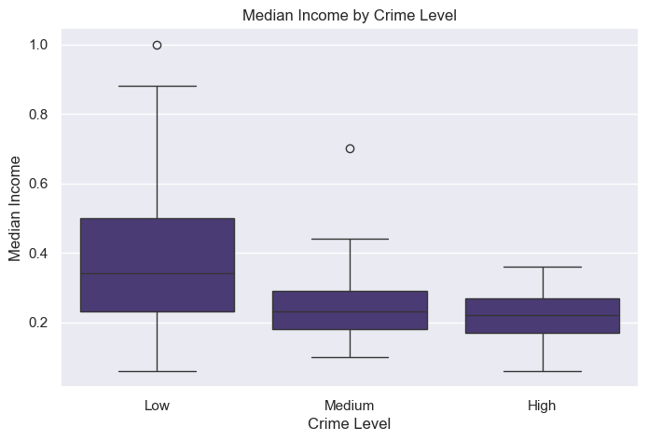
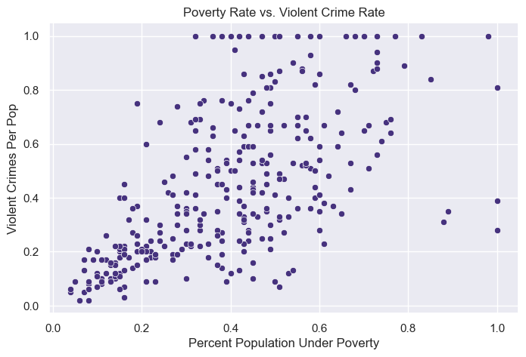
DATA EXPLORATORY ANALYSIS
Notes:
"We visualized our findings using histograms and scatter plots to make these relationships more intuitive.
These charts confirmed our statistical findings and helped us validate that our data preprocessing was on the right track.“
For example, the median income by Crime Level shows that higher income based areas reported less crime, while lower income based areas showed higher reported rates of crime.

Slide 13
MODEL BUILDING
5

Slide 14
MACHINE LEARNING MODELS
Selected models:
Linear regression
Decision tree regressor
Random forest regressor
Gradient boosted tree (GBT) regressor
VectorAssembler was used to create a vector of features – input for the ML models.
Split the data into training (80%) and testing (20%) sets.
RMSE for both train and test data as the main evaluation metric.

Slide 15
MODEL EVALUATION
6

Slide 16
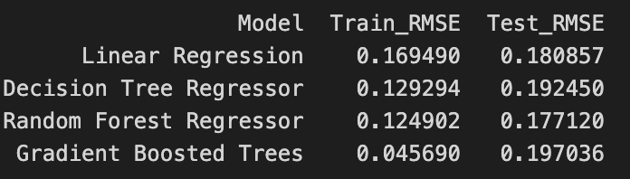
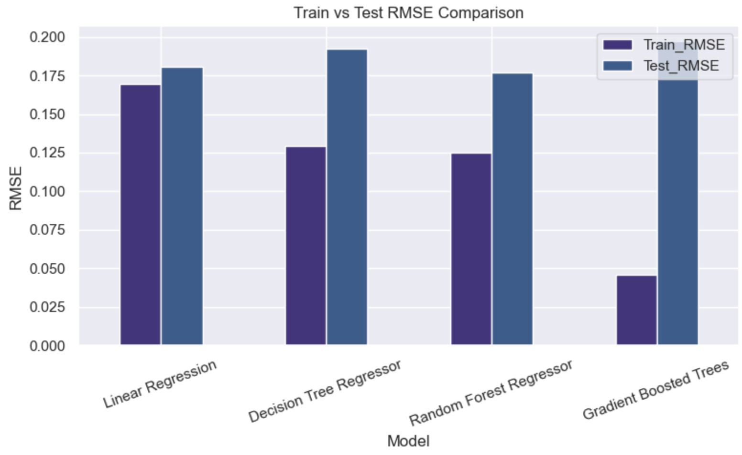
MODEL PERFORMANCE
Random Forest showed the best generalization (lowest test RMSE).
Gradient Boosted Trees showed overfitting (low train RMSE, higher test RMSE).
Linear Regression was stable.

Slide 17
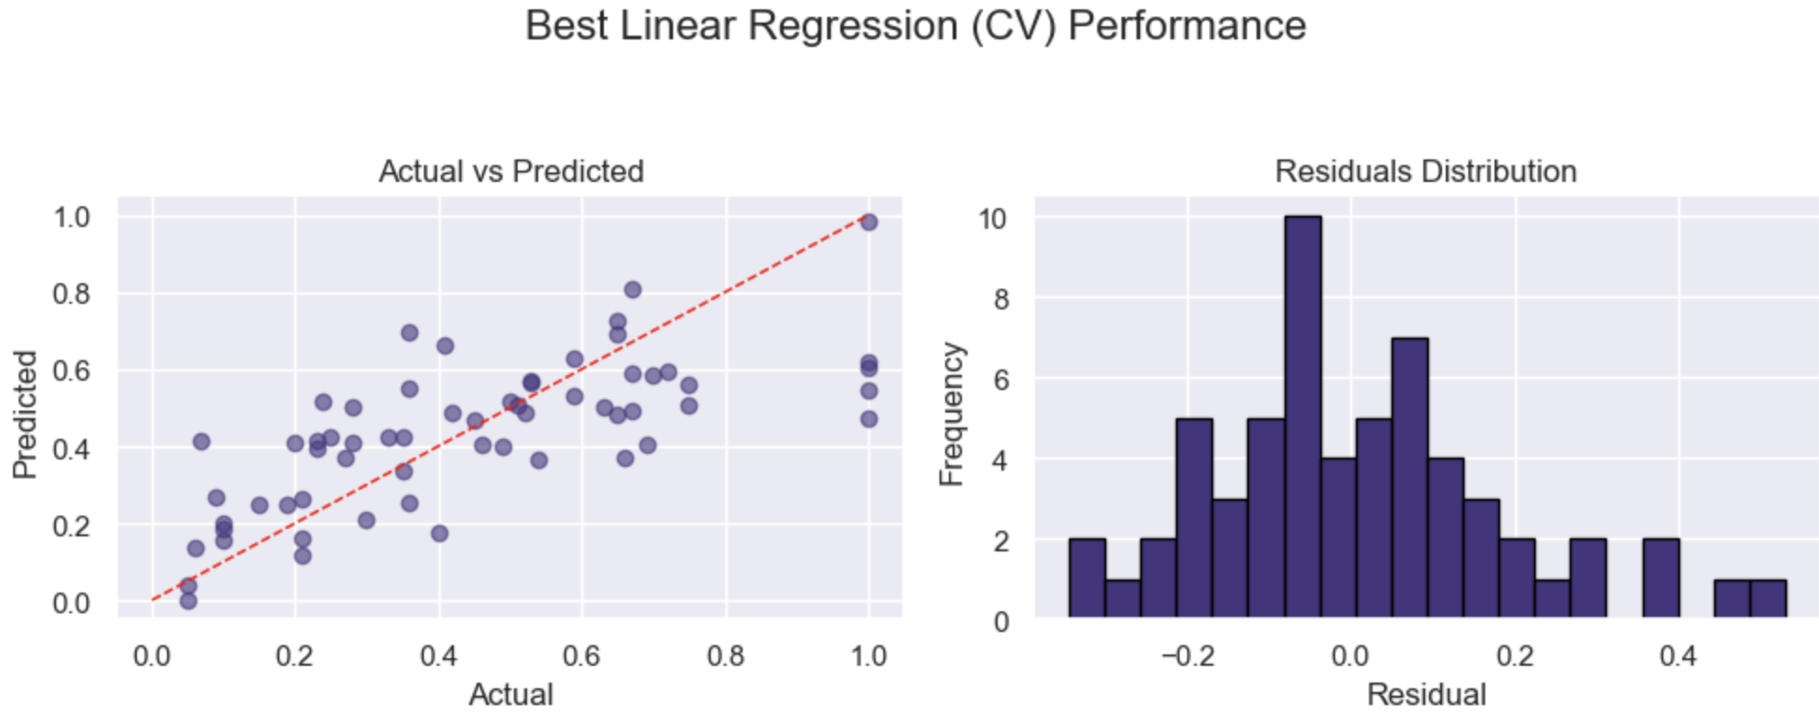
HYPERPARAMETER TUNING RESULTS
Used Spark’s CrossValidator and ParamGridBuilder to search:
Regularization parameter (regParam): 0.01, 0.1, 1.0
Elastic net parameter (elasticNetParam): 0 (ridge), 0.5 (mix), 1 (lasso)

Slide 18
Thank you
For Listening!

